Slide 1

Summarizing Data 3:
Range and Quantiles
Osborn

Slide 2
Measures of Data Spread
Sample range:
The difference between the largest and smallest value in the sample
Very sensitive to outliers (extreme observations)
Percentiles:
The p^{th} percentile data value, x, means that p-percent of the data are smaller than or equal to x.
Median = 50th percentile

Slide 3
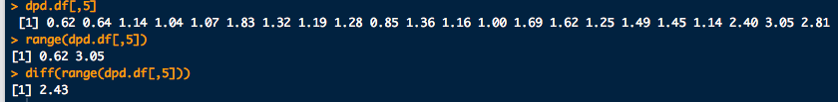
Measures of Data Spread
What is the sample range of deoxypyridinoline conc?
0.62, 0.64, 1.14, 1.04, 1.07, 1.83, 1.32, 1.19, 1.28, 0.85, 1.36, 1.16, 1.00, 1.69, 1.62, 1.25, 1.49, 1.45, 1.14, 2.40, 3.05, 2.81
# Dr. James Curran's dafs (http://www.stat.auckland.ac.nz/~curran)
library(dafs)
data(dpd.df) # Deoxypyridinoline data
range(dpd.df[,5]) # Look at column 5 for Deoxypyridinoline
# concentration and get its range
diff(range(dpd.df[,5])) # Range as defined in the notes

Slide 4
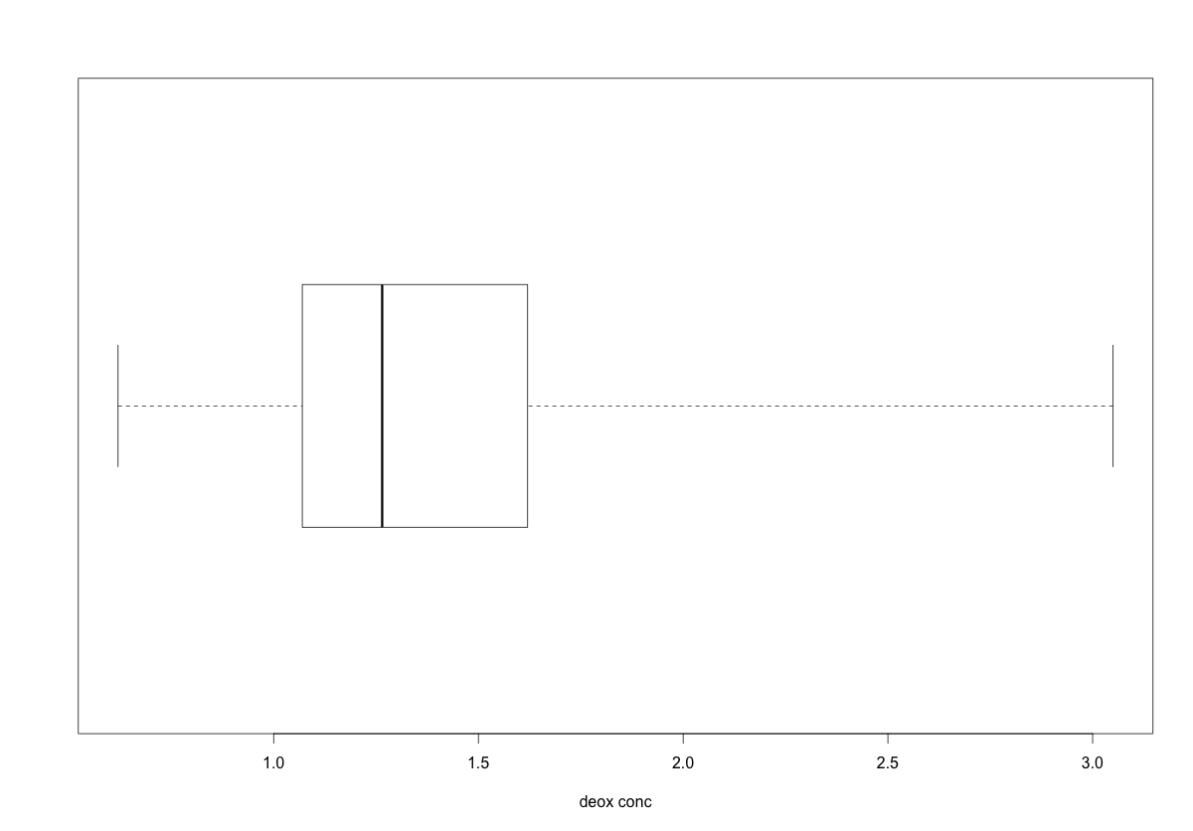
Measures of Data Spread
Box-and-whisker plot again for reference
Deoxypyridinoline conc?
0.62, 0.64, 1.14, 1.04, 1.07, 1.83, 1.32, 1.19, 1.28, 0.85, 1.36, 1.16, 1.00, 1.69, 1.62, 1.25, 1.49, 1.45, 1.14, 2.40, 3.05, 2.81
range
25th-%tile
1st-quartile
median
50th-%tile
75th-%tile
3rd-quartile
# Box and whiskers plots:
boxplot(dpd.df[,5], horizontal = T, range = 0, xlab = "Deoxypyridinoline conc.”)
summary(dpd.df[,5]) # Common summary statistics

Slide 5
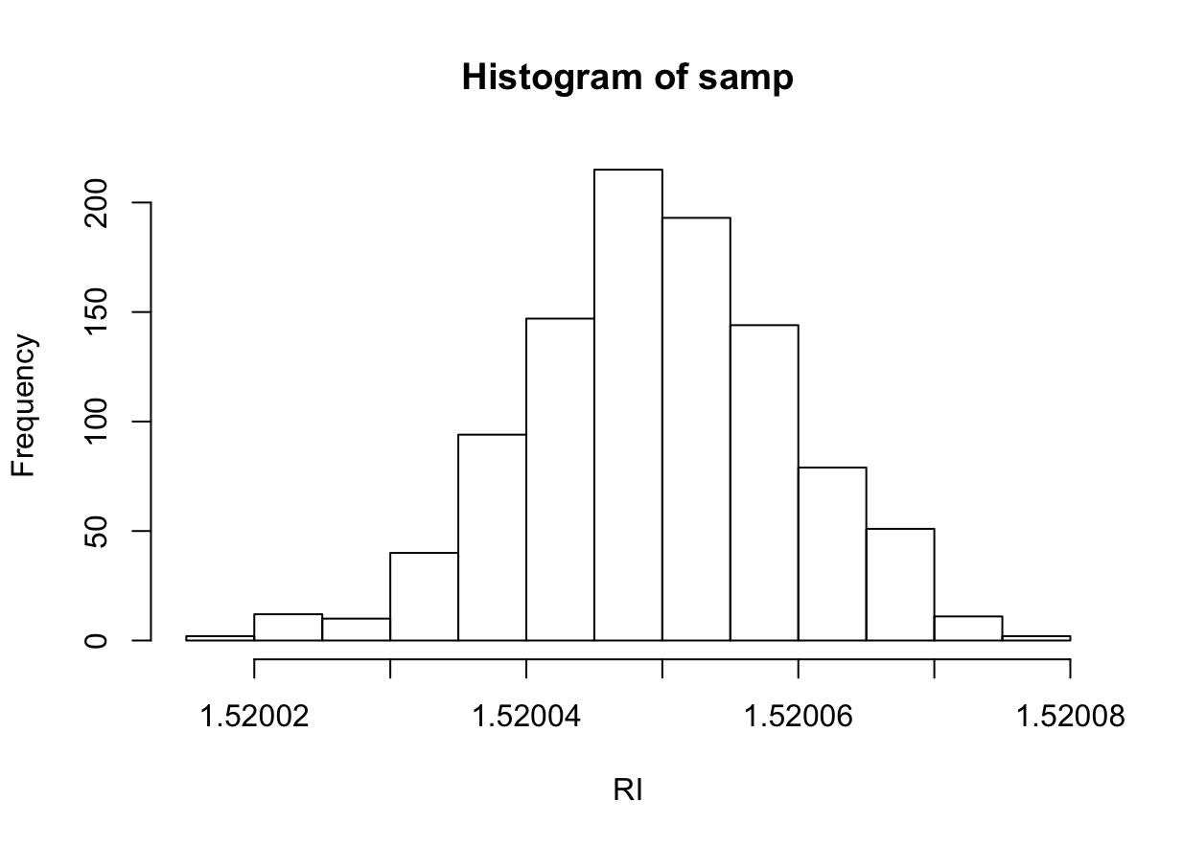
Measures of Data Spread
First 99% of the data is up to here
First 1% of the data is uo to here
99th-%tile
1st-%tile
1.520024
1.520071

Slide 6
Measures of Data Spread
# Finding quantiles:
# First lets get some (fake) data:
samp <- rnorm(1000, mean = 1.52005, sd = 0.00001)
hist(samp, xlab="RI")
# 1% and 99% quantiles of the data
quantile(samp, probs = c(0.01, 0.99))

Slide 7
Measures of Data Spread
Sample relative standard deviation:
Ratio of standard dev to the average
Also called coefficient of variation
Data quality-outliers:
Rule of thumb, if :
x_{i} > 75th-%tile + γ×(75th-%tile - 25th-%tile)
x_{i} < 25th-%tile - γ×(75th-%tile - 25th-%tile)
x_{i} outlier for γ = 1.5
x_{i} extreme outlier for γ = 3

Slide 8

Measures of Data Spread
Deoxypyridinoline conc.
%RSD?
Which data might be outliers?
0.62, 0.64, 1.14, 1.04, 1.07, 1.83, 1.32, 1.19, 1.28, 0.85, 1.36, 1.16, 1.00, 1.69, 1.62, 1.25, 1.49, 1.45, 1.14, 2.40, 3.05, 2.81

