Slide 1

A Little Bit of Probability 3
Conditional Probability and Bayes’ Theorem

Slide 2
Conditional Probability
Conditional probability:
The probability of A given B
The proportion of A and B in B
Conditional operator | “word flags”:
if, given, of the
Pr(A)
Note consequence:
Pr(B)

Slide 3
Example
In a large soil database 72% of the of the samples contain mica and 43% mica and schist. Assuming the database reflective of a relevant population, what is the probability that a randomly selected soil sample (from the same population) that contains mica also contains schist?

Slide 4
Example
= 43%
= 72%
= 0.43/0.72
= 0.597
≈ 60% chance

Slide 5
Multiplication Rule
Another important consequence of conditional probability is the multiplication rule:

Slide 6
Statistical Independence
If A is independent of B then the probability of A is not affected by knowledge of B.
If A and B are statistically independent if:
If A and B do not satisfy the above they are statistically dependent

Slide 7
Example
Using the information from the large soil database:
72% of the of the samples contain mica
43% contain mica and schist.
100% contain mica or schist
Compute:

Slide 8
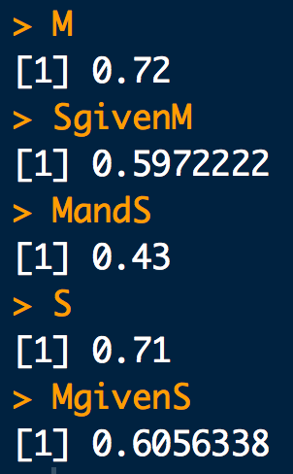
Example
# Data from the question:
M <- 0.72 # Schist
MandS <- 0.43 # Mica and Schist
# Pr(M)
M
# Pr(S|M) = Pr(SandM)/Pr(M)
SgivenM <- MandS/M
SgivenM
# Pr(S and M) = Pr(M and S)
MandS
# Pr(S) = Pr(S or M) + Pr(S and M) - Pr(M)
S <- 1 + 0.43 - 0.72
S
# Pr(M|S) = Pr(M and S)/Pr(S)
MgivenS <- 0.43/S
MgivenS
Notes:
REPLACE WITH HAND CALC

Slide 9
The Law of Total Probability
Suppose a sample space can be partitioned into a set of disjoint events B_{i} such that
B₁
B₄
B₃
A
B₂

Slide 10
The Law of Total Probability
Suppose a sample space can be partitioned into a set of disjoint events B_{i} such that
The probability of an arbitrary event A in Ω can be written as:
Law of total probability

Slide 11
Example: A medical test
Professor P LOVES hamburgers. But he’s also a hypochondriac. He thinks he is infected with “Mad Cow Disease” (MCD), so he gets himself tested (T).
The true positive rate of the test is: Pr(T⁺ | MCD⁺) = 0.7
The false positive rate of the test is: Pr(T⁺ | MCD⁻) = 0.1
The background prevalence of MCD in the yummy cow population is: Pr(MCD⁺) = 0.02
What is the probability that Prof. P tests positive for MCD, Pr(T⁺)?

Slide 12
Example: A medical test
# Data from the question:
Tp.given.MCDp <- 0.7
Tp.given.MCDm <- 0.1
MCDp <- 0.02
# Pr(T+) = Pr(T+ | MCD+) Pr(MCD+) + Pr(T+ | MCD-) Pr(MCD-)
Tp.given.MCDp * MCDp + Tp.given.MCDm * (1-MCDp)
Notes:
REPLACE WITH HAND CALC

Slide 13
There’s more than one way to condition:
Bayes’ Theorem
Intersection commutes:
So:
But from the multiplication rule we know:
So:
Bayes’ Theorem

Slide 14
Bayes’ Theorem
A slightly more general form for Bayes’ Theorem:
Suppose a sample space can be partitioned into a set of disjoint events B_{i} such that

Slide 15
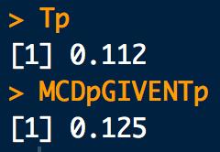
Example: A medical test again…
Suppose Professor P is positive for MCD. What is the probability that he truly has MCD, Pr(MCD⁺| T⁺)?
# Data from the question:
Tp.given.MCDp <- 0.7
Tp.given.MCDm <- 0.1
MCDp <- 0.02
# Pr(T+) = Pr(T+ | MCD+) Pr(MCD+) + Pr(T+ | MCD-) Pr(MCD-)
Tp <- Tp.given.MCDp * MCDp + Tp.given.MCDm * (1-MCDp)
Tp
# Pr(MCD+ | T+) = Pr(T+ | MCD+) Pr(MCD+) / Pr(T+)
(Tp.given.MCDp * MCDp)/Tp
Notes:
REPLACE WITH HAND CALC

