Slide 1
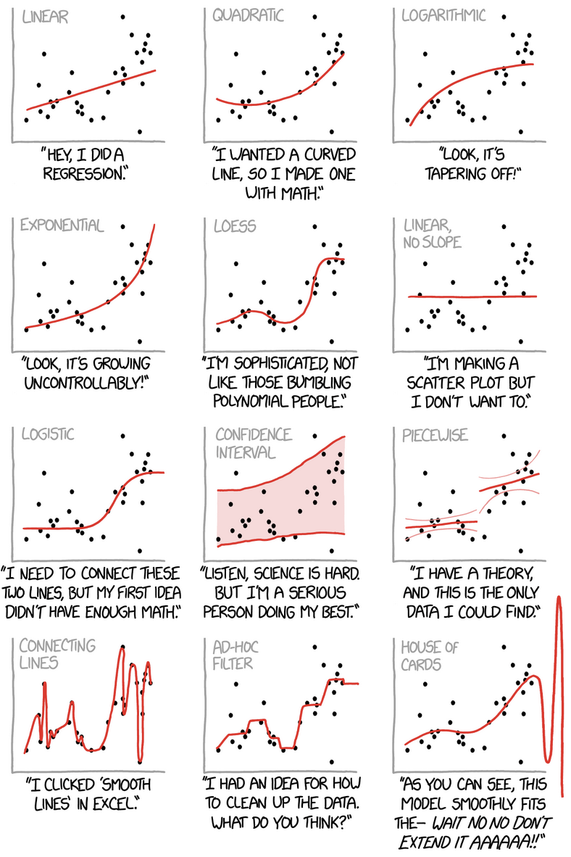
Model Evaluation and Comparison I
https://xkcd.com/2048/

Slide 2
Overview: Model Adequacy
A measure of model adequacy is how well it predicts data once it is fit
Can serve as measure of accuracy
Training data: Training accuracy/goodness-of-fit
Held out test data: Test/forecasting accuracy
Common adequacy metrics
Residuals analysis
Mean squared error
Error rates (for discrete predictions)
Checks
Model adequacy metrics can also be used to compare different model to each other
How well do different models on the data perform relative to each other?

Slide 3
Model Adequacy Lingo
Measures of probabilistic model based predictive accuracy are called scoring rules.
Models are “fit” when their parameters or parameter densities are determined
Likelihoods of fit models are called predictive densities
Logarithms of predictive densities are called (log) scores
The mean posterior predictive density for a new datapoint D_{i}^{test} under fit model m is:

Slide 4
Model Adequacy: Kullback-Leibler Divergence
How “close” p_{m}(D_{i}^{test} | D^{train}) is to the true data generating density p_{t}(D_{i}^{test}) is a good probabilistically-based measure of the model’s adequacyª.
Measure “closeness” of two pdfs, p_{A}(x) and p_{B}(x), with Kullback-Leibler divergence:
ªFor full details of the following cf. Gelman et al 2014 https://arxiv.org/pdf/1307.5928.pdf and Vehtari et al. 2016 https://arxiv.org/pdf/1507.04544.pdf

Slide 5
Model Adequacy: Kullback-Leibler Divergence
How “close” p_{m}(D_{i}^{test} | D^{train}) is to the true data generating density p_{t}(D_{i}^{test}) is a good probabilistically-based measure of the model’s adequacy.
The “closeness” of p_{m}(D_{i}^{test} | D^{train}) and p_{t}(D_{i}^{test}) is thus:
expected log predictive density (epld)
Model adequacy: Maximize epld to minimize KLD

Slide 6
Expected Log Pointwise Predictive Density
With expected log predictive density:
then for a test data set we define expected log pointwise predictive density (elppd):
So from this point of view, the model with the largest elppd is the “most adequate”.

Slide 7
Approximate Model Adequacy Measures
The problem is that we don’t have the true data generating density p_{t}(D_{i}^{test}) nor often D_{i}^{test} needed for elppd!
How elppd and related metrics are approximated leads to different concrete measures of model adequacy that can be used for model comparison
Replace with to obtain the “widely applicable information criterion” (WAIC):
correction for effective number of parameters to adjust for overfitting (because D_{i}^{train} was used)
Lower WAIC ⟶ more adequate model

Slide 8
Approximate Model Adequacy Measures
The problem is that we don’t have the true data generating density p_{t}(D_{i}^{test}) nor often D_{i}^{test} needed for elppd!
How elppd and related metrics are approximated leads to different concrete measures of model adequacy that cab be used for model comparison
Alternatively replace with to obtain the “leave one out information criterion” (LOOIC):
Successively fit model without data point i. Use data point i as the test data.
Lower LOOIC ⟶ more adequate model

Slide 9
Approximate Model Adequacy Measures
LOOIC mitigates the issue to assessing the model with the same data it was trained with (hence no bias correction term needed).
LOOIC preferred over WAIC when we can get it
An issue with LOOIC is that it requires successive re-fitting of the model
This can be VERY time consuming
Luckily several sampling/smoothing tricks exist to approximate the
without having to go through the LOO/re-fitting process.
Pareto-smoothed importance sampling (PSIS) - LOO
Even more luckily WAIC, LOO, PSIS-LOO implemented in the loo package. Just need log-likelihood of the data to be calculated.

Slide 10
Example: Basic Model Comparison
Recall the “twitter personality” example who received these morning (M), Afternoon (A) and Night (N) tweets over the course of 30 days.
M: 1154, 1062, 1203, 1125, 1091, 1120, 1202, 1129, 1103, 1098, 1169, 1142, 1174, 1111, 1148, 1134, 1146, 1179, 1165, 1076, 1152, 1209, 1205, 1139, 1227, 1145, 1140, 1220, 1059, 1165
A: 1326, 1362, 1297, 1350, 1324, 1384, 1343, 1373, 1345, 1399, 1364, 1380, 1303, 1232, 1330, 1306, 1309, 1336, 1367, 1291, 1325, 1348, 1318, 1351, 1382, 1340, 1305, 1306, 1333, 1337
N: 1251, 1234, 1337, 1235, 1189, 1289, 1318, 1190, 1307, 1224, 1279, 1331, 1310, 1244, 1246, 1168, 1267, 1274, 1262, 1254, 1139, 1236, 1310, 1227, 1310, 1255, 1230 ,1327, 1242, 1269
We fit three models to this data:
Model a: overall daily rate model (one lambda)
Model b: morning, afternoon and night rates model (three lambdas)
Model c: different rates for different days model (thirty lambdas)
Which of these three models is most adequate for this data?
Add loglikelihood calculations to each model
Compute WAIC for each model
Compute PSIS-LOOIC for each model
Intercompare the three models.

Slide 11
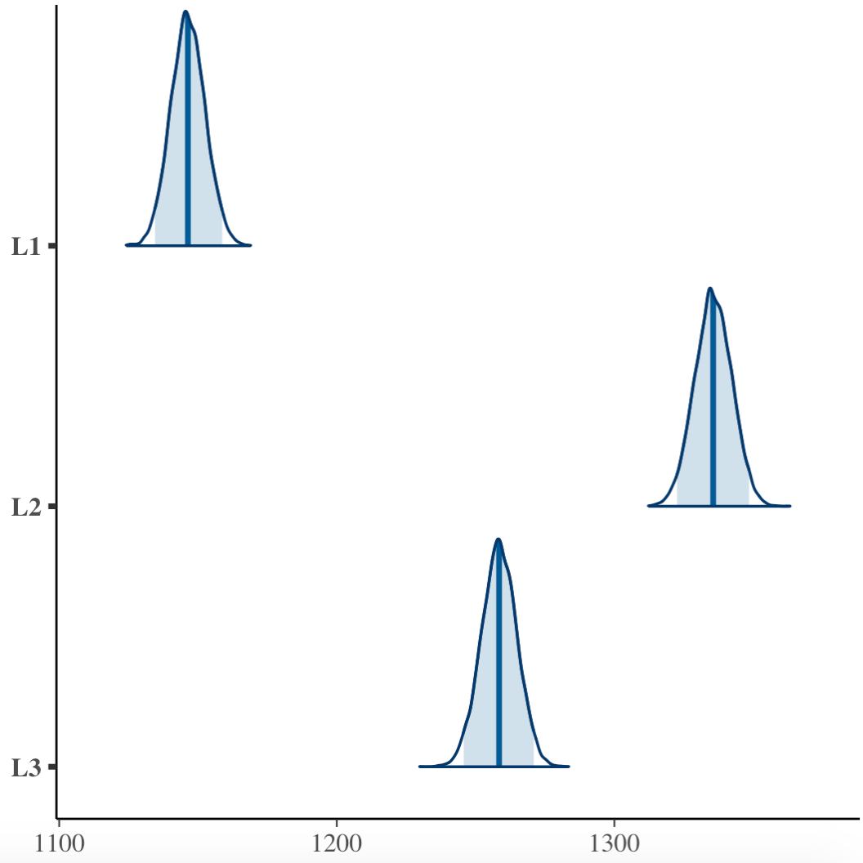
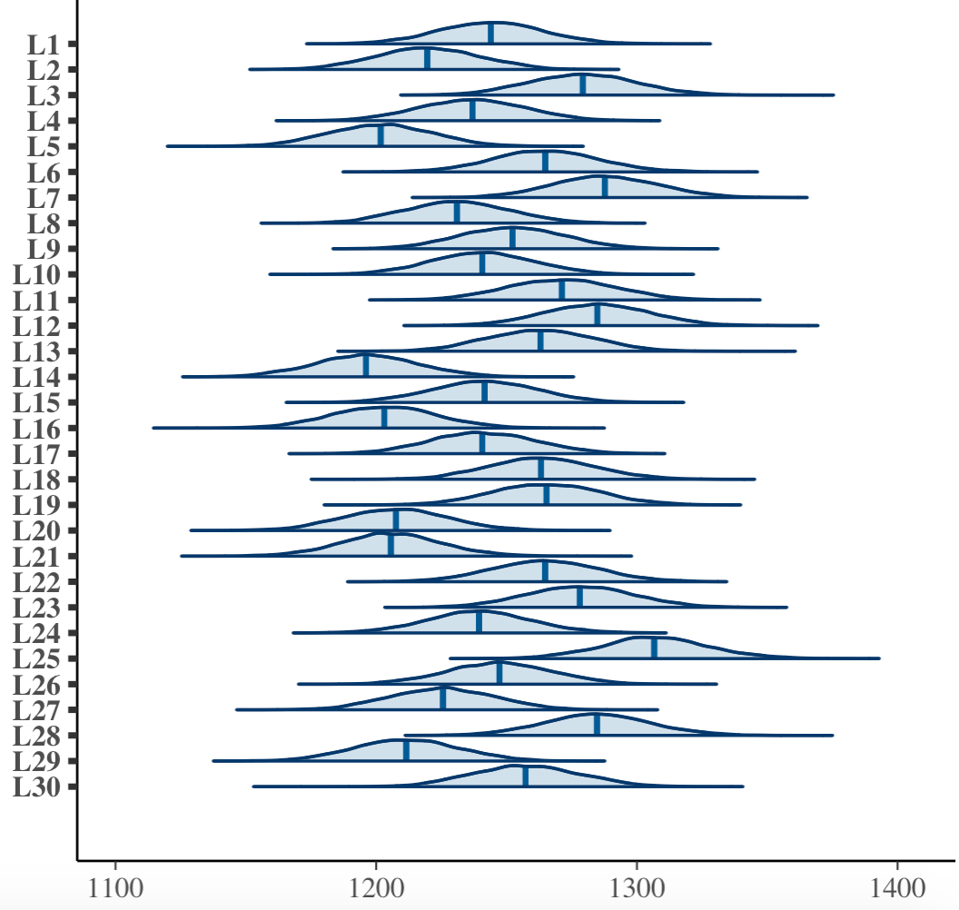
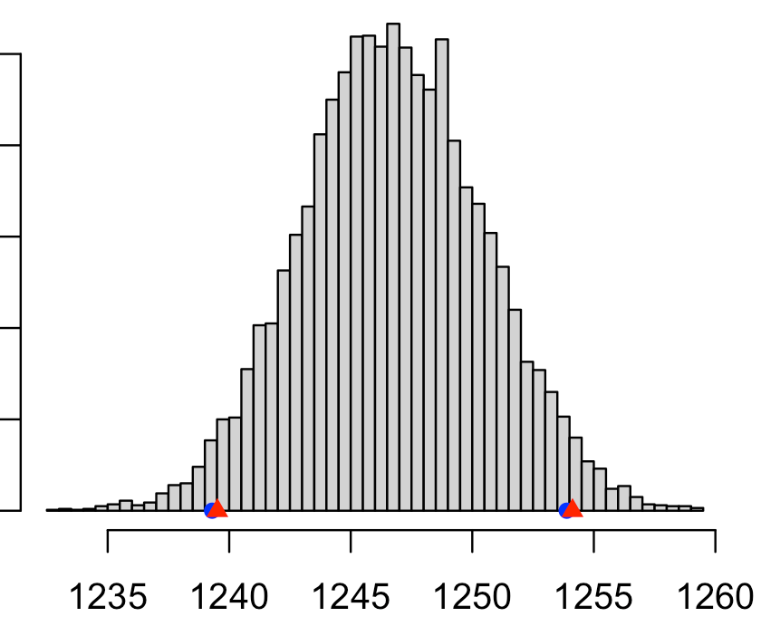
Example: Basic Model Comparison
Recall the “twitter personality” example who received these morning (M), Afternoon (A) and Night (N) tweets over the course of 30 days. Reminder:
Model a lambda
Model b lambdas
Model c lambdas

Slide 12
To save some slides, we’ll use the same (previous) Stan/JAGS script for all three models (poisson_gamma_multiple). The models only really differ by how the data is input.
data {
int<lower=0> n;
int<lower=0> m;
int<lower=0> s[n,m];
real<lower=0> a;
real<lower=0> b;
}
parameters {
real<lower=0> lambda[m];
}
model {
//Prior
target += gamma_lpdf(lambda | a,b);
//Likelihood
for(j in 1:m){
for(i in 1:n){
target += poisson_lpmf(s[i,j] | lambda[j]);
}
}
}
generated quantities {
vector[m*n] log_lik;
int count;
count = 1;
for(j in 1:m){
for(i in 1:n){
log_lik[count] = poisson_lpmf(s[i,j] | lambda[j]);
count = count + 1;
}
}
}
Stan model:
New chunk here to compute log likelihood for each data point

Slide 13
To save some slides, we’ll use the same (previous) Stan/JAGS script for all three models (poisson_gamma_multiple). The models only really differ by how the data is input.
JAGS model:
model{
# Priors
for(j in 1:m){
lambda[j] ~ dgamma(a, b)
}
# Likelihood and Log-likelihood
for(j in 1:m){
for(i in 1:n){
s[i,j] ~ dpois(lambda[j])
# Hack to give each log_lik value a unique name
log_lik[(i*m + j) - 1] <- log( dpois(s[i,j], lambda[j]) ) }
}
}
New chunk here to compute log likelihood for each data point

Slide 14
Run Stan code:
library(bayesutils)
library(loo)
# Extra options to set for Stan:
options(mc.cores = 1)
rstan_options(auto_write = TRUE)
# Load a Stan model:
stan.code <- paste(readLines(system.file("stan/poisson-gamma_multiple_wloglik.stan", package =
"bayesutils")),collapse='\n')
# Translate Stan code into C++
model.c <- stanc(model_code = stan.code, model_name = 'model', verbose=T)
# Compile the Stan C++ model:
sm <- stan_model(stanc_ret = model.c, verbose = T)
M <- c(1154, 1062, 1203, 1125, 1091, 1120, 1202, 1129, 1103, 1098, 1169, 1142, 1174, 1111, 1148,
1134, 1146, 1179, 1165, 1076, 1152, 1209, 1205, 1139, 1227, 1145, 1140, 1220, 1059, 1165)
A <- c(1326, 1362, 1297, 1350, 1324, 1384, 1343, 1373, 1345, 1399, 1364, 1380, 1303, 1232, 1330,
1306, 1309, 1336, 1367, 1291, 1325, 1348, 1318, 1351, 1382, 1340, 1305, 1306, 1333, 1337)
N <- c(1251, 1234, 1337, 1235, 1189, 1289, 1318, 1190, 1307, 1224, 1279, 1331, 1310, 1244, 1246,
1168, 1267, 1274, 1262, 1254, 1139, 1236, 1310, 1227, 1310, 1255, 1230 ,1327, 1242, 1269)
s <- array(c(M,A,N), c(length(c(M,A,N)), 1)) # Model a. One lambda. Feed data in as a column vector
#s <- cbind(M,A,N) # Model b. Three lambdas
#s <- rbind(M,A,N) # Model c. 30 lambdas. One for each day.
dat <- list(
"n" = nrow(s),
"m" = ncol(s),
"s" = s,
"a" = 25/16,
"b" = 1/16000
)
# Run the model:
fit1 <- sampling(sm, data = dat, iter=5000, thin = 1, chains = 4)
fit1

Slide 15
Run JAGS code:
library(bayesutils)
library(loo)
M <- c(1154, 1062, 1203, 1125, 1091, 1120, 1202, 1129, 1103, 1098, 1169, 1142, 1174, 1111, 1148,
1134, 1146, 1179, 1165, 1076, 1152, 1209, 1205, 1139, 1227, 1145, 1140, 1220, 1059, 1165)
A <- c(1326, 1362, 1297, 1350, 1324, 1384, 1343, 1373, 1345, 1399, 1364, 1380, 1303, 1232, 1330,
1306, 1309, 1336, 1367, 1291, 1325, 1348, 1318, 1351, 1382, 1340, 1305, 1306, 1333, 1337)
N <- c(1251, 1234, 1337, 1235, 1189, 1289, 1318, 1190, 1307, 1224, 1279, 1331, 1310, 1244, 1246,
1168, 1267, 1274, 1262, 1254, 1139, 1236, 1310, 1227, 1310, 1255, 1230 ,1327, 1242, 1269)
s <- array(c(M,A,N), c(length(c(M,A,N)), 1)) # Model a. One lambda. Feed data in as a column vector
#s <- cbind(M,A,N) # Model b. Three lambdas
#s <- rbind(M,A,N) # Model c. 30 lambdas. One for each day.
dat <- list(
"n" = nrow(s),
"m" = ncol(s),
"s" = s,
"a" = 25/16,
"b" = 1/16000
)
inits <- function (){
list(lambda=runif(ncol(s)))
}
# Run the model:
fit1 <- jags(data=dat,
inits=inits,
parameters.to.save = c("lambda", "log_lik"),
n.iter=20000, n.burnin = 500, n.thin = 10,
n.chains=4,
model.file = system.file("jags/poisson-gamma_multiple_wloglik.bug.R",
package = "bayesutils"))
fit1

Slide 16
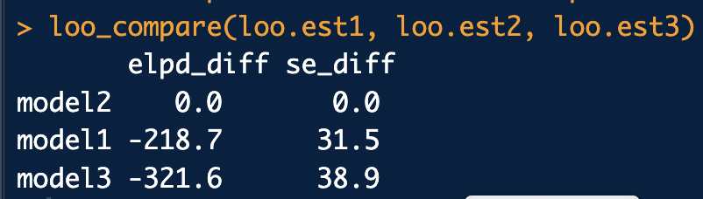
Analysis:
# Model a. adequacy metrics
log.lik1 <- extract.log.lik(fit1)
r.eff1 <- relative_eff(exp(log.lik1), cores = 2)
loo.est1 <- loo(log.lik1, r_eff = r.eff1, cores = 2)
waic.est1 <- waic(log.lik1)
print(loo.est1)
print(waic.est1)
# Model b. adequacy metrics
log.lik2 <- extract.log.lik(fit2)
r.eff2 <- relative_eff(exp(log.lik2), cores = 2)
loo.est2 <- loo(log.lik2, r_eff = r.eff2, cores = 2)
waic.est2 <- waic(log.lik2)
print(loo.est2)
print(waic.est2)
# Model c. adequacy metrics
log.lik3 <- extract.log.lik(fit3)
r.eff3 <- relative_eff(exp(log.lik3), cores = 2)
loo.est3 <- loo(log.lik3, r_eff = r.eff3, cores = 2)
waic.est3 <- waic(log.lik3)
print(loo.est3)
print(waic.est3)
plot(loo.est3, label_points = F)
# Intercompare models. Best on top:
loo_compare(loo.est1, loo.est2, loo.est3)

Slide 17
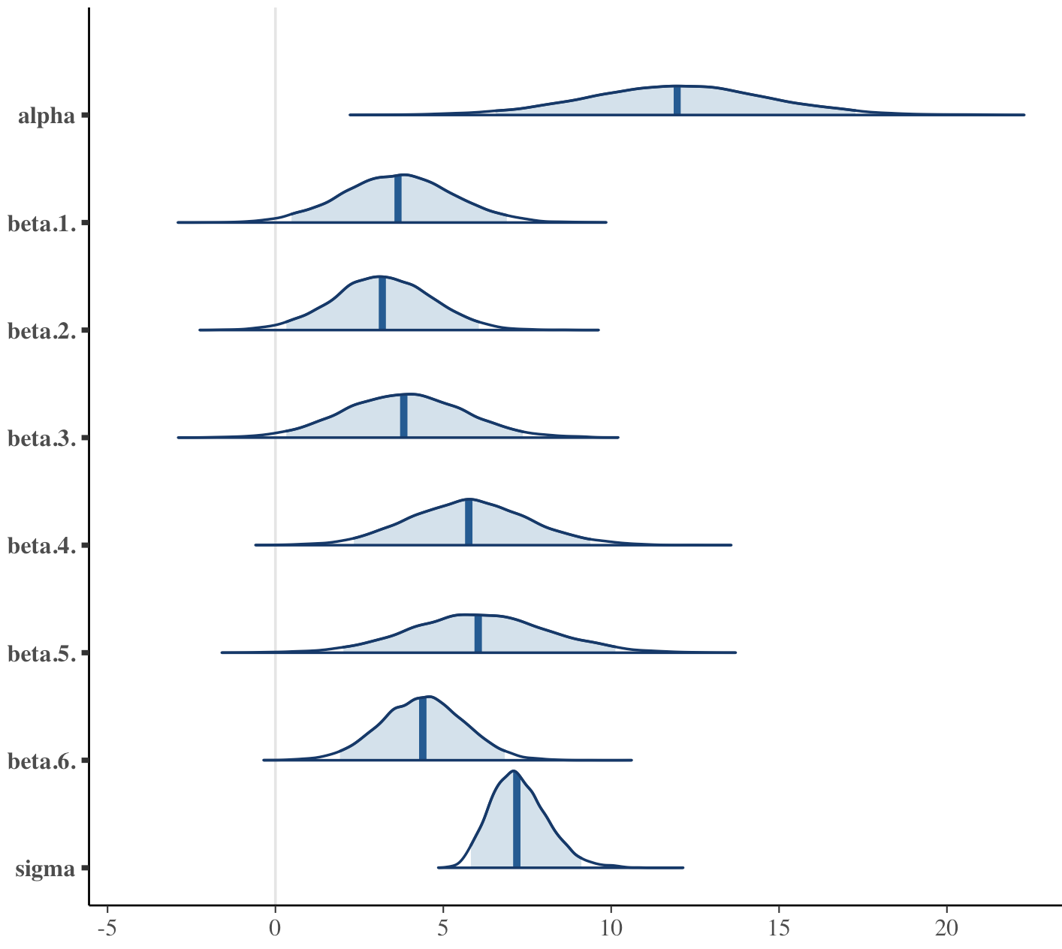
Example: Regression Model Refinement
Recall the Gustafson dataset where we used 6 dental features to fit a multivariate regression model to predict age at time of death. Here are the posteriors for the regression coefs:
A
S
A, S, P look a little iffy (may be = 0). 🤔
P
C
Add log-likelihood calculations to multivariate_linear_regression.
b. Compare the regression with all six features to a regression with only C, TT and R
TT
R

Slide 18
data{
int<lower=1> n;
int<lower=1> p;
matrix[n,p] X;
real y[n];
int<lower=1> nu_alpha;
real mu_alpha;
real<lower=0> sig_alpha;
int<lower=1> nu_beta;
real mu_beta;
real<lower=0> sig_beta;
real mu_sigma;
real<lower=0> sig_sigma;
}
parameters{
real alpha;
vector[p] beta;
real<lower=0> sigma;
}
model{
//Priors
target += student_t_lpdf(alpha | nu_alpha, mu_alpha, sig_alpha);
for(i in 1:p) {
target += student_t_lpdf(beta[i] | nu_beta, mu_beta,
sig_beta);
}
target += normal_lpdf(sigma | mu_sigma, sig_sigma);
//Likelihood
for(i in 1:n) {
target += normal_lpdf(y[i] | alpha + dot_product(beta, X[i,]),
sigma);
}
}
generated quantities{
real log_lik[n];
for(i in 1:n){
log_lik[i] = normal_lpdf(y[i] | alpha + dot_product(beta, X[i,]), sigma);
}
}
Stan model:
New chunk here to compute log likelihood for each data point

Slide 19
JAGS model:
model{
# Priors
alpha ~ dt(mu_alpha, 1/sig_alpha^2, nu_alpha)
for(i in 1:p) {
beta[i] ~ dt(mu_beta, 1/sig_beta^2, nu_beta)
}
sigma ~ dnorm(mu_sigma, 1/sig_sigma^2)T(0.0,)
# Likelihood and Log-likelihood
for(i in 1:n) {
y[i] ~ dnorm(alpha + inprod(beta, X[i,]), 1/sigma^2);
log_lik[i] <- log( dnorm(y[i], alpha + inprod(beta, X[i,]), 1/sigma^2) )
}
}
New chunk here to compute log likelihood for each data point

Slide 20
Run Stan code:
library(bayesutils)
library(dafs)
# Extra options to set for Stan:
options(mc.cores = 1)
rstan_options(auto_write = TRUE)
# Load a Stan model:
stan.code <- paste(readLines(system.file("stan/multivariate_linear_regression_wloglik.stan", package =
"bayesutils")),collapse='\n')
# Translate Stan code into C++
model.c <- stanc(model_code = stan.code, model_name = 'model', verbose=T)
# Compile the Stan C++ model:
sm <- stan_model(stanc_ret = model.c, verbose = T)
# Data
data("gustafson.df")
Age <- gustafson.df$Age
A <- gustafson.df$A
S <- gustafson.df$S
P <- gustafson.df$P
C <- gustafson.df$C
TT <- gustafson.df$T
R <- gustafson.df$R
X <- cbind(A,S,P,C,TT,R) # for fit 1
#X <- cbind(C,TT,R) # for fit 2
dat <- list(
"n" = nrow(X),
"p" = ncol(X),
"X" = X,
"y" = Age,
#
"nu_alpha" = 3,
"mu_alpha" = 0,
"sig_alpha" = 1,
"nu_beta" = 3,
"mu_beta" = 0,
"sig_beta" = 1,
"mu_sigma" = 0,
"sig_sigma" = 1
)
# Run the model:
fit1 <- sampling(sm, data = dat, iter=5000, thin = 1, chains = 4); fit

Slide 21
Run JAGS code:
library(bayesutils)
library(dafs)
# Data
data("gustafson.df")
Age <- gustafson.df$Age
A <- gustafson.df$A
S <- gustafson.df$S
P <- gustafson.df$P
C <- gustafson.df$C
TT <- gustafson.df$T
R <- gustafson.df$R
X <- cbind(A,S,P,C,TT,R) # for fit 1
#X <- cbind(C,TT,R) # for fit 2
dat <- list(
"n" = nrow(X),
"p" = ncol(X),
"X" = X,
"y" = Age,
#
"nu_alpha" = 3,
"mu_alpha" = 0,
"sig_alpha" = 1,
#
"nu_beta" = 3,
"mu_beta" = 0,
"sig_beta" = 1,
#
"mu_sigma" = 0,
"sig_sigma" = 1
)
inits <- function (){
list(alpha=rnorm(1), beta=rnorm(ncol(X)), sigma=runif(1))
}
#Run the model:
fit1 <- jags(data=dat,
inits=inits,
parameters.to.save = c("alpha", "beta", "sigma", "mu"),
n.iter=20000, n.burnin = 500, n.thin = 10,
n.chains=4,
model.file = system.file("jags/multivariate_linear_regression_wloglik.bug.R", package = "bayesutils"))
fit1

Slide 22
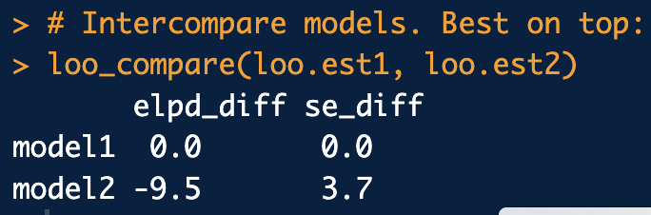
Analysis:
# Model fit1 adequacy metrics
log.lik1 <- extract.log.lik(fit1)
r.eff1 <- relative_eff(exp(log.lik1), cores = 2)
loo.est1 <- loo(log.lik1, r_eff = r.eff1, cores = 2)
waic.est1 <- waic(log.lik1)
print(loo.est1)
print(waic.est1)
# Model fit2 adequacy metrics
log.lik2 <- extract.log.lik(fit2)
r.eff2 <- relative_eff(exp(log.lik2), cores = 2)
loo.est2 <- loo(log.lik2, r_eff = r.eff2, cores = 2)
waic.est2 <- waic(log.lik2)
print(loo.est2)
print(waic.est2)
# Intercompare models. Best on top:
loo_compare(loo.est1, loo.est2, loo.est3)
Guess that A, S, P help in this model, but only a little. 🤔

