Slide 1

Model Comparison II
Marginal Likelihoods and Bayes Factors
https://www.countbayesie.com/

Slide 2
Odds form of Bayes’ theorem
Recall the odds form of Bayes theorem:
Discrete Data
Continuous Data
Weight of evidence: A measure of how much “weight” or “support” the “evidence” gives to one hypothesis relative to the other^{Jeffereys, Turing, Good}

Slide 3
Weight of Evidence Scales
A measure of how much “weight” or “support” the “evidence” gives to Theory A relative to Theory B
Weight of evidence ranges from 0 to infinity
VERY dependent on:
Likelihood (data) model
Priors on model parameters
W_{continuous} extremely difficult to compute in general!
Controversial even among Bayesians!^{Gelman}
Many other legitimate philosophical problems^{Iyer, Lund}

Slide 4
Weight of Evidence Scales
There are no completely accepted scales for weight of evidence!
Two common and generally accepted scales:
W | Jeffreys Scale^{J}
< 1 | Evidence supports for Theory B
1 to 3 | Evidence barely supports Theory A
3 to 10 | Evidence substantially supports Theory A
10 to 30 | Evidence strongly supports Theory A
30 to 100 | Evidence very strongly supports Theory A
> 100 | Evidence decisively supports Theory A
W | Kass-Raftery Scale^{KR}
< 1 | Evidence supports for Theory B
1 to 3 | Evidence barely supports Theory A
3 to 20 | Evidence positively supports Theory A
20 to 150 | Evidence strongly supports Theory A
> 150 | Evidence very strongly supports Theory A

Slide 5
Forget About All The Problems…
For now, lets forget about all the problems and only consider “continuous” data (because we want to go Bayes Factors).
So how do we compute these things??
First let’s pick apart the terms that make up the weight of evidence (now a Bayes Factor):
Same thing; a little shorter

Slide 6
Evidence: Marginal Likelihood
Let’s just take a closer look at the top (or bottom) of the fraction:
So each term in a Bayes factor is a denominator in a Bayes theorem!
The denominator in Bayes theorem is sometimes called the (Bayes) evidence.
Likelihood of observing the data given the theory (model) is true
marginal likelihood
expected likelihood
(Bayes) evidence
partition function (statistical mechanics)
normalization constant

Slide 7
Bayes Factor: Ratio of Marginal Likelihoods
So a Bayes Factor is a ratio of two marginal likelihoods for two different “theories” (models):
If we can evaluate these (generally high-dimensional and VERY DIFFICULT) integrals, we can compare the likelihood of observing data under different hypothesis…

Slide 8
Evidence: Marginal Likelihood
So how do we do this??:
There have been many ideas and approachesª
The most general, “easy-to-use” and successful way I have found is bridge sampling^{b}.
It’s a generalization of importance sampling, but without all the drama
Actually has been around for a while on paper and in toy/custom implementations…
New(-ish)ly implement in R package bridgesampling, meant to work with Stan among other packages (but is still general) so we’ll talk about it.
ªhttps://arxiv.org/abs/1111.1957
^{b}http://www.stat.columbia.edu/~gelman/research/published/path2.pdf

Slide 9
Bridge Sampling
Consider the integral for marginal likelihoodª
Let’s simplify the notation a bit to save my wrists:
Trick 1 for bridge sampling: Consider the superficially trivial looking identity:
ªhttps://cran.r-project.org/web/packages/bridgesampling/vignettes/bridgesampling_tutorial.pdf

Slide 10
Bridge Sampling
Multiply through the identity by p(D)
Note that:

Slide 11
Bridge Sampling
So lets now re-express p(D) as:
p(D) can be written as:

Slide 12
Bridge Sampling
Thus p(D) is just a ratio two expectations over two (accessible) distributions:
p(θ | D) is the posterior
is called the “proposal density”
is called the “bridge function”
To approximate:

Slide 13
Bridge Sampling
Trick 2 for bridge sampling: Considering minimum mean square error for the approximation gives an expression for the “optimal” bridging function:
The constant C will cancel in the ratio, so its value is irrelevant
Trick 3 for bridge sampling: Choosing multivariate normal density for the proposal , with parameters fit from the posterior sample usually gives good results^{a,b}
ªhttps://arxiv.org/pdf/1710.08162.pdf
^{b}https://cran.r-project.org/web/packages/bridgesampling/vignettes/bridgesampling_tutorial.pdf

Slide 14
Bridge Sampling
Trivia:
Solve iteratively because marginal likelihood appears in the approximation for the marginal likelihood (al-la the optimal bridge function)
Sums in the denominator damp ill effects due to tail disagreement of proposal distribution relative to the posterior distribution
Such effects plague importance sampling and harmonic mean estimators for p(D)
Posterior and proposal still need to have reasonable overlap…..

Slide 15
Bridge Sampling
Though, it’s clearly not perfect, bridge sampling is fairly general and the package provides the current most general “black box” solution if you just want to stick with R.
It’s trivial to get an estimate for p(D) for just about any model that runs in Stan:
library(rstan)
library(bidgesampling)
# *** First fit stan model as usual. Then: ***
Z.info <- bridge_sampler(fit, silent = F)
And that’s it!
For JAGS it’s much more of a pain 😩

Slide 16
Example: “twitter personality” yet again
We’ve been through this data set/models a few times and LOOIC/WAIC did a perfectly good job picking the models apart:
However, based on how we set it up in Stan, it’s all ready to go though the bridgesampling library.
Also with this example we’ll se what extras are needed to obtain marginal likelihoods with bridgesampling for JAGS based models.
Using Stan and bridgesampling, obtain the log marginal likelihoods, log(Z_{i}) = log(p(D| H_{i})), for each of the three models we fit to the “twitter personality” data set.
Perform the same exercise using JAGS instead
Obtain Bayes Factors to intercompare each model
Compare conclusions obtained with these BFs with those obtained with LOOIC and WAIC metrics

Slide 17
Run Stan code (exactly the same as last time):
library(bayesutils)
library(loo)
# Extra options to set for Stan:
options(mc.cores = 1)
rstan_options(auto_write = TRUE)
# Load a Stan model:
stan.code <- paste(readLines(system.file("stan/poisson-gamma_multiple_wloglik.stan", package =
"bayesutils")),collapse='\n')
# Translate Stan code into C++
model.c <- stanc(model_code = stan.code, model_name = 'model', verbose=T)
# Compile the Stan C++ model:
sm <- stan_model(stanc_ret = model.c, verbose = T)
M <- c(1154, 1062, 1203, 1125, 1091, 1120, 1202, 1129, 1103, 1098, 1169, 1142, 1174, 1111, 1148,
1134, 1146, 1179, 1165, 1076, 1152, 1209, 1205, 1139, 1227, 1145, 1140, 1220, 1059, 1165)
A <- c(1326, 1362, 1297, 1350, 1324, 1384, 1343, 1373, 1345, 1399, 1364, 1380, 1303, 1232, 1330,
1306, 1309, 1336, 1367, 1291, 1325, 1348, 1318, 1351, 1382, 1340, 1305, 1306, 1333, 1337)
N <- c(1251, 1234, 1337, 1235, 1189, 1289, 1318, 1190, 1307, 1224, 1279, 1331, 1310, 1244, 1246,
1168, 1267, 1274, 1262, 1254, 1139, 1236, 1310, 1227, 1310, 1255, 1230 ,1327, 1242, 1269)
s <- array(c(M,A,N), c(length(c(M,A,N)), 1)) # Model a. One lambda. Feed data in as a column vector
#s <- cbind(M,A,N) # Model b. Three lambdas
#s <- rbind(M,A,N) # Model c. 30 lambdas. One for each day.
dat <- list(
"n" = nrow(s),
"m" = ncol(s),
"s" = s,
"a" = 25/16,
"b" = 1/16000
)
# Run the model:
fit1 <- sampling(sm, data = dat, iter=5000, thin = 1, chains = 4)
fit1

Slide 18
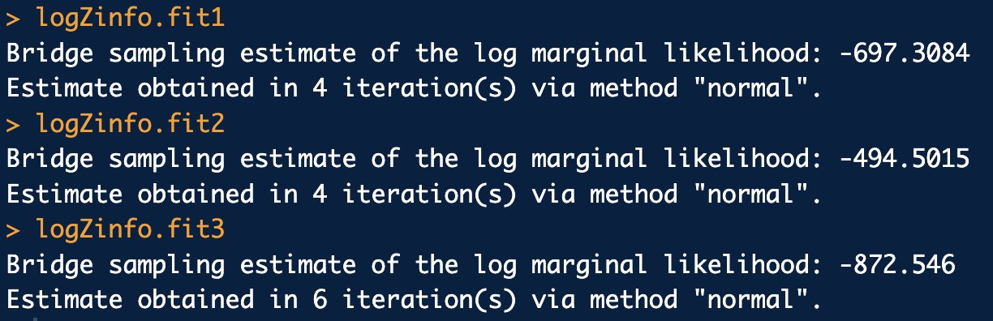
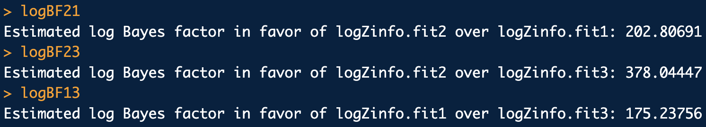
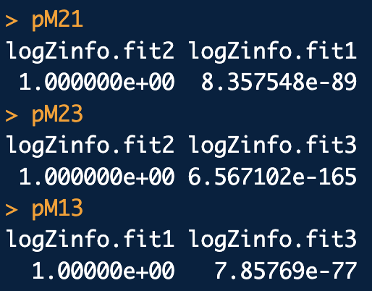
Analysis Stan:
# Compute log marginal likelihood (logZ) for each model
logZinfo.fit1 <- bridge_sampler(fit1, silent = F, use_neff = T)
logZinfo.fit2 <- bridge_sampler(fit2, silent = F, use_neff = T)
logZinfo.fit3 <- bridge_sampler(fit3, silent = F, use_neff = T)
logZinfo.fit1
logZinfo.fit2
logZinfo.fit3
# Some approximate error measures
error_measures(logZinfo.fit1)
error_measures(logZinfo.fit2)
error_measures(logZinfo.fit3)
# Compute log Bayes factors
logBF21 <- bf(logZinfo.fit2, logZinfo.fit1, log = T)
logBF23 <- bf(logZinfo.fit2, logZinfo.fit3, log = T)
logBF13 <- bf(logZinfo.fit1, logZinfo.fit3, log = T)
logBF21
logBF23
logBF13
# Compute p(M_i|D) vs p(M_j|D) assuming P(M) = 0.5
pM21 <- post_prob(logZinfo.fit2, logZinfo.fit1)
pM23 <- post_prob(logZinfo.fit2, logZinfo.fit3)
pM13 <- post_prob(logZinfo.fit1, logZinfo.fit3)
pM21
pM23
pM13

Slide 19
Example: “twitter personality” yet again
Running bridge sampling on JAGS output is MUCH more of a pain!
Mandatory preliminary steps:
Write stand alone function for log posterior of EACH model to be examined by porting JAGS model code over to R code
Caution: Format must be exactly what bridgesampling library expects.
Set up vectors of lower and upper bounds for all parameters of EACH model
Caution: Format must be exactly what bridgesampling library expects.

Slide 20
To begin: Run JAGS code for each model we want to compare
library(bayesutils)
library(bridgesampling)
M <- c(1154, 1062, 1203, 1125, 1091, 1120, 1202, 1129, 1103, 1098, 1169, 1142, 1174, 1111, 1148,
1134, 1146, 1179, 1165, 1076, 1152, 1209, 1205, 1139, 1227, 1145, 1140, 1220, 1059, 1165)
A <- c(1326, 1362, 1297, 1350, 1324, 1384, 1343, 1373, 1345, 1399, 1364, 1380, 1303, 1232, 1330,
1306, 1309, 1336, 1367, 1291, 1325, 1348, 1318, 1351, 1382, 1340, 1305, 1306, 1333, 1337)
N <- c(1251, 1234, 1337, 1235, 1189, 1289, 1318, 1190, 1307, 1224, 1279, 1331, 1310, 1244, 1246,
1168, 1267, 1274, 1262, 1254, 1139, 1236, 1310, 1227, 1310, 1255, 1230 ,1327, 1242, 1269)
s1 <- c(M,A,N) # Model a. One lambda.
dat1 <- list(
"n" = length(s1),
"s" = s1,
"a" = 25/16,
"b" = 1/16000
)
s2 <- cbind(M,A,N) # Model b. Three lambdas. One for M, A, N.
dat2 <- list(
"n" = nrow(s2),
"m" = ncol(s2),
"s" = s2,
"a" = 25/16,
"b" = 1/16000
)
s3 <- rbind(M,A,N) # Model c. 30 lambdas. One for each day.
dat3 <- list(
"n" = nrow(s3),
"m" = ncol(s3),
"s" = s3,
"a" = 25/16,
"b" = 1/16000
)

Slide 21
To begin: Run JAGS code for each model we want to compare
# Initalizations for each model
inits1 <- function (){
list(lambda=runif(1))
}
inits2 <- function (){
list(lambda=runif(ncol(s2)))
}
inits3 <- function (){
list(lambda=runif(ncol(s3)))
}
# Run the models:
fit1 <- jags(data=dat1,
inits=inits1,
parameters.to.save = c("lambda"),
n.iter=20000, n.burnin = 500, n.thin = 10,
n.chains=4,
model.file = system.file("jags/poisson-gamma.bug.R", package = "bayesutils"))
fit2 <- jags(data=dat2,
inits=inits2,
parameters.to.save = c("lambda"),
n.iter=20000, n.burnin = 500, n.thin = 10,
n.chains=4,
model.file = system.file("jags/poisson-gamma_multiple.bug.R", package = "bayesutils"))
fit3 <- jags(data=dat3,
inits=inits3,
parameters.to.save = c("lambda"),
n.iter=20000, n.burnin = 500, n.thin = 10,
n.chains=4,
model.file = system.file("jags/poisson-gamma_multiple.bug.R", package = "bayesutils"))

Slide 22
Port JAGS models to R code to compute log posterior density
lpf.poisson.gamma <- function(sample.row, data){
# *****NOTE these MUST be the arguments
# Extract parameter values:
# *****NOTE these MUST be in this named format
lambda <- sample.row[["lambda"]]
# This format does not work :(
#lambda <- sample.row[2]
# Initialize log posterior
lp <- -1e-12
# Priors
lp <- lp + dgamma(lambda, data$a, data$b, log = T)
# Likelihood and Log-likelihood
for(i in 1:data$n){
lp <- lp + dpois(data$s[i], lambda, log = T)
}
JAGS model a.
model{
# Priors
lambda ~ dgamma(a, b)
# Likelihood
for(i in 1:n){
s[i] ~ dpois(lambda)
}
}
Port to R to compute log posterior density

Slide 23
Port JAGS models to R code to compute log posterior density
lpf.poisson.gamma_multiple <- function(sample.row, data){
# Extract parameter values:
lambda <- sample.row[ paste0("lambda[", 1:data$m, "]") ]
# Initialize log posterior
lp <- -1e-12
# Priors
for(j in 1:data$m){
lp <- lp + dgamma(lambda[j], data$a, data$b, log = T)
}
# Likelihood and Log-likelihood
for(j in 1:data$m){
for(i in 1:data$n){
lp <- lp + dpois(data$s[i,j], lambda[j], log = T)
}
}
return(lp)
}
JAGS model b, c.
model{
# Priors
for(j in 1:m){
lambda[j] ~ dgamma(a, b)
}
# Likelihood
for(j in 1:m){
for(i in 1:n){
s[i,j] ~ dpois(lambda[j])
}
}
}
Port to R to compute log posterior density

Slide 24
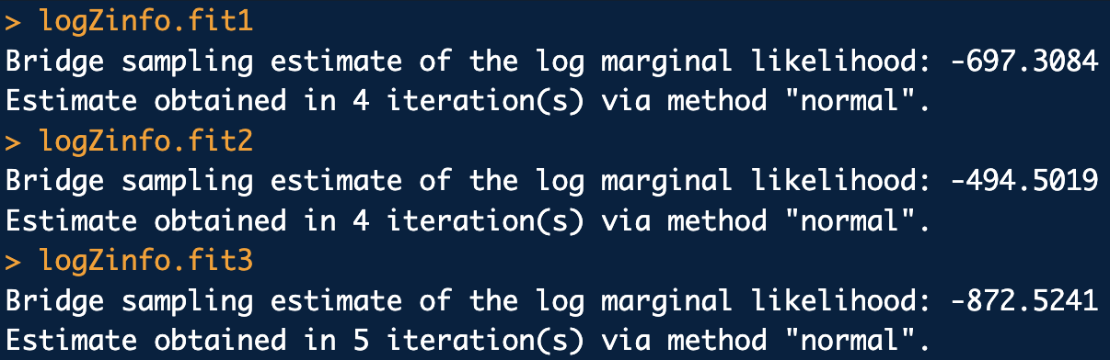
Analysis JAGS:
# Compute log marginal likelihood (logZ) for each model
# Set up parameter bounds
fit1.pb <- parameter.bounds(fit1, params.alt.bounds.list = list( "lambda"=c(0,Inf) ))
fit2.pb <- parameter.bounds(fit2, params.alt.bounds.list = list( "lambda"=c(0,Inf) ))
fit3.pb <- parameter.bounds(fit3, params.alt.bounds.list = list( "lambda"=c(0,Inf) ))
# Compute log marginal likelihood (logZ) for each model
logZinfo.fit1 <-
bridge_sampler(samples = fit1,
data = dat1,
log_posterior = lpf.poisson.gamma2,
lb = fit1.pb$lb.vec,
ub = fit1.pb$ub.vec,
silent = F)
logZinfo.fit2 <-
bridge_sampler(samples = fit2,
data = dat2,
log_posterior = lpf.poisson.gamma_multiple2,
lb = fit2.pb$lb.vec,
ub = fit2.pb$ub.vec,
silent = F)
logZinfo.fit3 <-
bridge_sampler(samples = fit3,
data = dat3,
log_posterior = lpf.poisson.gamma_multiple2,
lb = fit3.pb$lb.vec,
ub = fit3.pb$ub.vec,
silent = F)
logZinfo.fit1
logZinfo.fit2
logZinfo.fit3
So, with MUCH more work 😭, you can do the same thing with JAGS

Slide 25
Example: Lindley “Glass” again
Recall: the Lindley “glass problem”. This time we’ll formally compare the likelihood of the data under two different hypothesis (models):
The “Prosecutors Hypothesis” (H_{p}) is that the RI mean and standard deviation from the crime scene glass are the same as the mean and standard deviation RI from the suspect glass.
The “Defense Hypothesis” (H_{d}) is that the RI mean and standard deviation from the crime scene glass are different from the mean and standard deviation RI from the suspect glass.
Draw DAGs and compute posteriors for each
Compute marginal likelihoods of the data under each hypothesis
Obtain Bayes Factor
In the interests of keeping down slide bloat we are just going to work this problem with Stan

Slide 26
Example: Lindley “Glass” again
Recall: the Lindley “glass problem” data (standardized form):
The crime scene sample RI data standardized (X_{CS}):
-2.221394339, 0.446582786, 2.246618273, 1.990009440, 2.435301238, -0.402490556, -0.444000809, -0.364753963, -0.002482671, -0.138334405,
-0.659099389, -0.617589137, 0.027706604, -0.711930619, -0.417585194, -0.798724783, -0.251544184, -0.776082827, -0.232675888, -0.387395919,
0.046574900, -0.281733459, 0.420167171, -0.300601755, -0.364753963, -0.130787087, 1.303203447, -0.259091503, -0.032671945
The suspect’s sample RI data standardized (X_{SP}):
0.6994180, 0.8201751, 0.4126199, 0.4994140, -1.5874196, 0.6352658, 0.7409282, 0.9409322, -2.2817729

Slide 27
Example: Lindley “Glass” again
The “Prosecutors Hypothesis” (H_{p}) is that the RI mean and standard deviation from the crime scene glass are the same as the mean and standard deviation RI from the suspect glass.
0
10
3
0
1
μ
σ
6
X_{CS}
X_{SP}

Slide 28
Stan code for Model 1: Hp
data {
int<lower=0> nA;
int<lower=0> nB;
real DA[nA];
real DB[nB];
int<lower=0> nu_fix;
real<lower=0> mu_n_hyp;
real<lower=0> sigma_n_hyp;
int<lower=0> nu_t_hyp;
real<lower=0> mu_t_hyp;
real<lower=0> sigma_t_hyp;
}
parameters {
real mu;
real<lower=0> sigma;
}
model {
//Priors
target += normal_lpdf(mu | mu_n_hyp, sigma_n_hyp);
target += student_t_lpdf(sigma | nu_t_hyp, mu_t_hyp, sigma_t_hyp);
// Likelihood
target += student_t_lpdf(DA | nu_fix, mu, sigma);
target += student_t_lpdf(DB | nu_fix, mu, sigma);
}
This is very similar to T-norm_T_multiple.stan

Slide 29
Example: Lindley “Glass” again
The “Defense Hypothesis” (H_{d}) is that the RI mean and standard deviation from the crime scene glass are different from the mean and standard deviation RI from the suspect glass.
0
10
3
0
1
μ_{CS}
σ_{SP}
6
3
0
1
0
10
σ_{CS}
μ_{SP}
X_{CS}
X_{SP}

Slide 30
Stan code for Model 2: Hd
data {
int<lower=0> nA;
int<lower=0> nB;
real DA[nA];
real DB[nB];
int<lower=0> nu_fix;
real<lower=0> muA_n_hyp;
real<lower=0> sigmaA_n_hyp;
int<lower=0> nuA_t_hyp;
real<lower=0> muA_t_hyp;
real<lower=0> sigmaA_t_hyp;
real<lower=0> muB_n_hyp;
real<lower=0> sigmaB_n_hyp;
int<lower=0> nuB_t_hyp;
real<lower=0> muB_t_hyp;
real<lower=0> sigmaB_t_hyp;
}
parameters {
real muA;
real<lower=0> sigmaA;
real muB;
real<lower=0> sigmaB;
}
model {
//Priors
target += normal_lpdf(muA | muA_n_hyp, sigmaA_n_hyp);
target += student_t_lpdf(sigmaA | nuA_t_hyp, muA_t_hyp, sigmaA_t_hyp);
target += normal_lpdf(muB | muB_n_hyp, sigmaB_n_hyp);
target += student_t_lpdf(sigmaB | nuB_t_hyp, muB_t_hyp, sigmaB_t_hyp);
//Likelihood
target += student_t_lpdf(DA | nu_fix, muA, sigmaA);
target += student_t_lpdf(DB | nu_fix, muB, sigmaB);
}
This is basically just two T-norm_T_multiple.stan glued together.

Slide 31
Run Stan code
library(bayesutils)
library(bridgesampling)
# Extra options to set for Stan:
options(mc.cores = 4)
rstan_options(auto_write = TRUE)
# Load a Stan model1 (Hp):
stan.code1 <- paste(readLines(system.file("stan/compare_A-B_assume_same_mu_sig.stan",
package = "bayesutils")),collapse='\n')
# Translate Stan code into C++
model.c1 <- stanc(model_code = stan.code1, model_name = 'model1', verbose=T)
# Compile the Stan C++ model:
sm1 <- stan_model(stanc_ret = model.c1, verbose = T)
# Load a Stan model2 (Hd):
stan.code2 <- paste(readLines(system.file("stan/compare_A-B_assume_different_mu_sig.stan",
package = "bayesutils")),collapse='\n')
# Translate Stan code into C++
model.c2 <- stanc(model_code = stan.code2, model_name = 'model2', verbose=T)
# Compile the Stan C++ model:
sm2 <- stan_model(stanc_ret = model.c2, verbose = T)

Slide 32
Run Stan code
# Data
x.cs <- c(-2.221394339, 0.446582786, 2.246618273, 1.990009440, 2.435301238, -0.402490556, -0.444000809, -0.364753963,
-0.002482671, -0.138334405, -0.659099389, -0.617589137, 0.027706604, -0.711930619, -0.417585194, -0.798724783,
-0.251544184, -0.776082827, -0.232675888, -0.387395919, 0.046574900, -0.281733459, 0.420167171, -0.300601755,
-0.364753963, -0.130787087, 1.303203447, -0.259091503, -0.032671945)
x.sp <- c(0.6994180, 0.8201751, 0.4126199, 0.4994140, -1.5874196, 0.6352658, 0.7409282, 0.9409322, -2.2817729)
dat1 <- list(
"nA" = length(x.cs),
"nB" = length(x.sp),
"DA" = x.cs,
"DB" = x.sp,
"nu_fix" = 6,
"mu_n_hyp" = 0,
"sigma_n_hyp" = 100,
"nu_t_hyp" = 1,
"mu_t_hyp" = 0,
"sigma_t_hyp" = 5
)
dat2 <- list(
"nA" = length(x.cs),
"nB" = length(x.sp),
"DA" = x.cs,
"DB" = x.sp,
#
"nu_fix" = 6,
#
"muA_n_hyp" = 0,
"sigmaA_n_hyp" = 10,
"nuA_t_hyp" = 3,
"muA_t_hyp" = 0,
"sigmaA_t_hyp" = 1,
#
"muB_n_hyp" = 0,
"sigmaB_n_hyp" = 10,
"nuB_t_hyp" = 3,
"muB_t_hyp" = 0,
"sigmaB_t_hyp" = 1
)
fit1 <- sampling(sm1, data = dat1, iter=5000, thin = 1, chains = 4)
fit2 <- sampling(sm2, data = dat2, iter=5000, thin = 1, chains = 4)
fit1; fit2

Slide 33


# Compute log marginal likelihood (logZ) for each model
logZinfo.fit1 <- bridge_sampler(fit1, silent = F, use_neff = T)
logZinfo.fit2 <- bridge_sampler(fit2, silent = F, use_neff = T)
logZinfo.fit1
logZinfo.fit2
# Compute Bayes factor
logBF12 <- bf(logZinfo.fit1, logZinfo.fit2, log = T)
logBF21 <- bf(logZinfo.fit2, logZinfo.fit1, log = T)
exp(logBF12$bf)
exp(logBF21$bf)
# Compute p(M_i|D) vs p(M_j|D) assuming P(M) = 0.5
pM12 <- post_prob(logZinfo.fit1, logZinfo.fit2)
pM21 <- post_prob(logZinfo.fit2, logZinfo.fit1)
pM12
pM21
# For comparison, freq t-test for equivalence of two means:
var.test(x.cs, x.sp)
t.test(x.cs, x.sp, alternative = "two.sided", var.equal = T)
Analysis Stan:
So BF ~ 25 i.e. “Evidence strongly supports H_{p}”
However, with Cauchy(0,5) priors on the sigma’s, posteriors remain about the same but BF goes to ~85!
Even worse, if we put normal(0,100) priors on the mu’s as well, again posteriors remain about the same but BF goes to almost 900!
The BF is EXTREMELY SENSITVE TO PRIOR CHOICES.
Frequentist t-test for equivalence of two means gives the same conclusion as the BF
If it had not (which does happen in certain circumstances), this is called the Lindley's paradox.

