Slide 1

Important Probability Distributions

Slide 2
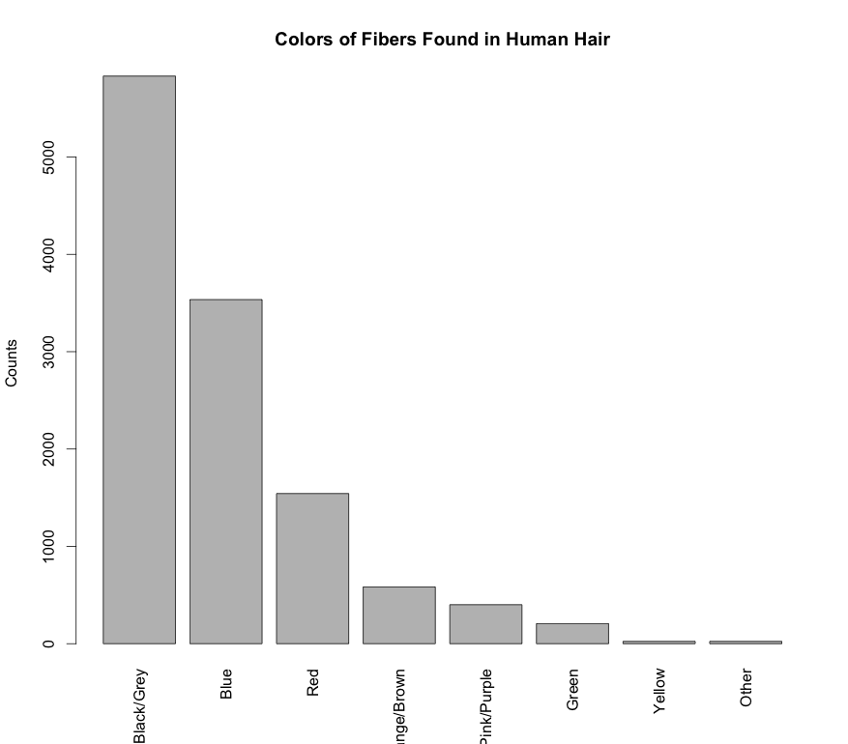
Probability Mass Function
Probability over a discrete set of outcomes is described by a probability mass function (PMF)
A PMF can be represented as a table or displayed as a histogram
Fiber Color | Probability
Black/Grey | 0.48
Blue | 0.291
Red | 0.127
Orange/Brown | 0.048
Pink/Purple | 0.033
Green | 0.017
Yellow | 0.002
Other | 0.002
library(dafs)
data("fiber.color.df")
table(fiber.color.df)
barplot(fiber.color.df[,3], names.arg = fiber.color.df[,1],
las=3, ylab = "Counts", xlab="",
main="Colors of Fibers Found in Human Hair")

Slide 3
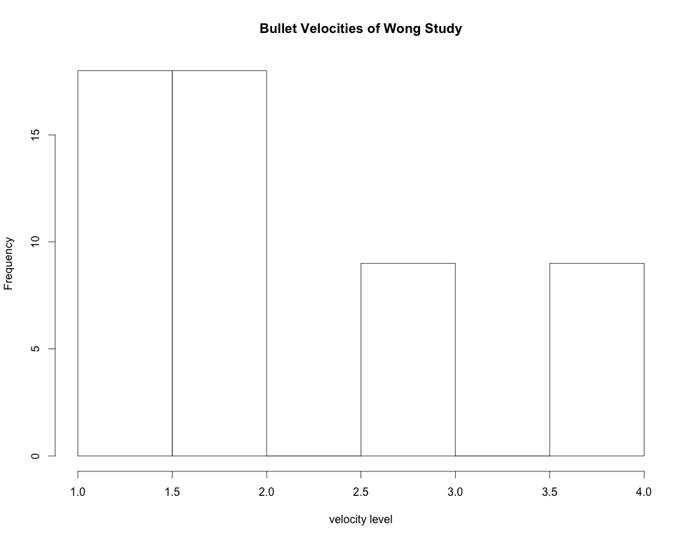
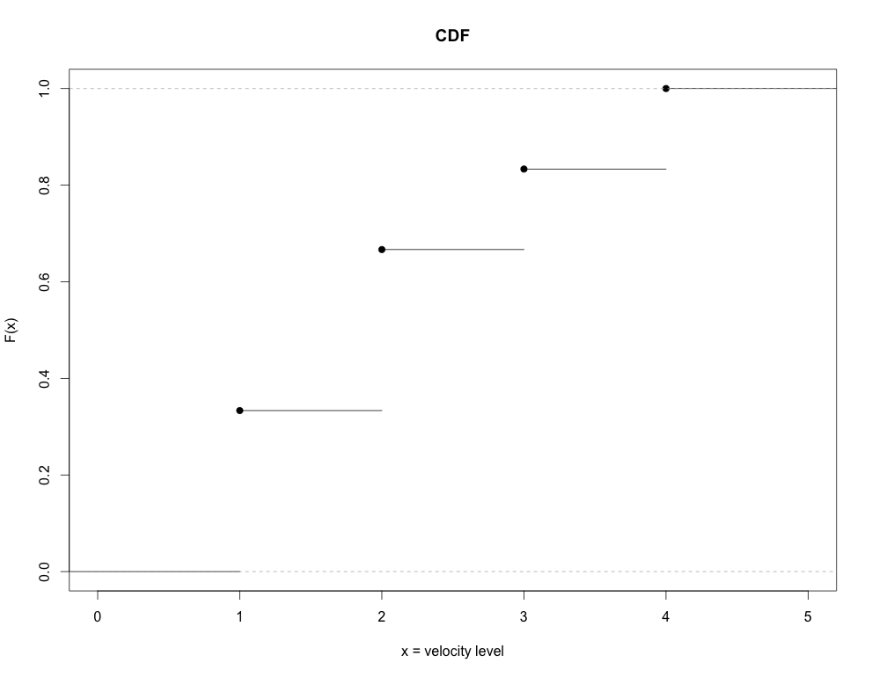
Cumulative Distribution Function
A function that gives the probability that a random variable is less than or equal to a specified value is a cumulative distribution function (CDF):
Varies between 0 and 1
CDFs for discrete RVs are step functions

Slide 4
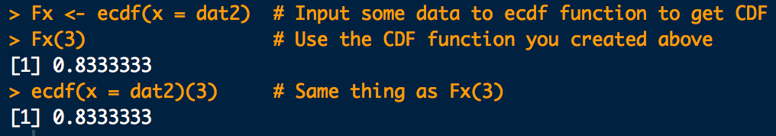
Cumulative Distribution Function
In R we can compute the empirical CDF, F(x) like this:
dat <- c(
1,1,1,1,1,1,1,1,1,1,1,1,1,1,1,1,1,1,
2,2,2,2,2,2,2,2,2,2,2,2,2,2,2,2,2,2,
3,3,3,3,3,3,3,3,3,
4,4,4,4,4,4,4,4,4
)
Fx <- ecdf(dat)
Fx(3)
ecdf(dat)(3)
Don’t name anything “F” in R.
F(x = 3)
Pr(X ≤ 3)

Slide 5
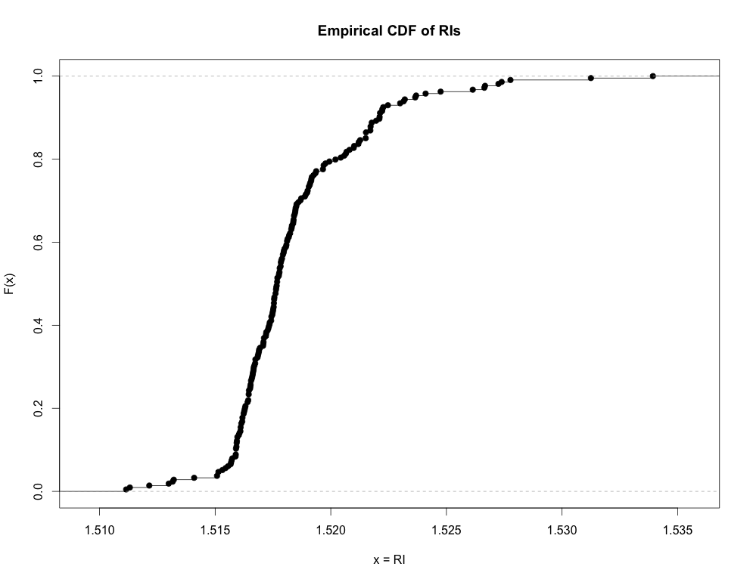
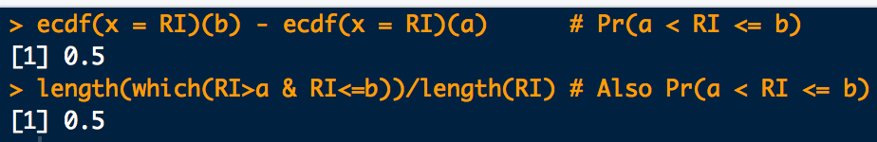
Cumulative Distribution Function
Use the CDF to compute the probability that a RV will lay between two specified values such that:
a <- 1.51593
b <- 1.51820
# Pr(a<RI<=b)
ecdf(x = RI)(b) - ecdf(x = RI)(a)
# Also Pr(a<RI<=b)
length(which(RI > a & RI <= b))/length(RI)
F(b)
F(a)
a
b

Slide 6
Moments and Expectation Values
Moments are handy numerical values that can systematically help to describe distribution location and shape properties.
m^{th}-order moments are found by taking the expectation value of an RV raised to the m^{th}-power:

Slide 7
Moments and Expectation Values
1st-order moment:
Number of times outcome x_{i} occurs
Total number of experiments
average value of X

Slide 8
Moments and Expectation Values
1st-order moment:
location descriptor
mean
average value of X
1st-order moment for a parameter g(X) on X:
average value of parameter g

Slide 9
Moments and Expectation Values
2nd-order moments:
Second order moment. Not that interesting…
but…
Second order central moment.
It can be shown that
Population standard deviation
spread descriptor

Slide 10
Moments and Expectation Values
Higher-order moments measure other distribution shape properties:
3rd order: “skewness”
4th order: “kurtosis” (pointy-ness/flat-ness)
no skew
leptokurtic
left skew
right skew
platykurtic

Slide 11
Bernoulli Distribution
Bernoulli PMF: “Coin Flipping” distribution
Probability of a “Heads” (success) is p
Probability of a “Tails” (fail) is 1 − p

Slide 12
Bernoulli Distribution
Mean:
Variance:
Cumulative distribution function (CDF):

Slide 13
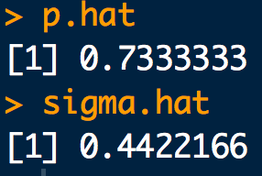
Example
Website access requests on a certain server are detected at the rising edge of the system clock with a period of 100ns. The following 3μs sequence of access requests are observed:
1, 0, 1, 1, 1, 1, 0, 0, 1, 1, 1, 1, 0, 1, 1, 1, 0, 0, 1, 0, 1, 1, 1, 1, 1, 0, 1, 1, 1, 1
Assuming the requests are independent, what is the approximate probability that a request is made within a clock cycle? What is the approximate uncertainty in this probability?
x <- c(1, 0, 1, 1, 1, 1, 0, 0, 1, 1, 1, 1, 0, 1, 1, 1, 0, 0, 1, 0, 1, 1, 1, 1, 1, 0, 1, 1, 1, 1)
p.hat <- sum(x)/length(x)
p.hat
sigma.hat <- sqrt(p.hat*(1-p.hat))
sigma.hat

Slide 14
Binomial Distribution
Binomial PMF: Number of “heads” (successes) in n flips
Number of “Heads” (successes) is x
Probability of a “Heads” is p
Number of flips (“Bernoulli trials”) is n

Slide 15
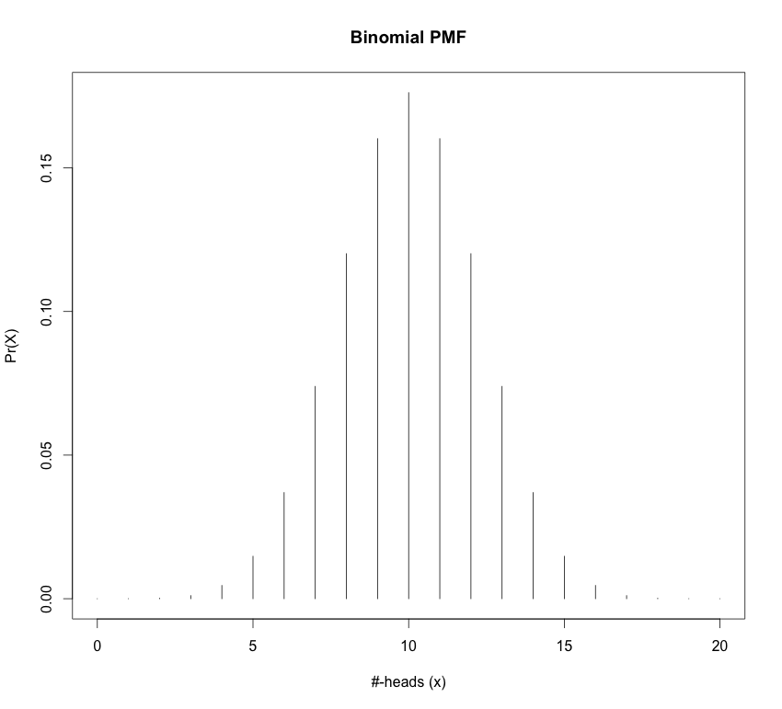
Binomial Distribution
Mean:
Variance:
n = 20
p = 0.5

Slide 16
Binomial Distribution
Cumulative distribution function (CDF):
Don’t worry. Just use this: pbinom(q = x, size = n, prob = p)
“p-functions” in R are the CDFs of the distribution
And while we’re at it:
dbinom “d-function” in R is the density (mass) of the distribution
pbinom “p-function” in R is the CDFs of the distribution
qbinom “q-function” in R give the quantiles of the distribution (x-values) for a given cumulative probability (p-value)
rbinom “r-functions” in R gives a random sample from the distribution
*NOTE: “p-functions” and “q-functions” are inverses of each other

Slide 17
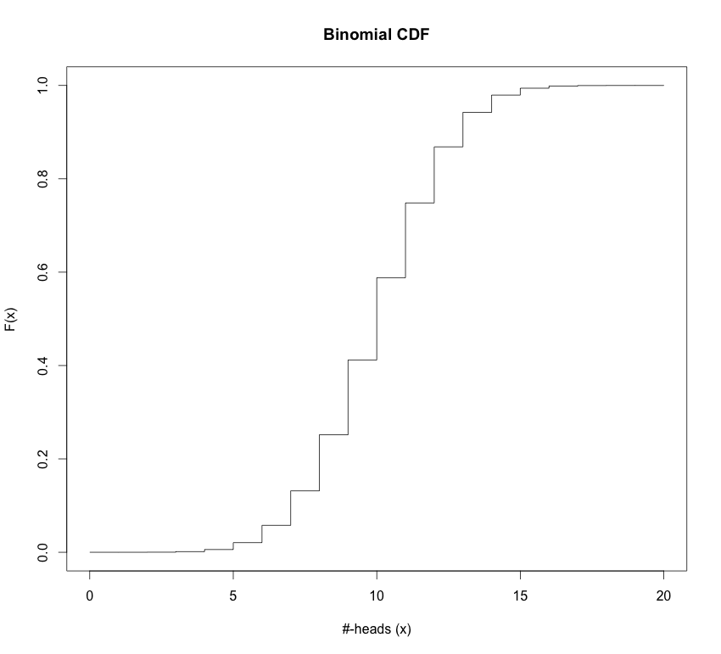
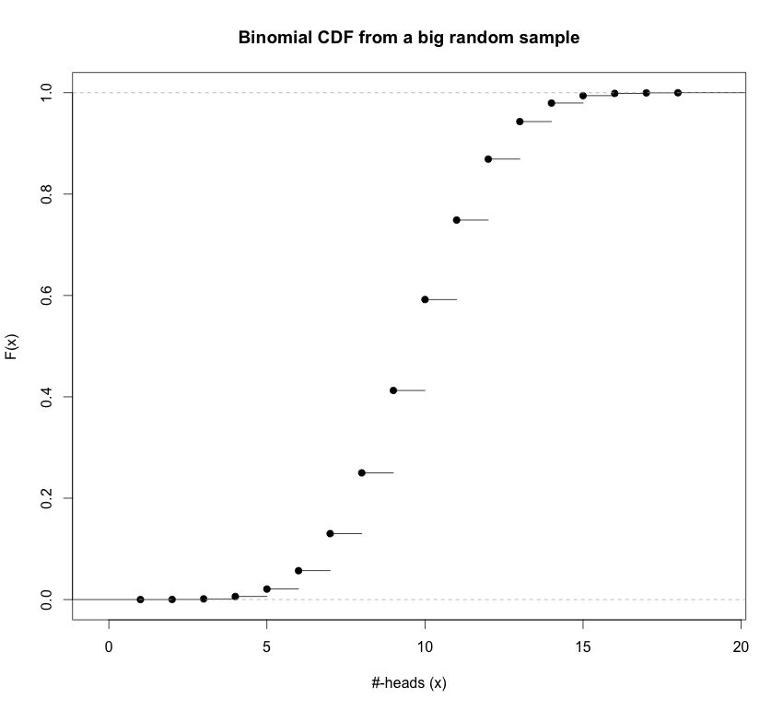
Binomial Distribution
Cumulative distribution function (CDF):
# Plot the Cumulative Distribution Function:
binomial.cdf <- pbinom(q = 0:20, size = n, prob = p)
plot(0:20, binomial.cdf, typ="s", main="Binomial CDF", xlab="#-heads (x)",ylab="F(x)")
# Make a prettier CDF plot by getting a big random sample
# and plotting the empirical CDF for it:
sample.of.binomial <- rbinom(100000, size = n, prob = p)
plot(ecdf(sample.of.binomial), main="Binomial CDF from a big random sample", xlab="#-heads (x)",
ylab="F(x)")

Slide 18
Example
Using data collected by Besson, Taroni et al. suggest that about 36% of bills in general circulation in Europe contain traces of cocaine.
What is the distribution of the number of European bills that contain traces of cocaine in a stack of 50?
What is approximate uncertainty in the count?
How many contaminated bills do you expect to find?
What is the probability of finding between 10 and 20 bills contaminated with cocaine?

Slide 19
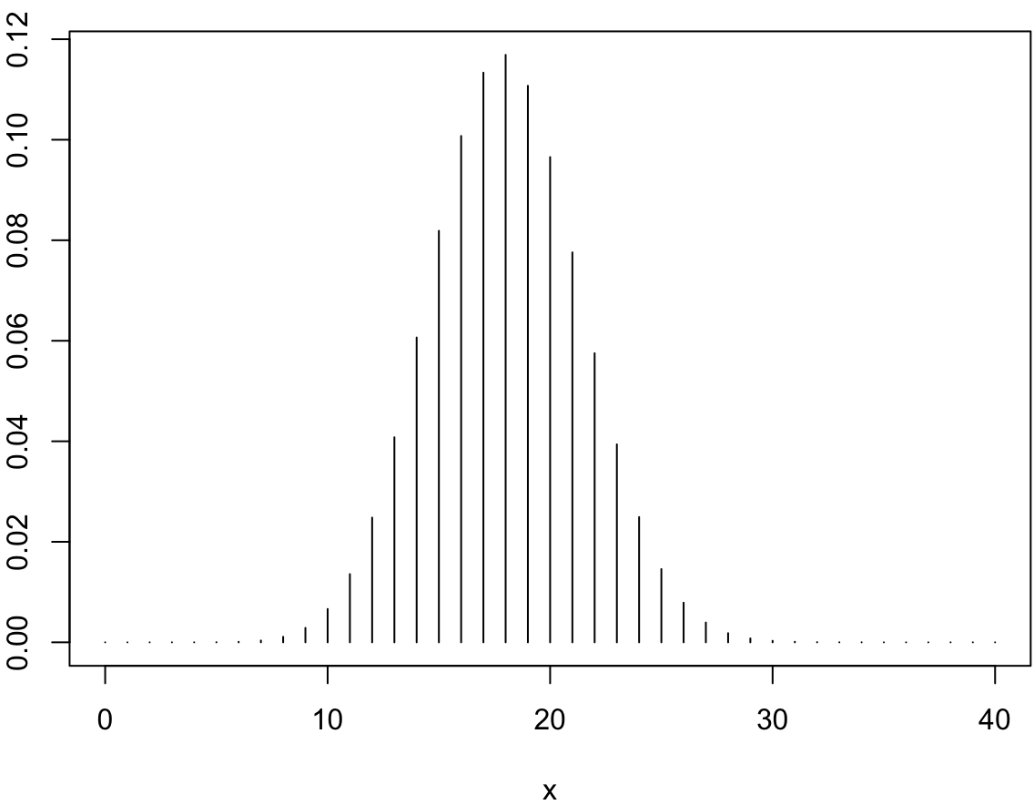
p <- 0.36
n <- 50
# a.
x <- seq(from=0, to=40)
pmf <- dbinom(x, size = n, prob = p)
plot(x, pmf, typ = "h")
# b.
sigma <- sqrt(n*p*(1-p))
sigma
# c.
mu <- n*p
mu
# d.
pbinom(20, size = n, prob = p) - pbinom(10, size = n, prob = p)

Slide 20

Poisson Distribution
Poisson PMF: You don’t know how many times you are going to “flip the coin” but you do know on average how many “heads” you get
is the mean rate for occurrence of an “event”, “success” or “head”.
Say on average you get 100 texts in a day. Then = 100.
Number of “events”, “successes”, “heads” (etc.) is x
*NOTE: The is no upper limit on “events” that can occur in an experiment, unlike for the binomial, where the upper limit of “successes” (“events”) is n.

Slide 21
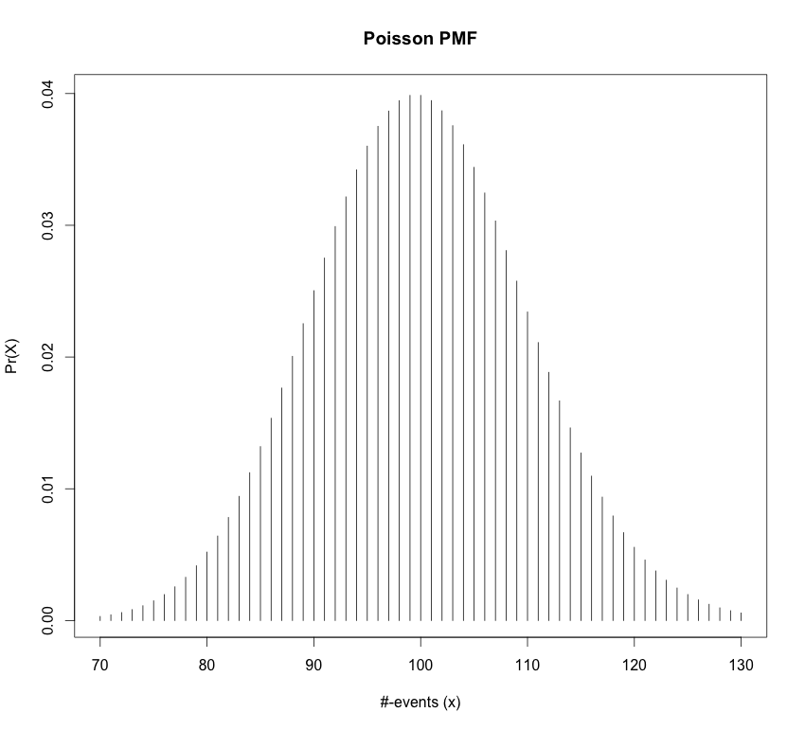

Poisson Distribution
Mean:
Variance:

Slide 22
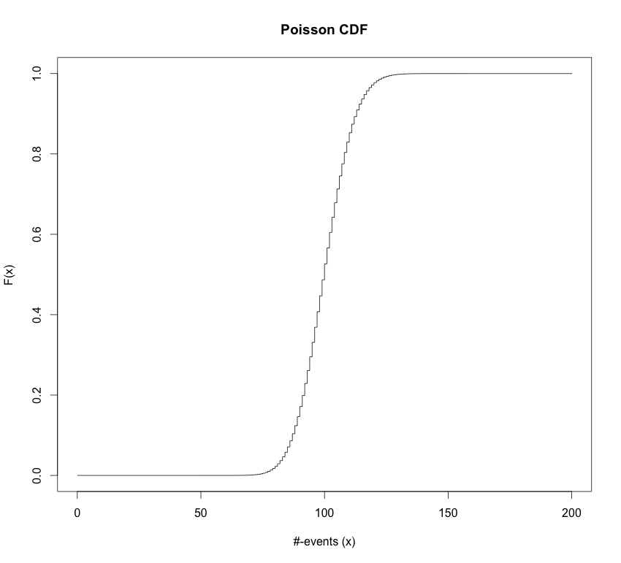
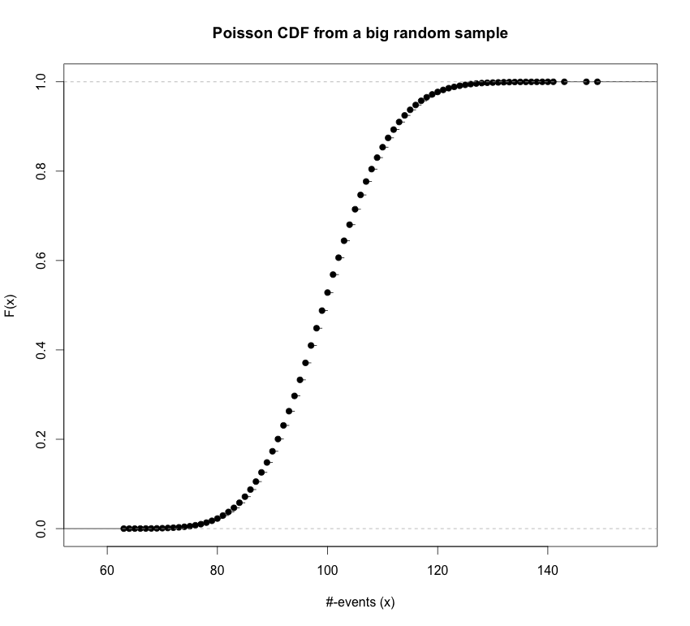
Poisson Distribution
Cumulative distribution function (CDF):
ppois(q = x, lambda = lam)

Slide 23
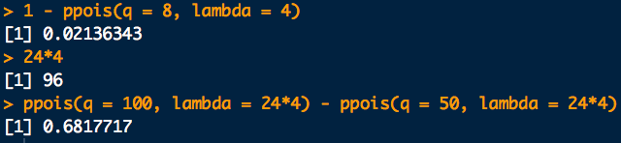
Example
A certain “user” of a social media site (may be a bot) posts at an average rate of about 4 per hour.
What is the probability that more than 8 posts will be put up in the next hour?
About how many posts can be expected in 24 hours?
What is the probability of between 50 and 100 posts appearing in 24 hours?
# a.
1 - ppois(q = 8, lambda = 4)
# b. mean poisson with new rate = 24*old rate:
24*4
# c.
ppois(q = 100, lambda = 24*4) - ppois(q = 50, lambda = 24*4)

Slide 24
Multinomial Distribution
Multinomial PMF:
multinomial coefficient
Means: the probability category 1 occurs x_{i} times
Assumes “occurrences” in a category happen independently
NOTE: each X_{i} is “marginally” (alone as a subset) distributed as:
Means: “is distributed as”

Slide 25
Multinomial Distribution
Multinomial PMF:
Mean for each category:
Variance for each category:
Since there are many categories, the X_{k} can “vary” with each other:
i.e. the X_{k} can “co-vary”
Covariance between occurrences in category i and category j:
Covariance can also be given on a standard scale for -1 to 1 called correlation:
Correlation between occurrences in category i and category j:
Cor(X_{i}, X_{i}) = 1

Slide 26
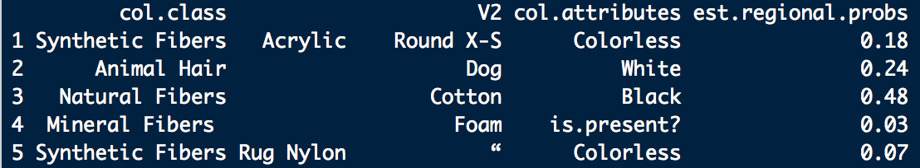
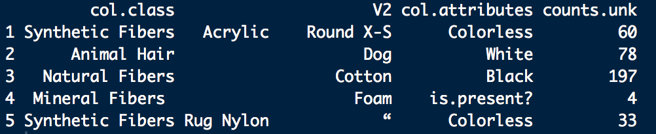
Example: Multinomial Distribution
In a certain apartment several dust bunnies are found and their constituents assessed. Using this data a dust bunny from the apartment has estimated composition of constituents:
A victim is found rolled up and stuffed in a closet in a neighboring apartment. A dust bunny is recovered with the victim. The constituents are the same and have the following counts:

Slide 27
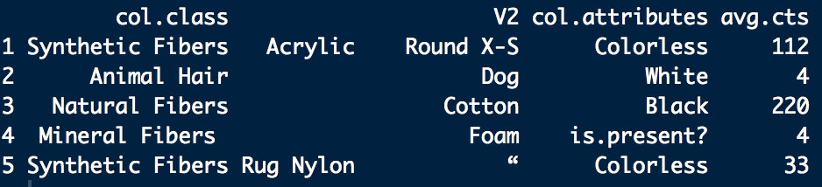
Example: Multinomial Distribution
Two small dust bunnies are found in the residence. A mass is selected from each. The first 372 items fitting into the categories of the unknown are counted. The fibers are returned to the main mass and mixed in. The process is repeated several times. The average counts for each category are found to be:
a. How do the probabilities of each configuration compare under the assumption that the dust bunnies are all from apartment 1?
b. What are some criticisms of this experiment and the probability model applied to it?

Slide 28
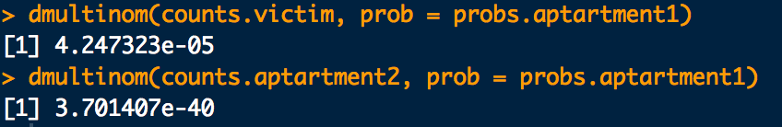
Example: Multinomial Distribution
probs.apartment1 <- c(0.16, 0.21, 0.53, 0.01, 0.09)
counts.victim <- c(60, 78, 197, 4, 33)
counts.apartment2 <- c(112, 4, 220, 4, 33)
dmultinom(x = counts.victim, prob = probs.apartment1)
dmultinom(x = counts.apartment2, prob = probs.apartment1)

Slide 29
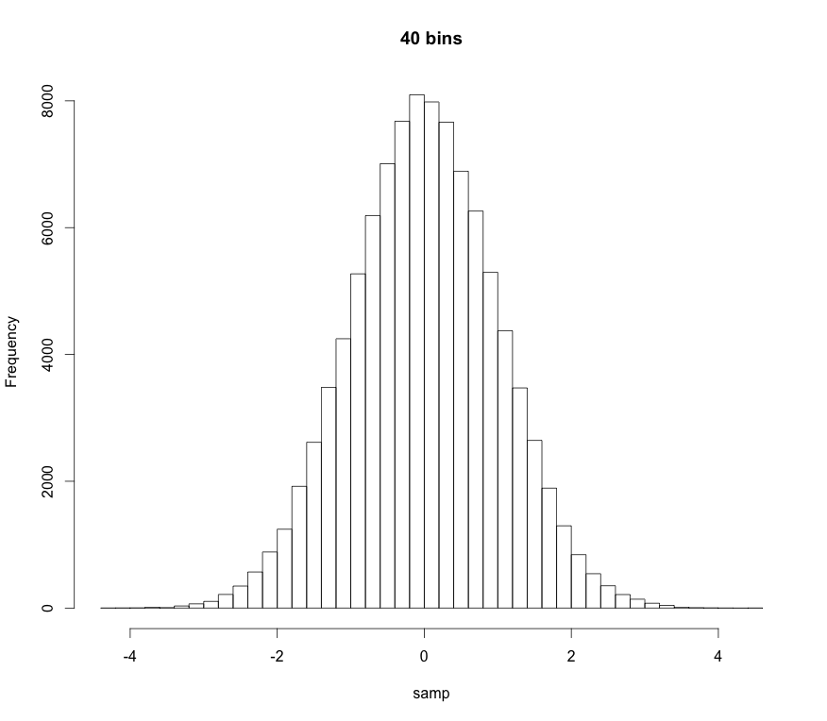
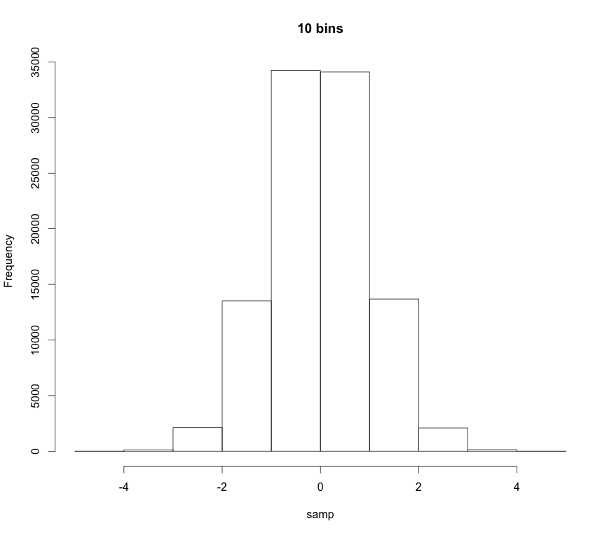
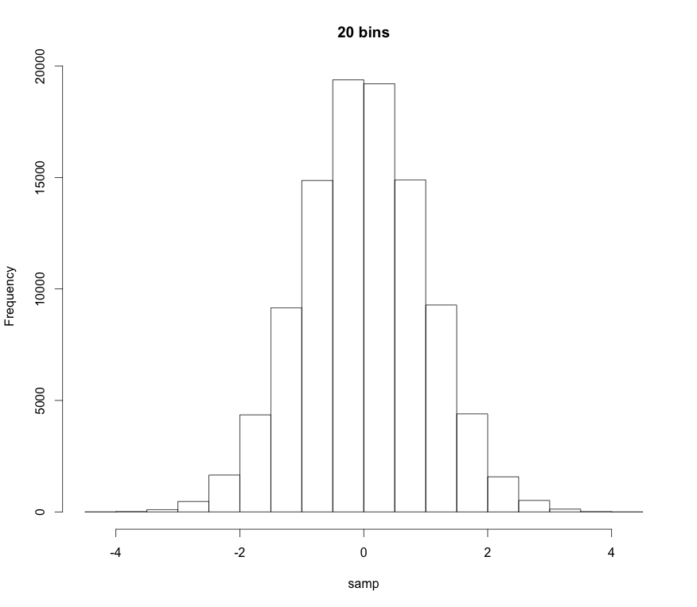
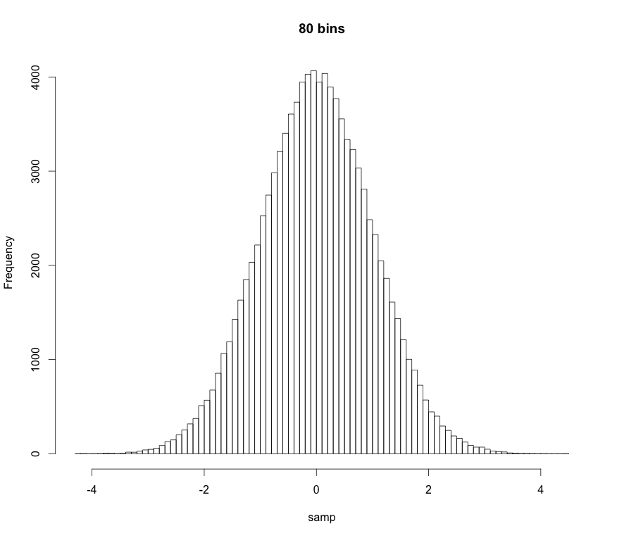
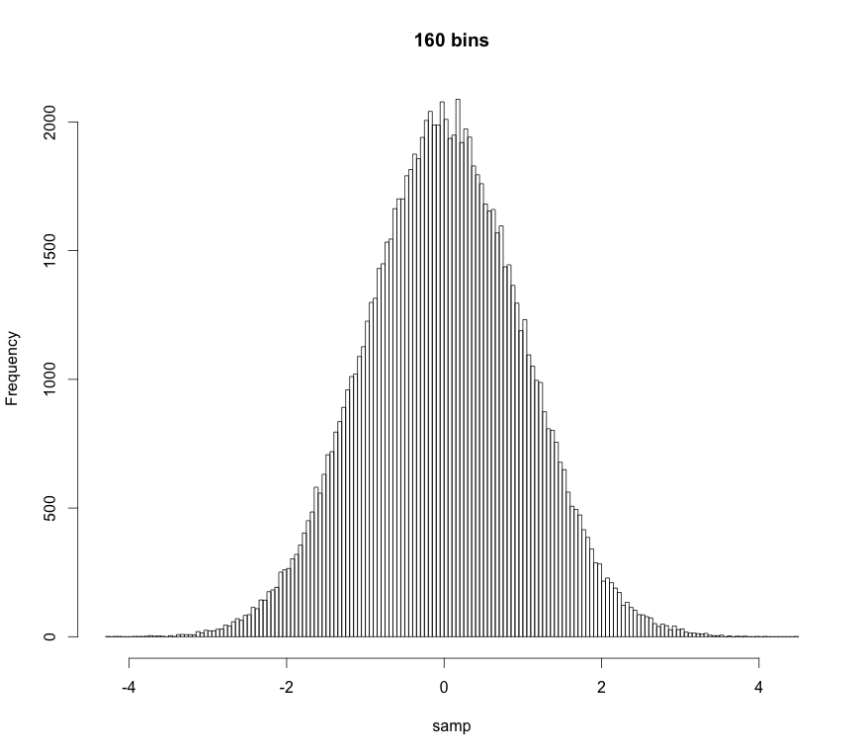
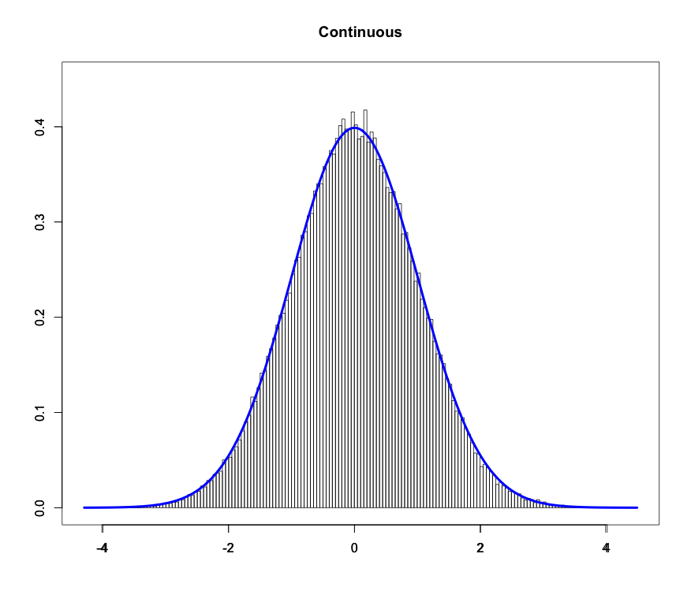
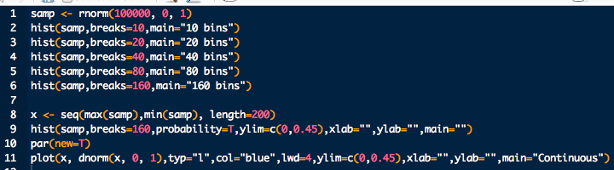
Probability Density Function
As we increase the number of “bins” in a histogram the “bars” get thinner and thinner
If there are an infinite number of bins the bars get infinitesimally thin:

Slide 30
Probability Density Function
Technical definition:
A random variate X is continuous if:
The probability that X lies between a and b
p(x): probability density function (pdf)
Note:
Proper pdfs should be normalized
“All space” for an r.v. is it’s domain. Also called its support
“All space” for us is usually 0 to ∞ or -∞ to ∞

Slide 31
Probability Density Function
Technical definition:
A random variate X is continuous if:
The probability that X lies between a and b
p(x): probability density function (pdf)
Note also:
The probability of obtaining a particular r.v. is 0
p(x) ≥ 0
The pdf is always greater than or equal to 0

Slide 32
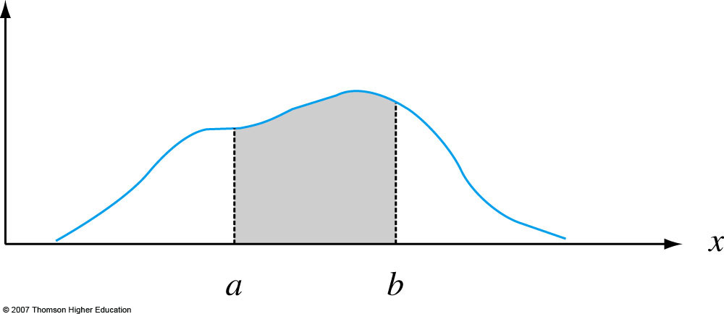
Probability Density Function
Graphically:
p(x)
Notes:
Figure 4.2
P (a ≤ X ≤ b) = the area under the density curve between a and b.

Slide 33
Moments and Expectation Values
Moments are numerical values that control a PDF’s location and shape properties.
m^{th}-order moments are found by taking the expectation value or average-value of an RV raised to the m^{th}-power:
Most of the time we only care about first-order and second-order-central moments.

Slide 34
Moments and Expectation Values
1st-order moment for X, i.e. the expectation value of X:
location descriptor
mean

Slide 35
Moments and Expectation Values
Important 2nd-order moments:
Second order central moment.
It can be shown that
Population standard deviation
spread descriptor

Slide 36
Uniform Distribution
Uniform PDF: Same “likelihood” for all x
Parameters:
a left bound
b right bound

Slide 37
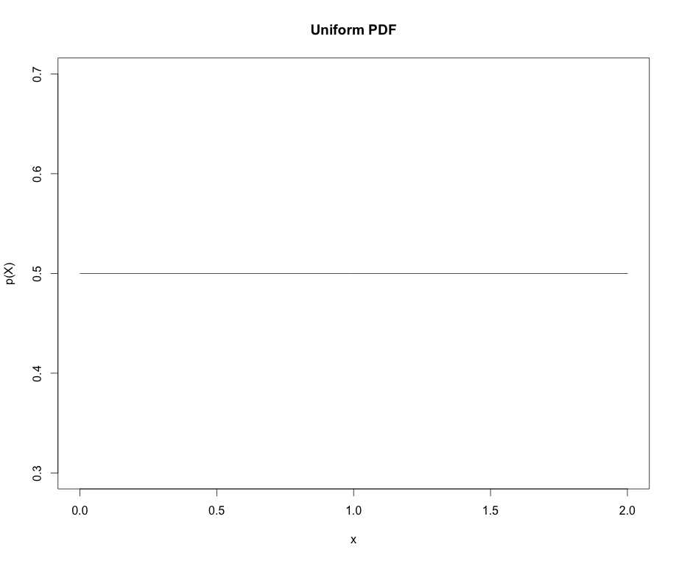
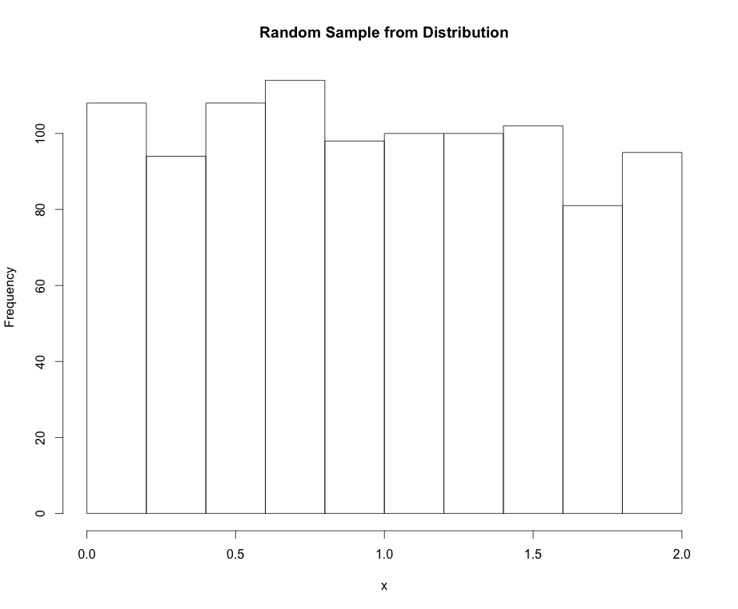
Uniform Distribution
Mean:
Variance:

Slide 38
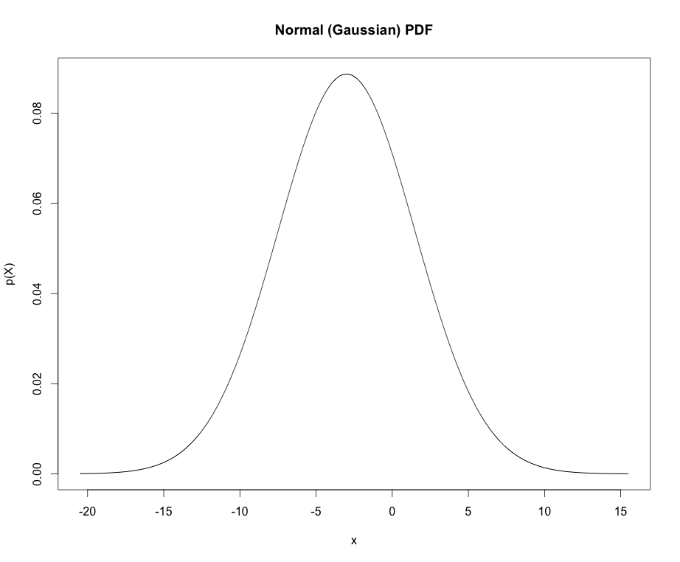


Normal Distribution
Normal PDF: The “bell cure”. Also called Gaussian dist.
Parameters:
mean
standard deviation

Slide 39
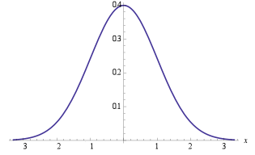
Normal Distribution
Points of interest for the Normal distribution:
If X ~ N(μ, σ) we can “standardize” (transform) to the z-scale:
Standard normal distribution
Handy equation
~ 68%
±1σ
~ 95%
±2σ
~ 99%
±3σ

Slide 40
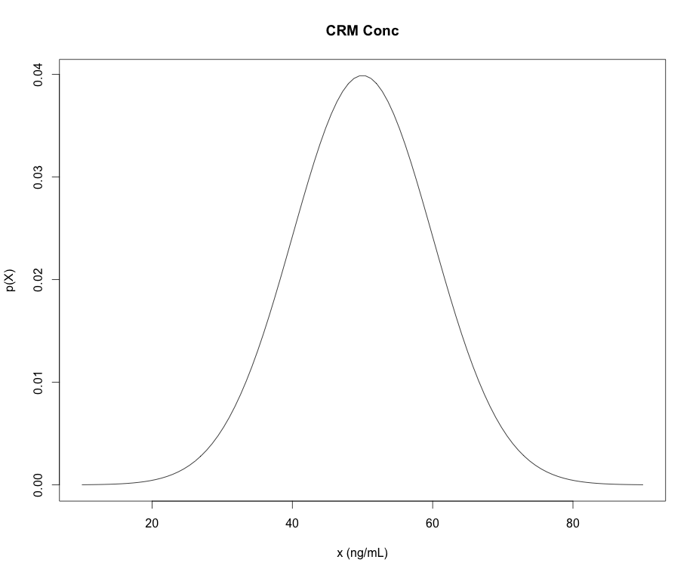
Some R Commands for PDFs
dnorm “d-function” in R is the density (mass) of the distribution
pnorm “p-function” in R is the CDFs of the distribution
qnorm “q-function” in R give the quantiles of the distribution (x-values) for a given cumulative probability (p-value)
rnorm “r-functions” in R gives a random sample from the distribution
*NOTE: “p-functions” and “q-functions” are inverses of each other
pnorm(q=47,mean=50,sd=10)=
0.42
0.42
“input quantity”
qnorm(p=0.42,mean=50,sd=10)=
47
47

Slide 41
Example: quantiles/percentiles
A sample of methamphetamine in blood certified reference material (CRM) is obtained as a standard for calibration of methodology in a tox lab.
The concentration of the CRM is certified to follow a normal distribution with mean concentration of 50 ng/mL and standard deviation of 10 ng/mL.
What maximum concentration can we expect for 90% of the samples we may measure?

Slide 42
Example: quantiles/percentiles
Another way to phrase: What measured sample concentration (quantile) should correspond to the 90th percentile with respect to the CRM?
0.9
?

Slide 43

Example: quantiles/percentiles
Another way to phrase: What measured sample concentration (quantile) should correspond to the 90th percentile with respect to the CRM?
# Parameters:
mu <- 50
sigma <- 10
# Quantile for the 90th percentile:
qnorm(0.9, mean=mu, sd=sigma)

Slide 44
Example: quantiles/percentiles
What is the probability of that the CRM’s concentration will be measured to be between 30 ng/mL and 70 ng/mL?
30 ng/mL
70 ng/mL
What would the code look like if we wanted Pr(X > 70ng/mL)?
# The “measurands” (parameters):
mu <- 50
sigma <- 10
# Pr(30 < X < 70):
pnorm(70, mean=mu, sd=sigma) – pnorm(30, mean=mu, sd=sigma)

Slide 45

Other Distributions We’ll Encounter
Student-t: Like Normal distribution but fatter tails. Can be a handy prior for means.
dt, qt, pt, rt
Parameters:
df: degrees of freedom
Chi-squared ( ): Handy especially for comparing raw set of counts. Also, it’s proportional to the likelihood of sample variance for IID data.
dchisq, qchisq, pchisq, rchisq
Parameters:
df: degrees of freedom

Slide 46



Other Distributions We’ll Encounter
Beta: Handy to represent beliefs about a proportion or a probability
Parameters:
dbeta, qbeta, pbeta, rbeta
shape1:
shape2:
Dirichlet: Handy to represent beliefs about many probabilities that sum to 1.
Parameters:
: shape parameters.

Slide 47
Other Distributions We’ll Encounter
Cauchy, Half-Cauchy : Bell/half-bell shaped but very fat tailed. Handy as weakly informative priors for means and standard deviations.
Parameters:
Shape, scale
Look around at other people’s applications. Some of their ideas may work for you.

