Slide 1

Important Probability Distributions 1
Important “named” discrete probability distributions that come up all the time

Slide 2
Bernoulli Distribution
Bernoulli PMF: “Coin Flipping” distribution
Probability of a “Heads” (success) is p
parameter
Probability of a “Tails” (fail) is 1 − p

Slide 3
Bernoulli Distribution
Important Moments to Remember:
Mean:
Variance:
Standard Deviation:

Slide 4
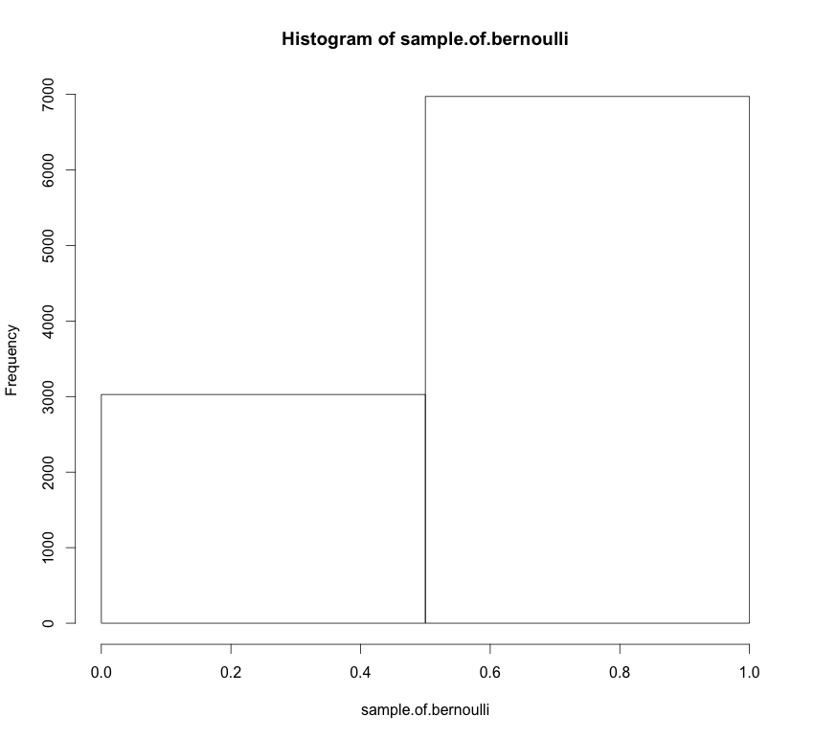
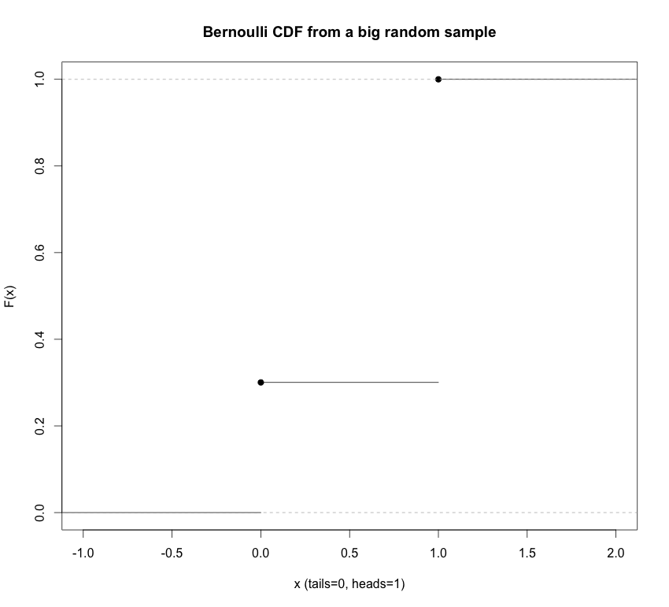
Bernoulli Distribution
Cumulative distribution function (CDF):
Example of a Bernoulli PMF
p = 0.3
The corresponding Bernoulli CDF
p = 0.3

Slide 5
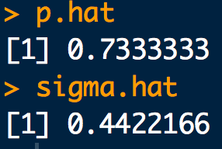
Example
Website access requests on a certain server are detected at the rising edge of the system clock with a period of 100ns. The following 3μs sequence of access requests are observed:
1, 0, 1, 1, 1, 1, 0, 0, 1, 1, 1, 1, 0, 1, 1, 1, 0, 0, 1, 0, 1, 1, 1, 1, 1, 0, 1, 1, 1, 1
Assuming the requests are independent, what is the approximate probability that a request is made within a clock cycle? What is the approximate uncertainty in this probability?
x <- c(1, 0, 1, 1, 1, 1, 0, 0, 1, 1, 1, 1, 0, 1, 1,
1, 0, 0, 1, 0, 1, 1, 1, 1, 1, 0, 1, 1, 1, 1)
p.hat <- sum(x)/length(x)
p.hat
sigma.hat <- sqrt(p.hat*(1-p.hat))
sigma.hat

Slide 6
Binomial Distribution
Binomial PMF: Number of “heads” (successes) in n flips
Number of “Heads” (successes) is x
Probability of a “Heads” is p
parameters
Number of flips (“Bernoulli trials”) is n

Slide 7
Binomial Distribution
Important Moments to Remember:
Mean:
Variance:
Standard Deviation:

Slide 8
Binomial Distribution
Cumulative distribution function (CDF):
Don’t worry. Just use this: pbinom(q = x, size = n, prob = p)
“p-functions” in R are the CDFs of the distribution
And while we’re at it:
dbinom “d-function” in R is the density (mass) of the distribution
pbinom “p-function” in R is the CDFs of the distribution
qbinom “q-function” in R give the quantiles of the distribution (x-values) for a given cumulative probability (p-value)
rbinom “r-functions” in R gives a random sample from the distribution
*NOTE: “p-functions” and “q-functions” are inverses of each other

Slide 9
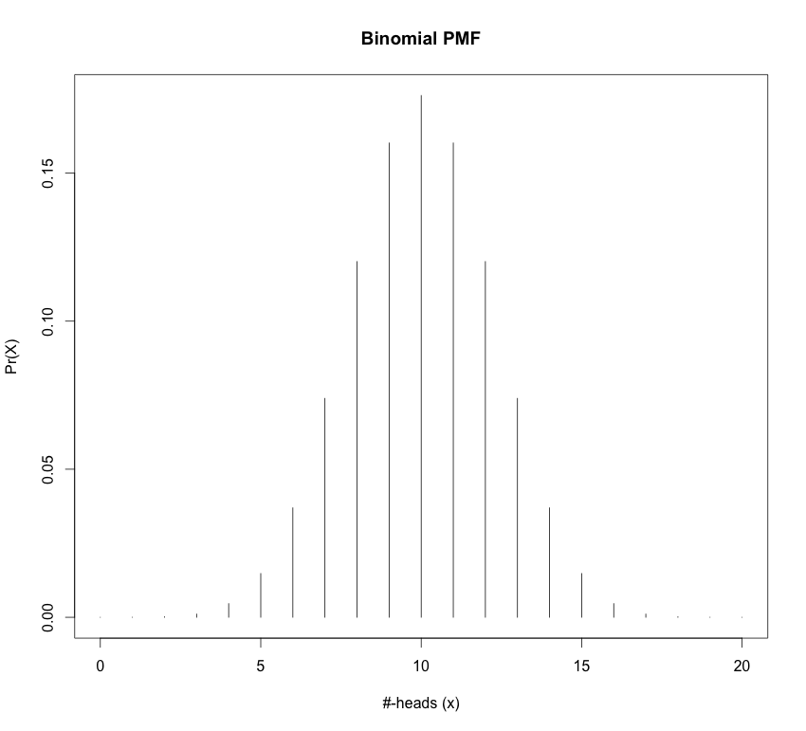
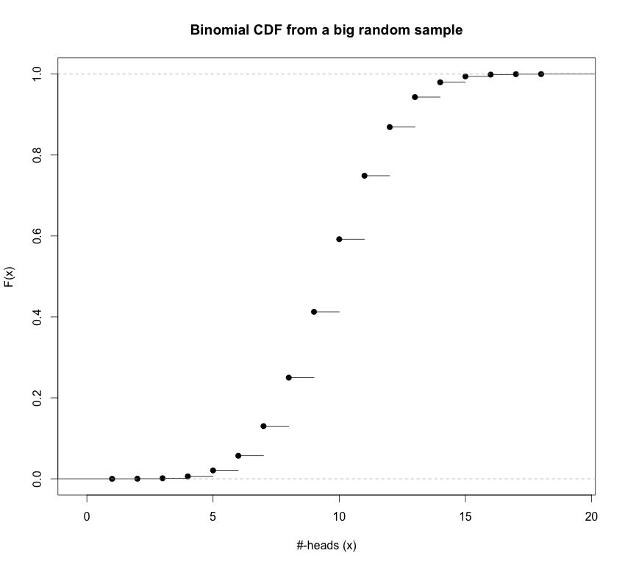
Binomial Distribution
Example of a Binomial PMF
The corresponding Binomial CDF
n = 20
p = 0.5

Slide 10
Example
Using data collected by Besson, Taroni et al. suggest that about 36% of bills in general circulation in Europe contain traces of cocaine.
What is the distribution of the number of European bills that contain traces of cocaine in a stack of 50 bills?
What is approximate uncertainty in the count?
How many contaminated bills do you expect to find?
What is the probability of finding greater than 10 and less than or equal to 20 bills contaminated with cocaine?
What is the probability that 13 bills or less contain traces of cocaine?
What is the probability that more than 15 bills contain traces of cocaine?
What is the probability that 15 or more bills contain traces of cocaine?

Slide 11
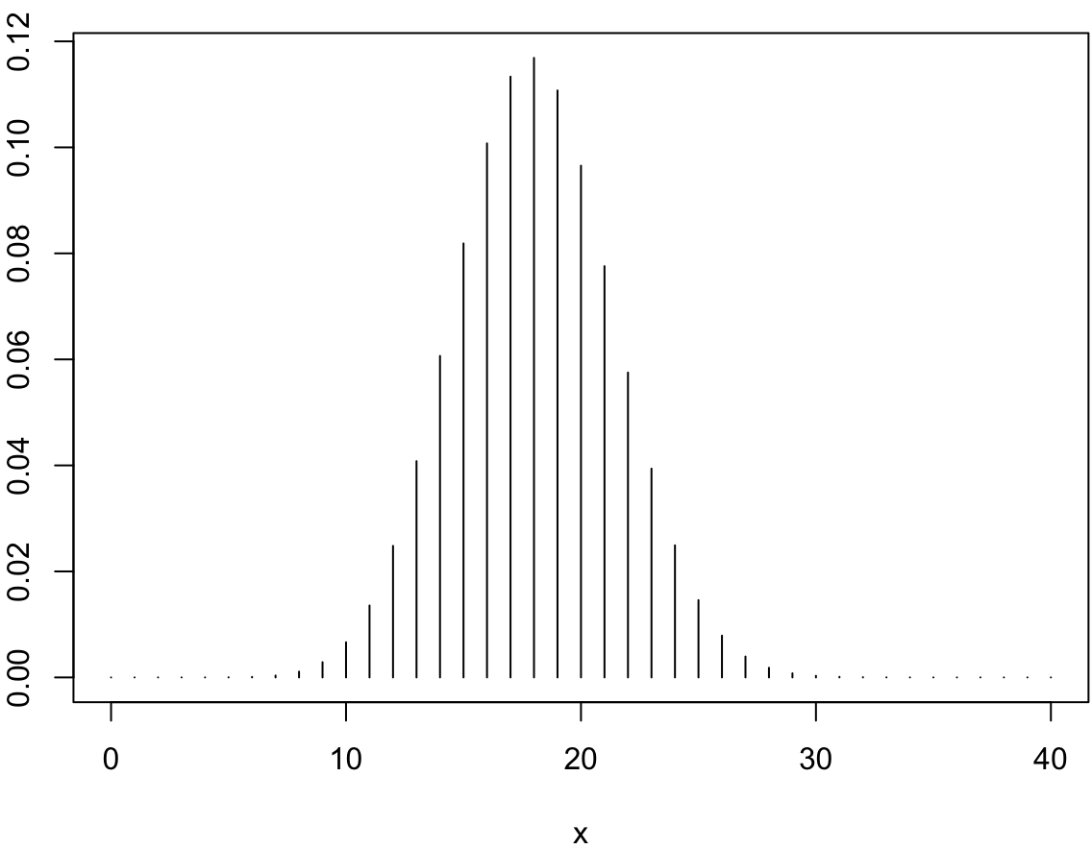
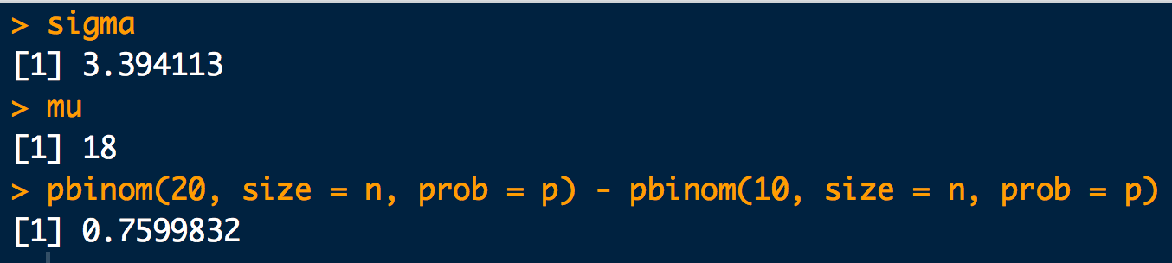
p <- 0.36
n <- 50
# a.
x <- seq(from=0, to=40)
pmf <- dbinom(x, size = n, prob = p)
plot(x, pmf, typ = "h")
# b.
sigma <- sqrt(n*p*(1-p))
sigma
# c.
mu <- n*p
mu
# d.
pbinom(20, size = n, prob = p) - pbinom(10, size = n, prob = p)

Slide 12
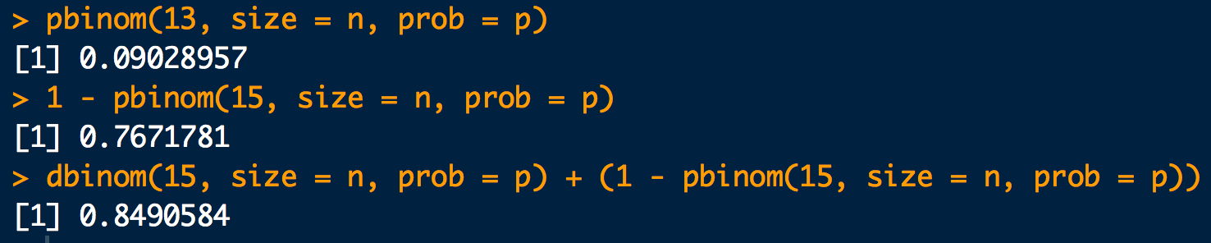
# e.
pbinom(13, size = n, prob = p)
# f.
1 - pbinom(15, size = n, prob = p)
# g.
dbinom(15, size = n, prob = p) + (1 - pbinom(15, size = n, prob = p))

Slide 13
Poisson Distribution
Poisson PMF: You don’t know how many times you are going to “flip the coin” but you do know on average how many “heads” you get λ
The rate for occurrence of an “event”, “success” or “head” is λ.
parameter
Say on average you get 100 texts in a day. Then λ = 100.
Number of “events”, “successes”, “heads” (etc.) is x
*NOTE: The is no upper limit on “events” that can occur in an experiment, unlike for the binomial, where the upper limit of “successes” (“events”) is n.

Slide 14
Poisson Distribution
Important Moments to Remember:
Mean:
Variance:
Standard Deviation:

Slide 15
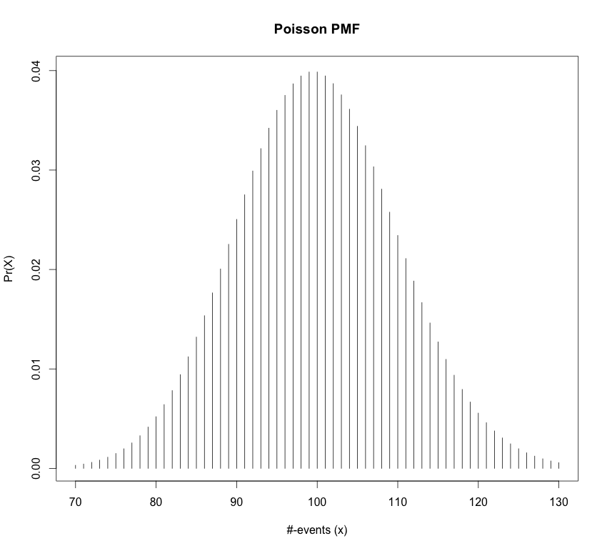
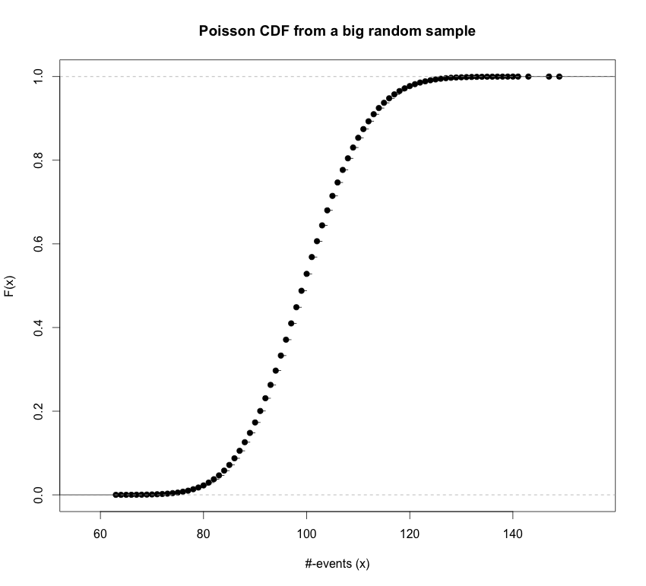
Poisson Distribution
Cumulative distribution function (CDF):
ppois(q = x, lambda = lam)
Example of a Poisson PMF
The corresponding Poisson CDF
= 100

Slide 16
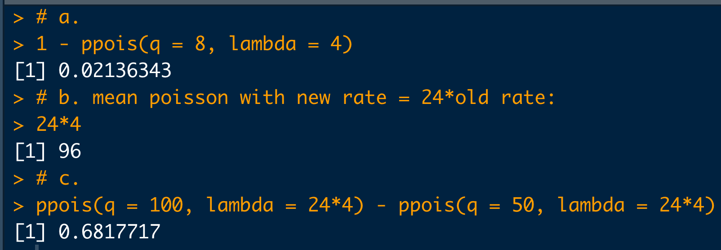
Example
A certain “user” of a social media site (may be a bot) posts at an average rate of about 4 per hour.
What is the probability that more than 8 posts will be put up in the next hour?
About how many posts can be expected in 24 hours?
What is the probability of more than 50 but less than or equal to 100 posts appearing in 24 hours?
# a.
1 - ppois(q = 8, lambda = 4)
# b. mean poisson with new rate = 24*old rate:
24*4
# c.
ppois(q = 100, lambda = 24*4) - ppois(q = 50, lambda = 24*4)

Slide 17
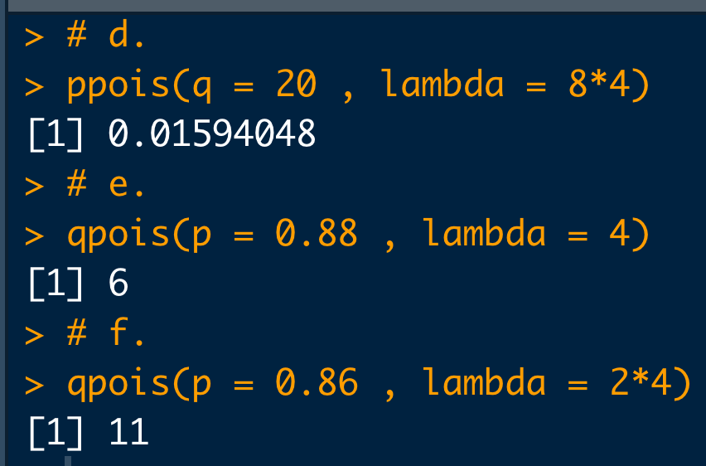
What is the probability that 20 or fewer posts will appear in the next 8 hours?
The probability of receiving q or less posts in the next hour is 0.88. What is the value of q?
The probability of receiving q or less posts in the next 2 hours is 0.86. What is the value of q?
# d.
ppois(q = 20 , lambda = 8*4)
# e.
qpois(p = 0.88 , lambda = 4)
# f.
qpois(p = 0.86 , lambda = 2*4)

