Slide 1


Bayesian Methods
Basic Bayesian Inference Workflow

Slide 2
Bayesian Statistics
The basic Bayesian philosophy:
Prior Knowledge × Data =
Updated Knowledge
A better understanding of the world
Prior × Data = Posterior

Slide 3
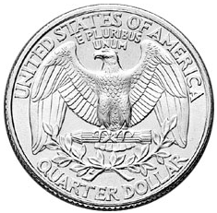
Is this a “fair coin”?

Slide 4
Is this a “fair coin”?
Before we gather any data on this coin’s flipping behavior, what do we believe about its probability to land on heads?
Represent your beliefs about a parameter before you’ve gathered data as a prior (a priori) density over it

Slide 5
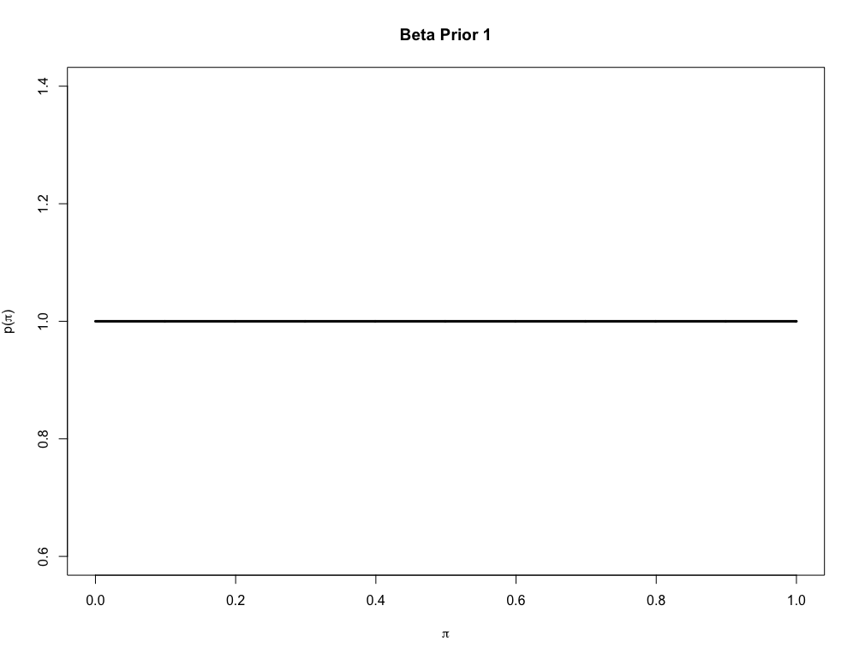
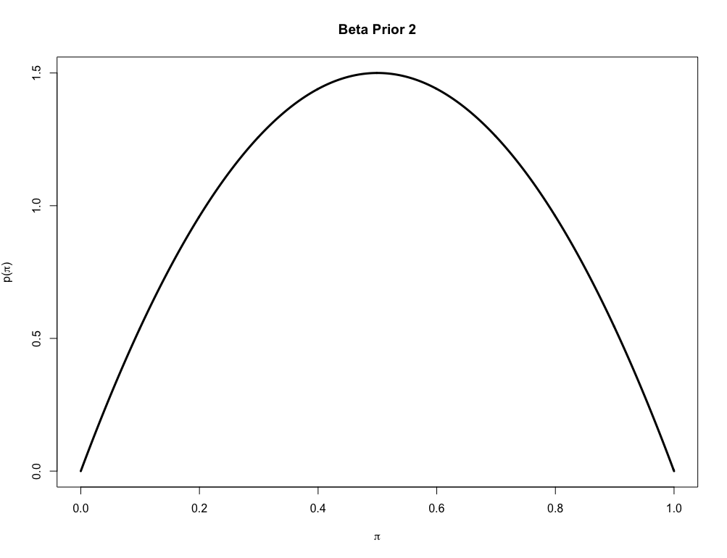
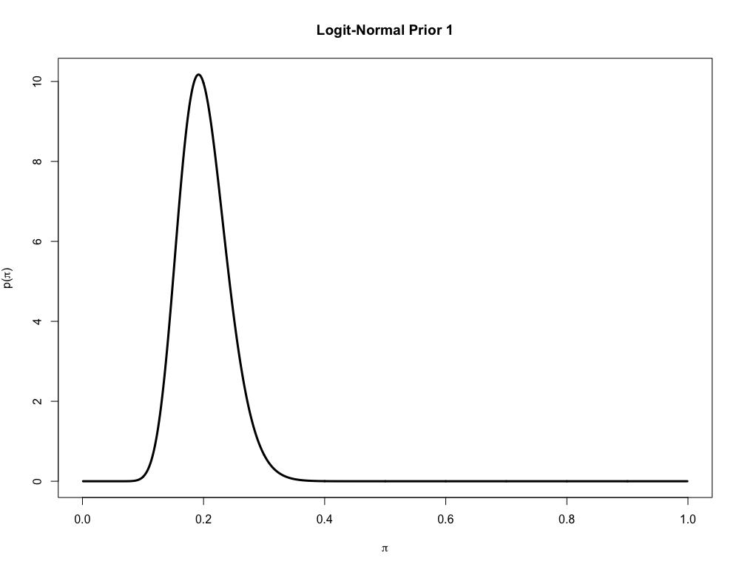
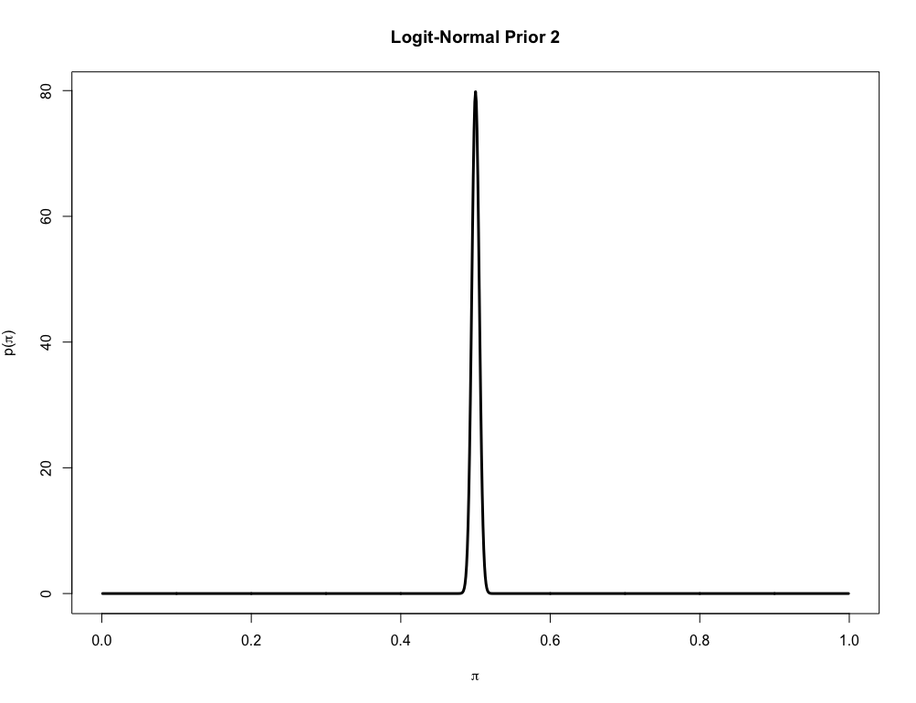
Some prior beliefs we may have about π_{Heads} for the coin

Slide 6
Is this a “fair coin”?
Now flip the coin and gather some data:
x = 1 1 0 0 0 0 0 1 1 0
1 = “Heads”, 0 = “Tails”
Based on this data and what we believed about π_{Heads} before, what can we say about it now?

Slide 7
Is this a “fair coin”?
The data (likelihood)
Our beliefs about π_{Heads} after we gathered the data (a posteriori probability)
Our beliefs about π_{Heads} before we gathered the data (a priori probability)

Slide 8
Is this a “fair coin”?
The likelihood of observing the data given π_{Heads} is the data model
Here, good models for the data are either the Bernoulli or Binomial likelihoods
or

Slide 9
Is this a “fair coin”?
The lets determine the posterior with a Beta(1,1) prior on π_{Heads} and a Binomial likelihood model for the data
Directed Acyclic Graph (DAG) representation: joint PDF

Slide 10
Is this a “fair coin”?
The model is simple enough that we can obtain an analytical solution for the posterior:

Slide 11
Is this a “fair coin”?
The model is simple enough that we can obtain an analytical solution for the posterior:
Conjugate model: When the posterior is the same form as the prior.
Many of these models were derived by Prof. Shenkin’s cousin: Howard Raiffa! Wow!
Cf. Raiffa, H. and Schlaiffer, R. (1961). Applied Statistical Decision Theory.

Slide 12
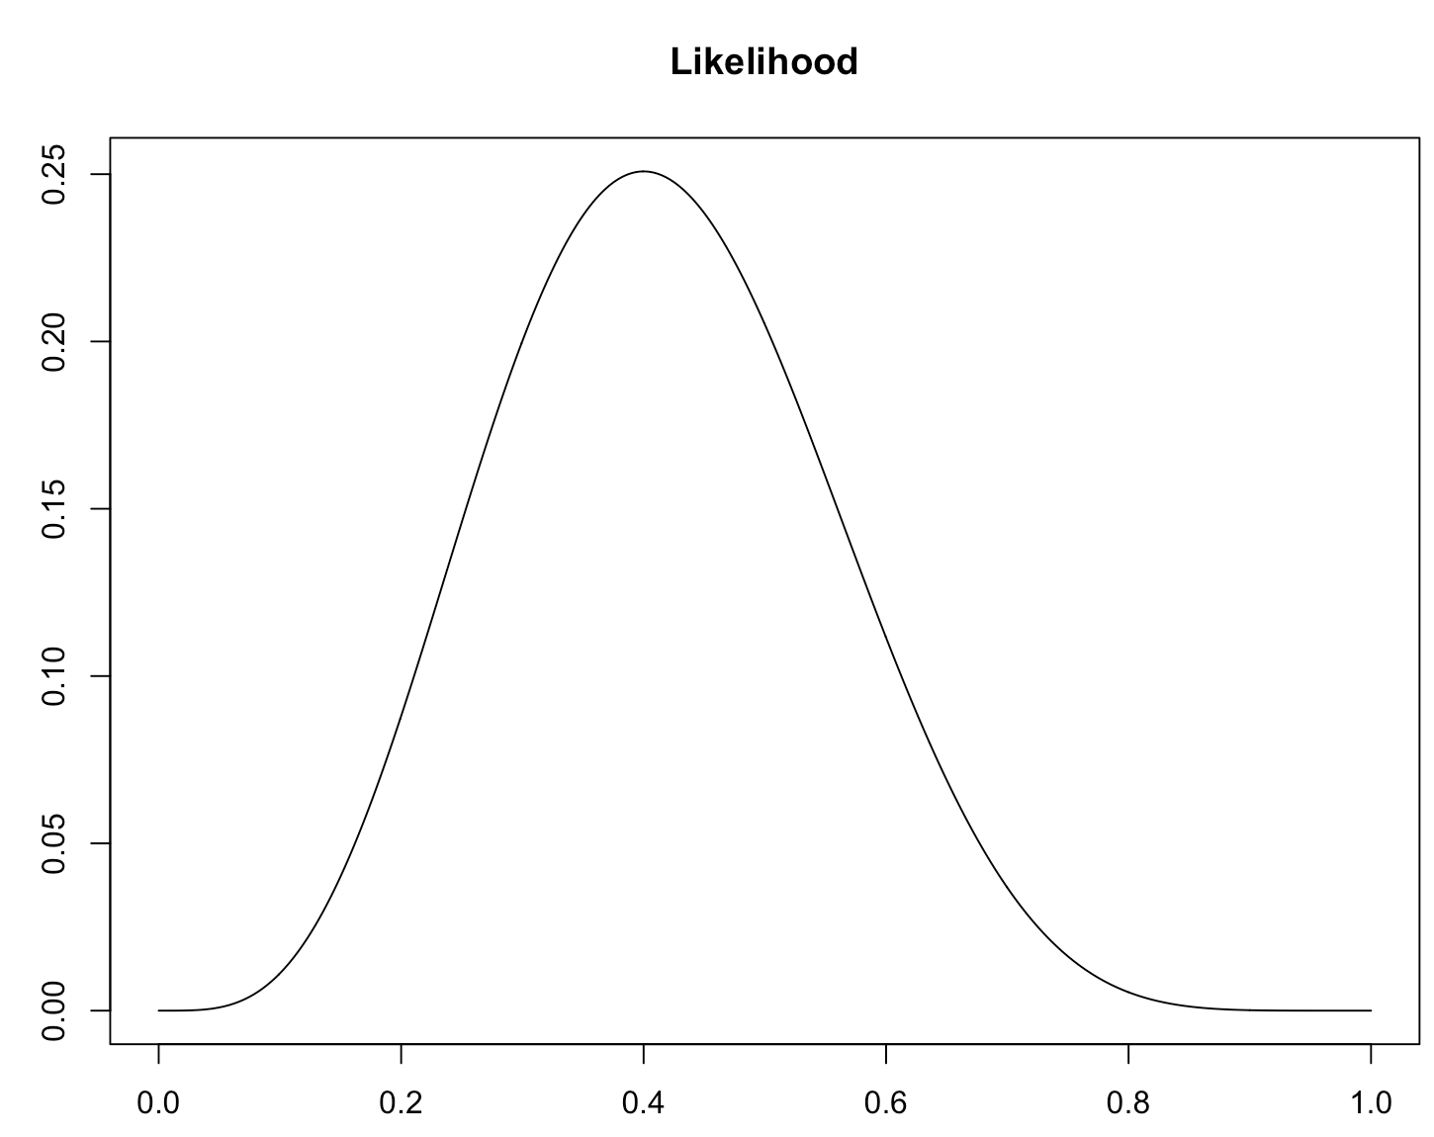
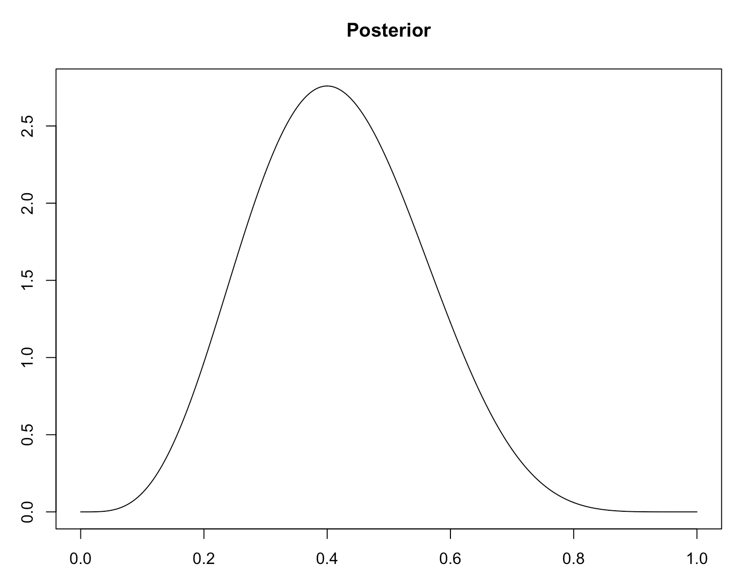
Side note: the MLE for π
Given this model, why does the posterior look like “the data”?
At this point, what would you bet on, H or T?

Slide 13
R code
This is a simple conjugate model so we could just hack it up in R:
# Prior hyper-parameters
a <- 1
b <- 1
# The data:
n <- 10 # Number of flips
s <- 4 # Number of heads
# What the prior looks like:
p <- seq(from=0, to=1, length.out=1000)
priorf <- dbeta(x = p, shape1 = a, shape2 = b)
plot(p, priorf)
# What the likelihood looks like:
likef <- dbinom(x = s, size = n, prob = p )
plot(p, likef)
# What the posterior looks like:
postf <- dbeta(x = p, shape1 = s+a, shape2 = n-s+b)
plot(p, postf)
binomial_beta_conjugate.R

Slide 14
Stan/R code
The point of this course however is to learn to do general Bayesian for which straight R hacks are not feasible, so let’s start practicing using Stan and JAGS
data{
real <lower=0> a;
real <lower=0> b;
int <lower=0> n;
int <lower=0> s;
}
parameters{
real <lower=0, upper=1> ppi;
}
model{
ppi ~ beta(a,b); // prior
s ~ binomial(n, ppi); // likelihood
}
binomial_beta.stan

Slide 15
Stan/R code
#library(rstan)
library(bayesutils)
# Extra options to set for Stan:
options(mc.cores = 1)
rstan_options(auto_write = TRUE)
#setwd("<path_to_Stan-file>")
# Load a Stan model:
stan.code <- paste(readLines(system.file("stan/binomial_beta.stan",
package = "bayesutils")), collapse='\n')
# Translate Stan code into C++
model.c <- stanc(model_code = stan.code)
# Compile the Stan C++ model:
sm <- stan_model(stanc_ret = model.c, verbose = T)
# Data:
dat <- list(
# Prior hyper-parameters
a = 1,
b = 1,
# The data:
n = 10, # Number of flips
s = 4 # Number of heads
)
#Run the model:
fit <- sampling(sm, data = dat, iter=5000, thin = 1, chains = 4)
fit; plot(fit)
params.chains <- extract.params(fit, by.chainQ = T)
mcmc_trace(params.chains, pars = c("ppi"))
# Examine posteriors:
params.mat <- extract.params(fit, as.matrixQ = T)
ppi <- params.mat$ppi
hist(ppi)
R code to run the stan model:
binomial_beta_STAN.R

Slide 16
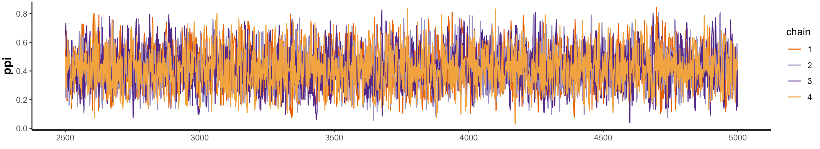
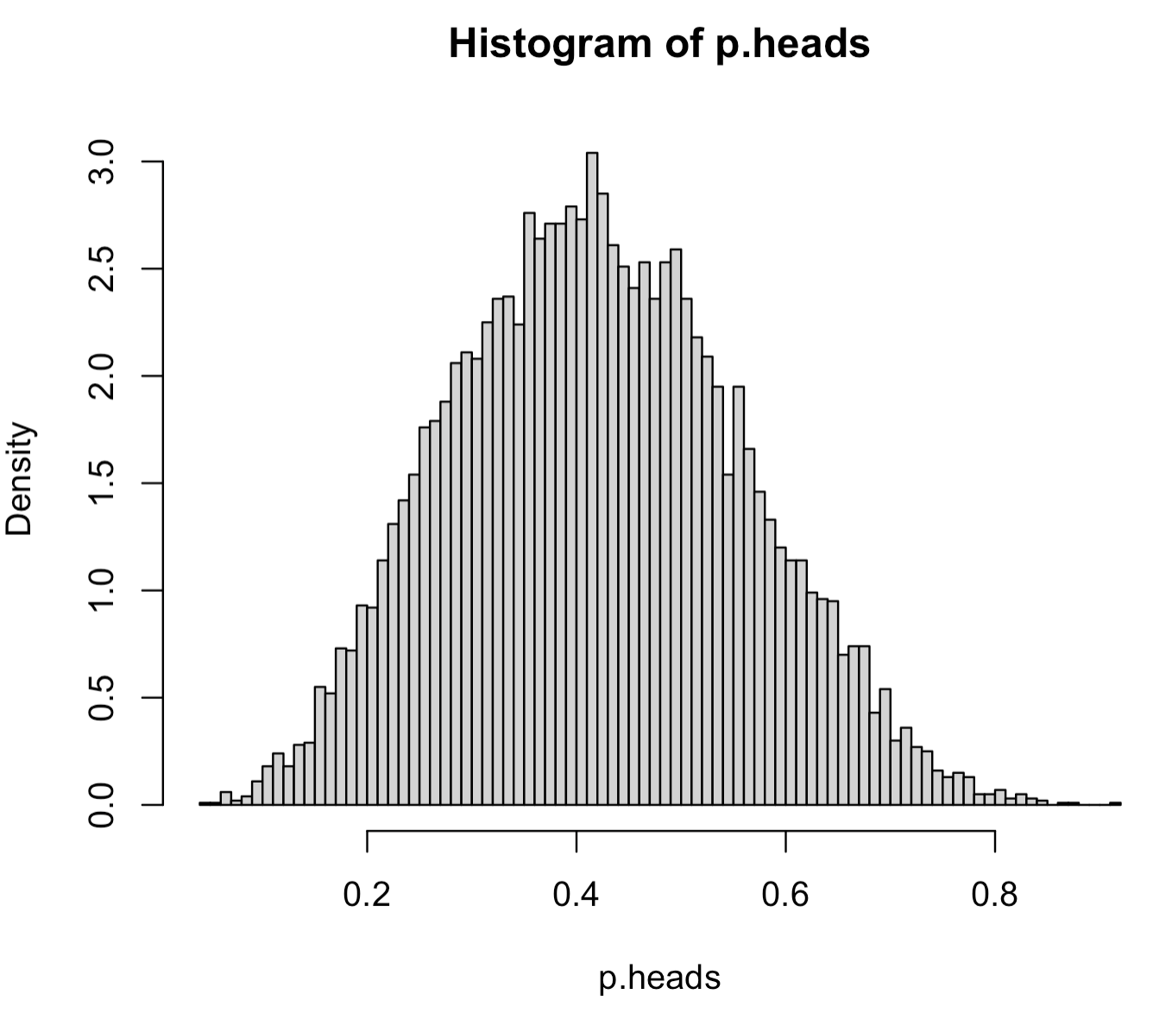
…and this is how the analysis would look coming from Stan
Trace plot
Posterior for the probability of obtaining a head:
ppi

Slide 17
JAGS/R code
The same model in JAGS code:
model{
# Likelihood
s ~ dbin(ppi, n)
# Prior:
ppi ~ dbeta(a,b)
}
binomial_beta.bug
JAGS code looks a lot more like R code but can be a little cluncky-ier to write than stan code

Slide 18
JAGS/R code
R code to run the JAGS model:
#library(rjags)
#library(R2jags)
library(bayesutils)
#setwd("<path_to_JAGS-bug-file>")
# Data:
dat <- list(
# Prior hyper-parameters
a = 1,
b = 1,
# The data:
n = 10, # Number of flips
s = 4 # Number of heads
)
# Run the model:
inits <- function (){
list(ppi=runif(1))
}
fit <- jags(data=dat,
inits=inits,
parameters.to.save = c("ppi"),
n.iter=20000, n.burnin = 500, n.thin = 10,
n.chains=4,
model.file=system.file("jags/binomial_beta.bug.R", package = "bayesutils"))
fit
params.chains <- extract.params(fit, by.chainQ = T)
mcmc_trace(params.chains, pars = c("ppi"))
plot(fit)
# Examine posteriors:
params.mat <- extract.params(fit, as.matrixQ = T)
ppi <- params.mat$ppi
hist(ppi)
binomial_beta_JAGS.R

Slide 19
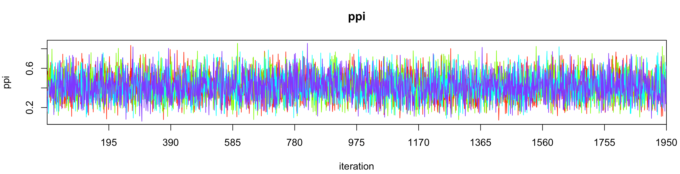
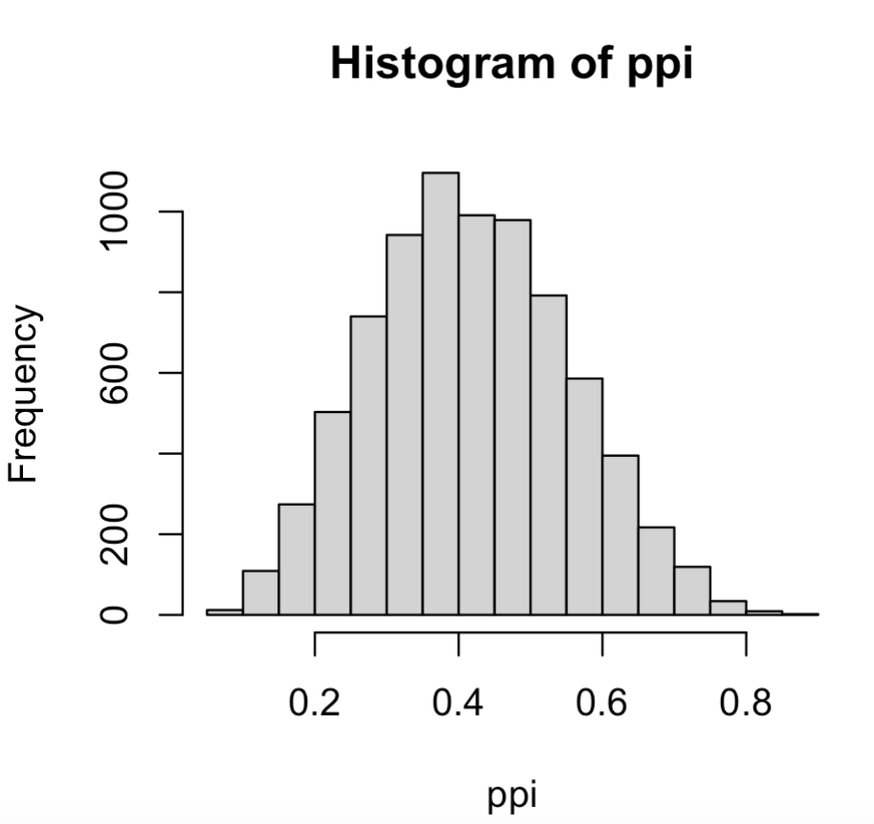
…and this is how the analysis would look coming from JAGS
Trace plot
Posterior for the probability of obtaining a head:

