Slide 1

Important Probability Distributions 2
Important “named” continuous probability distributions that come up all the time

Slide 2
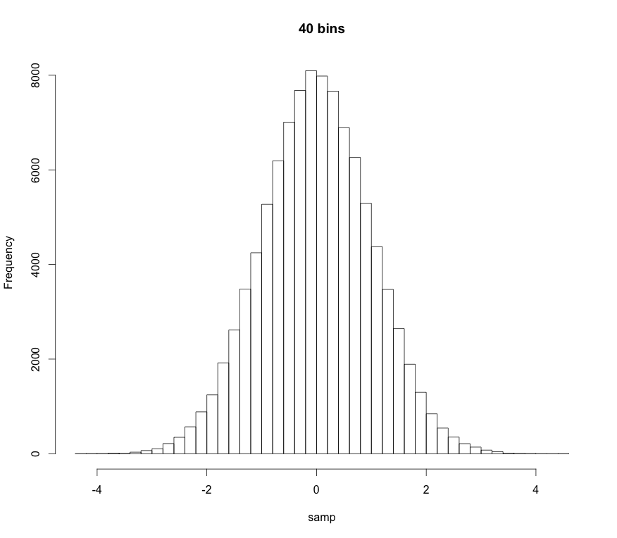
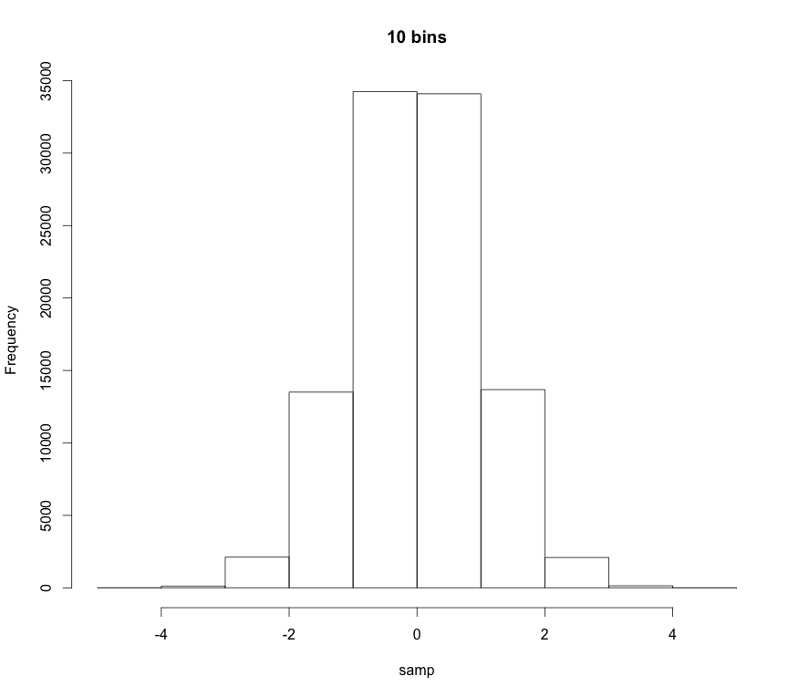
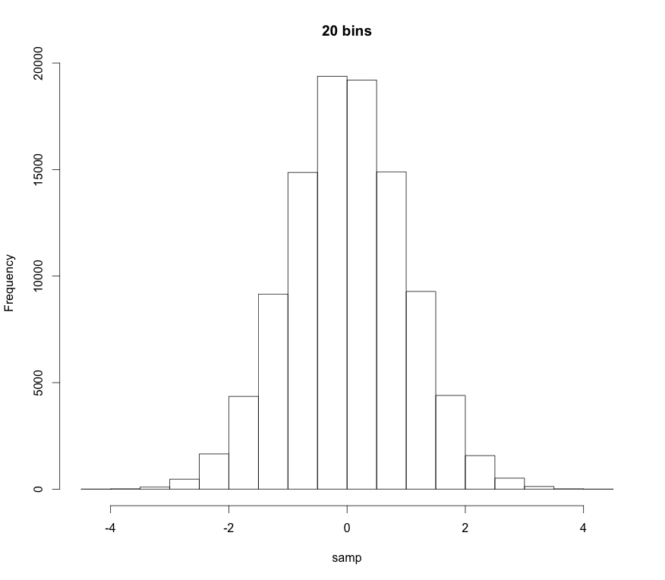
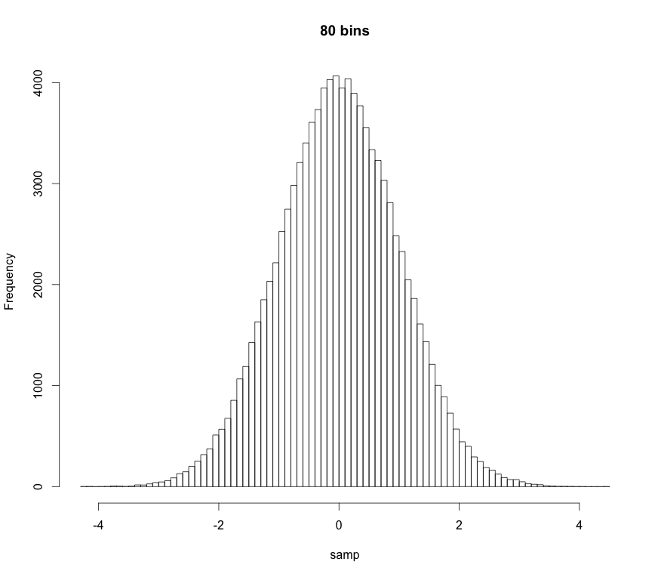
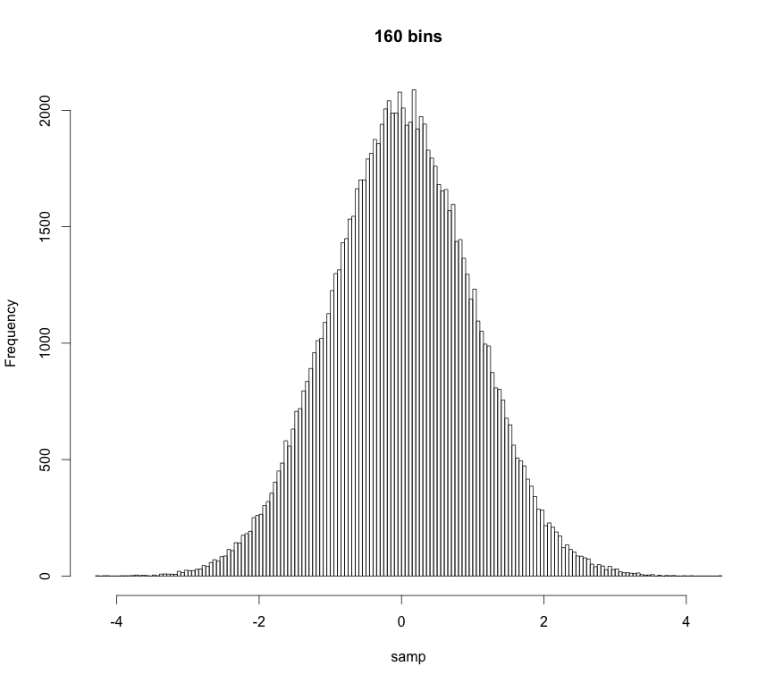
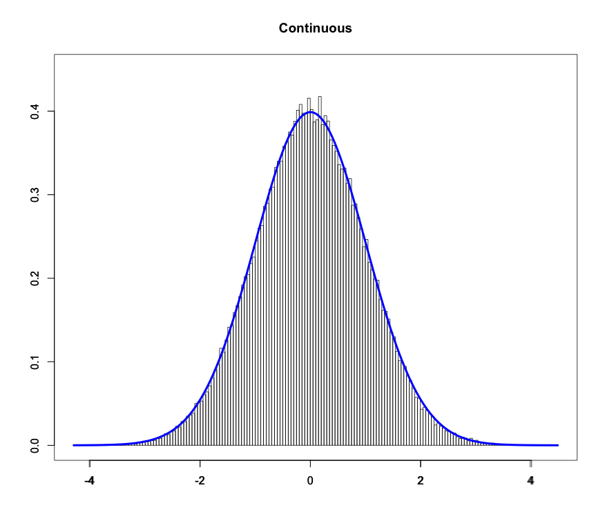
Probability Density Function
As we increase the number of “bins” in a histogram the “bars” get thinner and thinner
If there are an infinite number of bins the bars get infinitesimally thin:

Slide 3
Probability Density Function
Technical definition:
A random variate X is continuous if:
The probability that X lies between a and b
p(x): probability density function (pdf)
Note:
Proper pdfs should be normalized
“All space” for an r.v. is it’s domain. Also called its support
“All space” for us is usually 0 to ∞ or -∞ to ∞

Slide 4
Probability Density Function
Technical definition:
A random variate X is continuous if:
The probability that X lies between a and b
p(x): probability density function (pdf)
Note also:
The probability of obtaining a particular r.v. is 0
p(x) ≥ 0
The pdf is always greater than or equal to 0

Slide 5
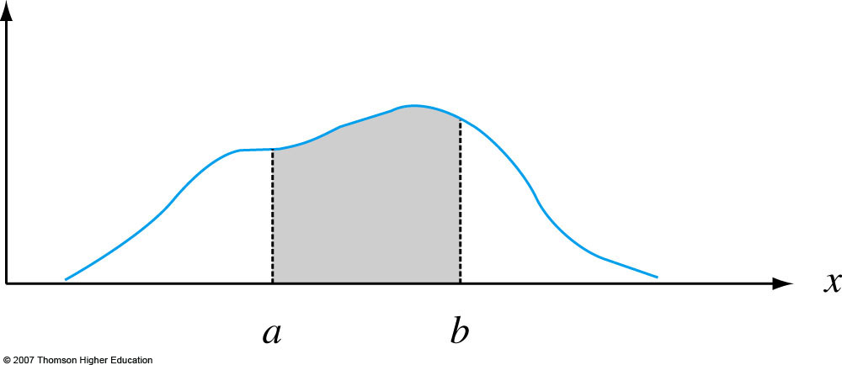
Probability Density Function
Graphically:
p(x)
Notes:
Figure 4.2
P (a ≤ X ≤ b) = the area under the density curve between a and b.

Slide 6
Moments and Expectation Values
Moments are numerical values that control a PDF’s location and shape properties.
m^{th}-order moments are found by taking the expectation value or average-value of an RV raised to the m^{th}-power:
Most of the time we only care about first-order and second-order-central moments.

Slide 7
Moments and Expectation Values
1st-order moment for X, i.e. the expectation value of X:
location descriptor
mean

Slide 8
Moments and Expectation Values
Important 2nd-order moments:
Second order central moment.
It can be shown that
Population standard deviation
spread descriptor

Slide 9
Uniform Distribution
Uniform PDF: Same “likelihood” for all x
Parameters:
a left bound
b right bound

Slide 10
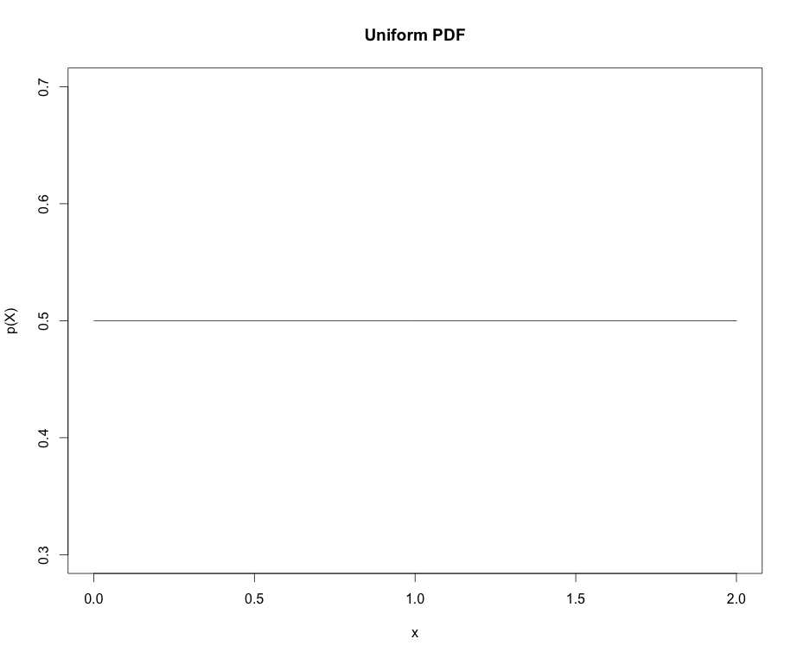
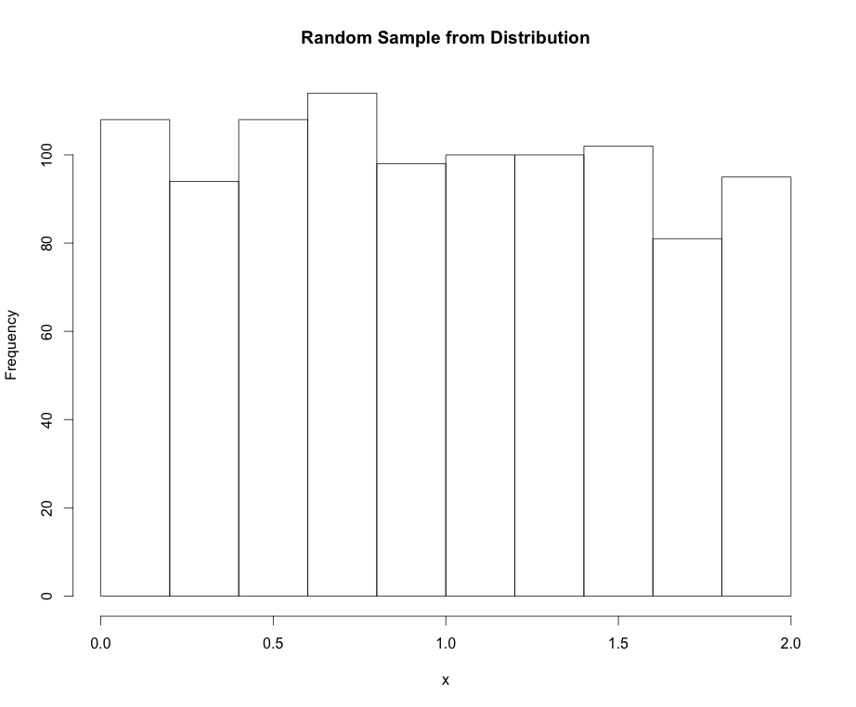
Uniform Distribution
Mean:
Variance:

Slide 11
Normal Distribution
Normal PDF: The “bell cure”. Also called Gaussian dist.
Parameters:
μ mean
σ standard deviation

Slide 12
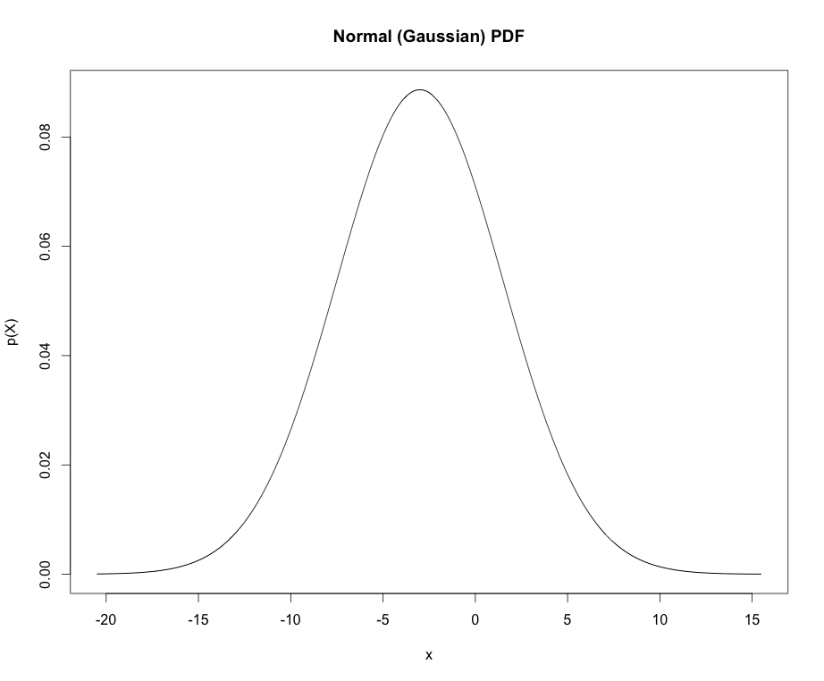
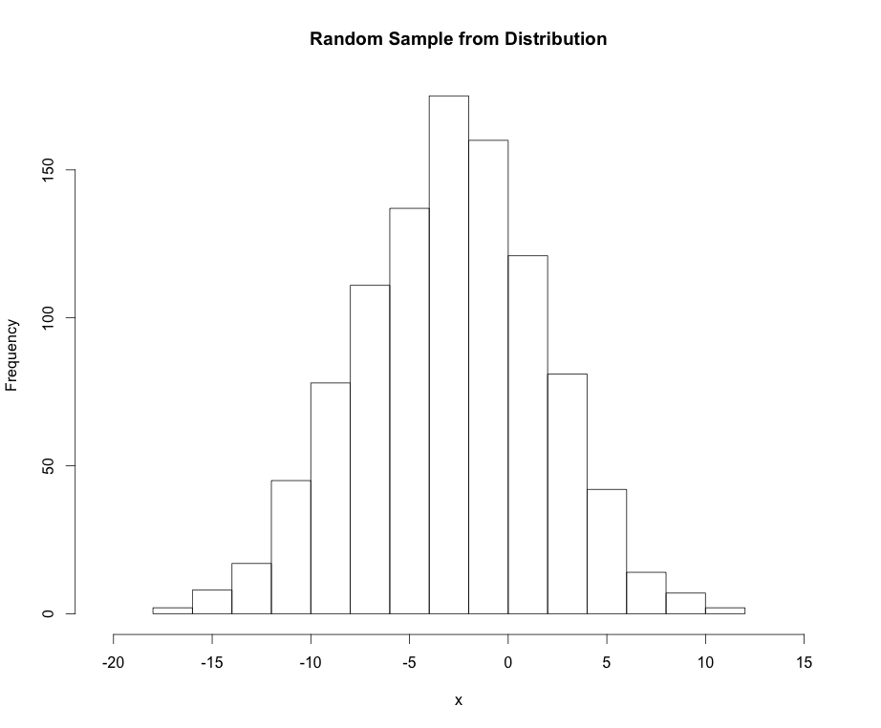
Normal Distribution
Mean: μ_{X} = μ
Variance: σ²_{X} = σ²

Slide 13
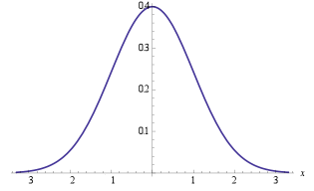
Normal Distribution
Points of interest for the Normal distribution:
If X ~ N(μ, σ) we can “standardize” (transform) to the z-scale:
Standard normal distribution
Handy equation
~ 68%
±1σ
~ 95%
±2σ
~ 99%
±3σ

Slide 14
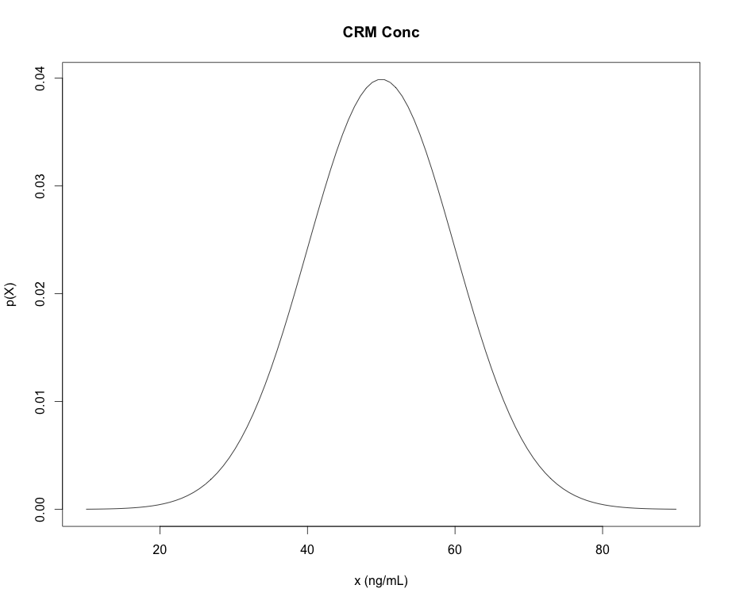
Some R Commands for PDFs
dnorm “d-function” in R is the density (mass) of the distribution
pnorm “p-function” in R is the CDFs of the distribution
qnorm “q-function” in R give the quantiles of the distribution (x-values) for a given cumulative probability (p-value)
rnorm “r-functions” in R gives a random sample from the distribution
*NOTE: “p-functions” and “q-functions” are inverses of each other
pnorm(q=47,mean=50,sd=10)=
0.42
0.42
“input quantity”
qnorm(p=0.42,mean=50,sd=10)=
47
47

Slide 15
Example: quantiles/percentiles
A sample of methamphetamine in blood certified reference material (CRM) is obtained as a standard for calibration of methodology in a tox lab.
The concentration of the CRM is certified to follow a normal distribution with mean concentration of 50 ng/mL and standard deviation of 10 ng/mL.
What maximum concentration can we expect for 90% of the samples we may measure?

Slide 16
Example: quantiles/percentiles
Another way to phrase: What measured sample concentration (quantile) should correspond to the 90th percentile with respect to the CRM?
0.9
?

Slide 17

Example: quantiles/percentiles
Another way to phrase: What measured sample concentration (quantile) should correspond to the 90th percentile with respect to the CRM?
# Parameters:
mu <- 50
sigma <- 10
# Quantile for the 90th percentile:
qnorm(0.9, mean=mu, sd=sigma)

Slide 18
Example: quantiles/percentiles
What is the probability that the CRM’s concentration will be measured to be between 30 ng/mL and 70 ng/mL?
30 ng/mL
70 ng/mL
What would the code look like if we wanted Pr(X > 70ng/mL)?
# The “measurands” (parameters):
mu <- 50
sigma <- 10
# Pr(30 < X < 70):
pnorm(70, mean=mu, sd=sigma) – pnorm(30, mean=mu, sd=sigma)

Slide 19
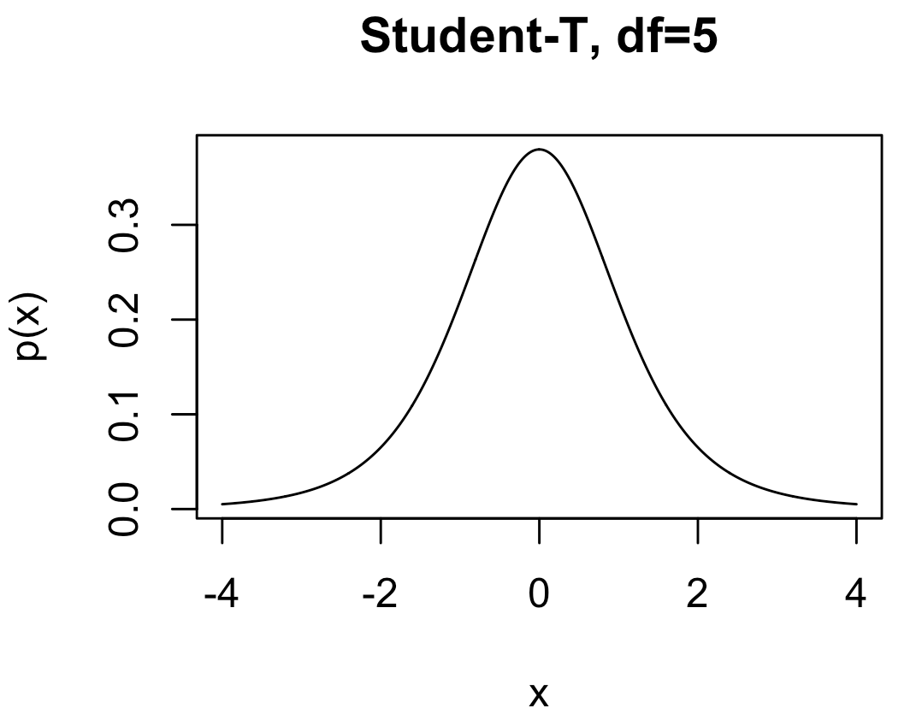
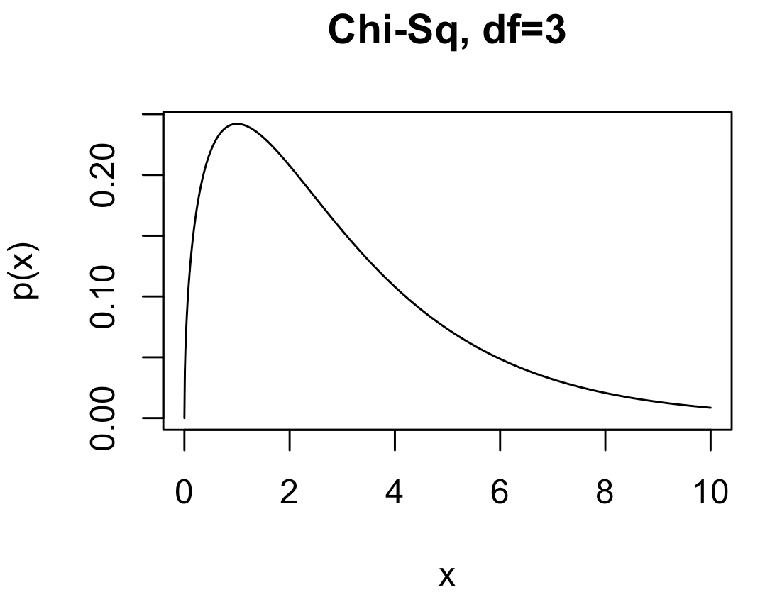
Other Distributions We’ll Encounter
Student-t: Like a standard normal distribution but fatter tails.
dt, qt, pt, rt
Parameters:
df: degrees of freedom
Chi-squared (χ²): Handy especially for comparing raw set of counts. Also, it’s proportional to the likelihood of sample variance for IID data.
dchisq, qchisq, pchisq, rchisq
Parameters:
df: degrees of freedom

Slide 20
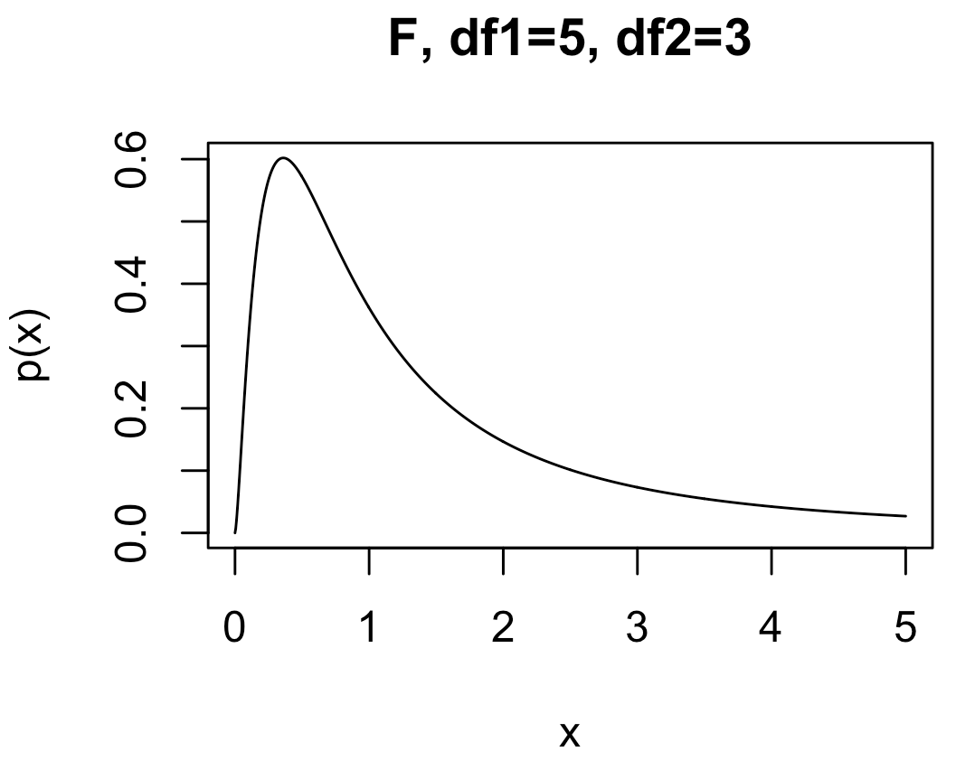
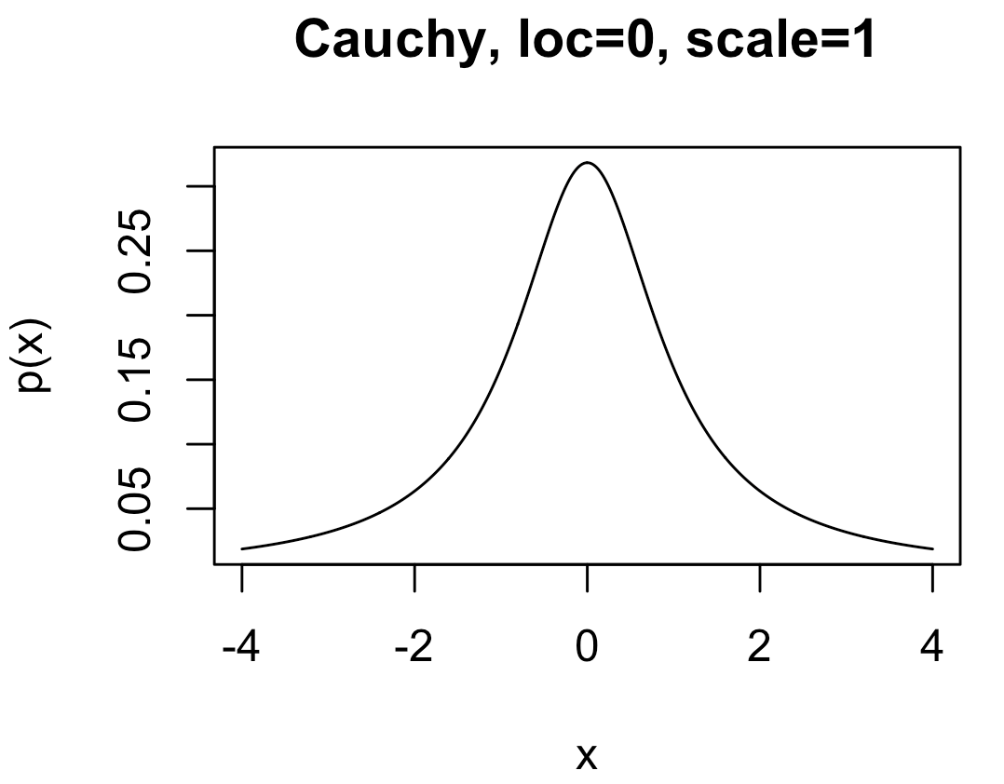
Other Distributions We’ll Encounter
F : Handy especially for comparing outcomes in three or more experiments with different conditions.
df, qf, pf, rf
Parameters:
df1: degrees of freedom 1
df2: degrees of freedom 2
Cauchy : A very fat-tailed distribution. Handy for expressing lots of uncertainty when modeling, while retaining formal properties of a proper probability distribution
dcauchy, qcauchy, pcauchy, rcauchy
Parameters:
location: peak location of the density
scale: “fat-ness” of the tails

