Slide 1

What is Statistics??
Osborn

Slide 2
What is Statistics??
Study of relationships in data
Descriptive Statistics – techniques to summarize data
E.g. mean, median, mode, range, standard deviation, stem and leaf plots, histograms, box and whiskers plots, etc.
Inferential Statistics – techniques to draw conclusions from a given data set taking into account inherent randomness
E.g. confidence intervals, hypothesis testing, Bayes’ theorem, forecasting, etc.

Slide 3
Data
Random variables - All measurements have an associated “randomness” component
Randomness –patternless, unstructured, typical, total ignorance^{Chaitin, Claude}
Any experiment/observation recorded is a random variate

Slide 4
T.I.C. of Gasoline

Slide 5
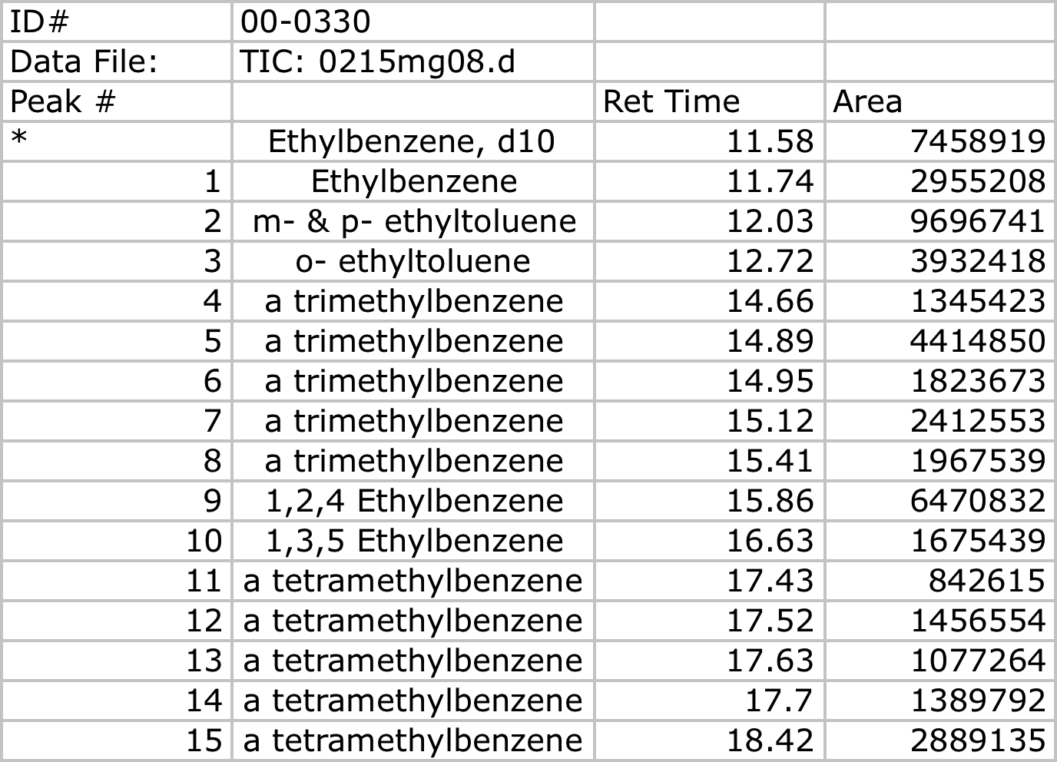
Observations from the T.I.C.
GC-MS instrument output for a gasoline :

Slide 6

Population and Sample
Almost all of statistics is based on a sample drawn from a population.
Population: The totality of observations that might occur as a result of an experiment
Why not measure the whole population?
Usually impossible
Likely wasteful
Population should be relevant.
Part logic
Part guess
Part philosophy….

Slide 7
Population and Sample
Sampling:
Sample: a few observations that are made from a population
Draw members out of as population with some given probability
Random sample: if all observations have an equal chance of being made and no observation affects any other
Also called independent and identically distributed random sample (I.I.D.)
Want a random sample to be representative of the population
Biased sample if not the case*

Slide 8
Data and Sampling
Sample Representations:
Representative
Sample
Population
Biased Samples
Population
Population
Sample
Sample

Slide 9
Parameters and Statistics
Parameter: any function of the population
Statistic: any function of a sample from the population
Statistics are used to estimate population parameters (strictly under type A analysis)
Statistics can be biased or unbiased
We may construct distributions for statistics
Populations have distributions for observations
Samples have distributions for observations and statistics

