Slide 1

Review of Essential Concepts

Slide 2
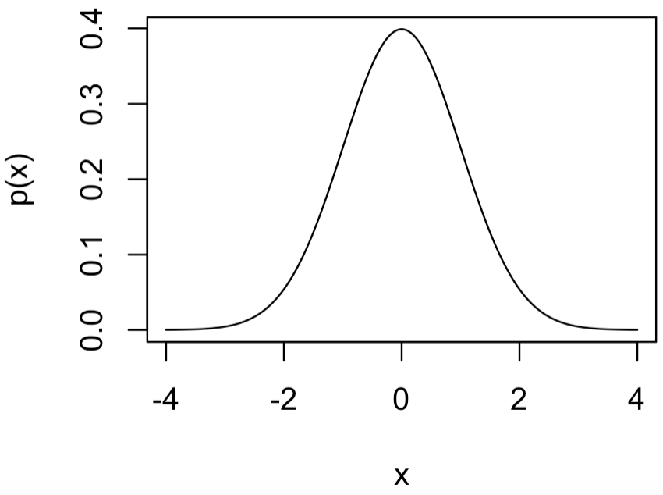
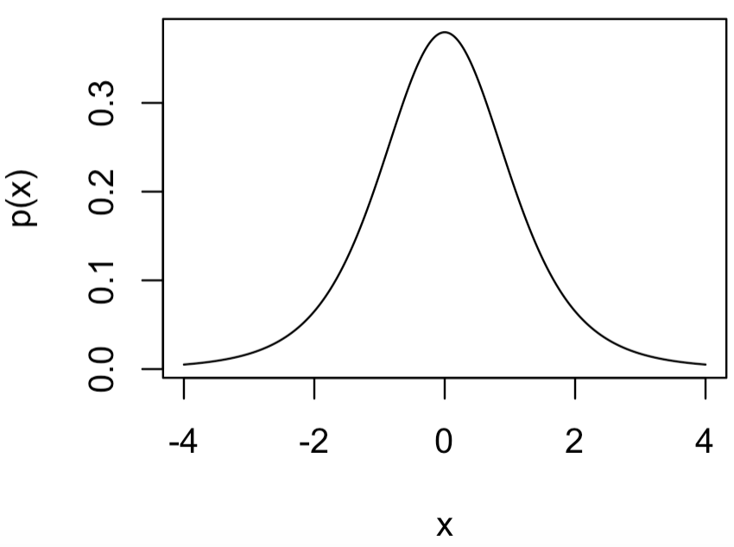
Distributions We’ll Encounter
Normal: Often good model for continuous data and parameters.
Stan: normal(mu, sigma)
JAGS: dnorm(mu, tau)
Parameters:
mu: mean
sigma: scale
tau: 1/sigma^2: precision
Student-t: Like a standard normal distribution but fatter tails.
Parameters:
Stan: student_t(nu, mu, sigma)
JAGS: dt(mu, tau, nu)
nu: df
mu: mean
sigma: scale
tau: 1/sigma^2: precision

Slide 3
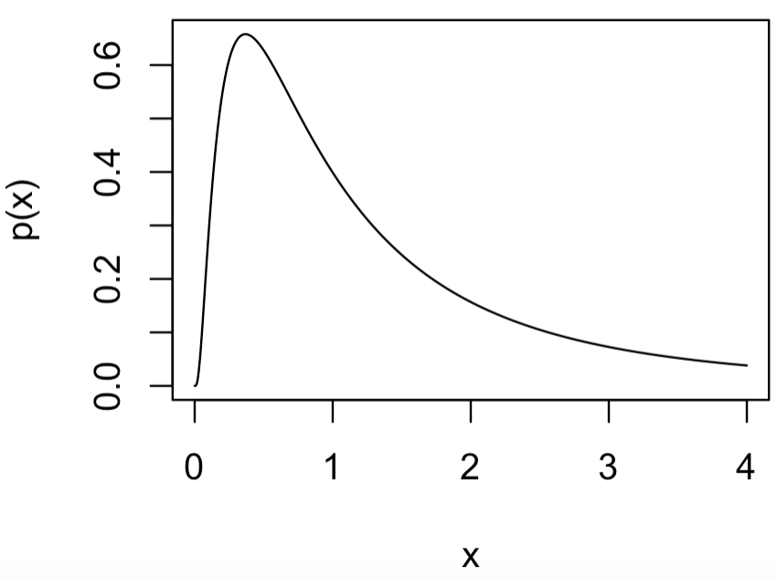
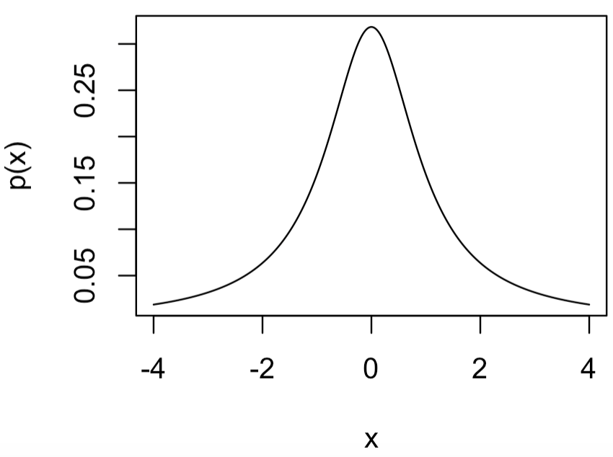
Distributions We’ll Encounter
Log-Normal: Logarithm of data or parameters is normal.
Stan: lognormal(mu, sigma)
JAGS: dlnorm(mu, tau)
Parameters:
mu: mean
sigma: scale
tau: 1/sigma^2: precision
Cauchy: VERY fat tailed distribution.
Parameters:
Stan: cauchy(mu, sigma)
JAGS: dt(mu, tau, 1)
mu: location
sigma: scale
tau: 1/sigma^2

Slide 4
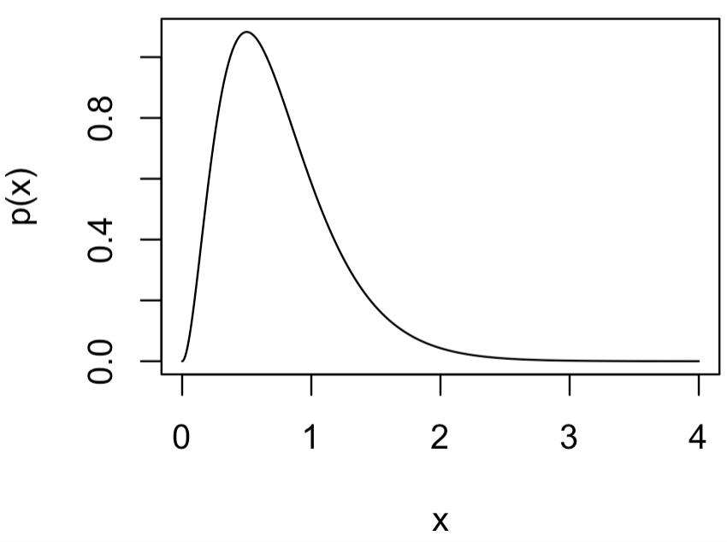
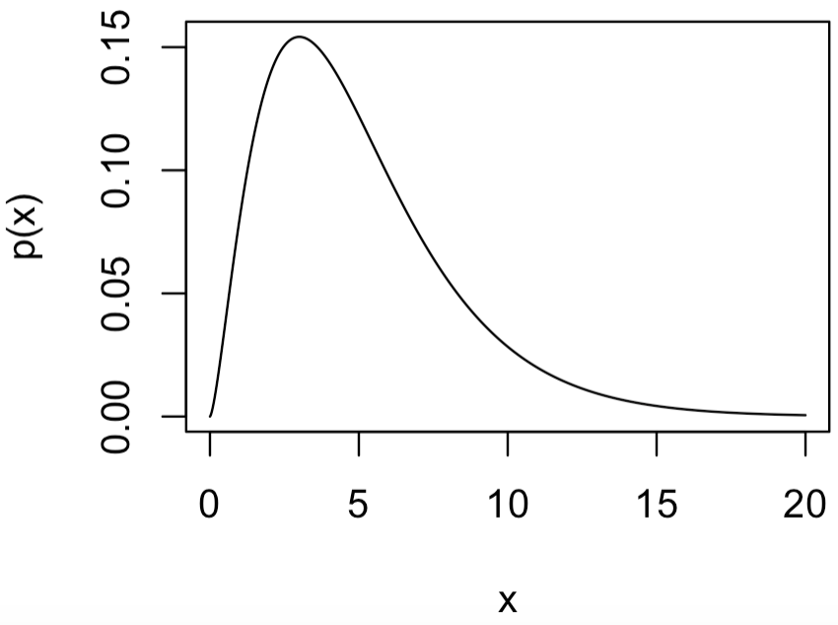
Distributions We’ll Encounter
Gamma: Often used as a prior for rate and scale parameters. Very flexible distribution related to many other distributions.
Stan: gamma(alpha, beta)
JAGS: gamma(alpha, beta)
Parameters:
alpha: shape
beta: rate
Chi-square: Can be useful as a prior for scale parameters.
Stan: chi_square(nu)
JAGS: dchisqr(nu)
Parameters:
nu: df

Slide 5
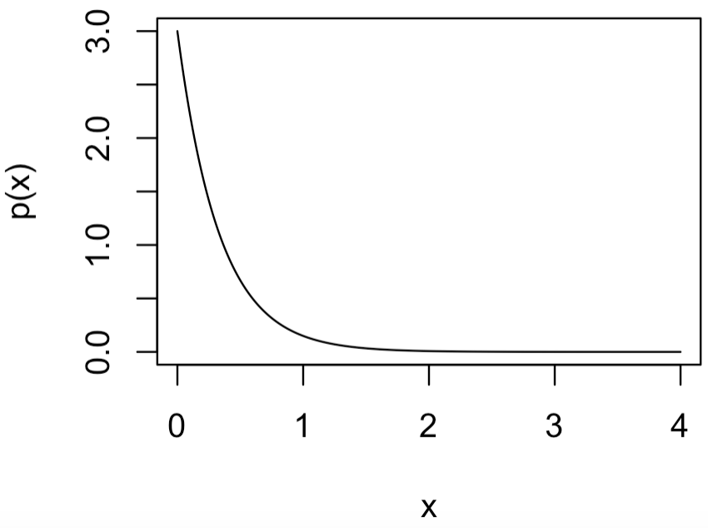
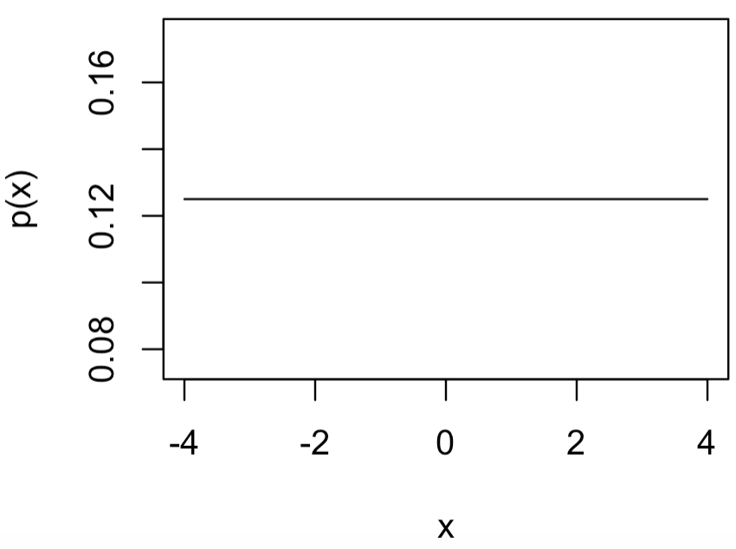
Distributions We’ll Encounter
Exponential: Good as a prior for scale parameters and as a likelihood to model time between independent events.
Stan: exponential(lambda)
JAGS: dexp(lambda)
Parameters:
lambda: rate
Uniform: Good as a prior for parameters without much information as to their value.
Stan: uniform(a, b)
JAGS: dunif(a, b)
Parameters:
a: min
b: max

Slide 6
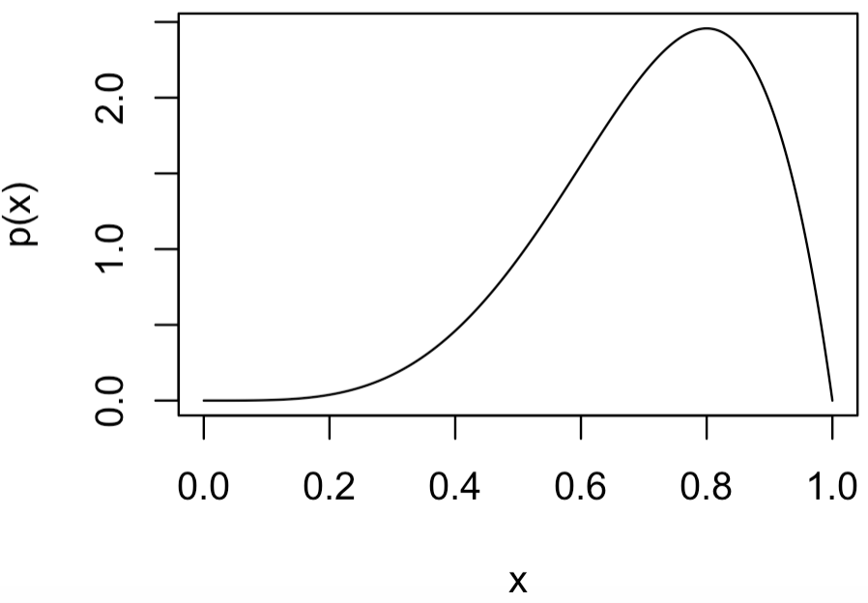
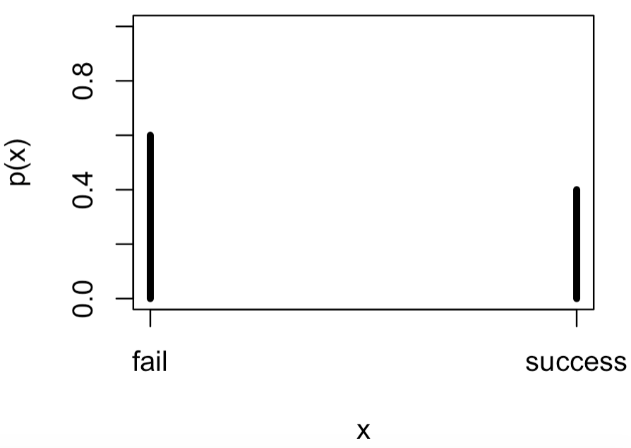
Distributions We’ll Encounter
Beta: Good for representing different beliefs (shapes) about parameters with values between 0 and 1
Stan: beta(a, b)
JAGS: dbeta(a, b)
Parameters:
a: shape parameter 1
b: shape parameter 2
Bernoulli: Good likelihood model for experiments with only two outcomes.
Stan: bernoulli(pi)
JAGS: dbern(pi)
Parameters:
pi: probability of a “success”

Slide 7
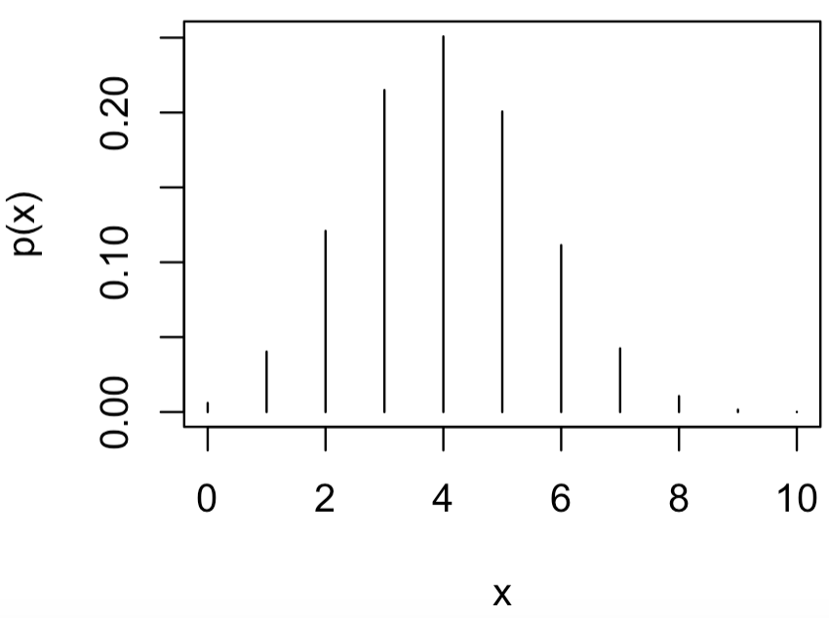
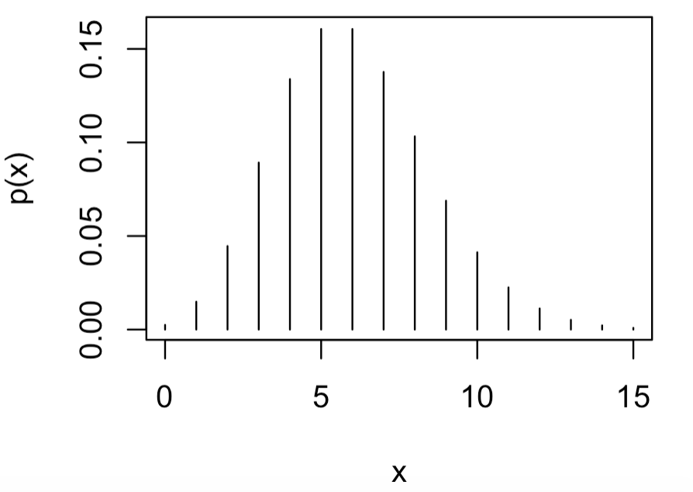
Distributions We’ll Encounter
Binomial: Good modeling the likelihood of x “successes” out of n tries.
Stan: binomial(n, pi)
JAGS: dbin(pi, n)
Parameters:
n: number of trials
pi: probability of a “success”
Poisson: Good likelihood model likelihood of x “successes” with the rate of “success”.
Stan: poisson(lambda)
JAGS: dpois(lambda)
Parameters:
lambda: rate of “success”
distributions.r

Slide 8
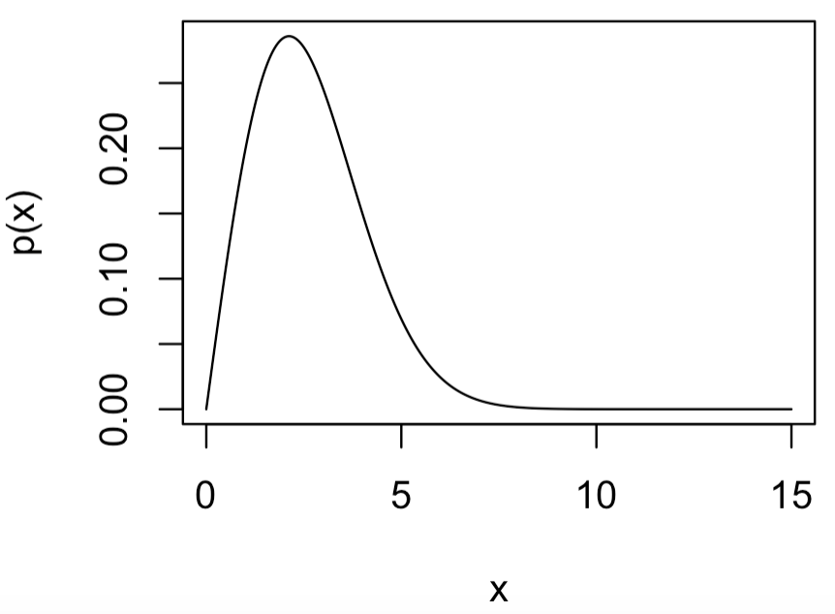
Distributions We’ll Encounter
Weibull: Many applications in engineering and failure analysis and useful as a two-parameter prior for scale parameters.
Stan: weibull(alpha, sigma)
JAGS: dweib(alpha, lambda)
Parameters:
alpha: shape
sigma: scale
lambda: sigma^(-alpha)

Slide 9
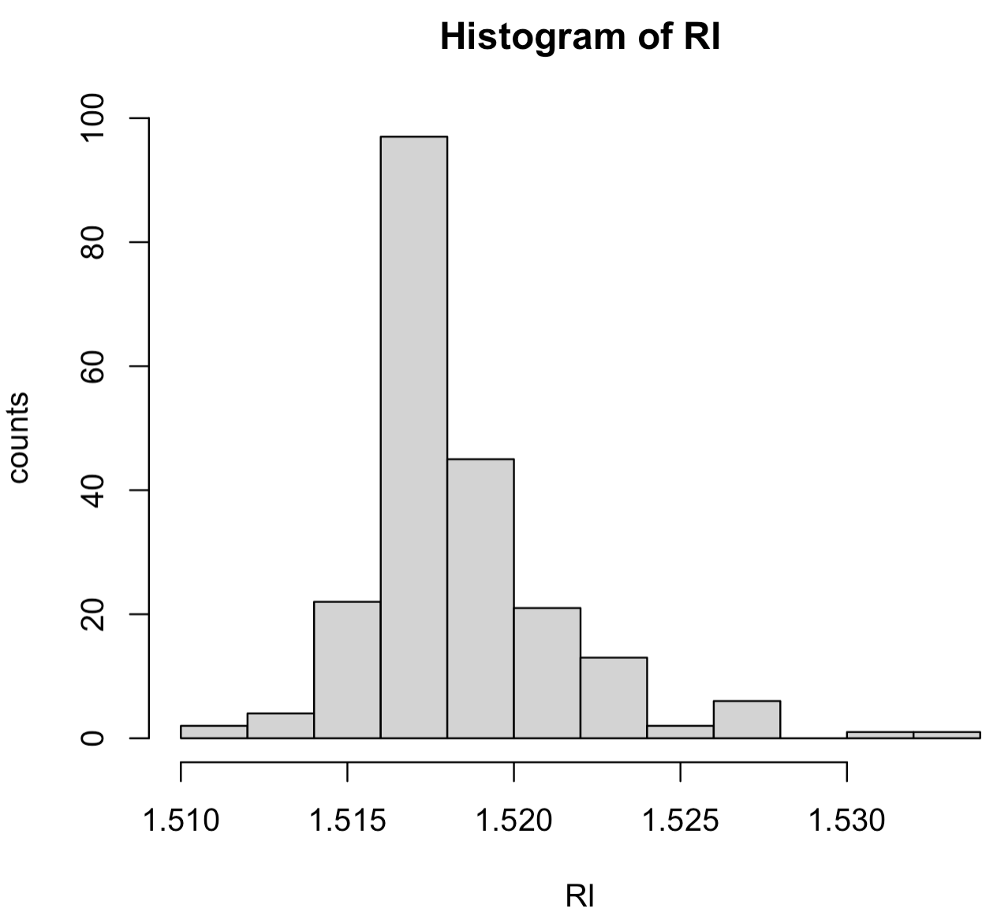
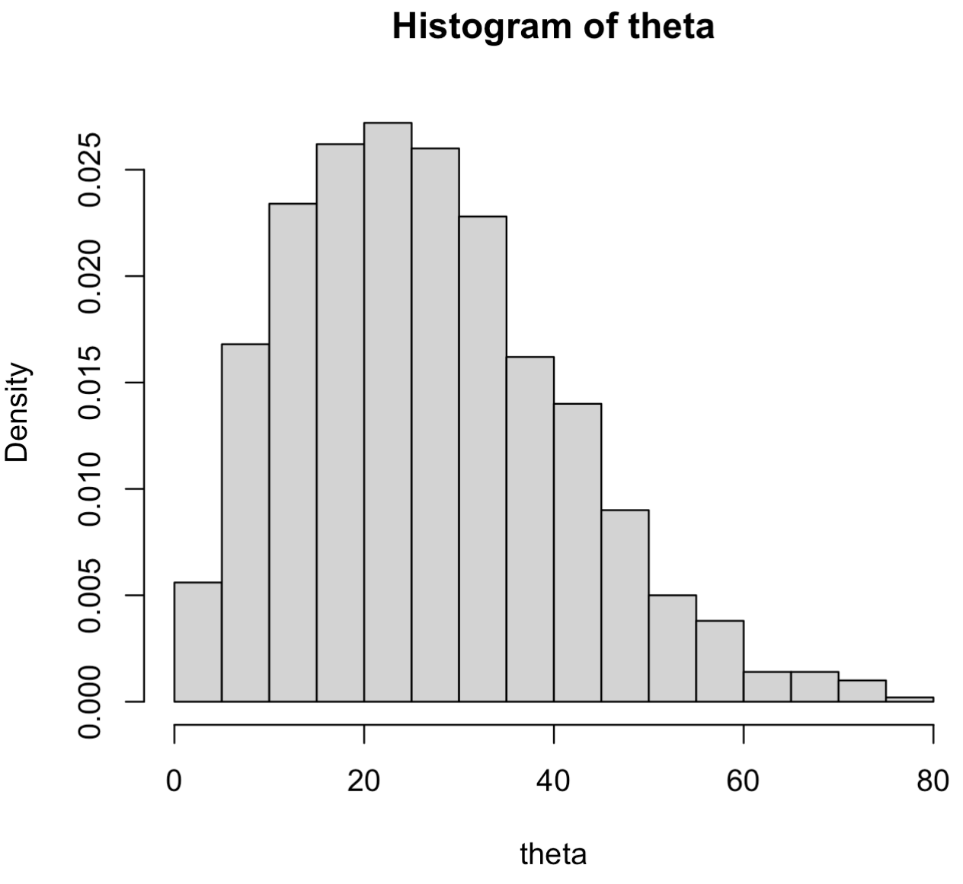
Histograms
Histograms: “bin” a variable and plot occurrence counts/frequencies in each “bin”
97
45
22
21
13
2
4
2
6
1
1
0

Slide 10
Box-and-Whiskers
Box-and-whiskers: think−view of histogram from above
range
possible
outliers
possible
outliers
25th-%tile
1st-quartile
median
50th-%tile
75th-%tile
3rd-quartile
RI

Slide 11
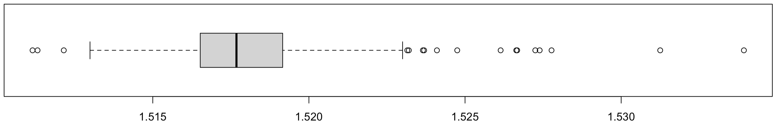
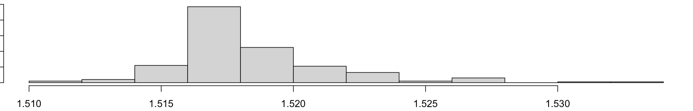
Box-and-Whiskers
Box-and-whiskers: think−view of histogram from above
plots.r

Slide 12
Summaries
Expectations: “average values” of data and parameters
First order moment = a mean: common measure of central tendency

Slide 13
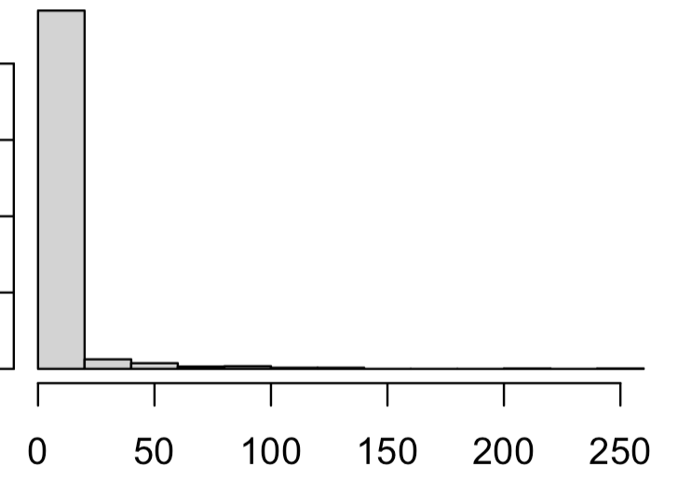
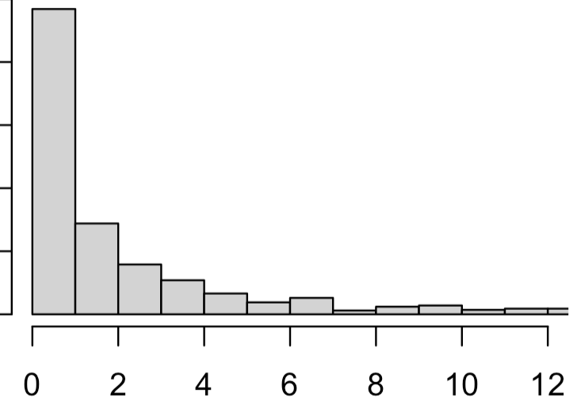
Summaries
Median (discrete):
Ordering the n pieces of data from smallest value to largest value, the median is the “middle value”:
If n is odd, median is largest data point.
If n is even, median is average of and largest data points.
Mean = 6.08
Median = 1.09

Slide 14
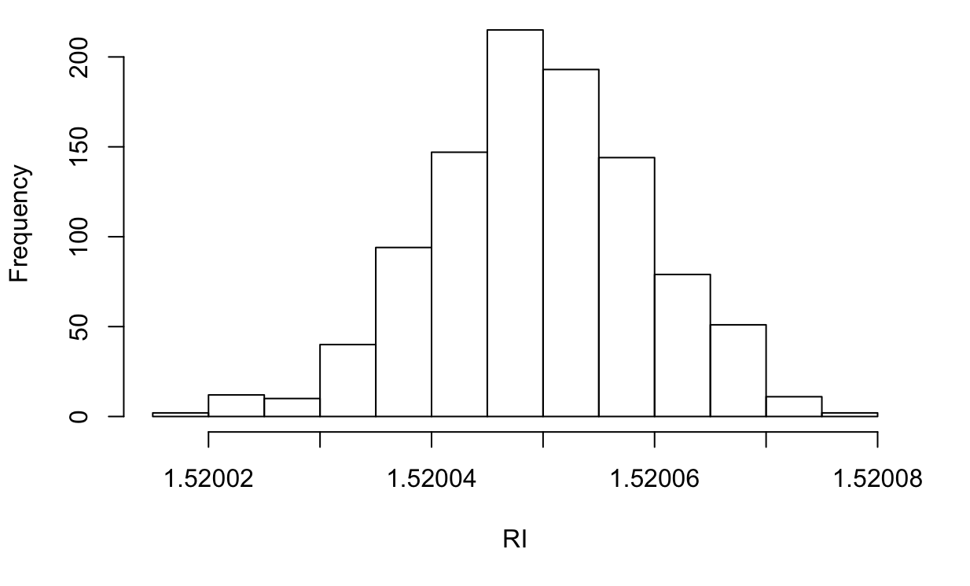
Summaries
Quantiles:
First 99% of the data is up to here
First 1% of the data is uo to here
99th-%tile
1st-%tile
1.520024
1.520071
summaries.r

