Slide 1

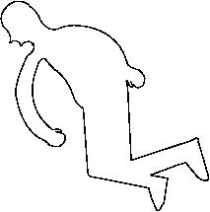
Bayesian Methods
Basic Bayesian Inference Workflow

Slide 2
Bayesian Statistics
The basic Bayesian philosophy:
Prior Knowledge × Data =
Updated Knowledge
Prior × Data = Posterior

Slide 3
Side by side: Bayes vs. Freq estimation
200 glassine envelopes are ceased as evidence in a drug investigation. All tested are found to contain xylazine. Compute the mean mass of xylazine contained in the envelopes from a randomly selected 10 envelopes. Also infer the variation in the mass of xylazine in the envelopes.
Mass data (mg):
X = 63.7697, 38.8534, 50.6481, 76.8564, 47.5911, 60.6131, 41.1518, 41.7563, 65.3300, 72.0342

Slide 4
Side by side: Bayes vs. Freq estimation
Frequentist approach:
Bayesian approach:
Assume there is about the same mass of xylazine in the envelopes that are not part of the sample of 10.
Represent data statistically by assuming a model for the way data (masses), X_{i}, behave. Say perhaps:
Estimate the mean mass μ_{X} with:
Put priors on model’s parameters to encode initial assumptions about what values they can reasonably take on:
Estimate the mass variation σ_{X} with:
Update knowledge about parameters by combining data model with priors (Bayes Theorem):
Take-home: Formula and procedure based
Take-home: Model based

Slide 5
Side by side: Bayes vs. Freq estimation
Frequentist approach first
55.8604, [46.0946, 65.6262]^{95%}
mean mass estimate
13.6516, [9.39006, 24.9225]^{95%}
mass variation estimate
frequentist_approach.R

Slide 6
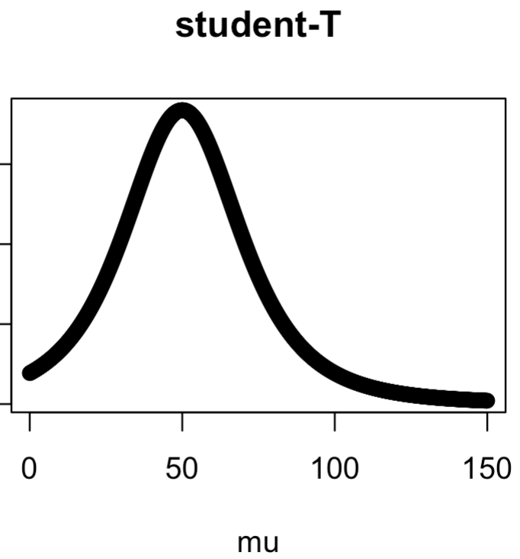
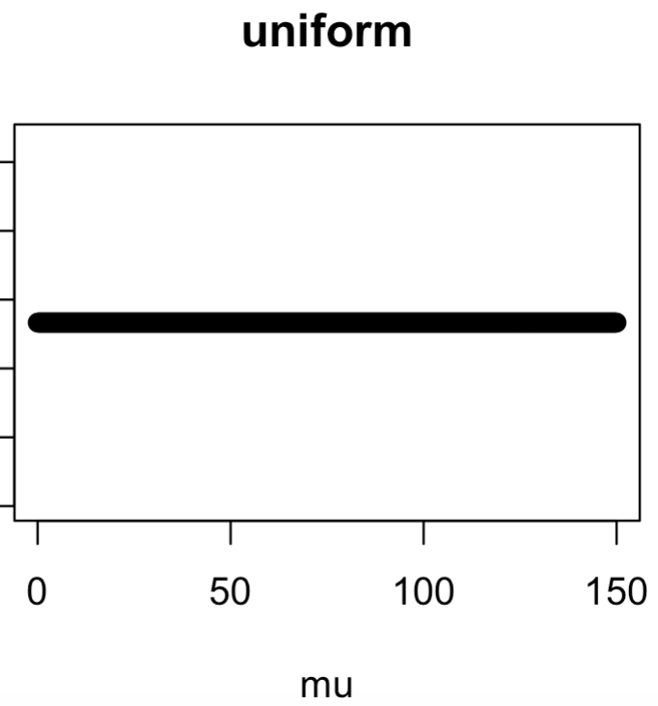
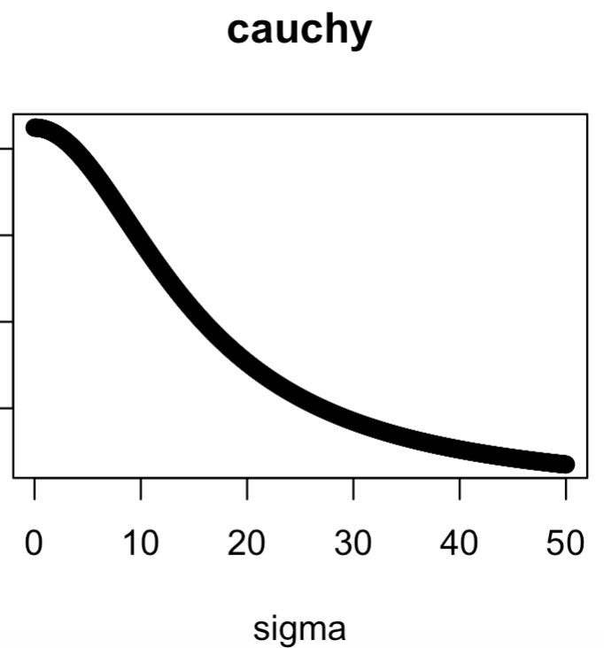
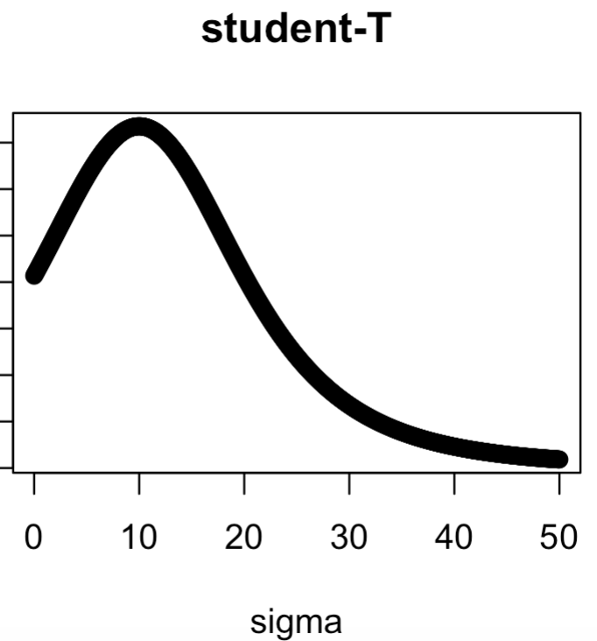
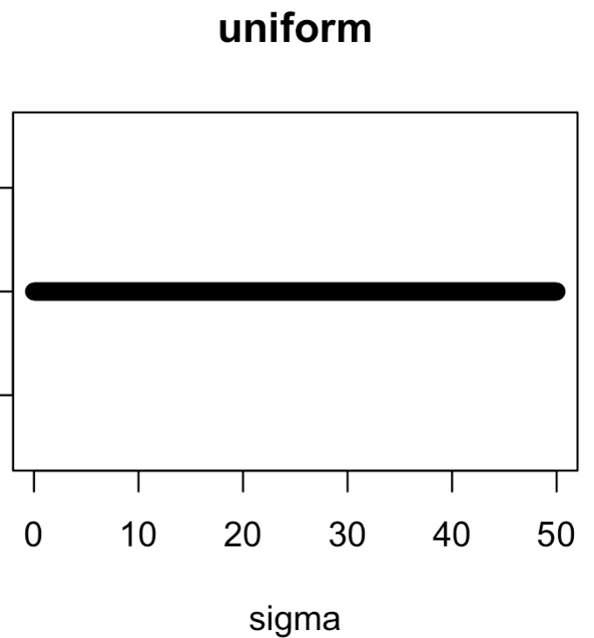
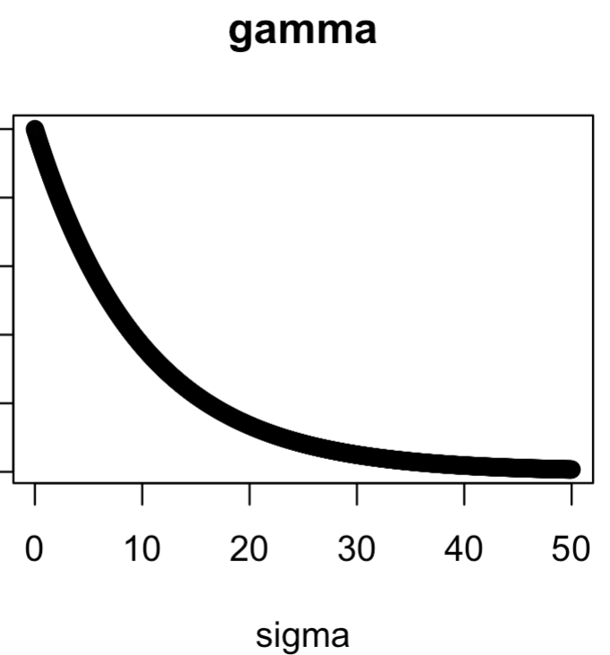
Side by side: Bayes vs. Freq estimation
Now Bayes approach
Some reasonable prior choices for p(μ_{X})
reasonable_priors.R
Some reasonable prior choices for p(σ_{X})

Slide 7
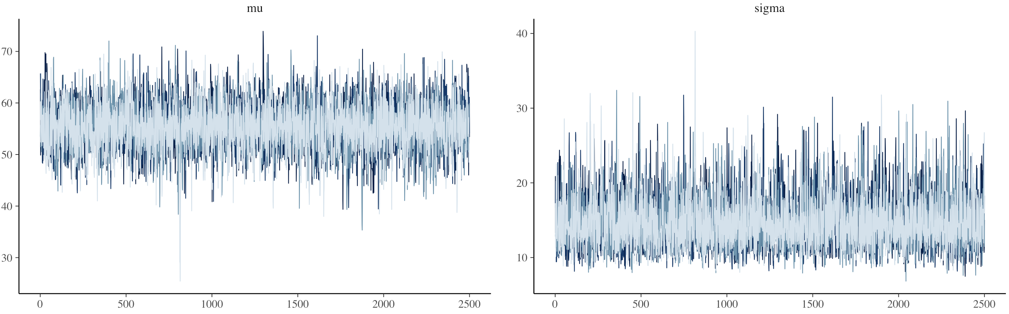
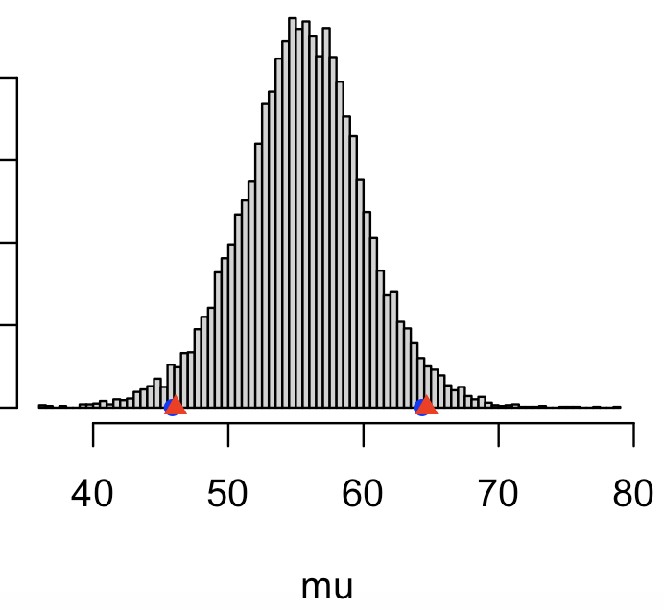
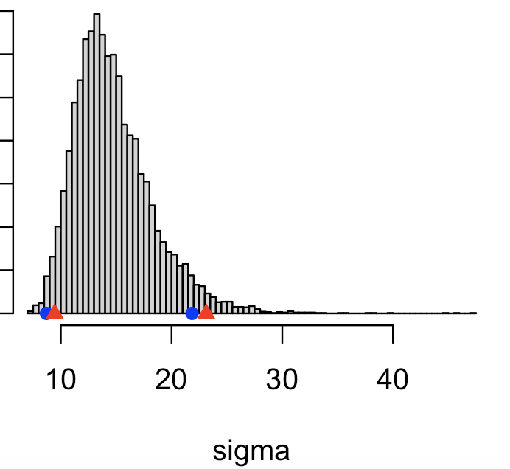
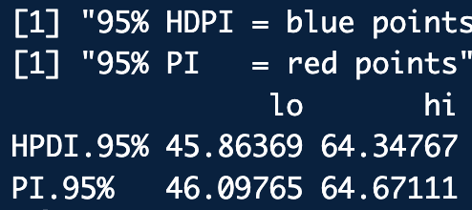
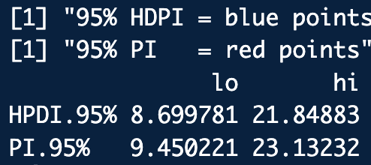
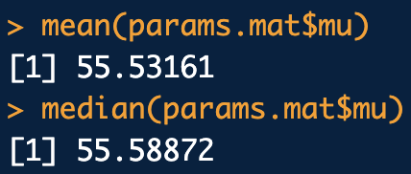
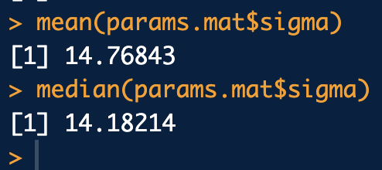
Side by side: Bayes vs. Freq estimation
Now Bayes approach
Check chains:
p(μ|X)
p(σ|X)
Posteriors:
bayes_approach2_STAN.R
bayes_approach2_JAGS.R

Slide 8
Discussion Questions
p(μ|X)
p(σ|X)
How certain should you be about the mean mass of xylazine/pill?
How certain should you be about the variation of mass of xylazine/pill?
If you randomly selected any pill from the seizure, should you be confident about quoting its mass as the mean mass?
Do you think you should sample more pills from the seizure? If so, what do you want to learn from the expanded sample?

