Slide 1

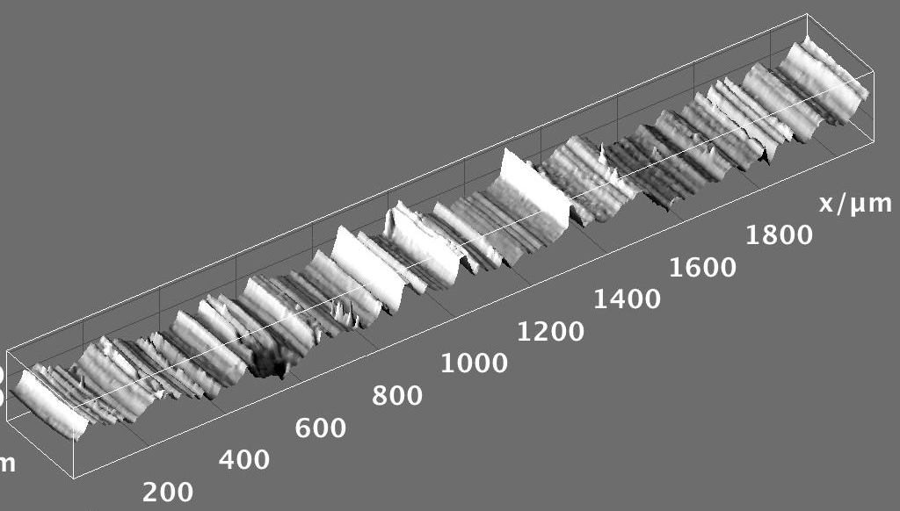


Hands-on Introduction to R

Slide 2
Outline
Mean, median, standard deviation, standard error of the mean
Confidence intervals
Hypothesis testing
Analysis of variance
Linear regression

Slide 3
Measures of Central Tendency
Given a sample from some population:
What is a good “summary” value which well describes the sample?
We will look at:
Average (arithmetic mean)
Median
Mode
For reference see (available on-line):
“The Dynamic Character of Disguised Behaviour for Text-based, Mixed and Stylized Signatures”
LA Mohammed, B Found, M Caligiuri and D Rogers
J Forensic Sci 56(1),S136-S141 (2011)

