Slide 1

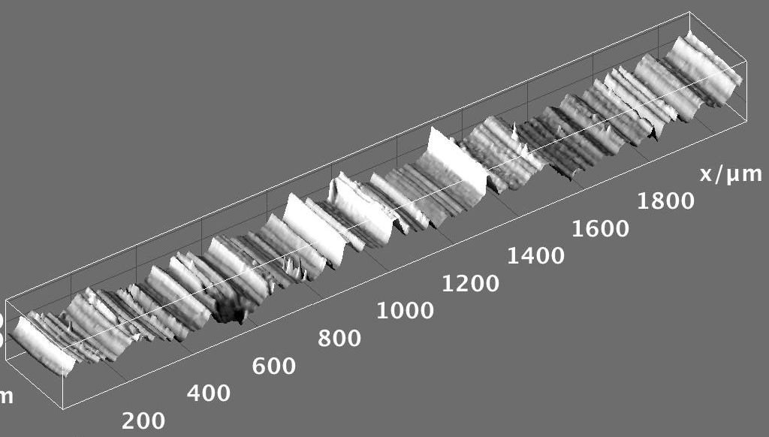


Hands-on Introduction to R

Slide 2
Outline
R : A powerful platform for scientific calculation and data analysis
Why bother learning R ?
Data, data, data, I cannot make bricks without clay ^{Copper Beeches}
A tour of RStudio. Basic Input and Output
Getting Help
Visualizing with Plots
Loading your data from Excel spreadsheets
Basic Plotting

Slide 3
Why ?
R is not a black box!
Codes available for review; totally transparent!
R maintained by a professional group of statisticians, and computational scientists
From very simple to state-of-the-art procedures available
Very good graphics for exhibits and papers
R is extensible (it is a full scripting language)
Coding/syntax similar to Python and MATLAB
Easy to link to C/C++ routines

Slide 4
Why ?
Where to get information on R :
R: http://www.r-project.org/
Just need the base
RStudio: http://rstudio.org/
A great IDE for R
Work on all platforms
Sometimes slows down performance…
CRAN: http://cran.r-project.org/
Library repository for R
Click on Search on the left of the website to search for package/info on packages

Slide 5
Finding our way around R/RStudio
Script Window
Command Line

Slide 6
Handy Commands:
Basic Input and Output
Numeric input
x <- 4
variables:
store
information
:Assignment operator
x <- “text goes in quotes”
Text (character) input

Slide 7
Handy Commands:
Get help on an command:
If you know the name: ?command name
?plot brings up html on plot command
If you don’t know the name:
Use Google (my favorite)
??key word

Slide 8
Handy Commands:
is driven with functions:
func(arguement1, argument2)
function name
input to function goes in parenthesis
function returns something; gets dumped into x
x <- func(arg1, arg2)

Slide 9
Using functions: Example
Say we have a vector of some data. Let’s enter it into R:
-2π, -1.5π, …, 2π
# Enter in the vector of data:
dat <- c(-2*pi, -1.5*pi, -1*pi, -0.5*pi, 0, 0.5*pi, 1*pi,
1.5*pi, 2*pi)
c() is the “collect” function
Compute the sin() of each of your data points:
# Example of USING a function:
out <- sin(dat)
out

Slide 10
Plots: Look at your data
We will visualize our resuts as much as possible. Let’s make some basic plots!
Plot cosine from -5π to 2.8π, and use 100 data points
Handy R function we’ll use all the time
# seq generates a sequence:
x <- seq(from= -5*pi, to= 2.8*pi, length.out = 100)
y <- cos(x)
plot(x, y, type="l")
Defines “x-axis”
Extra argument to connect the points
Defines “y-axis”

Slide 11
How to Load Spreadsheets of Data:
Input from Excel
Save spreadsheet as a CSV file
A .csv file is just a text version of an Excel file
We’ll use the read.csv function

Slide 12
How to Load Spreadsheets of Data:
Input from Excel
Method 1 save Excel spreadsheet as a CSV file and load directly
You’ll need to type in the path to the file in read.csv
Format of a Apple OS path:
"/Users/karen2/Desktop/Glass.csv"
For a Windows path try:
"C:\\Users\\karen2\\Desktop\\Glass.csv"
"C:\Users\karen2\Desktop\Glass.csv "
"C:/Users/karen2/Desktop/Glass.csv "

Slide 13
How to Load Spreadsheets of Data:
Load a CSV file that is on your (mine actually…) Desktop. The file is called bigdata.csv and I made it in Excel:
# Load the spreadsheet:
dat <- read.csv("/Users/karen2/Desktop/Glass.csv")
# Extract column 1
x <- dat[,1]
# Extract column 2
y <- dat[,2]
# Plot the data:
plot(x,y)

Slide 14
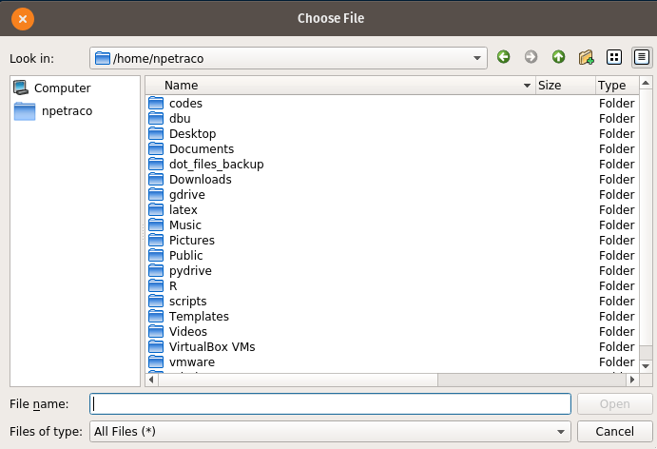
How to Load Spreadsheets of Data:
Input from Excel
Method 2: An alternative is to use file.choose() function with read.csv:
# file.choose lets you navigate to file you want and gets
# its path:
apath <- file.choose()
dat2 <- read.csv(apath)

Slide 15
How to Load Spreadsheets of Data:
Input from Excel
Method 3: We can load in a file directly from the internet using its URL address (if we have a working internet connection):
# A file on the internet. Use it’s URL to load:
dat3 <- read.csv("https://raw.githubusercontent.com/npetraco/workshop21/master/data/bigdata.csv", header = F)

Slide 16
Slicing and Dicing a Spreadsheets
Spreadsheets are called data frames, arrays or matrices in : X
X[,1] returns column 1 of matrix X
X[3,] returns row 3 of matrix X
Handy functions for data frames and matrices:
dim, nrow, ncol, rbind, cbind

Slide 17
Slicing and Dicing Spreadsheets
# Enter some data in a Matrix:
X <- rbind(
c(0.99, 0.92, 0.84, 0.39, 0.36),
c(0.87, 0.73, 0.80, 0.76, 0.87),
c(0.50, 0.11, 0.14, 0.43, 0.62),
c(0.08, 0.41, 0.68, 0.49, 0.02)
)
# What happens when we execute each of these line?:
X
X[1,3]
X[2,]
X[,1]
X[5,]
X[5]

Slide 18
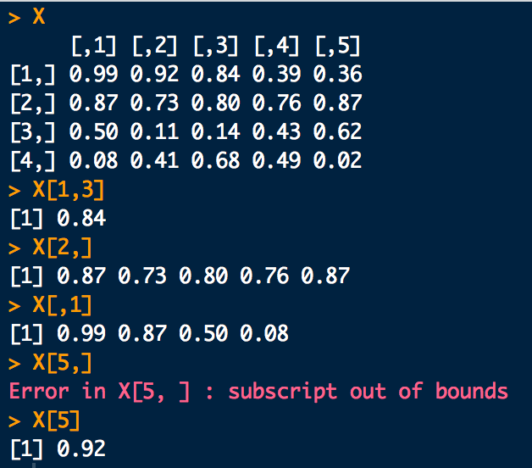
Slicing and Dicing Spreadsheets

Slide 19
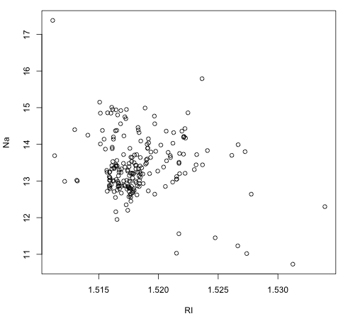
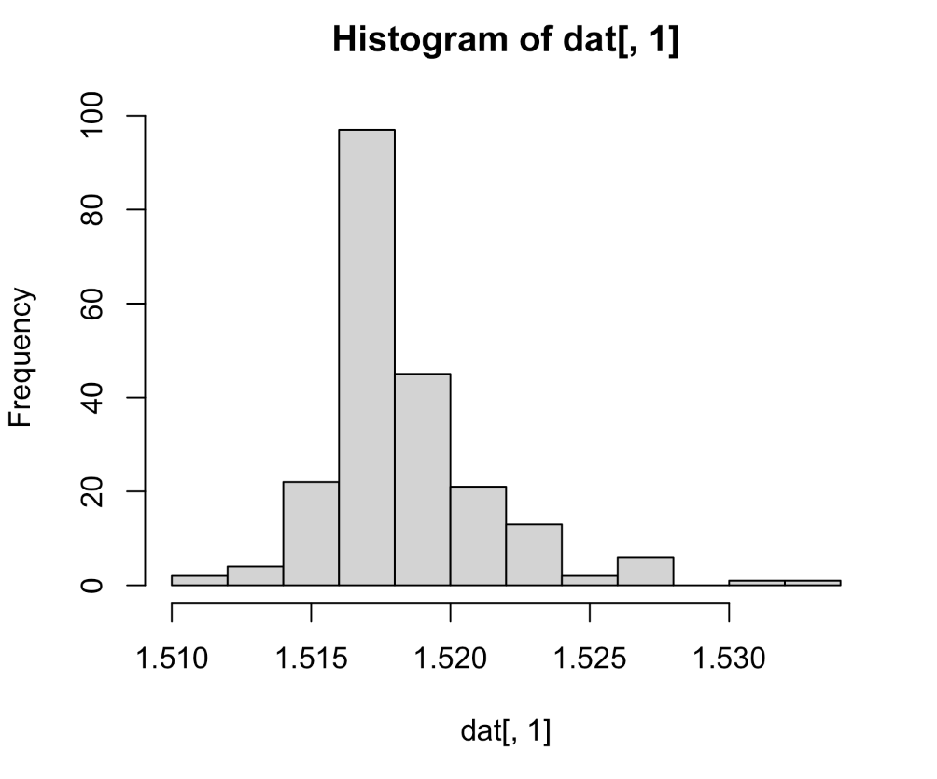
First Thing: Plot your Data
Explore the Glass dataset
Scatter plots: plot any two variables against each other
Histograms: “bin” a variable and plot frequencies

Slide 20
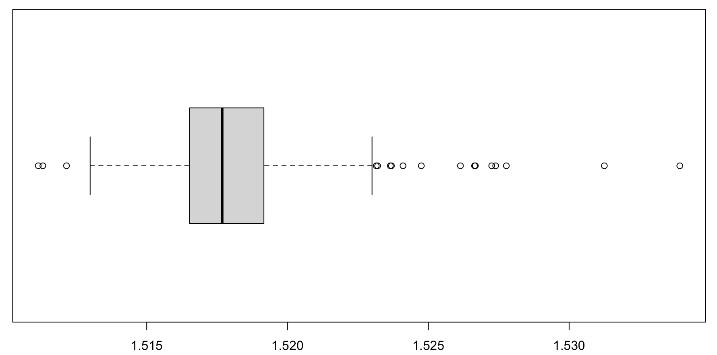
First Thing: Plot your Data
Box and Whiskers plots:
range
possible
outliers
possible
outliers
25th-%tile
1st-quartile
median
50th-%tile
75th-%tile
3rd-quartile
RI

Slide 21
Basic Plotting Commands:
# Load data:
dat <- read.csv("https://raw.githubusercontent.com/npetraco/workshop21/master/data/Glass.csv")
head(dat)
# Scatter plot:
plot(dat[,1], dat[,2])
# Histogram:
hist(dat[,1])
# Box and whisker plot:
boxplot(dat[,1], horizontal = T)

