Slide 1

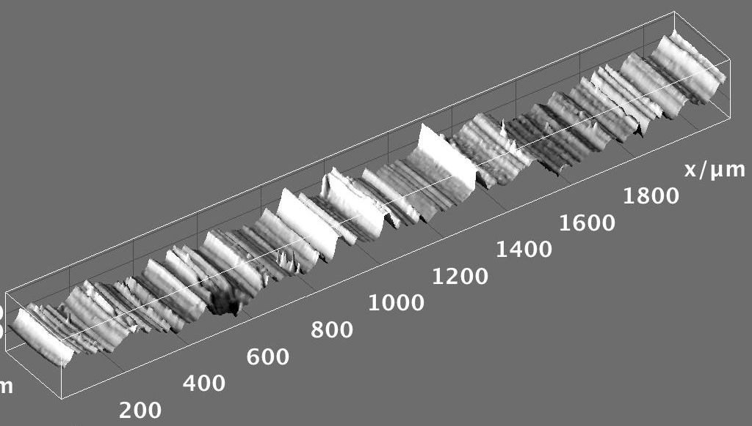


Hands-on Introduction to R

Slide 2
Outline
Mean, median, standard deviation, standard error of the mean
Basic probability calculations
Using built in distributions
Confidence intervals
Hypothesis testing

Slide 3
Measures of Central Tendency
Given a sample from some population:
What is a good “summary” value which well describes the sample and uncertainty?
We will look at:
Average (arithmetic mean)
Median
Mode
Standard deviation
Standard error of the mean
For reference see (available on-line):
“The Dynamic Character of Disguised Behaviour for Text-based, Mixed and Stylized Signatures”
LA Mohammed, B Found, M Caligiuri and D Rogers
J Forensic Sci 56(1),S136-S141 (2011)

Slide 4
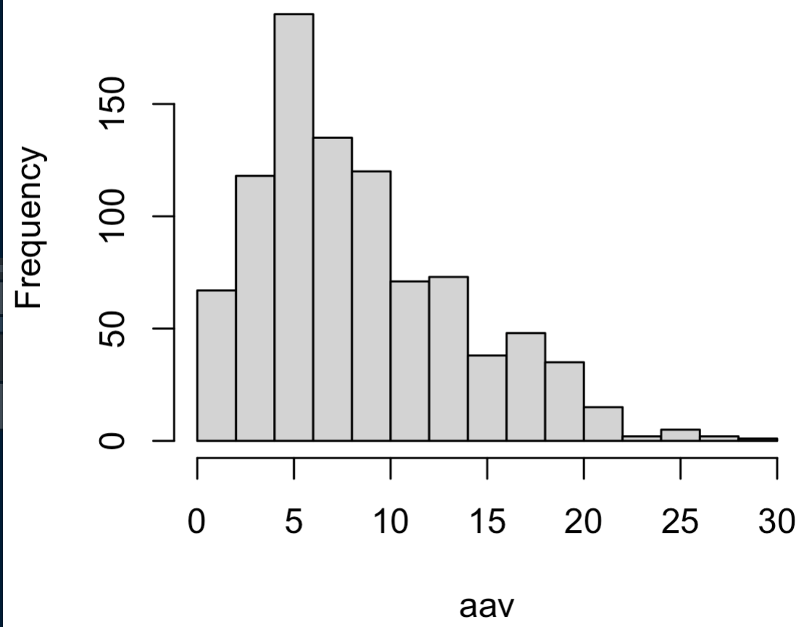
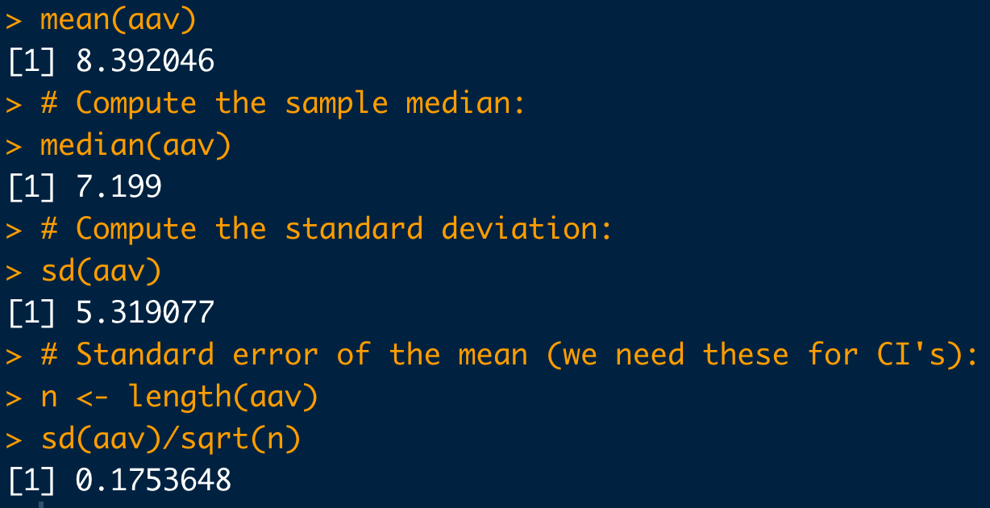
Basic Statistical Commands:
# Load data:
dat <- read.csv("https://raw.githubusercontent.com/npetraco/workshop21/master/data/lamwrite.csv", header=T)
head(dat)
dim(dat)
# Dump column 2 to a variable:
aav <- dat[,2]
# Look at the data:
hist(aav)
# Compute the sample mean:
mean(aav)
# Compute the sample median:
median(aav)
# Compute the standard deviation:
sd(aav)
# Standard error of the mean (we need these for CI's):
n <- length(aav)
sd(aav)/sqrt(n)

Slide 5
Basic Probability Problems
It isn’t necessary to use R for these types of questions.
I use this unit to just get class more used to R syntax by translating a word problem into R code with them
In the past I have asked them to “double check” their R calculations on their hand calculator
Notes:
REPLACE WITH HAND CALC

Slide 6
Example
Billy is hungry.
Let A = Billy went to Auntie Anne's for a pretzel. Pr(A) = 0.49
Let B = Billy went to Buffalo Wild Wings. Pr(B) = 0.54
Draw a Venn diagram for this scenario assuming A and B are not mutually exclusive. What would that mean?
Compute
Compute
Compute
Compute

Slide 7
Example
It isn’t necessary to use R for this question. All you need for most probability problems is a calculator.
# Data from the question:
A <- 0.49
B <- 0.54
# Pr(A')
An <- 1 - A
An
# Pr(A union B) = Pr(A) + Pr(B) - Pr(A intersect B)
AandB <- ((A+B) - 1)
AandB
AorB <- A + B - AandB
AorB
# Pr(A' and B') = Pr( (A or B)' )
1-AorB
# Pr(A' or B') = Pr( (A and B)' )
1 - AandB
Notes:
REPLACE WITH HAND CALC

Slide 8
Example: A medical test
Professor P LOVES hamburgers. But he’s also a hypochondriac. He thinks he is infected with “Mad Cow Disease” (MCD), so he gets himself tested (T).
The true positive rate of the test is: Pr(T⁺ | MCD⁺) = 0.7
The false positive rate of the test is: Pr(T⁺ | MCD⁻) = 0.1
The background prevalence of MCD in the yummy cow population is: Pr(MCD⁺) = 0.02
What is the probability that Prof. P tests positive for MCD, Pr(T⁺)?
Suppose Professor P is positive for MCD. What is the probability that he truly has MCD, Pr(MCD⁺| T⁺)?

Slide 9
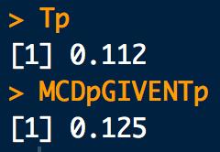
Example: A medical test
# Data from the question:
Tp.given.MCDp <- 0.7
Tp.given.MCDm <- 0.1
MCDp <- 0.02
# Pr(T+) = Pr(T+ | MCD+) Pr(MCD+) + Pr(T+ | MCD-) Pr(MCD-)
Tp <- Tp.given.MCDp * MCDp + Tp.given.MCDm * (1-MCDp)
Tp
# Pr(MCD+ | T+) = Pr(T+ | MCD+) Pr(MCD+) / Pr(T+)
(Tp.given.MCDp * MCDp)/Tp
Notes:
REPLACE WITH HAND CALC

Slide 10
Built in dists

Slide 11
Confidence Intervals
A confidence interval (CI) gives a range in which a true population parameter may be found.
Specifically, (1- α)×100% CIs for a parameter, constructed from a random sample (of a given sample size), will contain the true value of the parameter approximately (1- α)×100% of the time.

Slide 12
Confidence Intervals
Construction of a CI for a mean depends on:
Sample size n
Standard error for means
Level of confidence 1-α
α is significance level
Use α to compute t_{c}-value, the critical t-statistic
(1-α)×100% two-sided CI for population mean using a sample average and standard error is:

Slide 13
Confidence Intervals
Compute the 95% confidence interval for the mean average absolute velocity in the LAM data
# Load data:
dat <- read.csv("https://raw.githubusercontent.com/npetraco/workshop21/master/data/lamwrite.csv", header=T)
# Average absolute velocity data:
aav <- dat[,2]
n <- length(aav) # sample size
xbar <- mean(aav) # sample mean
se <- sd(aav)/sqrt(n) # standard error of the sample mean
conf <- 0.95 # level of confidence
alpha <- 1 - conf # level of significance
tc <- qt(1 -alpha/2, df = n-1) # tc for a two-sided CI
xbar.lo <- xbar - tc*se
xbar.hi <- xbar + tc*se
c(xbar.lo, xbar.hi) # Condifence interval for the mean

Slide 14
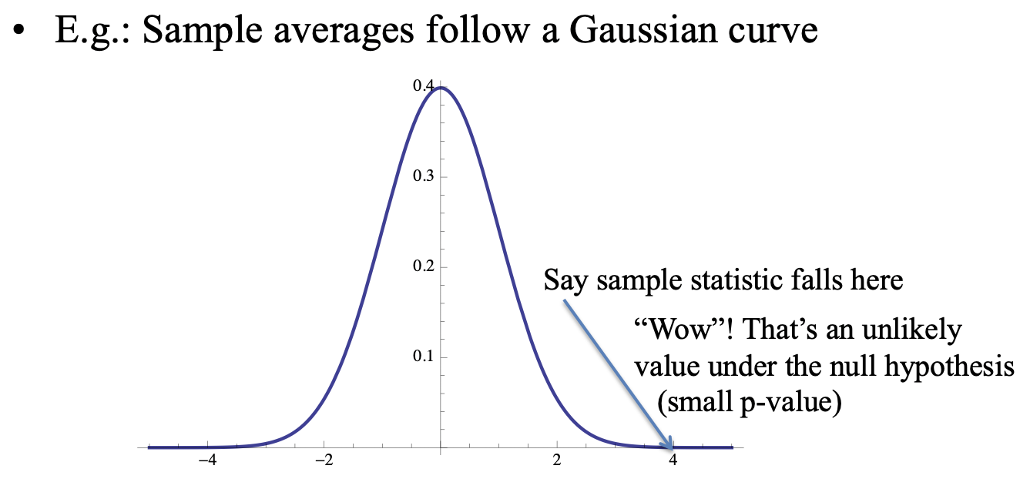
Hypothesis Testing
A hypothesis is an assumption about a statistic.
Form a hypothesis about the statistic
H₀, the null hypothesis
Identify the alternative hypothesis, H_{a}
“Accept” H₀ or “Reject” H₀ in favour of H_{a} at a certain confidence level (1-α)×100%
Technically, “Accept” means “Do not reject”

Slide 15
Example: One Sample Hypothesis Testing for the Mean
XXXX

Slide 16
Example: Two Sample Hypothesis Testing for the Mean
Could the two sets of glass shards be from the same window?
RIs # 1: 1.53419 1.53275 1.53345 1.53267 1.53292 1.53332 1.53464 1.53299 1.53430 1.53550
RIs # 2: 1.53577 1.53606 1.53602 1.53544 1.53618 1.53604 1.53551 1.53572 1.53580 1.53567
Do a two sample 95% confidence hypothesis test to test if : μ_{RI #1} ≠ μ_{RI #2} (H_{a}).

Slide 17
Example: Two Sample Hypothesis Testing for equivalence of Means
# Question of interest: Could the two sets of glass shards be from the same window ?
# NULL HYPOTHESIS: RI1 == RI2
# ALTERNATIVE HYPOTHESIS: RI1 != RI2
# RIs of shards from glass pane 1
RI1 <- c(1.53419, 1.53275, 1.53345, 1.53267, 1.53292, 1.53332, 1.53464, 1.53299, 1.53430, 1.53550)
# RIs of shards from glass pane 2
RI2 <- c(1.53577, 1.53606, 1.53602, 1.53544, 1.53618, 1.53604, 1.53551, 1.53572, 1.53580, 1.53567)
# It helps to look at a box-and-whiskers plot for two-sample tests:
boxplot(RI1, RI2)
# *Check to see if (H0) variances of the two samples equal = 1 (i.e. evidence that vars are not equal??):
var.test(RI1, RI2)
# Two sample two sided hypothesis test for equivalence between means:
t.test(RI1, RI2, var.equal = FALSE, alternative = "two.sided", conf.level = 0.95)
Η₀: μ_{RI #1} = μ_{RI #2}
Η_{a}: μ_{RI #1} ≠ μ_{RI #2}

