Slide 1

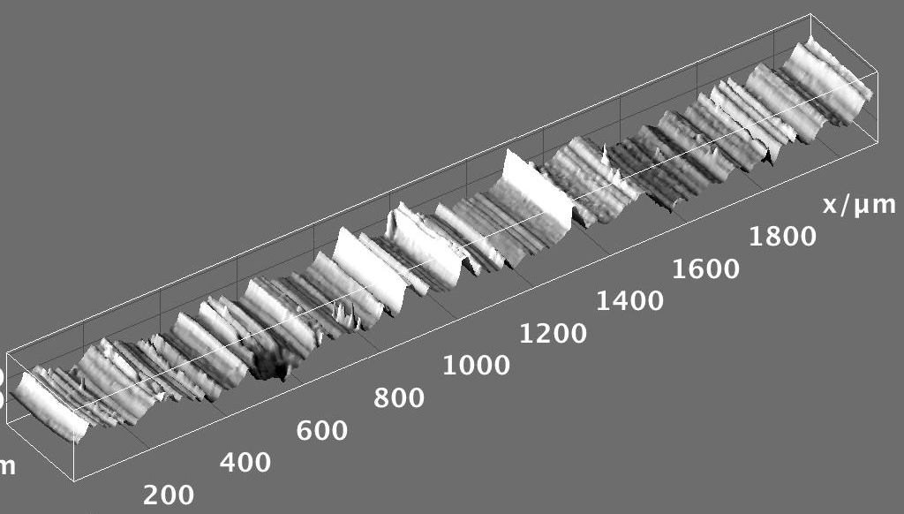


Hands-on Introduction to R

Slide 2
Outline
Mean, median, standard deviation, standard error of the mean
Basic probability calculations
Using built in distributions
Confidence intervals
Hypothesis testing

Slide 3
Measures of Central Tendency
Given a sample from some population:
What is a good “summary” value which well describes the sample and uncertainty?
We will look at:
Average (arithmetic mean)
Median
Mode
Standard deviation
Standard error of the mean
For reference see (available on-line):
“The Dynamic Character of Disguised Behaviour for Text-based, Mixed and Stylized Signatures”
LA Mohammed, B Found, M Caligiuri and D Rogers
J Forensic Sci 56(1),S136-S141 (2011)

Slide 4
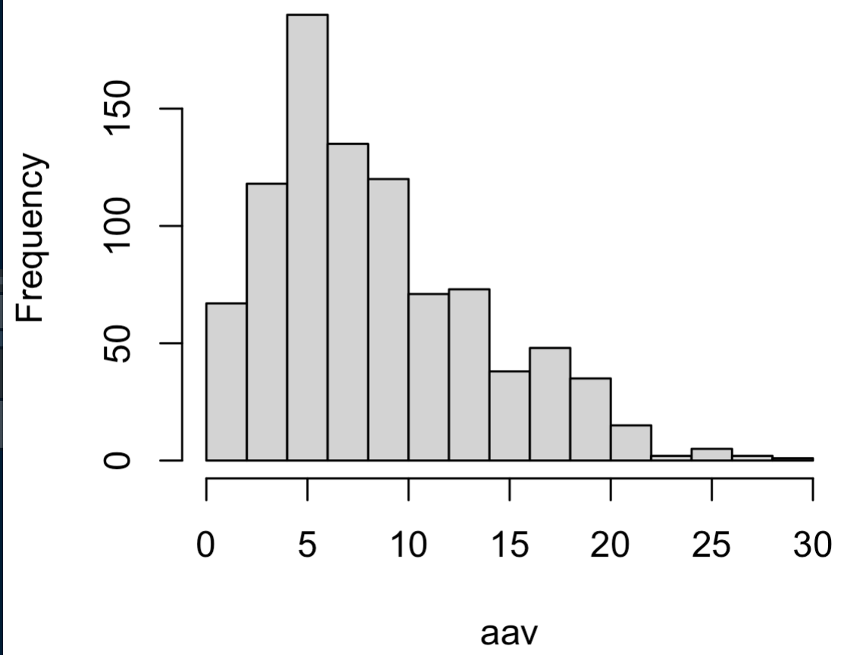
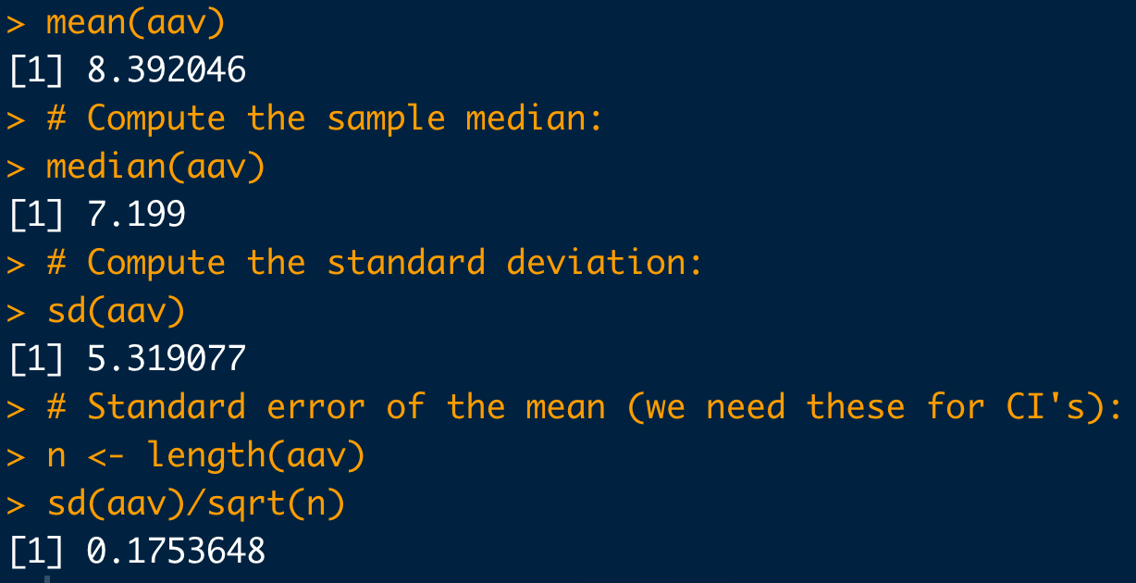
Basic Statistical Commands:
# Load data:
dat <- read.csv("https://raw.githubusercontent.com/npetraco/workshop21/master/data/lamwrite.csv", header=T)
head(dat)
dim(dat)
# Dump column 2 to a variable:
aav <- dat[,2]
# Look at the data:
hist(aav)
# Compute the sample mean:
mean(aav)
# Compute the sample median:
median(aav)
# Compute the standard deviation:
sd(aav)
# Standard error of the mean (we need these for CI's):
n <- length(aav)
sd(aav)/sqrt(n)

Slide 5
Basic Probability Problems
It isn’t necessary to use R for these types of questions.
I use this unit to just get class more used to R syntax by translating a word problem into R code with them
I give them longer versions of the example problem for HW and ask them for questions at subsequent classes
In the past I have asked them to “double check” their R calculations on their hand calculator
Notes:
REPLACE WITH HAND CALC

Slide 6
Example
Billy is hungry.
Let A = Billy went to Auntie Anne's for a pretzel. Pr(A) = 0.49
Let B = Billy went to Buffalo Wild Wings. Pr(B) = 0.54
Draw a Venn diagram for this scenario assuming A and B are not mutually exclusive. What would that mean?
Compute
Compute
Compute
Compute

Slide 7
Example
It isn’t necessary to use R for this question. All you need for most probability problems is a calculator.
# Data from the question:
A <- 0.49
B <- 0.54
# Pr(A')
An <- 1 - A
An
# Pr(A union B) = Pr(A) + Pr(B) - Pr(A intersect B)
AandB <- ((A+B) - 1)
AandB
AorB <- A + B - AandB
AorB
# Pr(A' and B') = Pr( (A or B)' )
1-AorB
# Pr(A' or B') = Pr( (A and B)' )
1 - AandB
Notes:
REPLACE WITH HAND CALC

Slide 8
Example: A medical test
Professor P LOVES hamburgers. But he’s also a hypochondriac. He thinks he is infected with “Mad Cow Disease” (MCD), so he gets himself tested (T).
The true positive rate of the test is: Pr(T⁺ | MCD⁺) = 0.7
The false positive rate of the test is: Pr(T⁺ | MCD⁻) = 0.1
The background prevalence of MCD in the yummy cow population is: Pr(MCD⁺) = 0.02
What is the probability that Prof. P tests positive for MCD, Pr(T⁺)?
Suppose Professor P is positive for MCD. What is the probability that he truly has MCD, Pr(MCD⁺| T⁺)?

Slide 9
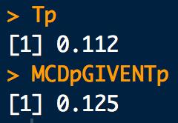
Example: A medical test
# Data from the question:
Tp.given.MCDp <- 0.7
Tp.given.MCDm <- 0.1
MCDp <- 0.02
# Pr(T+) = Pr(T+ | MCD+) Pr(MCD+) + Pr(T+ | MCD-) Pr(MCD-)
Tp <- Tp.given.MCDp * MCDp + Tp.given.MCDm * (1-MCDp)
Tp
# Pr(MCD+ | T+) = Pr(T+ | MCD+) Pr(MCD+) / Pr(T+)
(Tp.given.MCDp * MCDp)/Tp
Notes:
REPLACE WITH HAND CALC

Slide 10
Built in dists

Slide 11
Built in Probability Distributions
R has many built in discrete and continuous probability distributions
This is where R starts for become handy
I explain the parameters, PMFs, PDFs CDFs, moments and walk them through word problems with each
For each we translate the work problem into probability notation then build the R script to solve the problem using R’s built in functionality
Notes:
REPLACE WITH HAND CALC

Slide 12
Built in Probability Distributions
Each built in R distribution has:
A name:
Binomial: binom
Poisson: pois
Uniform: unif
Gaussian: norm
Four functions to deal with:
Likelihood/density values: “d-function”
Cumulative Probability “p-function”
Quantiles “q-function”
Random sampling “r-functions” (I don’t do anything with these for the undergrads)
These are the named distributions I emphasize. There are many more.
Notes:
REPLACE WITH HAND CALC

Slide 13
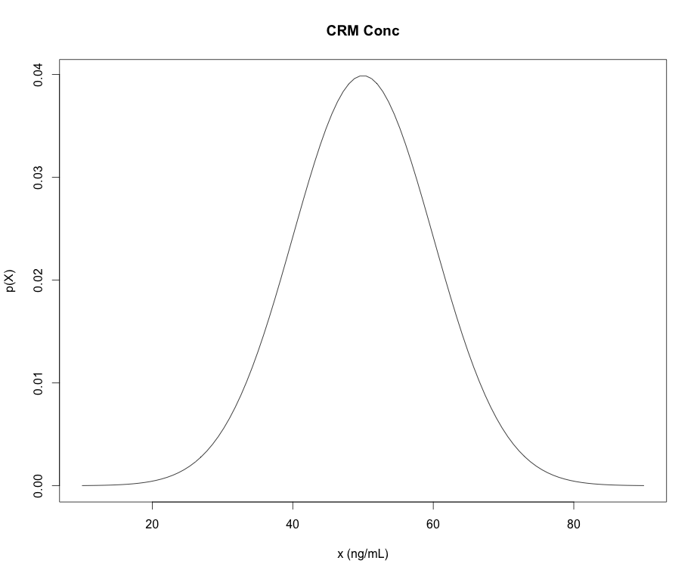
Example of a Named Distribution: Gaussians
dnorm “d-function” in R is the density (mass) of the distribution
pnorm “p-function” in R is the CDFs of the distribution
qnorm “q-function” in R give the quantiles of the distribution (x-values) for a given cumulative probability (p-value)
rnorm “r-functions” in R gives a random sample from the distribution
*NOTE: “p-functions” and “q-functions” are inverses of each other
pnorm(q=47,mean=50,sd=10)=
0.42
0.42
“input quantity”
qnorm(p=0.42,mean=50,sd=10)=
47
47

Slide 14
Example: Using the Binomial Distribution
Using data collected by Besson, Taroni et al. suggest that about 36% of bills in general circulation in Europe contain traces of cocaine.
What is the distribution of the number of European bills that contain traces of cocaine in a stack of 50 bills?
What is approximate uncertainty in the count?
How many contaminated bills do you expect to find?
What is the probability of finding greater than 10 and less than or equal to 20 bills contaminated with cocaine?
What is the probability that 13 bills or less contain traces of cocaine?
What is the probability that more than 15 bills contain traces of cocaine?
What is the probability that 15 or more bills contain traces of cocaine?

Slide 15
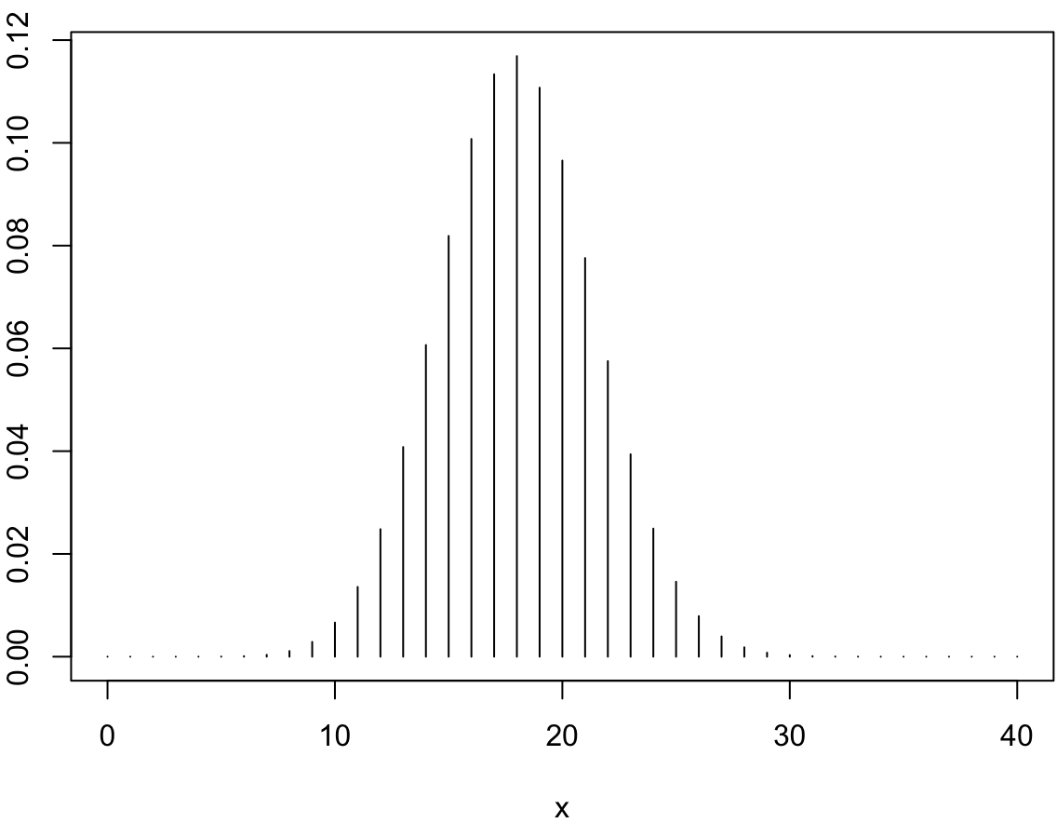
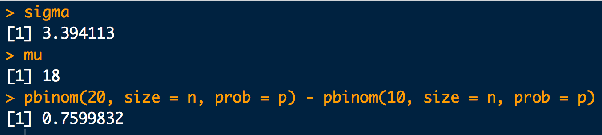
p <- 0.36
n <- 50
# a.
x <- seq(from=0, to=40)
pmf <- dbinom(x, size = n, prob = p)
plot(x, pmf, typ = "h")
# b.
sigma <- sqrt(n*p*(1-p))
sigma
# c.
mu <- n*p
mu
# d.
pbinom(20, size = n, prob = p) - pbinom(10, size = n, prob = p)

Slide 16
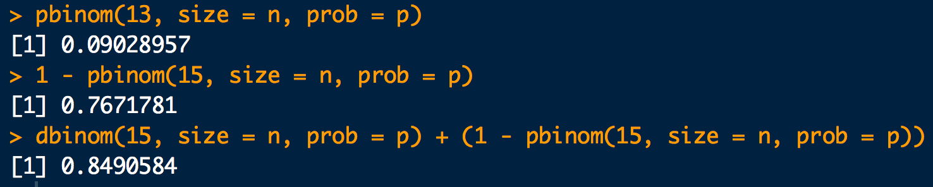
# e.
pbinom(13, size = n, prob = p)
# f.
1 - pbinom(15, size = n, prob = p)
# g.
dbinom(15, size = n, prob = p) + (1 - pbinom(15, size = n, prob = p))

Slide 17
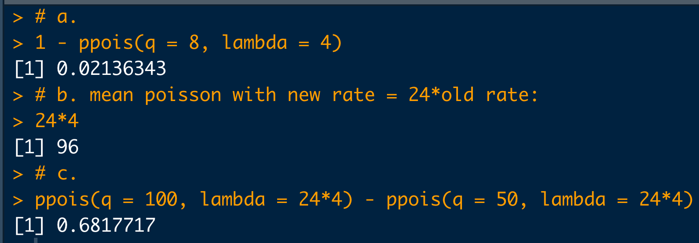
Example: Using the Poisson Distribution
A certain “user” of a social media site (may be a bot) posts at an average rate of about 4 per hour.
What is the probability that more than 8 posts will be put up in the next hour?
About how many posts can be expected in 24 hours?
What is the probability of more than 50 but less than or equal to 100 posts appearing in 24 hours?
# a.
1 - ppois(q = 8, lambda = 4)
# b. mean poisson with new rate = 24*old rate:
24*4
# c.
ppois(q = 100, lambda = 24*4) - ppois(q = 50, lambda = 24*4)

Slide 18
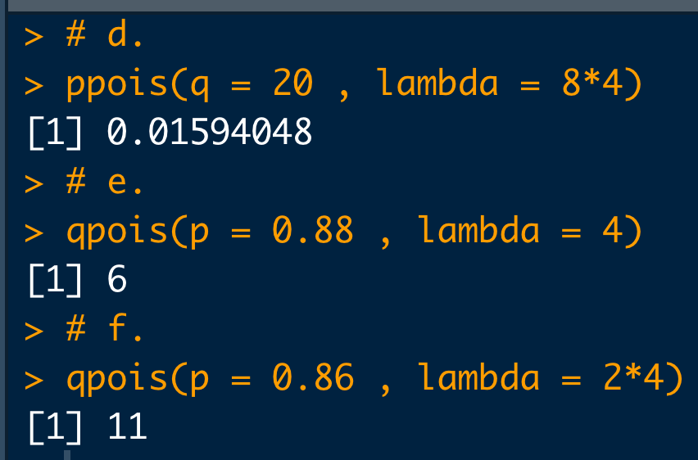
What is the probability that 20 or fewer posts will appear in the next 8 hours?
The probability of receiving q or less posts in the next hour is 0.88. What is the value of q?
The probability of receiving q or less posts in the next 2 hours is 0.86. What is the value of q?
# d.
ppois(q = 20 , lambda = 8*4)
# e.
qpois(p = 0.88 , lambda = 4)
# f.
qpois(p = 0.86 , lambda = 2*4)

Slide 19
Example: quantiles/percentiles with Continuous PDFs
The concentration is certified to follow a normal distribution with mean concentration of 50 ng/mL and standard deviation of 10 ng/mL.
0.9
What maximum concentration can we expect for 90% of the samples we may measure?
?

Slide 20

Example: quantiles/percentiles
Again, we translate the word problem and write a simple structured script together:
# Parameters:
mu <- 50
sigma <- 10
# Quantile for the 90th percentile:
qnorm(0.9, mean=mu, sd=sigma)

Slide 21
Example: quantiles/percentiles
What is the probability that the CRM’s concentration will be measured to be between 30 ng/mL and 70 ng/mL?
I emphasize that R does the calculus for you if you understand the meaning of the functions
30 ng/mL
70 ng/mL
# The “measurands” (parameters):
mu <- 50
sigma <- 10
# Pr(30 < X < 70):
pnorm(70, mean=mu, sd=sigma) – pnorm(30, mean=mu, sd=sigma)

Slide 22
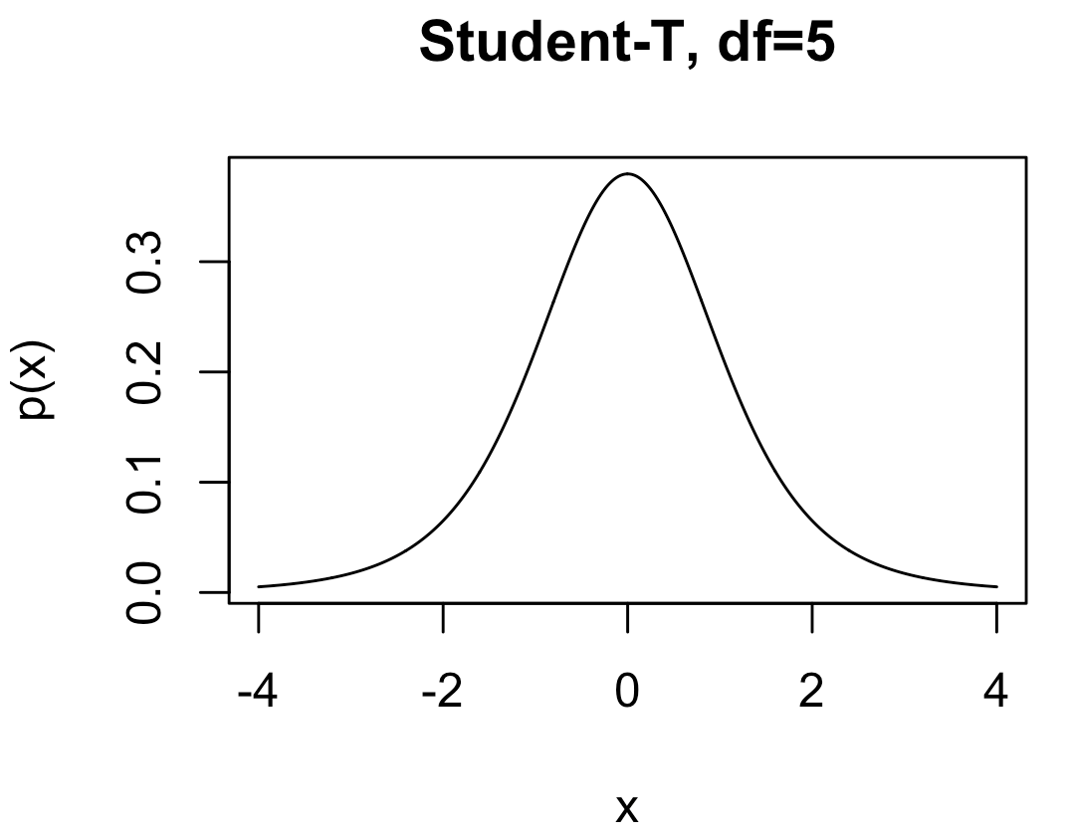
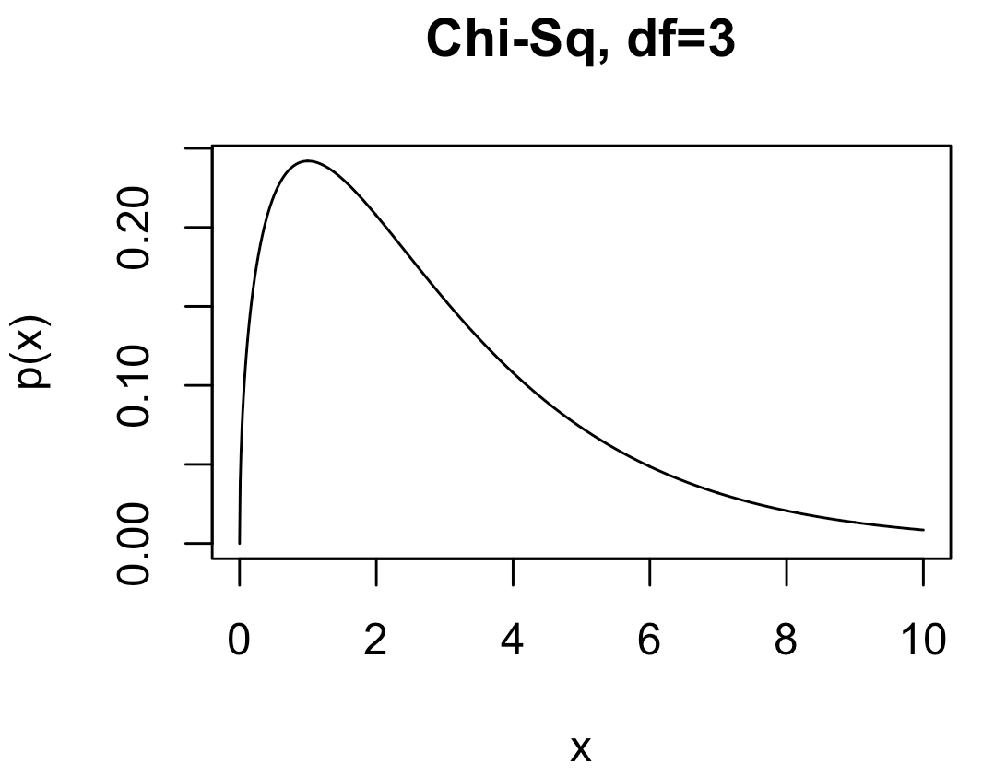
Other Distributions I Use
Student-t: Like a standard normal distribution but fatter tails.
dt, qt, pt, rt
Parameters:
df: degrees of freedom
Chi-squared (χ²): Handy especially for comparing raw set of counts. Also, it’s proportional to the likelihood of sample variance for IID data.
dchisq, qchisq, pchisq, rchisq
Parameters:
df: degrees of freedom

Slide 23
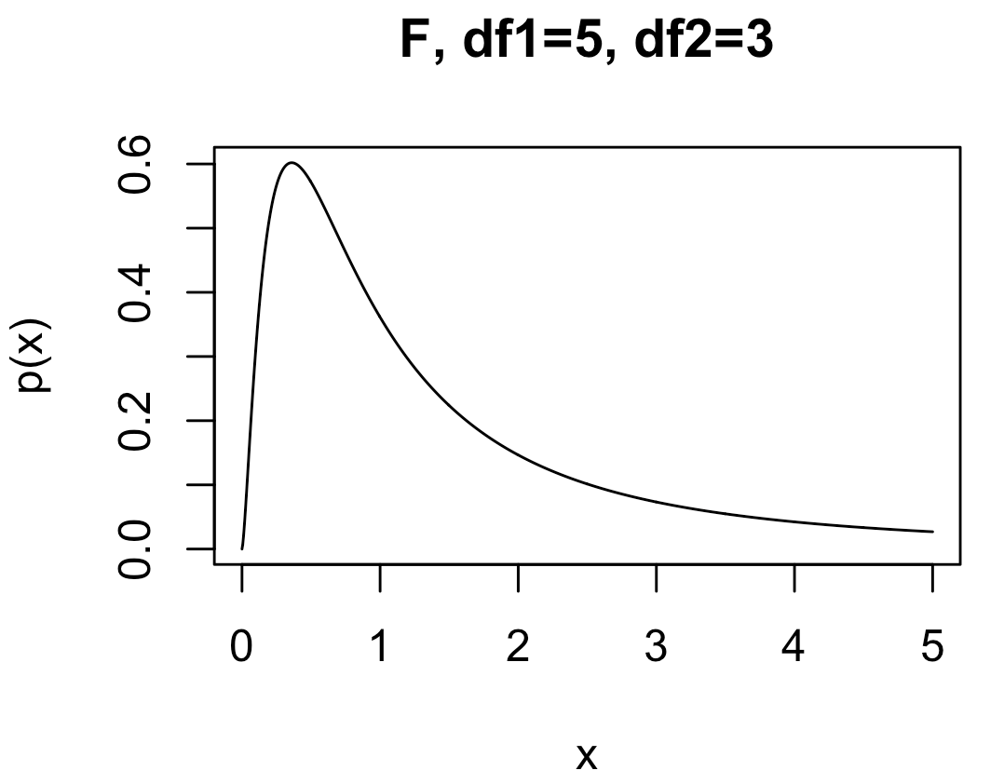
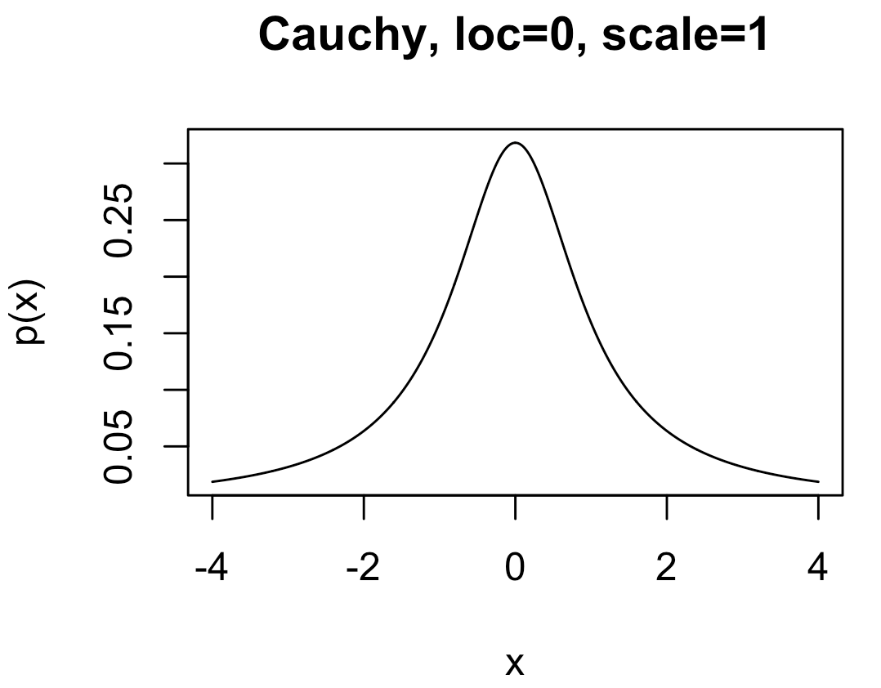
Other Distributions We’ll Encounter
F : Handy especially for comparing outcomes in three or more experiments with different conditions.
df, qf, pf, rf
Parameters:
df1: degrees of freedom 1
df2: degrees of freedom 2
Cauchy : A very fat-tailed distribution. Handy for expressing lots of uncertainty when modeling, while retaining formal properties of a proper probability distribution
dcauchy, qcauchy, pcauchy, rcauchy
Parameters:
location: peak location of the density
scale: “fat-ness” of the tails

Slide 24
Confidence Intervals
A confidence interval (CI) gives a range in which a true population parameter may be found.
Specifically, (1- α)×100% CIs for a parameter, constructed from a random sample (of a given sample size), will contain the true value of the parameter approximately (1- α)×100% of the time.

Slide 25
Confidence Intervals
Construction of a CI for a mean depends on:
Sample size n
Standard error for means
Level of confidence 1-α
α is significance level
Use α to compute t_{c}-value, the critical t-statistic
(1-α)×100% two-sided CI for population mean using a sample average and standard error is:

Slide 26
Confidence Intervals
Compute the 95% confidence interval for the mean average absolute velocity in the LAM data
# Load data:
dat <- read.csv("https://raw.githubusercontent.com/npetraco/workshop21/master/data/lamwrite.csv", header=T)
# Average absolute velocity data:
aav <- dat[,2]
n <- length(aav) # sample size
xbar <- mean(aav) # sample mean
se <- sd(aav)/sqrt(n) # standard error of the sample mean
conf <- 0.95 # level of confidence
alpha <- 1 - conf # level of significance
tc <- qt(1 -alpha/2, df = n-1) # tc for a two-sided CI
xbar.lo <- xbar - tc*se
xbar.hi <- xbar + tc*se
c(xbar.lo, xbar.hi) # Condifence interval for the mean

Slide 27
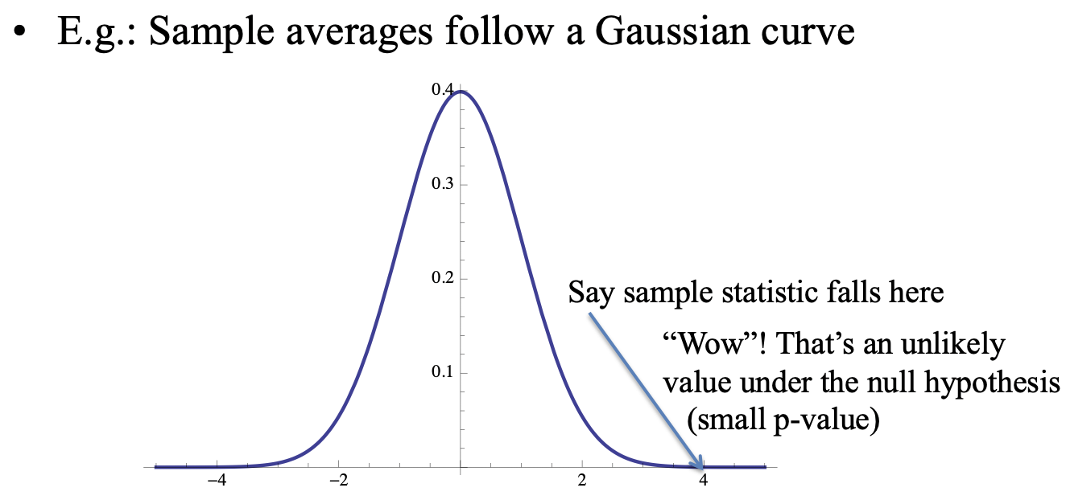
Hypothesis Testing
A hypothesis is an assumption about a statistic.
Form a hypothesis about the statistic
H₀, the null hypothesis
Identify the alternative hypothesis, H_{a}
“Accept” H₀ or “Reject” H₀ in favour of H_{a} at a certain confidence level (1-α)×100%
Technically, “Accept” means “Do not reject”

Slide 28
Example: One Sample Hypothesis Testing for the Mean
Consider a series of mass assays measurements (in grams) :
49.9996, 49.9994, 49.9993, 49.9996, 49.9995, 49.9995,49.9995, 49.9994, 49.9995, 49.9994
Do a 95% confidence hypothesis test to test if μ_{mass} ≠ 50.000g (H_{a}).
Do a 95% confidence hypothesis test to test if μ_{mass} < 50.000g (H_{a}).
Do a 95% confidence hypothesis test to test if μ_{mass} > 50.000g (H_{a}).

Slide 29
Example: One Sample Hypothesis Testing for the Mean
# Question of interest: Is the mean mass == 50.000g ?
x <- c(49.9996,49.9994,49.9993,49.9996,49.9995,49.9995,49.9995,49.9994,49.9995,49.9994)
mean(x)
# NULL HYPOTHESIS: mu == 50.000g
# ALTERNATIVE HYPOTHESIS: mu != 50.000g
t.test(x, alternative = "two.sided", mu = 50.000, conf.level = 0.95)
# The meaning of the output for t.test:
# Can we REJECT the NULL HYPOTHESIS? => Is there evidence that the mean mass is not equal to 50.000g?
# p-value = 2.704e-08
#
# So p < 0.05. REJECT the NULL HYPOTHESIS. The data is "unlikely" under the null.
# Another interperitation: If the Null were true, we wouldn't see data like this too often.
# BUT: We CANNOT SAY that the data is more likely under the Alternative hypothesis.
# 95 percent confidence interval:
# 49.99940 49.99954
# This means: given your sample, a set of plausible values for the mean is [49.99940 49.99954], with 95% "plausibility”
Η₀: μ_{mass} = 50.000g
Η_{a}: μ_{mass} ≠ 50.000g

Slide 30
Example: One Sample Hypothesis Testing for the Mean
# Question of interest: Is there evidence that the mean mass is less than 50.000g ?
x <- c(49.9996,49.9994,49.9993,49.9996,49.9995,49.9995,49.9995,49.9994,49.9995,49.9994)
mean(x)
# NULL HYPOTHESIS: mu >= 50.000g
# ALTERNATIVE HYPOTHESIS: mu < 50.000g
t.test(x, alternative = "less", mu = 50.000, conf.level = 0.95)
# The meaning of the output for t.test:
# Can we REJECT the NULL HYPOTHESIS? => Is there evidence that the mean mass is less than 50.000g?
# p-value = 1.352e-08
# So p < 0.05. REJECT the NULL HYPOTHESIS. The data is "unlikely" under the null.
# Another interperitation: If the Null were true, we wouldn't see data like this too often.
# BUT: We CANNOT SAY that the data is more likely under the Alternative hypothesis.
# 95 percent confidence interval:
# -Inf 49.99952
# This means: given your sample, the GREATEST value the mean could be is 49.99952, with 95% "plausibility"
Η₀: μ_{mass} ≥ 50.000g
Η_{a}: μ_{mass} < 50.000g

Slide 31
Example: One Sample Hypothesis Testing for the Mean
# Question of interest: Is there evidence that the mean mass is greater than or equal to 50.000g ?
x <- c(49.9996,49.9994,49.9993,49.9996,49.9995,49.9995,49.9995,49.9994,49.9995,49.9994)
mean(x)
# NULL HYPOTHESIS: mu <= 50.000g Assumes the opposite of what you seek evidence for.
# ALTERNATIVE HYPOTHESIS: mu > 50.000g
t.test(x, alternative = "greater", mu = 50.000, conf.level = 0.95)
# The meaning of the output for t.test:
# Can we REJECT the NULL HYPOTHESIS? => Is there evidence that the mean mass is greater than 50.000g?
# p-value = 1 (Wow!)
# So p is not < 0.05. CANNOT REJECT the NULL HYPOTHESIS. The data is "likely" under the null.
# Another interperitation: If the Null were true, we would see data like this often.
# 95 percent confidence interval:
# 49.99942 Inf
# This means: given your sample, the LEAST value the mean could be is 49.99942, with 95% "plausibility”
Η₀: μ_{mass} ≤ 50.000g
Η_{a}: μ_{mass} > 50.000g

Slide 32
Example: Two Sample Hypothesis Testing for the Mean
Could the two sets of glass shards be from the same window?
RIs # 1: 1.53419 1.53275 1.53345 1.53267 1.53292 1.53332 1.53464 1.53299 1.53430 1.53550
RIs # 2: 1.53577 1.53606 1.53602 1.53544 1.53618 1.53604 1.53551 1.53572 1.53580 1.53567
Do a two sample 95% confidence hypothesis test to test if : μ_{RI #1} ≠ μ_{RI #2} (H_{a}).

Slide 33
Example: Two Sample Hypothesis Testing for equivalence of Means
# Question of interest: Could the two sets of glass shards be from the same window ?
# NULL HYPOTHESIS: RI1 == RI2
# ALTERNATIVE HYPOTHESIS: RI1 != RI2
# RIs of shards from glass pane 1
RI1 <- c(1.53419, 1.53275, 1.53345, 1.53267, 1.53292, 1.53332, 1.53464, 1.53299, 1.53430, 1.53550)
# RIs of shards from glass pane 2
RI2 <- c(1.53577, 1.53606, 1.53602, 1.53544, 1.53618, 1.53604, 1.53551, 1.53572, 1.53580, 1.53567)
# It helps to look at a box-and-whiskers plot for two-sample tests:
boxplot(RI1, RI2)
# *Check to see if (H0) variances of the two samples equal = 1 (i.e. evidence that vars are not equal??):
var.test(RI1, RI2)
# Two sample two sided hypothesis test for equivalence between means:
t.test(RI1, RI2, var.equal = FALSE, alternative = "two.sided", conf.level = 0.95)
Η₀: μ_{RI #1} = μ_{RI #2}
Η_{a}: μ_{RI #1} ≠ μ_{RI #2}

