Slide 1

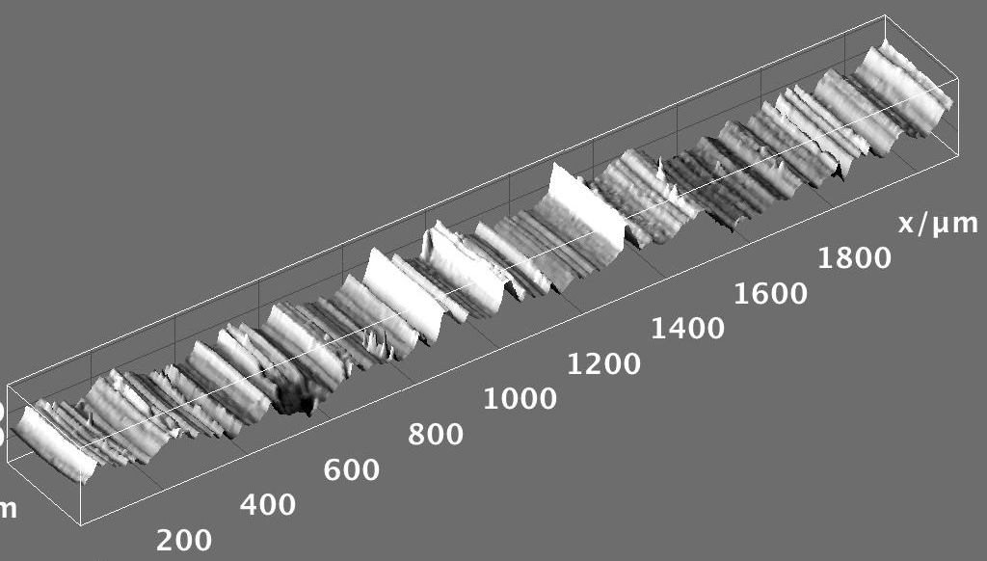


Hands-on Introduction to R

Slide 2
Outline
Mean, median, standard deviation, standard error of the mean
Confidence intervals
Hypothesis testing
Analysis of variance
Linear regression

Slide 3
Measures of Central Tendency
Given a sample from some population:
What is a good “summary” value which well describes the sample and uncertainty?
We will look at:
Average (arithmetic mean)
Median
Mode
Standard deviation
Standard error of the mean
For reference see (available on-line):
“The Dynamic Character of Disguised Behaviour for Text-based, Mixed and Stylized Signatures”
LA Mohammed, B Found, M Caligiuri and D Rogers
J Forensic Sci 56(1),S136-S141 (2011)

Slide 4
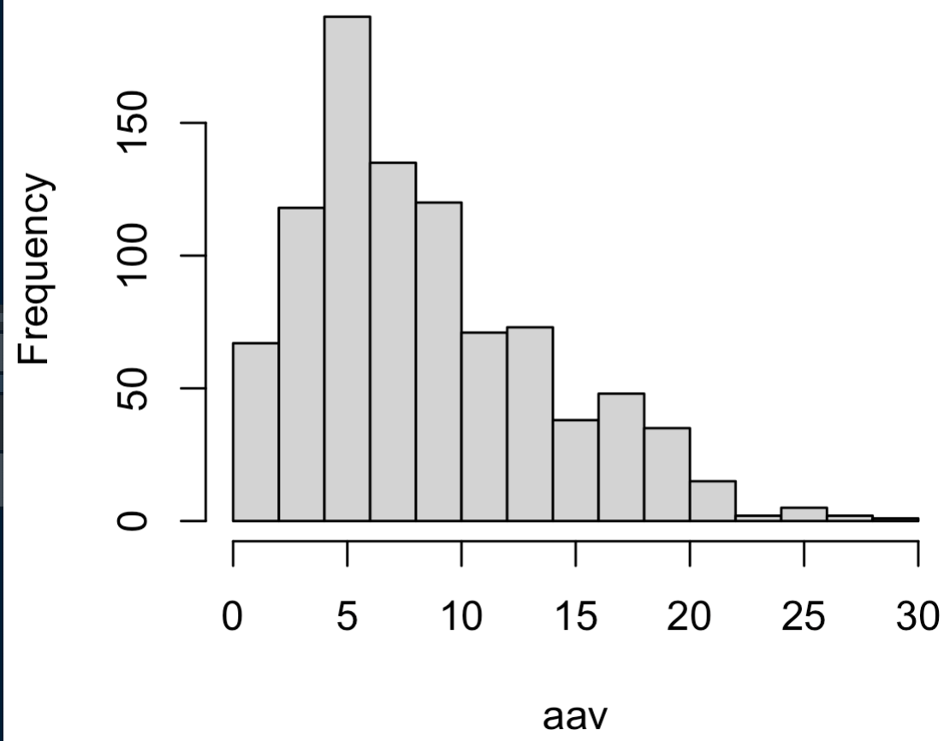
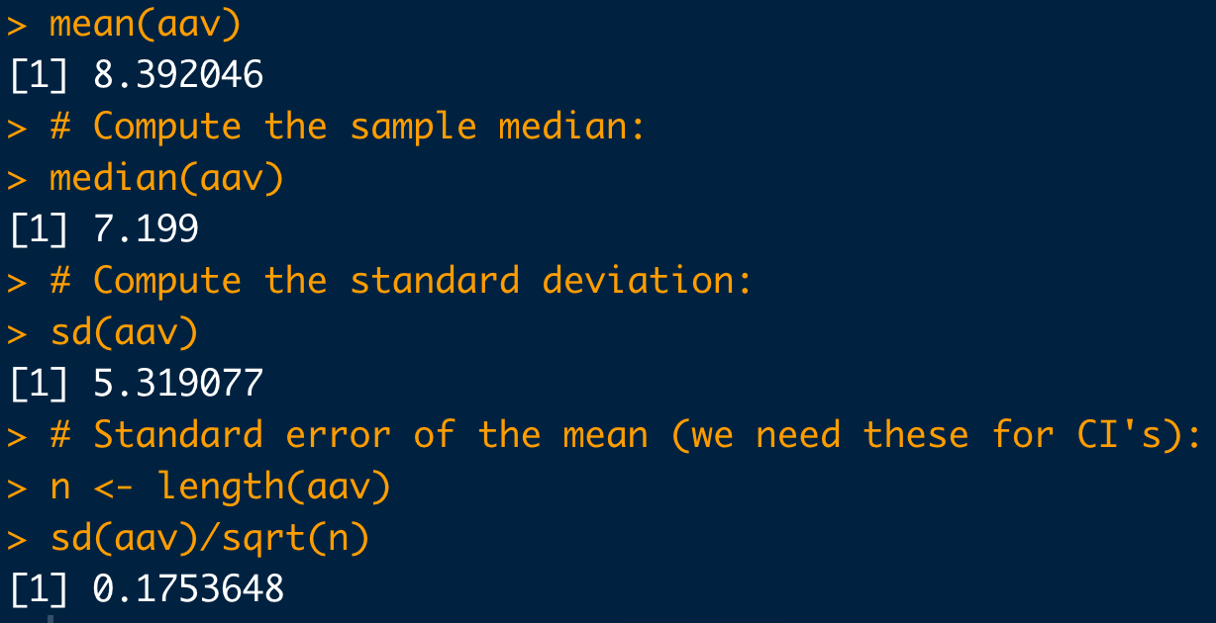
Basic Statistical Commands:
# Load data:
dat <- read.csv("https://raw.githubusercontent.com/npetraco/workshop21/master/data/lamwrite.csv", header=T)
head(dat)
dim(dat)
# Dump column 2 to a variable:
aav <- dat[,2]
# Look at the data:
hist(aav)
# Compute the sample mean:
mean(aav)
# Compute the sample median:
median(aav)
# Compute the standard deviation:
sd(aav)
# Standard error of the mean (we need these for CI's):
n <- length(aav)
sd(aav)/sqrt(n)

Slide 5
Confidence Intervals
A confidence interval (CI) gives a range in which a true population parameter may be found.
Specifically, (1- α)×100% CIs for a parameter, constructed from a random sample (of a given sample size), will contain the true value of the parameter approximately (1- α)×100% of the time.

Slide 6
Confidence Intervals
Construction of a CI for a mean depends on:
Sample size n
Standard error for means
Level of confidence 1-α
α is significance level
Use α to compute t_{c}-value, the critical t-statistic
(1-α)×100% two-sided CI for population mean using a sample average and standard error is:

Slide 7
Confidence Intervals
Compute the 95% confidence interval for the mean average absolute velocity in the LAM data
# Load data:
dat <- read.csv("https://raw.githubusercontent.com/npetraco/workshop21/master/data/lamwrite.csv", header=T)
# Average absolute velocity data:
aav <- dat[,2]
n <- length(aav) # sample size
xbar <- mean(aav) # sample mean
se <- sd(aav)/sqrt(n) # standard error of the sample mean
conf <- 0.95 # level of confidence
alpha <- 1 - conf # level of significance
tc <- qt(1 -alpha/2, df = n-1) # tc for a two-sided CI
xbar.lo <- xbar - tc*se
xbar.hi <- xbar + tc*se
c(xbar.lo, xbar.hi) # Condifence interval for the mean

