Slide 1


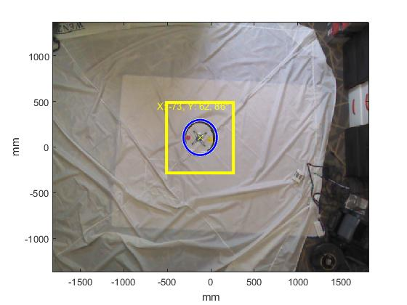
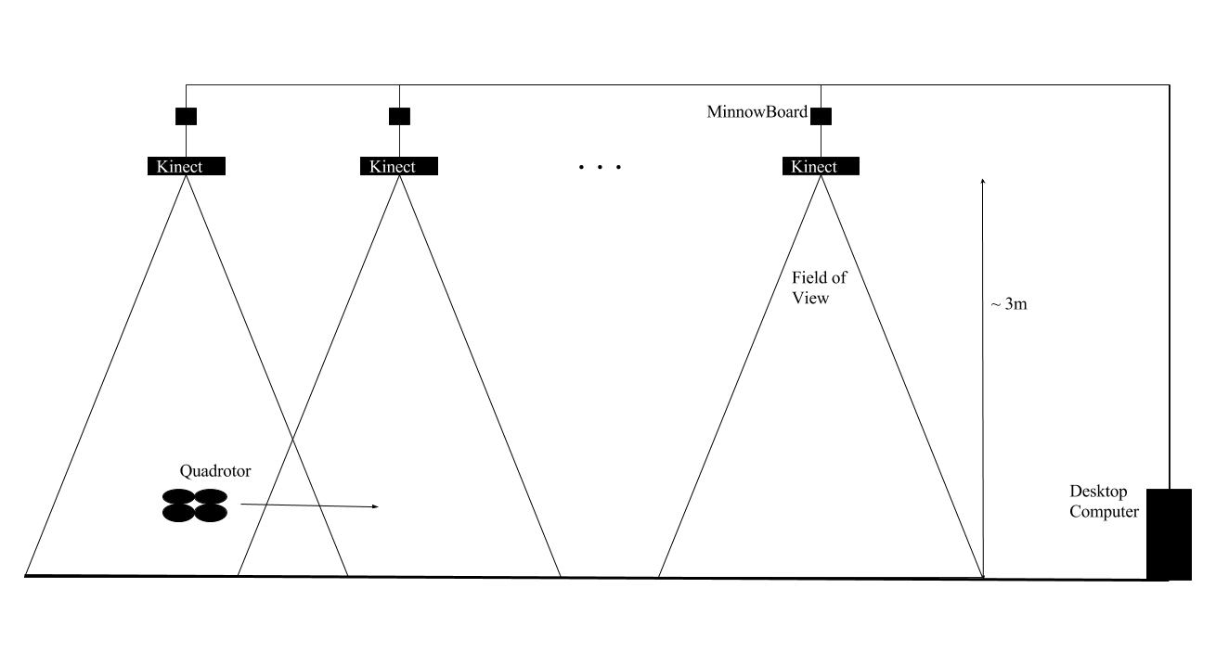
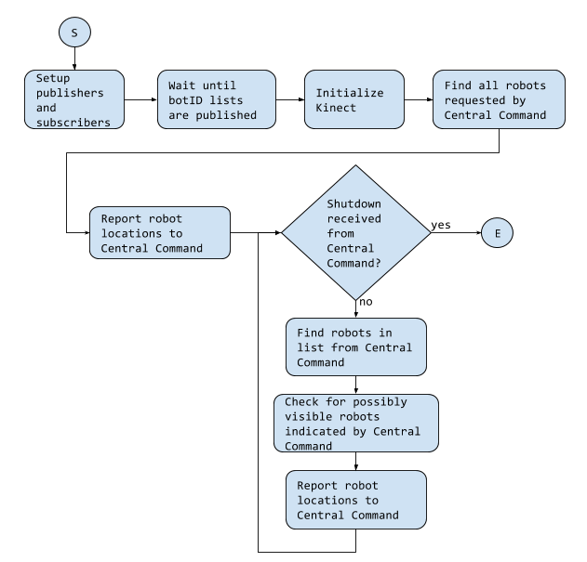
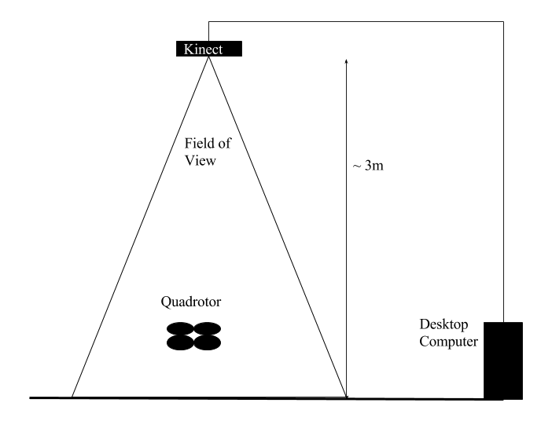
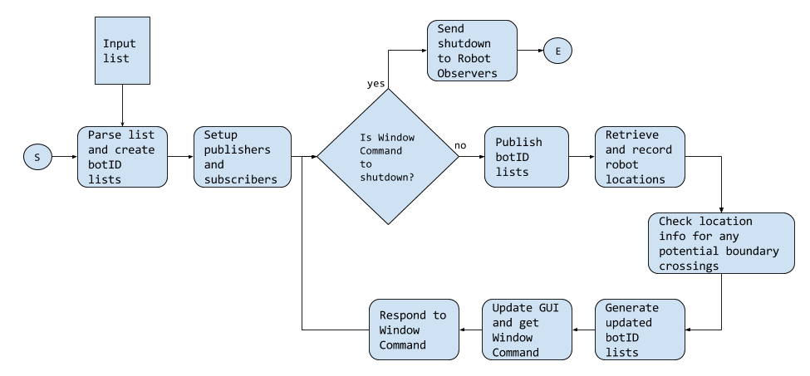
Architecture for An Indoor Distributed Cyber-Physical System Composed of Mobile Robots and Fog Computing Nodes
Nathaniel Paul Hamilton ● PhD Student at Vanderbilt University, Electrical Engineering ● nathaniel.p.hamilton@vanderbilt.edu ● Advisor: Dr. Taylor Johnson
Objective
Develop an architecture for providing localization information to robots using StarL across the view of multiple Kinect cameras connected to x86 MinnowBoards in a Fog Computing fashion
Localization Example
Robot Observer Subscription List
/botID_list
Full list of robot names, types, and colors
/shutdown
/kinect#/bot_list
A list of robots to track
/kinect#/incoming
A list of robots to watch the boundaries for
Desired Setup
Approach
StarL and examples are available at: https://github.com/verivital/starl
2 types of ROS nodes: Central Command, and Robot Observer
Central Command records position information and informs each Robot Observer node which drones to look for
Robot Observer nodes process the Kinect image and report location information to the Central Command node
Robot Observer Code Schematic
Motivation
The current system uses a single Kinect camera which limits the total field of view. By adding more Kinect cameras, the area covered by the localization method is expanded so tests can be run across a larger area. Additionally, the architecture could be used for other, similar distributed systems
Central Command Subscription List
/kinect#/locations
List of robot names and location information
/kinect#/response
Report from indicating whether or not a robot was found crossing its boundaries
Remaining and Future Work
Finish writing code
Fix issues between Kinect and MinnowBoard
Validate system design
Add more drone types to the system
Current Setup [1]
Central Command Code Schematic
References
[1] N. Hervey, “Localization and Control of Distributed Mobile Robots with the Microsoft Kinect and StarL”, April 2016
[2] J. M. O’Kane, A Gentle Introduction to ROS. Independently published, Oct. 2013, available at http://www.cse.sc.edu/∼jokane/agitr/.
Acknowledgments
The material presented in this poster is based upon work supported by the National Science Foundation (NSF) under grant numbers CNS 1464311, EPCN 1509804, and SHF 1527398, the Air Force Research Laboratory (AFRL) through contract numbers FA8750-15-1-0105, and FA8650-12-3-7255 via subcontract number WBSC 7255 SOI VU 0001, the Air Force Office of Scientific Research (AFOSR) under contract numbers FA9550-15-1-0258 and FA9550-16-1-0246, and the Vanderbilt Institute for Digital Learning (VIDL) MacroGrant program. The U.S. government is authorized to reproduce and distribute reprints for Governmental purposes notwithstanding any copyright notation thereon. Any opinions, findings, and conclusions or recommendations expressed in this publication are those of the authors and do not necessarily reflect the views of AFRL, AFOSR, or NSF.

