Slide 1


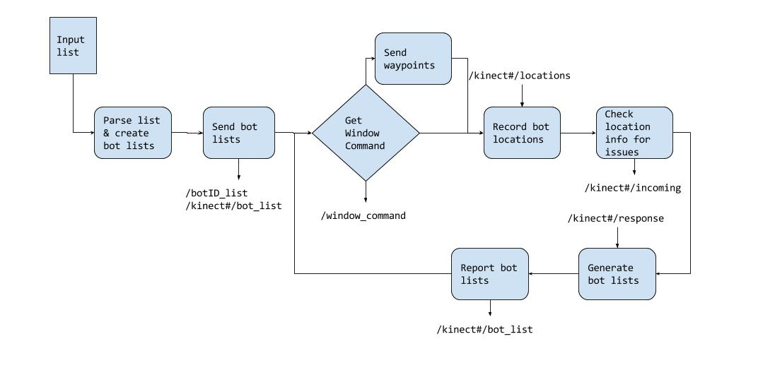
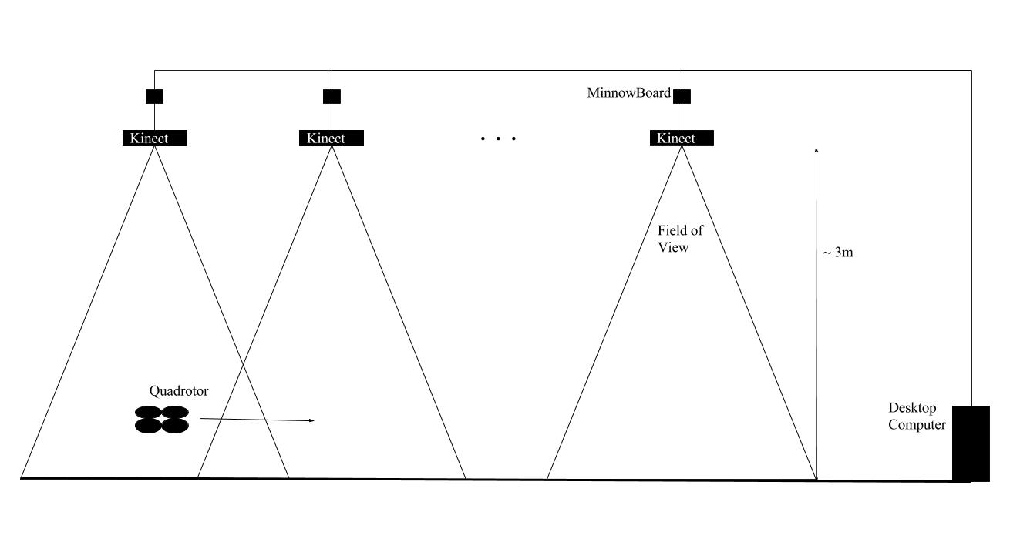
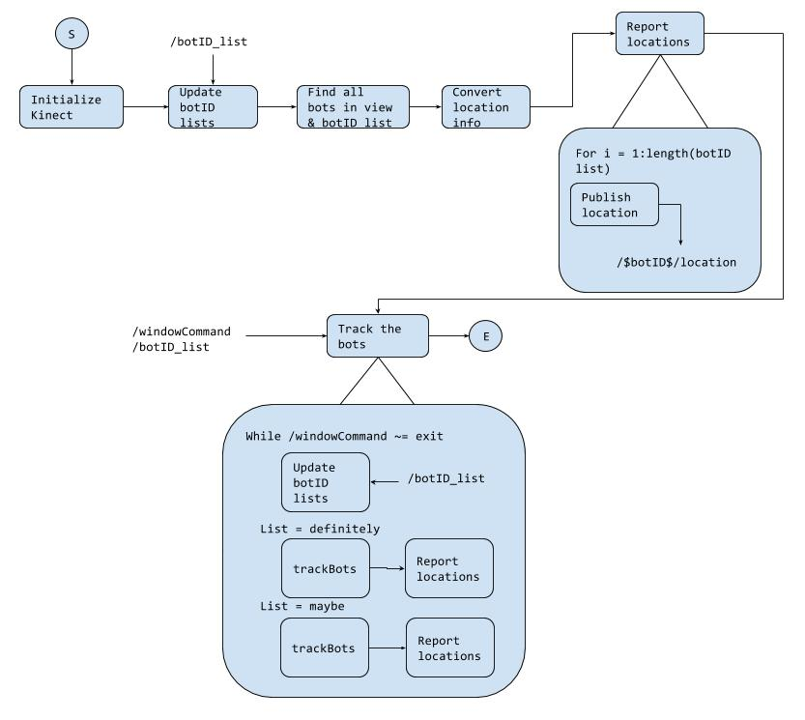
Architecture for An Indoor Distributed Cyber-Physical System Composed of Mobile Robots and Fog Computing Nodes
Nathaniel Paul Hamilton ● PhD Student at Vanderbilt University, Electrical Engineering ● nathaniel.p.hamilton@Vanderbilt.edu ● Advisor: Dr. Taylor Johnson
Objective
To develop an architecture for providing localization information to robots using StarL across the view of multiple Kinect cameras connected to x86 MinnowBoards in a Fog Computing fashion.
Future Work
STUFFFFFFFFFFFFFFFFFFFFFFFFFFFFFFF
Motivation
The current system uses a single Kinect camera which limits the total field of view. By adding more Kinect cameras, the area covered by the localization method is expanded so more tests can be run across a larger area. Additionally, the architecture could be used for other, similar distributed systems.
References
STUFFFFFFFF
Approach
The system was designed to run on ROS as two types of nodes. One node to act as a “Central Command” and the other to compute the localization information at each Kinect. The “Central Command” records position information and informs each Kinect node which drones it should be seeing.

