Slide 1


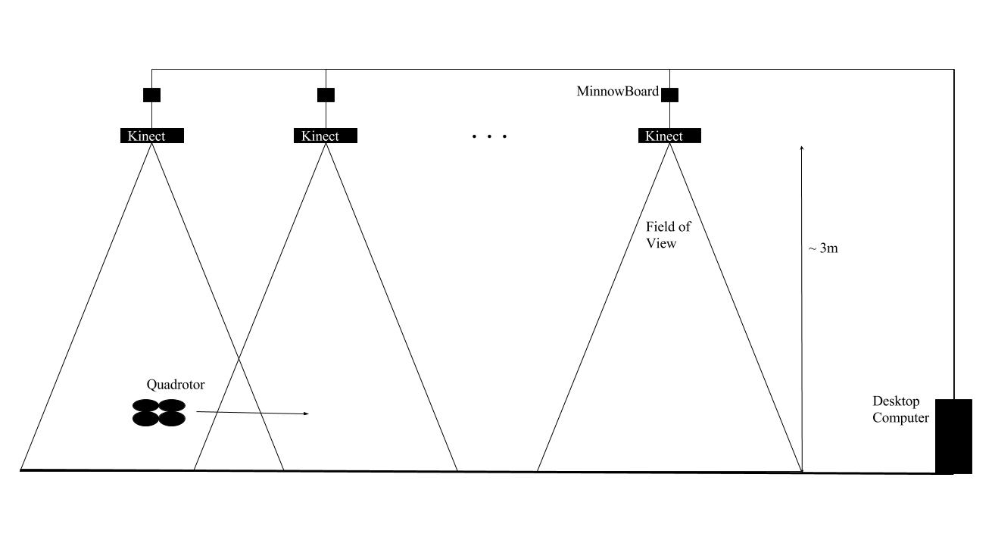
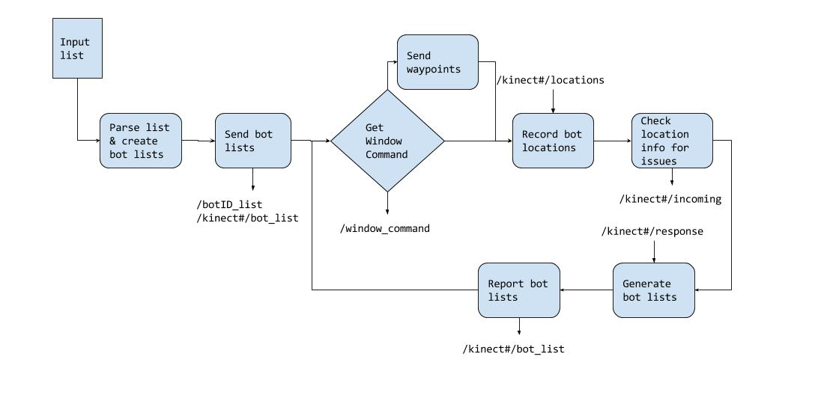
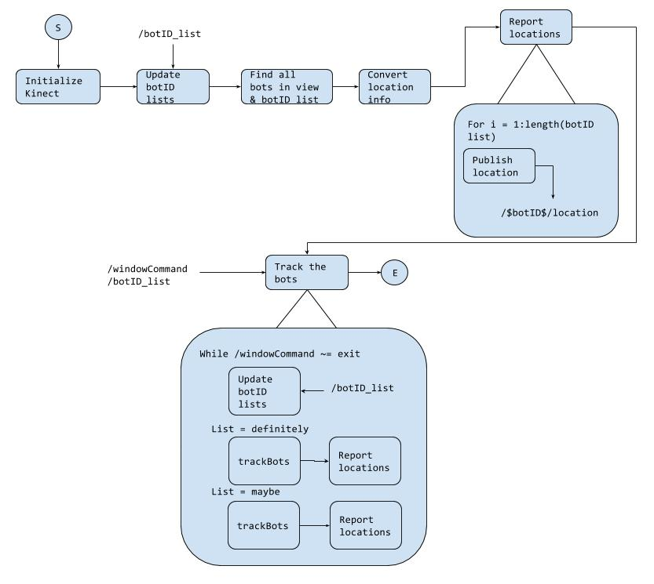
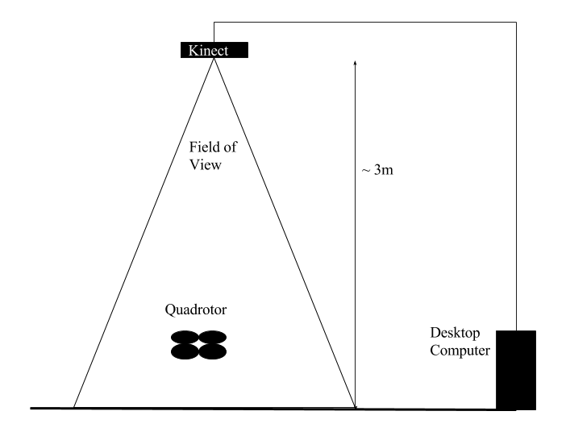
Architecture for An Indoor Distributed Cyber-Physical System Composed of Mobile Robots and Fog Computing Nodes
Nathaniel Paul Hamilton ● PhD Student at Vanderbilt University, Electrical Engineering ● nathaniel.p.hamilton@vanderbilt.edu ● Advisor: Dr. Taylor Johnson
Objective
Develop an architecture for providing localization information to robots using StarL across the view of multiple Kinect cameras connected to x86 MinnowBoards in a Fog Computing fashion
Approach
2 types of ROS nodes: Central Command, and Robot Observer
Central Command records position information and informs each Robot Observer node which drones to look for
Robot Observer nodes process the Kinect image and report location information to the Central Command node
Remaining and Future Work
Finish writing code
Fix issues between Kinect and MinnowBoard
Validate system design
Add more drone types to the system
Desired Setup
Central Command Code Schematic
Motivation
The current system uses a single Kinect camera which limits the total field of view. By adding more Kinect cameras, the area covered by the localization method is expanded so tests can be run across a larger area. Additionally, the architecture could be used for other, similar distributed systems
Robot Observer Code Schematic
Acknowledgments
I am not sure what to put here
Current Setup [1]
References
Nathan’s Thesis

