Slide 1
Topic Modeling & Document Ranking
Ngoc Phan
M.S. Business Analytics
nphan20181@gmail.com
Python Source Code on Github
https://github.com/nphan20181/Topic_Modeling_n_Document_Ranking

Slide 2
Dataset
PubMed
Text Retrieval Conference (TREC)

Slide 3
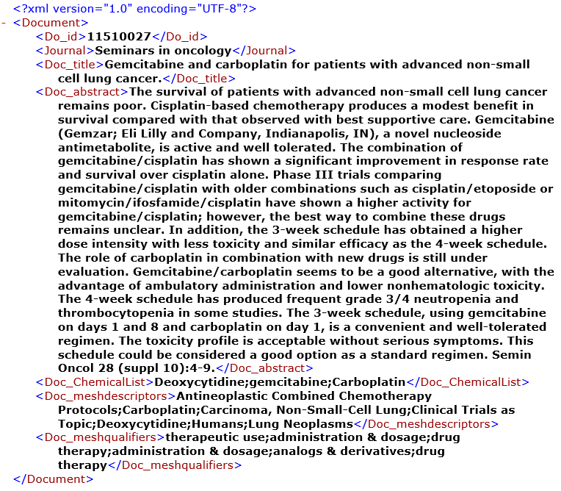
Abstracts of Scientific Articles
333 xml documents
Information about a particular type of cancer

Slide 4
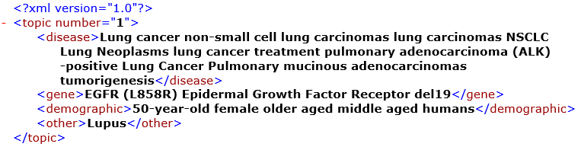
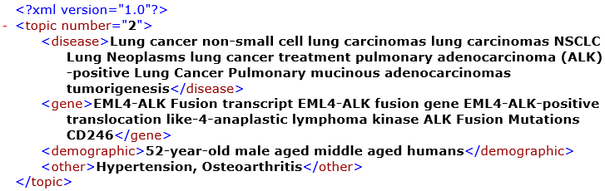
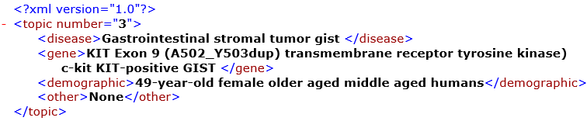
Query Topics
Information about a single patient suffering from a disease
Topic 1
lung cancer, egfr, aged female
Topic 2
lung cancer, eml4-alk, aged male
Topic 3
gist, kit exon, aged female

Slide 5
Data Analysis
Word Cloud

Slide 6
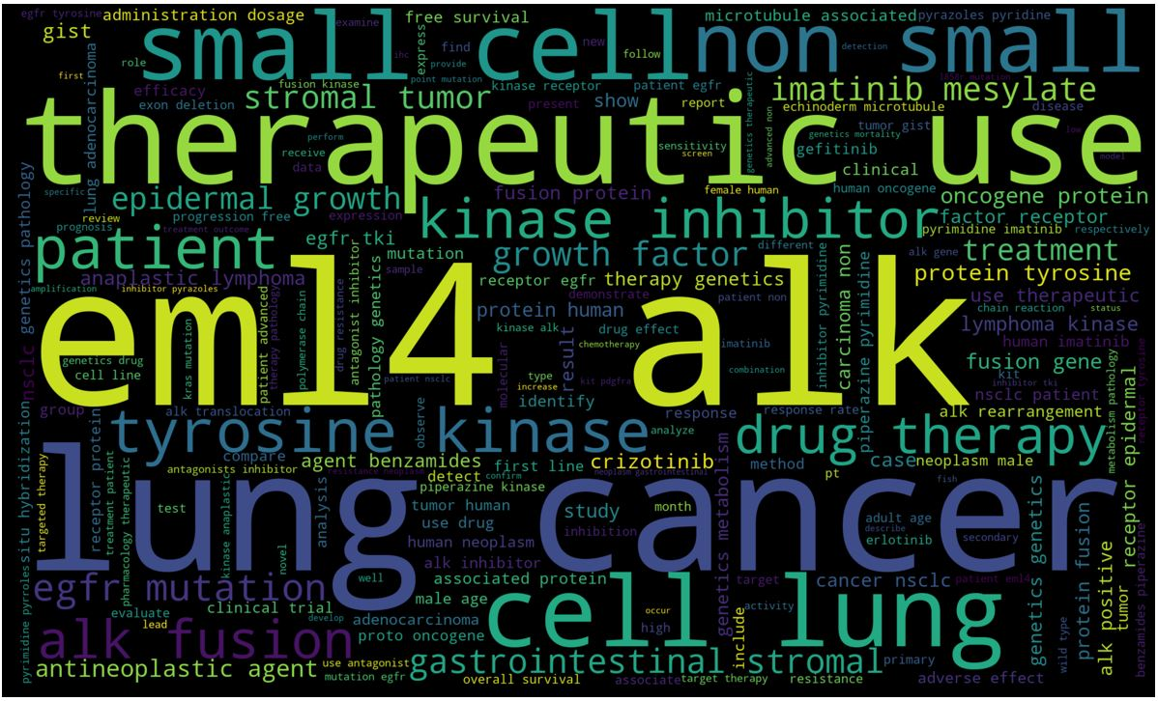
Word Cloud
Words found in the documents.
The size of each word indicates its frequency or importance.

Slide 7
Latent Dirichlet Allocation (LDA)
Topic Modeling

Slide 8
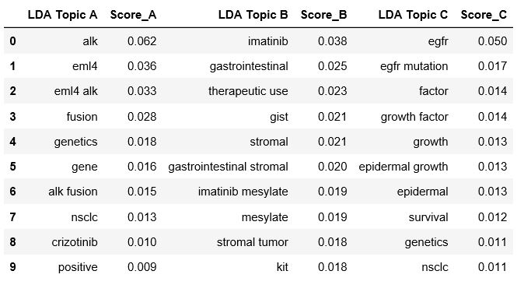
LDA Topics
Topic A (eml4, alk, positive)
Topic B (gist, kit, therapeutic use)
Topic C (egfr, epidermal, growth factor)

Slide 9
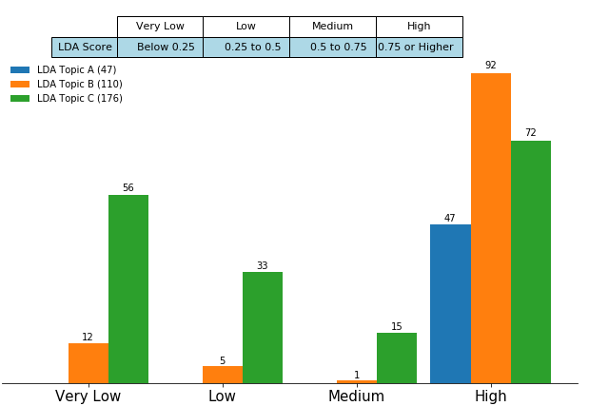
Documents Distribution per LDA Score
LDA Topics
Topic A (eml4, alk, positive)
Topic B (gist, kit, therapeutic use)
Topic C (egfr, epidermal, growth factor)

Slide 10
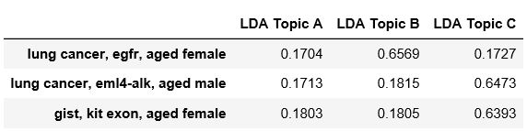
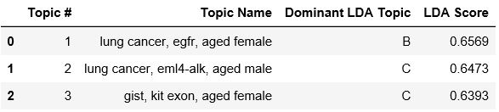
Query Topics Classification
LDA Topics
Topic A (eml4, alk, positive)
Topic B (gist, kit, therapeutic use)
Topic C (egfr, epidermal, growth factor)

Slide 11
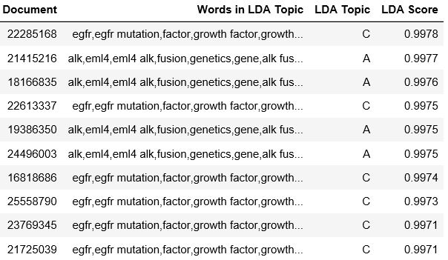
Documents Ranking on LDA Score

Slide 12
Text Clustering
Topic Modeling

Slide 13
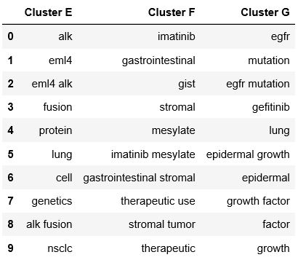
Clusters
Cluster E (eml4, alk, fusion, lung, cell)
Cluster F (gist, therapeutic use)
Cluster G (egfr, mutation, epidermal growth)

Slide 14
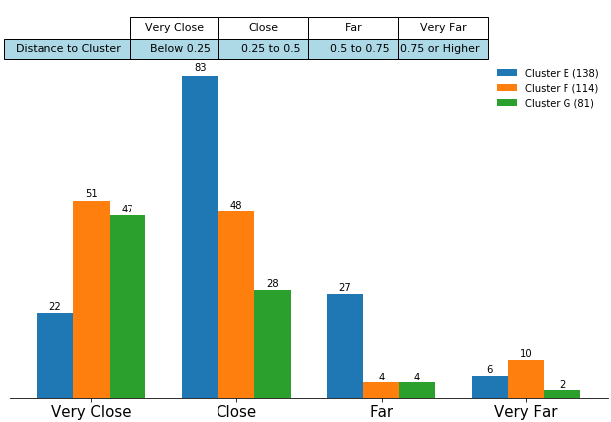
Documents Distribution per Distance to Cluster
Clusters
Cluster E (eml4, alk, fusion, lung, cell)
Cluster F (gist, therapeutic use)
Cluster G (egfr, mutation, epidermal growth)
* Distance to Cluster is the distance between the document and the closest cluster.

Slide 15
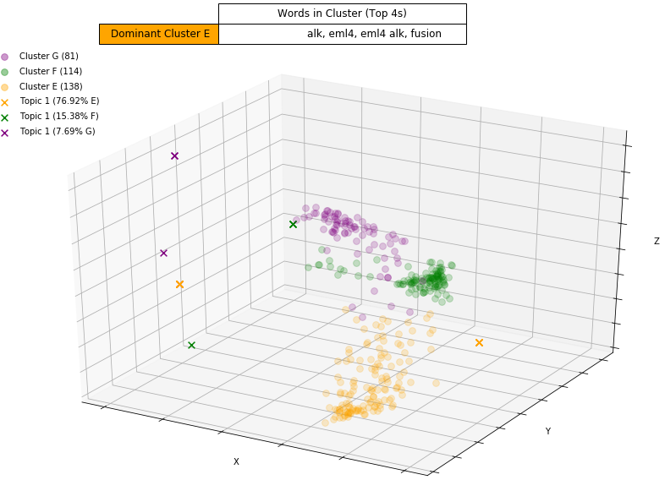
Topic Classification
Topic 1: lung cancer, egfr, aged female

Slide 16
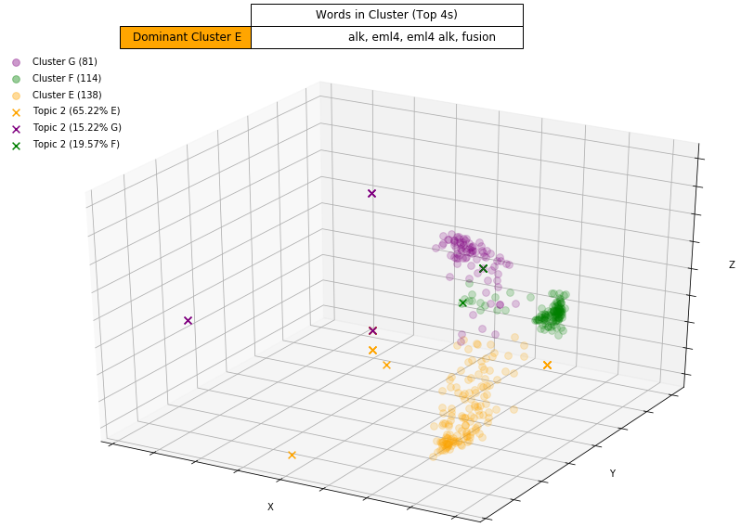
Topic Classification
Topic 2: lung cancer, eml4-alk, aged male

Slide 17
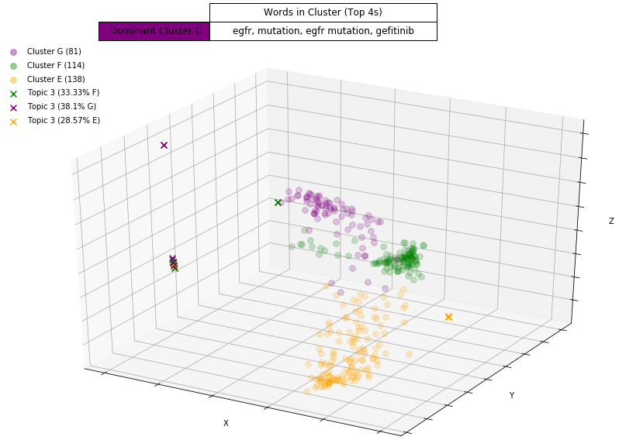
Topic Classification
Topic 3: gist, kit exon, aged female

Slide 18
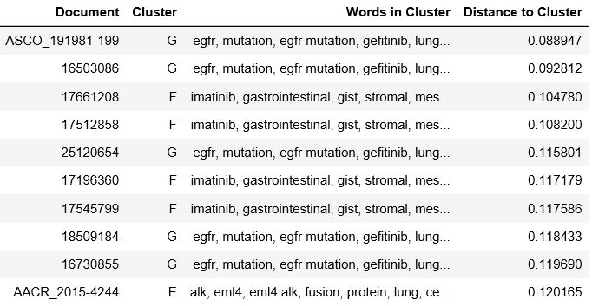
Documents Ranking on Distance to Cluster

Slide 19
Semantic Similarity
Documents Similarity

Slide 20
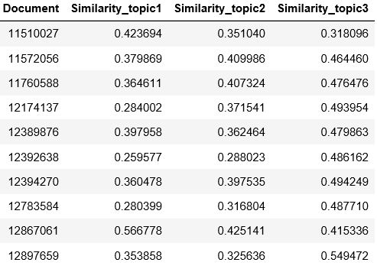
Similarity Score Between a Document and a Query Topic
Topic 1 (lung cancer, egfr, aged female)
Topic 2 (lung cancer, eml4-alk, aged male)
Topic 3 (gist, kit exon, aged female)

Slide 21

Conclusion

Slide 22
Thank You!

