Slide 1

Trend of Huge Rangolis by
Rangvalli Parivar, Thane, Mumbai, Maharashtra, India

Slide 2
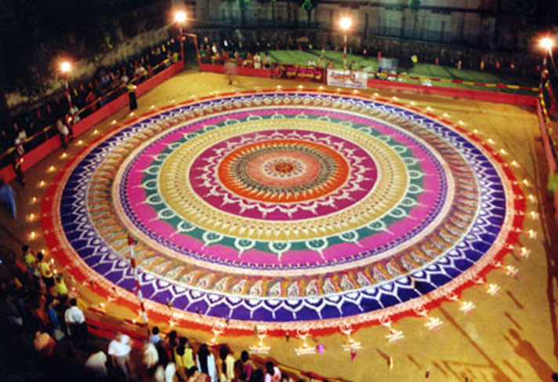
Year : 2002 - 75 ft. daimeter first biggest Rangoli on the occasion of Diwali, at Play Ground, Saraswati Mandir Trust, Thane

Slide 3
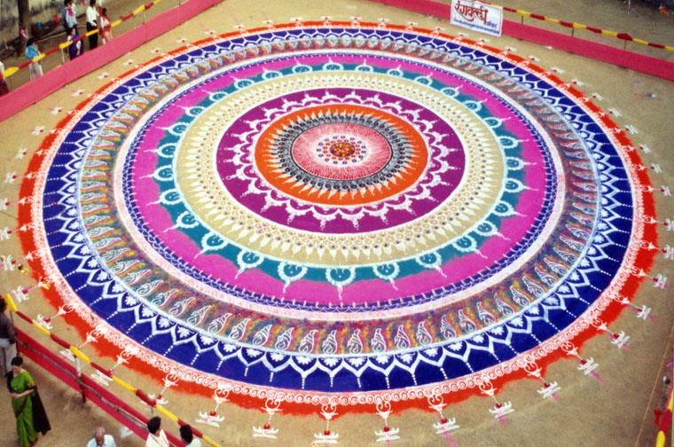
The same Rangoli in Day Light

Slide 4
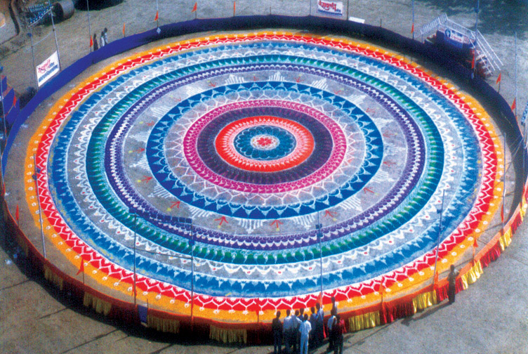
Year : 2003 - 101 ft. daimeter Group Rangoli drawn on the occasion of ‘Gudi Padwa’ at Gavdevi Maidan, Thane.

Slide 5
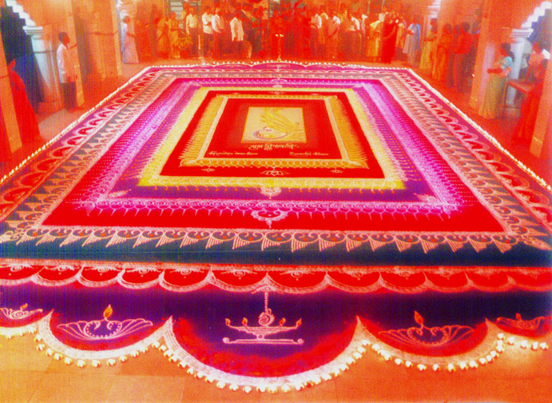
Year : 23rd Oct. 2003 (Diwali) Festival of Lights celebrated in Dnyaneshwar Mandir, Panchpakhadi, Thane. The Carpet Rangoli in size of 25ft.x50ft.

Slide 6
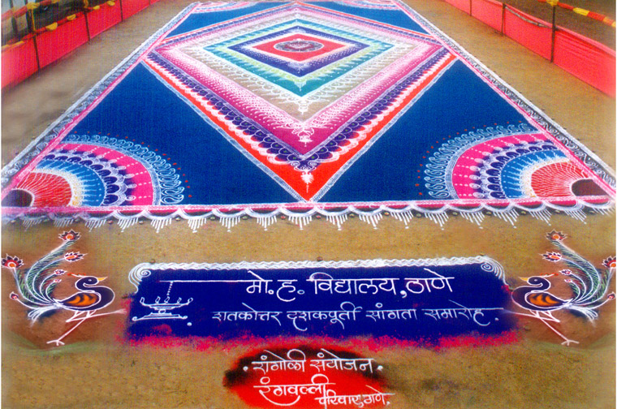
Year : 11th Nov. 2003 - Rangoli as Huge Carpet in 111 sq. mtr. Drawn on the completion of 110 years to educational institute M. H. High School, Thane.

Slide 7
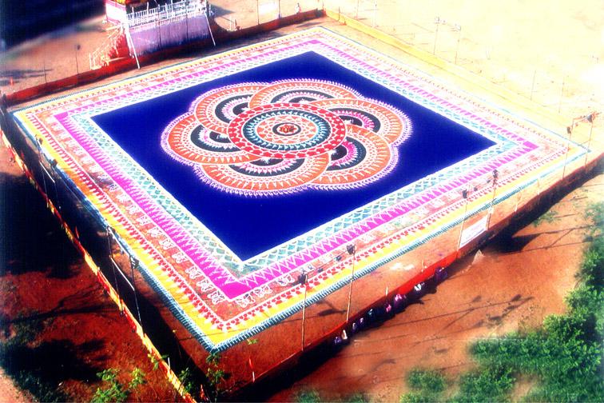
Year : 21st March 2004 - Hindu new year ‘Gudi-Padwa’ celebrated with Huge Rangoli of 15000 sq.ft. in square shape at Gavdevi Maidan, Thane.

Slide 8
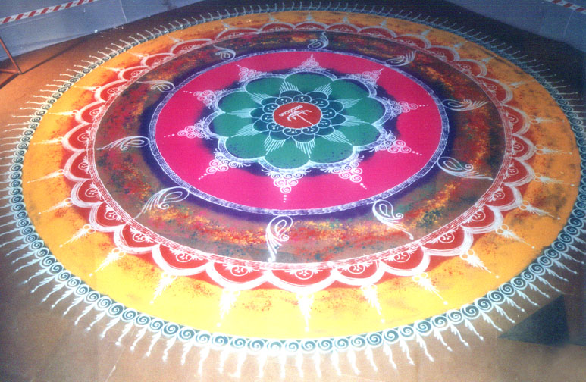
Year : 2004 - Annual Gathering of Jindal Steel Ltd. Bellary, Karnataka plant. Celebrated with huge Rangoli of 25 ft. diameter drawn in front of temple.

Slide 9
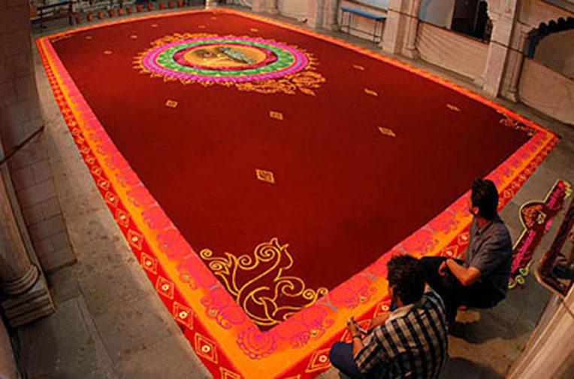
Year : Nov. 2004 - Celebrated festival of Lights with drawing Huge Carpet Style Rangoli of 25’x50’ in size on the eve of Diwali at Dnyaneshwar Temple, Thane,

Slide 10
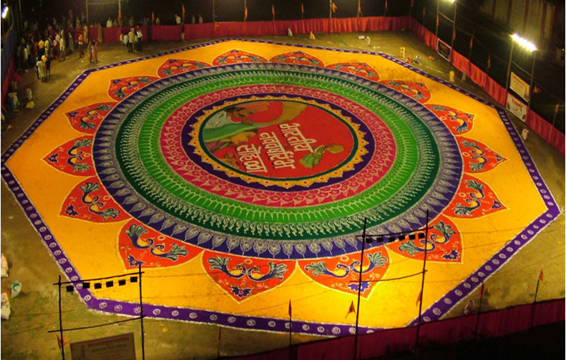
Year : 7th April 2005 -16000 sq.ft. Huge Group Rangoli with Calligraphy, Traditional Signs & Portrait style drawn on the eve of ‘Gudi Padwa’ in Thane

Slide 11
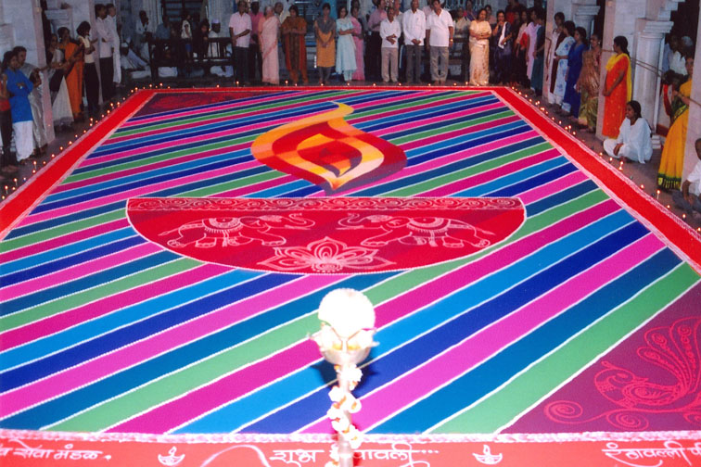
Year : 30th Oct. 2005 – Deepotsav celebrated at Dnyaneshwar Temple, Thane on the eve Diwali with lights, color strips & rangoli dots in 25’x50’ size

Slide 12
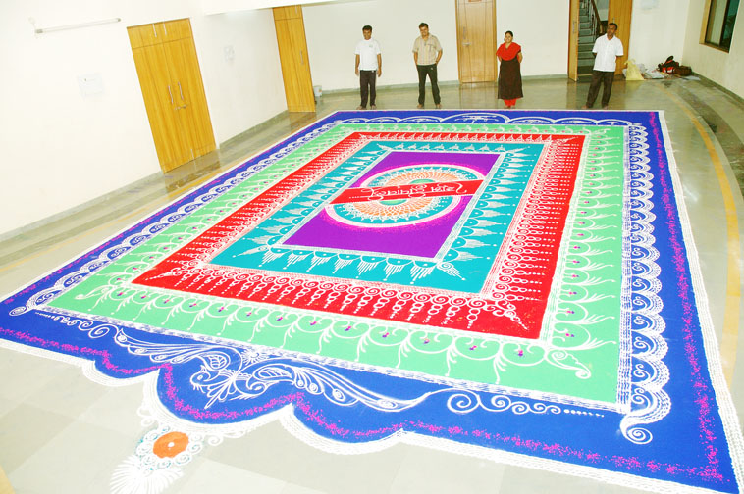
Year : 30th Oct. 2005 – Deepotsav (Festival of Lights) celebrated at Vijay Nagari Annex, Thane on the eve Diwali with Huge Rangoli of 25’x50’

Slide 13
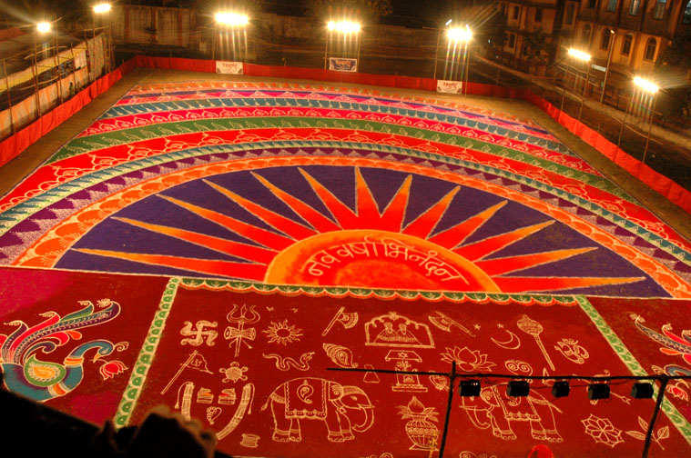
Year : 30th March 2006 – Gudi Padwa (Hindu New Year) celebrated with 17,000 sq.ft. Huge Rangoli of ‘Chaitrangan’ at Gavdevi Maidan, Thane

Slide 14
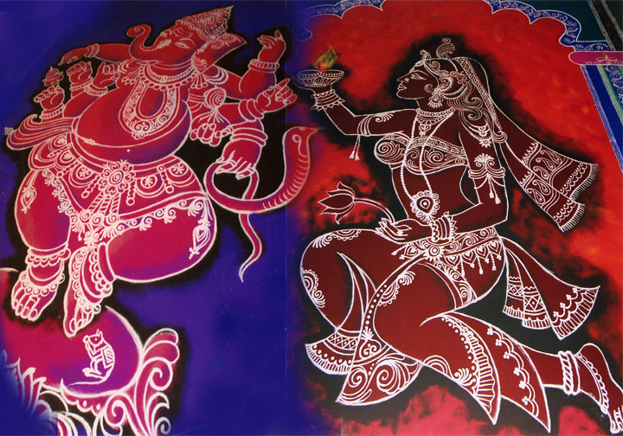
Year : 19th Oct. 2006 – Development in Rangoli, Celebration of Diwali with ‘Freehand Rangoli’ at Dnyaneshwar Temple, Panchpakhadi, Thane

Slide 15
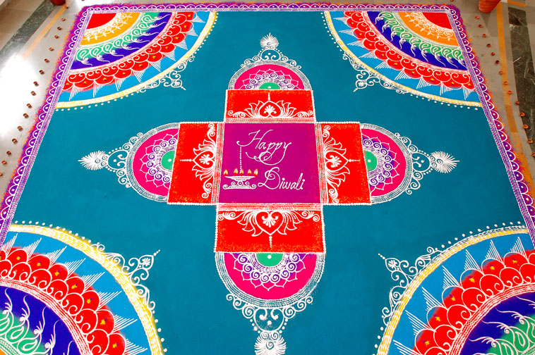
Year : 19th Oct. 2006 - Celebration of Diwali with ‘Huge Carpet Rangoli’ with freehand style at Vijay Nagari Annex, Thane

Slide 16
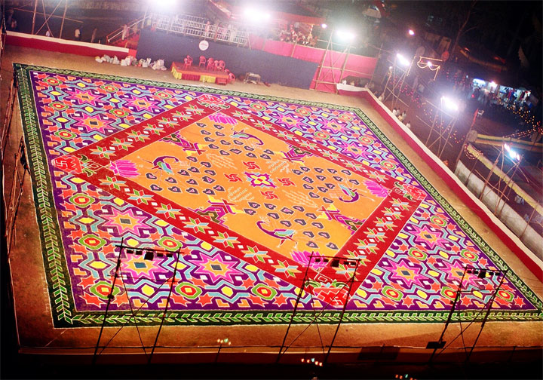
Year : 19th March 2007 - Gudi Padwa (Hindu New Year) celebrated with 18,000 sq.ft. Huge Traditional Dotted Rangoli with ‘2,50,000 dots’ at Thane

Slide 17
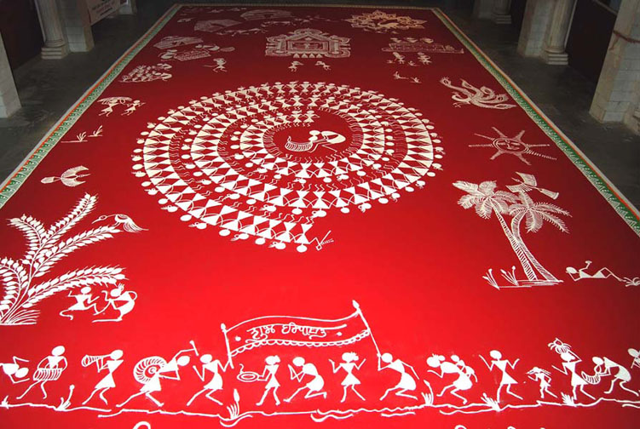
Year : 7th Nov. 2007 – ‘Warli in Rangoli’, Celebration of Diwali with the theme of Tribal Art form of Painting in Rangoli at Dnyaneshwar Temple,Thane

Slide 18
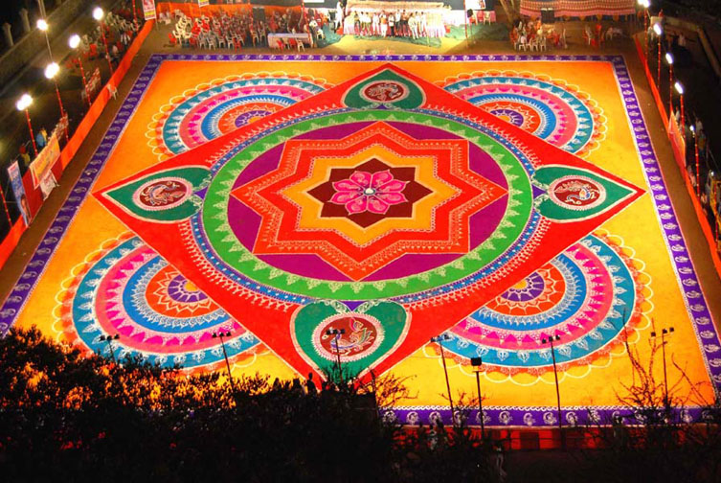
Year : 3rd April 2008 - Gudi Padwa celebrated with 20,000 sq.ft. Huge Rangoli with Traditional Motifs & ‘Shri Yantra’ (Goddess Laxmi’s seat) at Kalyan.

Slide 19
An Institute dedicated to the development and publicity of Rangoli as an Art form
Rangvalli Parivar, Thane
9, Anil, Gavand Path, Gokhale Rd, Naupada, Thane - 400602, Mumbai, Maharashtra, India.
Tel : 91-22-25415545,
E-mail : ved@rangvalli.com, ved.katti@gmail.com
Site : www.rangvalli.com
A presentation by Ved Katti

