Slide 1
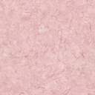
Play with your Food
“Don’t play with your food” is an admonishment
we have heard for many generations. But food-
especially fruits and vegetables - is often playful
in its own right.
Amit Akre presents images suggested by fruits and
vegetables themselves with absolute minimum of
alteration.

Slide 2
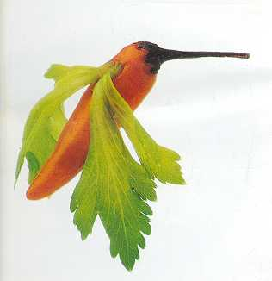
Humming Bird - made of chilly and celery leaf

Slide 3
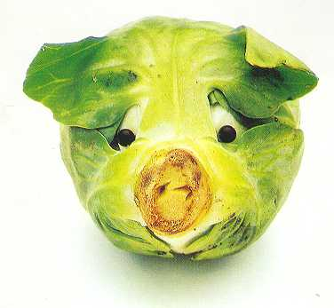
Dog - made of cabbage and beans

Slide 4
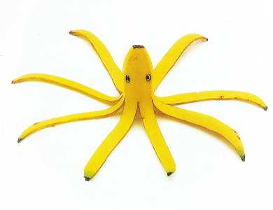
Octopus - made of banana and -eyed beans

Slide 5
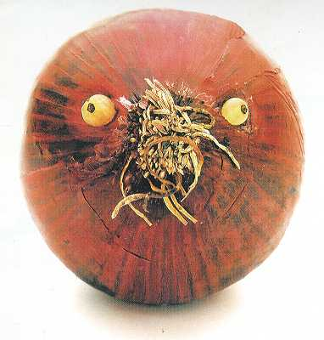
Walrus - made of onion and champagne grapes

Slide 6
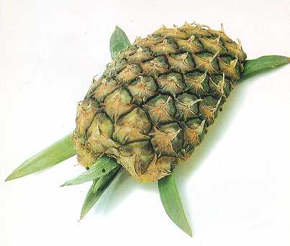
Turtle - made of pineapple,pineapple leaves and black paper com

Slide 7
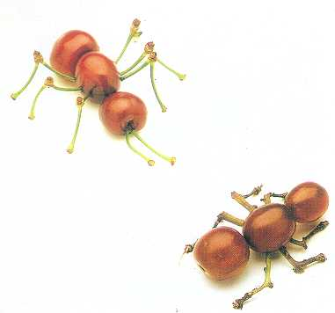
Red ants - made of cherries and joined cherry stem

Slide 8
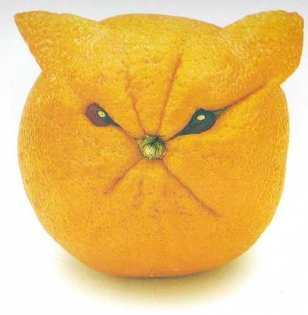
Cat - made of orange and beans

Slide 9
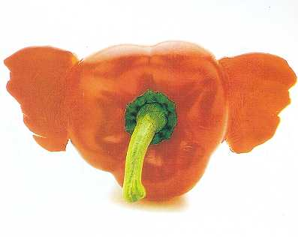
Elephant Head - made of red capsicum and
natural stem

Slide 10
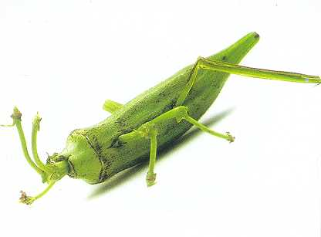
Grasshopper - made of lady’s finger and joined string-bean stem

Slide 11
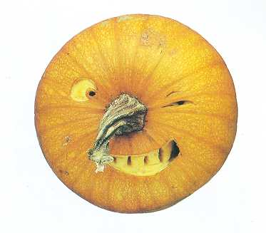
Face - made of pumpkin

Slide 12
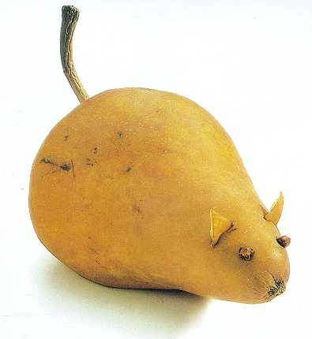
Mouse - made of pear and cloves,stem removed and repositioned as tail

Slide 13
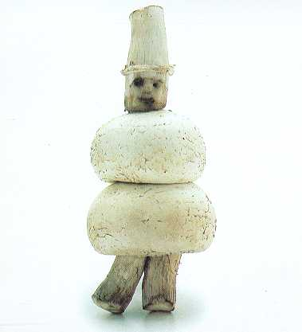
Man - made of mushrooms

