Slide 1

SHREE GANESH VANDANA Mantra

Slide 2
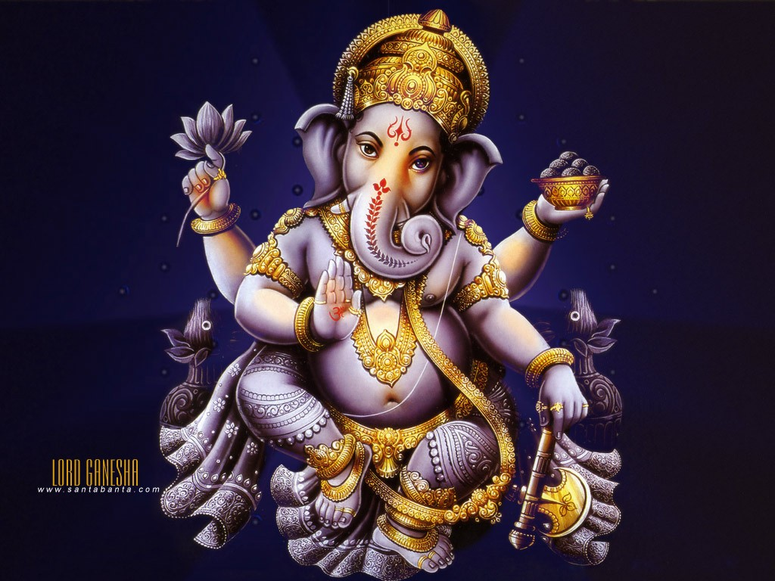
CHUKLAM BARATHARAM VISHNUM

Slide 3

SHASHI VARNAM CHATURBHUJAM

Slide 4

PRASANNA VADANAM DHYAYET

Slide 5

SARVA VIGHNOPA SHANTAYE

Slide 6

AGAJANANA PADMARGAM GAJANANA

Slide 7
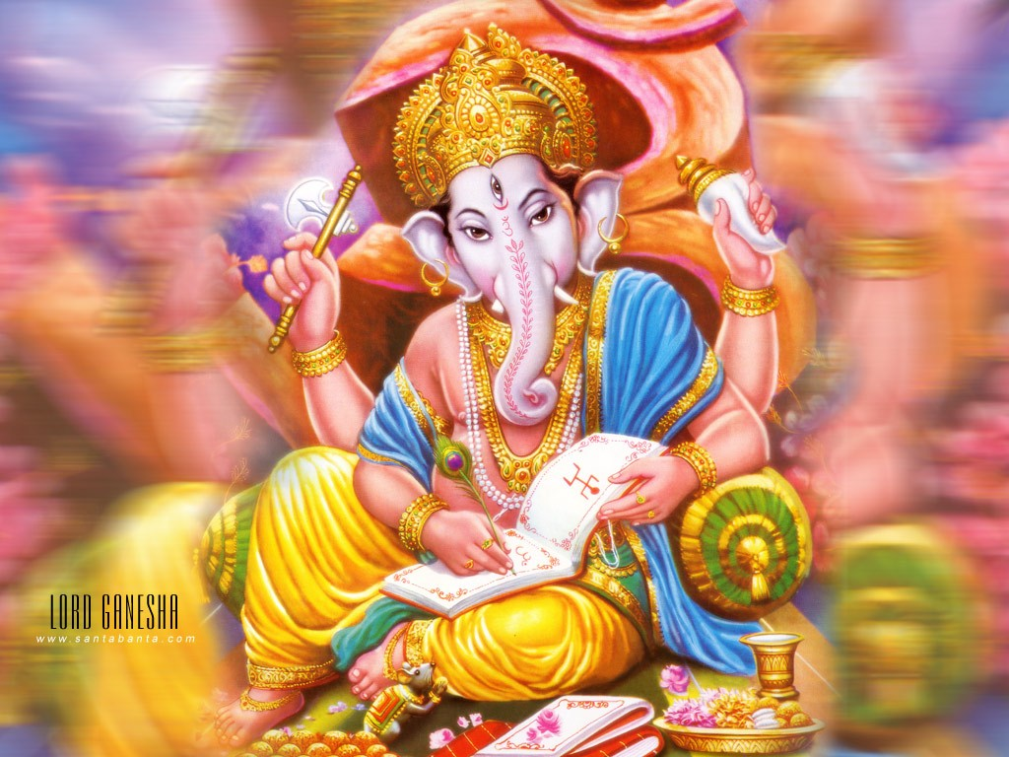
MAHIRSHAM ANEKA DANTAM BHAKTANAM

Slide 8
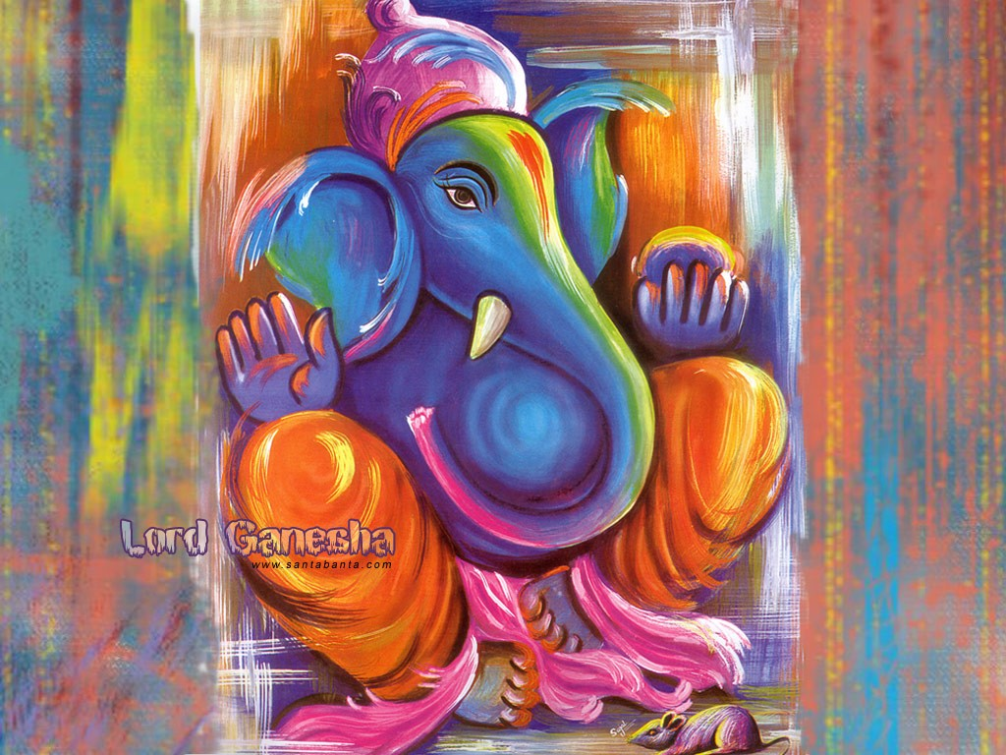
EKA DANTAM UPASMAHE

Slide 9

This is a powerful prayer of Ganesh
Send This to 7 People within the next 5 minutes and your wish will come true Somewhere, somehow. Do not keep this message. The mantra must leave your hands within 96 hours. You will get very pleasant surprise.

Slide 10
This is true, even if you are not superstitious. FORWARD THIS MANTRA E-MAIL TO AT LEAST 5 PEOPLE AND YOUR LIFE Will IMPROVE.
0-4 people: Your life will improve slightly.
5-9 people: Your life will improve to your liking.
9-14 people: You will have at least 5 surprises in the next 3 weeks.
15 people and above: Your life will improve drastically and everything you ever dreamed of will begin to take shape.

