Slide 1

TO BE A FRIEND MEANS...

Slide 2

NOT TO BE ASHAMED OF CRYING ...

Slide 3

TO NOT BE AFRAID OF APPEARING FUNNY ...

Slide 4
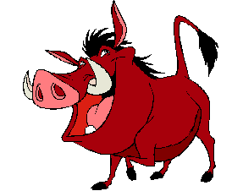
TO LAUGH AND BE LAUGHED AT …

Slide 5

TO PLAY THE FOOL AT TIMES ...

Slide 6

TO BE CHILD-LIKE …

Slide 7

… AND LIKE A PARENT TOO

Slide 8
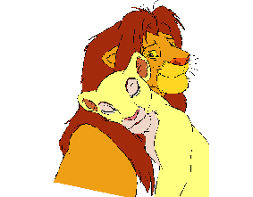
TO LISTEN …

Slide 9

TO FEEL HIS/HER PAIN …

Slide 10
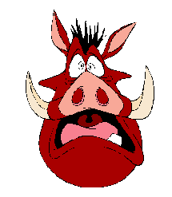
TO SHOW YOUR FEARS …

Slide 11
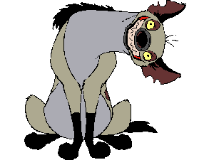
TO OFFER A SMILE, WHEN YOU DO NOT HAVE ONE IN YOU …

Slide 12

TO REMEMBER THE GOOD AND THE BAD TIMES…

Slide 13

TO EXCHANGE SECRETS …

Slide 14
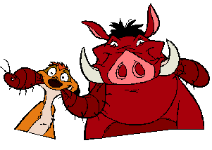
… AND KEEP THEM SECRET

Slide 15
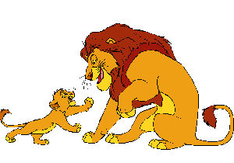
TO PAY ATTENTION …

Slide 16
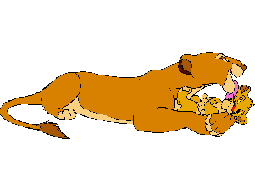
TO LAVISH AFFECTION …

Slide 17

TO CHEER HIM/HER UP …

Slide 18
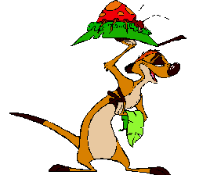
… WITH A FEW SURPRISES

Slide 19

TO SAY SORRY AND MEAN IT …

Slide 20
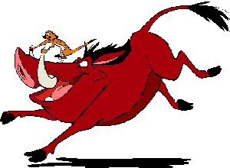
TO PLAY AND FORGET ALL YOUR WORRIES …

Slide 21

TO REVERT TO CHILDHOOD AT TIMES …

Slide 22
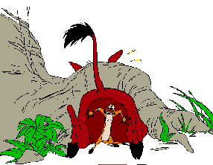
TO GIVE A LITTLE PUSH WHEN THE GOING GETS TOUGH …

Slide 23
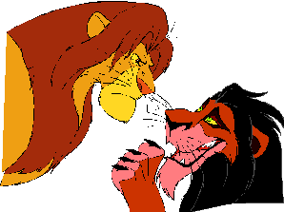
TO KNOW WHO IS A FRIEND AND WHO IS NOT …

Slide 24
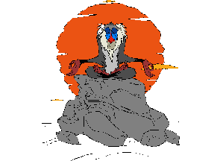
AND MOST IMPORTANTLY, TO KNOW WHEN TO BE ALONE.

Slide 25
Show your friends how much you care about them. Send this message to everyone you consider a FRIEND, even if this means to send it back to the same person who sent it to you. If this message comes back to you, you can prove for certain that your circle of friends is composed of true friends.

