Slide 1

Don't love someone because of who they are, but because of who they are when they are with u

Slide 2

No man is worth your tears, and the one who is WONT make you cry

Slide 3

Just because someone doesn't love you the way you want them to, doesn't mean they don't love you with all they have

Slide 4

They say love hides behind every corner , then I must be walking in circles

Slide 5

A true friend is someone who reaches for your hand and touches your heart.

Slide 6

The worst way to miss someone is to be sitting right beside them knowing you can't have them

Slide 7

To the world you may be one person, but to one person you may be the world

Slide 8

Don't waste your time on a guy/girl, who isn't willing to waste their time on you

Slide 9
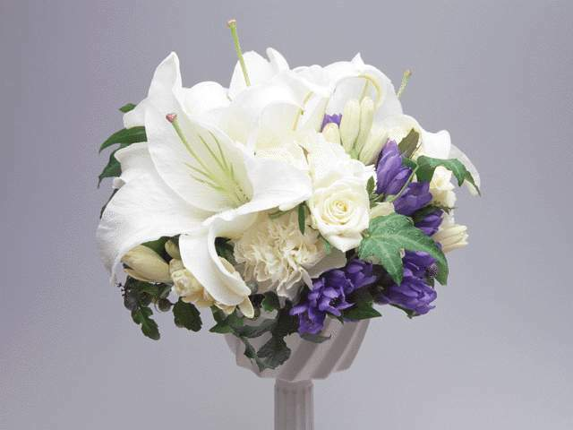
Maybe God wants us to meet a few wrong people before meeting the right one, so that when we finally meet the person, we will know how to be grateful

Slide 10

Don't cry because it is over,
SMILE:) because it happened

Slide 11

There's always going to be people that hurt you so what you have to do is keep on trusting and just be more careful about who you trust next time around

Slide 12

MAKE yourself a better person and know who you are before you try and know someone else and expect them to know you

Slide 13

DONT TRY SO HARD...THE BEST THINGS HAPPEN WHEN U LEAST EXPECT THEM TOO... Smile , It increases your face Value :-)

Slide 14

Never ruin an apology with an excuse

Slide 15

Sometimes facing opportunity is like staring at the knees of a giraffe

Slide 16

In the dictionary SUCCESS comes before WORK, in real life it does'nt

Slide 17

We would not need to change people, only if we knew people change. It takes 20 years to build a reputation and a minute to destroy it

Slide 18

Temper is what gets most of us into trouble. Pride is what keeps us there

Slide 19

True power is knowing that u can, but u don't

