Slide 1

SHREE GANESH VANDANA Mantra

Slide 2
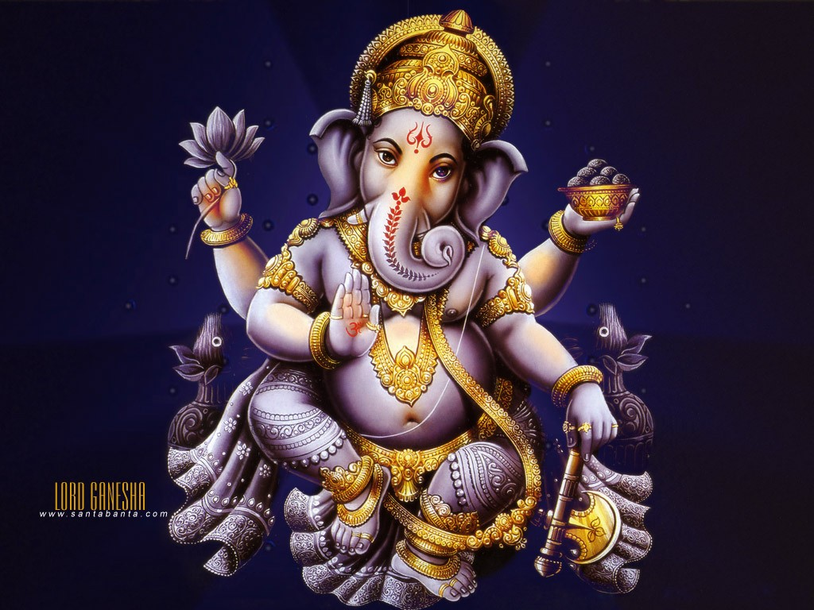
CHUKLAM BARATHARAM VISHNUM

Slide 3
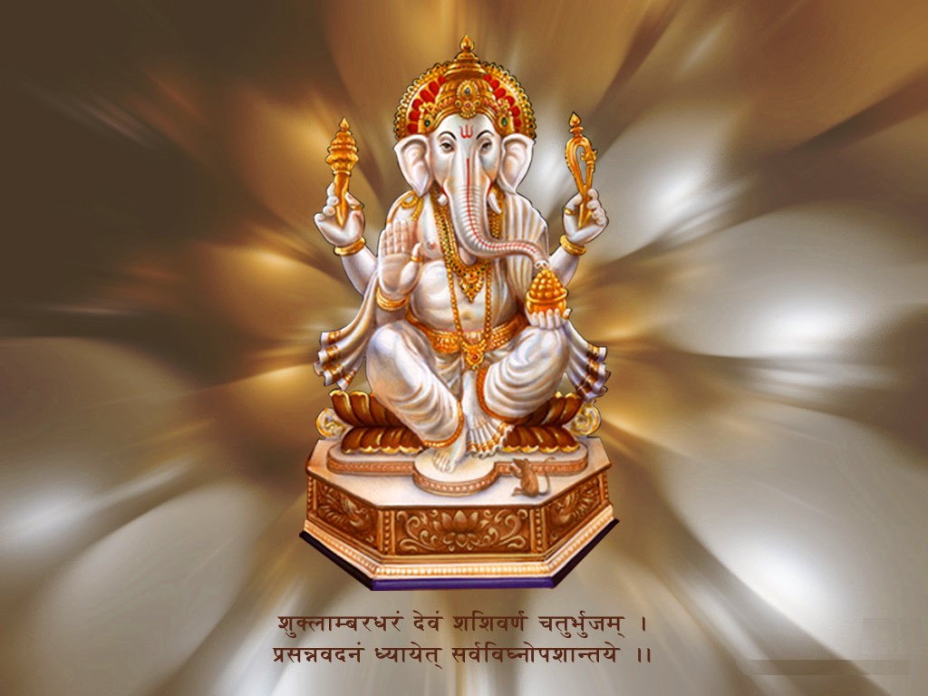
SHASHI VARNAM CHATURBHUJAM

Slide 4

PRASANNA VADANAM DHYAYET

Slide 5

SARVA VIGHNOPA SHANTAYE

Slide 6

AGAJANANA PADMARGAM GAJANANA

Slide 7
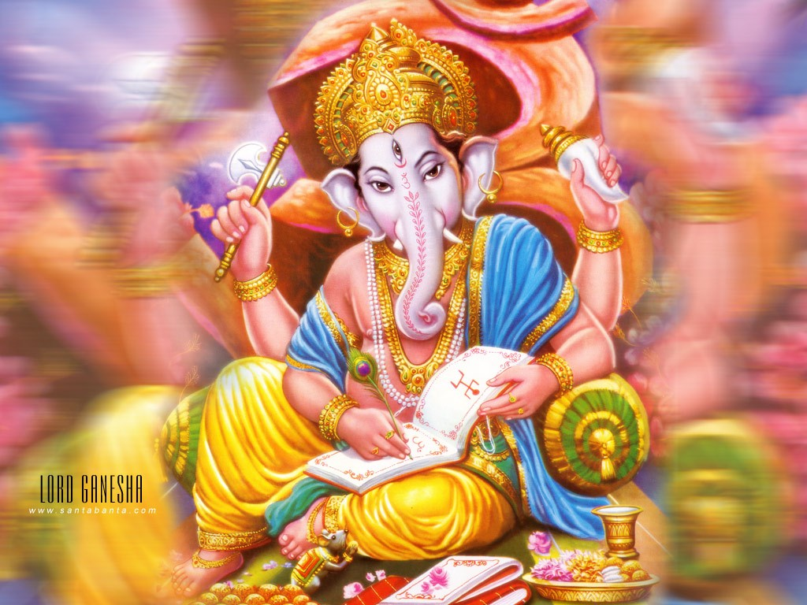
MAHIRSHAM ANEKA DANTAM BHAKTANAM

Slide 8
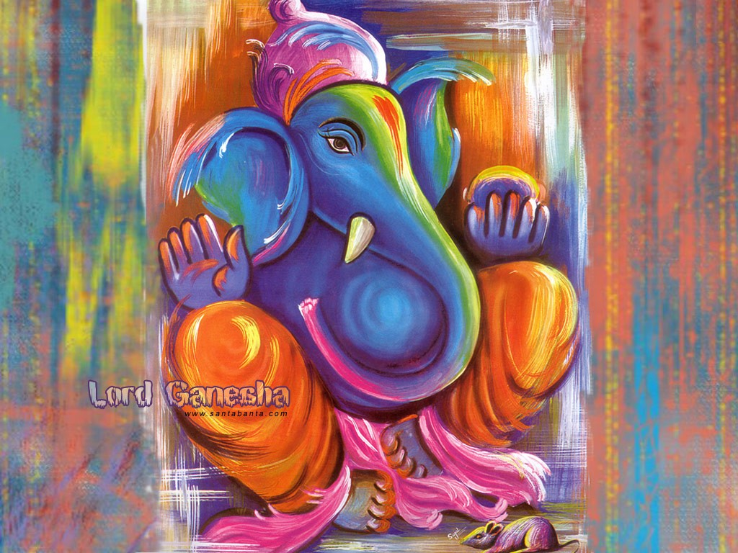
EKA DANTAM UPASMAHE

