Slide 1

CSE 554 Machine Learning Systems
Week 1 Lecture 1
Lecture 6 – Transformer Implementation
Baris Kasikci

Slide 2
Class Overview
Class Overview
GPU architecture and programming
Transformers (Architecture and Implementation)
Performance modeling
Quantization and Sparsity
Memory management
Mixture of Experts (MoE)
Retrieval-Augmented Generation (RAG)
Batching
Speculative decoding
Parallelism
End-to-end serving
Agentic systems
Large-scale deployment

Slide 3
Today
Transformer Implementation
Coding session

Slide 4
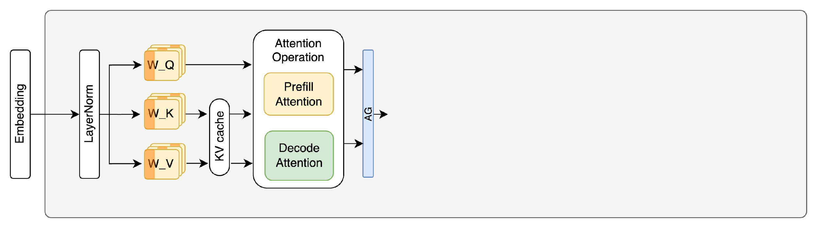
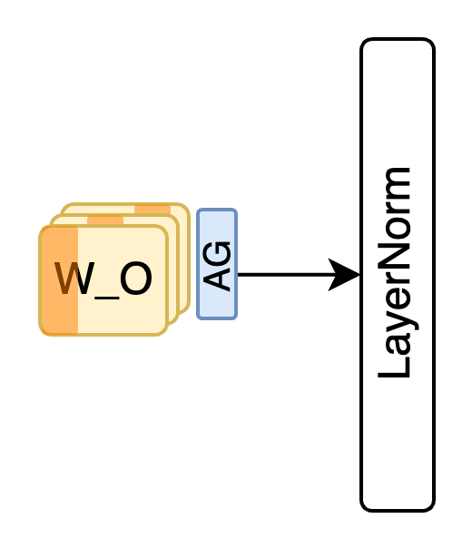
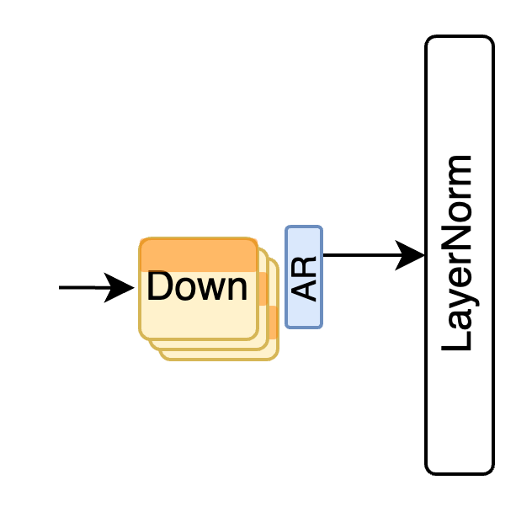

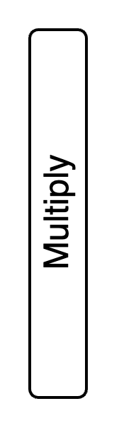
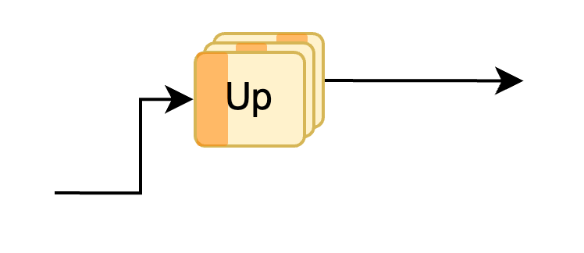
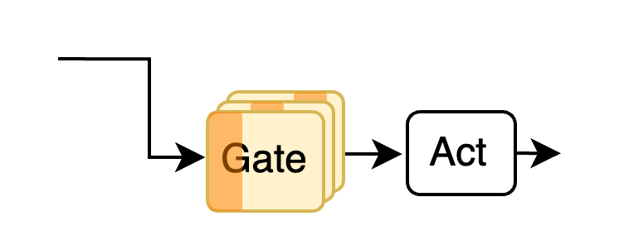
Last Time – Decoder-Only Transformer Architecture
+
+
Notes:
TODO: fix so multi-head attention is clearer

Slide 5
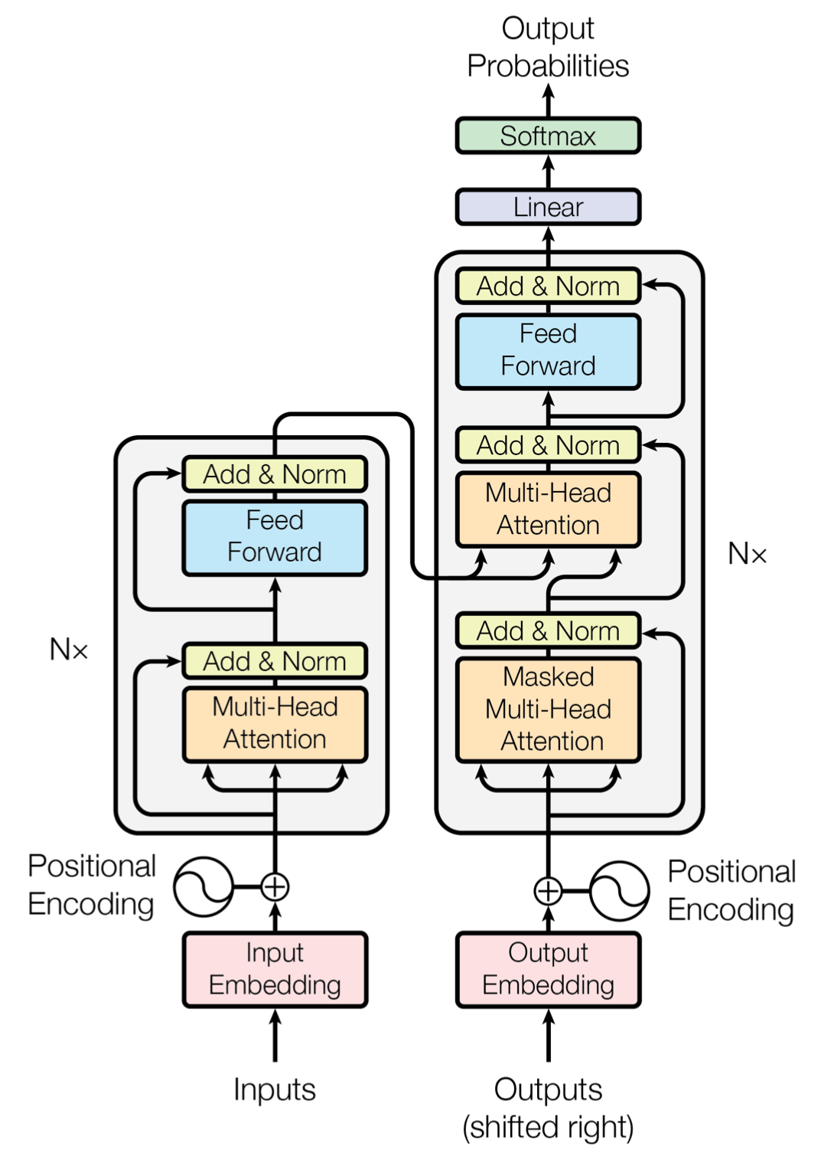
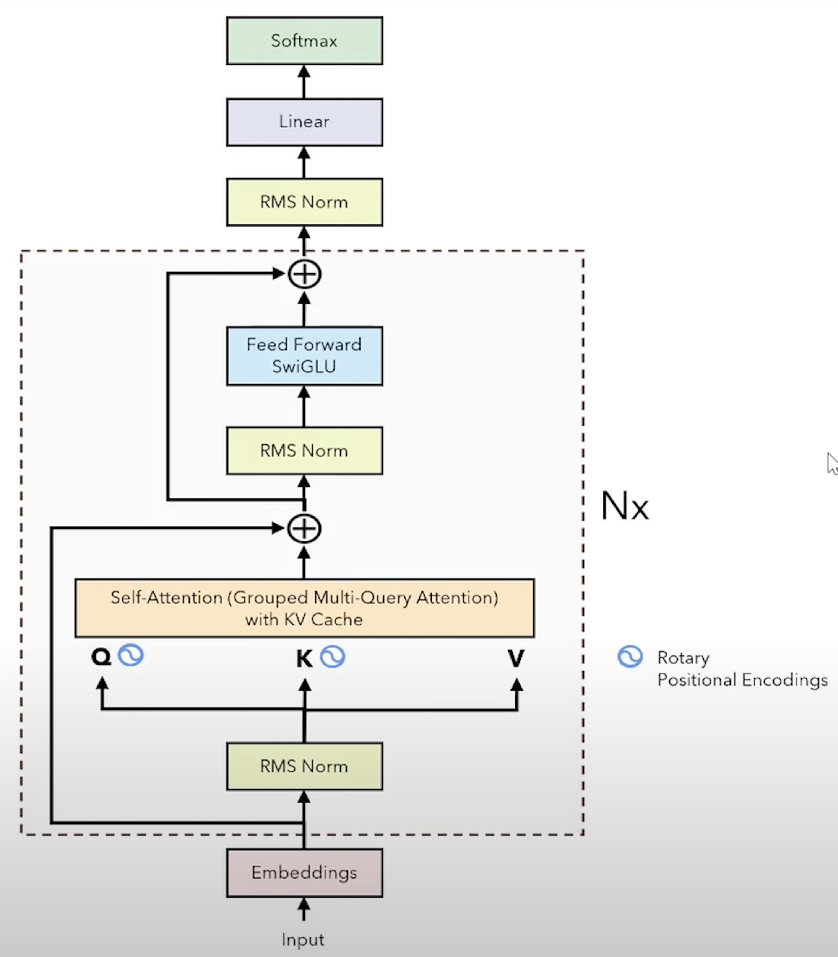
Attention is All you Need
Llama Architecture*
*Same as last time, lacking networking
Notes:
Llama architecture is quite similar to what I discussed last time and showed on the last slide. Even the FFN here on the actual Llama diagram doesn’t show the two parallel paths, if you expand the feed forward network it’s actually two parallel paths.
One difference

Slide 6
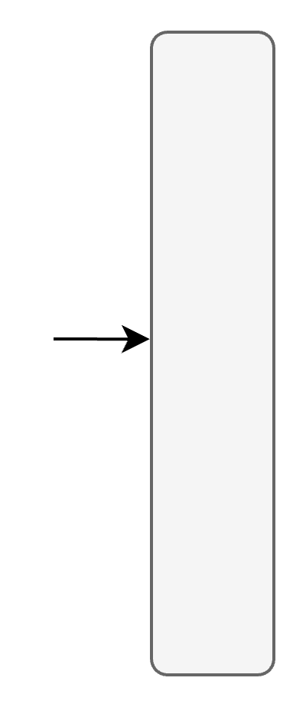
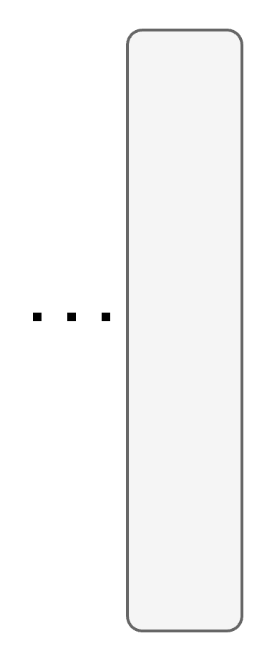
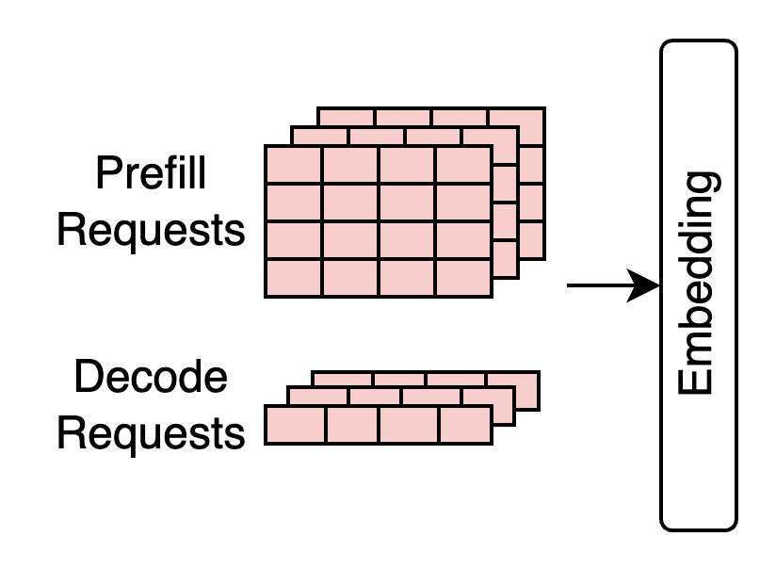
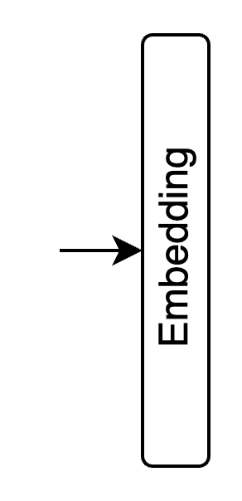
Transformer Layers and Iterations
Sampling
Inference Iteration
Output Token
Activations
Inference Layer
Notes:
Let’s zoom in on the transformer architecture a little more. The prefill and decode requests we just talked about are first converted into token embeddings, which are vector representations of the requests.
<click> These then go through a transformer layer, <click> and then through multiple transformer layers to generate a final output token through a process <click> called sampling. There are different strategies to go about wrt sampling, but we won’t cover that in detail necessarily.
<click> The inputs get transformed as they go through the layers and various networks, so we refer to these as the activations that get passed along the layers.
The number of layers varies from model to model, but for example in the GPT-3 model, there are 96 transformer layers.

Slide 7
Attention
Feed Forward Network
(FFN)
Transformer Layer
Inference Layer
Notes:
If we further zoom in on one of the layers, we see that it comprises an attention block and a feed forward network

Slide 8
Indexing into embeddings
input_ids: [The, University, …]
embeddings: {… : …,
The: [0, 1, 0, 1, …],
…
University: [0, 0 ,0 , …]
}
4096 elements in Llama-3

Slide 9
Grouped Query Attention¹
Attention Head
H₂
H₄
H₁
H₃
H_{N}
Weight
Input
KV cache
GPU
memory
[1] GQA: Training Generalized Multi-Query Transformer Models from Multi-Head Checkpoints Joshua Ainslie, James Lee-Thorp, Michiel de Jong, Yury Zemlyanskiy, Federico Lebrón, Sumit Sanghai
Notes:
So let’s look at this GPU memory diagram again, where we can see that not only the KV-cache occupies a large space as determined empirically by most existing work, it also primarily determines the size of input batches.
Why is that? <click> Recall that, each batch is processed by multiple transformer layers and heads, and each request in a batch has a corresponding KV cache entry per attention head.

Slide 10
Grouped Query Attention¹
Attention Head
H₂
H₄
H₁
H₃
H_{N}
Weight
Input
KV cache
GPU
memory
[1] GQA: Training Generalized Multi-Query Transformer Models from Multi-Head Checkpoints Joshua Ainslie, James Lee-Thorp, Michiel de Jong, Yury Zemlyanskiy, Federico Lebrón, Sumit Sanghai
Notes:
The idea in GQA is…

Slide 11
Grouped Query Attention¹
Group size: 4
H_{4N}
H₂
H₄
H₁
H₃
X
H_{N}
Weight
Input
KV cache
GPU
memory
GQA allows increasing the batch size by a factor of the group size
[1] GQA: Training Generalized Multi-Query Transformer Models from Multi-Head Checkpoints Joshua Ainslie, James Lee-Thorp, Michiel de Jong, Yury Zemlyanskiy, Federico Lebrón, Sumit Sanghai
Notes:
… for multiple query heads to share a KV cache, which of course means that attention operation is somewhat weakened since we don’t have individual keys and values for each query head, but it turns out that not to a degree that matters much in terms of accuracy.
<click> Here, I show a group size of 4, which means 4 heads share a KV cache.
<click> So what does this mean then? It means that we can accommodate 4 times more heads, which would correspond to a 4 times larger input batch!
<click> So GQA allows increasing the batch size by a factor of its group size

Slide 12
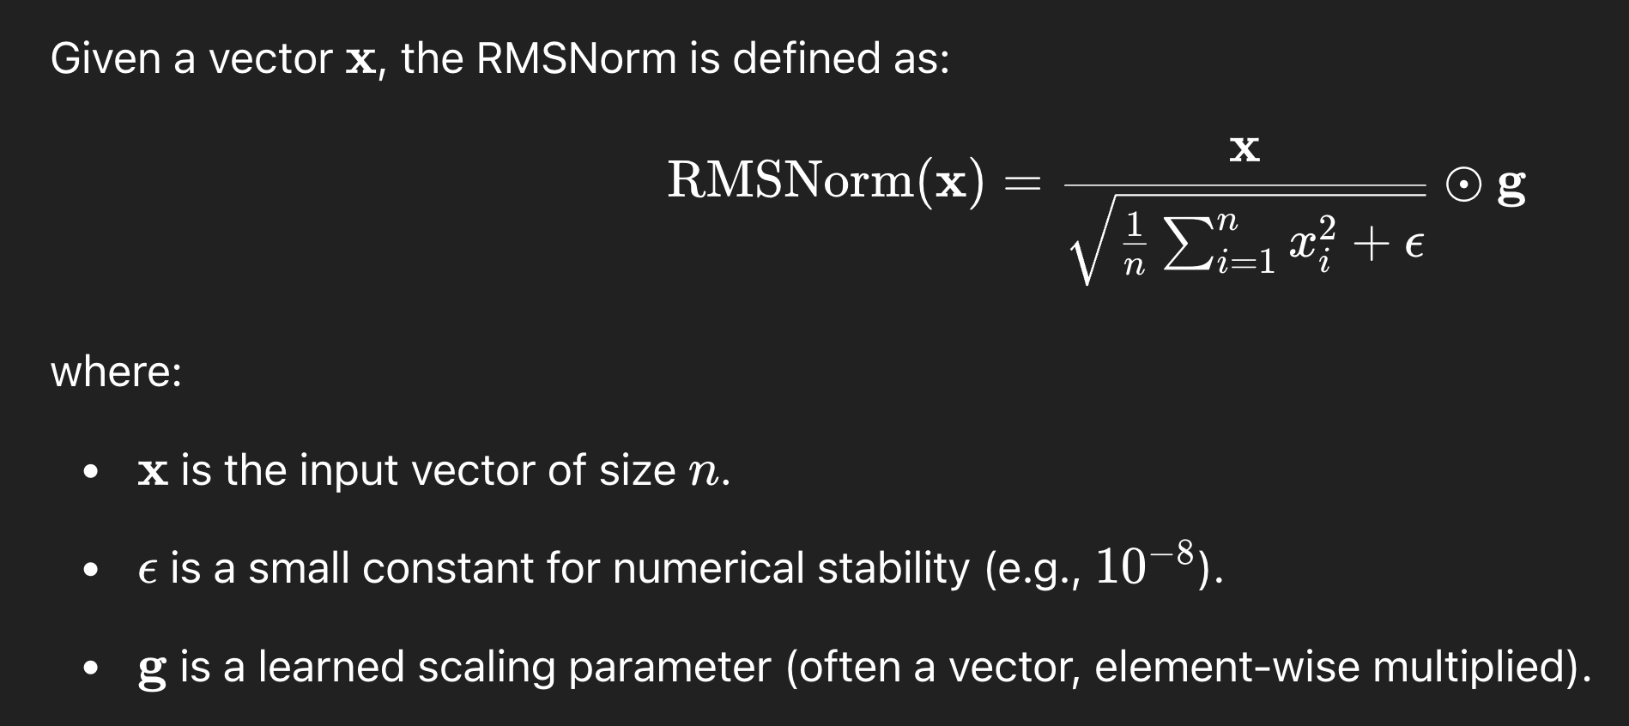
RMSNorm
Notes:
G is our “layernormAttn_weight”

Slide 13
Compute sub-components of QKV for each head
Rearrange Q and K so we can do QK^{T} for each head
view
(seq_len, num_qo_heads * head_dim)
(seq_len, num_qo_heads, head_dim)
View reshapes without changing axis order
permute
(seq_len, num_qo_heads, head_dim)
(num_qo_heads, seq_len, head_dim)
Permute reorders axes because attention scores are computed per head

Slide 14
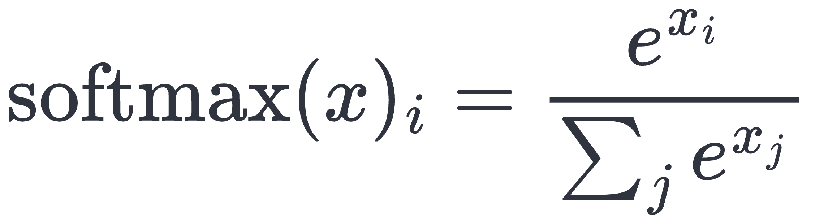
Self-Attention
T
Query
Key
Attention (Q, K, V) =
softmax
(
) Value
√d_{k}
d_{k} is head dimension
Notes:
The actual attention formula looks like this, where there is a softmax operations that operates on a scaled-down version of the dot product. The scaling is needed so the softmax output is stable.
Softmax of an element xi in a vector x is computed with this formula.

Slide 15

Causal Self-Attention
K_{i}
=
E_{i}
W_K_{i}
K
Q
 | A | blue | creature | roamed | the | verdant | forest
A
blue
creature
roamed
the
verdant
forest
Q_{i}
=
E_{i}
W_Q_{i}
K₁
K₂
K₃
K₄
K₅
K₆
K₇
Q₁
-∞
-∞
-∞
-∞
-∞
-∞
Causal mask
Q₂
-∞
-∞
-∞
-∞
-∞
Attention (Q, K, V) =
Q₃
-∞
-∞
-∞
-∞
-∞
-∞
-∞
Q₄
Q₅
-∞
-∞
Q₆
-∞
xi → -∞, softmax(xi) → 0
Q₇
Notes:
In order to avoid this, we perform what’s called causal self attention using masking.
Recall the attention formula <click> and also the softmax equation. An easy way to implement the effect of masking out these entries is to set them to –infinity before the softmax, so that they become 0 after the softmax.
Why don’t we want to set them to 0 after the softmax?
- Because we’d like to keep the property of sofmax with the individual probabilities adding up to 1, since we want the distribution to accurately represent the probabilities that a key is answering a particular query.

Slide 16
Separating Attention Heads
q = [[1, 2, 3, 4, 5, 6], # Token 1
[7, 8, 9, 10, 11, 12]] # Token 2
(seq_len, hidden_dim): (2, 6)
2
3
q = [[1, 2, 3, 4, 5, 6], # Token 1
[7, 8, 9, 10, 11, 12]] # Token 2
(seq_len, num_qo_heads * head_dim): (2, 6)
(2, 2, 3)
sub_q = [[[1, 2, 3], # Head 1 for Token 1
[4, 5, 6]], # Head 2 for Token 1
[[7, 8, 9], # Head 1 for Token 2
[10, 11, 12]]] # Head 2 for Token 2
(seq_len, num_qo_heads, head_dim)

Slide 17
Residual Connections
+
+
Residual connections*
*https://arxiv.org/abs/1512.03385
Notes:
TODO: fix so multi-head attention is clearer
Swish-Gated Linear Unit: SiLU with a Gate

