Slide 1

CSE 554 Machine Learning Systems
Week 1 Lecture 1
Lecture 7 - Performance Modeling
Baris Kasikci

Slide 2
Class Overview
GPU Architecture and Programming
Transformers (Architecture and Implementation)
Performance modeling
Quantization
Memory Management
Sparsity
Mixture of Experts (MoE)
Batching
Speculative decoding
Parallelism
End-to-end serving
Agentic systems
Large-scale deployment

Slide 3
Today
Performance Analysis
Roofline model
The first part will follow the Roofline paper and the roofline chapter from Google’s scaling book
Detailed model of Transformer performance

Slide 4

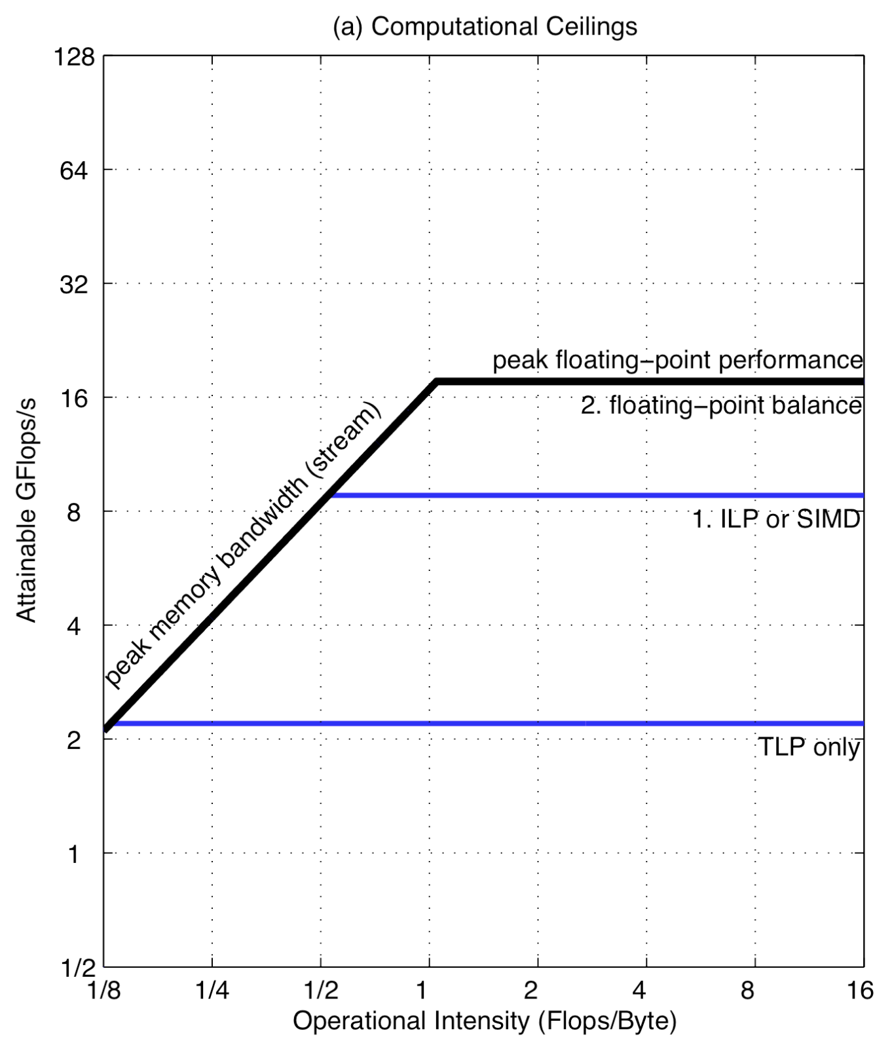
The Roofline Model
E.g., FLOPs/Sec
# of Operations
Operational
Intensity
=
# of Bytes Moved
E.g., Bytes/sec (Memory or Network Bandwidth)
Roofline Model with Ceilings for Opteron X2
Notes:
X axis is the number of FLOPS that your kernel can perform or your accelerator can achieve.

Slide 5
The Roofline Model – Computational Ceilings
Memory
Bound
Compute
Bound
Roofline
Compute optimizations:
Multithreading,
ILP, SIMD
Ceiling #2
Ceiling #1
Roofline Model with Ceilings for Opteron X2
Notes:
You can raise the ceiling by designing a new accelerator like a GPU.

Slide 6
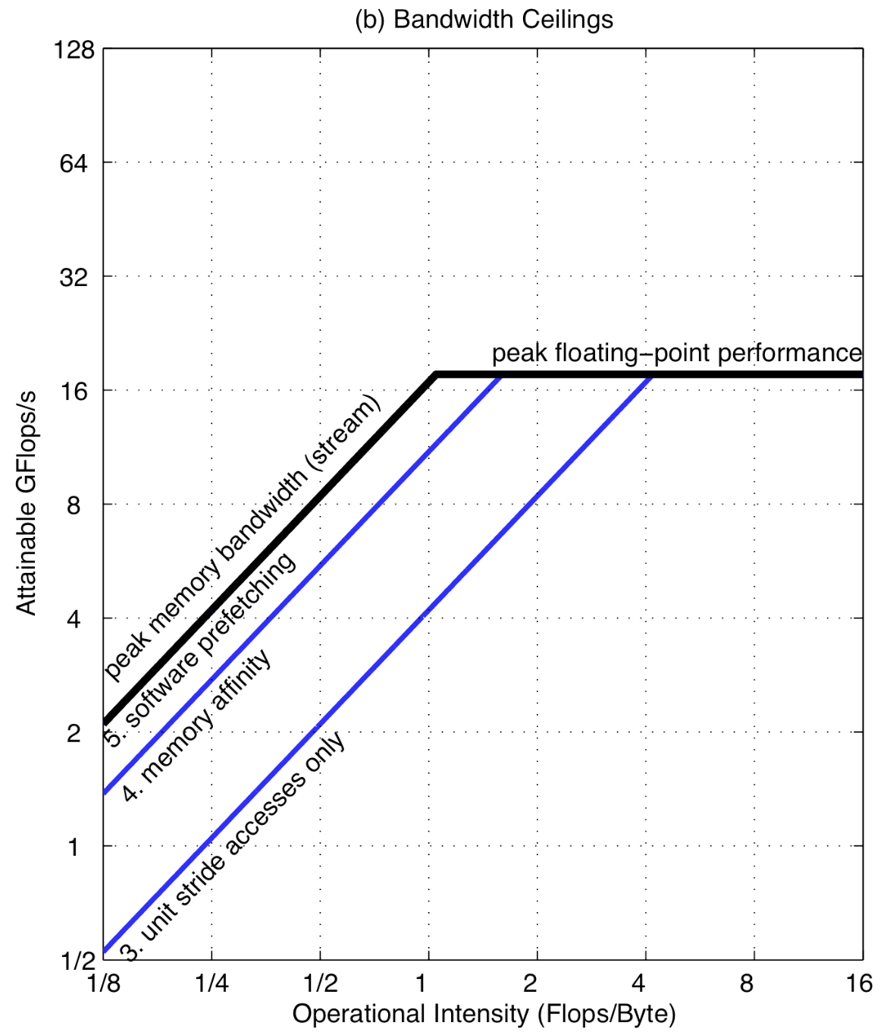
The Roofline Model – Bandwidth Ceilings
Memory
Bound
Compute
Bound
Roofline
Memory optimizations:
Stride accesses (HW prefetching),
Memory affinity (NUMA effect), Software prefetching
Ceiling #2
Ceiling #1
Roofline Model with Ceilings for Opteron X2
Notes:
Non-Uniform Memory Access: recall GPU interconnections in a server
The BW-bound segment has a 45 degree slope:
Performance=I⋅B
log(Performance)=log(I⋅B)=log(I)+log(B)
y=x+log(B)

Slide 7
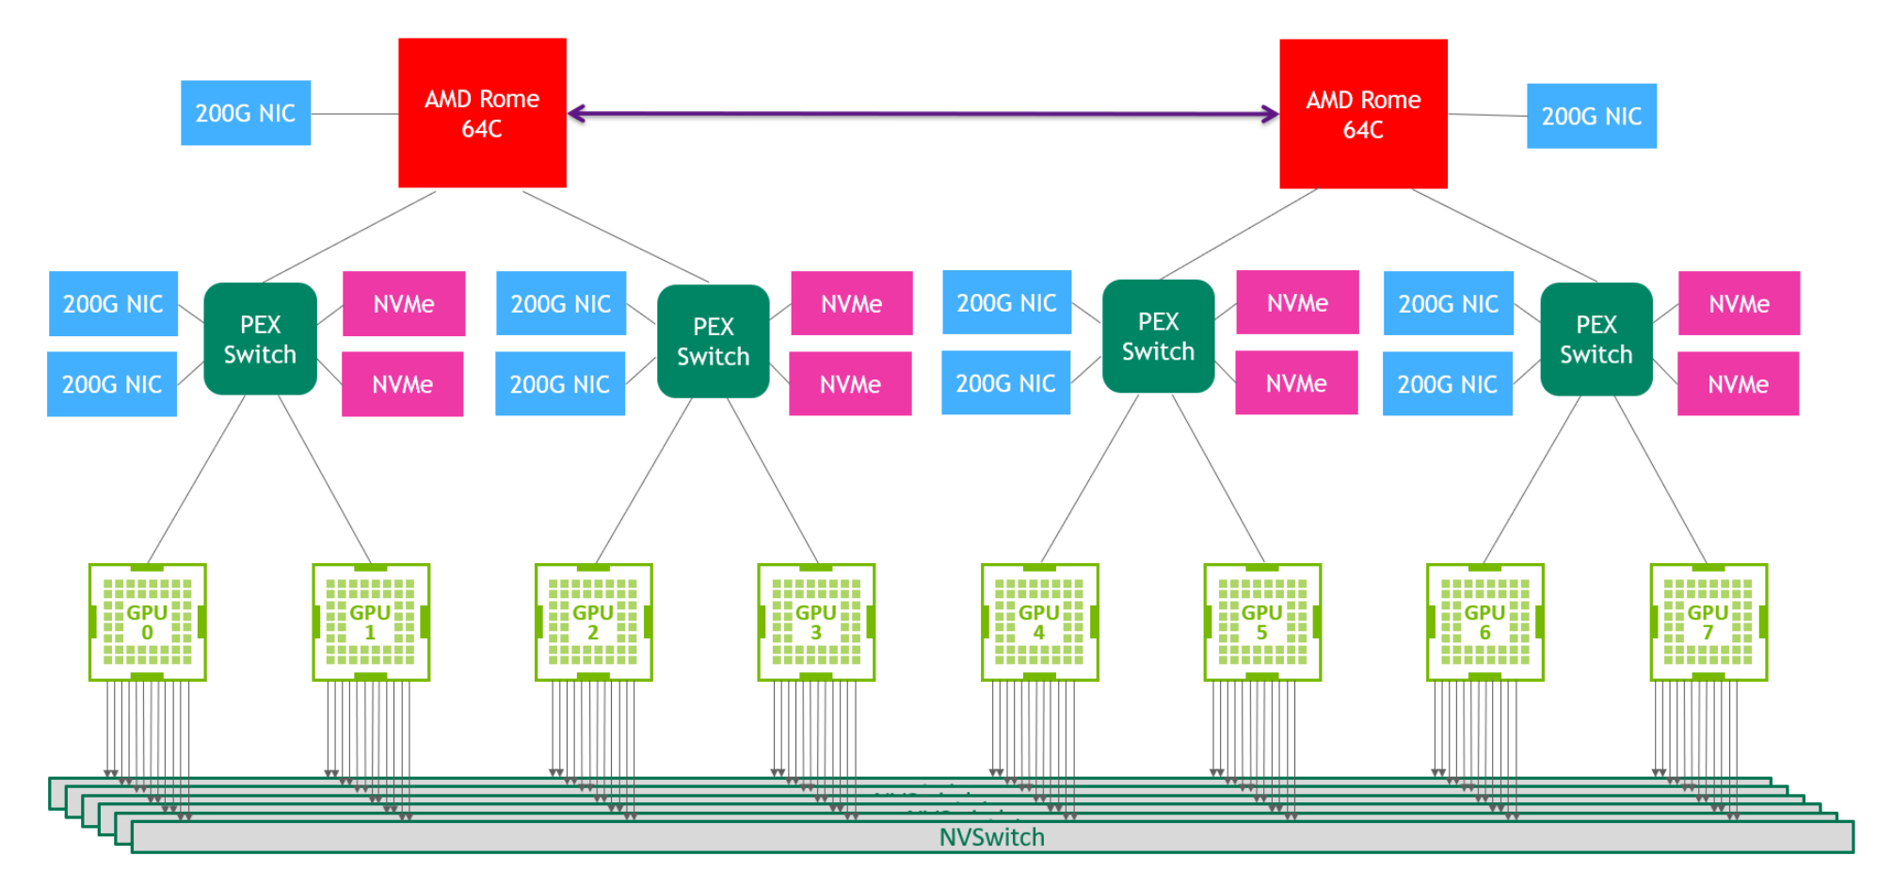
NUMA Effect with GPUs
Data Center Network
200 Gb/s = 25 GB/s
900 GB/s
https://images.nvidia.com/aem-dam/en-zz/Solutions/data-center/nvidia-ampere-architecture-whitepaper.pdf

Slide 8
Memory vs Compute Bound
Memory-Bound: Low Operational Intensity (OI)
Doing little computation per byte of data fetched
Spending time waiting for data rather than doing computation
Example:
Accelerator with a compute capacity of 10 TFLOPs/s
Kernel with 1 FLOP per 10 Bytes fetched, OI: 0.1 FLOP/byte
Memory BW of 100 GB/s
Max performance: BW x OI = 100 x 10^9 x 0.1 = 10 GFLOPs/s
Even though the processor can do more, it can’t get the data!
Compute-bound: High OI
Doing a lot of computation per byte of data fetched from memory
Notes:
If OI is low, it means you're doing very little computation for each byte of data fetched from memory. So, you're spending most of your time waiting for data to arrive rather than doing math.

Slide 9
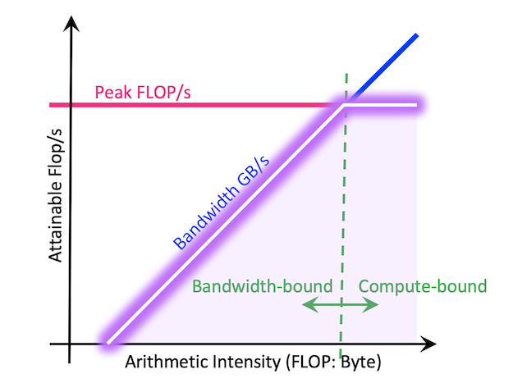
Critical Operational Intensity
Computation could be a GPU kernel, TPU program, CPU program etc.
Intensity(Computation)
=
Intensity(Accelerator)
Computation FLOPs
Accelerator FLOPs/s
=
Communication Bytes
Bandwidth Bytes/s
Compute-Bound
Computation FLOPs
Accelerator FLOPs/s
>
Communication Bytes
Bandwidth Bytes/s
Memory-Bound
Computation FLOPs
Accelerator FLOPs/s
<
Operational intensity (GFLOPs/Byte)
Communication Bytes
Bandwidth Bytes/s
https://jax-ml.github.io/scaling-book/roofline/, https://docs.nersc.gov/tools/performance/roofline/
Notes:
TODO:redraw

Slide 10
Example – NVIDIA H100
Peak FP16 Tensor TFLOPs/s (no sparsity/with sparsity)
1000/2000 TFLOPs/s
Memory bandwidth
3000 GB/s
Critical intensity:
(1000*1e12) / (3000*1e9) = 333 FLOPs/Byte
If the kernel has higher operational intensity than 333 FLOPS/Byte it is compute-bound, otherwise it is memory bound

Slide 11
Example: Dot Product with FP32
A₁ A₂ A_{3 . . .} A_{N}
B₁
B₂
B₃
.
.
.
B_{N}
=
B₁A₁ + B₂A₂ + B₃A₃ + . . . + A_{N}B_{N}
Compute
N multiplications, N additions*
= 2N FLOPs
Operational
Intensity
2N
1
=
≈
4N + 4
2
Memory
2 x 4N bytes read + 4 bytes written back
FP32 dot product on the H100 is memory-bound
* It is actually N and not N-1, why?
Notes:
Interesting point: Dot product’s operational intensity doesn’t depend on the matrix shapes/sizes

Slide 12
Example: Matrix Multiplication with FP16
[M,K]
Transformer matrix multiplications
(e.g., QKV generation):
N,K >> M
[N,K]
[M,N]
@
→
X @ Y → Z
Memory
2MN + 2NK bytes read
2MK bytes written back
Compute
2MNK FLOPs
(MNK multiplications and MNK additions)
hidden_dim, num_qo_heads*head_dim
seq_len
Operational
Intensity
2MNK
2MNK
≈
=
=
M
2MN + 2NK + 2MK
2MN + 2NK + 2MK
Matrix multiplication on H100 is compute-bound if M > 333
Critical intensity for H100 from 2 slides back
Notes:
2 because of FP16
From the Google book: as we scale up our matmul size, it becomes easier to hit the compute-saturated limit. This is extremely unusual, mainly because compute capacity increases faster than memory capacity and explains in large part why we use architectures dominated by matrix multiplication - they’re amenable to being scaled!

Slide 13
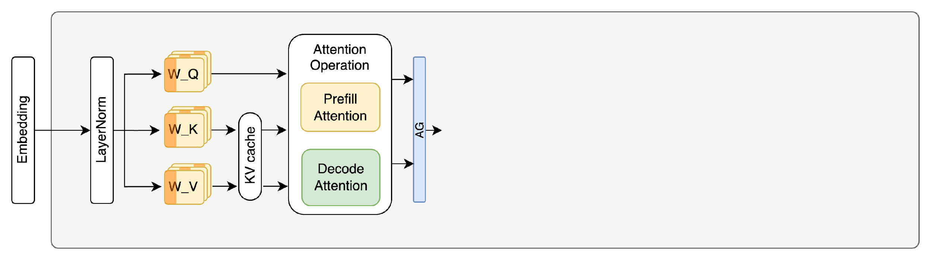
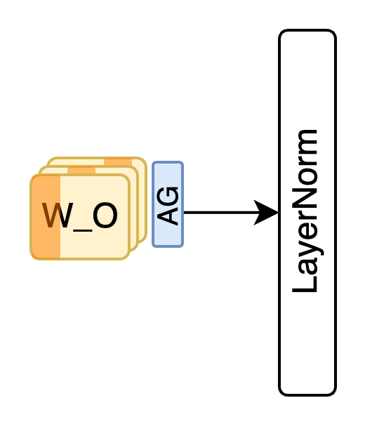
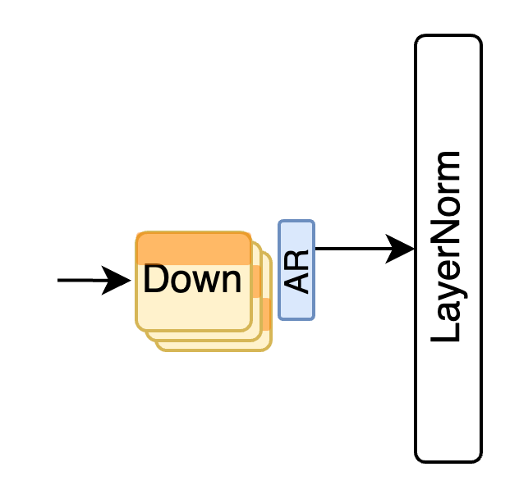

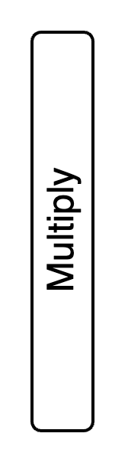
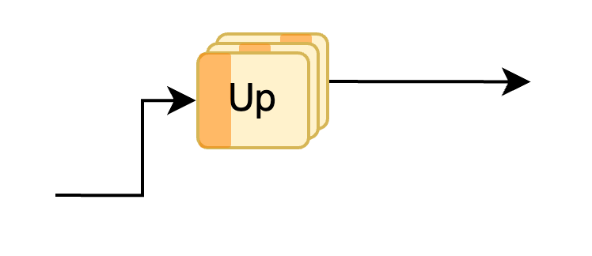
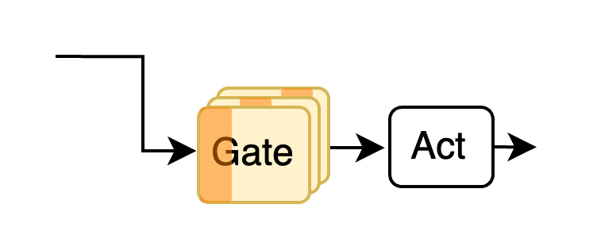
Decoder-Only Transformer Architecture
+
+

Slide 14
Key Factors For Serving Throughput – Hardware Spec
N_{GPU}: number of GPUs
MemBW (GB/s): aggregate GPU memory bandwidth
GPU_{mem} (GB): aggregate GPU memory capacity
Compute (GFLOPS/s): aggregate GPU compute capacity
NetBW (GB/s): aggregate GPU interconnect bandwidth

Slide 15
Key Factors For Serving Throughput – Model Config
D_{model}: hidden dimension size (hidden_dim)
L: number of layers
P_{model}: number of parameters
R_{GQA}: group size of GQA (group_size)
S_{Type}: Model parameters’ data size in bytes (e.g., 2 for FP16)

Slide 16
Key Factors For Serving Throughput – User Stats
p: average number of tokens in prompts to be prefilled
d: average number of tokens in output to be decoded
p + d: average number of tokens in user request (sequence length)
Throughput_{total}
: per request throughput
p + d
Throughput_{total}
d
: decoding throughput
p + d

Slide 17
Assumptions
We are operating at the maximum possible batch size of requests
Necessary for high GPU utilization

Slide 18
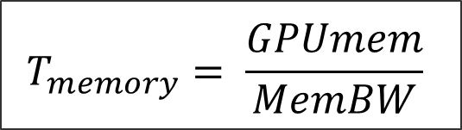
Memory-Centric Execution Time Estimation*
Weight
Input/
Actv.
KV cache
GPU
memory
Entire contents of the GPU memory would be loaded once during one iteration
* We assume operation at maximum batch size, which is necessary for optimal throughput
Notes:
And we’ll do that by estimating the time it takes to go through one iteration of the transformer from the perspective of memory accesses. Here, we assume that we are operating at the maximum possible batch size, as this is necessary to approach optimal serving throughput.
In this setup, <click> weights, inputs/activations and the KV-cache would occupy the entire GPU memory, and all of these would need to be loaded to GPU registers once during one iteration of a transformer.
<click> So we can estimate the execution time of an iteration of a transformer from a memory perspective to simply be the ratio of the GPU memory capacity to GPU memory bandwidth.

Slide 19
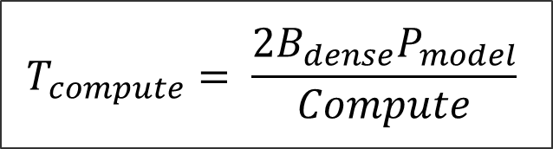
Compute-Centric Execution Time Estimation
N
Weight
Every GEMM compute =
2
B_{dense}
K
N
K
All Dense Operations
2
B_{dense}
K₁
N₁
K
2
B_{dense}
K₂
N₂
+
Output
2
K₃
N₃
Activations
being multiplied with weights in large batches
+
B_{dense}
Output
+
…
…
…
…
B_{dense}
Output
+
2
K_{i}
N_{i}
B_{dense}
Multiple user input
sequences
2
B_{dense}
P_{model}
Notes:
For compute, almost all the demand comes from dense operations which are due to activations being multiplied with large weight matrices in large batches.
In these dense general matrix matrix multiplication operations, GEMMs, every element is computed via a dot product of one row of the input with one column of the weight. Let's assume a weight matrix of KxN
<click> Therefore, K multiplications and K additions are required to compute one element, so that's how we get the 2 K term.
<click> There are B_dense*N output elements, where B_dense is the size of the input batch involved in dense operations.
Therefore, for one GEMM, 2B_dense KN compute operations is needed. <click> We can sum all the dense operations to derive the total number of compute operations. Note that the K N product is the number of elements inside weight matrices.
<click> Therefore, if we factor out the 2xBdense term, <click> the remaining sum is the total number of elements in all weight matrices, which can be approximated by the number of parameters of the Model, which we denote as Pmodel. I find this a neat way to think about compute demand of a model.
<click> Therefore, we can estimate the execution time from the compute perspective to be 2Bdense Pmodel divided by the compute capacity of the GPU in FLOPS/s.

Slide 20
Network-Centric Execution Time Estimation
(N_{GPU} – 1): # of hops
All-Gather Recap
A
B
C
D
A
B
C
D
(N_{GPU} – 1)
N_{GPU}
# of hops per AllGather
A
B
C
D
A
B
C
D
Notes:
Finally, let’s estimate the time for network operations. To do this, let’s first recap how an all gather works.
You have data that’s sharded across multiple GPUs, and the idea is you move shards to other GPUs until they all have the same data.
<click> So if you have N_GPUs, <click> you need to go over N_GPU-1 hops.
<click> let’s keep track of these here in the corner

Slide 21
Network-Centric Execution Time Estimation
(N_{GPU} – 1): # of hops
4: All-Gathers/layer
All-Reduce ≈ 2 x All-Gather
Notes:
All right, so how many all gathers we have per layer. <click> Well, we have 2 all gathers in Attention, and we have <click> an AllReduce in the feed forward network.
<click> And as we just discussed AllReduce is like 2 AllGathers.
So all in all, we have the equivalent of 4 AllGathers per layer

Slide 22
Network-Centric Execution Time Estimation
(N_{GPU} – 1): # of hops
4: All-Gathers/layer
B_{dense} x D_{model}: shape
S_{type}: data type size
Layer l
Layer l+1
Each element
of size S_{type}
[B_{dense}, D_{model}]
Notes:
The size of the data transmitted with collective communications equals the size of inputs for dense operations, because as we can see, collective communications are followed by these dense operations.
<click> The size of inputs to these dense operations is Bdense x Dmodel, Dmodel is the hidden dimension size
<click> Finally, each of the input element is of size Stype.

Slide 23
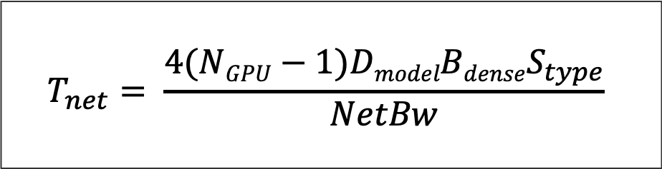
Network-Centric Execution Time Estimation
(N_{GPU} – 1): # of hops
4: All-Gathers/layer
B_{dense} x D_{model}: shape
S_{type}: data type size
Notes:
So if we bring it all together, the per layer execution time from a network’s perspective is the product of these terms divided by the network bandwidth.
<click> So assuming we have L layers in one iteration, we also have an L term that will be multiplied with this expression

Slide 24
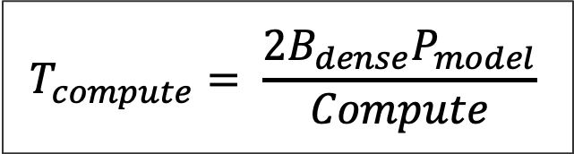
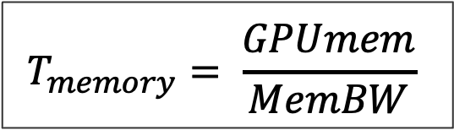
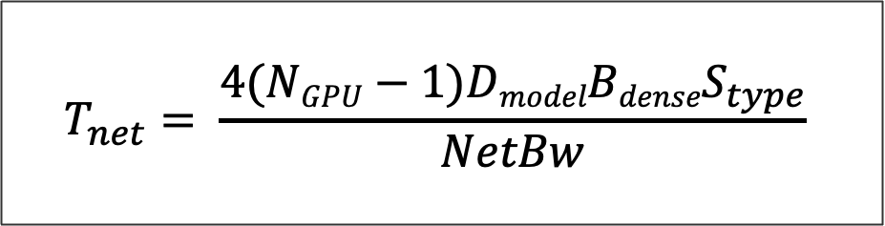
Execution Times wrt Different Resources
Notes:
So we have the following execution times wrt different resources.

Slide 25

Execution Times wrt Different Resources
Notes:
Let’s first compare compute versus networking

Slide 26
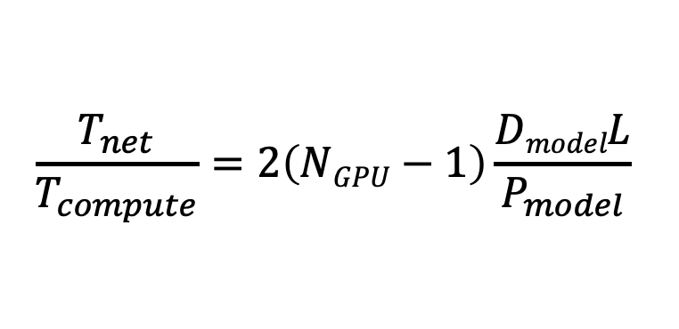
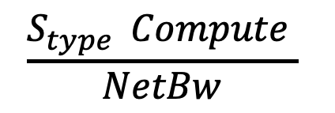

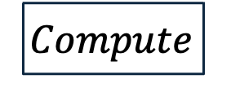
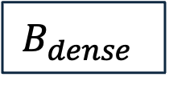

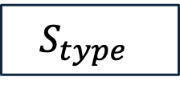
Compute vs Network
Shift to
Compute
Bound
Shift to
Network
Bound
Not
Relevant
LLM Serving is more compute-bound than network-bound
Notes:
So this is what the ratio of the two execution time models look like. I actually have a more analytical way to compare these but it is a bit involved and so I won’t get into the details here, instead, I’ll qualitatively compare them and then show some empirical validation results.
<click> We can see that increasing model sizes and network bandwidth pushes this ratio towards a compute bound regime, and both of these have been on a steep rise
<click> Increasing compute capacity and sizes of types would push the ratio in favor of a network bound regime. Compute capacity keeps increasing, mainly due to increased parallelism, but it is stunted at an individual core or SM level due to slowdown of effects such as Moore’s law. The sizes of datatypes tend to somewhat decrease thanks to advances in quantization methods.
<click> Finally, the dense batch size has no effect on this ratio as you can see.
<click> So the increase trend in network boundness lags behind that of compute boundness, therefore, LLM serving is more compute-bound than network-bound

Slide 27
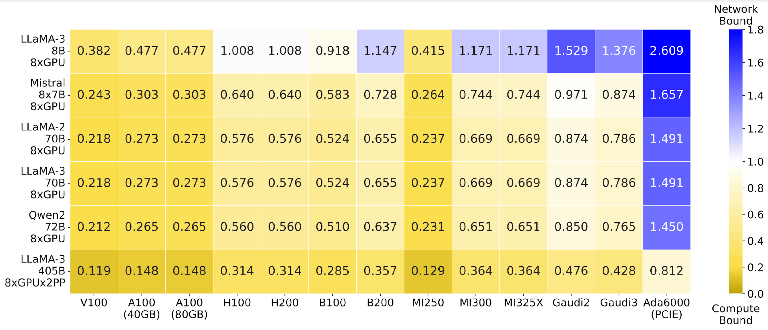
Compute vs Network - Validation
Notes:
As you can see for most GPUs and larger models, compute boundness dominates
Detail: PCIE is the main issue for Ada6000
Llama-3-8B 8GPU
[22.27]

Slide 28
Execution Times wrt Different Resources
Notes:
Ok now

Slide 29

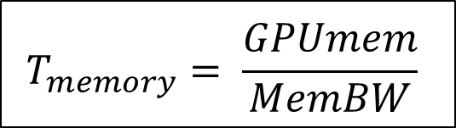
Execution Times wrt Different Resources
Notes:
Let’s compare execution time based on compute to the one based on memory

Slide 30
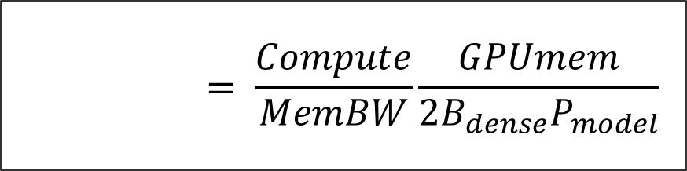
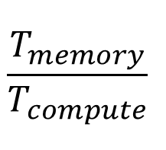
Compute vs Memory
Notes:
If we take the ratio of execution times wrt memory and compute we get this quantity.
So, before we reason about this ratio, there is one more detail I should mention and that’s wrt an attention optimization called grouped query attention

Slide 31
Grouped Query Attention¹
Attention Head
H₂
H₄
H₁
H₃
H_{N}
Weight
Input
KV cache
GPU
memory
[1] GQA: Training Generalized Multi-Query Transformer Models from Multi-Head Checkpoints Joshua Ainslie, James Lee-Thorp, Michiel de Jong, Yury Zemlyanskiy, Federico Lebrón, Sumit Sanghai
Notes:
So let’s look at this GPU memory diagram again, where we can see that not only the KV-cache occupies a large space as determined empirically by most existing work, it also primarily determines the size of input batches.
Why is that? <click> Recall that, each batch is processed by multiple transformer layers and heads, and each request in a batch has a corresponding KV cache entry per attention head.

Slide 32
Grouped Query Attention¹
Attention Head
H₂
H₄
H₁
H₃
H_{N}
Weight
Input
KV cache
GPU
memory
[1] GQA: Training Generalized Multi-Query Transformer Models from Multi-Head Checkpoints Joshua Ainslie, James Lee-Thorp, Michiel de Jong, Yury Zemlyanskiy, Federico Lebrón, Sumit Sanghai
Notes:
The idea in GQA is…

Slide 33
Grouped Query Attention¹
Group size: 4
H_{4N}
H₂
H₄
H₁
H₃
X
H_{N}
Weight
Input
KV cache
GPU
memory
GQA allows increasing the batch size by a factor of the group size
[1] GQA: Training Generalized Multi-Query Transformer Models from Multi-Head Checkpoints Joshua Ainslie, James Lee-Thorp, Michiel de Jong, Yury Zemlyanskiy, Federico Lebrón, Sumit Sanghai
Notes:
… for multiple query heads to share a KV cache, which of course means that attention operation is somewhat weakened since we don’t have individual keys and values for each query head, but it turns out that not to a degree that matters much in terms of accuracy.
<click> Here, I show a group size of 4, which means 4 heads share a KV cache.
<click> So what does this mean then? It means that we can accommodate 4 times more heads, which would correspond to a 4 times larger input batch!
<click> So GQA allows increasing the batch size by a factor of its group size

Slide 34
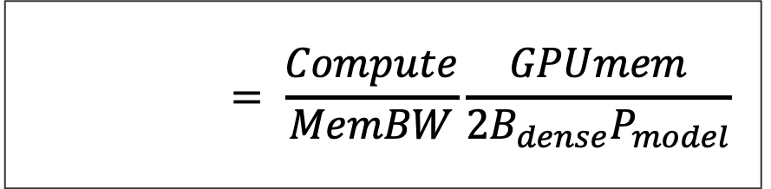
Compute vs Memory
Compute
Memory
GQA allows for a large batch size
Model sizes tend to increase
Batches with large decode requests increase memory accesses
LLM serving is more compute-bound than memory-bound
Notes:
Going back to the ratio of memory to compute times, grouped query attention, <click> used in more modern LLMs, yields to large batches.
<click> Similarly, the model size tends to increase pushing this ratio more towards a compute bound-regime.
<click> Again, we can further expand this formula get further insight into more detailed factors that impact this ratio for example length of decode requests, but we’ll skip that for the sake of time.
<click> Overall, there are more trends that contribute to the compute-boundness of modern models, and LLM serving ends up being is more compute-bound than memory-bound. I should add that for things like MLA in Deepseek, there is a similar effect, since in essence MLA achieves something similar to GQA.

Slide 35
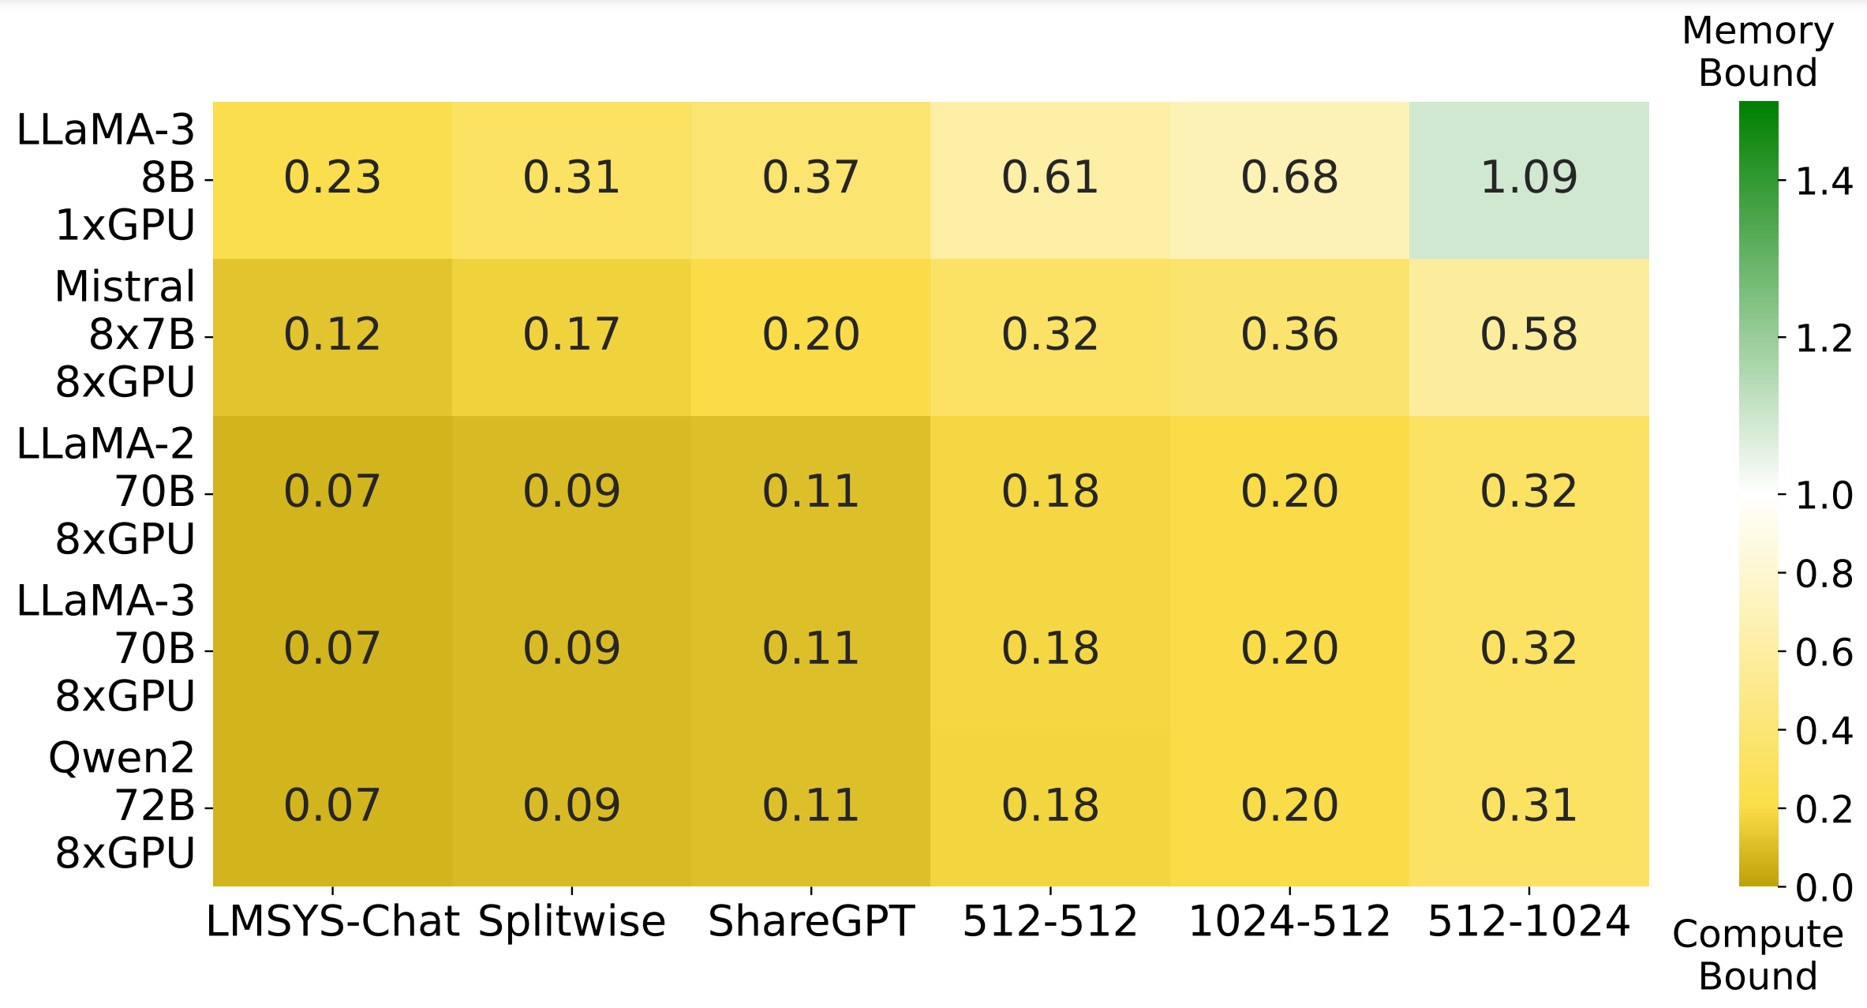
Compute vs Memory - Validation
*The GPU here is A100
High Utilization of GPU compute is the key for LLM serving
Notes:
If you look at older models like LLaMA 7B, which don’t use GQA, they can be more memory-bound, but on balance, most models are primarily compute-bound for a wide range of workloads
<click> Therefore, high compute utilization is key for high throughput LLM serving

Slide 36



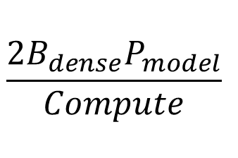


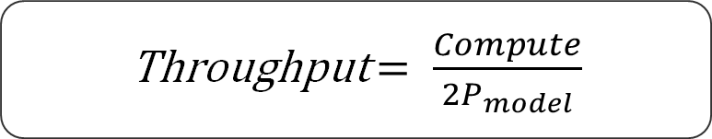
Optimal Throughput
Decode
Throughput
Throughput
+
=
+
=
=
=
Prefill
Throughput
e.g., LLaMa 70B, A100
1857 token/s/GPU
Notes:
Based on this insight, we can finally derive the optimal throughput of LLM serving.
<click> Total throughput is the sum of decode throughput and prefill throughput, which can be expressed as the ratio between the sum of decode and prefill batches, divided by the execution time.
<click> Since the input to dense layers batches both decode and prefill requests, this is equal to Bdense in the nominator.
<click> The execution time is from the perspective of compute, since we showed previously that compute is our bottleneck, so if we substitute our previous derivation in the denominator
<click> The Bdense terms cancel out and we get a nice and clean formula for throughput, which is the compute capacity divide by 2 times the number of model parameters.
I like this formula because I want to stress that it is independent of user input statistics as long as the workload is in the compute-bound regime. It is also independent of the actual batch size, GPU memory, or types of parallelism used. It gives us a very clean way to think about the resource needs of modern transformers.
Using this formula, we can easily calculate the optimal throughput for different models. <click> For example, LLaMa 70B on A100 can reach 1857 token/s/GPU
Detail: For MoE models, we need to calculate the effective model size, which is defined as activated size of weights. For example, in Mixtral 8*7, each token activates two experts, so the weight sizes for FFNs would be counted twice.

Slide 37
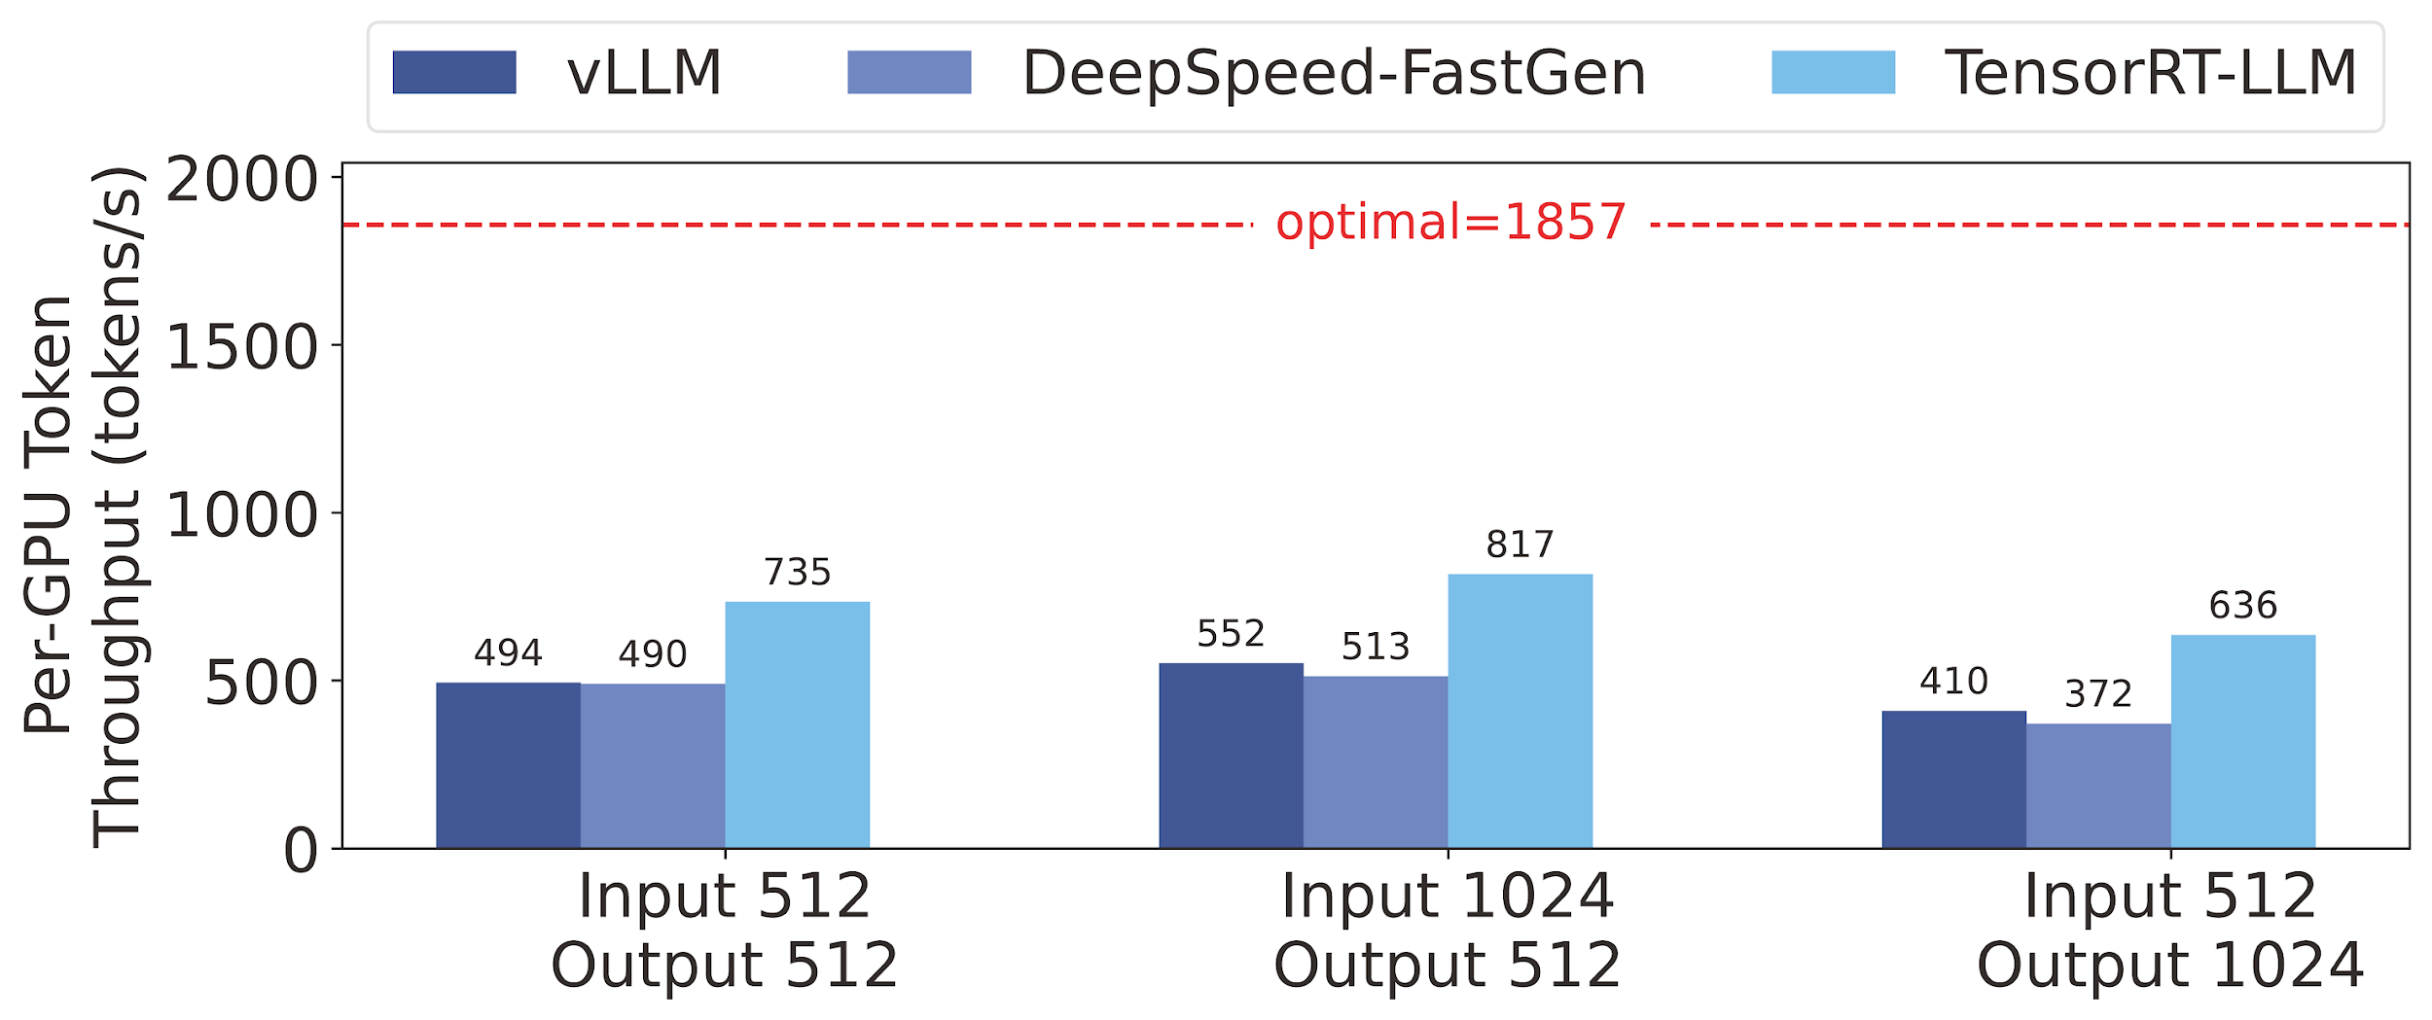
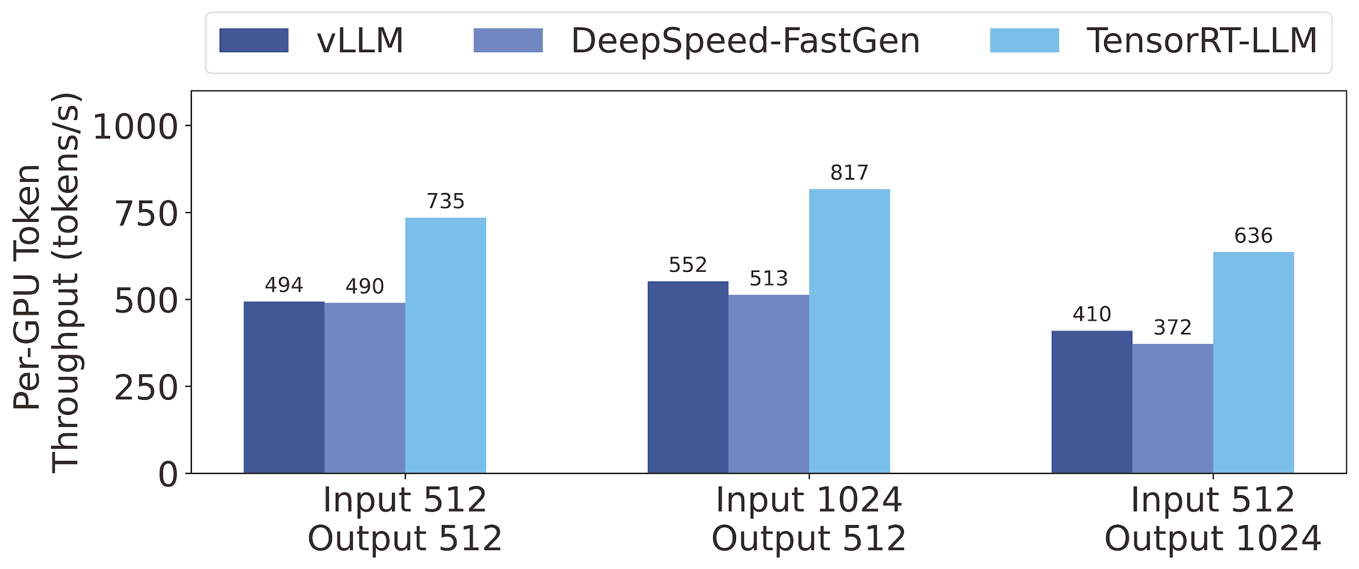
Revisit the performance of existing frameworks
There is a large gap to optimal throughput
Notes:
<click> That’s sort of where the line I showed earlier on this graph comes from, so there is still a large gap to optimal throughput.
Detail: Even tensorrtllm only reaches less than half of the throughput.

Slide 38
Memory Optimizations
KV Cache
Recall in the transformer implementation how we recompute keys and values at every iteration for each request
We can instead cache them!
Assignment 2
PagedAttention
FlashAttention

Slide 39
Compute Optimizations for GEMM
N
0
1
2
3
4
5
6
7
8
9
10
11
12
13
14
15
16
17
18
19
20
21
22
23
K
24
25
26
27
28
29
30
31
32
33
34
35
36
37
38
39
40
41
42
43
44
45
46
47
48
49
50
51
52
53
54
55
K
56
57
58
50
60
61
62
63
0
1
2
3
4
5
6
7
8
9
10
11
12
13
14
15
16
17
18
19
20
21
22
23
24
25
26
27
28
29
30
31
M
32
33
34
35
36
37
38
39
40
41
42
43
44
45
46
47
48
49
50
51
52
53
54
55
56
57
58
50
60
61
62
63

Slide 40
GEMM memory load pattern
N
0
1
2
3
4
5
6
7
Global memory
8
9
10
11
12
13
14
15
0
1
2
3
4
5
6
7
8
9
10
11
12
13
14
15
16
17
18
19
20
21
22
23
K
24
25
26
27
28
29
30
31
2×8 = 16 Global Access
32
33
34
35
36
37
38
39
40
41
42
43
44
45
46
47
48
49
50
51
52
53
54
55
L2 Cache
50MB
K
56
57
58
50
60
61
62
63
0
1
2
3
4
5
6
7
8
9
10
11
12
13
14
15
0
1
2
3
4
5
6
7
8
9
10
11
12
13
14
15
4×8 = 32 L2 Access
16
17
18
19
20
21
22
23
24
25
26
27
28
29
30
31
M
32
33
34
35
36
37
38
39
40
41
42
43
44
45
46
47
L1/Shared Memory
48
49
50
51
52
53
54
55
0
56
57
58
50
60
61
62
63
0
8
1
1
9
2
2
10
3
3
11
4
12
4
5
5
13
6
6
14
7
7
8
9
10
11
12
13
14
15
15
4×8 = 32 L1 Access

Slide 41
GEMM memory load
N
0
1
2
3
4
5
6
7
8
9
10
11
12
13
14
15
For every output element:
Load one row + one column
2K elements
In total MN output elements
Memory load = 2MNK
However, unique load is only
MK + NK
How can we reduce L2 accesses?
Use tiling!
16
17
18
19
20
21
22
23
K
24
25
26
27
28
29
30
31
32
33
34
35
36
37
38
39
40
41
42
43
44
45
46
47
48
49
50
51
52
53
54
55
K
56
57
58
50
60
61
62
63
0
1
2
3
4
5
6
7
8
9
10
11
12
13
14
15
16
17
18
19
20
21
22
23
24
25
26
27
28
29
30
31
M
32
33
34
35
36
37
38
39
40
41
42
43
44
45
46
47
48
49
50
51
52
53
54
55
56
57
58
50
60
61
62
63

Slide 42
GEMM memory load pattern
N
Global memory
0
1
2
3
4
5
6
7
0
1
2
3
4
5
6
7
8
9
10
11
12
13
14
15
8
9
10
11
12
13
14
15
16
17
18
19
20
21
22
23
2×8 = 16 Global Access
K
24
25
26
27
28
29
30
31
32
33
34
35
36
37
38
39
40
41
42
43
44
45
46
47
48
49
50
51
52
53
54
55
L2 Cache
50MB
0
1
2
3
4
5
6
7
K
56
57
58
50
60
61
62
63
8
9
10
11
12
13
14
15
0
1
2
3
4
5
6
7
2×8 = 16 L2 Access
8
9
10
11
12
13
14
15
16
17
18
19
20
21
22
23
24
25
26
27
28
29
30
31
M
32
33
34
35
36
37
38
39
L1/Shared Memory
4
5
6
7
40
41
42
43
44
45
46
47
0
1
2
3
12
13
14
15
48
49
50
51
52
53
54
55
8
9
10
11
56
57
58
50
60
61
62
63
2×2×8 = 32 L1 Access

Slide 43
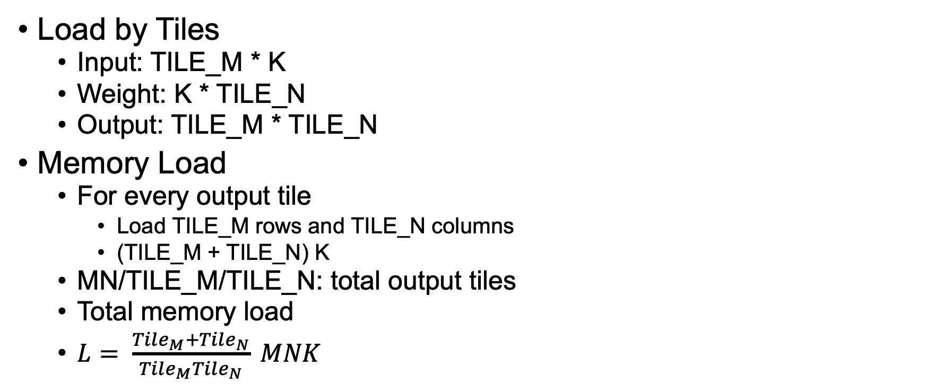
GEMM Tiling
N
0
1
2
3
4
5
6
7
8
9
10
11
12
13
14
15
16
17
18
19
20
21
22
23
K
24
25
26
27
28
29
30
31
32
33
34
35
36
37
38
39
40
41
42
43
44
45
46
47
48
49
50
51
52
53
54
55
K
56
57
58
50
60
61
62
63
0
1
2
3
4
5
6
7
8
9
10
11
12
13
14
15
16
17
18
19
20
21
22
23
24
25
26
27
28
29
30
31
M
32
33
34
35
36
37
38
39
40
41
42
43
44
45
46
47
48
49
50
51
52
53
54
55
56
57
58
50
60
61
62
63
L2 Access reduced by a factor of tile dimension (Assuming TileM = TileN)

Slide 44
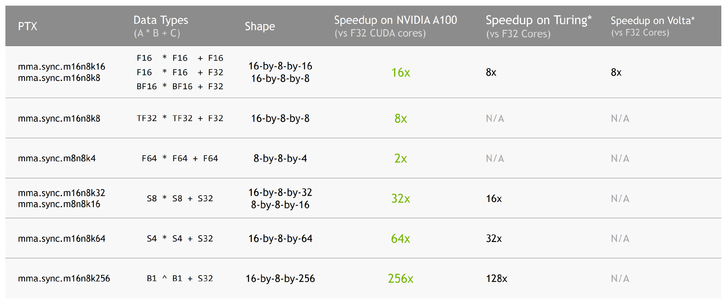
Tensor Cores – Specialized for small GEMMs
What is a tensor core?
A special hardware unit that performs a small shape GEMM
A warp (32 threads) collectively uses the tensor core
https://developer.download.nvidia.com/video/gputechconf/gtc/2020/presentations/s21745-developing-cuda-kernels-to-push-tensor-cores-to-the-absolute-limit-on-nvidia-a100.pdf

