Slide 1

CSE 554 Machine Learning Systems
Week 1 Lecture 1
Lecture 9 - Memory Management
Baris Kasikci

Slide 2
Class Overview
GPU Architecture and Programming
Transformers (Architecture and Implementation)
Performance Modeling
Quantization
Memory Management
NVIDIA Blackwell Architecture
Sparsity
Mixture of Experts (MoE)
Batching
Speculative decoding
Parallelism
End-to-end serving
Agentic systems

Slide 3
Calculating the KV cache size
Num KV heads
Head Dim
2 (stores both K and V)
Stype (2 Bytes)
Seqlen
Layer

Slide 4
Batch Size is limited by the KV Cache
Serving Llama3-8B model using H100 -> 80GB in total
Model weights 2*8=16GB
Activations are negligible
1024 input, 1024 output
Each request’s KV cache
(1024 + 1024 / 2) * 2 * 2 * 8 * 128 * 32 / 1024 / 1024 = 192 MB
Max possible batch size
(80 – 16 ) / (192 / 1024) = 341
Recall: batch size of 333 was needed to drive H100 to the compute-bound regime
We should fully utilize the GPU memory capacity to enlarge the batch size
Notes:
So the average number of generated tokens present over the course of producing 1024 tokens is roughly 1024/2.

Slide 5
Requests with different lengths
Serving Llama3-8B model using H100 -> 80GB in total
Model weights 2*8=16GB
1024 input, 50% 1024 output, 50% 4096 output
Each request’s KV cache
Min = (1024 + 1024 / 2) * 2 * 2 * 8 * 128 * 32 / 1024 / 1024 = 192 MB
Max = (1024 + 4096 / 2) * 2 * 2 * 8 * 128 * 32 / 1024 / 1024 = 384 MB
How to allocate the KV cache for requests with different lengths? (Note that before you are done decoding, you don’t know the decoding length)

Slide 6
Allocation Method 1 – Fixed Max seq_len
Allocate the KV cache for each request using the max sequence length the model supports
GPU memory
Req 0
Req 1
Req 2
Req 3
Finished!
Notes:
If the user tells you the maximum seq length, that’s one option. For Llama 3-3B max context length is 128K

Slide 7
Allocation Method 1 – Fixed Max Seq len
Allocate Max seqlen -> 4096
Max batch size = (80 – 16) / (384 / 1024) = 170
GPU memory
Wasted
Wasted
Wasted
Req 0
Req 1
Req 2
Req 3
Low utilization due to internal fragmentation

Slide 8
Allocation Method 2 – std::vector-style Allocation
Start with a small size, when fully occupied, double the size
Req 0
Req 2
Req 0
Req 1
Req 3
Req 1

Slide 9
Allocation Method 2 – std::vector-style Allocation
Now the waste inside a request is “well” controlled (avg 75% utilization)
Additional copy is acceptable
Wasted
Req 2
Req 0
Req 3
Req 1
Low utilization due to external fragmentation

Slide 10
Allocation Method 3 – PagedAttention
Chunk the global space into small pages
Each request picks some page as the KV cache
Each page is large enough for good bandwidth utilization
Page = 16 tokens’ KV = 16*2*2*8*128 = 64 KB⁺
Req 0
Req 1
No fragmentation
Kwon et al., Efficient Memory Management for Large Language Model Serving with PagedAttention
https://arxiv.org/abs/2309.06180
+8: number of KV heads
Notes:
You get good memory bandwidth utilization with a 64KB page. There is a tendency to reduce this for more flexibility.

Slide 11
Allocation Method 3 – PagedAttention
Due to the different number of pages per request, a basic page table is unbalanced
The page table also needs to be moved back and forth between the CPU and the GPU t every iteration.
Request ID | Page ID
0 | 1 | 4
1 | 8
2 | 2 | 5 | 0
3 | 6 | 10 | 15 | 17
How to handle page tables with variable-length entries without padding?
Notes:
You want a compact page table and don’t want this to be underutilized.

Slide 12
Multi-Level Page Table
kv_data is the real storage and all pages are stored sequentially at kv_data[pagd_id]
Max Page
kv_data
kv_indices
1
4
8
2
5
0
6
10
15
17
NumPage
kv_indices
[kv_indptr [i] ~ kv_indptr [i+1])
indicates the page id belongs to request i
kv_indptr
0
2
3
6
10
NumReq + 1
Req 0
Req 1
Req 2
Req 3
kv_indptr [i] ~ kv_indptr [i+1] indicates the page range belongs to request i
Notes:
Since kv_indptr starts from 0, there are numreq+1 such entries
Kv_indices is a flattened representation of all pages.

Slide 13
Prefix Sharing
What if these two pages are the same?
Req 0
Req 1
Notes:
If two pages have the same content, what do we do? Instead of doing two prefills, you can share the page in the KV cache.

Slide 14
Prefix Sharing
What if these two pages are the same?
Req 0
Req 1
Shared pages only need to prefill once and reduces both memory capacity and bandwidth in decoding

Slide 15
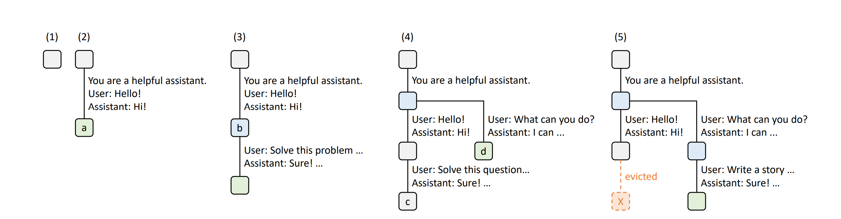
Prefix Tree
1. You are a helpful assistant. User:Hello, Assistant:Hi!
2. You are a helpful assistant. User:Hello, Assistant:Hi!, User: Solve this problem…
3. You are a helpful assistant. User:What can you do?
Multi-request Reuse
Multi-round Reuse
Zheng, Lianmin et al. “SGLang: Efficient Execution of Structured Language Model Programs.” Neural Information Processing Systems (2023).
Notes:
If the tree grows too much, you can decide to evict some entries.
When, sharing across users, the sharing of decode tokens is minimum, but you can share the system prompt. For a given user, in the case of multi-round conversations, you can share decode tokens.

Slide 16
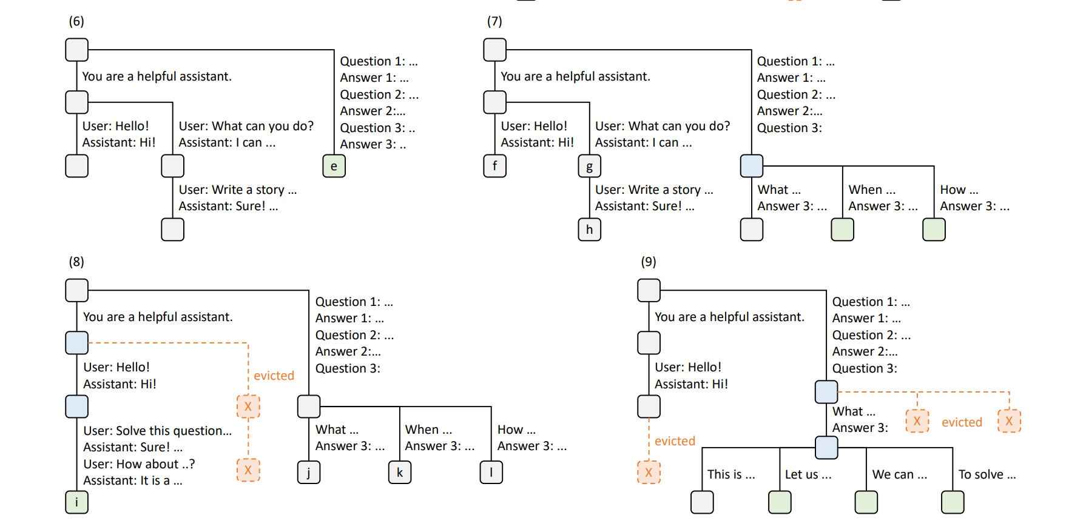
Radix Attention

Slide 17
Prefix Tree – Identify Prefix
The
Today
Washington
is
color
University
is
I
The
University
of
of
Washington
Notes:
Complexity is O(l)

Slide 18
Prefix Tree– Identify Prefix
The
Today,
Today,
we
will
color
University
the
I
of
Washington
Notes:
There are some works that reorder user requests to improve prefix sharing behavior.

Slide 19
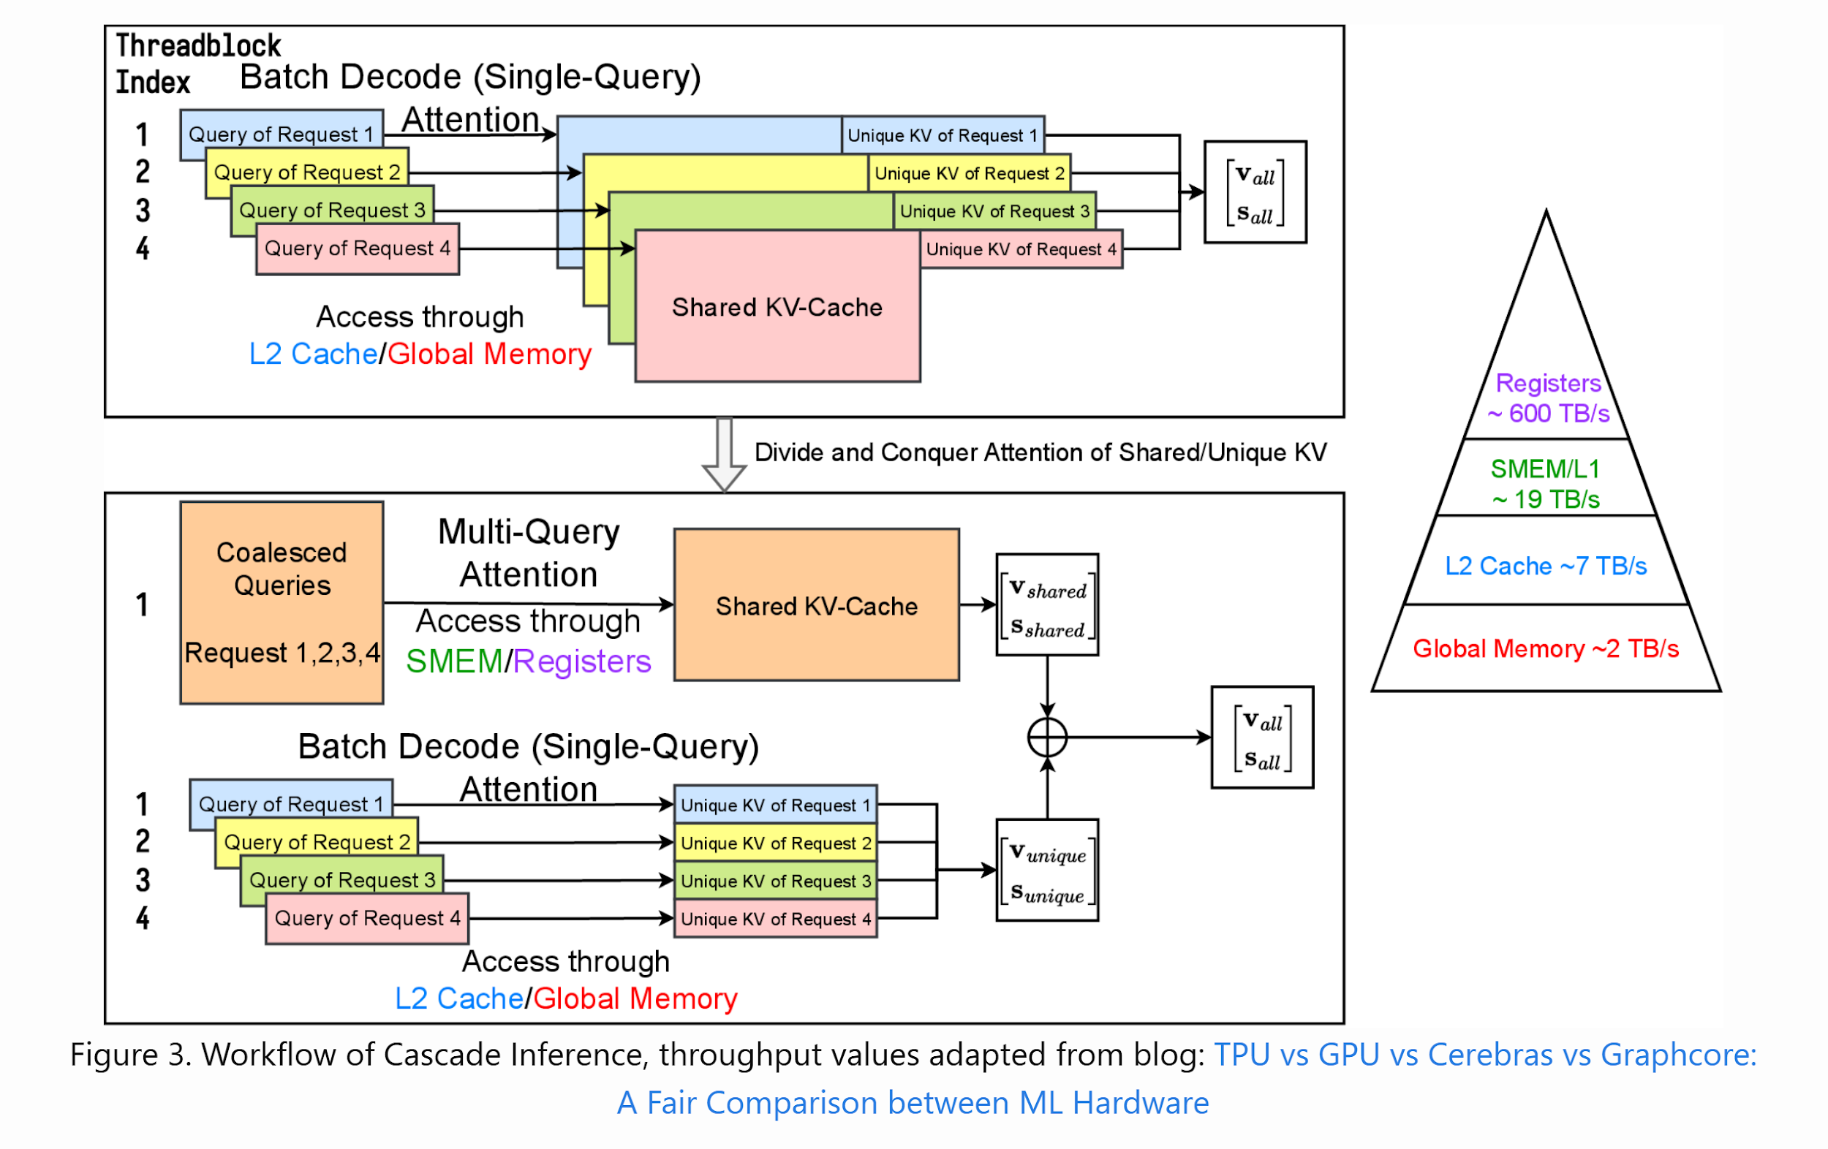
Batched Decoding Exploiting a Common Prefix
Concatenate Queries
https://flashinfer.ai/2024/02/02/cascade-inference.html
Notes:
Reusing during prefill is rather trivial, but reusing during decoding is a bit harder.
You are somehow batching decode requests. So in a way it was slightly misleading when we said decode attention cannot be batched well together, but there can be some partial batching, made especially effective with something like prefix sharing.

Slide 20
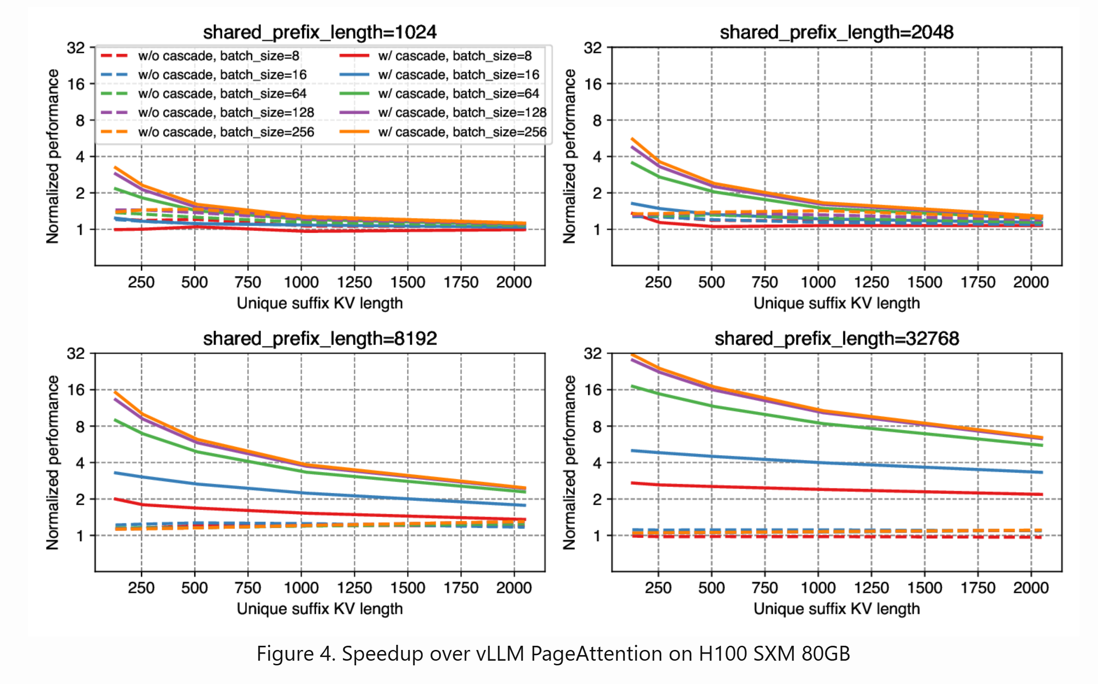
Performance gain of prefix sharing
https://flashinfer.ai/2024/02/02/cascade-inference.html

Slide 21
Prefix Sharing Pros and Cons
The prefix with length p shared across n requests
Reduced prefill computation (n*p -> p)
Reduced KV cache size (n*p -> p)
Reduced memory loading during decoding (n*p -> p)
The matching can be performed asynchronously.
When a new request comes
Need to store prefix chunks while some of them are not reused -> wasted GPU memory

Slide 22
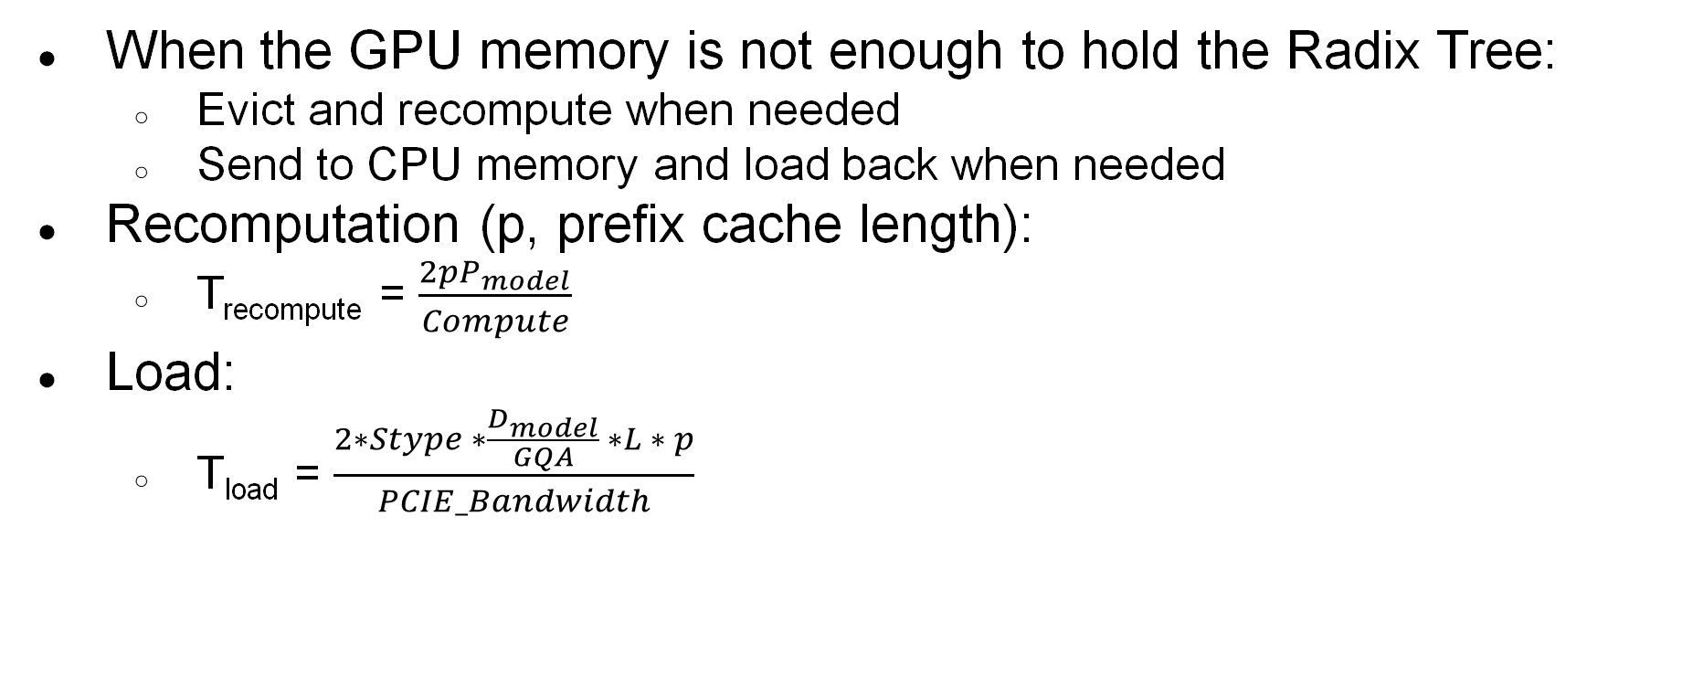
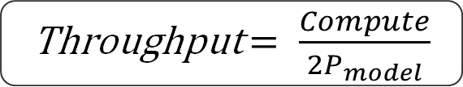
Recomputing vs Load/Offload
Notes:
Bandwidth here is the pcie bandwidth that we need to move data from GPU to the host
2 for K and V
Dmodel/GQA is head_dim*number of kv heads

Slide 23

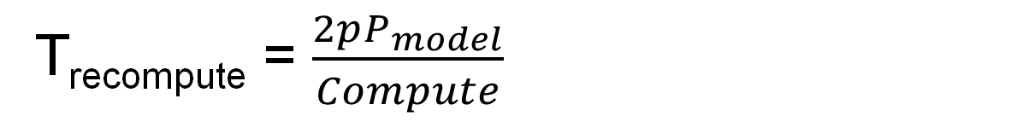
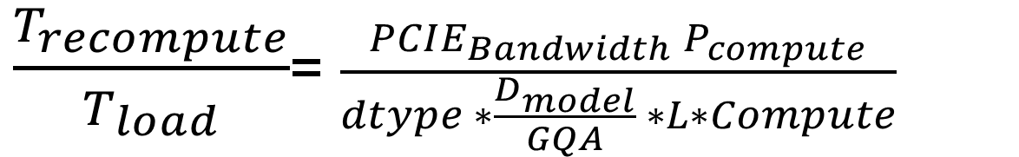
Recomputing vs Load/Offload
A100: 30G * 8 *10^9 / (2 * 1024 * 32 * 300T) = 12
Loading is much faster than recomputing

Slide 24
Revisit Prefill Attention
H_{dim}
Seq Len
Seq Len
V
H_{dim}
K^{T}
H_{dim}
Seq Len
Seq Len
H_{dim}
Attn
Score
Attn
Weight
Seq Len
Seq Len
Seq Len
Q
Seq Len
Out
Softmax
Notes:
Seqlen can be 128K at its max and this matrix can be very large, that’s like 16 GB each. You don’t want to move it back and forth, compute the max of each row, compute softmax etc.
But we really caare about the output matrix only. Theoretically if we can bypass these intermediate matrices, that’d bring huge savings.

Slide 25
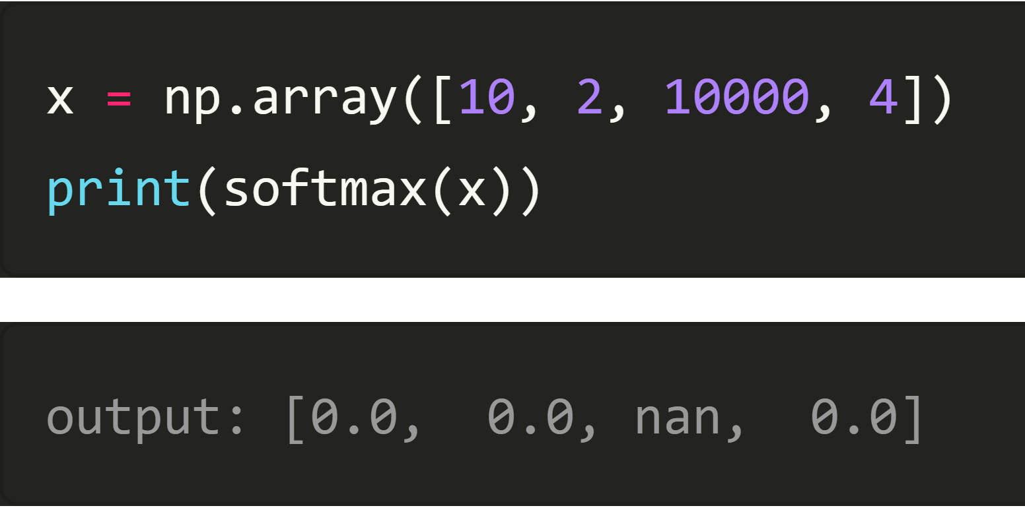
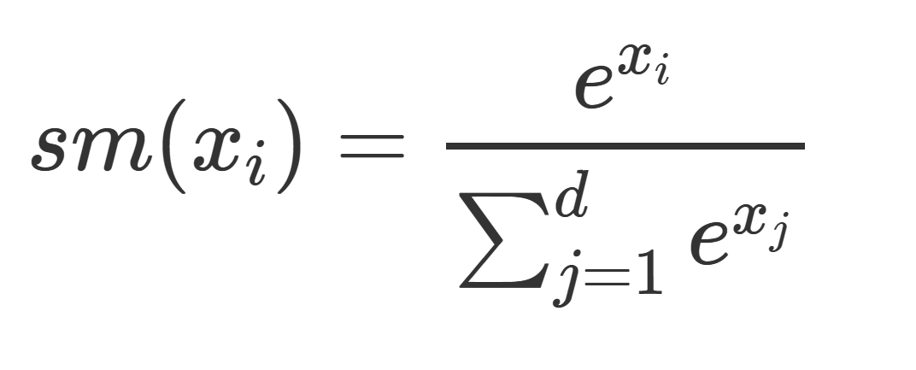
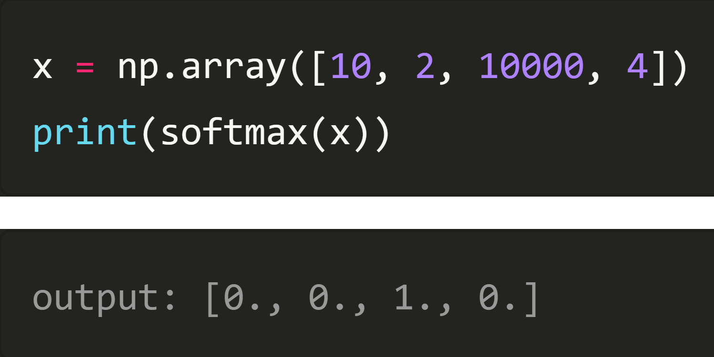
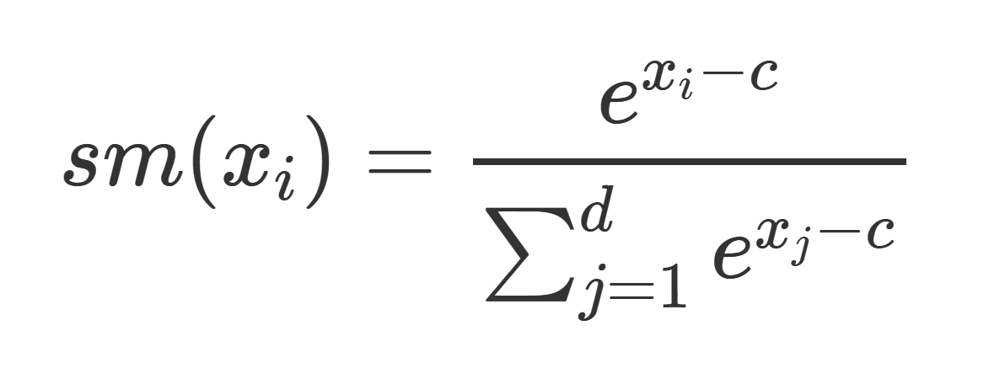
Softmax Numerical Stability
Too large!
Usually c=max(xi)
https://ogunlao.github.io/2020/04/26/you_dont_really_know_softmax.html

Slide 26
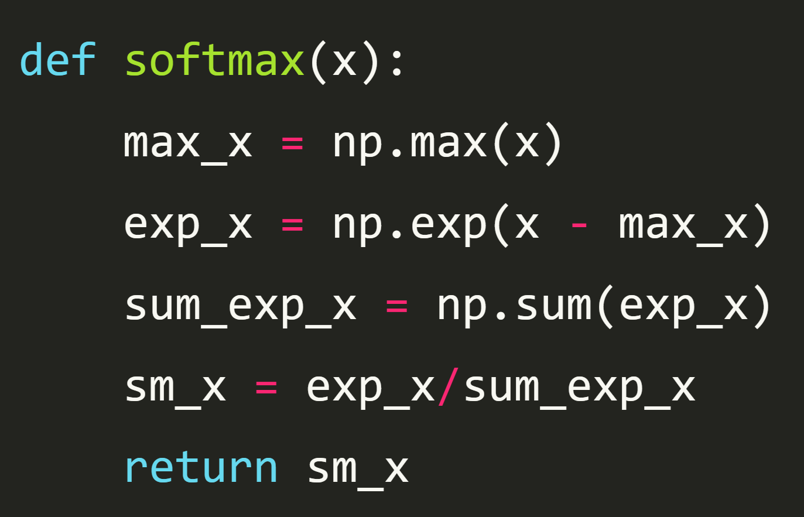
Softmax Numerical Stability

Slide 27
Revisit Prefill Attention
H_{dim}
Large for long context
Seq Len
Seq Len
V
H_{dim}
K^{T}
H_{dim}
Seq Len
Seq Len
H_{dim}
Attn
Score
Attn
Weight
Seq Len
Seq Len
Seq Len
Q
Seq Len
Out
Softmax

Slide 28
Revisit Prefill Attention – Tiling like GEMM
H_{dim}
Seq Len
How to deal with Softmax?
Seq Len
V
H_{dim}
K^{T}
H_{dim}
Seq Len
Seq Len
H_{dim}
Attn
Score
Attn
Weight
Seq Len
Seq Len
Seq Len
Q
Seq Len
Out
Softmax

Slide 29
Original Attention Calculation:
1 | 2 | 1 | -2
1 | 2 | -1 | 0
1 | 2 | 1 | 1
1 | 2 | 1 | 0
1 | 2
3 | 4
2 | -2
-3 | 1
S1 = e⁴⁻⁸ + e⁸⁻⁸ + e²⁻⁸ + e⁻¹⁻⁸
/ S1
2 | 2 | 2 | 2
2 | -2 | 4 | -2
4 | 8 | 2 | -1
1 | 2 | 3 | 0
e⁴⁻⁸ | e⁸⁻⁸ | e²⁻⁸ | e⁻¹⁻⁸
e¹⁻³ | e²⁻³ | e³⁻³ | e⁰⁻³
1e⁴⁻⁸+3e⁸⁻⁸ +2e²⁻⁸-3e⁻¹⁻⁸ | 2e⁴⁻⁸+4e⁸⁻⁸ - 2e²⁻⁸+e⁻¹⁻⁸
1e¹⁻³+3e²⁻³ +2e³⁻³-3e⁰⁻³ | 2e¹⁻³+4e²⁻³ - 2e³⁻³+e⁰⁻³
RowMax = 8
/ S1
RowMax = 3
/ S2
S2 = e¹⁻³ + e²⁻³ + e³⁻³ + e⁰⁻³
/ S2
Q*K^{T}/sqrt(D)
Stable Softmax
Softmax * V
Notes:
HEad dimension is 4

Slide 30
FlashAttn – Calculating the first block separately
1 | 2
1 | 2
1 | 2
1 | 2
1 | 2
3 | 4
S1 = e⁴⁻⁸ + e⁸⁻⁸
2 | 2 | 2 | 2
2 | -2 | 4 | -2
4 | 8
1 | 2
e⁴⁻⁸ | e⁸⁻⁸
e¹⁻² | e²⁻²
RowMax = 8
/ S1
1e⁴⁻⁸+3e⁸⁻⁸ | 2e⁴⁻⁸+4e⁸⁻⁸
1e¹⁻²+3e²⁻² | 2e¹⁻²+4e²⁻²
/ S1
RowMax = 2
/ S2
/ S2
S2 = e¹⁻² + e²⁻²
Q*K^{T}/sqrt(D)
Stable Softmax
Softmax * V
Dao et al. FlashAttention: Fast and Memory-Efficient Exact Attention with IO-Awareness https://arxiv.org/abs/2205.14135

Slide 31
FlashAttn – Calculating the second block separately
1 | -2
-1 | 0
1 | 1
1 | 0
2 | -2
-3 | 1
S1 = e²⁻² + e⁻¹⁻²
2 | 2 | 2 | 2
2 | -2 | 4 | -2
2 | -1
3 | 0
2e²⁻²-3e⁻¹⁻² | -2e²⁻²+e⁻¹⁻²
2e³⁻³-3e⁰⁻³ | -2e³⁻³+e⁰⁻³
RowMax = 2
e²⁻² | e⁻¹⁻²
e³⁻³ | e⁰⁻³
/ S1
/ S1
RowMax = 3
/ S2
/ S2
S2 = e³⁻³ + e⁰⁻³
Q*K^{T}/sqrt(D)
Stable Softmax
Softmax * V

Slide 32
FlashAttn – Combine two blocks
/
RowMax = 8
1e⁴⁻⁸+3e⁸⁻⁸ | 2e⁴⁻⁸+4e⁸⁻⁸
1e¹⁻²+3e²⁻² | 2e¹⁻²+4e²⁻²
S1 = e⁴⁻⁸ + e⁸⁻⁸
Step 0
/
RowMax = 2
S2 = e¹⁻² + e²⁻²
/
RowMax = 2
2e²⁻²-3e⁻¹⁻² | -2e²⁻²+e⁻¹⁻²
2e³⁻³-3e⁰⁻³ | -2e³⁻³+e⁰⁻³
S1 = e²⁻² + e⁻¹⁻²
Step 1
RowMax = 3
/
S2 = e³⁻³ + e⁰⁻³
1e⁴⁻⁸+3e⁸⁻⁸ +2e²⁻⁸-3e⁻¹⁻⁸ | 2e⁴⁻⁸+4e⁸⁻⁸ - 2e²⁻⁸+e⁻¹⁻⁸
1e¹⁻³+3e²⁻³ +2e³⁻³⁻3e⁰⁻³ | 2e¹⁻³+4e²⁻³ - 2e³⁻³+e⁰⁻³
RowMax = 8
/
S1 = e⁴⁻⁸ + e⁸⁻⁸ + e²⁻⁸ + e⁻¹⁻⁸
Final
/
RowMax = 3
S2 = e¹⁻³ + e²⁻³ + e³⁻³ + e⁰⁻³
Similar but have wrong scaling

Slide 33
FlashAttn – Rescaling numerator and denominator
/
RowMax = 8
1e⁴⁻⁸+3e⁸⁻⁸ | 2e⁴⁻⁸+4e⁸⁻⁸
1e¹⁻²+3e²⁻² | 2e¹⁻²+4e²⁻²
S1 = e⁴⁻⁸ + e⁸⁻⁸
Scaling = e⁸⁻⁸
Step 0
/
RowMax = 2
S2 = e¹⁻² + e²⁻²
Scaling = e²⁻³
/
RowMax = 2
2e²⁻²-3e⁻¹⁻² | -2e²⁻²+e⁻¹⁻²
2e³⁻³-3e⁰⁻³ | -2e³⁻³+e⁰⁻³
S1 = e²⁻² + e⁻¹⁻²
Global Max = 8
Scaling = e²⁻⁸
Step 1
RowMax = 3
/
S2 = e³⁻³ + e⁰⁻³
Global Max = 3
Scaling = e³⁻³
1e⁴⁻⁸+3e⁸⁻⁸ +2e²⁻⁸⁻3e⁻¹⁻⁸ | 2e⁴⁻⁸+4e⁸⁻⁸ - 2e²⁻⁸+e⁻¹⁻⁸
1e¹⁻³+3e²⁻³ +2e³⁻³⁻3e⁰⁻³ | 2e¹⁻³+4e²⁻³ - 2e³⁻³+e⁰⁻³
RowMax = 8
/
S1 = e⁴⁻⁸ + e⁸⁻⁸ + e²⁻⁸ + e⁻¹⁻⁸
Final
RowMax = 3
/
S2 = e¹⁻³ + e²⁻³ + e³⁻³ + e⁰⁻³

Slide 34
FlashAttn – Rescaling numerator
Scaling = e⁸⁻⁸
1e⁴⁻⁸+3e⁸⁻⁸ | 2e⁴⁻⁸+4e⁸⁻⁸
1e¹⁻²+3e²⁻² | 2e¹⁻²+4e²⁻²
e⁸⁻⁸(1e⁴⁻⁸+3e⁸⁻⁸) | e⁸⁻⁸(2e⁴⁻⁸+4e⁸⁻⁸)
e²⁻³(1e¹⁻²+3e²⁻² ) | e²⁻³(2e¹⁻²+4e²⁻² )
Step 0
Scaling = e²⁻³
Scaling = e²⁻⁸
2e²⁻²-3e⁻¹⁻² | -2e²⁻²+e⁻¹⁻²
2e³⁻³-3e⁰⁻³ | -2e³⁻³+e⁰⁻³
e²⁻⁸(2e²⁻²-3e⁻¹⁻²) | e²⁻⁸(-2e²⁻²+e⁻¹⁻²)
e³⁻³(2e³⁻³-3e⁰⁻³) | e³⁻³(-2e³⁻³+e⁰⁻³)
Step 1
Scaling = e³⁻³
1e⁴⁻⁸+3e⁸⁻⁸ +2e²⁻⁸⁻3e⁻¹⁻⁸ | 2e⁴⁻⁸+4e⁸⁻⁸ - 2e²⁻⁸+e⁻¹⁻⁸
1e¹⁻³+3e²⁻³ +2e³⁻³⁻3e⁰⁻³ | 2e¹⁻³+4e²⁻³ - 2e³⁻³+e⁰⁻³
/
S1 = e⁴⁻⁸ + e⁸⁻⁸ + e²⁻⁸ + e⁻¹⁻⁸
Final
/
S2 = e¹⁻³ + e²⁻³ + e³⁻³ + e⁰⁻³

Slide 35
FlashAttn – Rescaling the Numerator
e⁸⁻⁸(1e⁴⁻⁸+3e⁸⁻⁸) | e⁸⁻⁸(2e⁴⁻⁸+4e⁸⁻⁸)
e²⁻³(1e¹⁻²+3e²⁻² ) | e²⁻³(2e¹⁻²+4e²⁻² )
1e⁴⁻⁸+3e⁸⁻⁸ | 2e⁴⁻⁸+4e⁸⁻⁸
1e¹⁻³+3e²⁻³ | 2e¹⁻³+4e²⁻³
Step 0
+
e²⁻⁸(2e²⁻²-3e⁻¹⁻²) | e²⁻⁸(-2e²⁻²+e⁻¹⁻²)
e³⁻³(2e³⁻³-3e⁰⁻³) | e³⁻³(-2e³⁻³+e⁰⁻³)
2e²⁻⁸-3e⁻¹⁻⁸ | -2e²⁻⁸+e⁻¹⁻⁸
2e³⁻³-3e⁰⁻³ | -2e³⁻³+e⁰⁻³
Step 1
1e⁴⁻⁸+3e⁸⁻⁸ +2e²⁻⁸⁻3e⁻¹⁻⁸ | 2e⁴⁻⁸+4e⁸⁻⁸ - 2e²⁻⁸+e⁻¹⁻⁸
1e¹⁻³+3e²⁻³ +2e³⁻³⁻3e⁰⁻³ | 2e¹⁻³+4e²⁻³ - 2e³⁻³+e⁰⁻³
Final

Slide 36
FlashAttn – Rescaling the Denominator
Scaling = e⁸⁻⁸
S1 = e⁴⁻⁸ + e⁸⁻⁸
S1 = e⁸⁻⁸ ( e⁴⁻⁸ + e⁸⁻⁸ )
S1 = e⁴⁻⁸ + e⁸⁻⁸
Step 0
Scaling = e²⁻³
S2 = e¹⁻² + e²⁻²
S2 = e²⁻³ ( e¹⁻² + e²⁻² )
S2 = e¹⁻³ + e²⁻³
+
Scaling = e²⁻⁸
S1 = e²⁻² + e⁻¹⁻²
S1 = e²⁻⁸ ( e²⁻² + e⁻¹⁻² )
S1 = e²⁻⁸ + e⁻¹⁻⁸
Step 1
Scaling = e³⁻³
S2 = e³⁻³ + e⁰⁻³
S2 = e³⁻³ ( e³⁻³ + e⁰⁻³ )
S2 = e³⁻³ + e⁰⁻³
S1 = e⁴⁻⁸ + e⁸⁻⁸ + e²⁻⁸ + e⁻¹⁻⁸
Final
S2 = e¹⁻³ + e²⁻³ + e³⁻³ + e⁰⁻³

Slide 37
FlashAttn – Combine two blocks
RowMax = 8
1e⁴⁻⁸+3e⁸⁻⁸ | 2e⁴⁻⁸+4e⁸⁻⁸
1e¹⁻³+3e²⁻³ | 2e¹⁻³+4e²⁻³
S1 = e⁴⁻⁸ + e⁸⁻⁸
Step 0
RowMax = 2
S2 = e¹⁻³ + e²⁻³
RowMax = 2
2e²⁻⁸-3e⁻¹⁻⁸ | -2e²⁻⁸+e⁻¹⁻⁸
2e³⁻³-3e⁰⁻³ | -2e³⁻³+e⁰⁻³
S1 = e²⁻⁸ + e⁻¹⁻⁸
Step 1
RowMax = 3
S2 = e³⁻³ + e⁰⁻³
1e⁴⁻⁸+3e⁸⁻⁸ +2e²⁻⁸⁻3e⁻¹⁻⁸ | 2e⁴⁻⁸+4e⁸⁻⁸ - 2e²⁻⁸+e⁻¹⁻⁸
1e¹⁻³+3e²⁻³ +2e³⁻³⁻3e⁰⁻³ | 2e¹⁻³+4e²⁻³ - 2e³⁻³+e⁰⁻³
RowMax = 8
/
S1 = e⁴⁻⁸ + e⁸⁻⁸ + e²⁻⁸ + e⁻¹⁻⁸
Final
/
RowMax = 3
S2 = e¹⁻³ + e²⁻³ + e³⁻³ + e⁰⁻³

Slide 38
FlashAttn
1 | 2
1 | 2
1 | 2
1 | 2
1 | 2
3 | 4
e⁴⁻⁸ | e⁸⁻⁸
e¹⁻² | e²⁻²
4 | 8
1 | 2
1e⁴⁻⁸+3e⁸⁻⁸ | 2e⁴⁻⁸+4e⁸⁻⁸
1e¹⁻²+3e²⁻² | 2e¹⁻²+4e²⁻²
2 | 2 | 2 | 2
2 | -2 | 4 | -2
RowMax = 8
Global Max = 8
RowMax = 2
Global Max = 2
Keep
S1 = e⁴⁻⁸ + e⁸⁻⁸
Keep
S2 = e¹⁻² + e²⁻²
Keep

Slide 39
FlashAttn
1e⁴⁻⁸+3e⁸⁻⁸ | 2e⁴⁻⁸+4e⁸⁻⁸
1e¹⁻²+3e²⁻² | 2e¹⁻²+4e²⁻²
1e⁴⁻⁸+3e⁸⁻⁸ | 2e⁴⁻⁸+4e⁸⁻⁸
1e¹⁻³+3e²⁻³ | 2e¹⁻³+4e²⁻³
1 | -2
-1 | 0
1 | 1
1 | 0
Global Max = 8
2 | -2
-3 | 1
Global Max = 2
2 | 2 | 2 | 2
2 | -2 | 4 | -2
2 | -1
3 | 0
e²⁻⁸ | e⁻¹⁻⁸
e³⁻³ | e⁰⁻³
RowMax = 2
Global Max = 8
2e²⁻⁸-3e⁻¹⁻⁸ | -2e²⁻⁸+e⁻¹⁻⁸
2e³⁻³-3e⁰⁻³ | -2e³⁻³+e⁰⁻³
RowMax = 3
Global Max = 3
Keep
S1 = e⁴⁻⁸ + e⁸⁻⁸
S1 = e²⁻⁸ + e⁻¹⁻⁸
S1 = e⁴⁻⁸ + e⁸⁻⁸ + e²⁻⁸ + e⁻¹⁻⁸
1e⁴⁻⁸+3e⁸⁻⁸ +2e²⁻⁸⁻3e⁻¹⁻⁸ | 2e⁴⁻⁸+4e⁸⁻⁸ - 2e²⁻⁸+e⁻¹⁻⁸
1e¹⁻³+3e²⁻³ +2e³⁻³⁻3e⁰⁻³ | 2e¹⁻³+4e²⁻³ - 2e³⁻³+e⁰⁻³
Keep
S2 = e¹⁻² + e²⁻²
S2 = e³⁻³ + e⁰⁻³
S2 = e¹⁻³ + e²⁻³ + e³⁻³ + e⁰⁻³
Notes:
You do rescaling if you need to, sort of in a streaming fashion.

Slide 40
Revisit Prefill Attention
H_{dim}
Shared
S1 = e²⁻⁸ + e⁻¹⁻⁸
Reg
Seq Len
S2 = e³⁻³ + e⁰⁻³
Seq Len
V
Global Max
K^{T}
Reg
Global
H_{dim}
Global Max
Shared
Global
H_{dim}
Seq Len
Seq Len
H_{dim}
Shared
Attn
Score
Attn
Weight
Seq Len
Seq Len
Seq Len
Q
Seq Len
Out
Softmax
Global
Temp
Temp
Reg

Slide 41
Causal Mask
1 | 2
1 | 2
1 | 2
1 | 2
1 | 2
3 | 4
e⁴⁻⁴ | 0
e¹⁻² | e²⁻²
4 | -Inf
1 | 2
1e⁴⁻⁴ | 2e⁴⁻⁴
1e¹⁻²+3e²⁻² | 2e¹⁻²+4e²⁻²
2 | 2 | 2 | 2
2 | -2 | 4 | -2
RowMax = 4
Global Max = 4
RowMax = 2
Global Max = 2
Keep
S1 = e⁴⁻⁴
Keep
S2 = e¹⁻² + e²⁻²
Keep

Slide 42
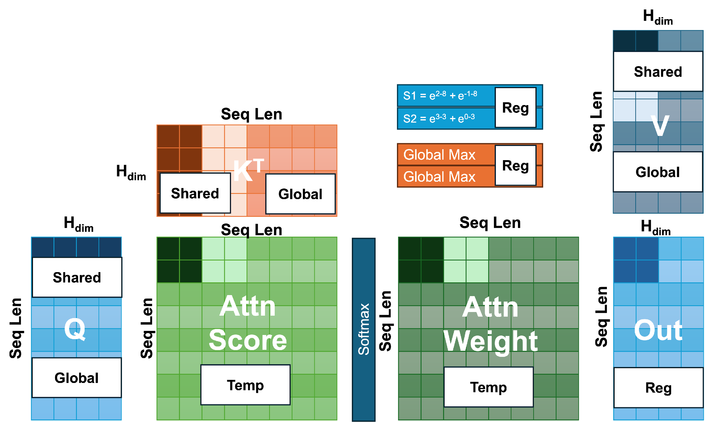
Grouped Query Attention of size 2
Block 0
Block 1
Block 2
Block 3
Block 4
Block 5
Block 6
Block 7
Notes:
You need to of course maintain different rowmaex etc.

Slide 43
Expanding to all KV heads

