Slide 1

CSE 554 Machine Learning Systems
Week 1 Lecture 1
Lecture 13 - Batching
Baris Kasikci

Slide 2
Class Overview
GPU Architecture and Programming
Transformers (Architecture and Implementation)
Performance Modeling
Quantization
Memory Management
NVIDIA Blackwell Architecture
Sparsity
Mixture of Experts (MoE)
Speculative decoding
Batching
Parallelism
RL for LLMs
Agentic systems

Slide 3
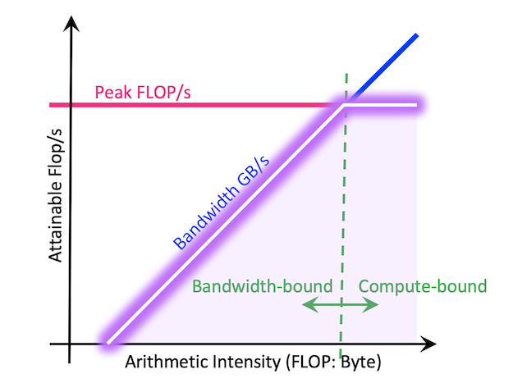
Batching is important in LLM serving
H100 needs a batch size of 333 to reach peak performance
How to form a batch?
Consideration 1:
User Experience
Consideration 2: Throughput

Slide 4
How to define user experience
Time to First Token (TTFT)
The time between user submitting the request and the generation of first token
TTFT = Queuing time + Prefill time
Time Per Output Token (TPOT/ITL/IBT)
The time between each output token
Average TPOT
The average time of producing one output token
End to end time
The time to queue, prefill and decode the whole request
Normalized Latency
End-to-end time / number of output tokens
Notes:
TPOT in this class is about maximum latency: if any two token have an interval larger than say a specific TPOT, then that hurst user experience.
IBT: interval between tokens
ITL: Inter-token latency

Slide 5
Service Level Agreement
TTFT + TPOT
TTFT + Avg TPOT
End to end time

Slide 6
Service Level Objective
Assumption: TTFT SLO of 6
TTFT | TPOT_{avg} | TPOT_{max} | E2E | TTFT+ TPOT_{avg} | TTFT+ TPOT_{max}
6 | 2 | 2 | 12
11 | 2 | 2 | 17 | TTFT | TTFT
3 | 3 | 5 | 12 | TPOT | TPOT
8 | 1 | 1 | 11 | TTFT | TTFT
6 | 2 | 4 | 12 |  | TPOT
6 | 2 | 4 | 12 |  | TPOT
Arrival
Schedule
Token
0 | 1 | 2 | 3 | 4 | 5 | 6 | 7 | 8 | 9 | 10 | 11 | 12 | 13 | 14 | 15 | 16 | 17 | 18
Difficulty: TTFT+TPOT_{max}>TTFT+TPOT_{avg}>E2E

Slide 7
Service Level Objective
0 | 1 | 2 | 3 | 4 | 5 | 6 | 7 | 8 | 9 | 10 | 11 | 12 | 13 | 14 | 15 | 16 | 17 | 18
“Faster” token generation but does not meet TTFT+TPOT_{max}
Generation stall but still passes TPOT_{avg}

Slide 8
Delay output and Deadline based SLO
0 | 1 | 2 | 3 | 4 | 5 | 6 | 7 | 8 | 9 | 10 | 11 | 12 | 13 | 14 | 15 | 16 | 17 | 18
Delay the token
Now meets TTFT+TPOT
Cannot delay!
Delay the token
Now the generation is more smooth

Slide 9
Delay output and Deadline based SLO
DDL 1
DDL 2
DDL 3
DDL 4
0 | 1 | 2 | 3 | 4 | 5 | 6 | 7 | 8 | 9 | 10 | 11 | 12 | 13 | 14 | 15 | 16 | 17 | 18
If deadlines are met, we can use delay to achieve TTFT+TPOT_{max}
TTFT+TPOT_{max}>=DDL > TTFT+TPOT_{avg}>E2E

Slide 10
Batching Requests with Different Input Lengths
GEMM
Prompt
Output
Req 1
Req 2
Req 3
Req 4
Req 6
Attn
Sequentially
Notes:
To batch requests with different prompt lengths, we aggregate all these tokens for GEMMs
Attention doesn’t get benefit. Why is that? What’s the exception to that?

Slide 11
Batching Requests with Different Input Lengths
Iteration 0
Iteration 1
Iteration 2
Req 1
Req 2
Req 3
Req 4
Req 5
Req 1
Req 2
Req 3
Req 4
Req 5
Req 1
Req 2
Req 3
Req 4
Req 5
Remove
Remove
Remove
Remove
Remove
GEMM
GEMM
Large batch size for prefill, small batch size for decode

Slide 12
Batching Requests with Different Output Lengths
Iteration 0
Iteration 1
Iteration 2
Req 1
Req 2
Req 3
Req 4
Req 5
Req 1
Req 2
Req 3
Req 4
Req 5
Req 1
Req 2
Req 3
Req 4
Req 5
Iteration 3
Iteration 4
Iteration 6
Req 1
Req 2
Req 3
Req 4
Req 5
Req 1
Req 2
Req 3
Req 4
Req 5
Req 1
Req 2
Req 3
Req 4
Req 5
Bottlenecked by the longest decode request

Slide 13
Orca: Continuous batching
Key insight: admit new request when the decode requests finish
Remove
Req 9
Req 6
Req 7
Req 8
Req 5
Req 1
Req 2
Req 3
Req 4
Req 5
Req 1
Req 6
Req 7
Req 8
Req 5
Remove
Remove
Remove
Batch Size = 5
Batch Size = 9
Batch Size = 9
Now the system achieves a stable batch size and will not be bottlenecked by the longest decoding request

Slide 14
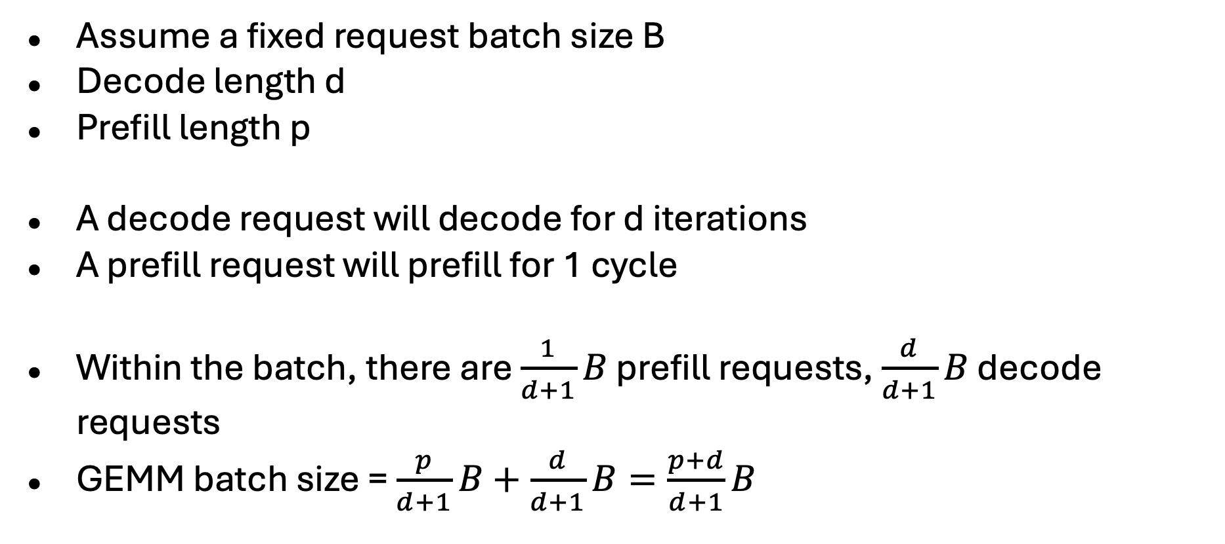
Continuous Batching Batch Size Calculation

Slide 15
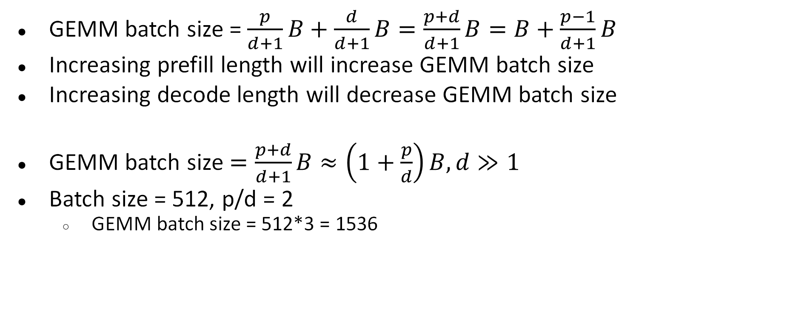
Continuous Batching Batch Size Calculation

Slide 16
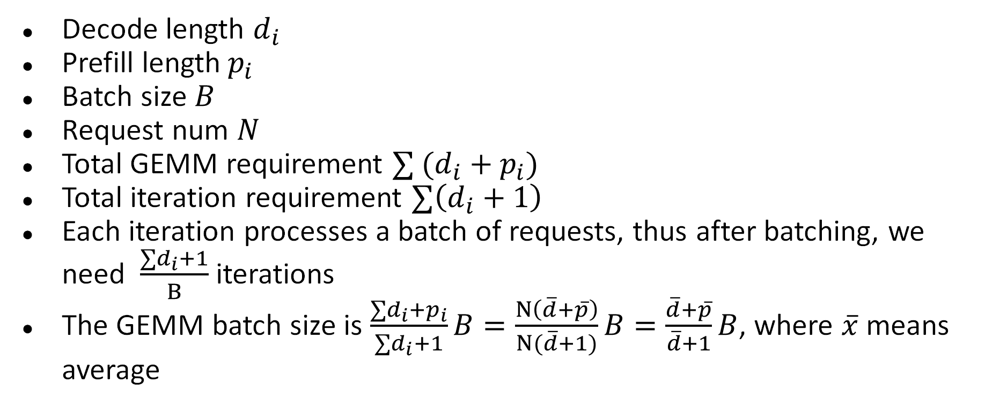
Batch size calculation for various d, p

Slide 17
Continuous Batching Performance Analysis
Higher throughput
No need to wait for the longest decode request
Stabilize the GEMM batch size
GEMM performance is a concave shape
GEMM of batch size 1 and 4095 is slower than 2 * GEMM of batch size 2048
Higher prefill latency
Now prefill is batched with decode request, so the prefill speed is reduced
Higher decode latency
Prefill also slows down the concurrent decode
Reduced queuing time
Now, a request can enter the batch at the token granularity

Slide 18
Simple Continuous batching struggles to meet SLO
Req 9
Req 6
Req 7
Req 8
Req 5
Remove
Req 1
Req 2
Req 3
Req 4
Req 5
Req 1
Req 6
Req 7
Req 8
Req 5
Remove
Remove
Remove
Remove
Batch Size = 5
Batch Size = 9
Batch Size = 24
Dec(1,2,3,4,5)
Pf(6,7,8) Dec(1,5)
Pf(9) Dec(5,6,8)
…
Time

Slide 19
SLO Attainment
Pf(1,2,3,4,5)
Dec(1,2,3,4,5)
Pf(6,7,8) Dec(1,5)
Pf(9) Dec(5,67,8)
 | Req 1
 | Req 2
 | Req 3
 | Req 4
 | Req 5
 | Req 6
 | Req 7
 | Req 8
 | Req 9
 |  | 0 | 1 | 2 | 3 | 4 | 5 | 6 | 7 | 8 | 9 | 10 | 11 | 12 | 13 | 14 | 15 | 16 | 17 | 18 | 19 | 20 | 21 | 22
Very long stall > TPOT
Very long stall > TPOT

Slide 20
Chunked prefill
Chunk size = 8
Only prefill the first 8 tokens
Req 9
Req 6
Req 7
Req 8
Req 5
Remove
Req 1
Req 2
Req 3
Req 4
Req 5
Req 1
Req 6
Req 7
Req 8
Req 5
Remove
Remove
Remove
Remove
Batch Size = 5
Batch Size = 9
Batch Size = 11
Req 9
Req 6
Req 8
Req 5
Req 9
Req 6
Req 8
Req 5
Consistent batch size
Batch Size = 11
Batch Size = 8

Slide 21
Chunked Prefill eliminates generation stall
Pf(1,2,3,4,5)
Dec(1,2,3,4,5)
Pf(6,7,8)
Dec(1,5)
Pf(9_P1)
Dec(5,6,8)
Pf(9_P2)
Dec(5,6,8)
Pf(9_P3)
Dec(5,6,8)
 | Req 1
 | Req 2
 | Req 3
 | Req 4
 | Req 5
 | Req 6
 | Req 7
 | Req 8
 | Req 9
 |  | 0 | 1 | 2 | 3 | 4 | 5 | 6 | 7 | 8 | 9 | 10 | 11 | 12 | 13 | 14 | 15 | 16 | 17 | 18 | 19 | 20 | 21 | 22
No Stall
Longer Prefill Time

Slide 22
Fixed Token Budget Chunked Prefill
Fixed Budget
Decode Request 1
Decode Request 2
…
Decode Request 5
Prefill Request 1
Next round
Prefill Request 2
Constant GEMM batch size

Slide 23
Chunked Prefill Performance Analysis
Slightly higher throughput
Additional KV cache load for chunked prefill
When the chunk size is large enough, it is still compute-bound
The additional load is negligible
Further stabilized the batch size
Again, since the TFLOPs curve is concave, GPU utilization is higher
Further harm the prefill latency
Now need to batch with decode requests for more cycles
Fractional chunks can add additional latency (e.g., 128 chunk, 257 length)
Controlled decode latency

Slide 24

Prefill Decode Disaggregation
Prefill Server
Decode Server
KV Cache
Req
Req
Req

Slide 25
Prefill Decode Disaggregation
Prefill Server
Prefill Server
Prefill Server
Req 1
Req 2
Req 3
Req 4
Req 5
Req 6
KV Cache
KV Cache
Decode Server
Decode Server
Decode Server
Decode Server
Req 1
Req 2
Req 1
Req 2
Req 1
Remove
Req 4
Req 5
Req 3
Req 3
Remove
Decoupled Prefill and Decode Latency

Slide 26
Prefill Decode Disaggregation KV Transfer
KV cache movement overhead can be significant in PD disaggregation
PF 16K token
2*2*16K*8*128*32 = 2GB
Net = 100Gbps = 12.5GB/s
Transfer overhead = 160ms
However, prefill itself is even slower
PF throughput = 16000 token/s
Prefill time = 1s
Therefore, we can use chunked prefill and layer-wise transfer to overlap the KV transfer
When prefill finishes, only need to transfer the last layer of last chunk

Slide 27
Prefill Decode Disaggregation KV Transfer
GPU
C0L0
C0L1
…
C0L31
C1L0
C1L1
…
…
C8L31
CPU
C0L0
C0L1
…
C0L31
C1L0
C1L1
…
…
C8L31
Decode Cluster CPU
C0L0
C0L1
…
C0L31
C1L0
C1L1
…
…
C8L31
Decode GPU
Time

Slide 28
Prefill Decode Disaggregation Performance Analysis
Throughput is not increased
The prefill cluster is fully utilized, while the decode cluster is underutilized
TTFT and TPOT are decoupled
By increasing machines, TTFT and TPOT can be reduced to “optimal”, when one request is exclusively executed on one machine

Slide 29
Comparison
Method | Throughput | TTFT | TPOT | Infra Complexity
Simple | Lowest | Short | Short | Low
Continuous Batching | High | Longer | Long, Unstable | Low
Chunked Prefill | Highest | Longest | Long, Controlled | Medium
PD DisAgg | Low | Short | Short | High

Slide 30
Limiting factors of batching
Batching is good for throughput, but there are limits
SLO
Larger batching means higher iteration time, which may violate TTFT and TPOT
KV cache capacity
The available memory for GPU is limited, and the KV cache must fit in GPU memory

Slide 31
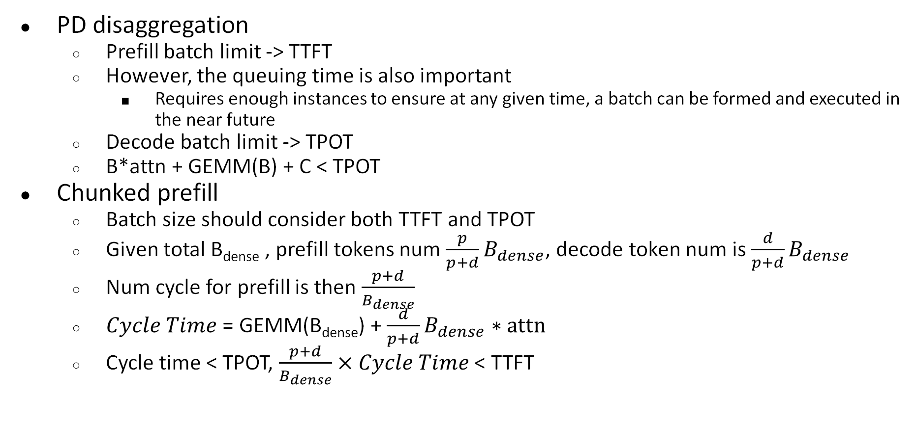
Batch Limit due to SLO

Slide 32
Batch Limit due to GPU capacity
Total KV cache tokens < limit
For 8B, H100, num tokens
64*1024*1024*1024/2/2/32/1024 = 524288 = 512K
Challenges: KV cache can grow over time, and output length is unknown
Example: 1K input, 1K output
If scheduled at once, all request reach max length at same time, max batch = 512K / (1K+1K) = 256
If scheduled uniformly, average length is then 1.5K, max batch = 341

Slide 33
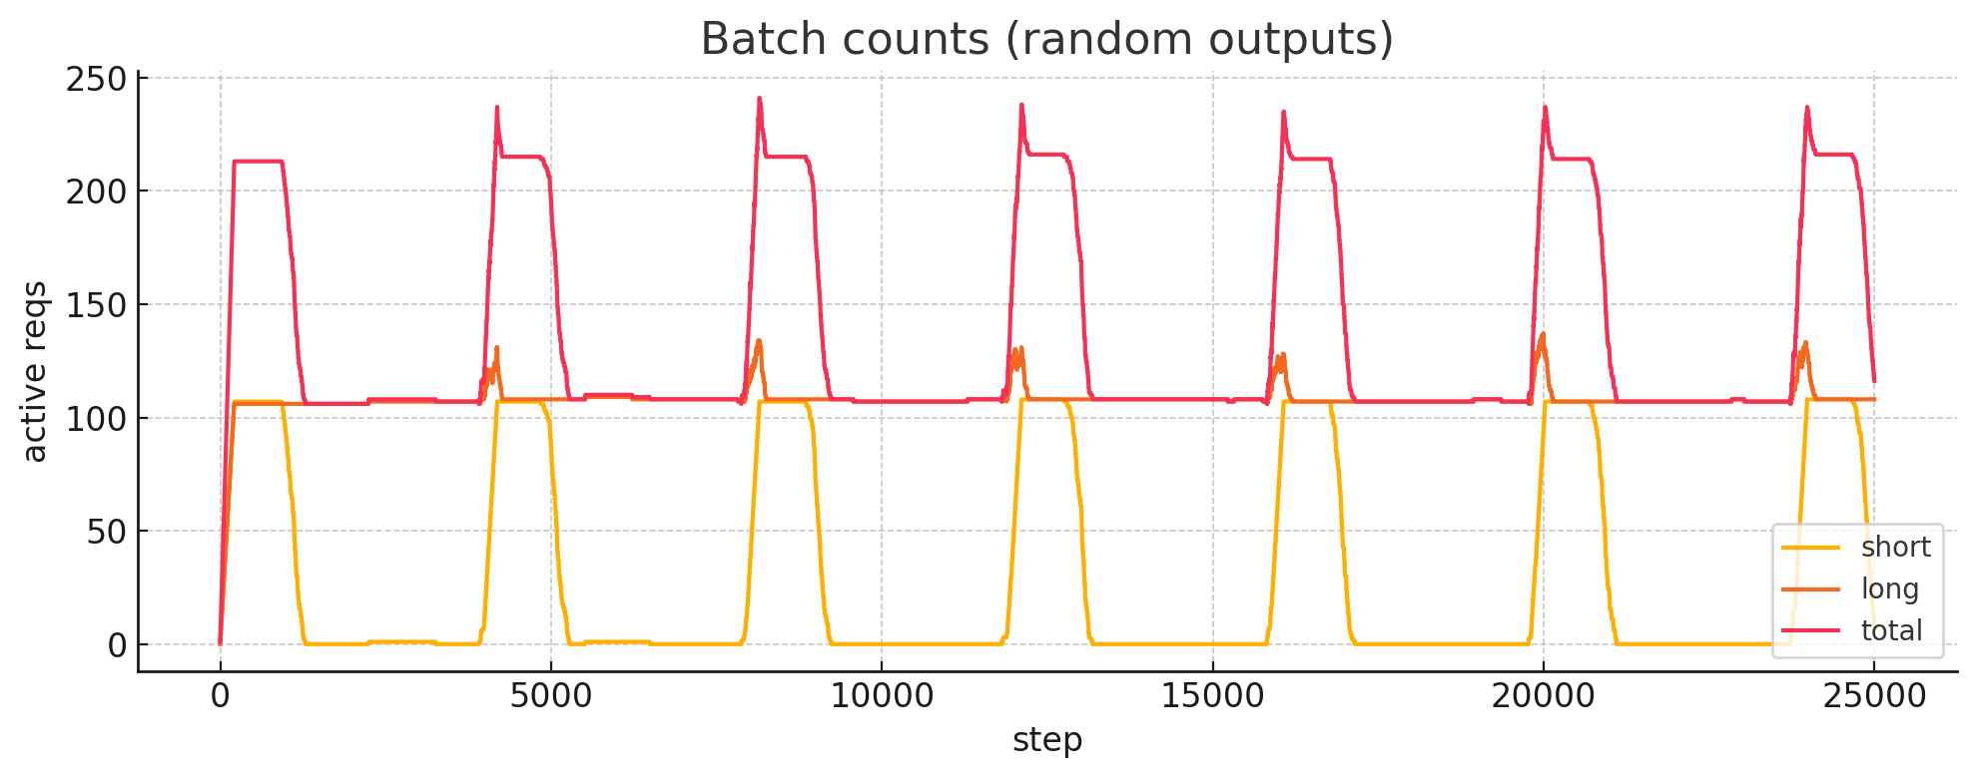
Batch Limit due to GPU capacity
What if output length is various?
1k input, 50% 1k output, 50% 4k output

Slide 34
Batch Limit due to GPU capacity
1k input, uniform distribution (0-4k) output length
Average output length = 2k
Batch size = 512 / (1+2/2) = 256?

Slide 35
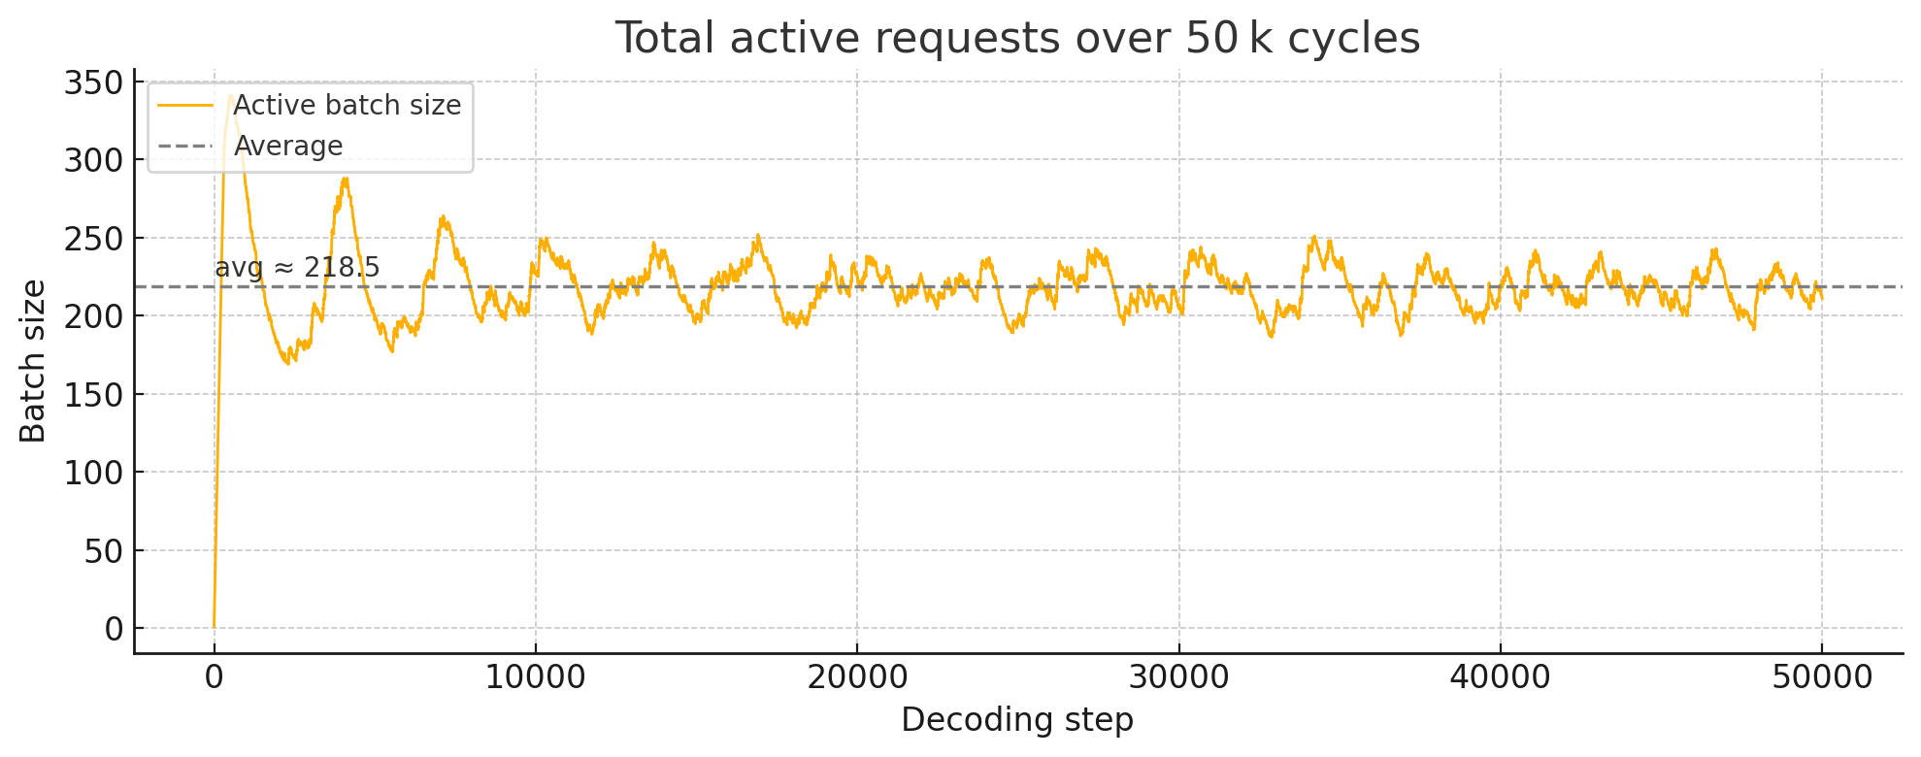
Batch Limit due to GPU capacity
1k input, uniform distribution (0-4k) output length
Indeed, batch size is ~ 220
Longer request stays longer in the KV cache!

Slide 36
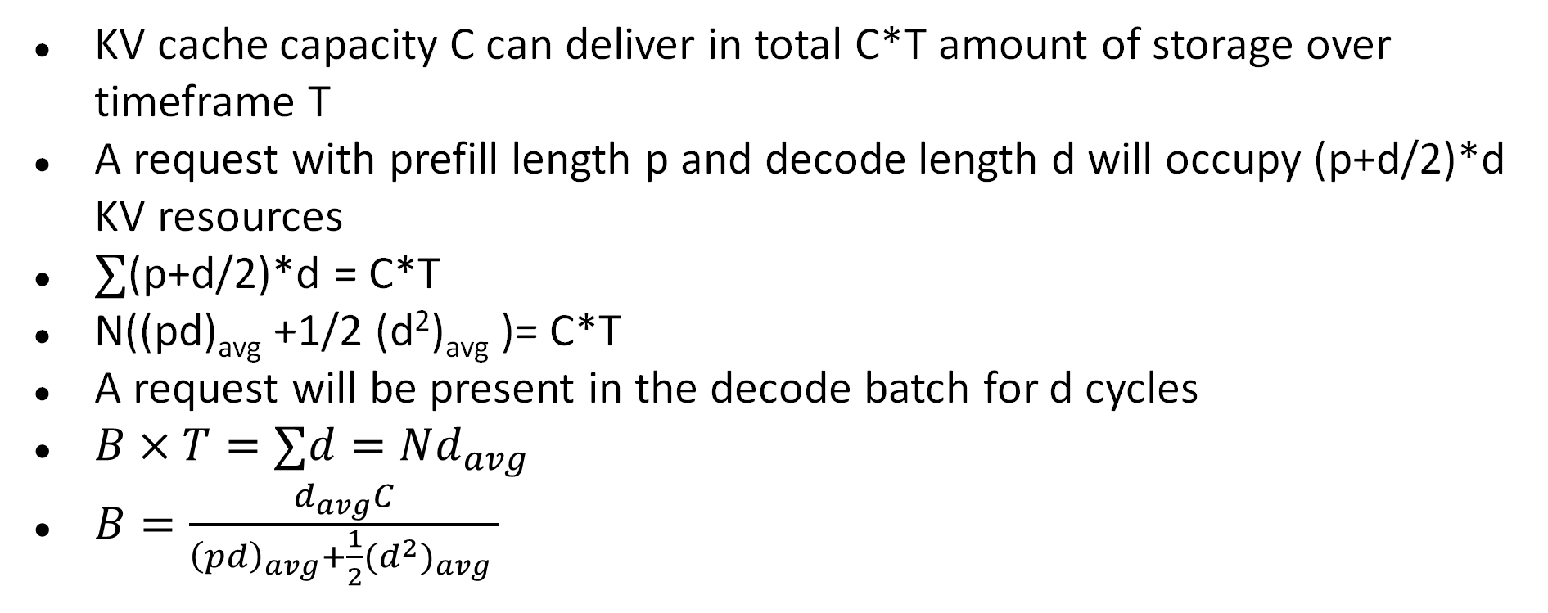
Batch size limit for various output length

Slide 37
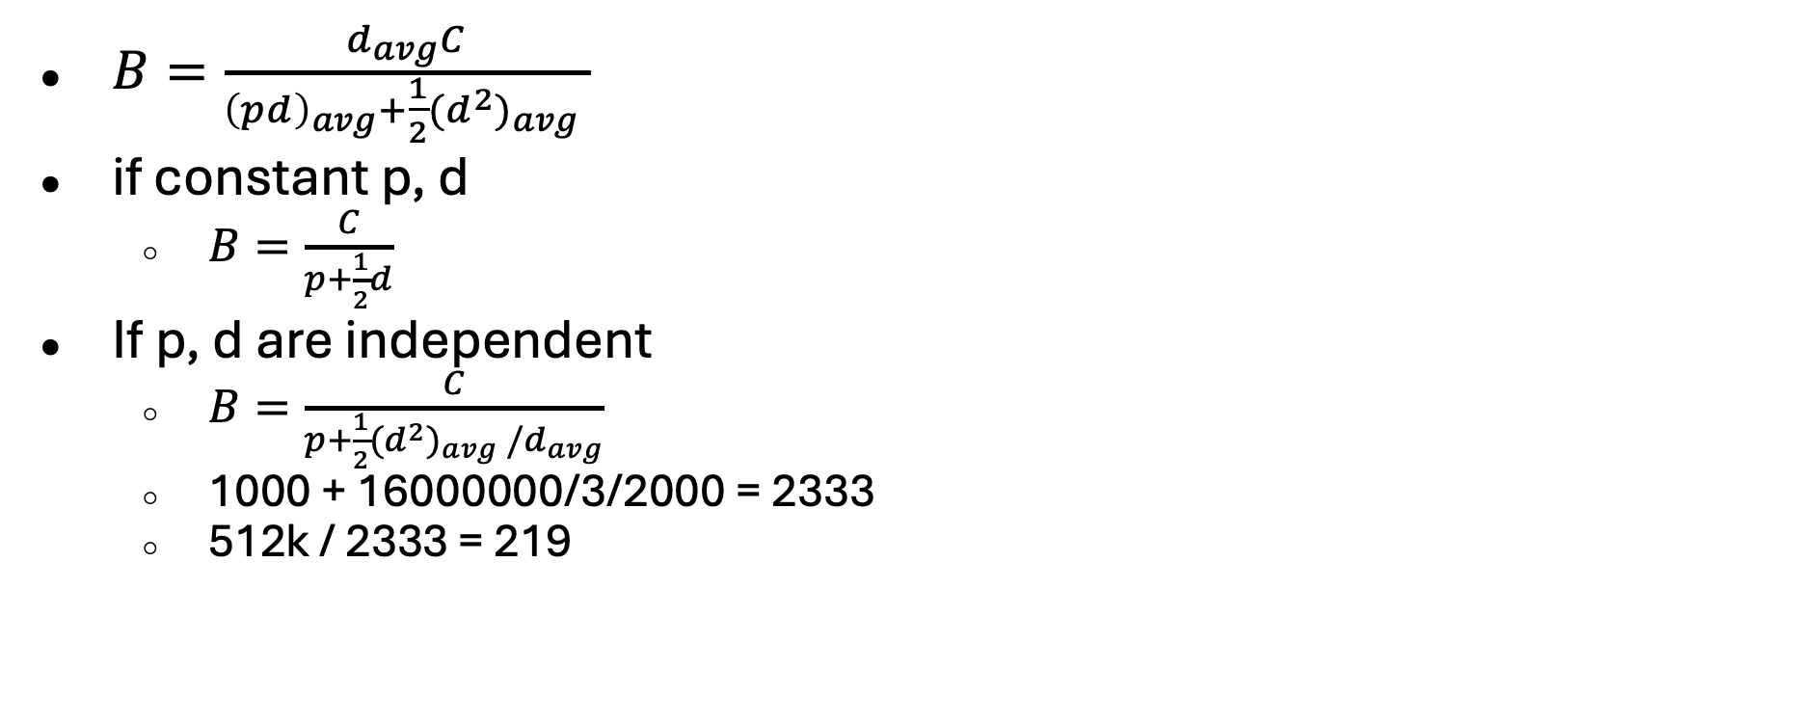
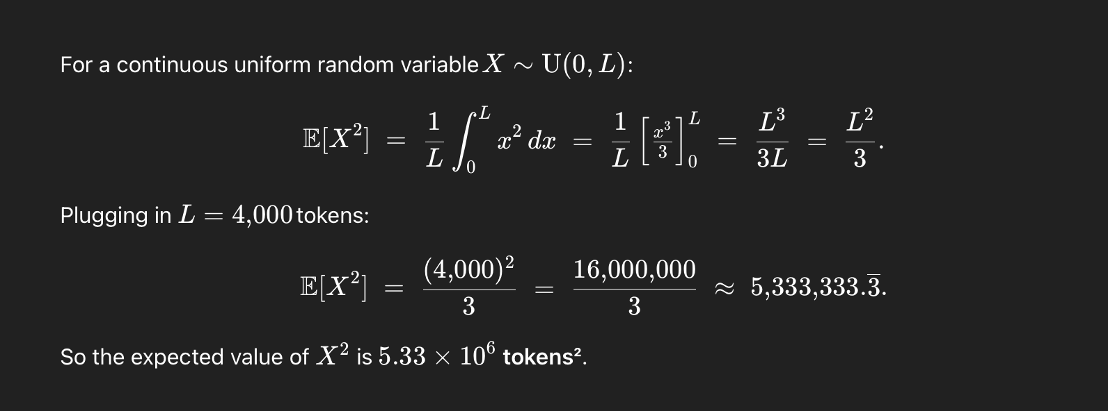
Batch size limit for various output length

Slide 38
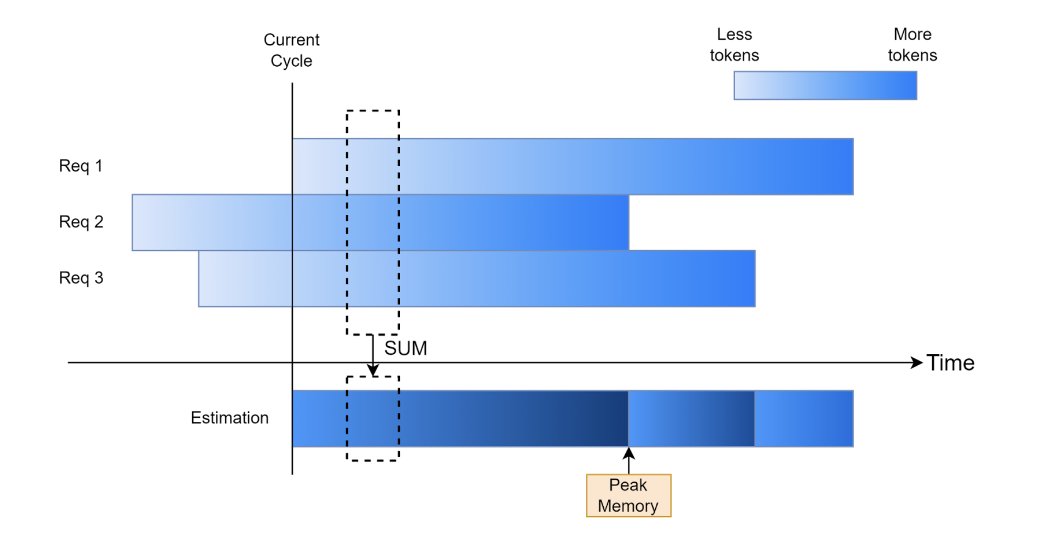
Control the batch size through prediction

Slide 39
Control batch size for PD Disaggregation
Add a decode pending queue to hold prefilled requests
Use prediction to limit the decode batch size

Slide 40
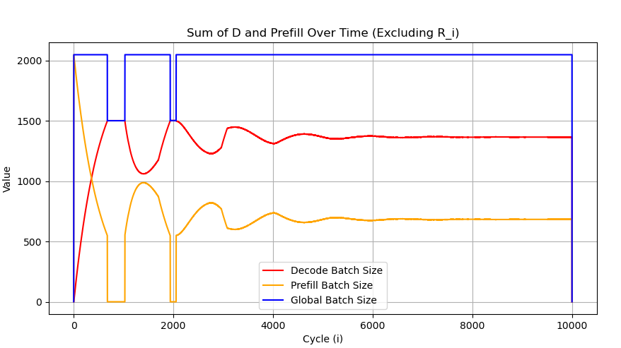
Control batch size for Chunked Prefill
Stop prefill when the KV cache is predicted to exceed the capacity
When the KV cache is enough, the system will stabilize for both prefill and decode batch size

Slide 41
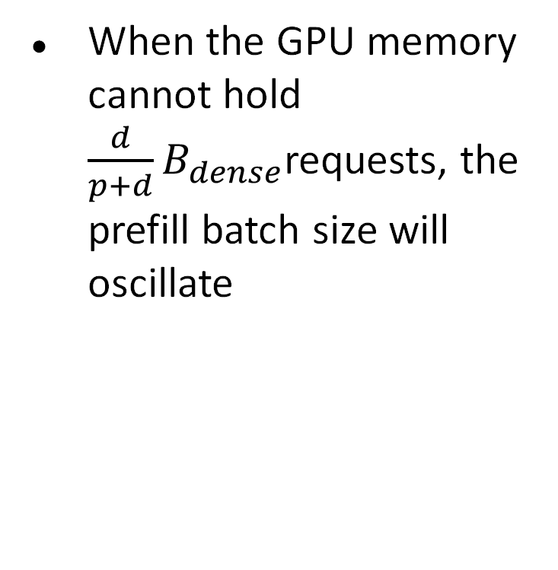
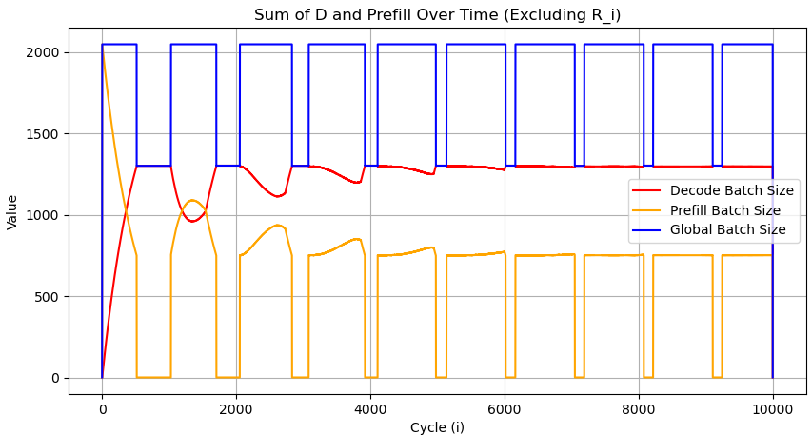
Control Batch Size for Chunked Prefill

Slide 42
Output length prediction
Predicting output length is hard
For same input, different trials may have different output length
Still, rough estimation is possible
E.g. translation task will have similar input and output length
Use a small encoder model to predict length
Reuse the token embedding of the target model to predict the length

Slide 43
Handling out of memory
Similar to prefix sharing eviction, when the GPU is actually out of memory during decoding, we need to either evict the KV cache or offload the KV cache
Again, offloading is faster than recompution

Slide 44
Tricks for “higher” SLO attainment
To maintain 95% SLO attainment
Can we drop the long input/output request?
Can we infinitely delay the request if we predict it will not satisfy SLO?
Can we only serve higher SLO requests and violate low SLO requests?
Need additional constraints and SLO evaluation methods
Fairness: all request should make progress, and every user get equal share of the throughput
SLO violation “Badness”: instead of attain or violate SLO, we calculate the gap between the actual token generation and SLO deadline.

