Slide 1
Who Said That?
Determining the Author of Tweets with Machine Learning
Nigel Tan and Joe Teague

Slide 2
Why?
Identification of anonymous users
Identification of users attempting to circumvent a ban
Identification of celebrities, politicians, and other people who may have ghost writers or a social media team

Slide 3
Our Data
Tweets from six prolific Twitter users selected
Training set (when needed) consists of 10 000 total tweets
50% from “target user” and 50% split evenly between the other five
Test set consists of 1000 total tweets
50% from “target user” and 50% split evenly between the other five

Slide 4

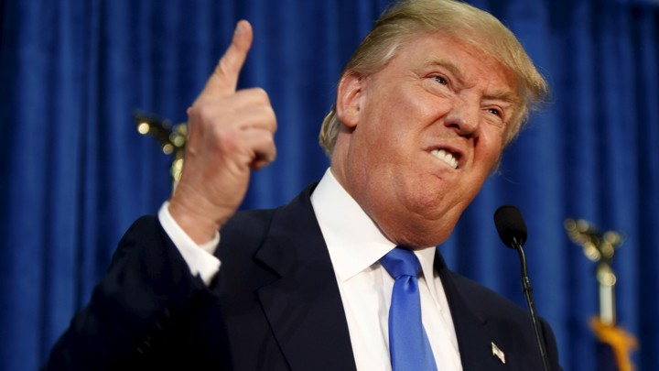

Donald Trump

Slide 5
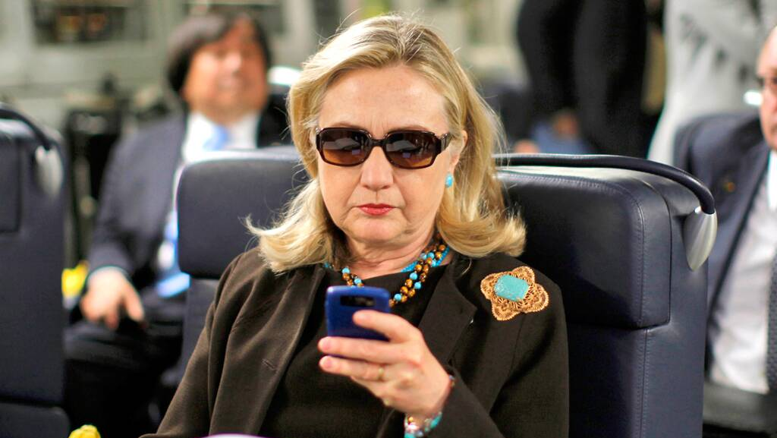
Hillary Clinton

Slide 6
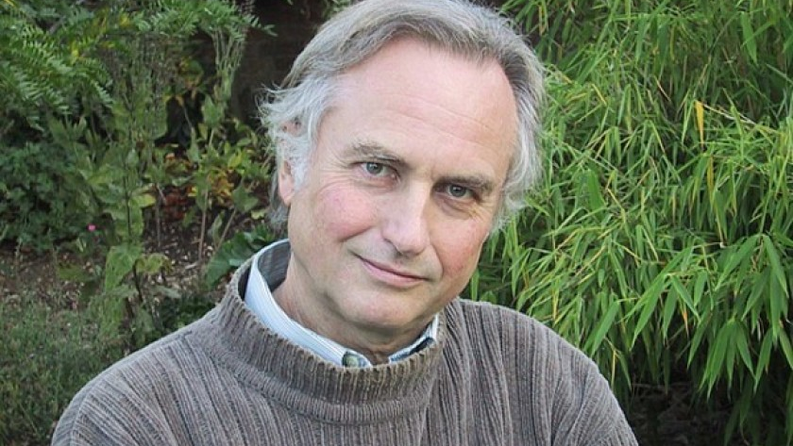
Richard Dawkins

Slide 7
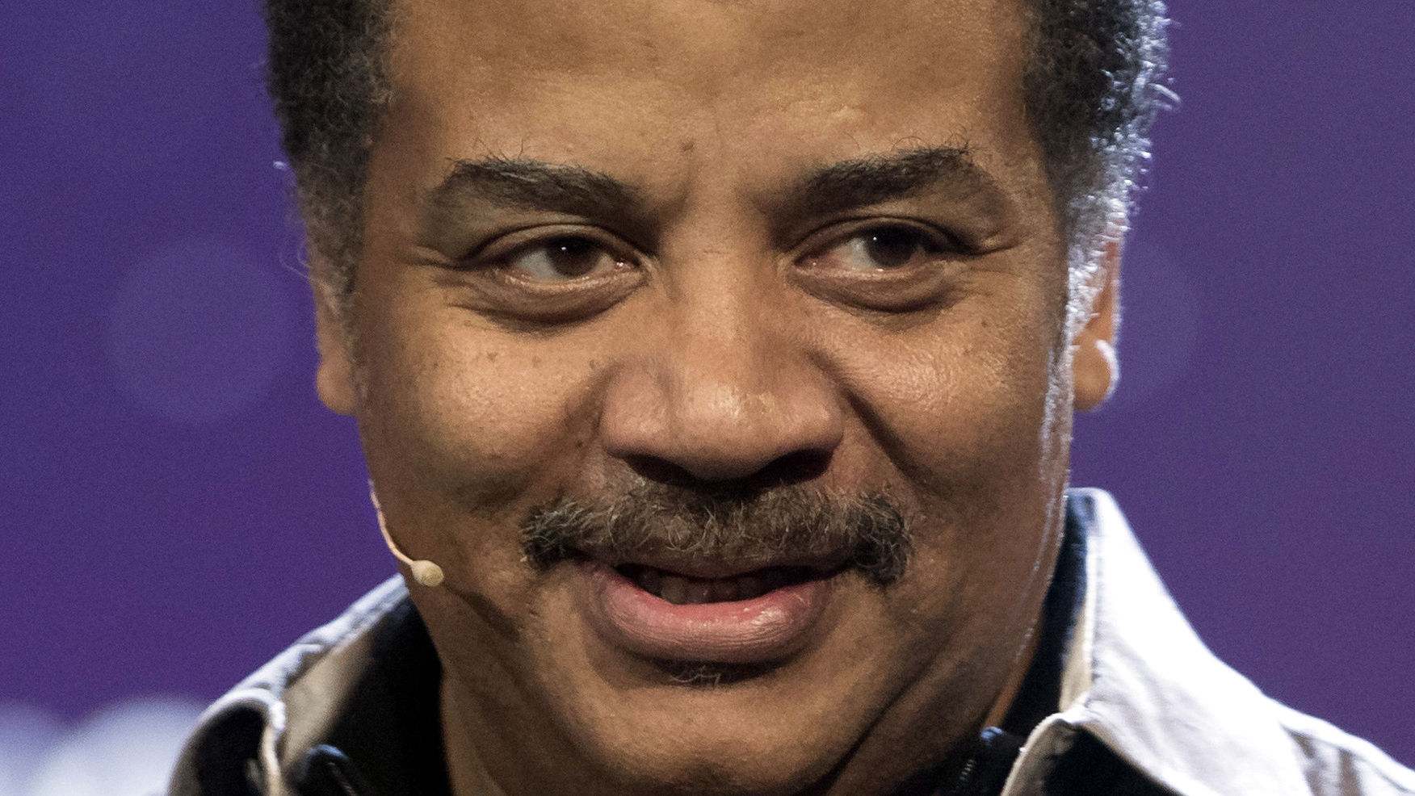
Neil DeGrasse Tyson

Slide 8
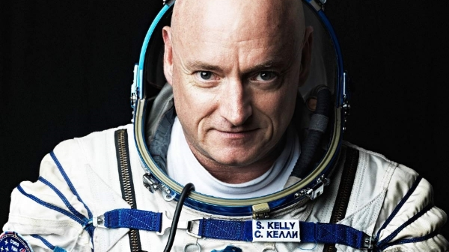
Astronaut Scott Kelly

Slide 9

Kim Kardashian

Slide 10
Features
Repeated punctuation (“!!!!!”)
Inclusion of images
@-ing other users
Words in all caps (“SPACE”)
Inclusion of links
Use of #hashtags
Quotes
Use of words phrases specific to an individual (e.g., only Scott Kelly would say “when I was in space”)

Slide 11
Methodology
Python scripts used to extract features from datasets and provide labels
Labels are binary: is this tweet from the person we’re looking for, or is it not?
Most learning models adapted from previous labs
Decision trees used from SKLearn
Supervised methods:
Cases 1, 2, and 3
k-Nearest Neighbors
SVM
Decision Tree
Unsupervised methods:
k-Means
Winner-Take-All
Kohonen Maps

Slide 12
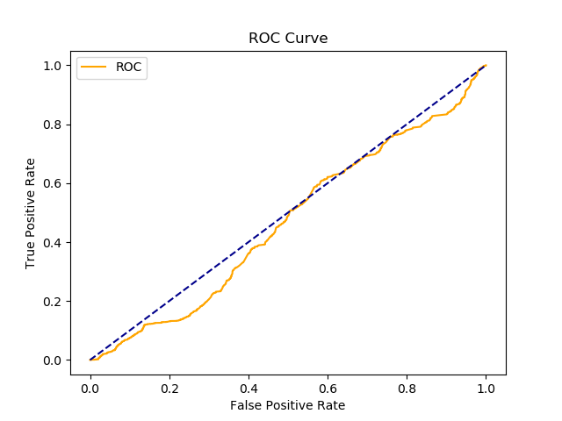
Results: MPP
Case 1:
.04 sensitivity
.93 specificity
Case 2:
.12 sensitivity
.86 specificity
Case 3:
.08 sensitivity
.88 specificity
MPP Case 2 ROC Curve

Slide 13
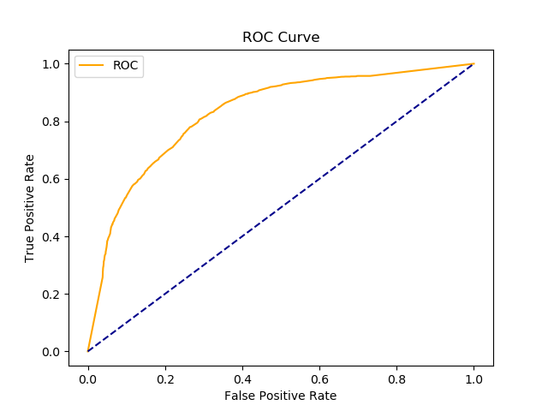
Results: Supervised LEarning
Decision Tree:
.67 sensitivity
.82 specificity
Linear SVM:
0 sensitivity (uh-oh)
1.00 specificity
Not a good overall solution
Poly SVM:
.17 sensitivity
.99 specificity
Decision Tree ROC Curve

Slide 14
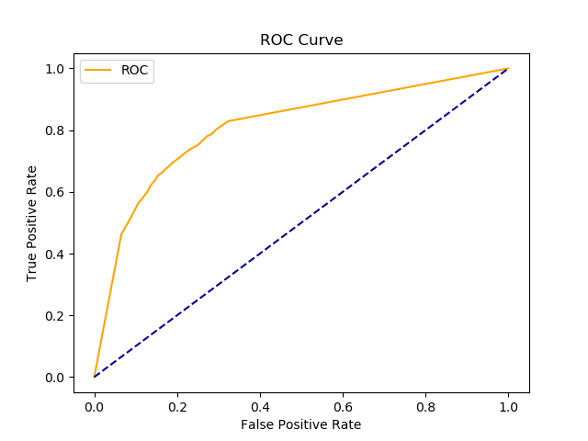
Results: Supervised LEarning
Sigmoid SVM:
.14 sensitivity
.85 specificity
kNN (k = 3):
.38 sensitivity
.92 specificity
Back-propagating neural network:
.66 sensitivity
.79 specificity
BPNN ROC Curve

Slide 15
Results: K-Means
Generic features only:
75-85% sensitivity (not bad!)
Poor (~50%) specificity – barely better than a coin flip
Targeted features included:
No substantial changes
Starting cluster centers generated randomly – exact results varied based on runs
FLD breaks classifier – everything shoved into a single cluster
PCA increases sensitivity slightly and decreases specificity slightly

Slide 16
Results: Winner-Take-All
Generic features only:
Very good sensitivity (> 90% on some runs)
Very Poor specificity (< 30% on some runs)
Targeted features included:
Slightly improved specificity, but no substantial change
Starting cluster centers generated randomly – exact results varied based on runs
FLD breaks classifier – everything shoved into a single cluster
PCA has no noticeable effects in either direction
e = 0.01

Slide 17
Results: Kohonen maps
Generic features only:
Good sensitivity (around 80%)
Poor specificity (50% or less)
Targeted features included:
Increased sensitivity (> 90%)
Decreased specificity (25-30%)
Starting cluster centers generated randomly – exact results varied based on runs
FLD slightly improves results
PCA slightly reduces sensitivity and slightly increases specificity
e = 0.0001, 100 iterations

Slide 18
overview
Unsupervised methods overall had good sensitivity but poor specificity
Supervised methods overall had poor sensitivity but good specificity
Back-propagating neural networks provided the best overall results from a single classifier (i.e. nothing is exceptionally bad)
A combined approach is needed to develop a useful classifier

Slide 19
Future Work
Detailed feature extraction based on sentence structure would probably yield better classifier results
This was beyond the scope of our abilities for this project, in terms of both time and computing power
Previous work has been done on ”sentiment analysis” – this would be THE most promising technique to accomplish what we want to accomplish
Makes heavy use of text analysis and natural language processing

