Slide 1
Who Said That?
Determining the Author of Tweets with Machine Learning
Nigel Tan and Joe Teague

Slide 2
Why?
Identification of anonymous users
Identification of users attempting to circumvent a ban
Identification of celebrities, politicians, and other people who may have ghost writers or a social media team

Slide 3
Our Data?
Tweets from six prolific Twitter users selected

Slide 4

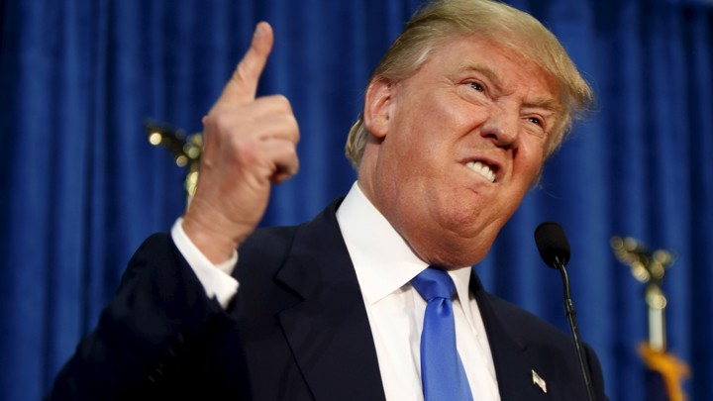

Donald Trump

Slide 5
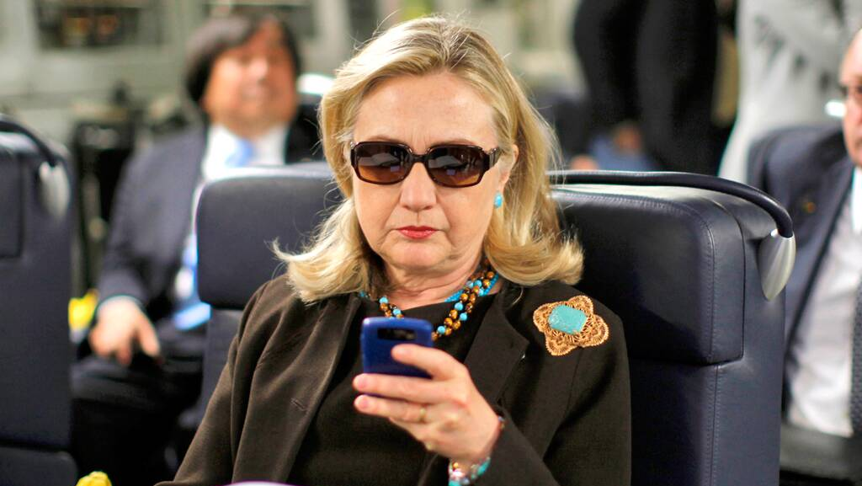
Hillary Clinton

Slide 6
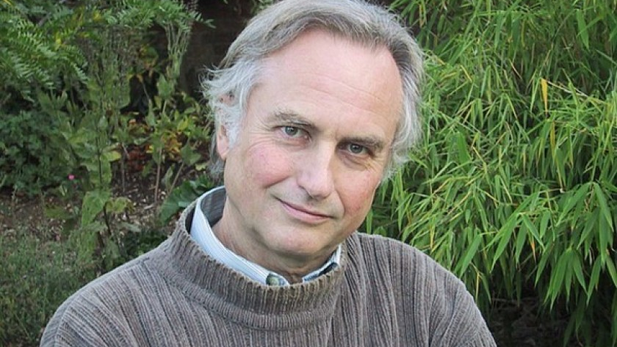
Richard Dawkins

Slide 7
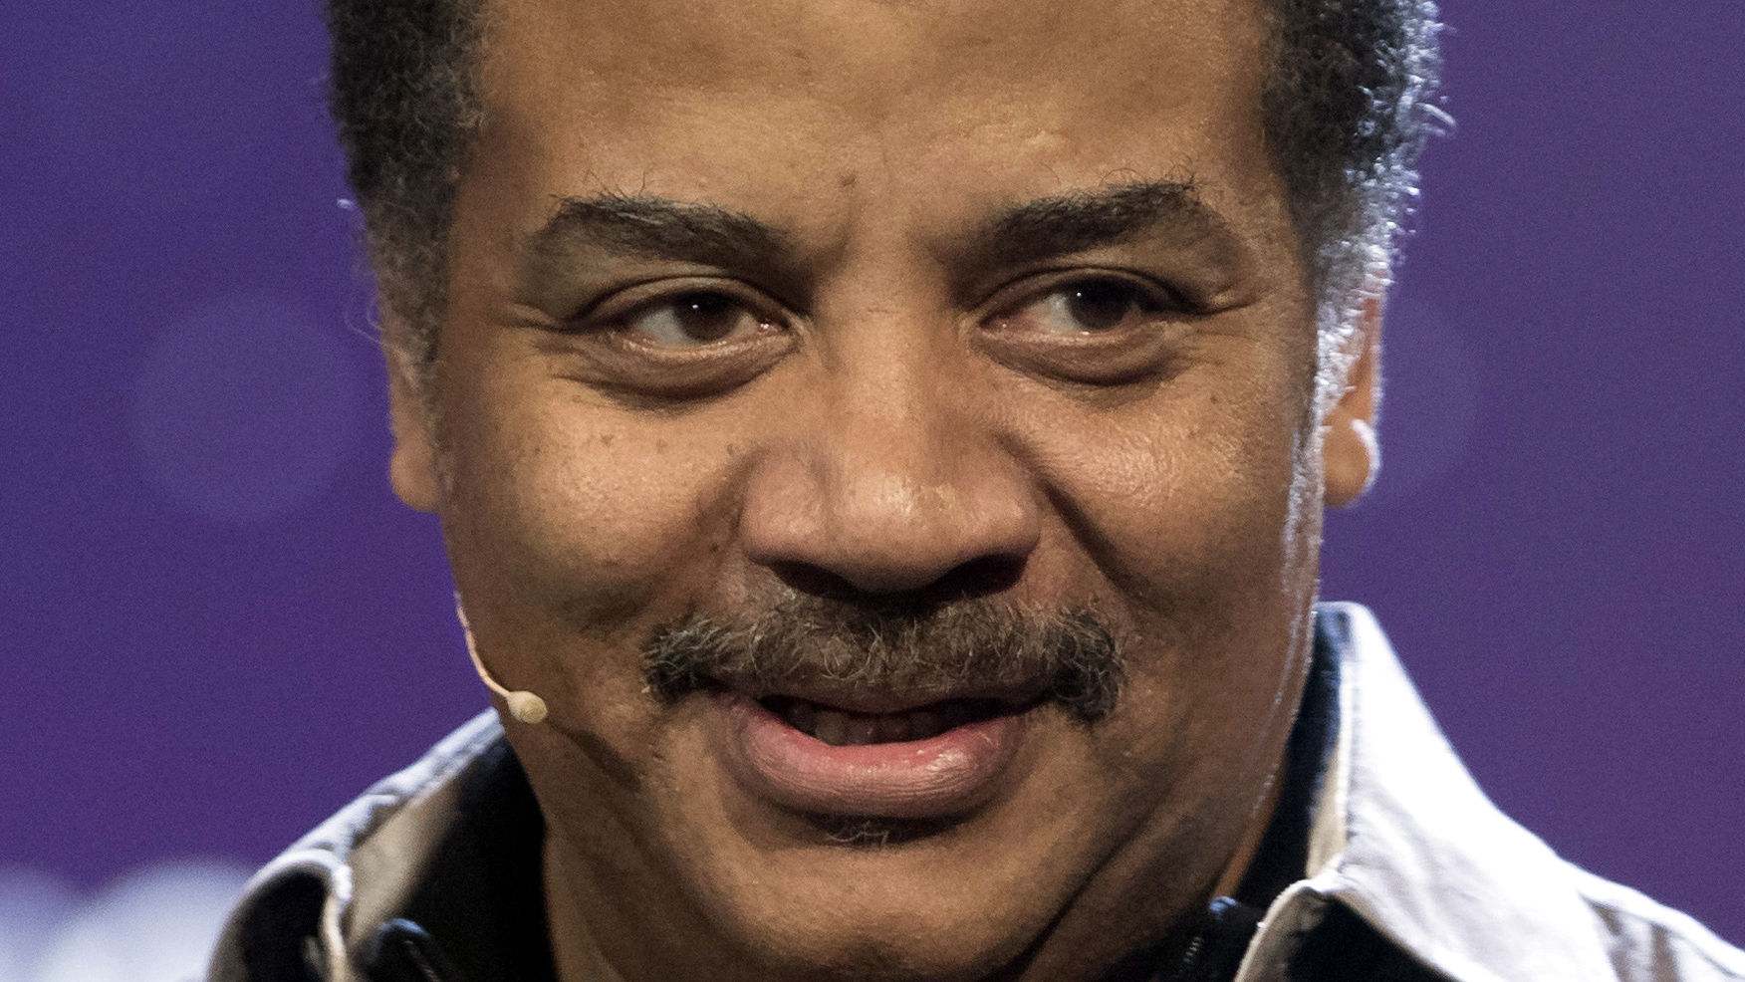
Neil DeGrasse Tyson

Slide 8
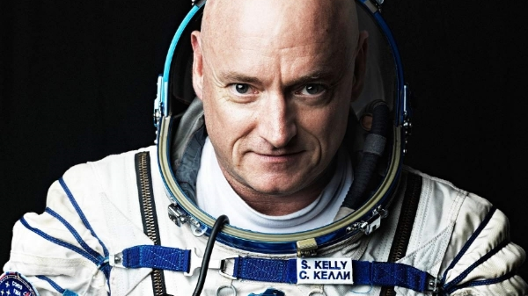
Astronaut Scott Kelly

Slide 9

Kim Kardashian

Slide 10
Features
Repeated punctuation (“!!!!!”)
Inclusion of images
@-ing other users
Words in all caps (“SPACE”)
Inclusion of links
Use of #hashtags
Quotes
Use of words phrases specific to an individual (e.g., only Scott Kelly would say “when I was in space”)

Slide 11
Methodology
Python scripts used to extract features from datasets and provide labels
Labels are binary: is this tweet from the person we’re looking for, or is it not?
Most learning models adapted from previous labs
Decision trees used from SKLearn
Supervised methods:
Cases 1, 2, and 3
k-Nearest Neighbors
SVM
Unsupervised methods:
k-Means
Winner-Take-All
Kohonen Maps

Slide 12
Results: K-Means
Generic features only:
75-85% sensitivity (not bad!)
Poor (~50%) specificity – barely better than a coin flip
Targeted features included:
No substantial changes
Starting cluster centers generated randomly – exact results varied based on runs

Slide 13
Results: Winner-Take-All
Generic features only:
Very good sensitivity (> 90% on some runs)
Very Poor specificity (< 30% on some runs)
Targeted features included:
Slightly improved specificity, but no substantial change
Starting cluster centers generated randomly – exact results varied based on runs
e = 0.01

Slide 14
Results: Kohonen maps
Generic features only:
Good sensitivity (around 80%)
Poor specificity (50% or less)
Targeted features included:
Increased sensitivity (> 90%)
Decreased specificity (25-30%)
Starting cluster centers generated randomly – exact results varied based on runs
e = 0.0001, 100 iterations

Slide 15
Unsupervised overview
Methods overall performed poorly
Ability to correctly identify an author of limited utility if the model can’t identify NOT the author

Slide 16
Future Work
Detailed feature extraction based on sentence structure would probably yield better classifier results
This was beyond the scope of our abilities for this project, in terms of both time and computing power

