Slide 1
Relational Algebra
What is it?
Why we need it?
Notes:
Think about algebra.
For example (a^2+b)*c/d.
Algebra has symbols defining for different operations.
These operations has different level of priority. So (a^2+b)*c/d is different from a^2+b*c/d
We can rewrite the same formula for faster calculation. (a^2+b)*c/d = a^2*c/d+b*c/d, but the left hand side have less operations, so faster to calculate

Slide 2
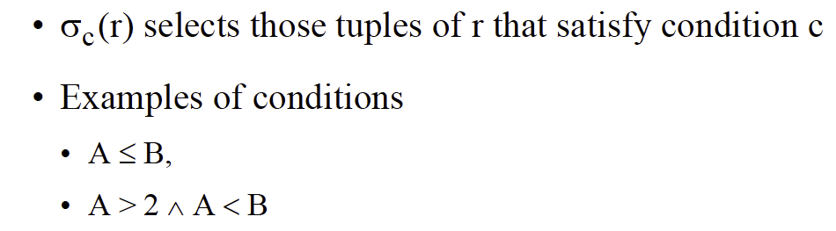

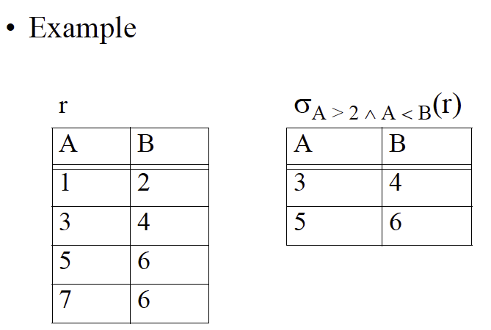
Select Operator
Notes:
Sigma $σ$

Slide 3
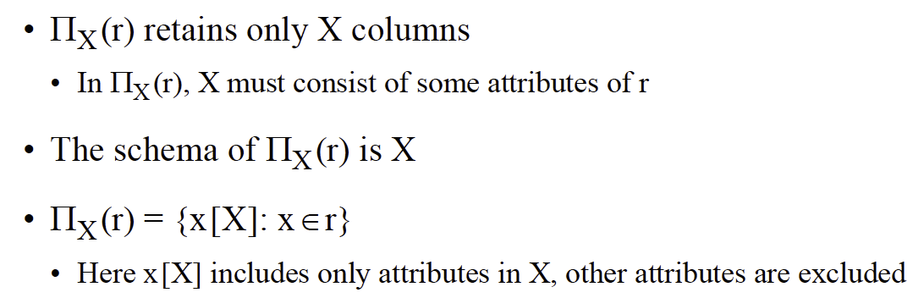
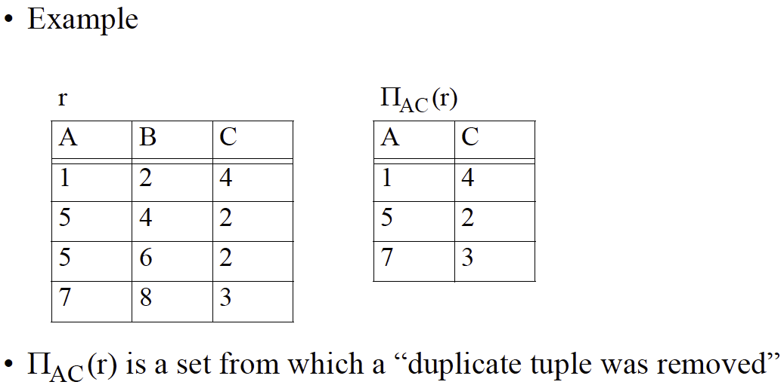
Project Operator
Notes:
Pi $π$

Slide 4
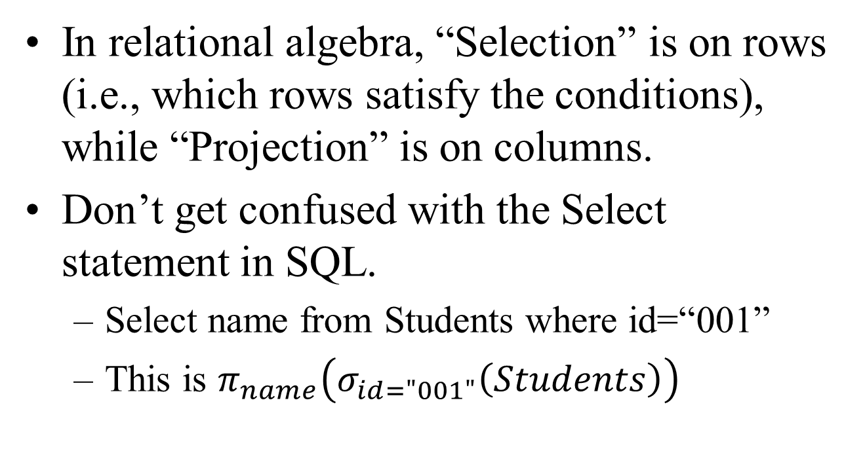
Row VS Column
In relational algebra, “Selection” is on rows (i.e., which rows satisfy the conditions), while “Projection” is on columns.
Don’t get confused with the Select statement in SQL.
Select name from Students where id=“001”
This is $π_{name}\left(σ_{id="001"}\left(Students\right)\right)$
Notes:
$π_{name}\left(σ_{id="001"}\left(Students\right)\right)$ chooses the row first and then choose the column.
Can we switch these two operations?

Slide 5
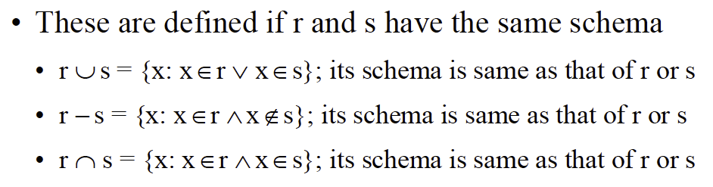
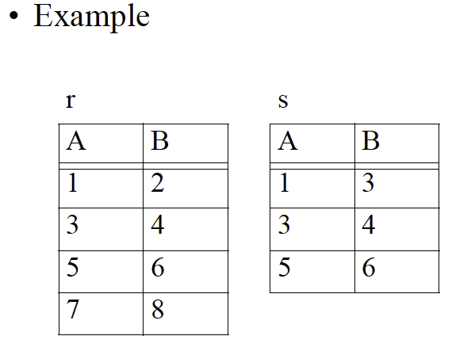
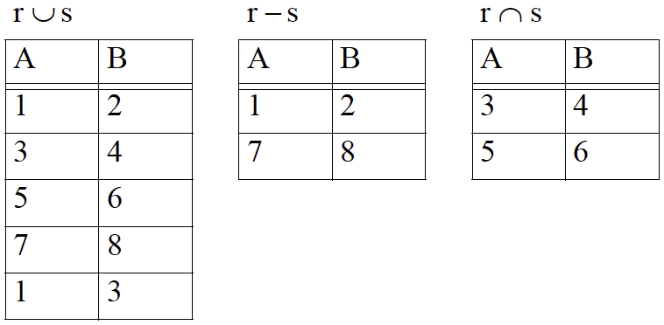
Union, Intersection and Difference Operators
Notes:
Start with the basic
Relations are sets of tuples
So all set operators can be applied here (but there is a requirement: the schema of the two relations has to be the same)
Union $∪$
Intersection $∩$
Difference $−$

Slide 6

Question
Is $r∩s=s∩r$
Is$r∪s=s∪r$
Is $r−s=s−r$
r
s

Slide 7
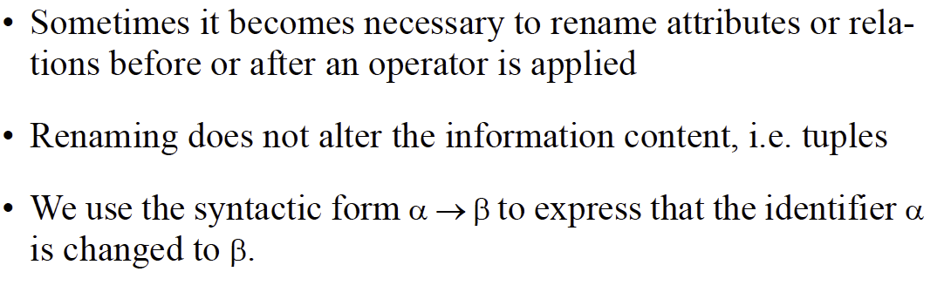
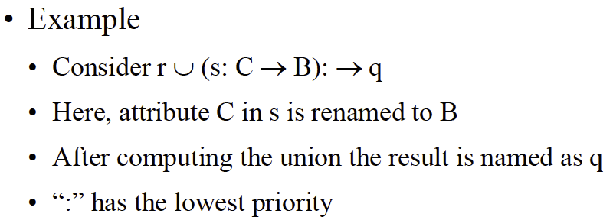
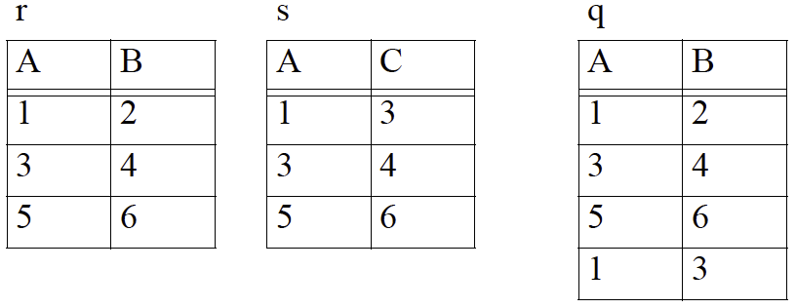
Renaming Operator

Slide 8
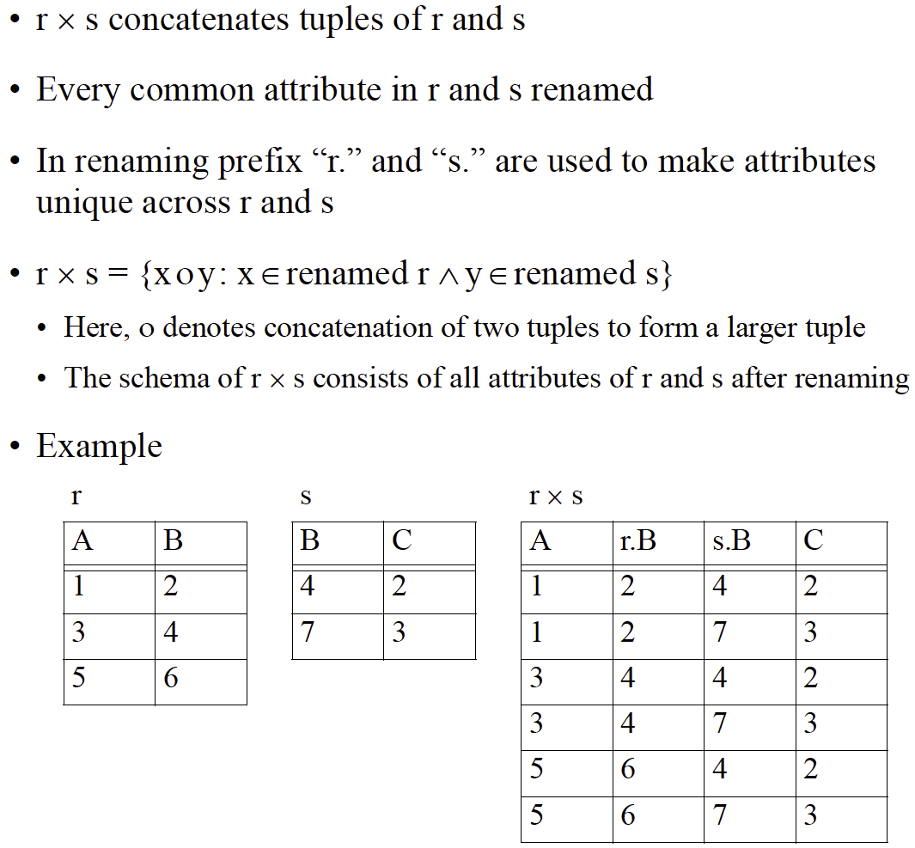
Cross Product Operator
Notes:
Cross product (aka Cartesian product)

Slide 9
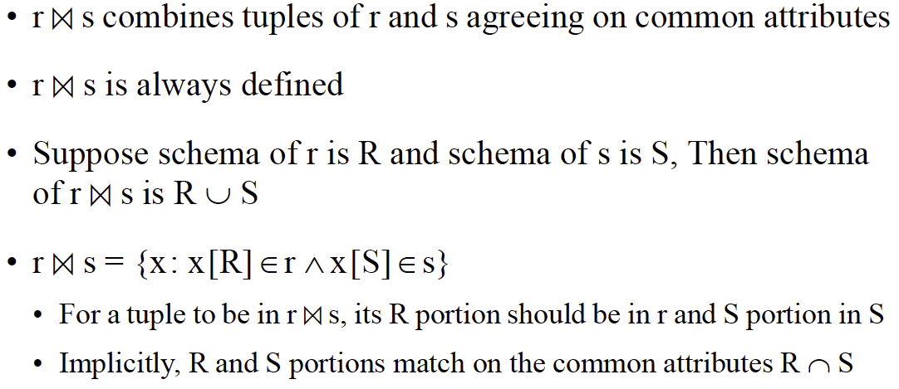

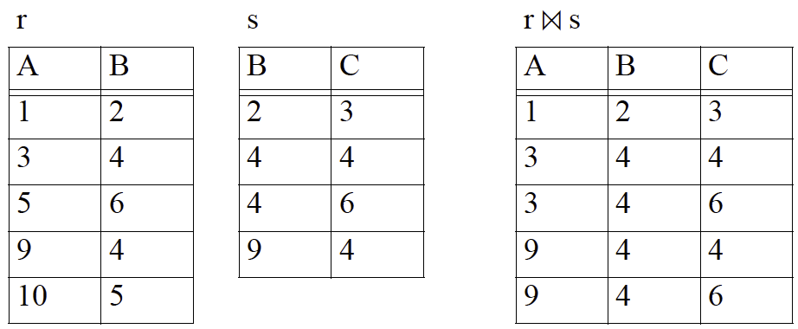
Natural Join Operator
Notes:
Join $⋈$

Slide 10
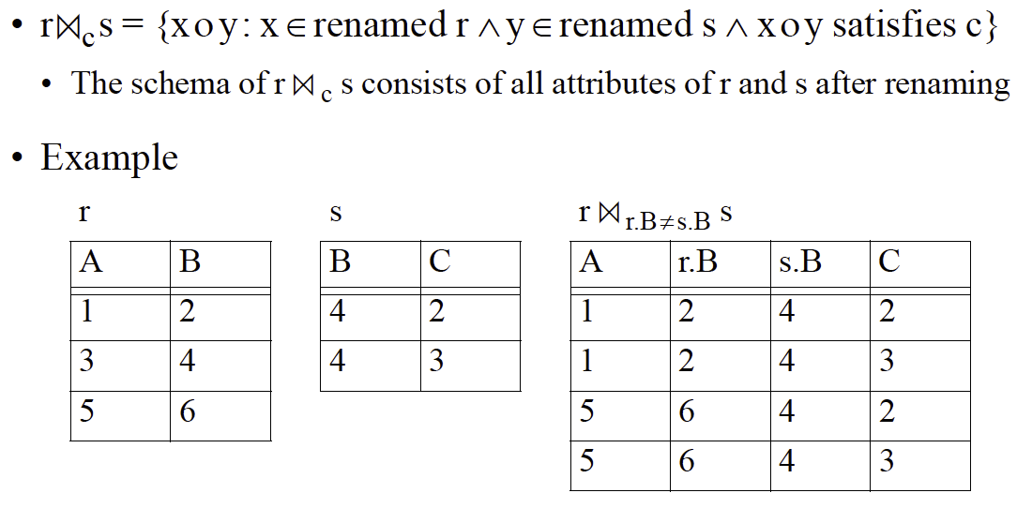
Condition Join Operators

Slide 11

Question
Can you link natural join with cross product?
$s×r$
$s⋈r$

Slide 12
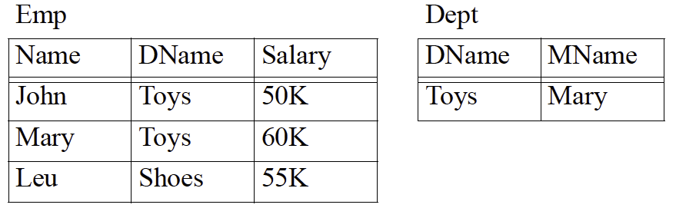
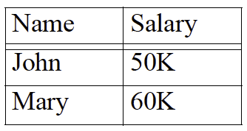
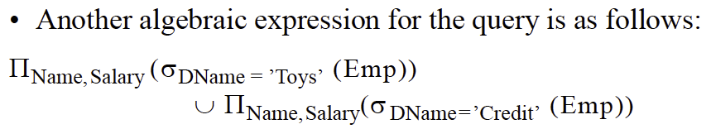
Relational Algebra as a Query Language

Slide 13
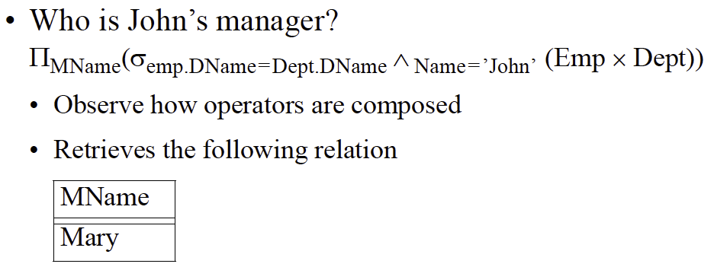
Relational Algebra as a Query Language

Slide 14
Go to examples on OneNote

