Slide 1
Polar Bear Demography
Development of service for evaluation of polar bear demographic features
Nikita Platonov Evgeny Ivanov Ilia Mordvintsev Sergey Naidenko Viatcheslav Rozhnov
A. N. Severtsov Institute of Ecology and Evolution Russian Academy of Sciences, Moscow
Xth International Conference «Marine Mammals of the Holarctic» 2018
Arkhangelsk, 30 October 2018

Slide 2


Slide 3
Connection of individual demographical parameters to the holistic demographical system to reduce data lack.
Using the most sensitive demographical parameters as a metric for estimating of population status
Involving into design and analysis of polar bear researches
Veriﬁcation of results obtained by other approaches.

Slide 4


Slide 5
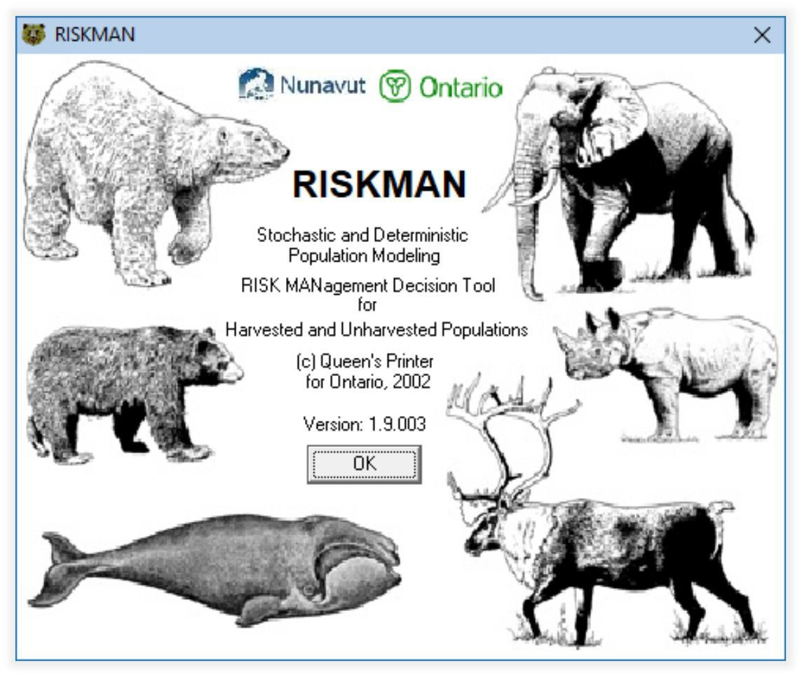
Riskman
Population Modelling for Sustainability Assessment

Slide 6
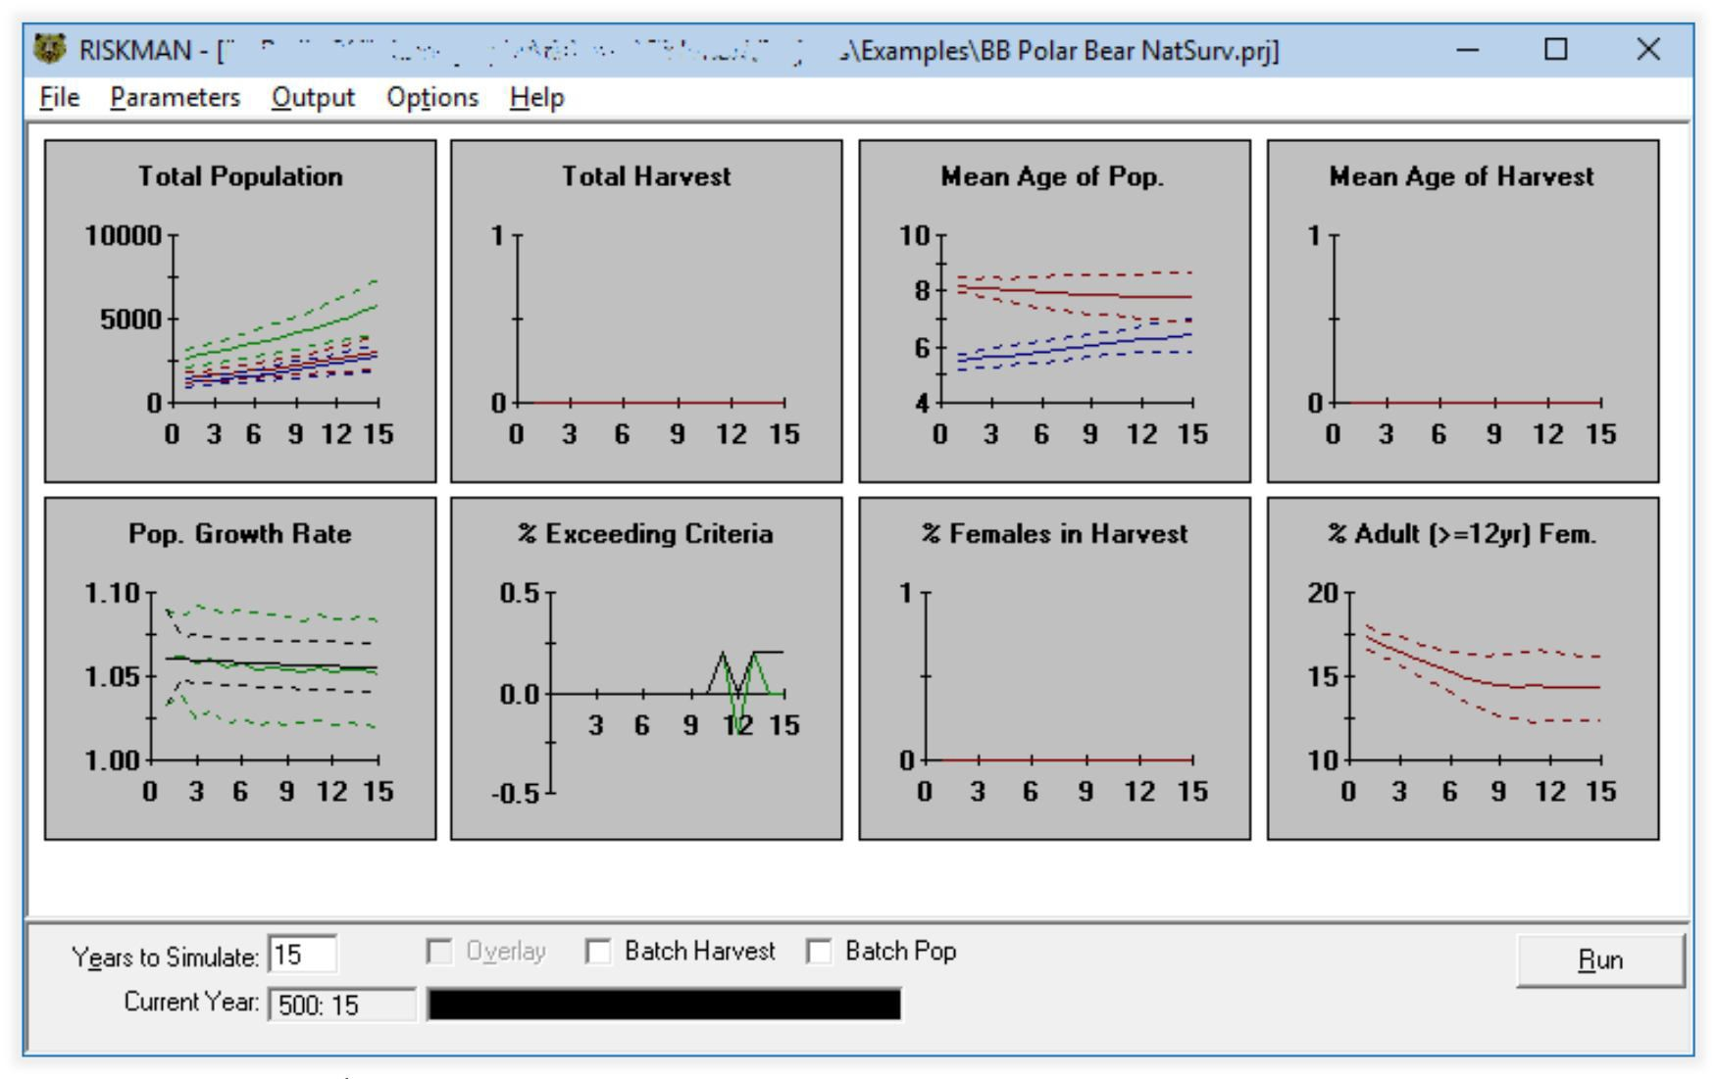
Riskman
Results of stochastic simulation
Can be exported.

Slide 7
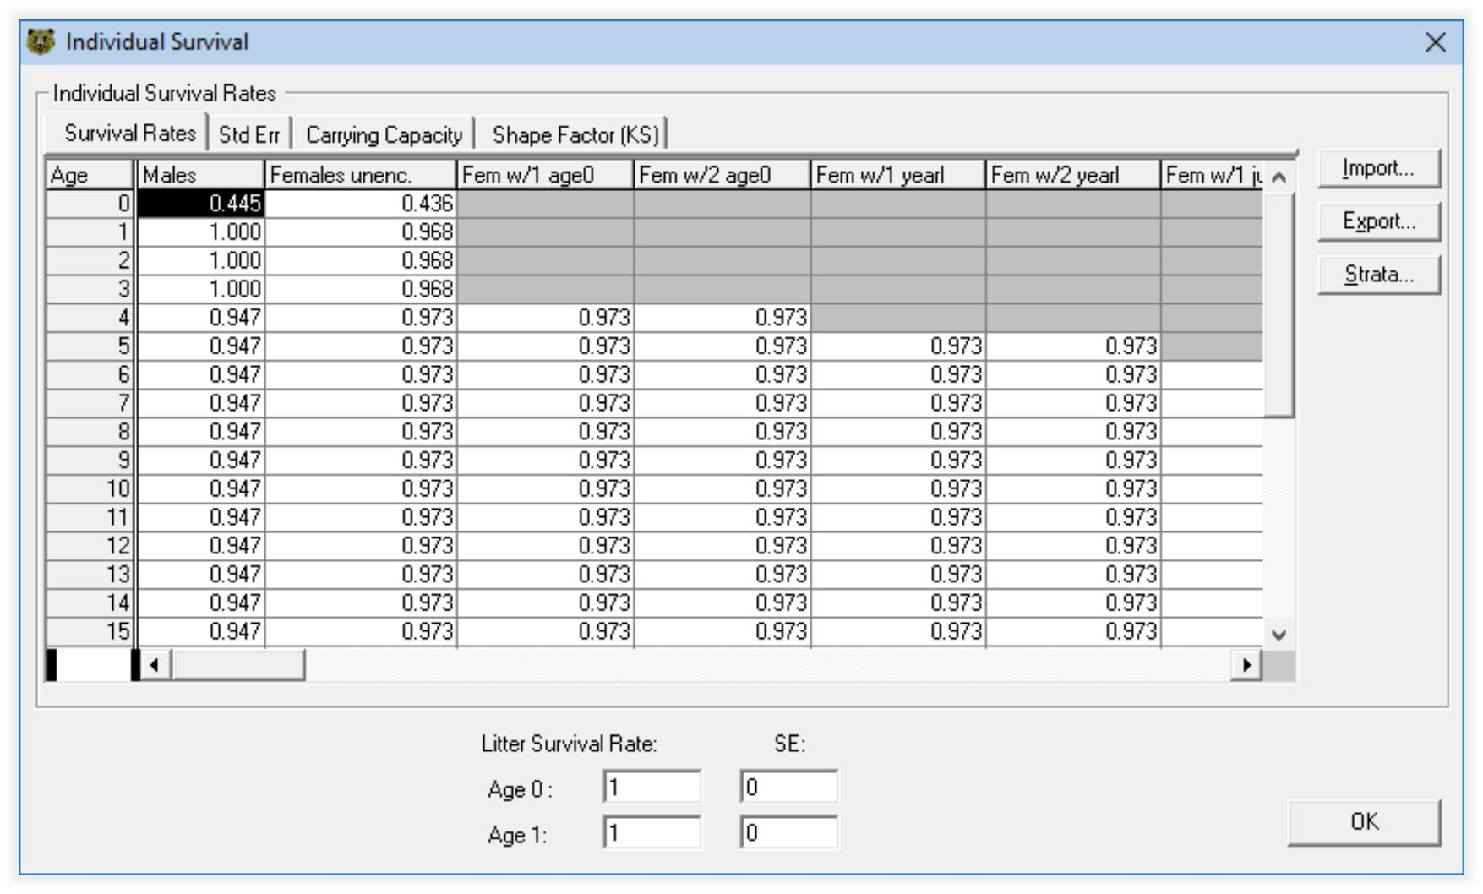
Riskman
Detailed parameterization
Completeness of estimates.

Slide 8
Matrix Projection Model
Available as R (R Core Team, 2018) package popdemo (StoĴ
et al., 2018) with data for Beaufort Sea (Hunter et al., 2010).
Six parameters: 2-year-old (0.106), 3-year-old (0.068), 4-year- old (0.106), adult available to breed (0.461), adult with cub (0.151), adult with yearling (0.108).

Slide 9
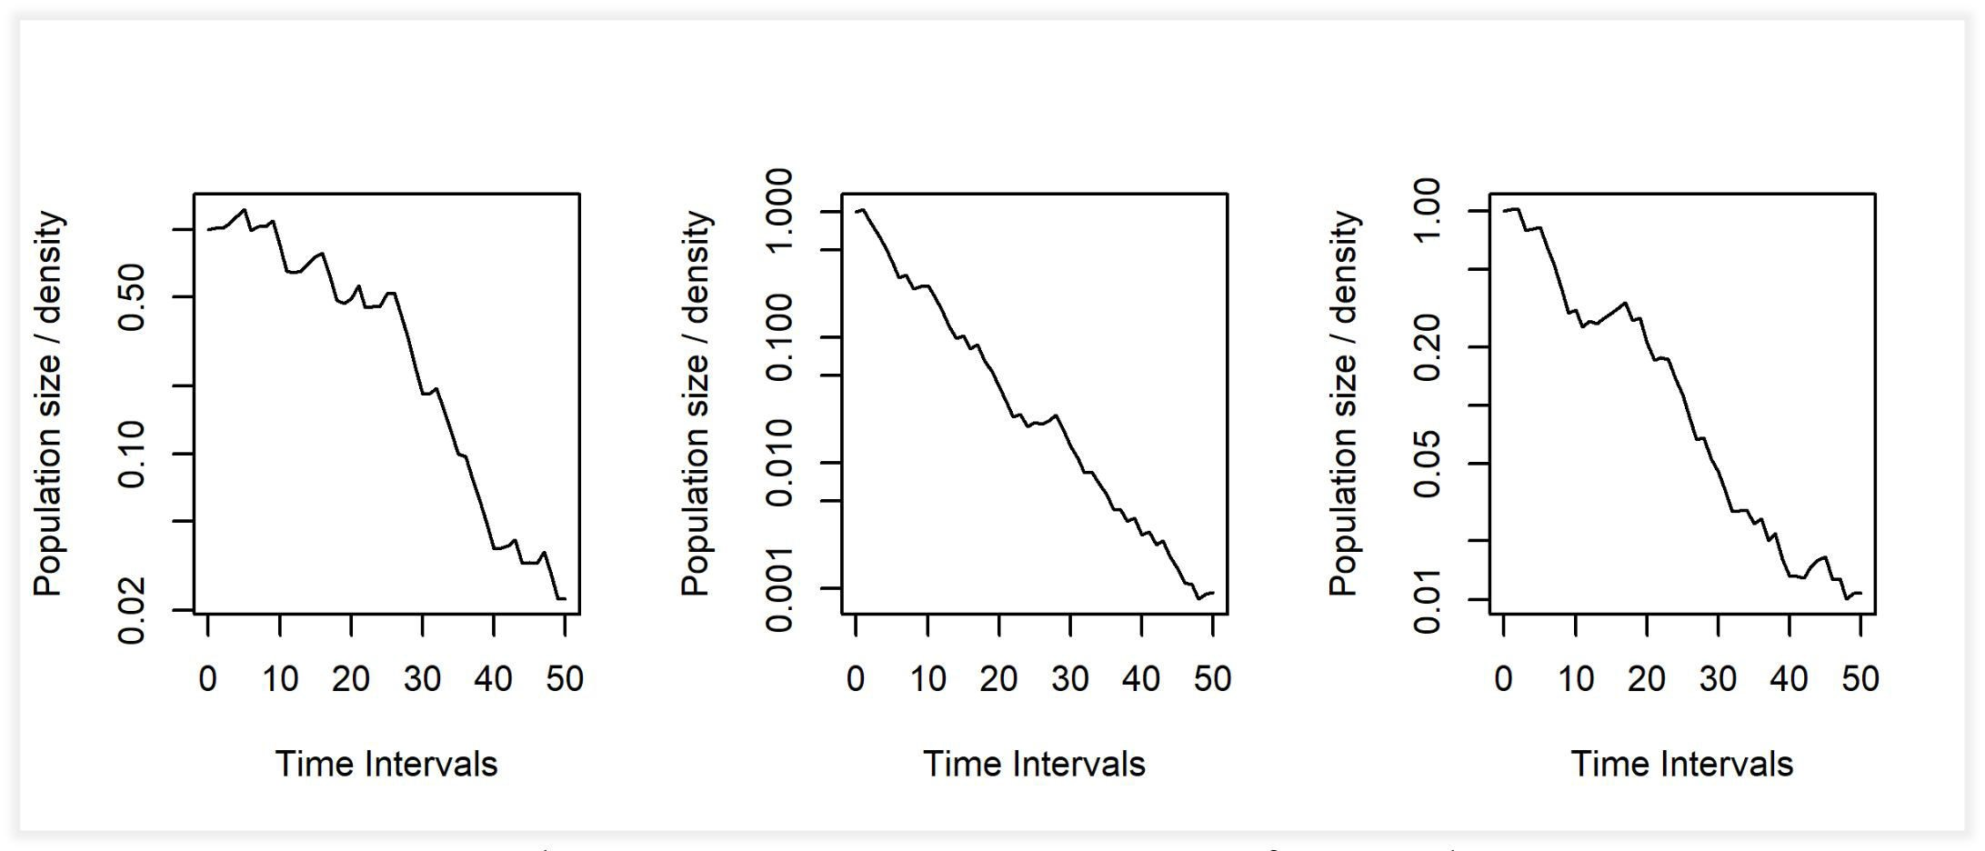
Matrix Projection Model
Consequent random repetitions one of conditions 2001-2005, where conditions 2001-2003 are good, and 2004-2005 are poor.

Slide 10
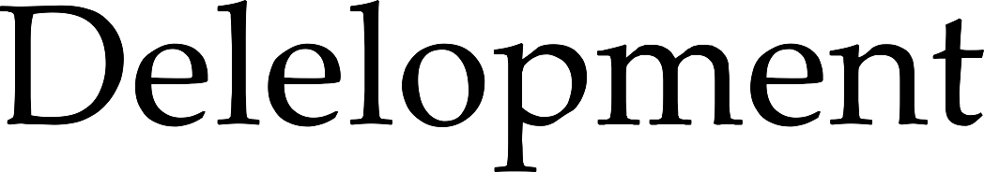

Slide 11

Standalone R (R Core Team, 2018) local application Shiny web application (“dashboard” with tabs)
Hosted on https://github.com/nplatonov/demography. Licence MIT.

Slide 12
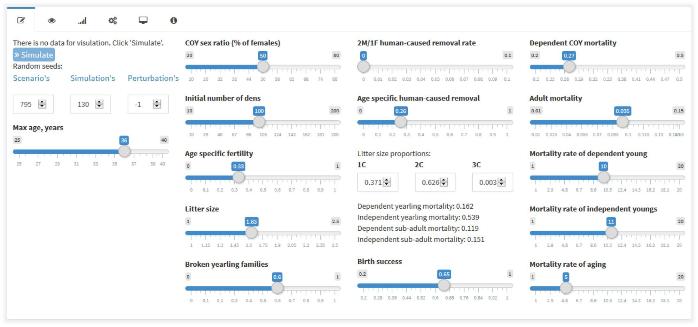
Shiny tabs: Input
Set of sliders for data input

Slide 13
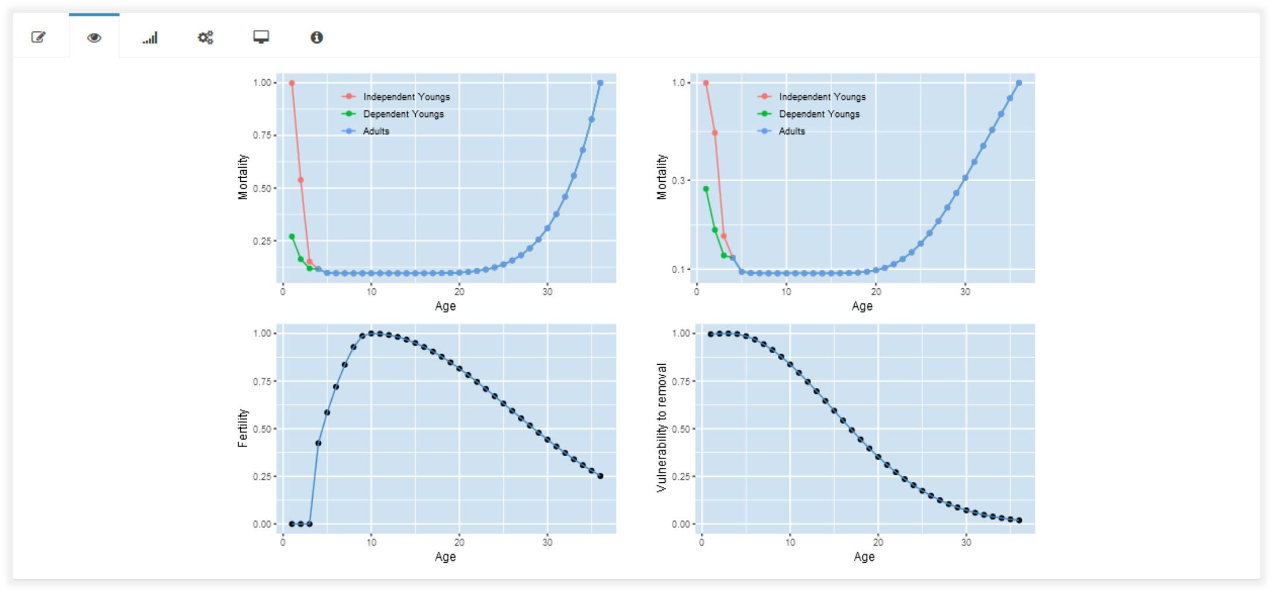
Shiny tabs: Check
Visualization for overview of inpuĴed data.

Slide 14
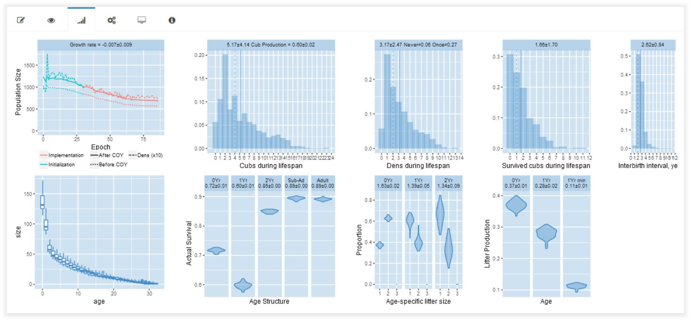
Shiny tabs: Results
Visualization of results of simulation

Slide 15
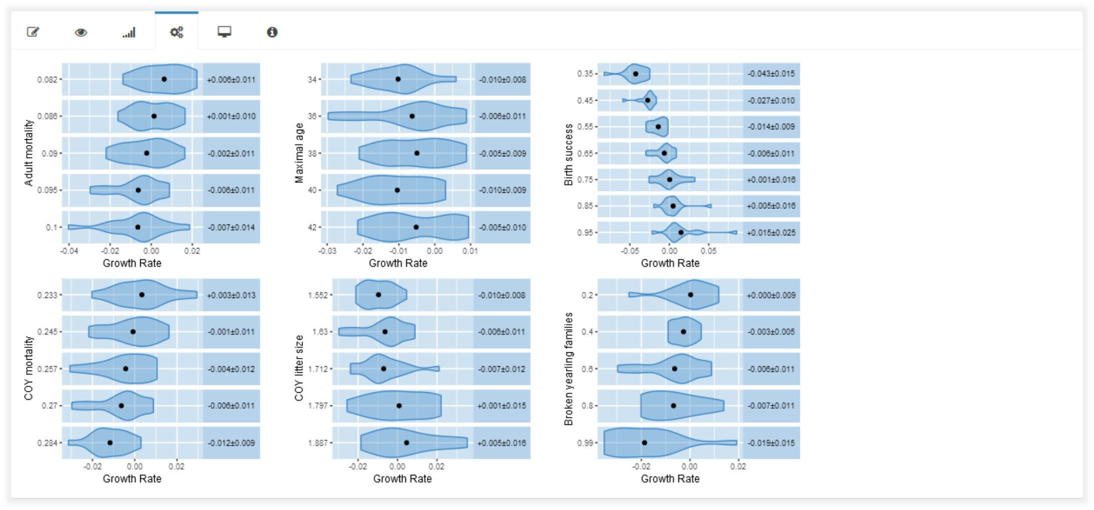
Shiny tabs: Perturbation
Visualization for single-variable adjustment to equilibrium growth rate.

Slide 16


Slide 17
Stochastic simulation
Randomized selection.
Randomized scenarios for learning purposes with ﬁxed random seed number for reproducible researches.
Randomized simulation for with fixed random seed number for reproducible researches.
No portion of individuals. No half of last bear: either “Yes” or “No”. Occasional choice for multiple sample.
Increasing size of modelled population increases precision of applied demographical parameters.

Slide 18
Time of census for annual score
Time of census for annual score is period of cubs emergence. At the same time, two states of population are considered:
Applying “+1 year” aging, applying annual mortality – all without COYs (minimal population size).
COYs are taken into account (maximal population size).

Slide 19
Inter-generation relation
Named unique identiﬁer for each individual for all peers and generations.
Connection between mother and dependent cubs; is canceled for independent cubs.

Slide 20
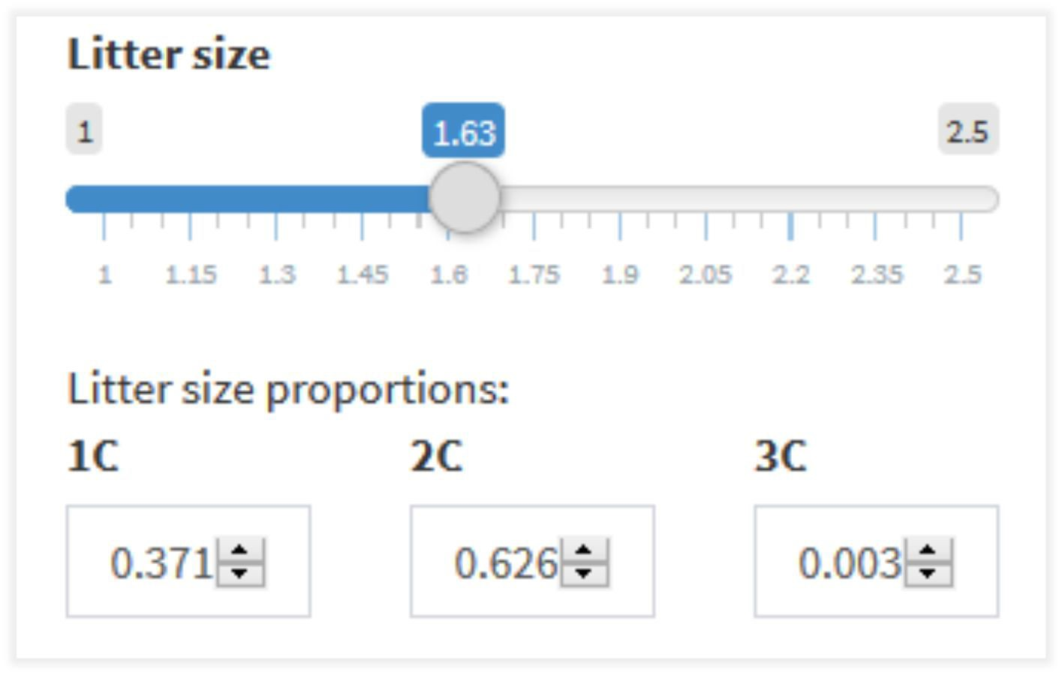
Litter size is from 1 to 3 cubs
Current realization takes only COY litter size from inputs; litter fraction is is a function of litter size.
There is no limitation to consider litter size from 1 to 4 cubs.

Slide 21
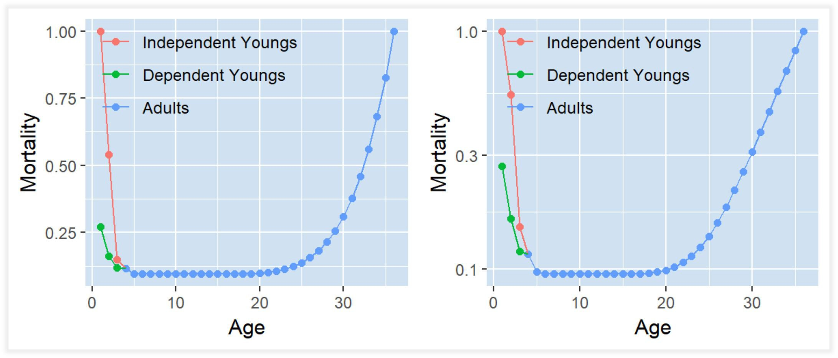
Survival at young age
Mothers leave their cubs up to age both 1 and 2 years old.
Separate age speciﬁc survival rates for dependent and independent cubs.

Slide 22
Survival at old age
Survival of older individuals decreases with aging (Gomperĵ–Makeham law of mortality)

Slide 23
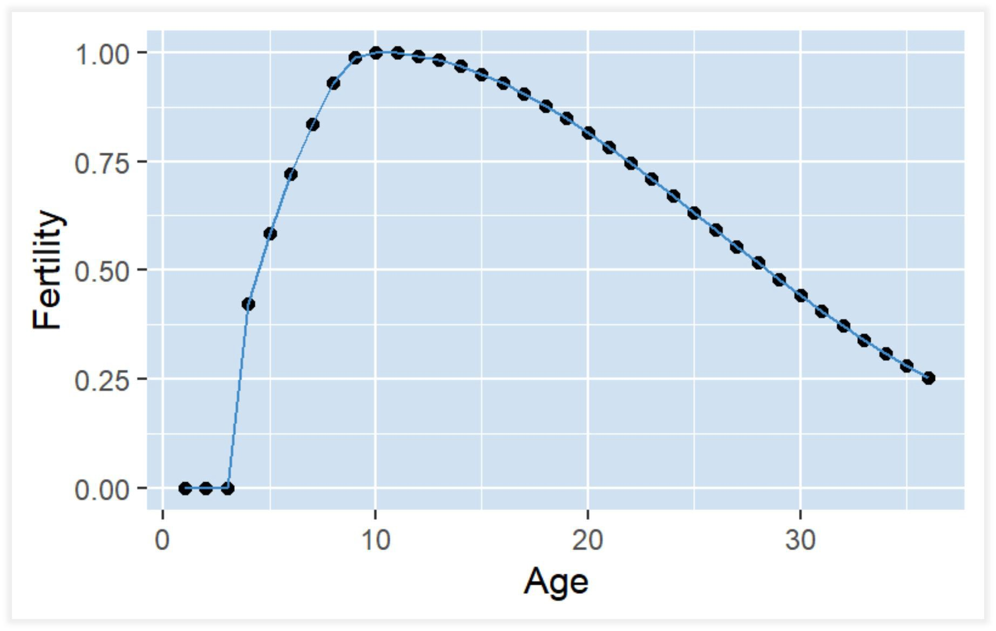
Age-speciﬁc female fertility

Slide 24


Slide 25
Selected scenario in example
COY litter size: 1.63.
Cub fractions (1C, 2C, 3C) simulation: 0.371, 0.625, 0.003. Mortality of dependent COY: 0.27
Mortality of adult (in the green): 0.095
Maximal age: 36
Age speciﬁc fertility: 0.33 Birth success: 0.65
Fraction of broken families with yearlings: 0.6
Scenario random seed: 795, simulation random seed: 130.

Slide 26
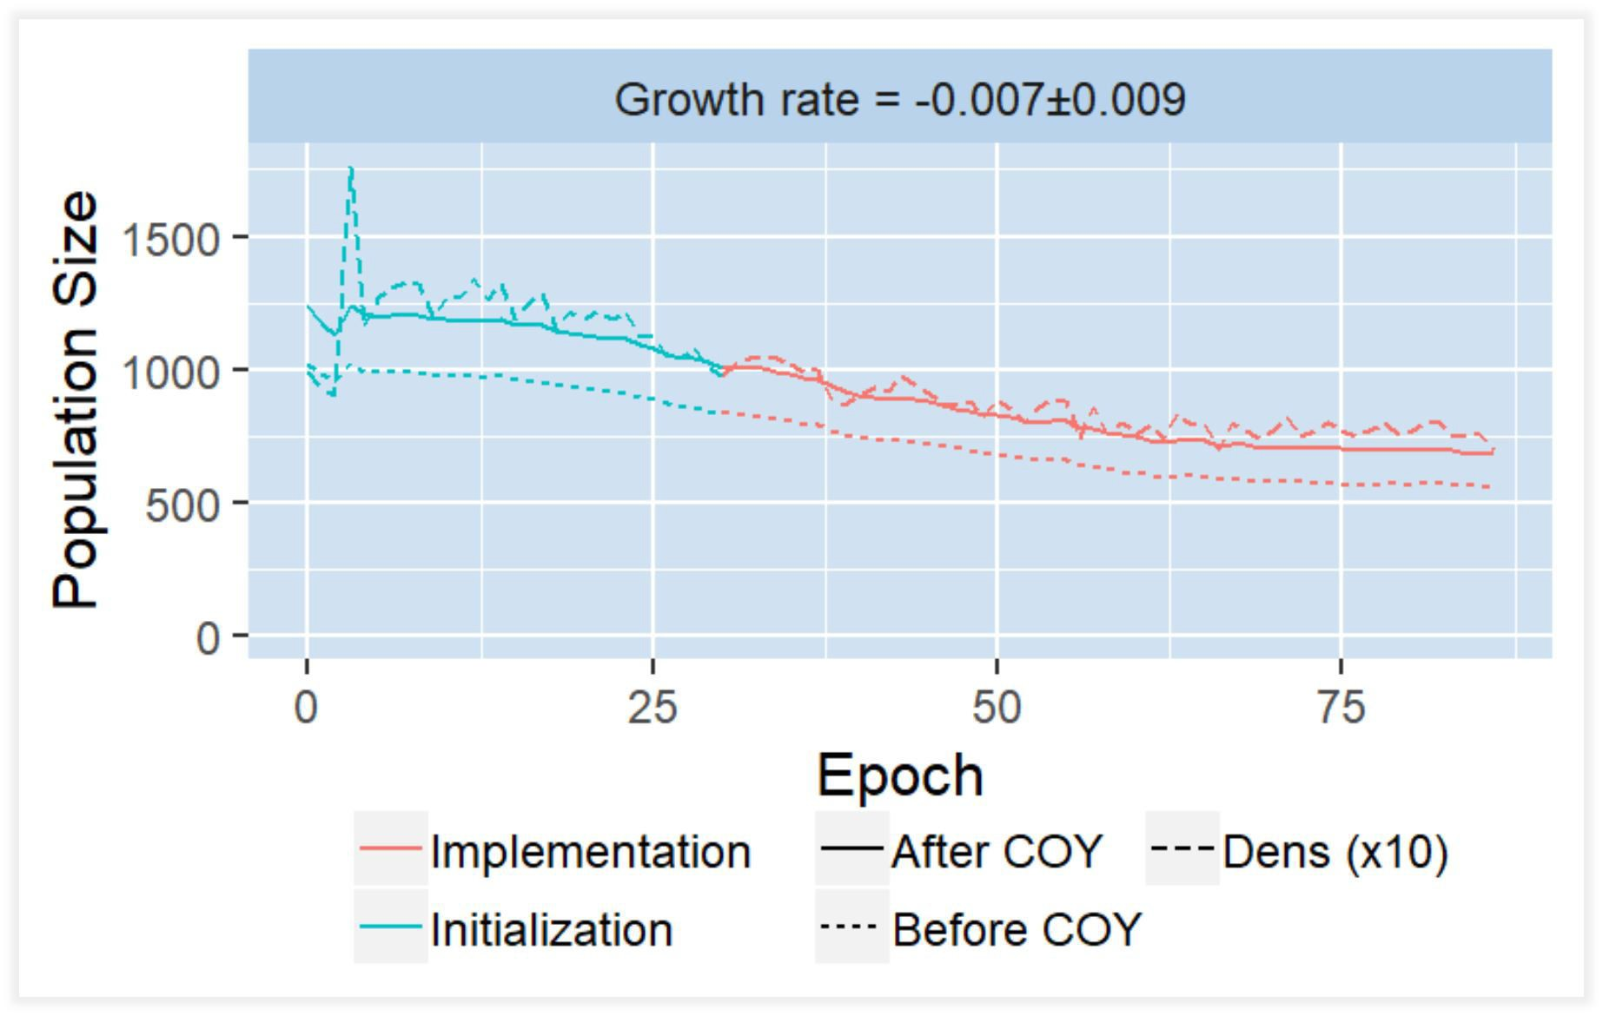
Growth rate

Slide 27
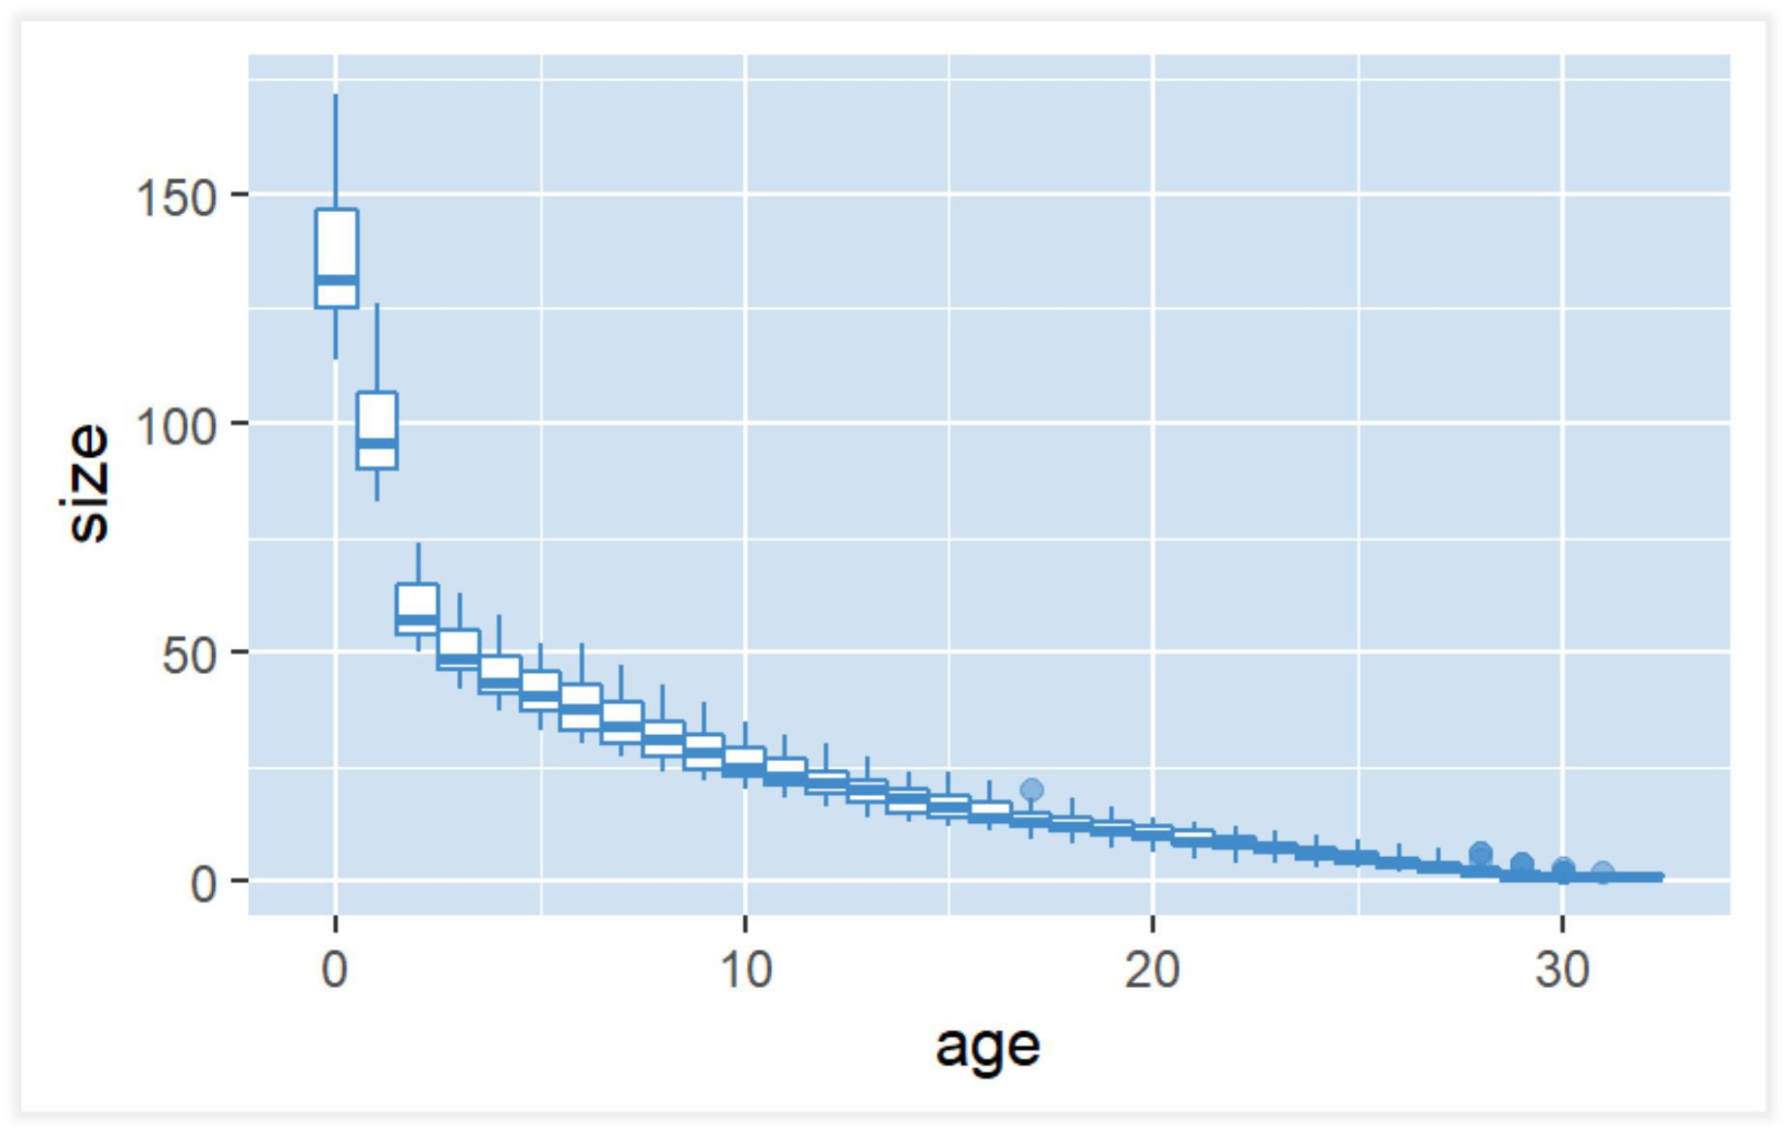
Population peer structure

Slide 28
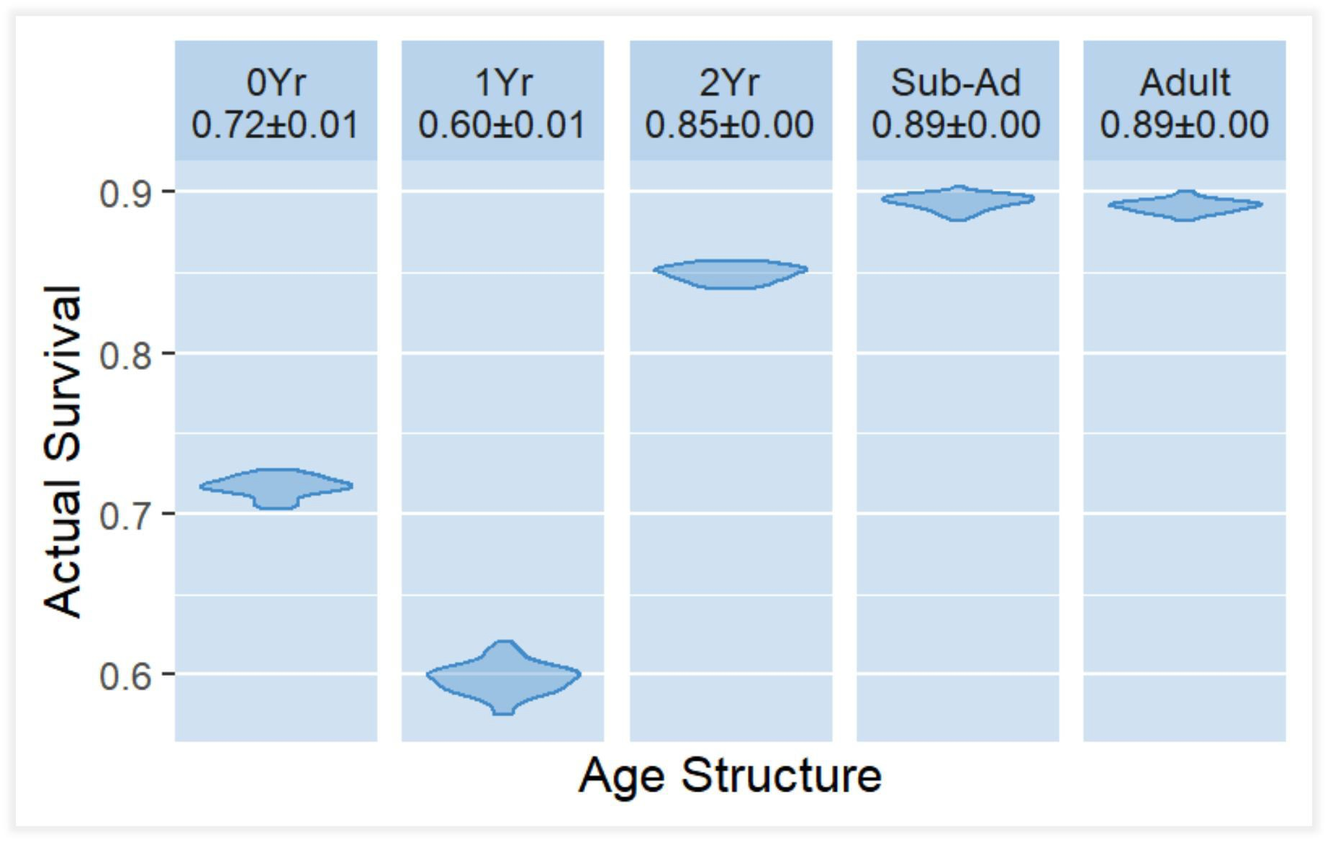
Survival of diﬀerent age groups

Slide 29
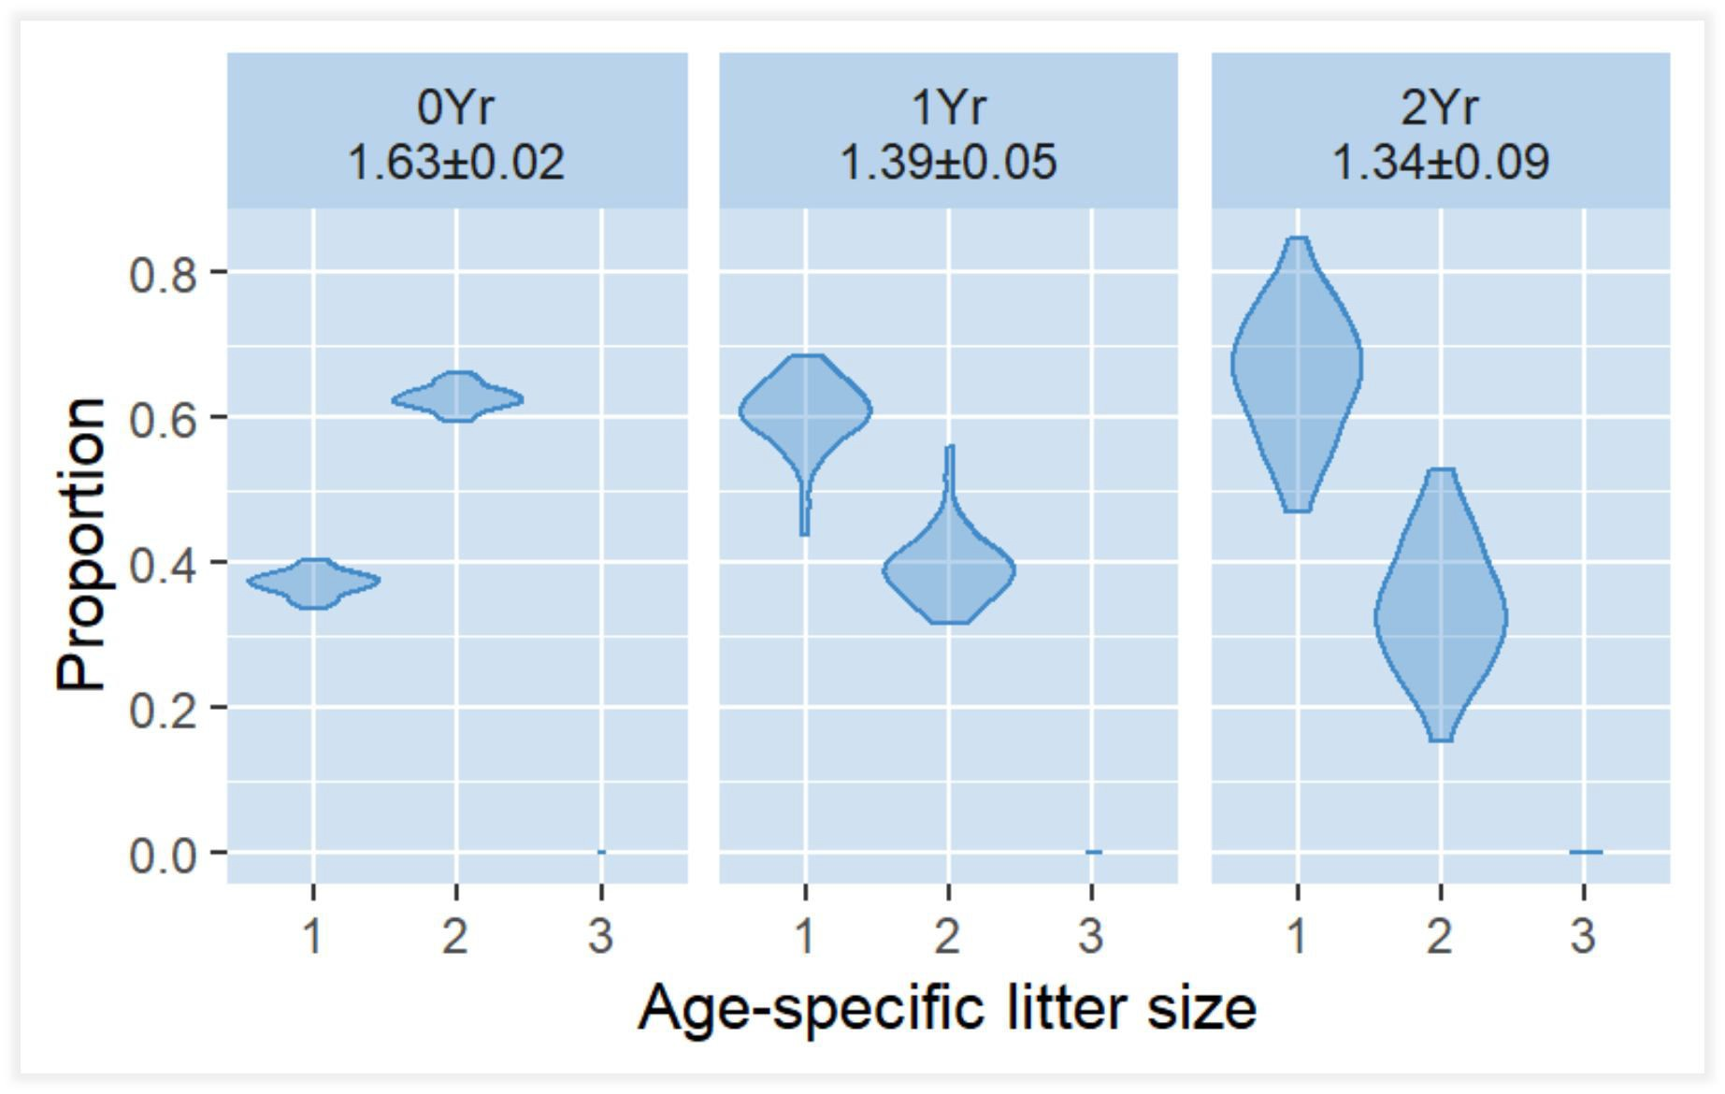
Age-speciﬁc litter size

Slide 30
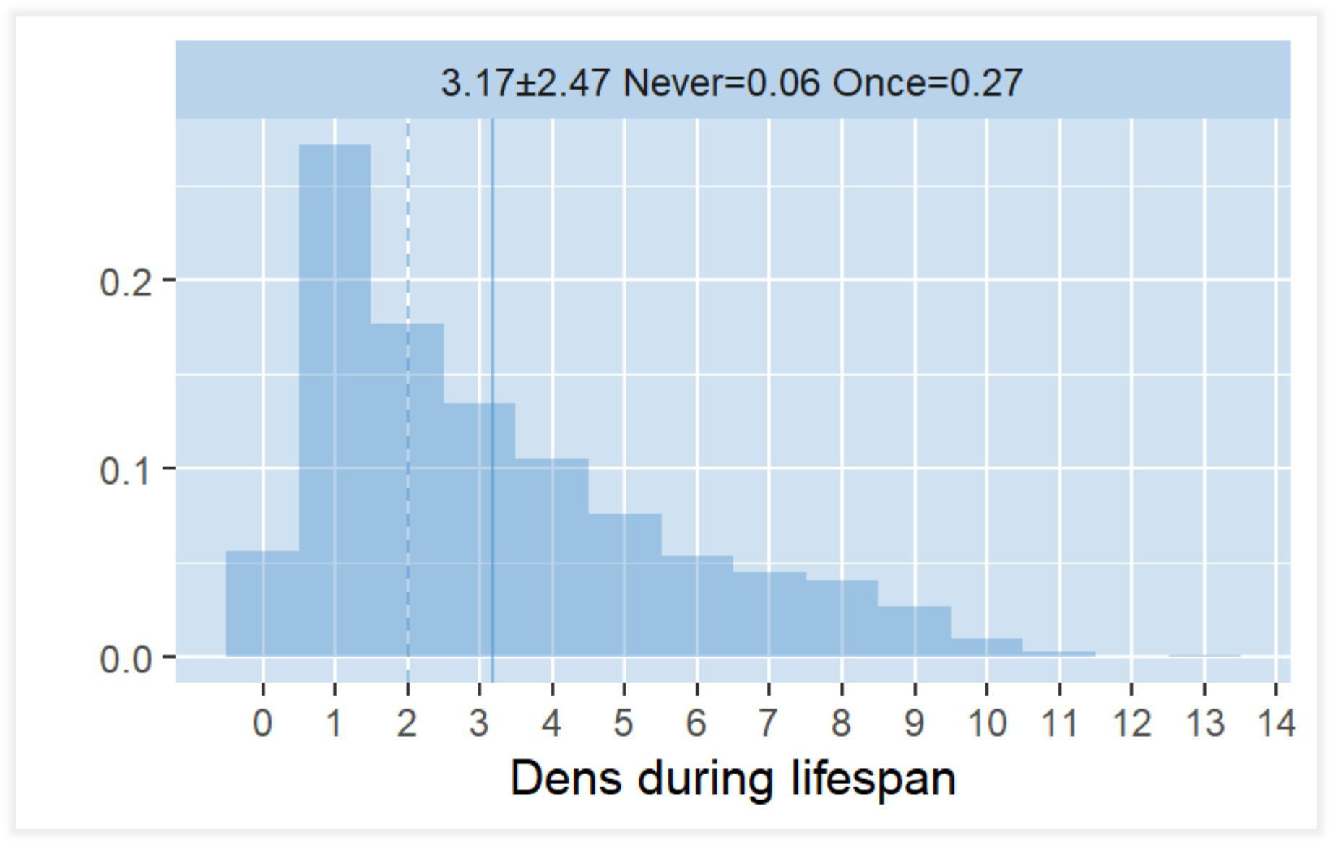
Dens during lifespan

Slide 31
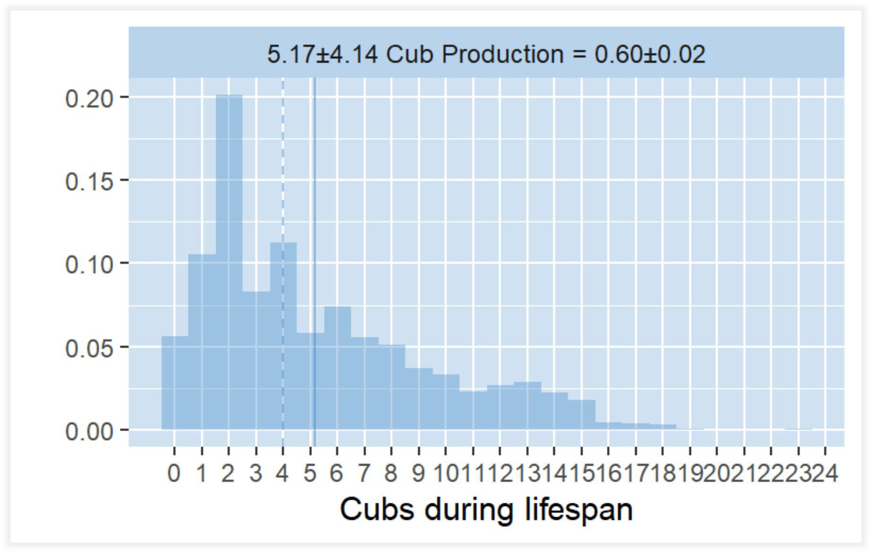
Cubs during lifespan

Slide 32
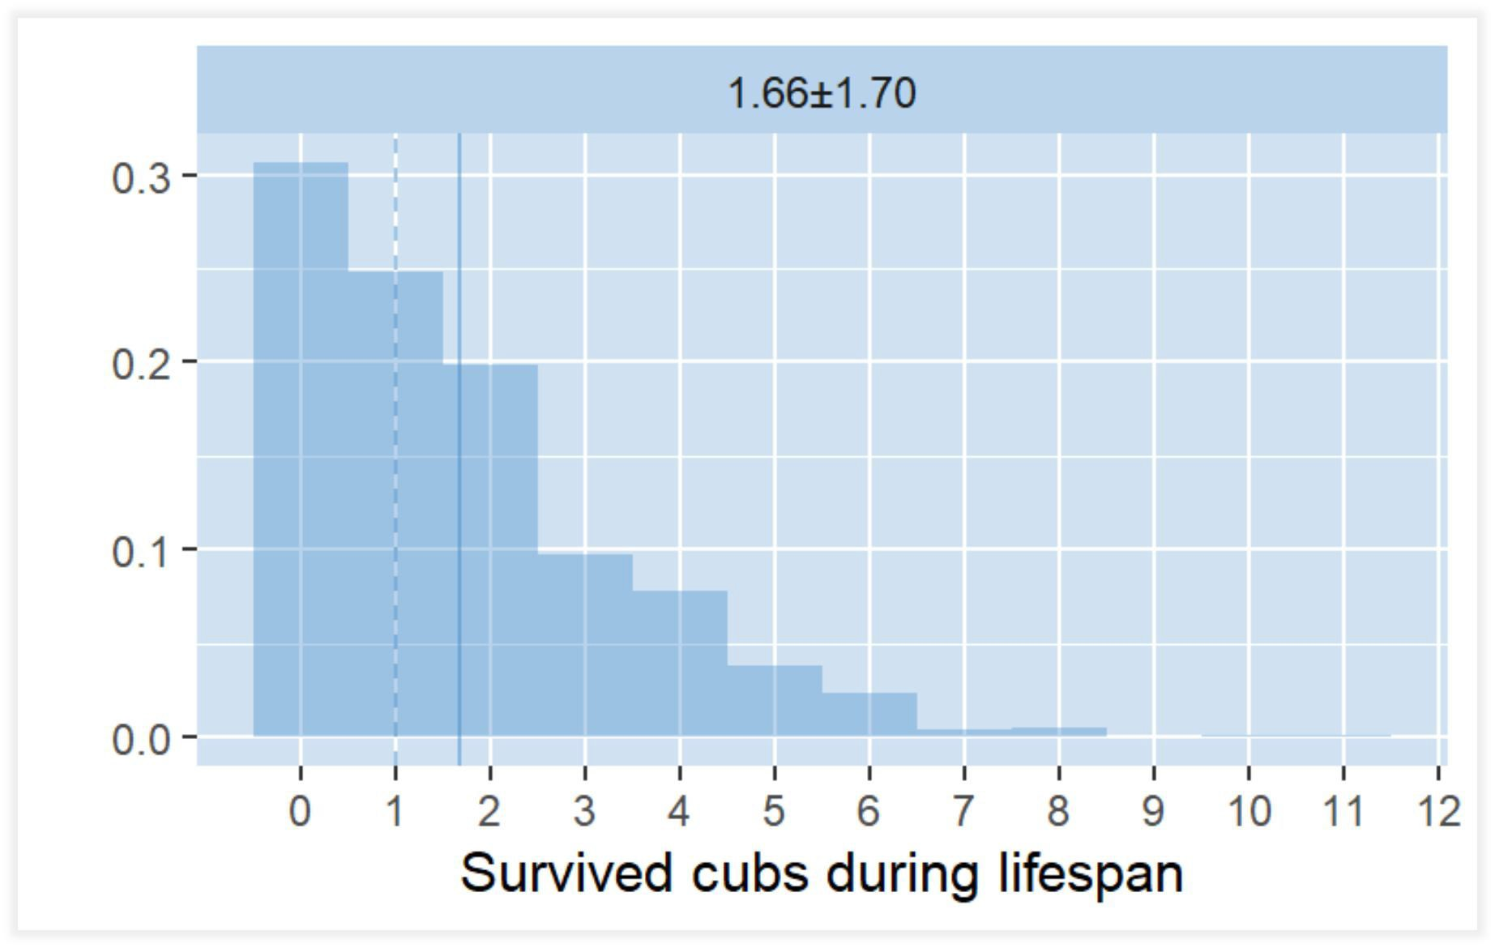
Survived cubs during lifespan

Slide 33
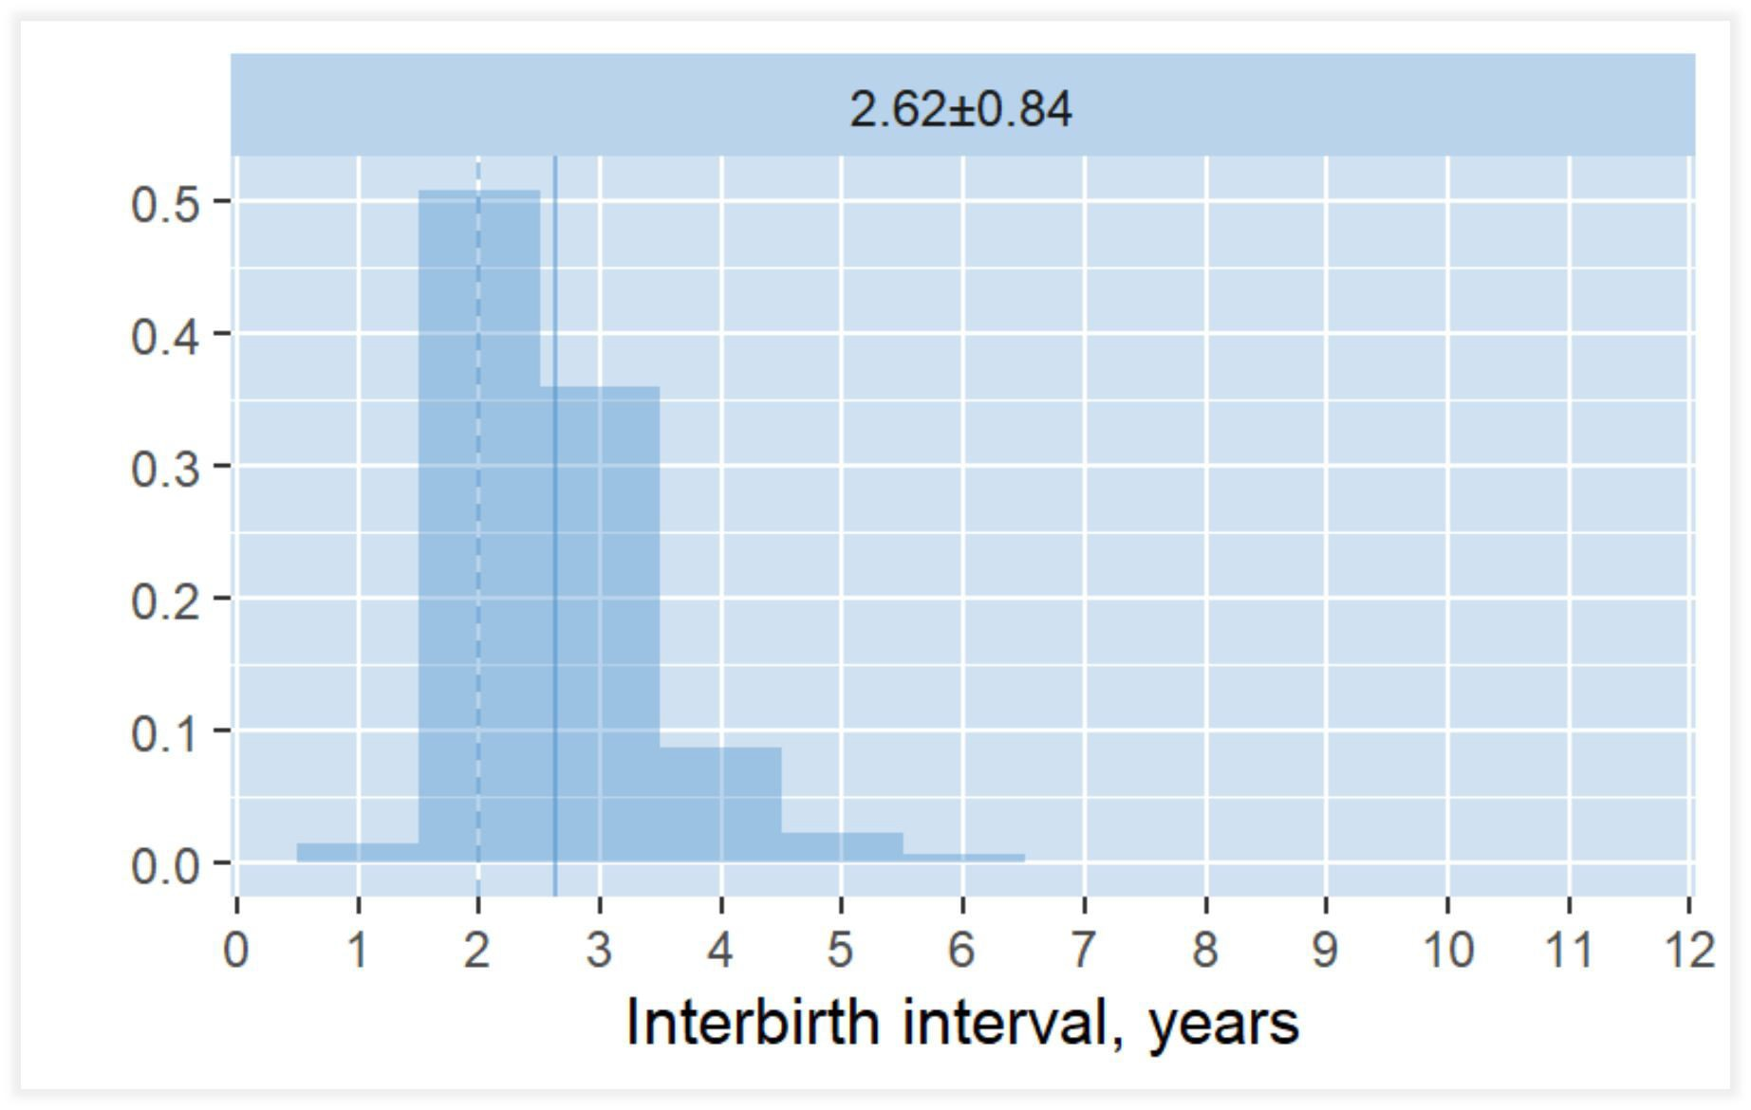
Interbirth interval
Re-mating by assuming monthly COYs mortality during May-June and constant value of probability.

Slide 34
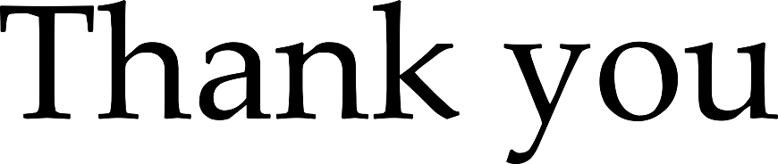

Slide 35
Submitted abstract
The dynamical simulation for evaluation of polar bear (Ursus maritimus) demography has been developed. On each stage, the change of age and sexual structure (with explicit mother-cub relations) of modelled subpopulation is forced by speciﬁed demographical parameters. The followed approaches and statements are considered: temporal resolution is one year, time of census is period of cubs emergence; liĴer size is 1 to 3 cubs; Gompertz–Makeham law of mortality is involved; the female fertility is age-speciﬁc; mothers leave their cubs in both ages of 1 and 2, and age-speciﬁc survival rates for dependent and independent cubs is diﬀerent. All selections are random, and calculations are integer.
This service allows extracting generalized features of polar bear demography. On the average, interbirth (mating) interval is 2-3 years; it depends how long cubs remain with their mothers. A half of females gives birth to 3-4 litters or less during their lifespan; the long-lived females can produce 11-12 litters or less. The single and double births are most frequent, and frequency of each subsequent appearance of cubs falls. In general, among all cubs having a birth from one female during her lifespan only two ones or less reach the age 3 or older.
Relevant data inputs expand set of extracted demographical features. For example, averaged estimates of litter size (1.69, cubs of the year), cub production rate (0.63), litter production rate of cubs of the year (0.36) and yearlings (0.13) for polar bears in the western part of the Barents Sea from Environmental monitoring of Svalbard and Jan Mayen (MOSJ) were deﬁned as target indicators.
Several sets of demographical parameters for which these indicators are achieved were selected. Generally, the birth success is near 0.65-0.70, and around 45-50 % of females wean cubs before age of two.
Project is hosted on https://github.com/nplatonov/demography.

Slide 36
References
Hunter CM, Caswell H, Runge MC, Regehr EV, Amstrup SC, Stirling I. 2010. Climate change threatens polar bear populations: A stochastic demographic analysis. Ecology, 91(10): 2883–2897. Wiley. doi:10.1890/09-1641.1
R Core Team. 2018. R: A language and environment for statistical computing. R Foundation for Statistical Computing: Vienna, Austria https://www.R-project.org/
StoĴ I, Hodgson D, Townley S. 2018. Popdemo: Demographic Modelling Using Projection Matrices. R package version 1.3-0. https://CRAN.R-project.org/package=popdemo (accessed 16 July 2018).

