Slide 1

Discovering Statistics Using IBM SPSS Statistics
Andy Field
This deck incorporates accessible elements, such as standardized content reading order, and image description for all figures presented.

Slide 2
Chapter 3
The Phoenix of Statistics

Slide 3
Aims and Objectives
Problems with NHST
  Misconceptions
  All-or-nothing thinking
  NHST and wider issues in science
A phoenix from the EMBERS
  Effect sizes
  Meta-analysis
  Bayesian Estimation
  Registration
  Sense

Slide 4
Misconceptions Around p-values
Misconception 1: A significant result means that the effect is important
  No, because significance depends on sample size.
Misconception 2: A non-significant result means that the null hypothesis is true
  No, a non-significant result tells us only that the effect is not big enough to be found (given our sample size); it doesn’t tell us that the effect size is zero.
Misconception 3: A significant result means that the null hypothesis is false?
  No, it is logically not possible to conclude this.

Slide 5
Logical Flaw
If ‘null hypothesis’ is true, then it is highly unlikely to get this test statistic:
  This test statistic has occurred.
  Therefore, the null hypothesis is highly unlikely.
If ‘person plays guitar’ is true, then it is highly unlikely that he plays in Iron Maiden
  This person plays in Iron Maiden
  Therefore, ‘person plays guitar’ is highly unlikely.
Notes:
About 50 million people play guitar, 3 of them are in Iron maiden, so the first statement is true, only 3/50 million people play guitar in iron maiden.
If the man plays in Iron Maiden then there is a 3/6 chance that he plays guitar, so about 50%, which is a fairly high probability.

Slide 6
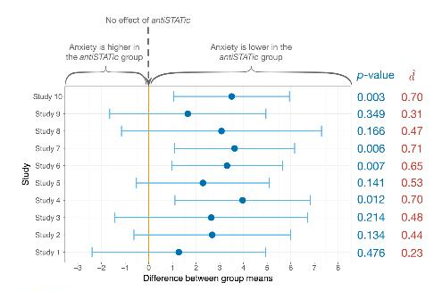
All-Or-Nothing Thinking
Figure 3.2 Results of 10 different studies looking at the difference between two interventions. The circles show the mean difference between groups

Slide 7
NHST and Wider Problems in Science
Incentive structures and publication bias
Researcher degrees of freedom
p-hacking and HARKing

Slide 8

Calculating ‘Error’ (1 of 2)
A deviation is the difference between the mean and an actual data point.
Deviations can be calculated by taking each score and subtracting the mean from it:
$$\text{deviance}=\text{outcom}{\text{e}}_{i}−\text{mode}{\text{l}}_{i}$$

Slide 9
Calculating ‘Error’ (2 of 2)

Slide 10
Use the Total Error?
We could just take the error between the mean and the data and add them.
Score | Mean | Deviation
1 | 2.6 | -1.6
2 | 2.6 | -0.6
3 | 2.6 | 0.4
3 | 2.6 | 0.4
4 | 2.6 | 1.4
 | Total = | 0

Slide 11
Sum of Squared Errors
We could add the deviations to find out the total error.
Deviations cancel out because some are positive and others are negative.
Therefore, we square each deviation.
If we add these squared deviations, we get the Sum of Squared Errors (SS).

Slide 12
Incentive Structures (1 of 2)
Beth and Danielle
  Can people with extreme views literally not see grey areas?
  Participants see words displayed in various shades of grey and for each word they try to match its colour by clicking along a gradient of greys from near white to near black.
Danielle:
  finds that politically moderate participants are significantly more accurate (the shades of grey they chose more closely matched the colour of the word) than participants with extreme political views to the left or right.
Beth
  Found no significant differences in accuracy between groups.

Slide 13
Incentive Structures (2 of 2)
Danielle’s study was no different than Beth’s (except for the results) but:
  Danielle’s interesting, surprising and media-friendly result is more likely to be published than Beth’s null finding.
  Danielle now has a better-looking CV than Beth: she will be a stronger candidate for jobs, research funding and internal promotion.
Fanelli, 2010
  In the USA, scientists from institutions that publish a large amount are more likely to publish results supporting their hypothesis.
  Given that a good proportion of hypotheses ought to be wrong, do those working in high-stress ‘publish or perish’ environments less often have wrong hypotheses, or do they cheat more?

Slide 14
Researcher Degrees of Freedom
A scientist has many decisions to make when designing and analysing a study.
  The alpha level, the level of power, how many participants should be collected, which statistical model to fit, how to deal with extreme scores, which control variables to consider, which measures to use, and so on.
Researchers might use these researcher degrees of freedom to shed their results in the most favourable light (Simmons, Nelson, & Simonsohn, 2011).
Fanelli (2009) assimilated data from studies in which scientists reported on other scientists’ behaviour.
  On average, 14.12% had observed fabricating or falsifying data, or altering results to improve the outcome.
  A disturbingly high 28.53% reported other questionable practices.

Slide 15
p-hacking and HARKing (1 of 2)
p-hacking
  Researcher degrees of freedoms that lead to the selective reporting of significant p-values
    Trying multiple analyses/measuring multiple outcomes but reporting only the significant results
    Stopping data collection at a point other than when the pre-determined sample size is reached
    Including (or not) data based on the effect they have on the p-value.
    Including (or excluding) variables in an analysis based on how those variables affect the p-value.

Slide 16
p-hacking and HARKing (2 of 2)
    Merging groups of variables or scores to yield significant results
    Transforming or otherwise manipulating scores to yield significant p-values
HARKing
  The practice in research articles of presenting a hypothesis that was made after data collection as though it were made before data collection

Slide 17
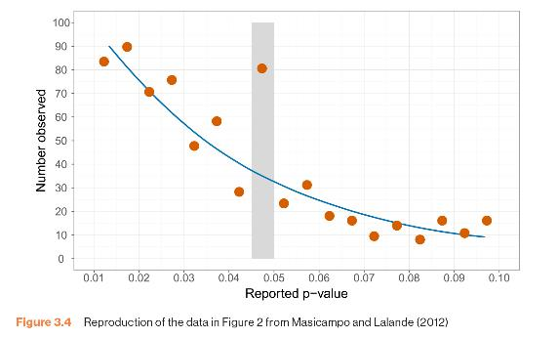
Evidence for p-hacking?
Figure 3.4 Reproduction of the data in Figure 2 from Masicampo and Lalande (2012)

Slide 18
Sense (1 of 2)
The ASA statement on p-values (Wasserstein & American Statistical Association, 2016).
  The ASA points out that p-values can indicate how incompatible the data are with a specified statistical model (e.g. how incompatible the data are with the null hypothesis). You are at liberty to use the degree of incompatibility to inform your own beliefs about the relative plausibility of the null and alternative hypotheses, as long as you don’t interpret p-values as a measure of the probability that the hypothesis in question is true. They are also not the probability that the data were produced by random chance alone.
  Scientific conclusions and policy decisions should not be based only on whether a p-value passes a specific threshold.

Slide 19
Sense (2 of 2)
  Don’t p-hack. Be fully transparent about the number of hypotheses explored during the study, and all data collection decisions and statistical analyses.
  Don’t confuse statistical significance with practical importance. A p-value does not measure the size of an effect and is influenced by the sample size, so you should never interpret a p-value in any way that implies that it quantifies the size or importance of an effect.
  ‘By itself, a p-value does not provide a good measure of evidence regarding a model or hypothesis’.

Slide 20
Preregistration
Open science
  A movement to make the process, data and outcomes of research freely available to everyone.
Pre-registration of research
  The practice of making all aspects of your research process (rationale, hypotheses, design, data processing strategy, data analysis strategy) publicly available before data collection begins.
  Registered reports in an academic journal
    If the protocol is deemed to be rigorous enough and the research question novel enough, the protocol is accepted by the journal typically with a guarantee to publish the findings no matter what they are.
  Public websites (e.g. the Open Science Framework).

Slide 21
Effect Sizes
An effect size is a standardized measure of the size of an effect:
  Standardized = comparable across studies
  Not (as) reliant on the sample size
  Allows people to objectively evaluate the size of observed effect.

Slide 22
Effect Size Measures
There are several effect size measures that can be used:
  Cohen’s d
  Pearson’s r
  Odds Ratio/Risk rates
Pearson’s r is a good intuitive measure
  Oh, apart from when group sizes are different …

Slide 23
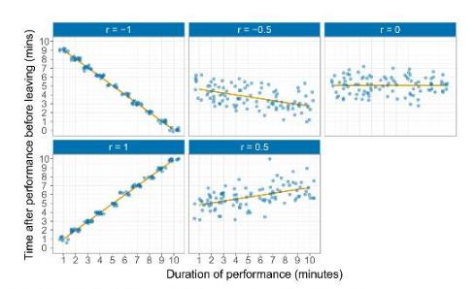
The Correlation Coefficient, r
We’ll cover this measure later in detail …
Figure 3.5 Different relationships shown by different correlation coefficients

Slide 24
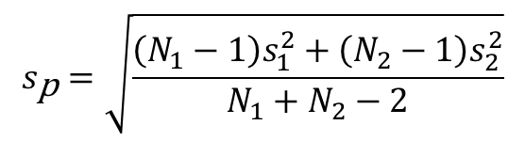
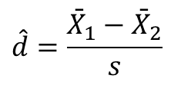
Cohen’s d
$$\hat{d}=\frac{{\bar{X}}_{1}−{\bar{X}}_{2}}{s}$$
$$s_{\text{p}}=\sqrt{\frac{\left(N_{1}−1\right)s_{1}^{2}+\left(N_{2}−1\right)s_{2}^{2}}{N_{1}+N_{2}−2}}$$

Slide 25
Effect Size Measures
r = .1, d = .2 (small effect):
  the effect explains 1% of the total variance.
r = .3, d = .5 (medium effect):
  the effect accounts for 9% of the total variance.
r = .5, d = .8 (large effect):
  the effect accounts for 25% of the variance.
Beware of these ‘canned’ effect sizes though:
  The size of effect should be placed within the research context.

Slide 26
Advantages of Effect Sizes
They encourage interpreting effects on a continuum and not applying a categorical decision rule such as ‘significant’ or ‘not significant’.
Effect sizes and sample size
  Effect sizes are affected by sample size (larger samples yield better estimates of the population effect size), but, unlike p-values, there is no decision rule attached to effect sizes, so the interpretation of effect sizes is not confounded by sample size.
Effect sizes and researcher degrees of freedom
  Although there are researcher degrees of freedom (not related to sample size) that researchers could use to maximize (or minimize) effect sizes, there is less incentive to do so because effect sizes are not tied to a decision rule in which effects either side of a certain threshold have qualitatively opposite interpretations.

Slide 27
Meta-Analysis
Meta-analysis involves computing effect sizes for a series of studies that investigated the same research question, and taking a weighted average of those effect sizes.
Each effect size is weighted by its precision (i.e. how good an estimate of the population it is) before the average is computed.
Large studies, which will yield effect sizes that are more likely to closely approximate the population, are given more ‘weight’ than smaller studies, which should have yielded imprecise effect size estimates.
The aim of meta-analysis is not to look at p-values and assess ‘significance’, but to estimate the population effect.
  Therefore, it overcomes the same problems of NHST that we discussed for effect sizes.

Slide 28
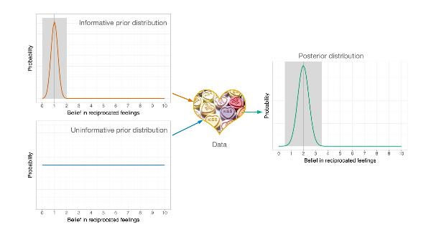
Bayesian Estimation
Figure 3.6 The process of updating your beliefs with Bayesian statistics

Slide 29
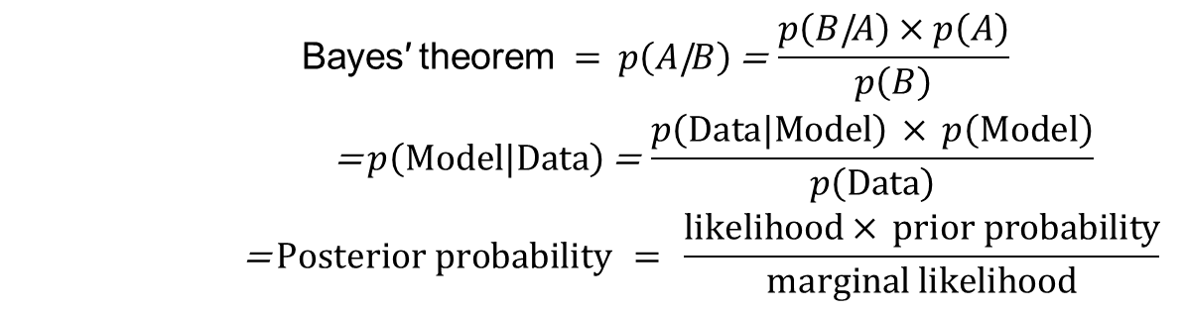
Bayes’ Theorem
$$\begin{matrix} \text{Bayes}\text{′ }\text{theorem} = p\left(A\text{|}B\right)\text{ = }\frac{p\left(B\text{|}A\right)×p\left(A\right)}{p\left(B\right)} \\ \text{ = }p\left(\text{Model}\text{|}\text{Data}\right)\text{ = }\frac{p\left(\text{Data}\text{|}\text{Model}\right) × p\left(\text{Model}\right)}{p\left(\text{Data}\right)} \\ \text{ = }\text{Posterior} \text{probability} = \frac{\text{likelihood}× \text{prior} \text{probability}}{\text{marginal} \text{likelihood}}\end{matrix}$$

Slide 30
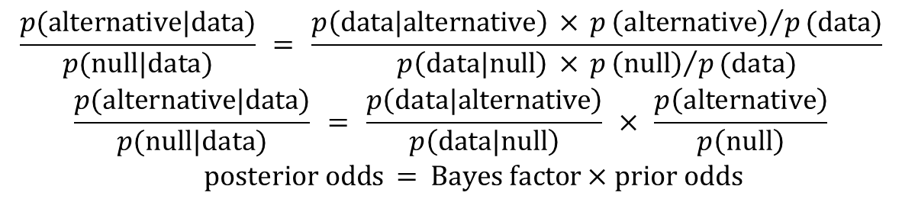
Bayes Factor
$$\begin{matrix}\frac{p\text{(}\text{alternative}\text{|}\text{data}\text{)}}{p\text{(}\text{null}\text{|}\text{data}\text{)}} = \frac{p\left(\text{data}\text{|}\text{alternative}\right) × p{\left(\text{alternative}\right)}/p\text{(}\text{data}\text{)}}{p\left(\text{data}\text{|}\text{null}\right) × p{\left(\text{null}\right)}/p\text{(}\text{data}\text{)}} \\ \frac{p\text{(}\text{alternative}\text{|}\text{data}\text{)}}{p\text{(}\text{null}\text{|}\text{data}\text{)}} = \frac{p\left(\text{data}\text{|}\text{alternative}\right)}{p\left(\text{data}\text{|}\text{null}\right)} × \frac{p\left(\text{alternative}\right)}{p\left(\text{null}\right)} \\ \text{posterior} \text{odds} = \text{Bayes} \text{factor}×\text{prior} \text{odds}\end{matrix}$$

Slide 31
Benefits of Bayesian Approaches
Bayesian approaches specifically evaluate the evidence for the null hypothesis.
  Unlike NHST, you can draw conclusions about the likelihood that the null hypothesis is true.
Unlike p-values Bayesian methods are not confounded by the sample size and the stopping rules applied to data collection.
Bayesian methods focus on estimating parameter values (which quantify effects) or evaluating relative evidence for the alternative hypothesis (Bayes factors).
  Because there is no black-and-white thinking, only estimation and interpretation, behaviour such as p-hacking is circumvented.

