Slide 1

Discovering Statistics Using IBM SPSS Statistics
Andy Field
This deck incorporates accessible elements, such as standardized content reading order, and image description for all figures presented.

Slide 2
Chapter 4
The IBM SPSS Statistics Environment

Slide 3
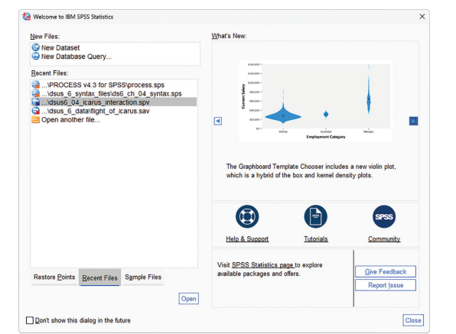
Starting IBM SPSS Statistics
Figure 4.2 The start-up window of IBM SPSS

Slide 4
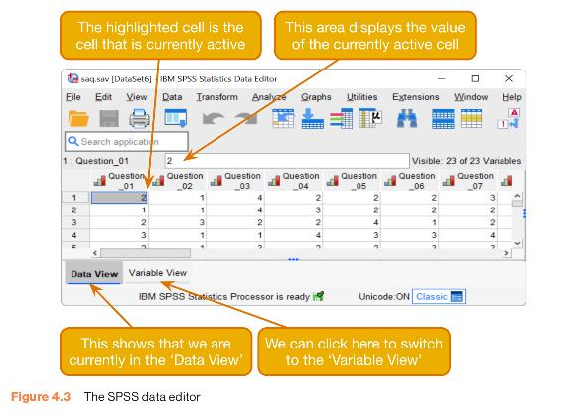
The Data Editor
Figure 4.3 The SPSS data editor

Slide 5
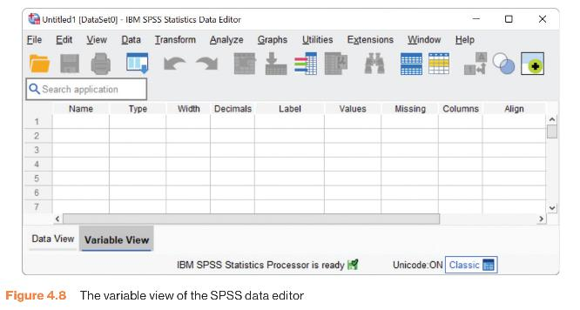
The Variable View
Figure 4.8 The variable view of the SPSS data editor

Slide 6
Variable Types
Numeric
  Numbers (e.g. 7, 0, 120)
String
  Letters (e.g. ‘Andy’, ‘Idiot’)
Currency
  Currency (e.g. £20, $34, €56)
Date
  Dates (e.g. 21-06-1973, 06-21-73, 21-Jun-1973)

Slide 7
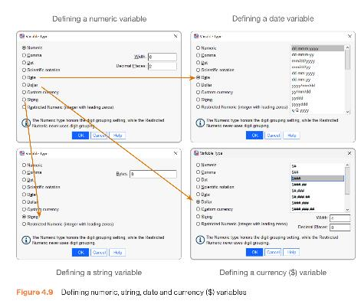
Defining Numeric, String, Date and Currency ($) Variables
Figure 4.9 Defining numeric, string, date and currency ($) variables

Slide 8
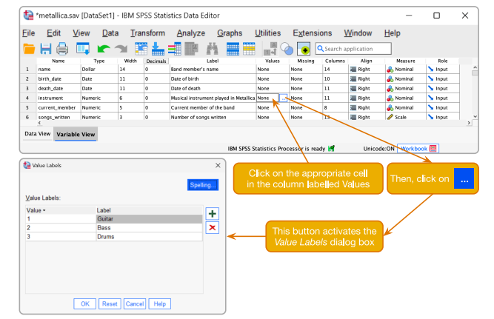
Creating a Coding Variable
Figure 4.10 Defining coding variables and their values

Slide 9
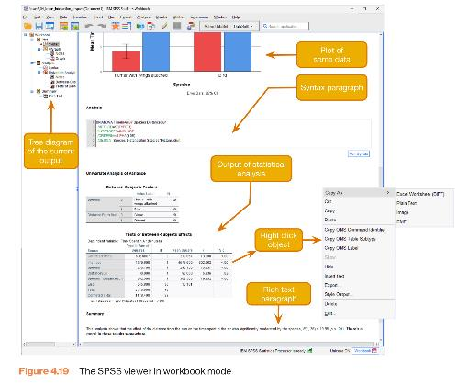
The Viewer in Workbook Mode
Figure 4.19 The SPSS viewer in workbook mode

Slide 10
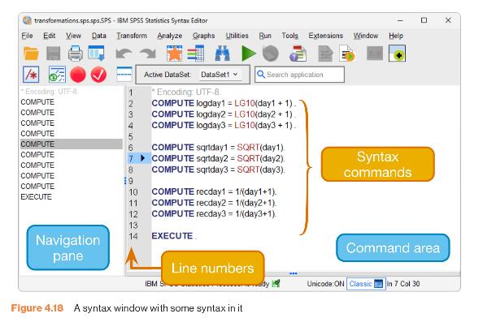
The Syntax Window
Figure 4.18 A syntax window with some syntax in it

Slide 11
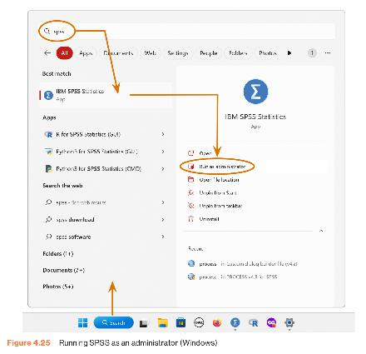
Running SPSS as an Administrator (Windows)
Figure 4.25 Running SPSS as an administrator (Windows)

