Slide 1

Discovering Statistics Using IBM SPSS Statistics
Andy Field
This deck incorporates accessible elements, such as standardized content reading order, and image description for all figures presented.

Slide 2
Chapter 5
Data Visualization

Slide 3
Aims
How to present data clearly
The Chart Builder
Graphs
  Histograms
  Boxplots
  Error bar charts
  Scatterplots

Slide 4
The Art of Presenting Data
Graphs should (Tufte, 2001):
  Show the data.
  Induce the reader to think about the data being presented (rather than some other aspect of the graph).
  Avoid distorting the data.
  Present many numbers with minimum ink.
  Make large data sets (assuming you have one) coherent.
  Encourage the reader to compare different pieces of data.
  Reveal data.

Slide 5
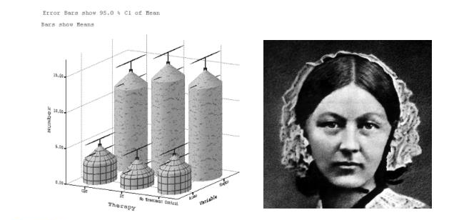
Why is this Graph Bad?
Figure 5.2 A cringingly bad example of a plot from the first edition of this book (left) and Florence Nightingale (right) giving my plot the ‘stare of death’

Slide 6
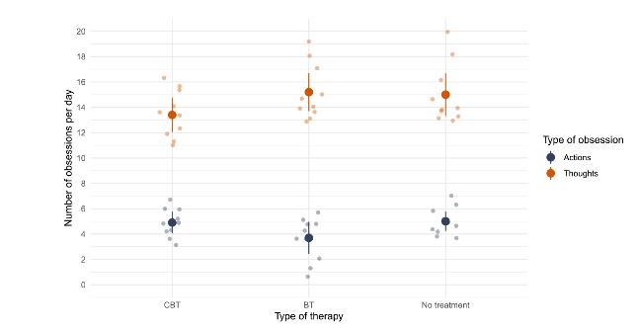
Why is this Graph Better?
Figure 5.3 Figure 5.2 plotted properly

Slide 7
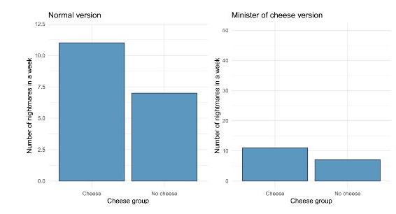
Deceiving the Reader
Figure 5.4 Two plots about cheese

Slide 8
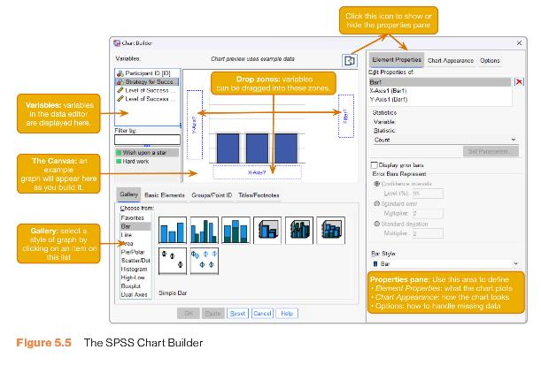
The Chart Builder
Figure 5.5 The SPSS Chart Builder

Slide 9
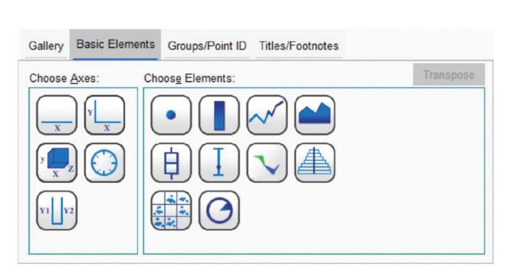
Figure 5.6 Building a Plot from Basic Elements

Slide 10
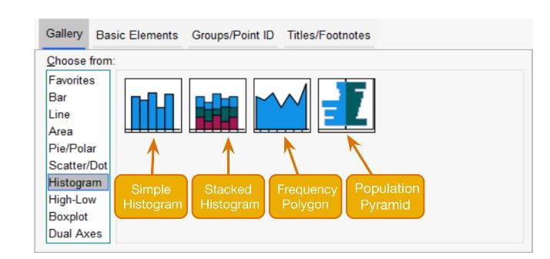
Histograms: Spotting Obvious Mistakes
Figure 5.8 The histogram gallery

Slide 11
Histograms
Histograms plot:
  The score (x-axis)
  The frequency (y-axis)
Histograms help us to identify:
  The shape of the distribution
    Skew
    Kurtosis
    Spread or variation in scores
  Unusual scores

Slide 12
Histograms: Example
I wanted to test the Disney philosophy that ‘Wishing upon a star makes all your dreams come true’.
Measured the success of 250 people using a composite measure involving their salary, quality of life and how close their life matches their aspirations.
Success was measured using a standardized technique :
  Score ranged from 0 to 4
    0 = Complete failure
    4 = Complete success
Participants were randomly allocated to either, wish upon a star or work as hard as they can for next 5 years.
Success was measured again after 5 years.

Slide 13
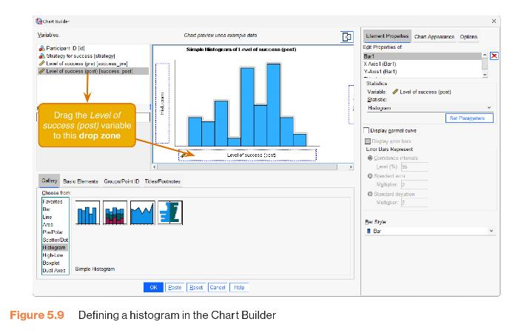
Figure 5.9 Defining a Histogram in the Chart Builder

Slide 14
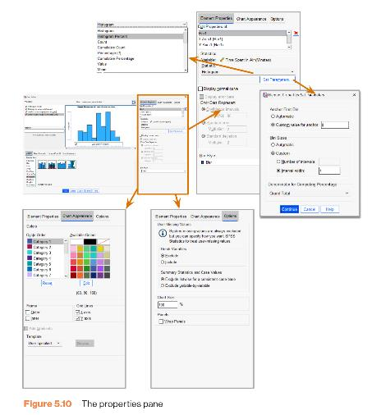
Figure 5.10 The Properties Pane

Slide 15
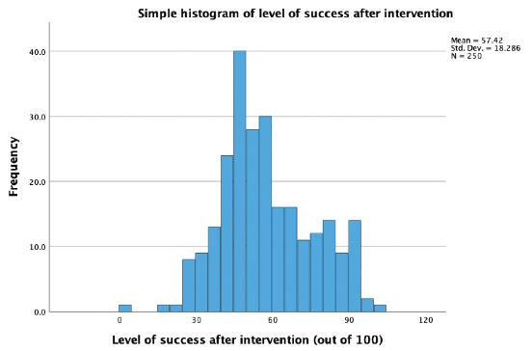
The Resulting Histogram
Figure 5.11 Histogram of the post-intervention success scores

Slide 16
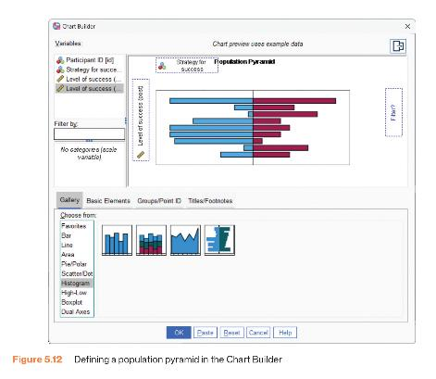
Creating a Population Pyramid
Figure 5.12 Defining a population pyramid in the Chart Builder

Slide 17
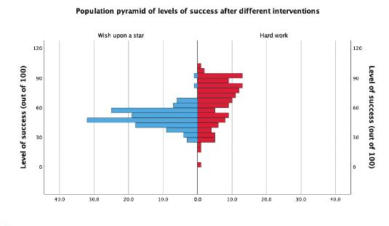
Population Pyramid of Success Scores
Figure 5.13 Population pyramid of success scores (5 years after different strategies were implemented)

Slide 18
Boxplots (box-whisker diagrams) (1 of 2)
Boxplots are made up of a box and two whiskers.
The box shows:
  The median
  The upper and lower quartile
  The limits within which the middle 50% of scores lie.
The whiskers show:
  The range of scores
  The limits within which the top and bottom 25% of scores lie.

Slide 19
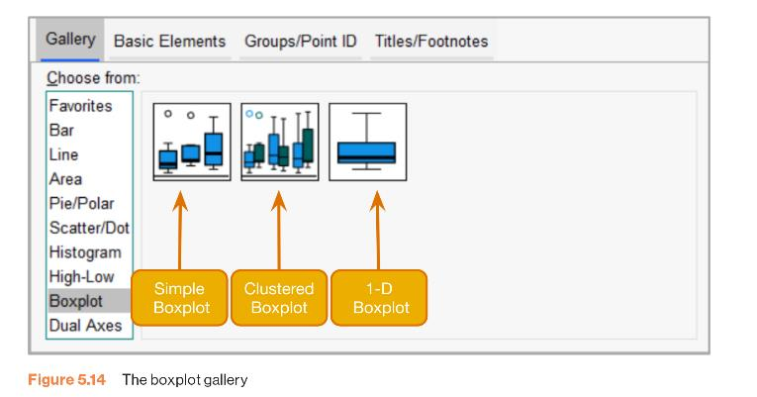
Boxplots (box-whisker diagrams) (2 of 2)
Figure 5.14 The boxplot gallery

Slide 20
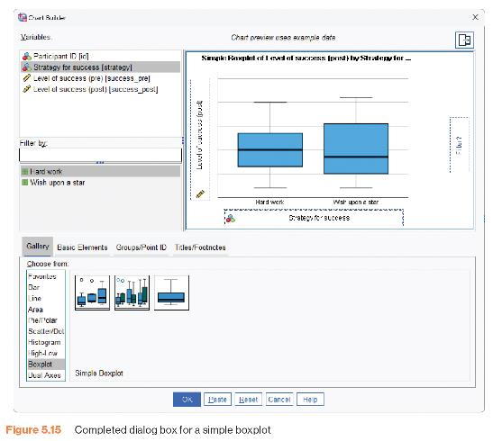
Figure 5.15 Completed Dialogue Box for a Simple Boxplot

Slide 21
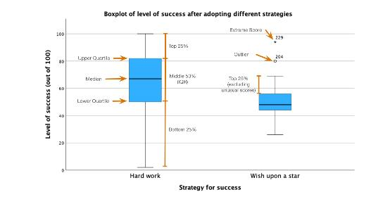
The Boxplot
Figure 5.16 Boxplot of success scores 5 years after implementing a strategy of working hard or wishing upon a star

Slide 22
Error Bar Charts
The bar (usually) shows the mean score.
The error bar sticks out from the bar like a whisker.
The error bar displays the precision of the mean in one of three ways:
  The confidence interval (usually 95%)
  The standard deviation
  The standard error of the mean

Slide 23
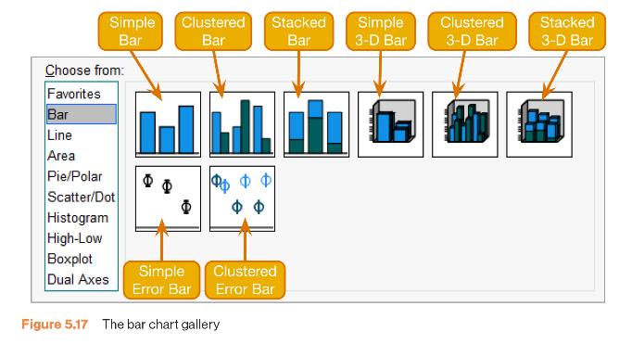
Bar Chart Gallery
Figure 5.17 The bar chart gallery

Slide 24
Bar Chart: One Independent Variable
Is there such a thing as a ‘chick flick’?
Participants:
  20 men
  20 women
Half of each sample saw one of two films:
  A ‘chick flick’ (The Notebook),
  Control (A documentary about notebooks).
Outcome measure
  Physiological arousal as an indicator of how much they enjoyed the film.

Slide 25
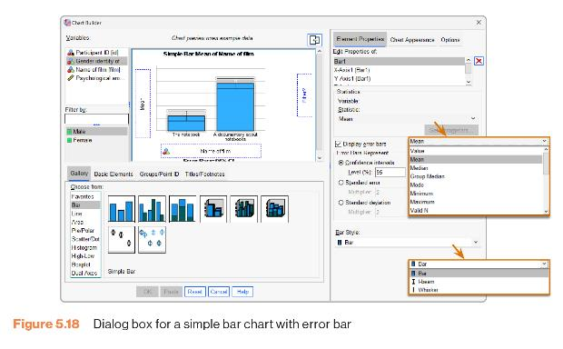
Simple Bar Chart with Error Bar
Figure 5.18 Dialogue box for a simple bar chart with error bar

Slide 26
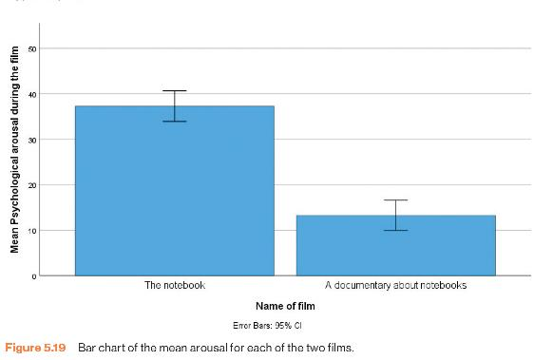
Bar Chart: One Independent Variable
Figure 5.19 Bar chart of the mean arousal for each of the two films.

Slide 27
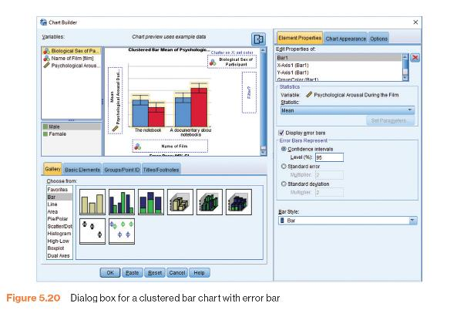
Clustered Bar Chart with Error Bar
Figure 5.20 Dialogue box for a clustered bar chart with error bar

Slide 28
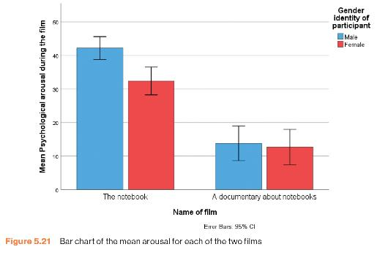
Bar Chart: Two Independent Variables
Figure 5.21 Bar chart of the mean arousal for each of the two films

Slide 29
Bar Chart: Repeated Measures (1 of 2)
How to cure hiccups?
Participants:
  15 hiccup sufferers
Each tries 4 interventions (in random order):
  Baseline
  Tongue-pulling manoeuvres,
  Massage of the carotid artery,
  Digital rectal massage
Outcome measure
  The number of hiccups in the minute after each procedure

Slide 30
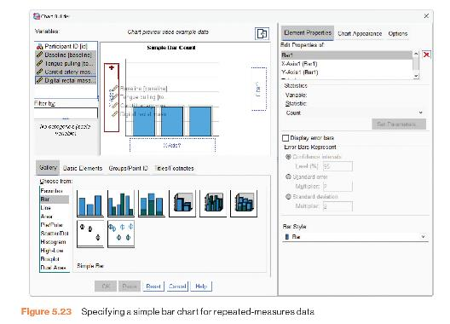
Bar Chart: Repeated Measures (2 of 2)
Figure 5.23 Specifying a simple bar chart for repeated-measures data

Slide 31
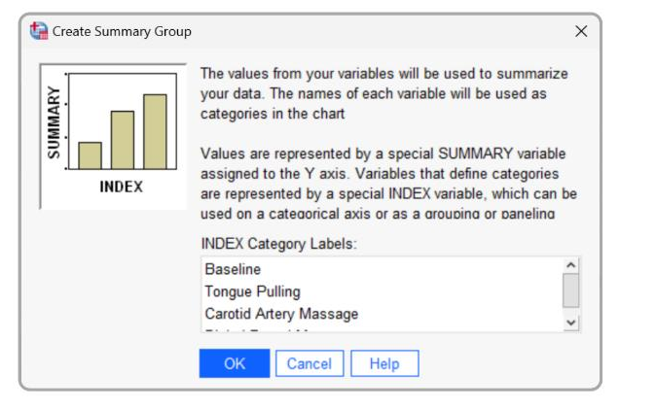
Figure 5.24 The Create Summary Group Dialogue Box

Slide 32
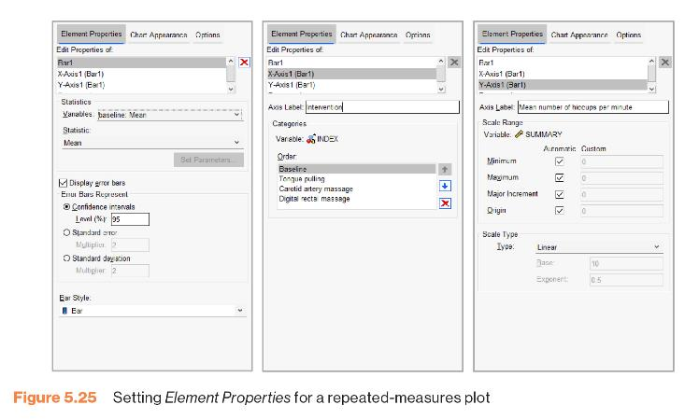
Figure 5.25 Setting Element Properties for a Repeated-measures Plot

Slide 33
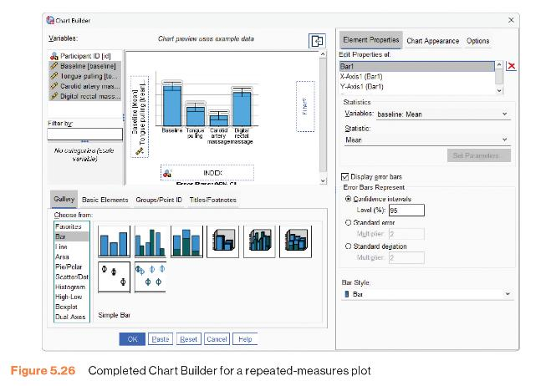
Figure 5.26 Completed Chart Builder for a Repeated-measures Plot

Slide 34
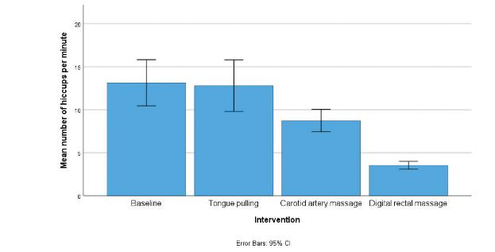
Error Bar Chart for Repeated Measures
Figure 5.27 Bar chart of the mean number of hiccups at baseline and after various interventions

Slide 35
Bar Chart: Mixed Designs (1 of 4)
Is text-messaging bad for your grammar?
Participants:
  50 children
Children split into two groups:
  Text-messaging allowed
  Text-messaging forbidden
Each child measures at two points in time:
  Baseline
  6 months later
Outcome measure
  Percentage score on a grammar test

Slide 36
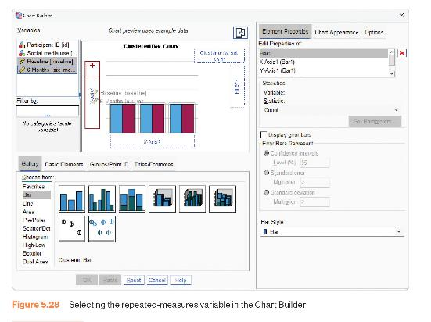
Bar Chart: Mixed Designs (2 of 4)
Figure 5.28 Selecting the repeated-measures variable in the Chart Builder

Slide 37
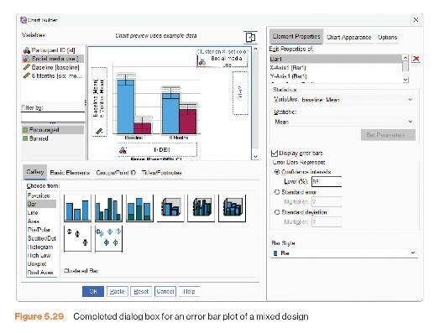
Bar Chart: Mixed Designs (3 of 4)
Figure 5.29 Completed dialogue box for an error bar plot of a mixed design

Slide 38
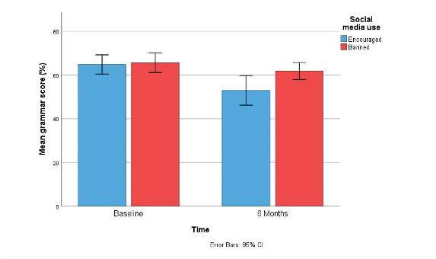
Bar Chart: Mixed Designs (4 of 4)
Figure 5.30 Error bar plot of the mean grammar score over 6 months in people who were encouraged to use social media compared to those who were banned

Slide 39
Scatterplots (1 of 2)
Anxiety and Exam Performance
Participants:
  103 students
Measures
  Time spent revising (hours)
  Exam performance (%)
  Exam Anxiety (the EAQ, score out of 100)
  Gender

Slide 40
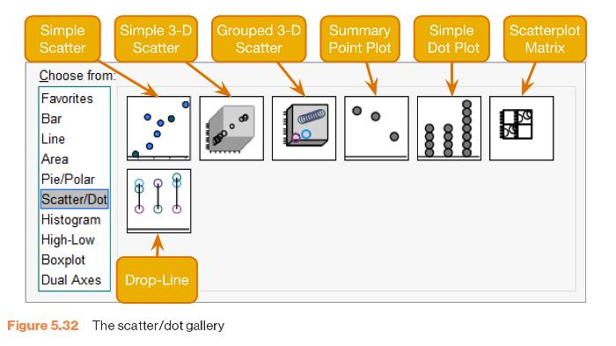
Scatterplots (2 of 2)
Figure 5.32 The scatter/dot gallery

Slide 41
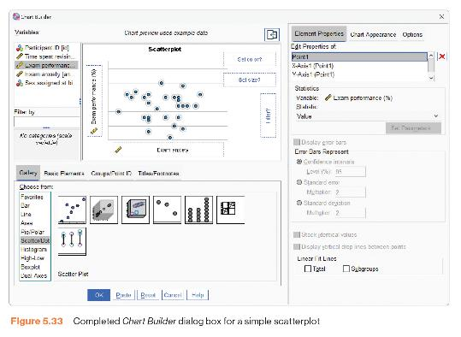
Simple Scatterplot (1 of 2)
Figure 5.33 Completed Chart Builder dialogue box for a simple scatterplot

Slide 42
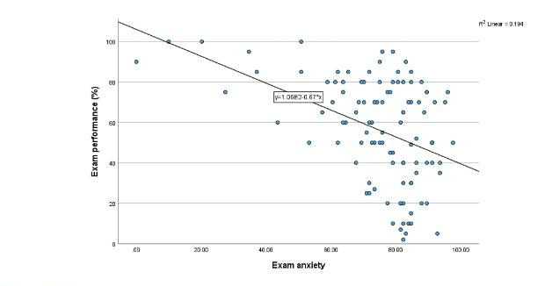
Simple Scatterplot (2 of 2)
Figure 5.34 Scatterplot of exam anxiety and exam performance

Slide 43
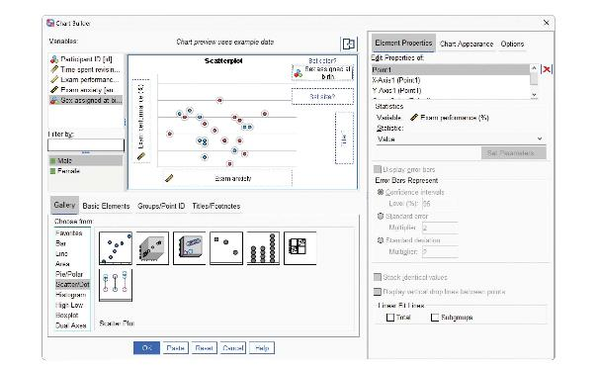
Grouped Scatterplot (1 of 2)
Figure 5.37 Completed Chart Builder dialog box for a grouped scatterplot

Slide 44
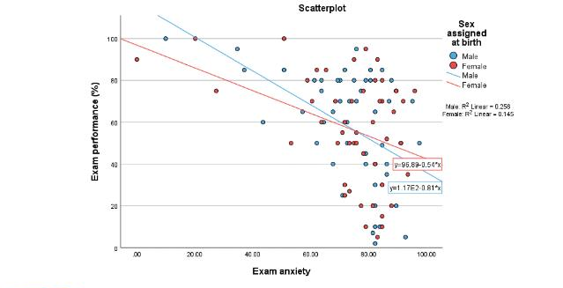
Grouped Scatterplot (2 of 2)
Figure 5.38 Scatterplot of exam anxiety and exam performance split by sex

Slide 45
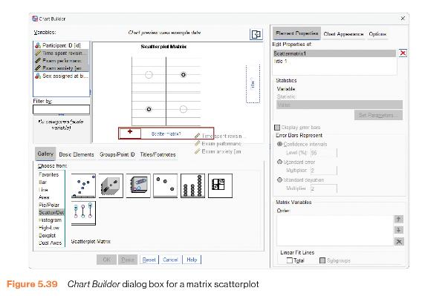
Matrix Scatterplot (1 of 2)
Figure 5.39 Chart Builder dialogue box for a matrix scatterplot

Slide 46
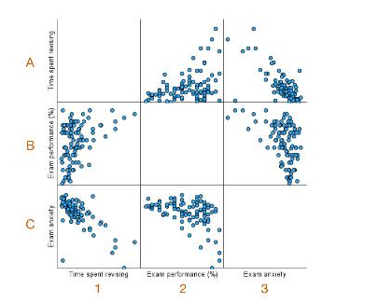
Matrix Scatterplot (2 of 2)
Figure 5.40 Matrix scatterplot of exam performance, exam anxiety and revision time. Grid references have been added for clarity

