Slide 1

Discovering Statistics Using IBM SPSS Statistics
Andy Field
This deck incorporates accessible elements, such as standardized content reading order, and image description for all figures presented.

Slide 2
Chapter 7
Non-Parametric Models

Slide 3
Aims
When and why we use non-parametric tests?
  Mann–Whitney test
    Wilcoxon rank-sum test
  Wilcoxon signed-rank test
  Kruskal–Wallis test
  Jonckheere–Terpstra test
  Friedman’s ANOVA
Ranking data
Interpretation of results
Reporting results
Calculating an effect size

Slide 4
When to Use Nonparametric Tests
Non-parametric tests are used when assumptions of parametric tests are not met.
It is not always possible to correct for problems with the distribution of a data set .
  In these cases, we have to use non-parametric tests.
  They make fewer assumptions about the type of data on which they can be used.
  In general, you are better off trying to use a robust test, but the range of robust tests is limited in SPSS.

Slide 5
The Wilcoxon Rank-Sum Test and Mann–Whitney Test (1 of 2)
These tests are the non-parametric equivalent of the independent t-test.
Use either to test differences between two conditions in which different participants have been used.

Slide 6
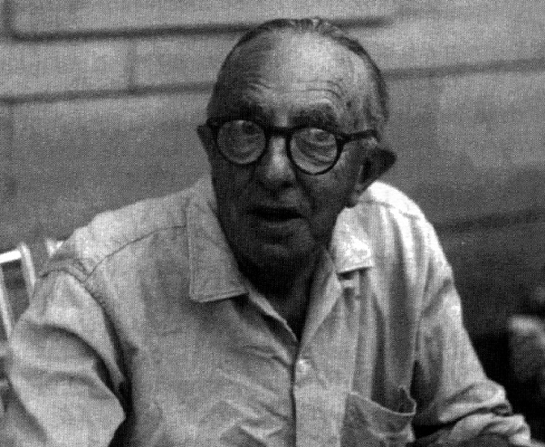
The Wilcoxon Rank-Sum Test and Mann–Whitney Test (2 of 2)
Figure 7.5 Frank Wilcoxon

Slide 7
Ranking Data
The tests in this lecture work on the principle of ranking the data for each group:
  Lowest score = a rank of 1,
  Next highest score = a rank of 2, and so on.
  Tied ranks are given the same rank: the average of the potential ranks.
For an unequal group size
  The test statistic (Ws) = sum of ranks in the group that contains the least people.
For an equal group size
  Ws = the value of the smaller summed rank.
Add up the ranks for the two groups and take the lowest of these sums to be our test statistic.
The analysis is carried out on the ranks rather than the actual data.

Slide 8
Theory
A neurologist investigated the depressant effects of certain recreational drugs.
  Tested 20 clubbers.
  10 were given an ecstasy tablet to take on a Saturday night.
  10 were allowed to drink only alcohol.
  Levels of depression were measured using the Beck Depression Inventory (BDI) the day after and midweek.
Rank the data ignoring the group to which a person belonged
  A similar number of high and low ranks in each group suggests depression levels do not differ between the groups.
  A greater number of high ranks in the ecstasy group than the alcohol group suggests the ecstasy group is more depressed than the alcohol group.

Slide 9
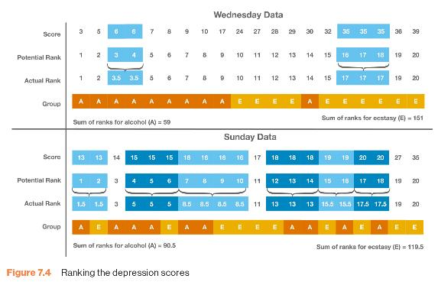
Ranking the Depression Scores for Wednesday and Sunday
Figure 7.4 Ranking the depression scores

Slide 10
Provisional Analysis Using IBM SPSS Statistics
First enter the data into SPSS Statistics
  Because the data are collected using different participants in each group, we need to input the data using a coding variable.
    For example, ‘Drug’ with the codes; 1 = ecstasy group and 2 = alcohol group.
    When you enter the data into SPSS remember to tell the computer that a code of 1 represents the group that was given ecstasy and a code of 2 represents the group that was restricted to alcohol.
First, run some exploratory analyses on the data
  Run these exploratory analyses for each group because we’re going to be looking for group differences.

Slide 11
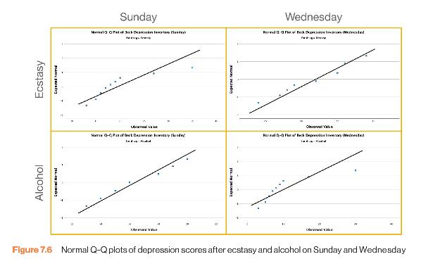
Exploratory Analysis Output
Figure 7.6 Normal Q-Q plots of depression scores after ecstasy and alcohol on Sunday and Wednesday

Slide 12
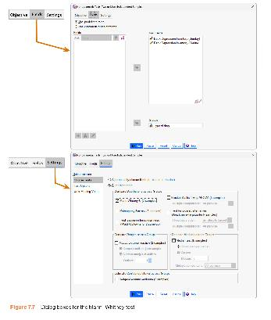
The Mann-Whitney Test
Figure 7.7 Dialogue boxes for the Mann–Whitney test

Slide 13
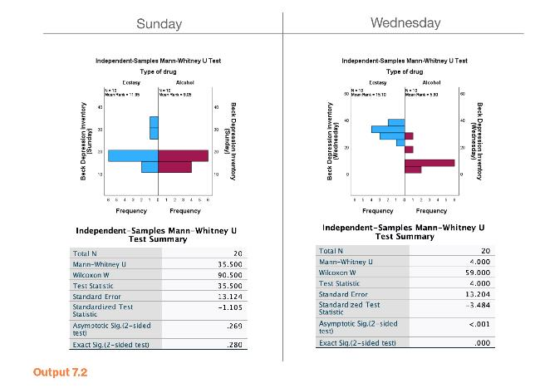
Output 7.2

Slide 14
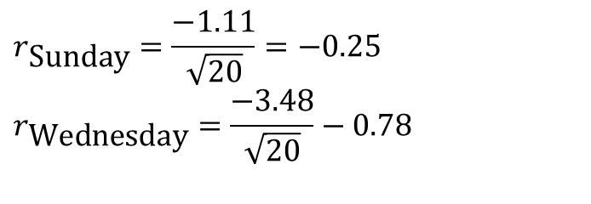
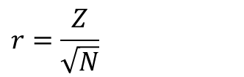
Calculating an Effect Size
The equation to convert a z-score into the effect size estimate, r, is as follows (from Rosenthal, 1991: 19):
  z is the z-score that SPSS produces
  N is the size of the study (i.e. the number of total observations)
  We had 10 ecstasy users and 10 alcohol users and so the total number of observations was 20
$$r=\frac{Z}{\sqrt{N}}$$
$$r_{\text{Sunday}}=\frac{−1.11}{\sqrt{20}}=−0.25 \\ r_{\text{Wednesday}}=\frac{−3.48}{\sqrt{20}}−0.78$$

Slide 15
Reporting the Results (1 of 2)
For the Mann–Whitney test:
  Depression levels in ecstasy users (Mdn = 17.50) did not differ significantly from alcohol users (Mdn = 16.00) the day after the drugs were taken, U = 35.50, z = −1.11, p = .280, r = −.25. However, by Wednesday, ecstasy users (Mdn = 33.50) were significantly more depressed than alcohol users (Mdn = 7.50), U = 4.00, z = −3.48, p < .001, r = −.78.

Slide 16
Reporting the Results (2 of 2)
Or we could report Wilcoxon’s test:
  Depression levels in ecstasy users (Mdn = 17.50) did not significantly differ from alcohol users (Mdn = 16.00) the day after the drugs were taken, Ws = 90.50, z = −1.11, p = .280, r = −.25. However, by Wednesday, ecstasy users (Mdn = 33.50) were significantly more depressed than alcohol users (Mdn = 7.50), Ws = 59.00, z = −3.48, p < .001, r = −.78.

Slide 17
Comparing Two Related Conditions: The Wilcoxon Signed-Rank Test
Uses:
  To compare two sets of scores, when these scores come from the same participants.
Imagine the experimenter was interested in the change in depression levels for each drug.
  Non-parametric test because the distributions of scores for both drugs were non-normal on one of the days.

Slide 18
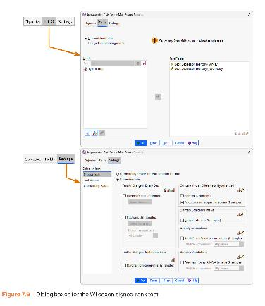
Wilcoxon Signed-Rank Test
Figure 7.9 Dialogue boxes for the Wilcoxon signed-rank test

Slide 19
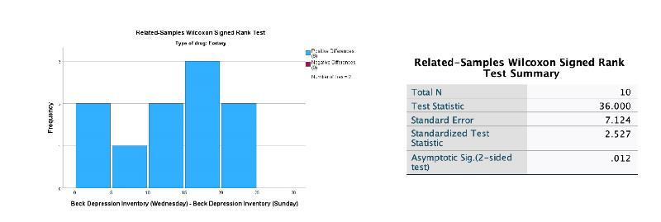
Output for the Ecstasy Group
Output 7.3

Slide 20
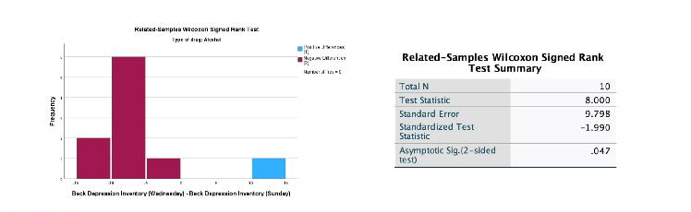
Output for the Alcohol Group
Output 7.4

Slide 21
Calculating an Effect Size (1 of 2)
The effect size can be calculated in the same way as for the Mann–Whitney test.
In this case SPSS Output tells us that for the ecstasy group z is –2.53, and for the alcohol group is −1.99.
In both cases, we had 20 observations
  (Although we only used 10 people and tested them twice, it is the number of observations, not the number of people, that is important here).

Slide 22
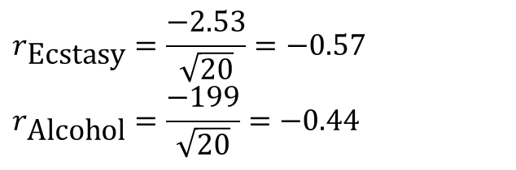
Calculating an Effect Size (2 of 2)
The effect sizes are therefore:
$$r_{\text{Ecstasy}}=\frac{−2.53}{\sqrt{20}}=−0.57 \\ r_{\text{Alcohol}}=\frac{−199}{\sqrt{20}}=−0.44$$

Slide 23
Reporting the Results
Reporting Test-Statistic:
  For ecstasy users, depression levels were significantly higher on Wednesday (Mdn = 33.50) than on Sunday (Mdn = 17.50), T = 36, p = .012, r = .57. However, for alcohol users, the opposite was true: depression levels were significantly lower on Wednesday (Mdn = 7.50) than on Sunday (Mdn = 16.0), T = 8, p = .047, r = −.44.
Reporting the values of z:
  For ecstasy users, depression levels were significantly higher on Wednesday (Mdn = 33.50) than on Sunday (Mdn = 17.50), z = 2.53, p = .012, r = .57. However, for alcohol users, the opposite was true: depression levels were significantly lower on Wednesday (Mdn = 7.50) than on Sunday (Mdn = 16.0), z = −1.99, p = .047, r = −.44.

Slide 24
Differences Between Several Independent Groups: The Kruskal–Wallis Test
The Kruskal–Wallis test (Kruskal & Wallis, 1952) is the non-parametric counterpart of the one-way independent ANOVA.
The theory is very similar to that of the Mann–Whitney (and Wilcoxon rank-sum) test:
  It is based on ranked data.
  The sum of ranks for each group is denoted by R_{i} (where i is used to denote the particular group).

Slide 25
Example 1
Does eating soya affect your sperm count?
Variables
  Outcome: sperm (millions)
  IV: Number of soya meals per week
    No Soya meals
    1 Soya meal
    4 soya meals
    7 soya meals
Participants
  80 males (20 in each group)

Slide 26
Data for the Soya Example with Ranks (1 of 2)
Table 7.3 Data for the soya example with ranks
No Soya |  | 1 Soya Meal |  | 4 Soya Meals |  | 7 Soya Meals
Sperm (million/ml) | Rank | Sperm (million/ml) | Rank | Sperm (million/ml) | Rank | Sperm (million/ml) | Rank
3.51 | 4 | 3.26 | 3 | 4.03 | 6 | 3.10 | 1
5.76 | 9 | 3.64 | 5 | 5.98 | 10 | 3.20 | 2
8.84 | 17 | 6.29 | 11 | 9.59 | 19 | 5.60 | 7
9.23 | 18 | 6.36 | 12 | 12.03 | 21 | 5.70 | 8
12.17 | 22 | 7.66 | 14 | 13.13 | 24 | 7.09 | 13
15.10 | 30 | 15.33 | 32 | 13.54 | 27 | 8.09 | 15
15.17 | 31 | 16.22 | 34 | 16.81 | 35 | 8.71 | 16
15.74 | 33 | 17.06 | 36 | 18.28 | 37 | 11.80 | 20
24.29 | 41 | 19.40 | 38 | 20.98 | 40 | 12.50 | 23
27.90 | 46 | 24.80 | 42 | 29.27 | 48 | 13.25 | 25
34.01 | 55 | 27.10 | 44 | 29.59 | 49 | 13.40 | 26
45.15 | 59 | 41.16 | 57 | 29.95 | 50 | 14.90 | 28

Slide 27
Data for the Soya Example with Ranks (2 of 2)
Table 7.3 Data for the soya example with ranks
No Soya |  | 1 Soya Meal |  | 4 Soya Meals |  | 7 Soya Meals
Sperm (million/ml) | Rank | Sperm (million/ml) | Rank | Sperm (million/ml) | Rank | Sperm (million/ml) | Rank
47.20 | 60 | 56.51 | 61 | 30.87 | 52 | 15.02 | 29
69.05 | 65 | 67.60 | 64 | 33.64 | 54 | 20.90 | 39
75.78 | 68 | 70.79 | 66 | 43.37 | 58 | 27.00 | 43
77.77 | 69 | 72.64 | 67 | 58.07 | 62 | 27.48 | 45
96.19 | 72 | 79.15 | 70 | 59.38 | 63 | 28.30 | 47
100.48 | 73 | 80.44 | 71 | 101.58 | 74 | 30.67 | 51
103.23 | 75 | 120.95 | 77 | 109.83 | 76 | 32.78 | 53
210.80 | 80 | 184.70 | 79 | 182.10 | 78 | 41.10 | 56
Total (R_{i}) | 927 |  | 883 |  | 883 |  | 547
Average (R−_{i}) | 46.35 |  | 44.15 |  | 44.15 |  | 27.35

Slide 28
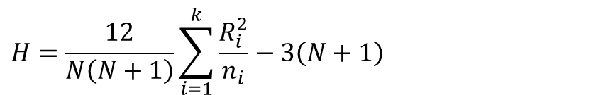
Kruskal-Wallis Test Theory (1 of 2)
Once the sum of ranks has been calculated for each group. The test statistic, H, is calculated as:
  R_{i} is the sum of ranks for each group.
  N is the total sample size.
  n_{i} is the sample size of a particular group.
$$H=\frac{12}{N\left(N+1\right)}\sum_{i=1}^{k}{\frac{R_{i}^{2}}{n_{i}}−3\left(N+1\right)}$$

Slide 29
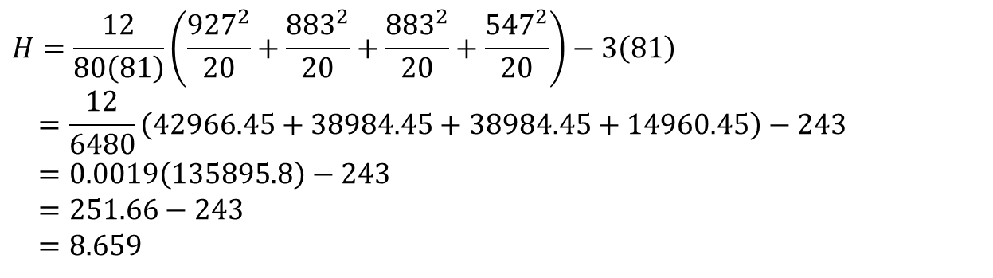
Kruskal-Wallis Test Theory (2 of 2)
$$H=\frac{12}{80\left(81\right)}\left(\frac{927^{2}}{20}+\frac{883^{2}}{20}+\frac{883^{2}}{20}+\frac{547^{2}}{20}\right)−3\left(81\right) \\ =\frac{12}{6480}\left(42966.45+38984.45+38984.45+14960.45\right)−243 \\ =0.0019\left(135895.8\right)−243 \\ =251.66−243 \\ =8.659$$

Slide 30
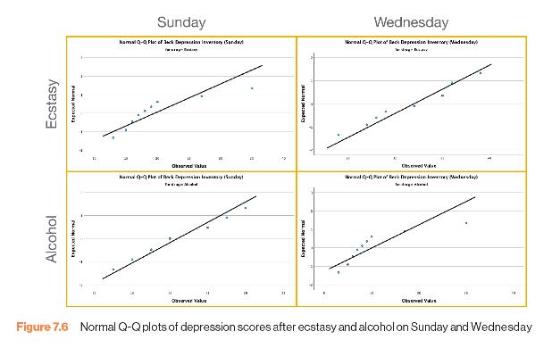
Provisional Analysis 1
Figure 7.6 Normal Q-Q plots of depression scores after ecstasy and alcohol on Sunday and Wednesday

Slide 31
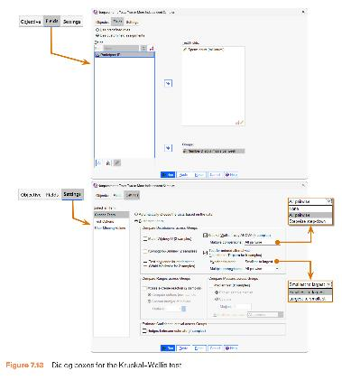
Dialogue Boxes for the Kruskal–Wallis Test
Figure 7.13 Dialogue boxes for the Kruskal–Wallis test

Slide 32
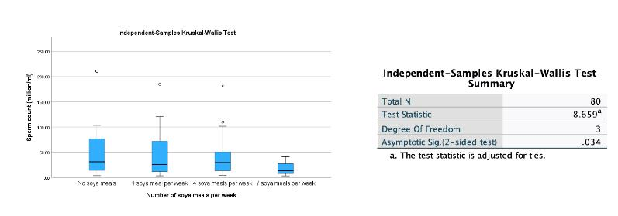
Output from the Kruskal–Wallis Test
Output 7.6

Slide 33
Follow-Up Analysis
There are two ways to follow up a Kruskal–Wallis test using SPSS statistics:
  Pairwise Comparisons:
    Test 1: one soya meal per week compared to no soya meals
    Test 2: four soya meals per week compared to no soya meals
    Test 3: seven soya meals per week compared to no soya meals
      Adjust p values.
  Stepped Procedure

Slide 34
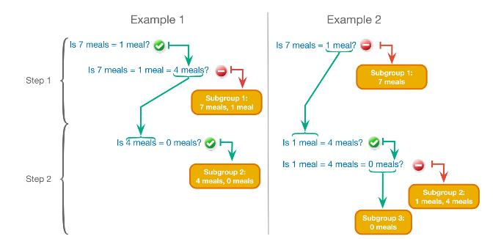
Stepped Procedure
Figure 7.11 The non-parametric step-down procedure

Slide 35
Testing for Trends: The Jonckheere–Terpstra Test
This statistic tests for an ordered pattern to the medians of the groups you’re comparing.
Essentially, it does the same thing as the Kruskal–Wallis test but it incorporates information about whether the order of the groups is meaningful.
  Use this test when you expect the groups you’re comparing to produce a meaningful order of medians.
  In the current example, we expect that the more soya a person eats, the more their sperm count will go down.

Slide 36
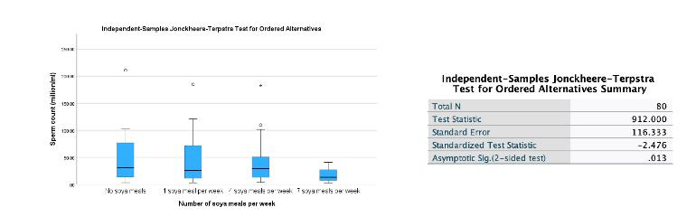
Output for Jonckheere-Terpstra Test
Output 7.9

Slide 37
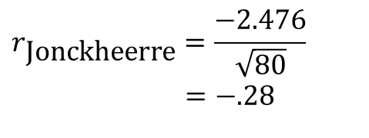
Calculating an Effect Size
$$r_{\text{Jonckheerre}}=\frac{−2.476}{\sqrt{80}}$$
$$=−.28$$

Slide 38
Writing the Results (1 of 4)
For the Kruskal–Wallis test, we need only report the test statistic (H), its degrees of freedom and its significance:
  Sperm counts were significantly affected by eating soya meals, H(3) = 8.66, p = .034.

Slide 39
Writing the Results (2 of 4)
Follow-up tests:
  Sperm counts were significantly affected by eating soya meals, H(3) = 8.66, p = .034. Pairwise comparisons with adjusted p values showed that there were no significant differences between sperm counts when people ate 7 soya meals per week compared to 4 meals (p = .133, r = .36), 1 meal (p = .133, r = .36), or no meals (p = .058, r = .41). There were also no differences in sperm counts between those eating 4 soya meals per week and those eating 1 meal (p = 1.00, r = .00) and no meals (p = 1.00, r = .05 ). Finally, there were no significant differences in sperm counts between those eating 1 soya meal per week and those eating none (p = 1.00, r = .05).

Slide 40
Writing the Results (3 of 4)
  Sperm counts were significantly affected by eating soya meals, H(3)= 8.66, p = .034. Step-down follow-up analysis showed that if soya is eaten every day, it significantly reduces sperm counts compared to eating none; however, eating soya less than every day has no significant effect on sperm counts, p = .943.

Slide 41
Writing the Results (4 of 4)
Or, we might want to report our trend:
  Sperm counts were significantly affected by eating soya meals, H(3)= 8.66, p = .034. Jonckheere’s test revealed a significant trend in the data: as more soya was eaten, the median sperm count decreased, J = 912, z = −2.48, p = .013, r = −.28.

Slide 42
Differences Between Several Related Groups: Friedman’s ANOVA
Used for testing differences between conditions when:
  There are more than two conditions
  The same participants have been used in all conditions (each case contributes several scores to the data).
If you have violated some assumption of parametric tests then this test can be a useful way around the problem.

Slide 43
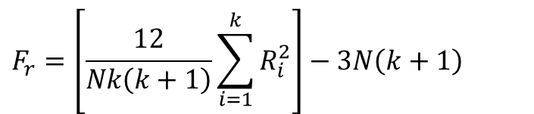
Theory of Friedman’s ANOVA
The theory for Friedman’s ANOVA is much the same as the other tests: it is based on ranked data.
Once the sum of ranks has been calculated for each group, the test statistic, F_{r}, is calculated as:
$$F_{r}=\left[\frac{12}{Nk\left(k+1\right)}\sum_{i=1}^{k}{R_{i}^{2}}\right]−3N\left(k+1\right)$$

Slide 44
Example 2
Does the ‘andikins’ diet work?
Variables
  Outcome: weight (Kg)
  IV: Time since beginning the diet
    Baseline
    1 Month
    2 Months
Participants
  10 women

Slide 45
Data for the Diet Example with Ranks
Table 7.5 Data for the diet example with ranks
 | Weight |  |  |  | Weight
 | Start | Month 1 | Month 2 |  | Start (Ranks) | Month 1 (Ranks) | Month 2 (Ranks)
Person 1 | 63.75 | 65.38 | 81.34 |  | 1 | 2 | 3
Person 2 | 62.98 | 66.24 | 69.31 |  | 1 | 2 | 3
Person 3 | 65.98 | 67.70 | 77.89 |  | 1 | 2 | 3
Person 4 | 107.27 | 102.72 | 91.33 |  | 3 | 2 | 1
Person 5 | 66.58 | 69.45 | 72.87 |  | 1 | 2 | 3
Person 6 | 120.46 | 119.96 | 114.26 |  | 3 | 2 | 1
Person 7 | 62.01 | 66.09 | 68.01 |  | 1 | 2 | 3
Person 8 | 71.87 | 73.62 | 55.43 |  | 2 | 3 | 1
Person 9 | 83.01 | 75.81 | 71.63 |  | 3 | 2 | 1
Person 10 | 76.62 | 67.66 | 68.60 |  | 3 | 1 | 2
 |  |  |  | R_{i} | 19 | 20 | 21

Slide 46
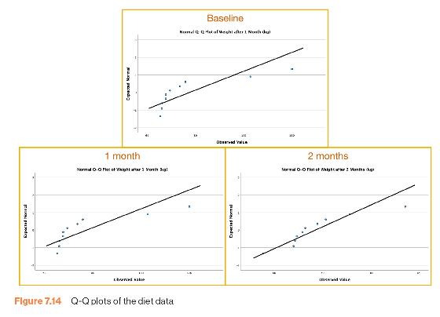
Provisional Analysis 2
Figure 7.14 Q-Q plots of the diet data

Slide 47
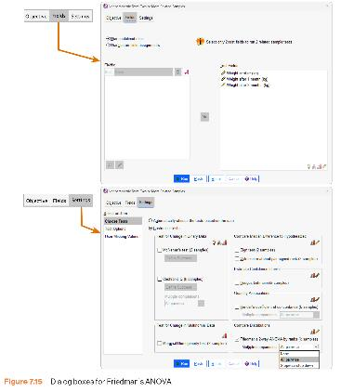
Dialogue Boxes for Friedman’s ANOVA
Figure 7.15 Dialogue boxes for Friedman’s ANOVA

Slide 48
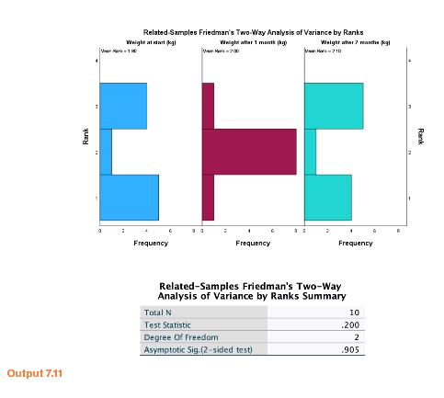
Output from Friedman’s ANOVA
Output 7.11

Slide 49
Writing and Interpreting the Results
For Friedman’s ANOVA, we need only report the test statistic (χ²), its degrees of freedom and its significance:
  The weight of participants did not significantly change over the two months of the diet, χ²(2) = 0.20, p = .91.

Slide 50
To Sum Up …
When data violate the assumptions of parametric tests we can sometimes find a nonparametric equivalent
  Usually based on analysing the ranked data
Mann-Whitney/Wilcoxon rank-sum test
  Compares two independent groups of scores
Wilcoxon signed rank test
  Compares two dependent groups of scores
Kruskal-Wallis test
  Compares > 2 independent groups of scores
Friedman’s test
  Compares > 2 dependent groups of scores

