Slide 1
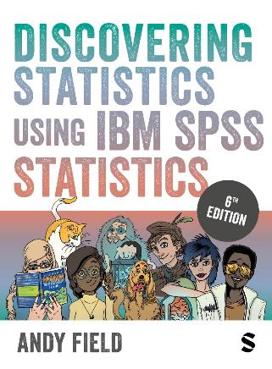
Discovering Statistics Using IBM SPSS Statistics
Andy Field
This deck incorporates accessible elements, such as standardized content reading order, and image description for all figures presented.

Slide 2
Chapter 11
Moderation and Mediation

Slide 3
Moderation
The combined effect of two variables on another is known conceptually as moderation, and in statistical terms as an interaction effect.

Slide 4
Example
Do violent video games make people antisocial?
Participants
  442 youths
Outcome
  Aggression,
  Callous unemotional traits (CaUnTs)
  Number of hours spent playing video games per week

Slide 5
Conceptual Moderation Model (1 of 2)
If callous-unemotional traits were a moderator, then we’re saying that the strength or direction of the relationship between game playing and aggression is affected by callous-unemotional traits.

Slide 6
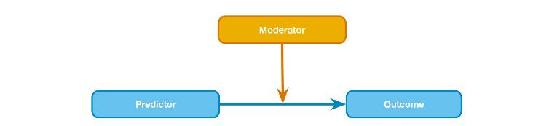
Conceptual Moderation Model (2 of 2)
Figure 11.2 Diagram of the conceptual moderation model

Slide 7
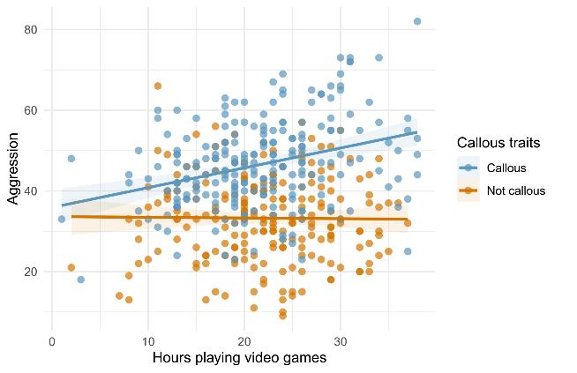
Figure 11.3 A categorical moderator (callous traits)

Slide 8
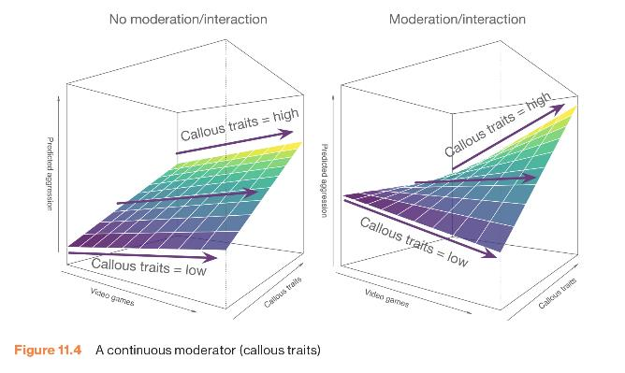
Figure 11.4 A continuous moderator (callous traits)

Slide 9
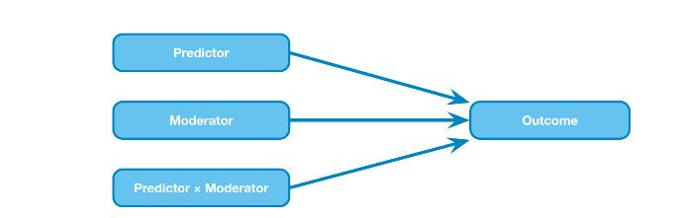
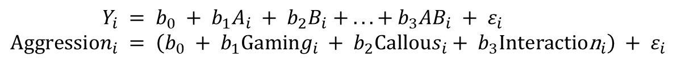
The Statistical Moderation Model
Figure 11.5 Diagram of the statistical moderation model
$$Y_{i} = b_{0} + b_{1}A_{i} + b_{2}B_{i} + ... + b_{3}AB_{i} + ε_{i} \\ Aggression_{i} = \left(b_{0} + b_{1}Gaming_{i} + b_{2}Callous_{i}+ b_{3}\text{Interactio}{\text{n}}_{i}\right) + ε_{i}$$

Slide 10
Centering Variables
The interaction term makes the bs for the main predictors uninterpretable in many situations.
For this reason, it is common to transform the predictors using grand mean centring.
Centring refers to the process of transforming a variable into deviations around a fixed point.

Slide 11
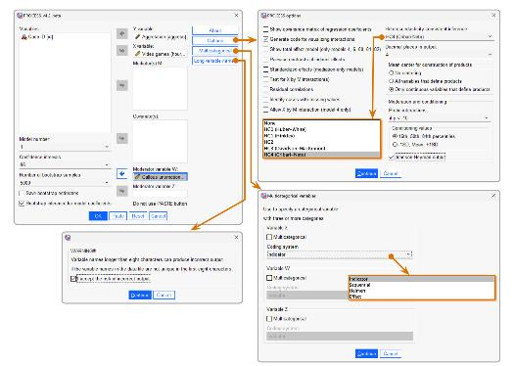
Running Moderation Analysis
Figure 11.6 The dialogue boxes for running moderation analysis

Slide 12
Output (1 of 3)
Output 11.1
**************************************************************************
Model : 1
Y : aggress
X : vid_game
W : caunts
Sample
Size: 442
**************************************************************************
OUTCOME VARIABLE:
aggress
Model Summary
R R-sq MSE F(HC4) df1 df2 p
.6142 .3773 99.5266 90.1077 3.0000 438.0000 .0000
Model
coeff se(HC4) t p LLCI ULCI
constant 39.9671 .4744 84.2543 .0000 39.0348 40.8994
vid_game .1696 .0762 2.2255 .0266 .0198 .3194
caunts .7601 .0467 16.2775 .0000 .6683 .8519
Int_1 .0271 .0074 3.6621 .0003 .0125 .0416
Product terms key:
Int_1 : vid_game x cauntsz

Slide 13
Output (2 of 3)
Output 11.2
*********** BOOTSTRAP RESULTS FOR REGRESSION MODEL PARAMETERS ************
OUTCOME VARIABLE:
aggress
Coeff BootMean BootSE BootLLCI BootULCI
constant 39.9671 39.9825 .4699 39.0839 40.9030
vid_game .1696 .1662 .0741 .0197 .3148
caunts .7601 .7605 .0463 .6710 .8511
Int_1 .0271 .0273 .0072 .0134 .0417

Slide 14
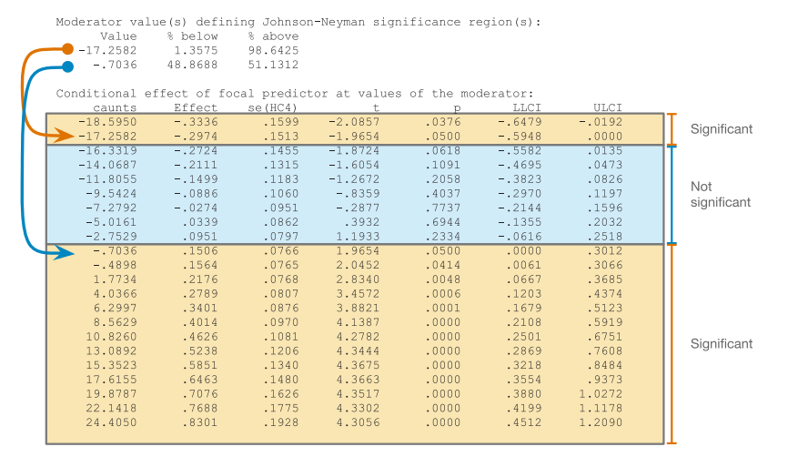
Output (3 of 3)
Output 11.4

Slide 15
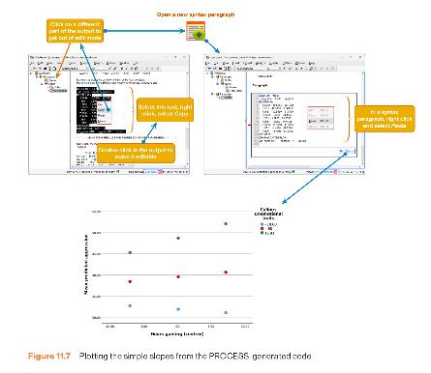
Following Up Moderation with Simple Slopes Analysis
Figure 11.7 Plotting the simple slopes from the PROCESS-generated code

Slide 16
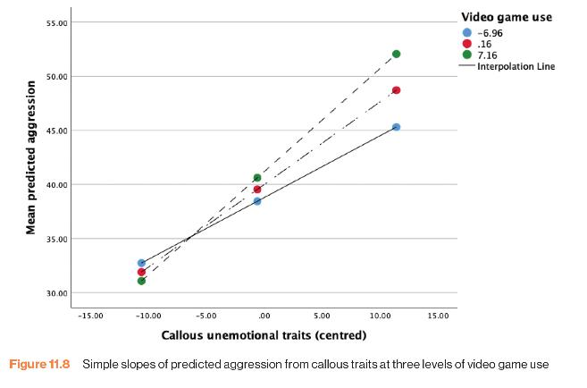
Figure 11.8 Simple slopes of predicted aggression from callous traits at three levels of video game use

Slide 17


Reporting Moderation Analysis
Table 11.1 Linear model of predictors of aggression.
 |  | SE | t | p
Constant | 39.97 [39.03, 40.90] | 0.475 | 84.25 | p < 0.001
Callous traits (centred) | 0.76 [0.67, 0.85] | 0.047 | 16.30 | p < 0.001
Gaming (centred) | 0.17 [0.02, 0.32] | 0.076 | 2.23 | p = 0.027
Callous traits × Gaming | 0.027 [0.01, 0.04] | 0.007 | 3.66 | p = 0.003
$$\overset{̑}{b}$$
$$\overset{̑}{b}$$
Note. R² = 0.38

Slide 18
Mediation
Refers to a situation when the relationship between a predictor variable and outcome variable can be explained by their relationship to a third variable (the mediator).

Slide 19
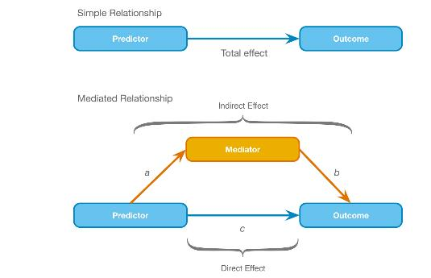
The Statistical Model
Figure 11.9 Diagram of a mediation model

Slide 20
Baron & Kenny, (1986) (1 of 2)
Mediation is tested through three regression models:
  Predicting the outcome from the predictor variable.
  Predicting the mediator from the predictor variable.
  Predicting the outcome from both the predictor variable and the mediator.

Slide 21
Baron & Kenny, (1986) (2 of 2)
Four conditions of mediation:
  The predictor must significantly predict the outcome variable.
  The predictor must significantly predict the mediator.
  The mediator must significantly predict the outcome variable.
  The predictor variable must predict the outcome variable less strongly in model 3 than in model 1.

Slide 22
Limitations of Baron & Kenny’s (1986) Approach
How much of a reduction in the relationship between the predictor and outcome is necessary to infer mediation?
  People tend to look for a change in significance, which can lead to the ‘all or nothing’ thinking that p-values encourage.

Slide 23
Sobel Test (Sobel, 1982)
An alternative is to estimate the indirect effect and its significance using the Sobel test (Sobel, 1982).
If the Sobel test is significant, there is significant mediation.
Significance tests depend upon sample size.

Slide 24
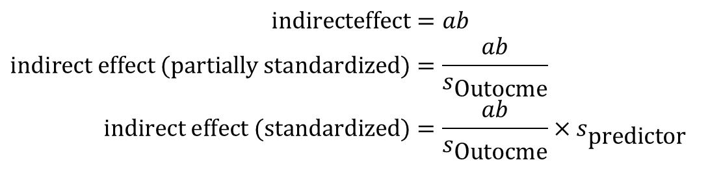
Effect Sizes of Mediation (1 of 2)
$$\text{indirecteffect}=ab \\ \text{indirect} \text{effect} (\text{partially} \text{standardized})=\frac{ab}{s_{\text{Outocme}}} \\ \text{indirect} \text{effect} (\text{standardized})=\frac{ab}{s_{\text{Outocme}}}×s_{\text{predictor}}$$

Slide 25
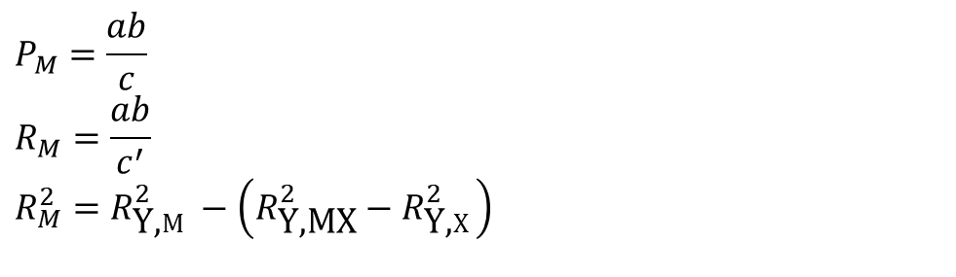
Effect Sizes of Mediation (2 of 2)
$$P_{M}=\frac{ab}{c} \\ R_{M}=\frac{ab}{c^{′}} \\ R_{M}^{2}=R_{\text{Y}\text{,}M}^{2}−\left(R_{\text{Y}\text{,}\text{MX}}^{2}−R_{\text{Y}\text{,}X}^{2}\right)$$

Slide 26
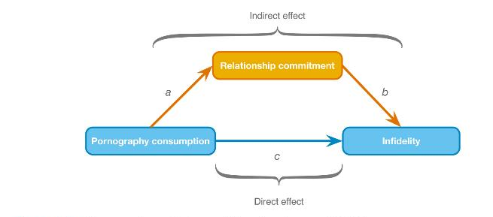
Example of a Mediation Model
Figure 11.10 Diagram of a mediation model from Lambert et al. (2012)

Slide 27
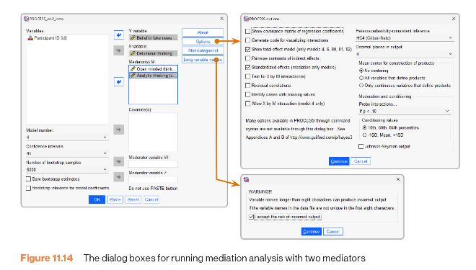
Fitting the Model
Figure 11.11 The dialogue boxes for running mediation analysis

Slide 28
Output (1 of 3)
Output 11.6
**************************************************************************
Model : 4
Y : phys_inf
X : ln_porn
M : commit
Sample
Size: 239
**************************************************************************
OUTCOME VARIABLE:
commit
Model Summary
R R-sq MSE F(HC4) df1 df2 p
.1418 .0201 .5354 3.9438 1.0000 237.0000 .0482
Model
coeff se(HC4) t p LLCI ULCI
constant 4.2027 .0530 79.2857 .0000 4.0983 4.3071
ln_porn -.4697 .2365 -1.9859 .0482 -.9356 -.0038
Standardized coefficients
coeff
ln_porn -.1418

Slide 29
Output (2 of 3)
Output 11.7
**************************************************************************
OUTCOME VARIABLE:
phys_inf
Model Summary
R R-sq MSE F(HC4) df1 df2 p
.3383 .1144 .4379 9.2618 2.0000 236.0000 .0001
Model
coeff se(HC4) t p LLCI ULCI
constant 1.3704 .3315 4.1337 .0000 .7173 2.0235
ln_porn .4573 .2588 1.7673 .0785 -.0525 .9672
commit -.2710 .0746 -3.6310 .0003 -.4180 -.1240
Standardized coefficients
coeff
ln_porn .1455
commit -.2855

Slide 30
Output (3 of 3)
Output 11.8
************************** TOTAL EFFECT MODEL ****************************
OUTCOME VARIABLE:
phys_inf
Model Summary
R R-sq MSE F(HC4) df1 df2 p
.1859 .0346 .4754 5.3078 1.0000 237.0000 .0221
Model
coeff se(HC4) t p LLCI ULCI
constant .2315 .0478 4.8434 .0000 .1374 .3257
ln_porn .5846 .2538 2.3039 .0221 .0847 1.0845
Standardized coefficients
coeff
ln_porn .1859

Slide 31
Output 11.9
************** TOTAL, DIRECT, AND INDIRECT EFFECTS OF X ON Y **************
Total effect of X on Y
Effect se(HC4) t p LLCI ULCI c_cs
.5846 .2538 2.3039 .0221 .0847 1.0845 .1859
Direct effect of X on Y
Effect se(HC4) t p LLCI ULCI c’_cs
.4573 .2588 1.7673 .0785 -.0525 .9672 .1455
Indirect effect(s) of X on Y:
Effect BootSE BootLLCI BootULCI
commit .1273 .0693 .0023 .2741
Completely standardized indirect effect(s) of X on Y:
Effect BootSE BootLLCI BootULCI
commit .0405 .0215 .0007 .0850

Slide 32
Sobel Test
Normal theory tests for indirect effect
Effect se Z p
.1273 .0652 1.9526 .0509

Slide 33
Reporting Mediation Analysis (1 of 2)
There was a significant indirect effect of pornography consumption on infidelity through relationship commitment, b = 0.127, 95% BCa CI [0.017, 0.297].

Slide 34
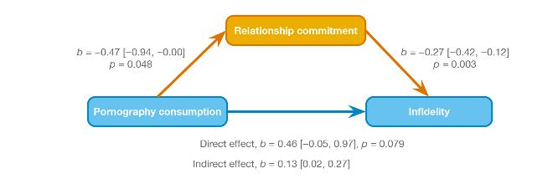
Reporting Mediation Analysis (2 of 2)
Figure 11.12 Model of pornography consumption as a predictor of infidelity, mediated by relationship commitment. The confidence interval for the indirect effect is a BCa bootstrapped CI based on 5000 samples

Slide 35
Categorical Predictors in Regression
Often, you will have categorical predictors that have more than two categories.
These groups cannot be distinguished using a single variable coded with zeros and ones. Therefore, we use what’s called dummy variables.

Slide 36
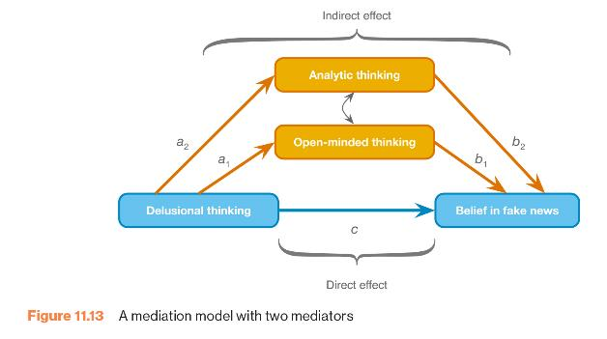
A Mediation Model with Two Mediators
Figure 11.13 A mediation model with two mediators

Slide 37
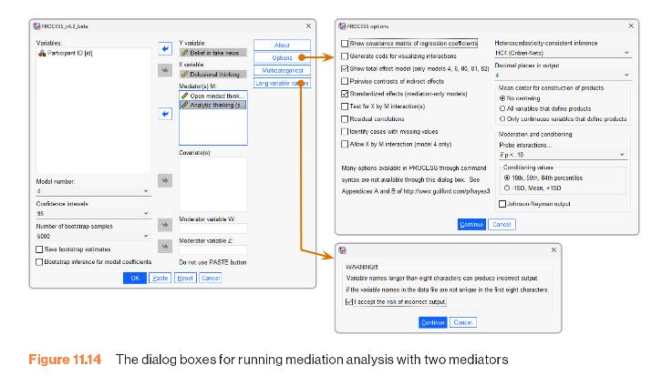
Figure 11.14 The dialogue boxes for running mediation analysis with two mediators

