Slide 1

Discovering Statistics Using IBM SPSS Statistics
Andy Field
This deck incorporates accessible elements, such as standardized content reading order, and image description for all figures presented.

Slide 2
Chapter 13
GLM 2: Comparing Means Adjusted for Other Predictors (Analysis of Covariance)

Slide 3
Aims
What is ANCOVA?
Partitioning variance
Carrying out on IBM SPSS statistics
Interpretation
  Main effects
  Covariates

Slide 4
When and Why
To test for differences between groups means to know that an extraneous variable affects the outcome variable.
Used to adjust for known extraneous variables.

Slide 5
Advantages of ANCOVA
Reduces Error Variance
  By explaining some of the unexplained variance (SSR) the error variance in the model can be reduced.
Greater Experimental Control:
  By controlling known extraneous variables, we gain greater insight into the effect of the predictor variable(s).

Slide 6
An Example
We will use Field’s (2017) puppy therapy example (from the GLM1 lecture).
  There are several possible confounding variables – e.g. love of puppies.
We can replicate the RCT of puppy therapy but also measure love of puppies.
  Outcome (or DV) = participant’s happiness
  Predictor (or IV) = Dose of puppy therapy (control, 15-mins & 30-mins)
  Covariate = love of puppies

Slide 7
Data Summary
Table 13.2 Means (and standard deviations) from puppy_love.sav
Dose | Participant’s happiness | Love of puppies
Control | 3.22 (1.79) | 3.44 (2.07)
15 minutes | 4.88 (1.46) | 3.12 (1.73)
30 minutes | 4.85 (2.12) | 2.00 (1.63)
Total | 4.37 (1.96) | 2.73 (1.86)

Slide 8
Covariates in the Linear Model (1 of 2)
$$\begin{matrix}{\text{Happiness}}_{i}=b_{0}+b_{1}{\text{Long}}_{i}+b_{2}{\text{Short}}_{i}+b_{3}{\text{Covariate}}_{i}+ε_{i} \\ {\text{Happiness}}_{i}=b_{0}+b_{1}{\text{Long}}_{i}+b_{2}{\text{Short}}_{i}+b_{3}\text{Puppy} {\text{Love}}_{i}+ε_{i} \end{matrix}$$

Slide 9
Covariates in the Linear Model (2 of 2)
Output 13.2
Coefficientsª
Model |  | Unstandardized B | Coefficient Std. Error | Standardized Coefficient Beta | t | Sig.
1 | (Constant) | 3.657 | .634 |  | 5.764 | <.001
 | Love of Puppies (0-7) | .260 | .193 | .246 | 1.345 | .189
2 | (Constant) | 1.789 | .867 |  | 2.063 | .049
 | Love of puppies | .416 | .187 | .395 | 2.227 | .035
 | Control vs.15mins (Dummy 1) | 1.786 | .849 | .411 | 2.102 | .045
 | Control vs.15mins (Dummy 2) | 2.225 | .803 | .573 | 2.771 | .010
a. Dependent Variable: Happiness (0-10)

Slide 10
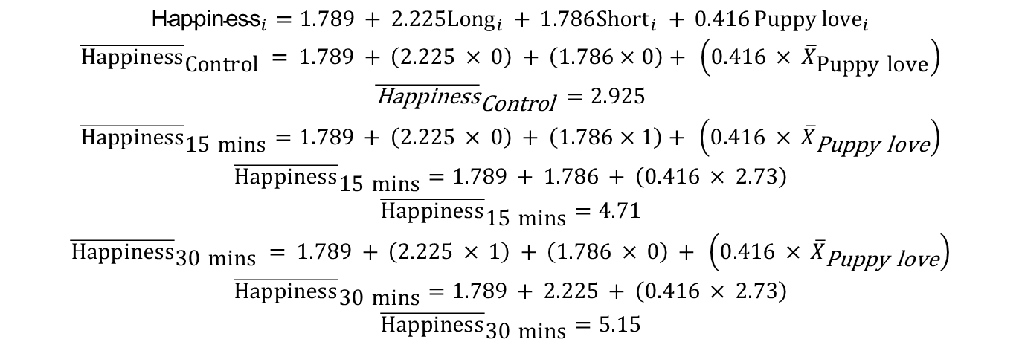
Adjusting Means
$$\begin{matrix}{\text{Happiness}}_{i}=1.789 + 2.225{\text{Long}}_{i} + 1.786{\text{Short}}_{i} + 0.416 \text{Puppy} {\text{love}}_{i} \\ {\overline{\text{Happiness}}}_{\text{Control}} = 1.789 + \left(2.225 × 0\right) + \left(1.786×0\right)+ \left(0.416 × {\overline{X}}_{\text{Puppy} \text{love}}\right) \\ {\overline{\text{Happiness}}}_{\text{Control}} =2.925 \\ {\overline{\text{Happiness}}}_{\text{15 }\text{mins}}=1.789 + \left(2.225 × 0\right) + \left(1.786×1\right)+ \left(0.416 × {\overline{X}}_{\text{Puppy} \text{love}}\right) \\ {\overline{\text{Happiness}}}_{\text{15 }\text{mins}}=1.789 + 1.786 + \left(0.416 × 2.73\right) \\ {\overline{\text{Happiness}}}_{\text{15 }\text{mins}}=4.71 \\ {\overline{\text{Happiness}}}_{\text{30 }\text{mins}} = 1.789 + \left(2.225 × 1\right) + \left(1.786 × 0\right) + \left(0.416 × {\overline{X}}_{\text{Puppy} \text{love}}\right) \\ {\overline{\text{Happiness}}}_{\text{30 }\text{mins}}=1.789 + 2.225 + \left(0.416 × 2.73\right) \\ {\overline{\text{Happiness}}}_{\text{30 }\text{mins}}=5.15\end{matrix}$$

Slide 11
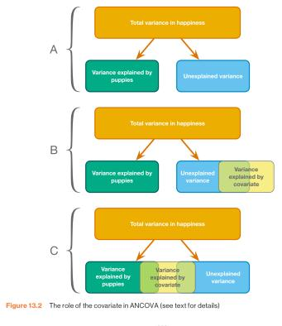
Relationships Between the IV and Covariate
Figure 13.2 The role of the covariate in ANCOVA (see text for details)

Slide 12
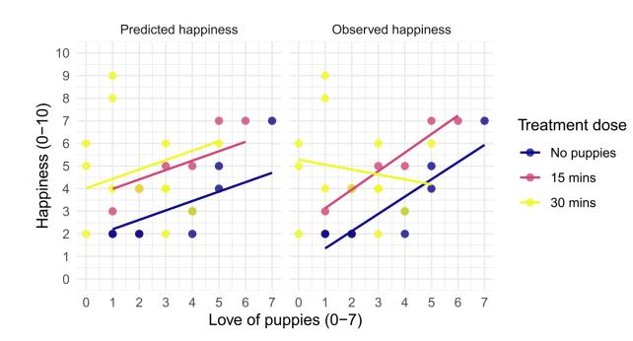
Homogeneity of Slopes
Figure 13.3 Scatterplot and linear models of happiness against love of puppies for each therapy condition

Slide 13
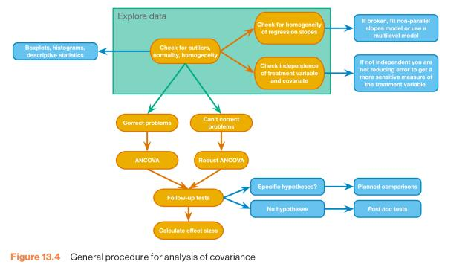
The Process
Figure 13.4 General procedure for analysis of covarianceSELF TEST

Slide 14
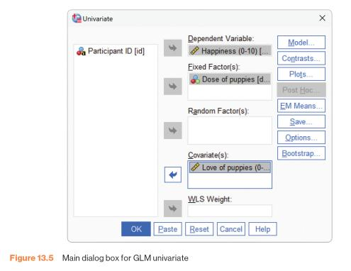
Main Dialogue Box for GLM Univariate
Figure 13.5 Main dialogue box for GLM univariate

Slide 15
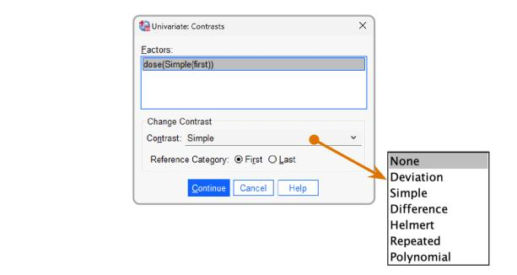
Contrasts
Figure 13.6 Options for standard contrasts in GLM univariate

Slide 16
Options
Figure 13.6 Options for standard contrasts in GLM univariate

Slide 17
Without the Covariate
Output 13.5
Tests of Between-Subjects Effects
Dependent Variable: Happiness (0-10)
Source | Type Ill Sum of Squares | df | Mean Square | F | Sig.
Corrected Model | 16.844ª | 2 | 8.422 | 2.416 | .108
Intercept | 535.184 | 1 | 535.184 | 153.522 | <.001
dose | 16.844 | 2 | 8.422 | 2.416 | .108
Error | 94.123 | 27 | 3.486
Total | 683.000 | 30
Corrected Total | 110.967 | 29
a. R Squared = .152 (Adjusted R Squared = .089)

Slide 18
With the Covariate
Output 13.6
Tests of Between-Subjects Effects
Dependent Variable:Happiness (0-10)
Source | Type Ill Sum of Squares | df | Mean Square | F | Sig. | Partial Eta Squared
Corrected Model | 31.920ª | 3 | 10.640 | 3.500 | .030 | .288 .490
Intercept | 76.069 | 1 | 76.069 | 25.020 | <.001
puppy love | 15.076 | 1 | 15.076 | 4.959 | .035 | .160
dose | 25.185 | 2 | 12.593 | 4.412 | 0.27 | .242
Error | 79.047 | 26 | 3.040
Total | 683.000 | 30
Corrected Total | 110.967 | 29
a. R Squared = .288 (Adjusted R Squared = .205)

Slide 19
Output (1 of 2)
Output 13.8
Parameter Estimates
Dependent Variable:Happiness (0-10)
Parameter | B | Std. Error | t | Sig. | 95% Confidence interval
 |  |  |  |  | Lower Bound | Upper Bound
Intercept | 4.014 | .611 | 6.568 | <.001 | 2.758 | 5.270
puppy_love | .416 | .187 | 2.227 | .035 | .032 | .800
[dose=1] | -2.225 | .803 | -2.771 | .010 | -3.875 | -.575
[dose=2] | -.439 | .811 | -.541 | .593 | -2.107 | 1.228
[dose=3] | 0ª |  | • | • | • | •
a. This parameter is set to zero because it is redundant.

Slide 20
Output (2 of 2)
Output 13.8
Bootstrap for Parameter Estimates
Dependent Variable:Happiness (0-10)
 |  |  |  | Bootstrapª
Parameter | B | Bias | Std. Error | Sig. (2-taild) | BCa 95% Confidence interval
 |  |  |  |  | Lower | Upper
Intercept | 4.014 | .038 | .815 | .002 | 2.023 | 5.790
puppy love | .416 | -.024 | .192 | .046 | .015 | .686
[dose=1] | -2.225 | .007 | .719 | .016 | -3.734 | -.765
[dose=2] | -.439 | .029 | .696 | .556 | -1.901 | .904
[dose=3] | 0 | 0 | 0
a. Unless otherwise noted, bootstrap results are based on 1000 bootstrap samples

Slide 21
Contrasts
Output 13.10
Contrast Results (K Matrix)
Dose of puppies simple Contrastª |  |  | Dependent Variable Happiness (0-10)
Level 2 vs Level 1 | Contrast Estimate |  | 1.786
 | Hypothesized Value |  | 0
 | Difference (Estimate - Hypothesized) |  | 1.786
 | Std. Error |  | .849
 | Sig |  | .045
 | 95% Confidence Interval for Difference | Lower Bound | .040
 |  | Upper Bound | 3.532
Level 3 vs Level 1 | Contrast Estimate |  | 2.225
 | Hypothesized Value |  | 0
 | Difference (Estimate - Hypothesized) |  | 2.225
 | Std.Error |  | .803
 | Sig |  | .010
 | 95% Confidence Interval for Difference | Lower Bound | .575
 |  | Upper Bound | 3.875
a. Reference category = 1

Slide 22
Post Hoc Tests (1 of 2)
Output 13.11
Pairwise Comparisons
Dependent Variable: Happiness (0-10)
(I) Dose of puppies | (J) Dose of puppies | Mean Difference(I_J) | Std. Error | Sig ^{b} | 95% Confidence Interval for Difference
No puppies | 15 mins | -1.786 | .849 | .130 | Lower Bound | Upper Bound
 | 30 mins | -2.225 | .803 | .030 | -4.273 | -.177
15 mins | No puppies | 1.786 | .849 | .130 | -.381 | 3.953
 | 30 mins | -.439 | .811 | .932 | -2.509 | 1.631
30 mins | No puppies | 2.225. | .803 | .030 | .177 | 4.273
 | 15 mins | .439 | .811 | .932 | -1.631 | 2.509
Based on estimated marginal means
*. The mean difference is significant at the .05 level
. b. Adjustment for multiple comparisons: Sidak.

Slide 23
Post Hoc Tests (2 of 2)
Output 13.11
Bootstrap Pairwise Comparisons
Dependent Variable: Happiness (0-10)
 |  |  |  |  | Boostrspª
(I) Dose of puppies | (J) Dose of puppies | Mean Difference(I_J) | Bias | Std.Error | Sig (2-tailed) | Bca 95% Confidence Interval for
 |  |  |  |  |  | Lower Bound | Upper Bound
No puppies | 15 mins | -1.786 | -.021 | .514 | .003 | -2.737 | -.815
 | 30 mins | -2.225 | .007 | .719 | .016 | -3.734 | -.765
15 mins | No puppies | 1.786 | .021 | .514 | .003 | .643 | 2.842
 | 30 mins | -.439 | .029 | .696 | .556 | -1.901 | .904
30 mins | No puppies | 2.225 | -.007 | .719 | .016 | .976 | 3.599
 | 15 mins | .439 | -.029 | .696 | .556 | -.830 | 1.768
a. Unless otherwise noted, bootstrap results are based on 1000 bootstrap samples

Slide 24
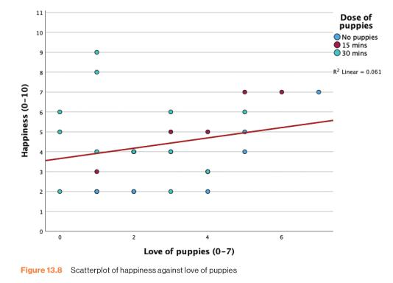
The Covariate
Figure 13.8 Scatterplot of happiness against love of puppies

Slide 25
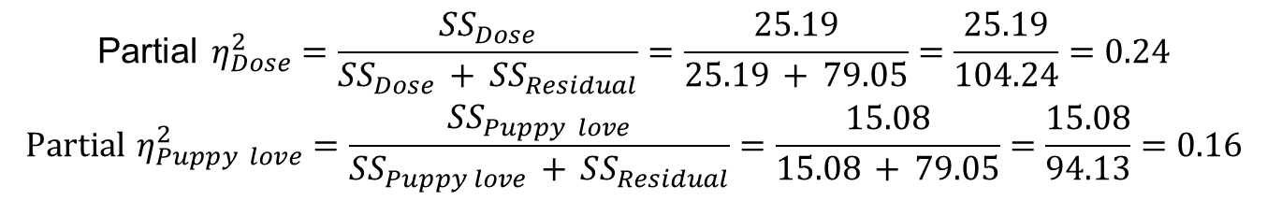
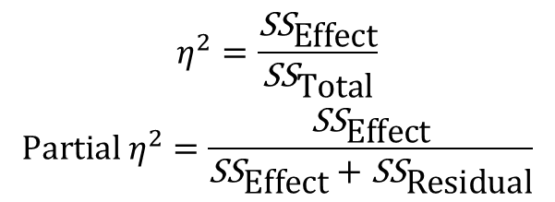
Calculating the Effect Size of Main Effects
$$\begin{matrix}η^{2}=\frac{{\text{SS}}_{\text{Effect}}}{{\text{SS}}_{\text{Total}}} \\ \text{Partial} η^{2}=\frac{{\text{SS}}_{\text{Effect}}}{{\text{SS}}_{\text{Effect}}+{\text{SS}}_{\text{Residual}}}\end{matrix}$$
$$\begin{matrix}\text{Partial} η_{Dose}^{2}=\frac{SS_{Dose}}{SS_{Dose} + SS_{Residual}}=\frac{25.19}{25.19 + 79.05}=\frac{25.19}{104.24}=0.24 \\ \text{Partial} η_{Puppy love}^{2}=\frac{SS_{Puppy love}}{SS_{Puppy love} + SS_{Residual}}=\frac{15.08}{15.08 + 79.05}=\frac{15.08}{94.13}=0.16\end{matrix}$$

Slide 26
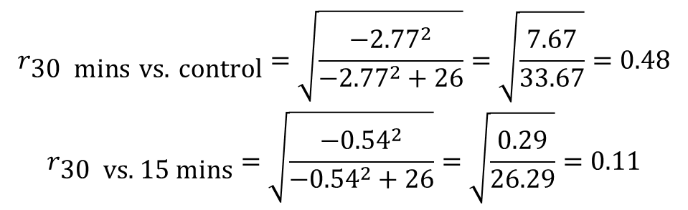
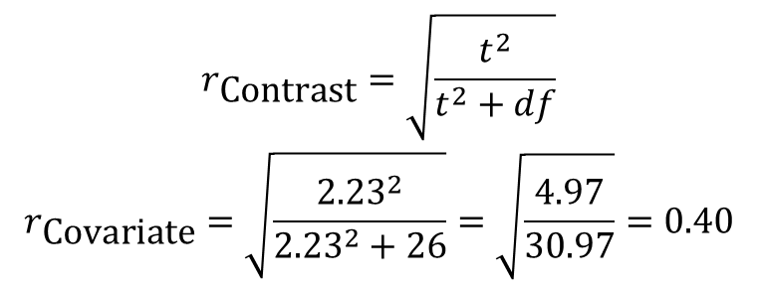
Calculating Effect Size of Contrasts
$$\begin{matrix}r_{\text{Contrast}}=\sqrt{\frac{t^{2}}{t^{2}+df}} \\ r_{\text{Covariate}}=\sqrt{\frac{{2.23}^{2}}{{2.23}^{2}+26}}=\sqrt{\frac{4.97}{30.97}}=0.40\end{matrix}$$
$$\begin{matrix}r_{\text{30 }\text{mins} \text{vs}\text{. }\text{control}}=\sqrt{\frac{−{2.77}^{2}}{−{2.77}^{2}+26}}=\sqrt{\frac{7.67}{33.67}}=0.48 \\ r_{\text{30 }\text{vs}\text{. 15 }\text{mins}}=\sqrt{\frac{−{0.54}^{2}}{−{0.54}^{2}+26}}=\sqrt{\frac{0.29}{26.29}}=0.11\end{matrix}$$

Slide 27
Reporting Main Effects
The covariate, love of puppies, was significantly related to the participant’s happiness, F(1, 26) = 4.96, p = 0.035, r = 0.40. There was also a significant effect of puppy therapy on levels of happiness after controlling for the effect of love of puppies, F(2, 26) = 4.14, p = 0.027, partial η² = 0.24.

Slide 28
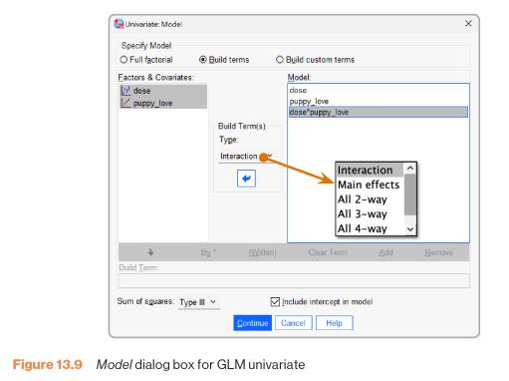
The Non-parallel Slopes Model
Figure 13.9 Model dialogue box for GLM univariate

Slide 29
Robust ANCOVA (1 of 2)
Syntax:
  BEGIN PROGRAM R.
  library(WRS2)
  mySPSSdata = spssdata.GetDataFromSPSS(factorMode = "labels")
  ancboot(happiness ~ dose + puppy_love, data = mySPSSdata, tr = 0.2, nboot = 1000)
  END PROGRAM.

Slide 30
Robust ANCOVA (2 of 2)
Output 13.13
n1 n2 diff lower CI upper CI statistic p-value
puppy_love = 2 22 13 -1.0873 -3.0837 0.9091 -1.6952 0.101
puppy_love = 3 27 15 -1.0719 -2.7501 0.6063 -1.9881 0.060
puppy_love = 5 30 22 -0.6508 -2.3612 1.0596 -1.1843 0.264
puppy_love = 6 23 21 -0.9846 -3.2477 1.2785 -1.3542 0.202
puppy_love = 8 12 13 -1.5278 -4.2264 1.1708 -1.7622 0.109

Slide 31
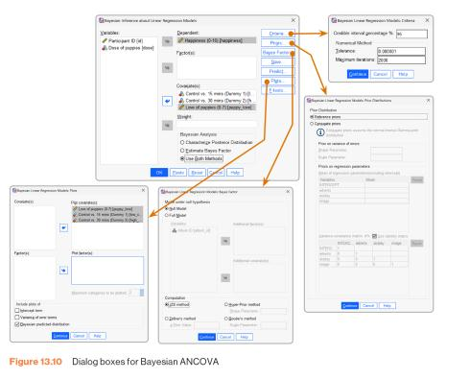
Bayesian Analysis with Covariates (1 of 3)
Figure 13.10 Dialogue boxes for Bayesian ANCOVA

Slide 32
Bayesian Analysis with Covariates (2 of 3)
Output 13.14
Bayes Factor Model Summary^{a'b}
Bayes Factor^{c} | R | R Square | Adjusted R Square | Std. Error of the Estimate
.651 | .536 | .288 | .205 | 1.74
a. Method: JZS
b. Model: (Intercept), Control vs. 15 mins (Dummy 1), Control vs. 30 mins (Dummy 2), Love of puppies (0-7)
c. Bayes factor: Testing model versus null model (Intercept).

Slide 33
Bayesian Analysis with Covariates (3 of 3)
Output 13.14
Bayesian Estimates of Coefficients^{a,b,c}
Parameter | Mode | Posterior Mean | Variance | 95% Credible Interval
 |  |  |  | Lower Bound | Upper Bound
(Intercept) | 1.789 | 1.789 | .815 | .007 | 3.572
Control vs. 15 mins (Dummy 1) | 1.786 | 1.786 | .782 | .040 | 3.532
Control vs. 30 mins (Dummy 2) | 2.225 | 2.225 | .698 | .575 | 3.875
Love of puppies (0-7) | .416 | .416 | .038 | .032 | .800
Dependent Variable: Happiness (0-10)
Model: (Intercept), Control vs. 15 mins (Dummy 1), Control vs. 30 mins (Dummy 2), Love of puppies (0-7)
Assume standard reference priors.

Slide 34
Reporting Contrasts
Planned contrasts revealed that having 30 minutes of puppy therapy significantly increased happiness compared to having a control, t(26) = −2.77, p = 0.01, r = 0.48, but not compared to having 15 minutes, t(26) = −0.54, p = 0.59, r = 0.11.

