Slide 1

Discovering Statistics Using IBM SPSS Statistics
Andy Field
This deck incorporates accessible elements, such as standardized content reading order, and image description for all figures presented.

Slide 2
Chapter 14
GLM 3: Factorial Designs

Slide 3
Aims
Rationale of factorial designs
Partitioning variance
Interaction effects
  Interaction graphs
  Interpretation

Slide 4
Naming Experimental Designs
Factorial design
  More than one independent/predictor variable has been manipulated.
The number of independent/predictor variables manipulated
  n-way = n predictors/independent variables, for example:
    Two-way = 2 independent variables.
    Three-way = 3 independent variables.
The allocation of participants
  Independent design = different entities in all conditions.
  Repeated measures design = the same entities in all conditions
  Mixed design = different entities in all conditions of at least one IV, the same entities in all conditions of at least one other IV.

Slide 5
Benefit of Factorial Designs
We can look at how variables Interact.
Interactions
  Show how the effects of one predictor might depend on the effects of another.
  Are often more interesting than main effects.
  Think back to moderation.

Slide 6
An Example
Testing the ‘beer-goggles effect’
  Example in Field (2017) based on research by Chen et al. (2014).
Design
  IV 1 (Alcohol dose)
    Placebo: 500 ml of alcohol-free beer.
    Low dose: 500 ml of average strength beer (4% ABV).
    High dose: 500 ml of strong beer (7% ABV).
  IV 2 (Face type): attractive, unattractive.
  Outcome variable: median rating of attractiveness of 50 photos on a scale from 0 (pass me a paper bag) to 10 (pass me their phone number).

Slide 7
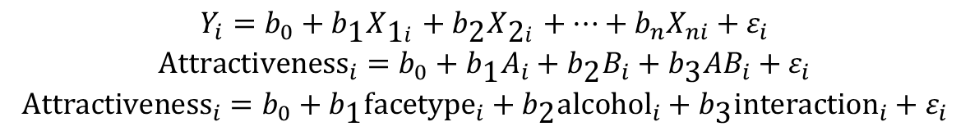
The Model
$$\begin{matrix}Y_{i}=b_{0}+b_{\text{1}}X_{\text{1}i}+b_{\text{2}}X_{\text{2}i}+…+b_{n}X_{ni}+ε_{i} \\ {\text{Attractiveness}}_{i}=b_{0}+b_{\text{1}}A_{i}+b_{\text{2}}B_{i}+b_{\text{3}}AB_{i}+ε_{i} \\ {\text{Attractiveness}}_{i}=b_{0}+b_{\text{1}}{\text{facetype}}_{i}+b_{\text{2}}{\text{alcohol}}_{i}+b_{\text{3}}{\text{interaction}}_{i}+ε_{i}\end{matrix}$$

Slide 8
The Data
Table 14.1 Data for the beer-goggles effect
alcohol | placebo |  | Low dose |  | high dose
facetype | attractive | unattractive | attractive | unattractive | attractive | unattractive
 | 6 | 2 | 7 | 3 | 5 | 5
 | 7 | 4 | 6 | 5 | 6 | 6
 | 6 | 3 | 8 | 7 | 7 | 8
 | 7 | 3 | 7 | 5 | 5 | 6
 | 6 | 4 | 6 | 4 | 7 | 7
 | 5 | 6 | 7 | 4 | 6 | 8
 | 8 | 5 | 6 | 5 | 5 | 7
 | 6 | 1 | 5 | 6 | 8 | 6
Total | 51 | 28 | 52 | 39 | 49 | 53
Mean | 6.375 | 3.500 | 6.500 | 4.875 | 6.125 | 6.625
Variance | 0.839 | 2.571 | 0.857 | 1.554 | 1.268 | 1.125
 | Grand mean = 5.667 Grand variance = 2.525

Slide 9
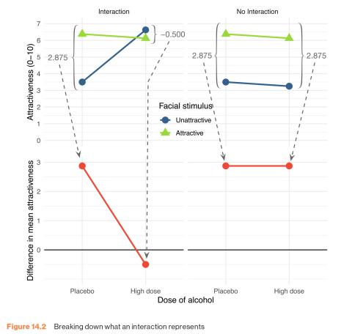
Figure 14.2 Breaking down what an interaction represents

Slide 10
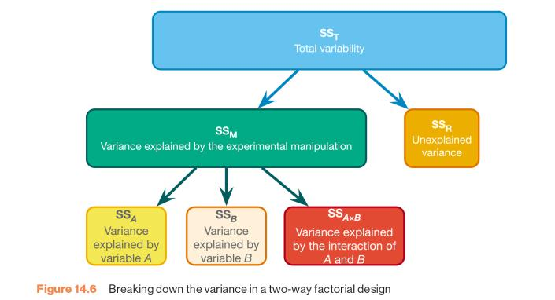
Figure 14.6 Breaking down the variance in a two-way factorial design

Slide 11
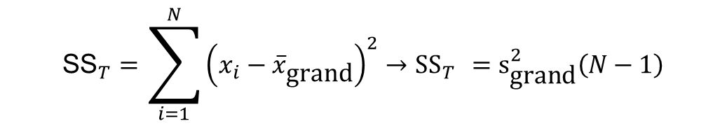
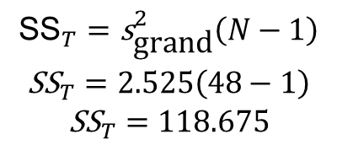
SS_{T}
$${\text{SS}}_{T}=\sum_{i=1}^{N}{{\left(x_{i}−{\overline{x}}_{\text{grand}}\right)}^{2}→{\text{SS}}_{T} ={\text{s}}_{\text{grand}}^{2}\left(N−1\right)}$$
$$\begin{matrix}{\text{SS}}_{T}={\text{s}}_{\text{grand}}^{2}\left(N−1\right) \\ {\text{SS}}_{T}=2.525\left(48−1\right) \\ {\text{SS}}_{T}=118.675\end{matrix}$$

Slide 12
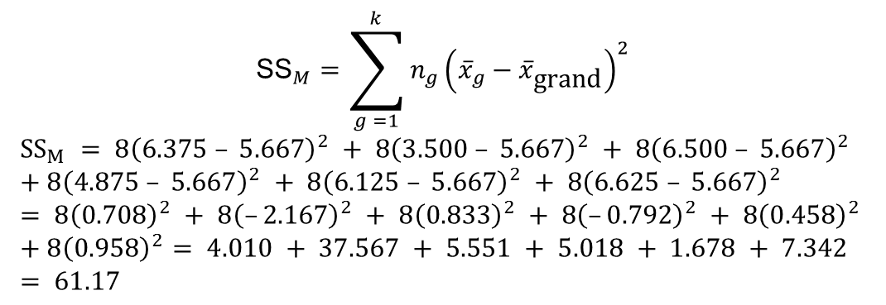
SS_{M}
$${\text{SS}}_{M}=\sum_{g =1}^{k}{n_{g}{\left({\overline{x}}_{g}−{\overline{x}}_{\text{grand}}\right)}^{2}}$$
$$SS_{M} = 8{\left(6.375 – 5.667\right)}^{2} + 8{\left(3.500 – 5.667\right)}^{2} + 8{\left(6.500 – 5.667\right)}^{2} \\ + 8{\left(4.875 – 5.667\right)}^{2} + 8{\left(6.125 – 5.667\right)}^{2} + 8{\left(6.625 – 5.667\right)}^{2} \\ = 8{\left(0.708\right)}^{2} + 8{\left(–2.167\right)}^{2} + 8{\left(0.833\right)}^{2} + 8{\left(–0.792\right)}^{2} + 8{\left(0.458\right)}^{2} \\ + 8{\left(0.958\right)}^{2}= 4.010 + 37.567 + 5.551 + 5.018 + 1.678 + 7.342 \\ = 61.17$$

Slide 13
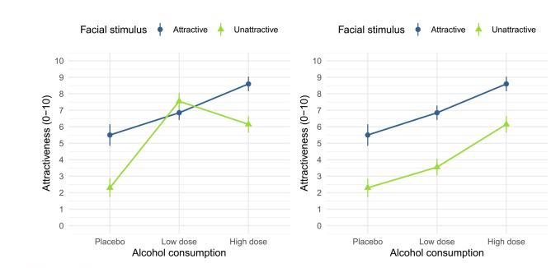
Interaction Plots (1 of 2)
Figure 14.3 Interaction plots

Slide 14
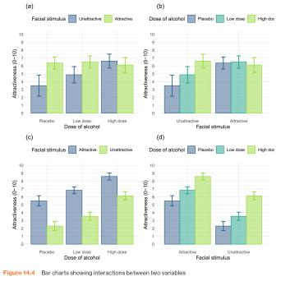
Interaction Plots (2 of 2)
Figure 14.4 Bar charts showing interactions between two variables

Slide 15
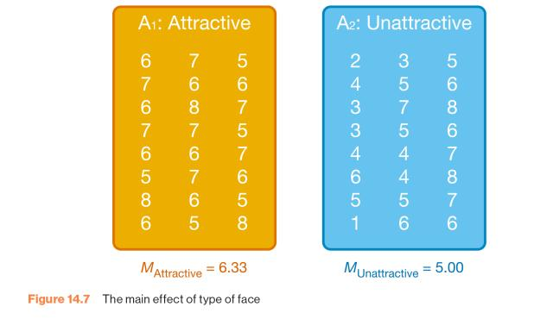
SS_{A} (1 of 2)
Figure 14.7 The main effect of type of face

Slide 16
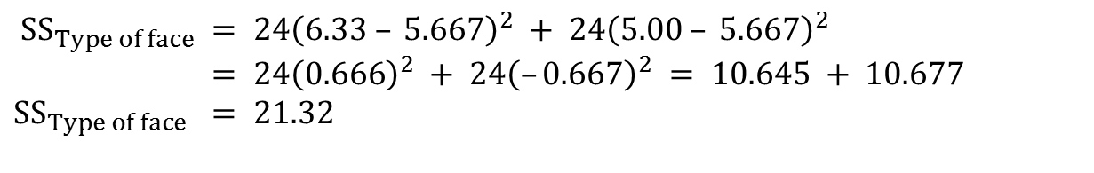
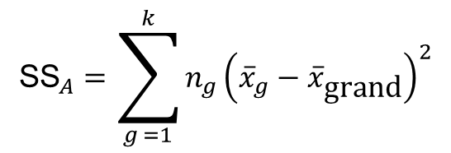
SS_{A} (2 of 2)
$${\text{SS}}_{A}=\sum_{g =1}^{k}{n_{g}{\left({\overline{x}}_{g}−{\overline{x}}_{\text{grand}}\right)}^{2}}$$
$$SS_{Type of face} = 24{\left(6.33 – 5.667\right)}^{2} + 24{\left(5.00 – 5.667\right)}^{2} \\ = 24{\left(0.666\right)}^{2} + 24{\left(–0.667\right)}^{2} = 10.645 + 10.677 \\ SS_{Type of face} = 21.32$$

Slide 17
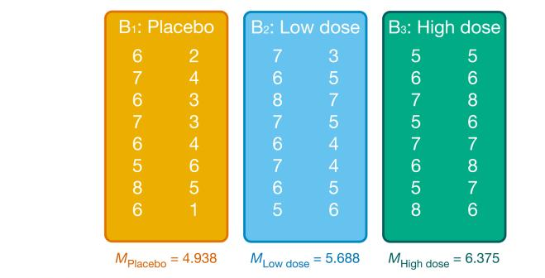
SS_{B} (1 of 2)
Figure 14.8 The main effect of alcohol

Slide 18
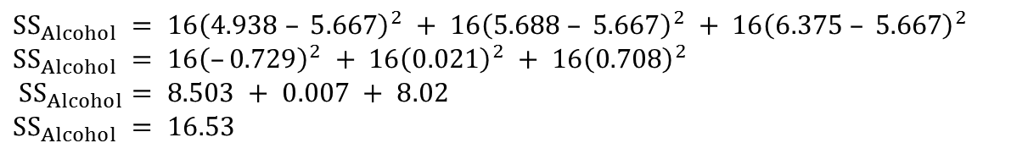
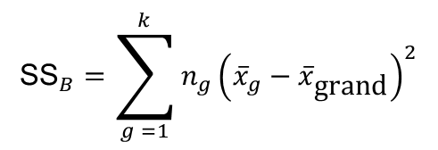
SS_{B} (2 of 2)
$${\text{SS}}_{B}=\sum_{g =1}^{k}{n_{g}{\left({\overline{x}}_{g}−{\overline{x}}_{\text{grand}}\right)}^{2}}$$
$$SS_{Alcohol} = 16{\left(4.938 – 5.667\right)}^{2} + 16{\left(5.688 – 5.667\right)}^{2} + 16{\left(6.375 – 5.667\right)}^{2} \\ SS_{Alcohol} = 16{\left(–0.729\right)}^{2} + 16{\left(0.021\right)}^{2} + 16{\left(0.708\right)}^{2} \\ SS_{Alcohol}= 8.503 + 0.007 + 8.02 \\ SS_{Alcohol} = 16.53$$

Slide 19
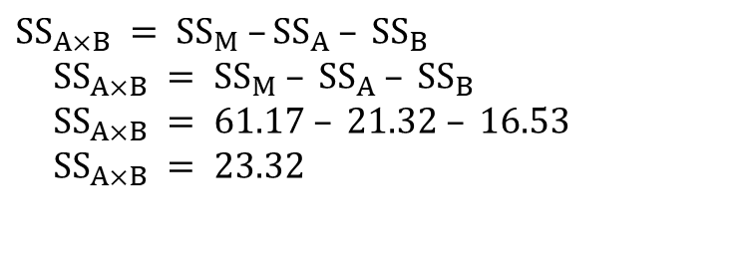
SS_{A × B}
$$SS_{A×B} = SS_{M} –SS_{A} – SS_{B}$$
$$SS_{A×B} = SS_{M} – SS_{A} – SS_{B} \\ SS_{A×B} = 61.17 – 21.32 – 16.53 \\ SS_{A×B} = 23.32$$

Slide 20
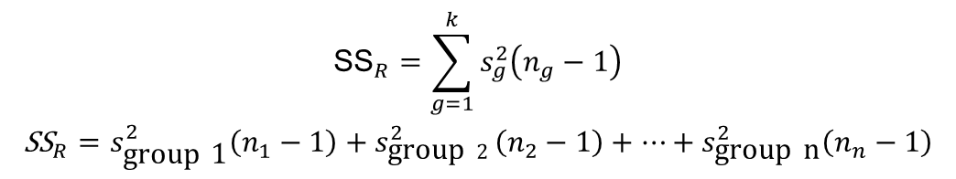
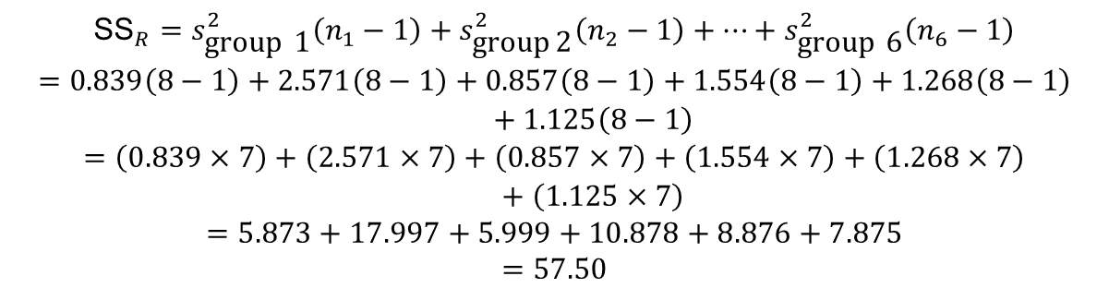
SS_{R}
$$\begin{matrix}{\text{SS}}_{R}=\sum_{g=1}^{k}{s_{g}^{2}\left(n_{g}−1\right)} \\ {\text{SS}}_{R}=s_{\text{group}\text{ 1}}^{2}\left(n_{1}−1\right)+s_{\text{group} 2}^{2}\left(n_{2}−1\right)+⋯+s_{\text{group} \text{n}}^{2}\left(n_{n}−1\right)\end{matrix}$$
$$\begin{matrix}{\text{SS}}_{R}=s_{\text{group}\text{ 1}}^{2}\left(n_{1}−1\right)+s_{\text{group}\text{ 2}}^{2}\left(n_{2}−1\right)+⋯+s_{\text{group}\text{ 6}}^{2}\left(n_{6}−1\right) \\ =0.839\left(8−1\right)+2.571\left(8−1\right)+0.857\left(8−1\right)+1.554\left(8−1\right)+1.268\left(8−1\right) \\ +1.125\left(8−1\right) \\ =\left(0.839×7\right)+\left(2.571×7\right)+\left(0.857×7\right)+\left(1.554×7\right)+\left(1.268×7\right) \\ +\left(1.125×7\right) \\ =5.873+17.997+5.999+10.878+8.876+7.875 \\ =57.50\end{matrix}$$
Notes:
The residual sum of squares is calculated in the same way as for one-way ANOVA and again represents individual differences in performance or the variance that can’t be explained by factors that were systematically manipulated. We saw in one-way ANOVA that the value is calculated by taking the squared error between each data point and its corresponding group mean. An alternative way to express this was as in equation 1 in the slide.
So, we use the individual variances of each group and multiply them by one less than the number of people within the group (n). We have the individual group variances in our original table of data (first page of this handout) and there were 8 people in each group (therefore, n = 8) and so the equation becomes the second equation on the slide.
The degrees of freedom for each group will be one less than the number of scores per group (i.e. 7). Therefore, if we add the sums of squares for each group, we get a total of 6 × 7 = 42.

Slide 21
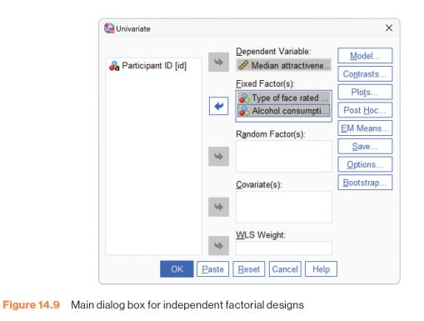
Independent Factorial Design (1 of 2)
Figure 14.9 Main dialogue box for independent factorial designs

Slide 22
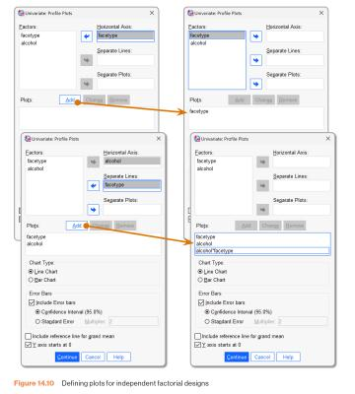
Independent Factorial Design (2 of 2)
Figure 14.10 Defining plots for independent factorial designs

Slide 23
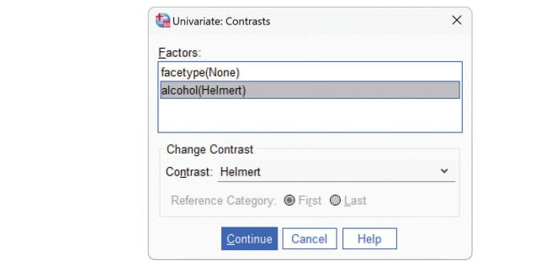
Contrasts
Figure 14.11 Defining contrasts for independent factorial designs

Slide 24
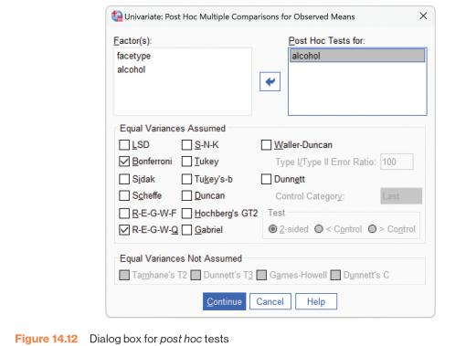
Post hoc Tests
Figure 14.12 Dialogue box for post hoc tests

Slide 25
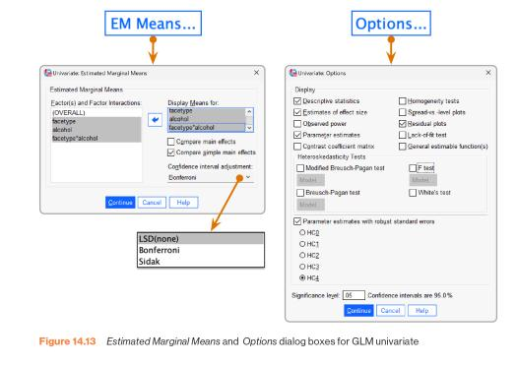
Simple Effects and Bootstrapping
Figure 14.13 Estimated Marginal Means and Options dialogue boxes for GLM univariate

Slide 26
Outputs (1 of 4)
Output 14.2
Tests of Between-Subjects Effects
Dependent Variable: Median attractiveness rating
Source | Type III Sum of Squares | df | Mean Square | F | Sig. | Partial Eta Squared
Corrected Model | 61.167ª | 5 | 12.233 | 8.936 | <.001 | .515
Intercept | 1541.333 | 1 | 1541.333 | 1125.843 | <.001 | .964
facetype | 21.333 | 1 | 21.333 | 15.583 | <.001 | .271
alcohol | 16.542 | 2 | 8.271 | 6.041 | .005 | .223
facetype * alcohol | 23.292 | 2 | 11.646 | 8.507 | <.001 | .288
Error | 57.500 | 42 | 1.369
Total | 1660.000 | 48
Corrected Total | 118.67 | 47
a. R Squared = .515 (Adjusted R Squared = .458)

Slide 27
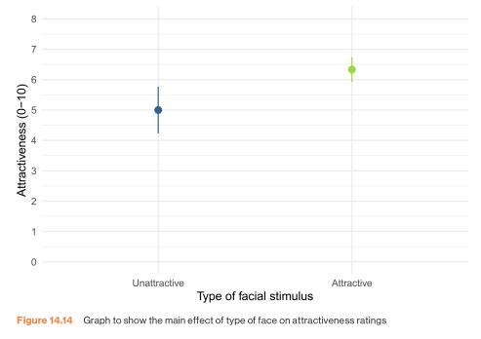
Outputs (2 of 4)
Figure 14.14 Graph to show the main effect of type of face on attractiveness ratings

Slide 28
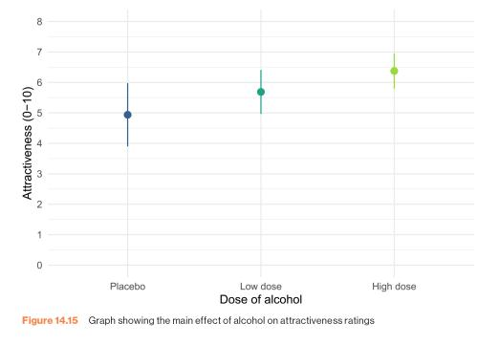
Outputs (3 of 4)
Figure 14.15 Graph showing the main effect of alcohol on attractiveness ratings

Slide 29
Outputs (4 of 4)
Output 14.3
Contrast Results (K Matrix)
Alcohol consumption Helmert Contrast |  |  | Dependent Variable Median attractiveness rating
Level 1 vs. Later | Contrast Estimate |  | -1.094
 | Hypothesized Value |  | 0
 | Difference (Estimate - Hypothesized) |  | -1.094
 | Std. Error |  | .358
 | Sig. |  | .004
 | 95% Confidence Interval Difference | Lower Bound | -1.817
 |  | Upper Bound | -3.71
Level 2 vs. Level 3 | Contrast Estimate |  | -.687
 | Hypothesized Value |  | 0
 | Difference (Estimate - Hypothesized) |  | -.687
 | Std. Error |  | .414
 | Sig. |  | ..104
 | 95% Confidence Interval Difference | Lower Bound | -1.522
 |  | Upper Bound | .147

Slide 30
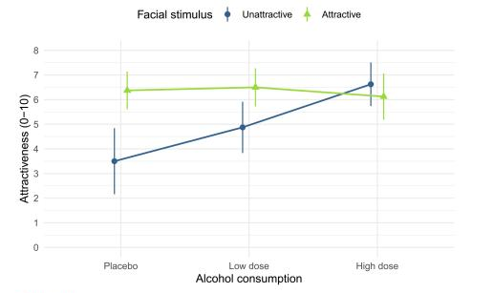
Interaction Effect
Figure 14.16 Graph of the interaction of type of face and alcohol consumption on attractiveness ratings

Slide 31
Output 14.5
3. Attractiveness of facial stimuli * Alcohol consumption
Estimates
Dependent Variable: Median attractiveness rating
Attractivenss of facial | Median attractiveness rating |  |  | 95% Confidence Interval |  |  | Bootstrap for Meanª BCa 95% Confidence Interval
Attractive of facial Stimuli | Alcohol consumption | Mean | Std. Error | Lower Bound | Upper Bound | Bias | Std. Error | Lower | Upper
Unattractive | Placebo | 3.500 | .414 | 2.665 | 4.335 | -.018 | .570 | 2.429 | 4.571
 | Low dose | 4.875 | .414 | 4.040 | 5.710 | .006 | .433 | 4.000 | 5.800
 | High dose | 6.625 | .414 | 5.790 | 7.460 | .002 | .363 | 6.000 | 7.333
Attractive | Placebo | 6.375 | .414 | 5.540 | 7.210 | -.002 | .312 | 5.826 | 7.000
 | Low dose | 6.500 | .414 | 5.665 | 7.335 | .015 | .316 | 5.833 | 7.200
 | High dose | 6.125 | .414 | 5.290 | 6.960 | .007 | .404 | 5.375 | 7.000
a. Unless otherwise noted, bootstrap results are based on 1000 bootstrap samples

Slide 32
Robust Models
Output 14.10
Parameter Estimates with Robust Standard Errors
Dependent Variable: Median attractiveness rating
Parameter | B | Robust Std Errorª | t | Sig. | 95% Confidence Interval |  | Partial Eta Squared
 |  |  |  |  | Lower Bound | Upper Bound
Intercept | 6.125 | .398 | 15.386 | <.001 | 5.322 | 6.928 | .849
[face type=0] | .500 | .547 | .918 | .366 | -.604 | 1.604 | .020
[face type=1] | 0^{b} | . | . | . | . | . | .
 |  | .513 | 487 | .629 | -7.86 | 1.286 | .006
[alcohol=0] | .250 | .515 | .728 | .471 | -6.65 | 1.415 | .012
[alcohol=1] | .375 | . | . | . | . | . | .
[alcohol=2] | 0^{b} | 852 | -3.963 | <.001 | -5.094 | -1.656 | .272
[face type=0] *[alcohol=0] | -3.375 | .775 | -2.742 | .009 | -3.689 | -5.61 | .152
[face type=0] *[alcohol=1] | -2.125 | . | . | . | . | . | .
[face type=0] *[alcohol=2] | 0^{b} | . | . | . | . | . | .
[face type=1] *[alcohol=0] | 0^{b} | . | . | . | . | . | .
[face type=0] *[alcohol=1] | 0^{b} | . | . | . | . | . | .
[face type=0] *[alcohol=2] | 0^{b} | . | . | . | . | . | .
a. HC4 method
b. This parameter is set to zero because it is redundant.

Slide 33
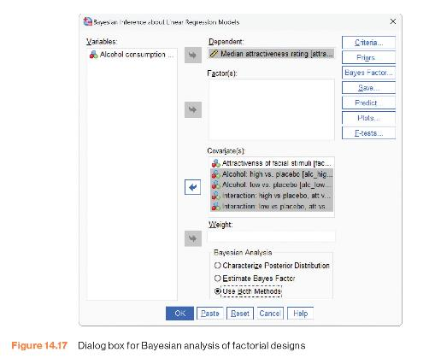
Bayesian Models of Factorial Designs (1 of 3)
Figure 14.17 Dialogue box for Bayesian analysis of factorial designs

Slide 34
Bayesian Models of Factorial Designs (2 of 3)
Output 14.12
Bayes Factor Model Summary^{a,b}
Bayes Factor^{c} | R | R Square | Adjusted R Square | Std. Error of the Estimate
1195.598 | .718 | .515 | .458 | 1.17
a. Method: JZS
b. Model: (Intercept), Attractivenss of facial stimuli, Alcohol: high vs. placebo, Alcohol: low vs. placebo, Interaction: high vs placebo, att vs unatt, Interaction: low vs placebo, att vs unatt
c. Bayes factor: Testing model versus null model (Intercept).

Slide 35
Bayesian Models of Factorial Designs (3 of 3)
Output 14.12
Bayesian Estimates of Coefficients^{a,b,c}
Parameter | Mode | Posterior Mean | Variance | 95% Credible Interval
 |  |  |  | Lower Bound | Upper Bound
(Intercept) | 3.500 | 3.500 | .180 | 2.665 | 4.335
Attractiveness of facial stimuli | 2.875 | 2.875 | .359 | 1.694 | 4.056
Alcohol: high vs. placebo | 3.125 | 3.125 | .359 | 1.944 | 4.306
Alcohol: low vs. placebo | 1.375 | 1.375 | .359 | .194 | 2.556
Interaction: high vs placebo, att vs unatt | -3.375 | -3.375 | .719 | -5.045 | -1.705
Interaction: low vs placebo, att vs unatt | -1.250 | -1.250 | .719 | -2.920 | .420
a. Dependent Variable: Median attractiveness rating
b. Model: (Intercept), Attractivenss of facial stimuli, Alcohol: high vs. placebo, Alcohol: low vs. placebo, Interaction: high vs placebo, att vs unatt, Interaction: low vs placebo, att vs unatt
c. Assume standard reference priors.

