Slide 1
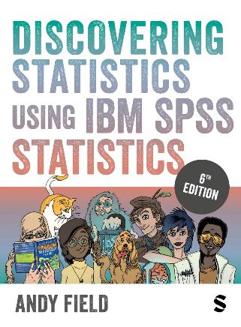
Discovering Statistics Using IBM SPSS Statistics
Andy Field
This deck incorporates accessible elements, such as standardized content reading order, and image description for all figures presented.

Slide 2
Chapter 16
GLM 5: Mixed Designs

Slide 3
Aims
What is a mixed design?
Analysing mixed designs using IBM SPSS statistics
Interpretation
  Main effects
  Interactions

Slide 4
A Speed-Dating Example
Dating strategies:
  If someone is committed to pursuing a relationship with a person who plays hard to get, they will find that person more desirable but less likeable (Dai, Dong, & Jia, 2014).
  Field (2017) fictitious study to look at the interplay between looks, personality and dating strategies on evaluations of a date.
Design
  IV 1 (attractiveness): Attractive, Average, Ugly.
  IV 2 (charisma): High Charisma, Some Charisma, Dullard.
  IV 3 (strategy): normal or playing hard to get.
Outcome: P’s rating of the date
  100% = ‘I’d pay a large sum of money for their phone number’.
  0% = ‘I’d pay a large sum of money for a plane ticket to get me as far away from them as possible’.

Slide 5
Table 16.1 Data from a fictional speed dating study (1 of 2)
Charisma | High Charisma |  |  | Some Charisma |  |  | Bore
Looks | Attractive | Average | Unattractive | Attractive | Average | Unattractive | Attractive | Average | Unattractive
Strategy
Hard to get | 86 | 84 | 67 | 88 | 69 | 50 | 97 | 48 | 47
 | 91 | 83 | 53 | 83 | 74 | 48 | 86 | 50 | 46
 | 89 | 88 | 48 | 99 | 70 | 48 | 90 | 45 | 48
 | 89 | 69 | 58 | 86 | 77 | 40 | 87 | 47 | 53
 | 80 | 81 | 57 | 88 | 71 | 50 | 82 | 50 | 45
 | 80 | 84 | 51 | 96 | 63 | 42 | 92 | 48 | 43
 | 89 | 85 | 61 | 87 | 79 | 44 | 86 | 50 | 45
 | 100 | 94 | 56 | 86 | 71 | 54 | 84 | 54 | 47
 | 90 | 74 | 54 | 92 | 71 | 58 | 78 | 38 | 45
 | 89 | 86 | 63 | 80 | 73 | 49 | 91 | 48 | 39

Slide 6
Table 16.1 Data from a fictional speed dating study (2 of 2)
Charisma | High Charisma |  |  | Some Charisma |  |  | Bore
Looks | Attractive | Average | Unattractive | Attractive | Average | Unattractive | Attractive | Average | Unattractive
Strategy
Normal | 89 | 91 | 93 | 88 | 65 | 54 | 55 | 48 | 52
 | 84 | 90 | 85 | 95 | 70 | 60 | 50 | 44 | 45
 | 99 | 100 | 89 | 80 | 79 | 53 | 51 | 48 | 44
 | 86 | 89 | 83 | 86 | 74 | 58 | 52 | 48 | 47
 | 89 | 87 | 80 | 83 | 74 | 43 | 58 | 50 | 48
 | 80 | 81 | 79 | 86 | 59 | 47 | 51 | 47 | 40
 | 82 | 92 | 85 | 81 | 66 | 47 | 50 | 45 | 47
 | 97 | 69 | 87 | 95 | 72 | 51 | 45 | 48 | 46
 | 95 | 92 | 90 | 98 | 64 | 53 | 54 | 53 | 45
 | 95 | 93 | 96 | 79 | 66 | 46 | 52 | 39 | 47

Slide 7
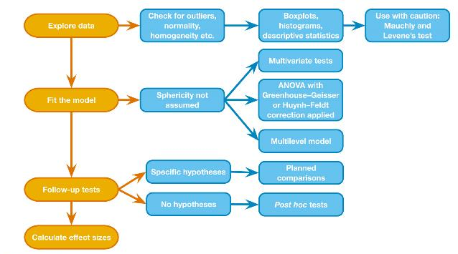
Mixed Designs: Process
Figure 16.2 The process for analysing mixed designs

Slide 8
Effects (1 of 2)
Main effects
  We will get an F-ratio for the main effect of each independent variable:
    Attractiveness
    Charisma
    Strategy
Two-way interactions
  We will get F-ratios for all possible interactions between pairs of variables:
    Attractiveness × Charisma
    Attractiveness × Strategy
    Charisma × Strategy

Slide 9
Effects (2 of 2)
Three-way interaction
  We will get an F-ratio for the interaction between all three variables
    Attractiveness × Charisma × Strategy

Slide 10
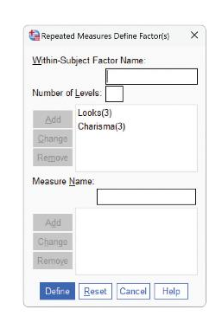
Define the Repeated-Measures Variables
Figure 16.4 The dialogue box for defining repeated measures

Slide 11
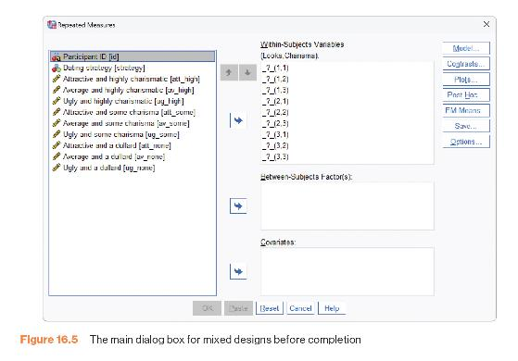
Define Levels of the Repeated-Measures Variables
Figure 16.5 The main dialogue box for mixed designs before completion

Slide 12
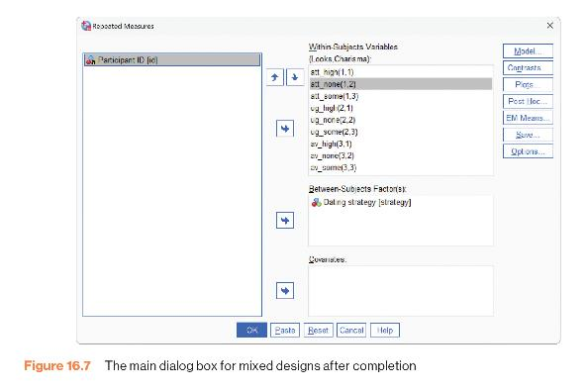
Define Levels of the Repeated-Measures Variables and Select the Between-Group Variable
Figure 16.7 The main dialogue box for mixed designs after completion

Slide 13
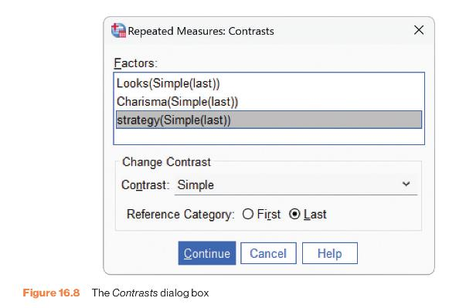
Define Contrasts
Figure 16.8 The Contrasts dialogue box

Slide 14
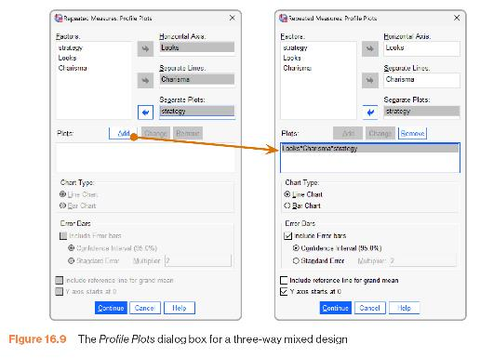
Profile Plots
Figure 16.9 The Profile Plots dialogue box for a three-way mixed design

Slide 15
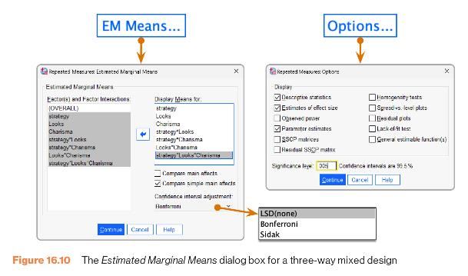
Estimated Marginal Means Dialogue Box
Figure 16.10 The Estimated Marginal Means dialogue box for a three-way mixed design

Slide 16
Output: Sphericity
Output 16.2
Mauchly’s Test of Sphericityª
Measure: MEASURE _1
 |  |  |  |  |  | Epsilon^{b}
Within Subject Effect | Mauchly's W | Approx. Chi-Square | df | Sig. | Greenhouse-Geisser | Huynh-Feldt | Lower-bound
Looks | .960 | .690 | 2 | .708 | .962 | 1.000 | .500
Charisma | .929 | 1.246 | 2 | .536 | .934 | 1.000 | .500
Looks * charisma | .613 | 8.025 | 9 | .534 | .799 | 1.000 | .250
Tests the null hypothesis that the error covariance matrix of the orthonormalized transformed dependent variables is proportional to an identity matrix.
a. Design: Intercept + strategy Within Subjects Design: Looks + Charisma + Looks * Charisma
b. May be used to adjust the degrees of freedom for the averaged tests of significance. Corrected tests are displayed in the Tests of Within-Subjects Effects table.

Slide 17
Repeated-Measures Effects
Output 16.3
Tests of Within-Subjects Effects
Measure: MEASURE _1
Greenhouse-Geisser
Source | Type III Sum of Squares | df | Mean Square | F | Sig. | Partial Eta Squared
Looks | 20779.633 | 1.923 | 10803.275 | 423.733 | <.001 | .959
Looks * strategy | 3944.100 | 1.923 | 2050.527 | 80.427 | <.001 | .817
Error (Looks) | 882.711 | 34.622 | 25.496
Charisma | 23233.600 | 1.868 | 12437.761 | 328.250 | <.001 | .948
Charisma * strategy | 4420.133 | 1.868 | 2366.252 | 62.449 | <.001 | .776
Error (Charisma) | 1274.044 | 33.624 | 37.891
Looks * Charisma | 4055.267 | 3.197 | 1268.295 | 36.633 | <.001 | .671
Looks * Charisma * strategy | 2669.667 | 3.197 | 834.945 | 24.116 | <.001 | .573
Error (Looks*Charisma) | 1992.622 | 57.554 | 34.622
Notes:
Note that I’ve collapsed the table across sphericity corrections so that you can actually read it

Slide 18
Between-Subjects Effect
Output 16.5
Tests of Between-Subjects Effects
Measure: MEASURE 1
Transformed Variable: Average
Source | Type III Sum of Squares | df | Mean Square | F | Sig. | Partial Eta Squared
Intercept | 94027.756 | 1 | 94027.756 | 20036.900 | <.001 | .999
Strategy | 0.22 | 1 | .022 | .005 | .946 | .000
Error | 84.469 | 18 | 4.693

Slide 19
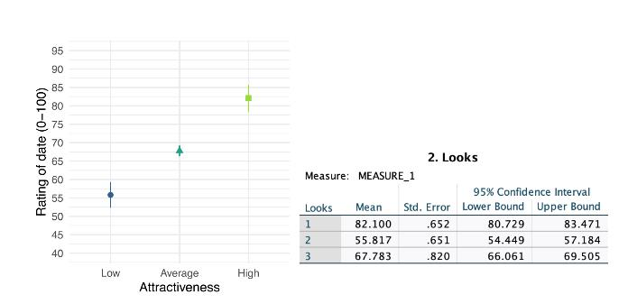
Main Effect of Looks
Figure 16.12 Means and plot of the main effect of Looks

Slide 20
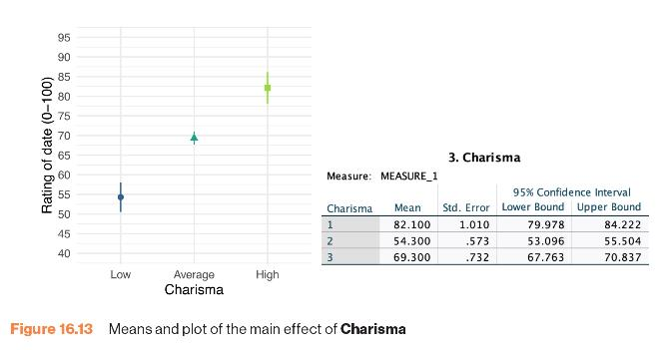
Main Effect of Charisma
Figure 16.13 Means and plot of the main effect of Charisma

Slide 21
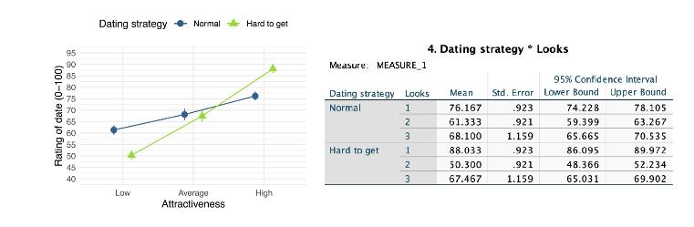
The Strategy × Looks Interaction
Figure 16.14 Means and plot of the strategy × Looks interaction

Slide 22
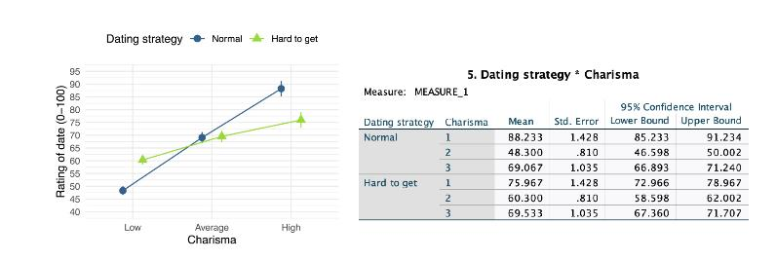
The Strategy× Charisma Interaction
Figure 16.15 Means and plot of the strategy × Charisma interaction

Slide 23
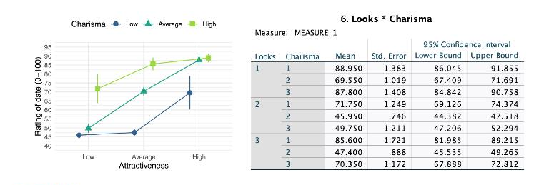
The Looks × Charisma Interaction
Figure 16.16 Means and plot of the Looks × Charisma interaction

Slide 24
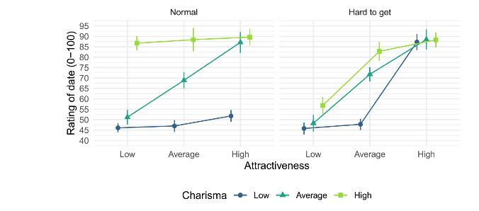
The Strategy × Looks × Charisma Interaction
Figure 16.18 Graphs showing the Looks × Charisma interaction for different dating strategies

Slide 25
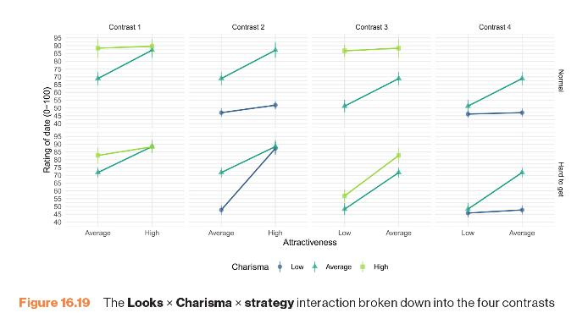
Figure 16.19 The Looks × Charisma × strategy interaction broken down into the four contrasts

