Slide 1

Discovering Statistics Using IBM SPSS Statistics
Andy Field
This deck incorporates accessible elements, such as standardized content reading order, and image description for all figures presented.

Slide 2
Chapter 17
Multivariate Analysis of Variance (MANOVA)

Slide 3
Aims
When and why do we use MANOVA?
Issues for MANOVA analysis
Theory behind MANOVA:
  SSCP matrices
  Discriminant variates
  MANOVA test statistics

Slide 4
When and Why
To test for differences between groups.
When we have Several Outcome variables (DVs).
Better than multiple ANOVA
  Controls familywise error rate (Type I error).
  Takes account of relationships between DVs.

Slide 5
Issues in MANOVA
Selecting dependent variables.
Test statistics (choice of four).
Power
  Power depends upon correlations between dependent variables.
  Conflicting evidence about test power.

Slide 6
Theory: An Example
Efficacy of psychotherapy on OCD
Three Groups:
  Cognitive behaviour therapy (CBT)
  Behaviour therapy (BT)
  No treatment (NT)
Two Outcome Variables (DVs):
  Obsession-related actions
  Obsession-related thoughts

Slide 7





Example Data
Table 17.1 Data from ocd.sav
 | DV 1: Actions |  |  | DV 2: Thoughts
Group: | CBT (1) | BT (2) | NT (3) | CBT (1) | BT (2) | NT (3)
 | 5 | 4 | 4 | 14 | 14 | 13
 | 5 | 4 | 5 | 11 | 15 | 15
 | 4 | 1 | 5 | 16 | 13 | 14
 | 4 | 1 | 4 | 13 | 14 | 14
 | 5 | 4 | 6 | 12 | 15 | 13
 | 3 | 6 | 4 | 14 | 19 | 20
 | 7 | 5 | 7 | 12 | 13 | 13
 | 6 | 5 | 4 | 15 | 18 | 16
 | 6 | 2 | 6 | 16 | 14 | 14
 | 4 | 5 | 5 | 11 | 17 | 18
 | 4.90 | 3.70 | 5.00 | 13.40 | 15.20 | 15.00
s | 1.20 | 1.77 | 1.05 | 1.90 | 2.10 | 2.36
s² | 1.43 | 3.12 | 1.11 | 3.60 | 4.40 | 5.56
$$\bar{X}$$
$${\bar{X}}_{grand(Actions)}=4.53$$
$${\bar{X}}_{grand(Thoughts)}=14.53$$
$${S^{2}}_{grand(Actions)}=2.1195$$
$${S^{2}}_{grand(Thoughts)}=4.8782$$

Slide 8
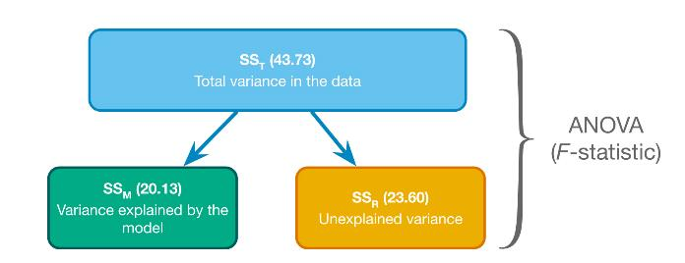
Theory of ANOVA (Revision)
F ∝ SS_{M}/SS_{R}
Figure 12.5 Partitioning variance for ANOVA

Slide 9
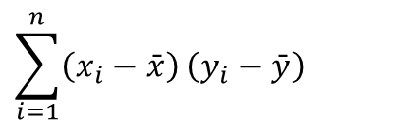
Cross Products
$$\sum_{i=1}^{n}{\left(x_{i}−\bar{x}\right)}\left(y_{i}−\bar{y}\right)$$

Slide 10
Total Cross Products (1 of 3)
Table 17.2 Calculation of the total cross-product
Group | Actions | Thoughts | Actions – X−_{grand (Actions)} (D₁) | Thoughts – X−_{grand (Thoughts)} (D₂) | D₁ × D₂
CBT | 5 | 14 | 0.47 | −0.53 | −0.25
 | 5 | 11 | 0.47 | −3.53 | −1.66
 | 4 | 16 | −0.53 | 1.47 | −0.78
 | 4 | 13 | −0.53 | −1.53 | 0.81
 | 5 | 12 | 0.47 | −2.53 | −1.19
 | 3 | 14 | −1.53 | −0.53 | 0.81
 | 7 | 12 | 2.47 | −2.53 | −6.25
 | 6 | 15 | 1.47 | 0.47 | 0.69
 | 6 | 16 | 1.47 | 1.47 | 2.16
 | 4 | 11 | −0.53 | −3.53 | 1.87

Slide 11
Total Cross Products (2 of 3)
Table 17.2 Calculation of the total cross-product
Group | Actions | Thoughts | Actions – X−_{grand (Actions)} (D₁) | Thoughts – X−_{grand (Thoughts)} (D₂) | D₁ × D₂
BT | 4 | 14 | −0.53 | −0.53 | 0.28
 | 4 | 15 | −0.53 | 0.47 | −0.25
 | 1 | 13 | −3.53 | −1.53 | 5.40
 | 1 | 14 | −3.53 | −0.53 | 1.87
 | 4 | 15 | −0.53 | 0.47 | −0.25
 | 6 | 19 | 1.47 | 4.47 | 6.57
 | 5 | 13 | 0.47 | −1.53 | −0.72
 | 5 | 18 | 0.47 | 3.47 | 1.63
 | 2 | 14 | −2.53 | −0.53 | 1.34
 | 5 | 17 | 0.47 | 2.47 | 1.16

Slide 12
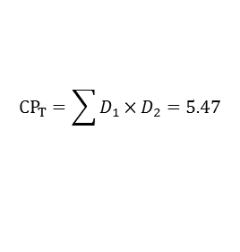
Total Cross Products (3 of 3)
Table 17.2 Calculation of the total cross-product
Group | Actions | Thoughts | Actions – X−_{grand (Actions)} (D₁) | Thoughts – X−_{grand (Thoughts)} (D₂) | D₁ × D₂
NT | 4 | 13 | −0.53 | −1.53 | 0.81
 | 5 | 15 | 0.47 | 0.47 | 0.22
 | 5 | 14 | 0.47 | −0.53 | −0.25
 | 4 | 14 | −0.53 | −0.53 | 0.28
 | 6 | 13 | 1.47 | −1.53 | −2.25
 | 4 | 20 | −0.53 | 5.47 | −2.90
 | 7 | 13 | 2.47 | −1.53 | −3.78
 | 4 | 16 | −0.53 | 1.47 | −0.78
 | 6 | 14 | 1.47 | −0.53 | −0.78
 | 5 | 18 | 0.47 | 3.47 | 1.63
X−_{grand} | 4.53 | 14.53
$$CP_{T}={\sum{D_{1}×D_{2}=5.47}}^{\text{​}}$$

Slide 13


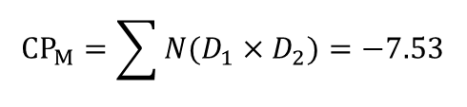

Calculating the Model Cross-Product
Table 17.3 Calculating the model cross-product
 | Actions | (D₁) | Thoughts | (D₂) | D₁ × D₂ | N(D₁ × D₂)
CBT | 4.9 | 0.37 | 13.4 | −1.13 | −0.418 | −4.18
BT | 3.7 | −0.83 | 15.2 | 0.67 | −0.556 | −5.56
NT | 5.0 | 0.47 | 15.0 | 0.47 | 0.221 | 2.21
 | 4.53 |  | 14.53
$${\bar{X}}_{group}$$
$${\bar{X}}_{group}×{\bar{X}}_{grand}$$
$${\bar{X}}_{group}$$
$${\bar{X}}_{group}×{\bar{X}}_{grand}$$
$$CP_{M}={\sum{N(D_{1}×D_{2})=−7.53}}^{\text{​}}$$
$${\bar{X}}_{grand}$$

Slide 14
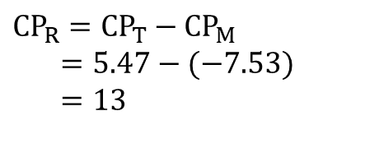
Residual Cross Products
$$CP_{R}=CP_{T}−CP_{M} \\ =5.47−(−7.53) \\ =13$$

Slide 15
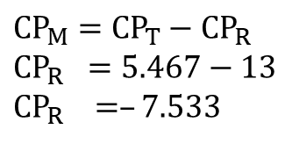
Model Cross Products
$$CP_{M}=CP_{T}−CP_{R} \\ CP_{R} =5.467−13 \\ CP_{R} =–7.533$$

Slide 16
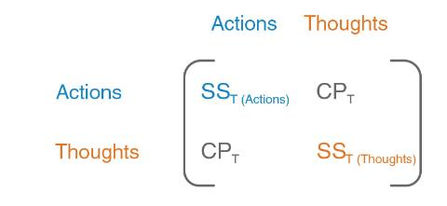
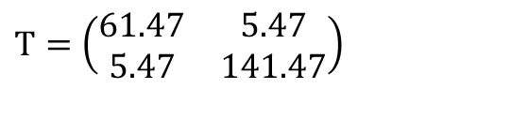
Total SSCP (T)
Figure 17.2 The components of the total SSCP
$$T=\left(\begin{matrix}61.47 & 5.47 \\ 5.47 & 141.47\end{matrix}\right)$$

Slide 17
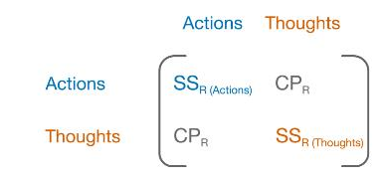
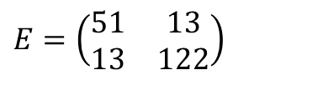
Residual SSCP (E)
Figure 17.3 The components of the residual SSCP
$$E=\left(\begin{matrix}51 & 13 \\ 13 & 122\end{matrix}\right)$$

Slide 18
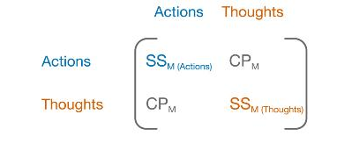
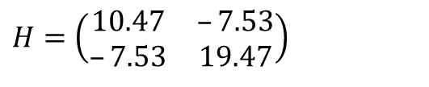
Model SSCP (M)
Figure 17.4 The components of the model SSCP
$$H=\left(\begin{matrix}10.47 & –7.53 \\ –7.53 & 19.47\end{matrix}\right)$$

Slide 19
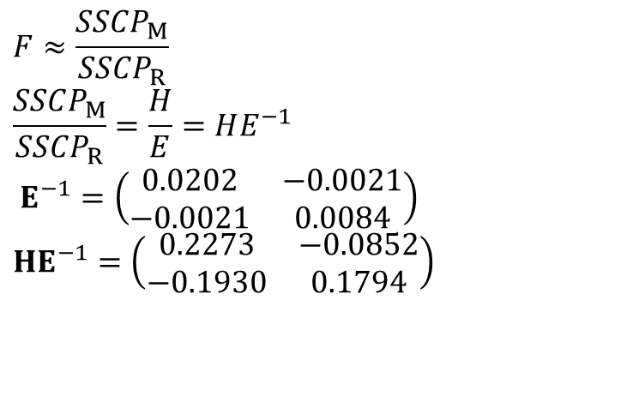
An Equivalent to F …
$$F≈\frac{SSCP_{M}}{SSCP_{R}} \\ \frac{SSCP_{M}}{SSCP_{R}}=\frac{H}{E}=HE^{−1}$$
$$E^{−1}=\left(\begin{matrix}0.0202 & −0.0021 \\ −0.0021 & 0.0084\end{matrix}\right) \\ HE^{−1}=\left(\begin{matrix}0.2273 & −0.0852 \\ −0.1930 & 0.1794\end{matrix}\right)$$

Slide 20
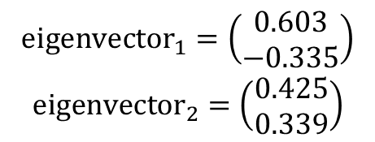
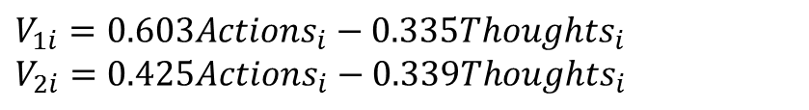
Discriminant Variates
$$V_{1i}=b_{0}+b_{1}Actions_{i}+b_{2}Thoughts_{i}$$
$$\begin{matrix}{\text{eigenvector}}_{1}=\left(\begin{matrix}0.603 \\ −0.335\end{matrix}\right) \\ {\text{eigenvector}}_{2}=\left(\begin{matrix}0.425 \\ 0.339\end{matrix}\right)\end{matrix}$$
$$V_{1i}=0.603Actions_{i}−0.335Thoughts_{i} \\ V_{2i}=0.425Actions_{i}−0.339Thoughts_{i}$$

Slide 21
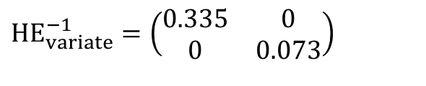
Eigenvalues (λi)
$$HE_{variate}^{−1}=\left(\begin{matrix}0.335 & 0 \\ 0 & 0.073\end{matrix}\right)$$

Slide 22
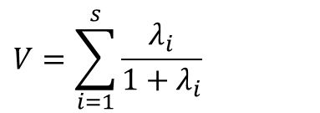
Pillai-Bartlett Trace
$$V=\sum_{i=1}^{s}{\frac{λ_{i}}{1+λ_{i}}}$$

Slide 23
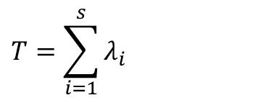
Hotelling’s Trace
$$T=\sum_{i=1}^{s}{λ_{i}}$$

Slide 24
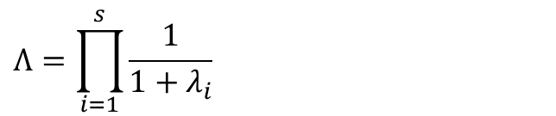
Wilk’s Lambda
$$Λ=\prod_{i=1}^{s}{\frac{1}{1+λ_{i}}}$$

Slide 25

Roy’s Largest Root
$$Θ=λ_{Largest}$$

Slide 26
Which Test Statistic?
Issues to consider
  Power
  Robustness
  Equality of sample sizes.
Pillai’s trace
  Robust when sample sizes are equal.

Slide 27
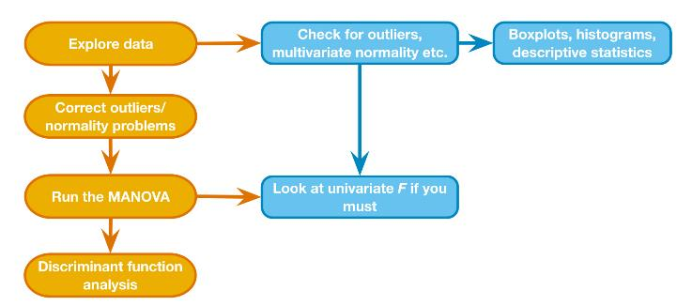
The Process
Figure 17.6 Overview of the general procedure for MANOVA

Slide 28
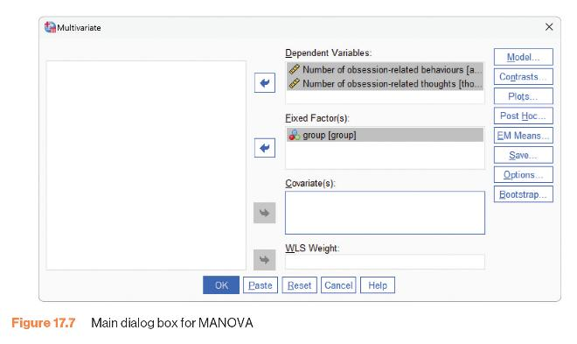
MANOVA Main Dialogue Box
Figure 17.7 Main dialogue box for MANOVA

Slide 29
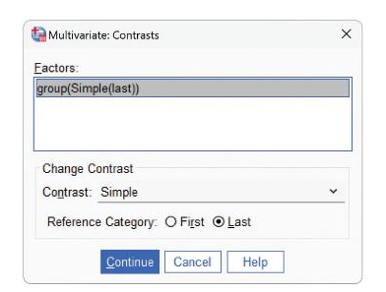
MANOVA Contrasts
Figure 17.8 Contrasts for independent variable(s) in MANOVA

Slide 30
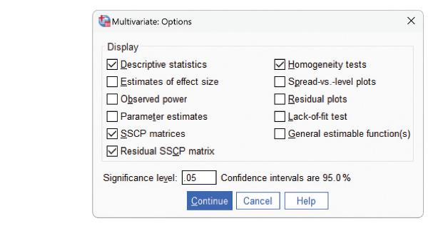
MANOVA Options
Figure 17.9 Additional options in MANOVA

Slide 31
Main Output
Output 17.3
Multivariate Testsª
Effect |  | Value | F | Hypothesis df | Error df | Sig
Intercept | Pilla’s Trace | .983 | 745.230^{b} | 2.000 | 26.000 | <.001
 | Wilks’ Lambda | 0.17 | 745.230^{b} | 2.000 | 26.000 | <.001
 | Hostelling’s Trace | 57.325 | 745.230^{b} | 2.000 | 26.000 | <.001
 | Roy’s Largest Root | 57.325 | 745.230^{b} | 2.000 | 26.000 | <.001
group | Pilla’s Trace | .318 | 2.557 | 4.000 | 54.000 | .049
 | Wilk’s Lambda | .699 | 2.555^{b} | 4.000 | 52.000 | .050
 | Hostellings’ Trace | .407 | 2.546 | 4.000 | 50.000 | .051
 | Roys Largest Root | .335 | 4.520 | 2.000 | 27.000 | .020
a. Design: Intercept + group
b. Exact statistic
c. The statistic is an upper bound on F that yields a lower bound on the significance level.

Slide 32
Univariate Fs (1 of 2)
Output 17.4
Levene’s Test of Equality of Error Variancesª
Based on Mean
 | Levene Statistic | df1 | df2 | Sig.
Number of obsession-related behaviours | 1.828 | 2 | 27 | .180
Number of obsession-related thoughts | 0.76 | 2 | 27 | .927
Tests the null hypothesis that the error variance of the dependent variable is equal across groups.
a. Design: Intercept + group

Slide 33
Univariate Fs (2 of 2)
Output 17.4
Tests of Between-Subjects Effects
Source | Dependent Variable | Type III of Squares | df | Mean Square | F | Sig.
Corrected Model | Number of obsession-related behaviours | 10.467ª | 2 | 5.233 | 2.771 | .080
 | Number of obsession-related thoughts | 19.467^{b} | 2 | 9.733 | 2.154 | .136
Intercept | Number of obsession-related behaviours | 616.533 | 1 | 616.533 | 326.400 | <.001
 | Number of obsession-related thoughts | 6336.533 | 1 | 6336.533 | 1402.348 | <.001
group | Number of obsession-related behaviours | 10.467 | 2 | 5.233 | 2.771 | .080
 | Number of obsession-related thoughts | 19.467 | 2 | 9.733 | 2.154 | .136
Error | Number of obsession-related behaviours | 51.000 | 27 | 1.889
 | Number of obsession-related thoughts | 122.000 | 27 | 4.519
Total | Number of obsession-related behaviours | 678.000 | 30
 | Number of obsession-related thoughts | 6478.000 | 30
Corrected Total | Number of obsession-related behaviours | 61.467 | 29
 | Number of obsession-related thoughts | 141.467 | 29
a. R Squared = .170 (Adjusted R Squared = .109)
b. R Squared = .138 (Adjusted R Squared = .074)

Slide 34
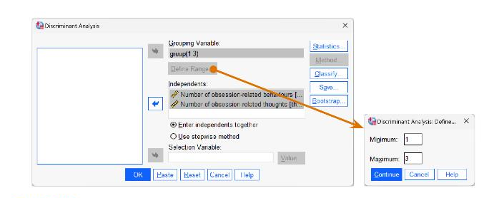
Following MANOVA with Discriminant Function Analysis
Figure 17.10 Main dialogue box for discriminant analysis

Slide 35
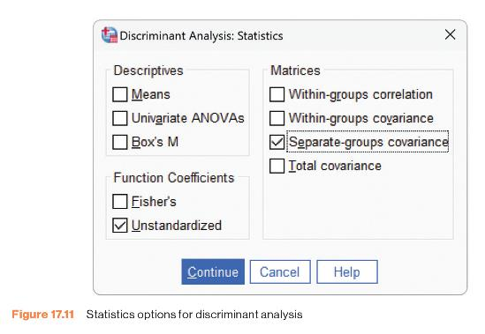
Discriminant Function Analysis: Statistics
Figure 17.11 Statistics options for discriminant analysis

Slide 36
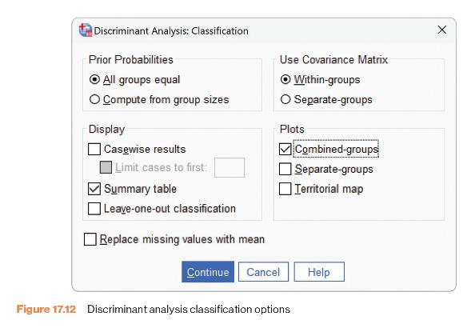
Discriminant Function Analysis: Classification
Figure 17.12 Discriminant analysis classification options

Slide 37
Discriminant Function Analysis (1 of 4)
Output 17.8
Eigenvalues
Function | Eigenvalue | % of Variance | Cumulative % | Canonical Correlation
1 | .335ª | 82.2 | 82.2 | .501
2 | .073ª | 17.8 | 100.0 | .260
a. First 2 canonical discriminant functions were used in the analysis.
Wilks’ Lambda
Test of Function(s) | Wilks’ Lambda | Chi-square | df | Sig.
1 through 2 | .699 | 9.508 | 4 | .050
2 | .932 | 1.856 | 1 | .173

Slide 38
Discriminant Function Analysis (2 of 4)
Output 17.9
Standardized Canonical Discriminant Function Coefficients
 | Function
 | 1 | 2
Number of obsession-related behaviours | .829 | .584
Number of obsession-related thoughts | -7.13 | .721
Structure Matrix
 | Function
 | 1 | 2
Number of obsession-related behaviours | .711* | -.703
Number of obsession-related thoughts | -5.76 | .817*
Pooled within-groups correlations between discriminating variables and standardized canonical discriminant functions
Variables ordered by absolute size of correlation within function.
*. Largest absolute correlation between each variable and any discriminant function

Slide 39
Discriminant Function Analysis (3 of 4)
Output 17.10
Canonical Discriminant Function Coefficients
 | Function
 | 1 | 2
Number of obsession-related behaviours | .603 | .425
Number of obsession-related thoughts | -.335 | .339
(Constant) | 2.139 | -6.857
Unstandardized coefficients
Functions at Group Centroids
 | Function
group | 1 | 2
CBT | .601 | -.229
BT | -.726 | -.128
No Treatment Control | .125 | .357
Unstandardized canonical discriminant functions evaluated at group means

Slide 40
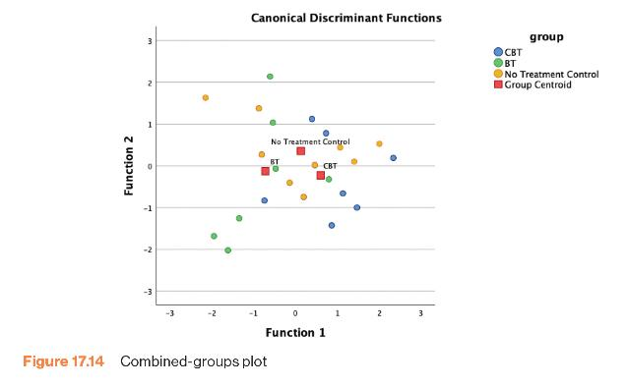
Discriminant Function Analysis (4 of 4)
Figure 17.14 Combined-groups plot

