Slide 1

Discovering Statistics Using IBM SPSS Statistics
Andy Field
This deck incorporates accessible elements, such as standardized content reading order, and image description for all figures presented.

Slide 2
Chapter 20
Categorical Outcomes: Logistic Regression

Slide 3
Aims
When and why do we use logistic regression?
  Binary
  Multinomial
Theory behind logistic regression
  Assessing the model
  Assessing predictors
  Things that can go wrong
Interpreting logistic regression

Slide 4
When and Why
To predict an outcome variable that is categorical from one or more categorical or continuous predictor variables.
Used because having a categorical outcome variable violates the assumption of linearity in normal regression.

Slide 5
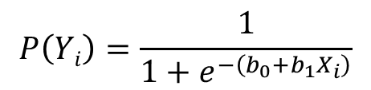
With One Predictor
$$P\left(Yi\right)=\frac{1}{1+e^{−\left(b_{0}+b_{1}X_{i}\right)}}$$
Outcome
  We predict the probability of the outcome occurring
b₀ and b₁
  Can be thought of in much the same way as the linear model.
  Note the linear model equation forms part of the logistic regression equation.

Slide 6
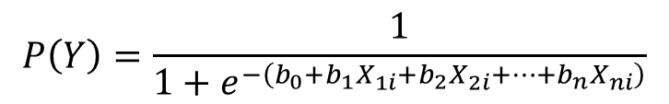
With Several Predictor
$$P\left(Y\right)=\frac{1}{1+e^{−\left(b_{0}+b_{1}X_{1i}+b_{2}X_{2i}+⋯+b_{n}X_{ni}\right)}}$$
Outcome
  We still predict the probability of the outcome occurring.
Differences
  Note the linear model equation forms part of the logistic regression equation.
  This part of the equation expands to accommodate additional predictors.

Slide 7
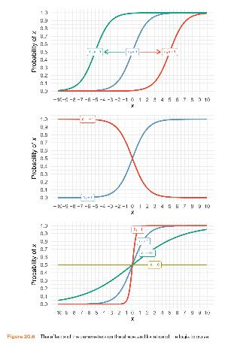
Figure 20.6 The effects of the parameters on the shape and location of the logistic curve

Slide 8
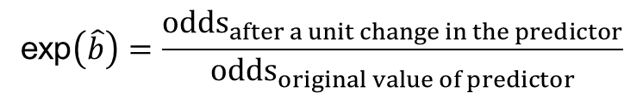
The odds ratio, exp(B)
$$\text{exp}\left(\hat{b}\right)=\frac{{\text{odds}}_{after a unit change in the predictor}}{{\text{odds}}_{original value of predictor}}$$
Indicates the change in odds resulting from a unit change in the predictor.
  OR > 1: Predictor ↑, Probability of outcome occurring ↑.
  OR < 1: Predictor ↑, Probability of outcome occurring ↓.

Slide 9
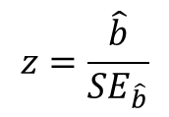
The Wald Statistic
$$z=\frac{\hat{b}}{SE_{\hat{b}}}$$
Similar to t-statistic in the linear model
Tests the null hypothesis that b = 0
Is biased when b is large.
Better to look at likelihood-ratio statistics.

Slide 10
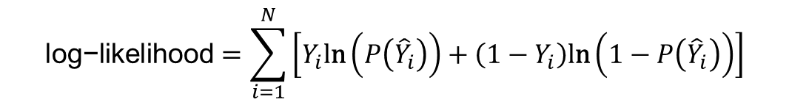
The log-likelihood
$$\text{log}\text{−}\text{likelihood}=\sum_{i=1}^{N}{\left[Y_{i}\text{l}\text{n}\left(P\left({\hat{Y}}_{i}\right)\right)+\left(1−Y_{i}\right)\text{l}\text{n}\left(1−P\left({\hat{Y}}_{i}\right)\right)\right]}$$
The log-likelihood statistic
  Analogous to the residual sum of squares in the linear model.
  It is an indicator of how much unexplained information there is after the model has been fitted.
  Large values indicate poorly fitting statistical models.

Slide 11
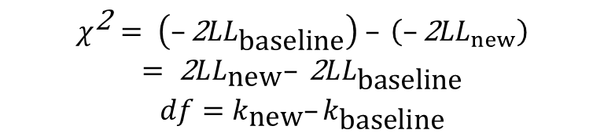
The Deviance Statistic
The deviance is very closely related to the log-likelihood: it’s given by
  Deviance = −2LL
It’s possible to calculate a log-likelihood or deviance for different models and to compare these models by looking at the difference between their deviances.
$$\begin{matrix}χ^{\text{2}}= \left(–\text{2}LL_{\text{baseline}}\right) – \left(–\text{2}LL_{new}\right) \\ =\text{ 2}LL_{\text{new}}–\text{ 2}LL_{\text{baseline}} \\ df=k_{\text{new}}–k_{\text{baseline}}\end{matrix}$$

Slide 12
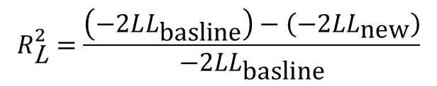
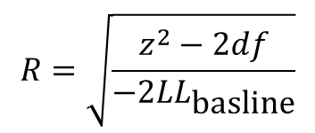
R and R²
This R-statistic
  is the partial correlation between the outcome variable and each of the predictor variables.
  It can vary between −1 and 1.
The R-statistic is given by:
Or:
$$R=\sqrt{\frac{z^{2}−2df}{−2LL_{\text{basline}}}}$$
$$R_{\text{L}}^{2}=\frac{\left(−2LL_{\text{basline}}\right)−\left(−2LL_{\text{new}}\right)}{−2LL_{\text{basline}}}$$

Slide 13
Building the Model
Forced entry: all variables entered simultaneously.
Hierarchical: variables entered in blocks.
  Blocks should be based on past research or theory being tested. Good method.
Stepwise: variables entered on the basis of statistical criteria (i.e. relative contribution to predicting outcome).
  Should be used only for exploratory analysis.

Slide 14
Model Building and Parsimony
When building a model, we should strive for parsimony.
  predictors should not be included unless they have explanatory benefit.
First fit the model that includes all potential predictors, and then systematically remove any that don’t seem to contribute to the model.

Slide 15
Things that can go Wrong
Assumptions from linear regression:
  Linearity
  Independence of errors
  Multicollinearity
Unique problems
  Incomplete information
  Complete separation
  Overdispersion

Slide 16
Incomplete Information From the Predictors
Categorical predictors:
  Predicting cancer from smoking and eating tomatoes.
  We don’t know what happens when nonsmokers eat tomatoes because we have no data in this cell of the design.
Continuous variables
  Will your sample include an 80-year-old, highly anxious, Buddhist left-handed lesbian?

Slide 17
Table 20.2 Incomplete contingency table
Do you smoke? | Do you eat tomatoes? | Do you have cancer?
Yes | No | Yes
Yes | Yes | Yes
No | No | Yes
No | Yes | ??????

Slide 18
Complete Separation
When the outcome variable can be perfectly predicted
  E.g. predicting whether someone is a burglar, your teenage son or your cat based on weight.
  Weight is a perfect predictor of cat/burglar unless you have a very fat cat indeed!

Slide 19
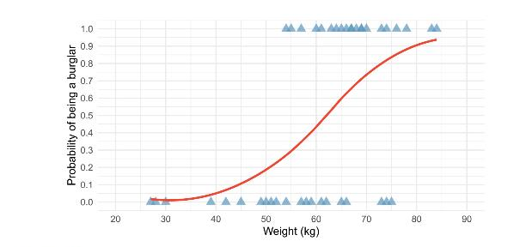
Figure 20.8 An example of the relationship between weight and a dichotomous outcome variable (being a burglar or not). Note that the weights of burglars (y = 1) and non-burglars (y = 0) overlap

Slide 20
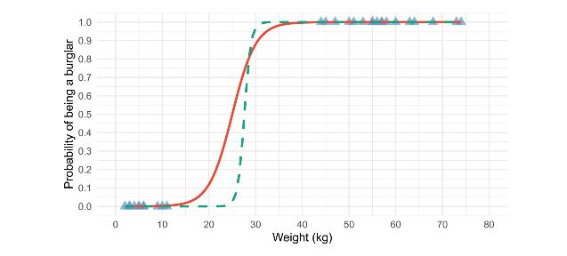
Figure 20.9 An example of complete separation. Note that the weights of the burglars (y = 1) and non-burglars (y = 0) do not overlap

Slide 21
Overdispersion
When the outcome contains more than two categories.
Overdispersion is where the variance is larger than expected from the model.
This can be caused by violating the assumption of independence.
This problem makes the standard errors too small.

Slide 22
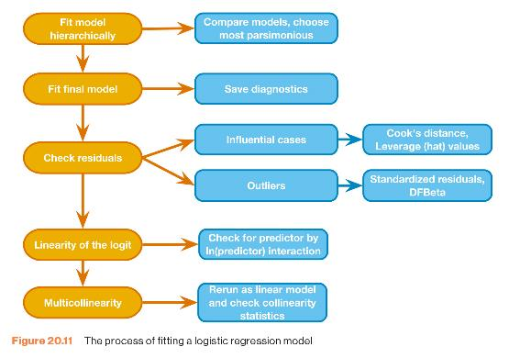
The Process
Figure 20.11 The process of fitting a logistic regression model

Slide 23
An Example
Predictors of a treatment intervention.
Participants
  113 adults with a medical problem.
Outcome:
  Cured (1) or not cured (0).
Predictors:
  Intervention: intervention or no treatment.
  Duration: the number of days before treatment that the patient had the problem.

Slide 24
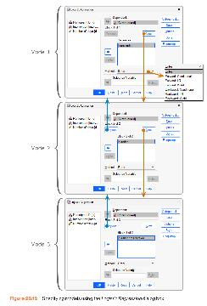
Logistic Regression
Figure 20.12 Specifying models using the Logistic Regression dialogue box

Slide 25
Output 20.1
Dependent Variable
Encoding
Original Value | Internal Value
Not Cured | 0
Cured | 1
Categorical Variables Coding
 |  | Frequency | Parameter Coding(1)
Intervention | No treatment | 56 | .000
 | Intervention | 57 | 1.000

Slide 26
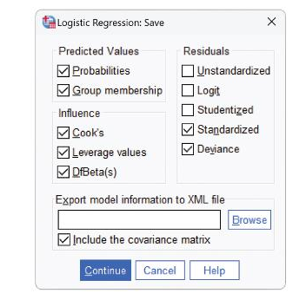
Obtaining Residuals
Figure 20.14 Dialogue box for obtaining residuals for logistic regression

Slide 27
Interpreting Logistic Regression
Output 20.3
Iteration History^{a,b,c}
Iteration |  | -2 Log likelihood | Coefficients Constant
Step 0 | 1 | 154.084 | .301
 | 2 | 154.084 | .303
 | 3 | 154.084 | .303
a. Constant is included in the model.
b. Initial -2 Log Likelihood: 154.084
c. Estimation terminated at iteration number 3 because parameter.
estimates changed by less than .001.

Slide 28
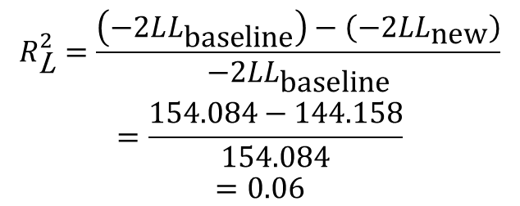
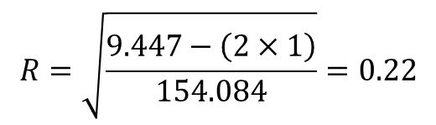
Model Summary
$$R=\sqrt{\frac{9.447−\left(2×1\right)}{154.084}}=0.22$$
$$\begin{matrix}R_{\text{L}}^{2}=\frac{\left(−2LL_{\text{baseline}}\right)−\left(−2LL_{\text{new}}\right)}{−2LL_{\text{baseline}}} \\ =\frac{154.084−144.158}{154.084} \\ =0.06\end{matrix}$$

Slide 29
Classification
Output 20.6
Step number 1 Observed Groups and Predicted Probabilities
 | 80 + |  |  |  |  |  |  |  |  |  | +
 | I |  |  |  |  |  |  |  |  |  | I
 | I |  |  |  |  |  |  |  |  |  | I
F | I |  |  |  |  |  |  |  |  |  | I
R | 60 + |  |  |  |  |  |  |  |  |  | +
E | I |  |  | C |  |  |  | C |  |  | I
Q | I |  |  | C |  |  |  | C |  |  | I
U | I |  |  | C |  |  |  | C |  |  | I
E | 40 + |  |  | C |  |  |  | C |  |  | +
N | I |  |  | C |  |  |  | C |  |  | I
C | I |  |  | N |  |  |  | C |  |  | I
Y | I |  |  | N |  |  |  | C |  |  | I
 | 20 + |  |  | N |  |  |  | C |  |  | +
 | I |  |  | N |  |  |  | N |  |  | I
 | I |  |  | N |  |  |  | N |  |  | I
 | I |  |  | N |  |  |  | N |  |  | I
Predicted | ------------+------------+------------+------------+------------+------------+------------+------------+------------+----------
Prob: | 0 | .1 | .2 | .3 | .4 | .5 | 6 |  | .7 | .8 |  | 9 | 1
Group: | NNNNNNNNNNNNNNNNNNNNNNNNNNNCCCCCCCCCCCCCCCCCCCCCCCCCCCCCCCCCCCC
Predicted Probability is of Membership for Cured The Cut Value is .50 Symbols: N — Not cured C — Cured Each Symbol Represents 5 Cases.

Slide 30
Summary
The overall fit of the final model is shown by −2LL and its associated chi-square statistic.
  If the significance of the chi-square statistic is less than .05, then the model is a significant fit of the data.
Check the table labelled Variables in the equation to see the regression parameters for any predictors in the model.
Look at the Wald statistic and its significance.
Use the odds ratio, exp(B), for interpretation.
  OR > 1, then as the predictor increases, the odds of the outcome occurring increase.
  OR < 1, then as the predictor increases, the odds of the outcome occurring decrease.
  The confidence interval of Exp(B) should not cross 1.

Slide 31

Reporting the Analysis
Table 20.5 Coefficients of the model predicting whether a patient was cured (95% BCa bootstrap confidence intervals based on 1000 samples in brackets)
 |  | 95% CI for Odds Ratio
 |  | Lower | Odds Ratio | Upper
Included
Constant | −0.29 [−0.77, 0.20]
Intervention | 1.23* [0.42, 2.06] | 1.56 | 3.42 | 7.48
$$\hat{b}$$
Note. R² = 0.06 (Hosmer–Lemeshow), 0.08 (Cox–Snell), 0.11 (Nagelkerke). Model c²(1) = 9.93, p = 0.002. *p < 0.01.

Slide 32
Multinomial Logistic Regression
Logistic regression to predict membership of more than two categories.
It (basically) works in the same way as binary logistic regression.
The analysis breaks the outcome variable down into a series of comparisons between two categories.
  E.g., if you have three outcome categories (A, B and C), then the analysis will consist of two comparisons that you choose:
    Compare everything against your first category (e.g. A vs. B and A vs. C),
    Or your last category (e.g. A vs. C and B vs. C),
    Or a custom category (e.g. B vs. A and B vs. C).
The important parts of the analysis and output are much the same as we have just seen for binary logistic regression.

