Slide 1

Discovering Statistics Using IBM SPSS Statistics
Andy Field
This deck incorporates accessible elements, such as standardized content reading order, and image description for all figures presented.

Slide 2
Chapter 21
Multilevel Linear Models

Slide 3
Aims
Multilevel models
  Hierarchical data
  Intraclass correlation
  Benefits
  Fixed and random coefficients
  Comparing models
  Covariance structures
  Centring
  Conducting and interpreting an example analysis
Growth models
  Types of growth model
  Conducting and interpreting an example analysis

Slide 4
Hierarchical Data
Data structures are often hierarchical
Examples:
  Children nested within classrooms
  Data points nested within people
  Employees nested within organizations
  Patients nested within hospitals
  Patients nested within doctors nested within clinics.

Slide 5
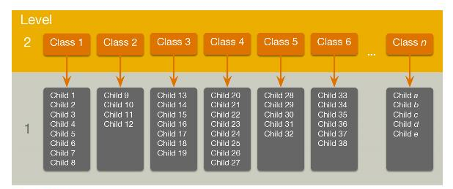
A Two-Level Hierarchy
Figure 21.2 An example of a two-level hierarchical data structure. Children (level 1) are organized within classrooms (level 2)

Slide 6
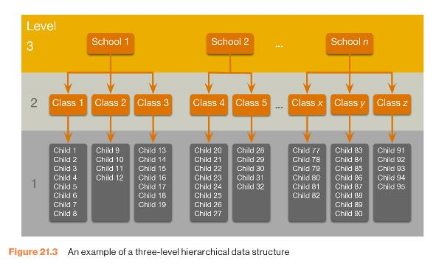
A Three-Level Hierarchy
Figure 21.3 An example of a three-level hierarchical data structure

Slide 7
Intraclass Correlation (ICC)
Data from the same context will be more similar than data from different contexts.
  E.g. Children in the same class will perform more similarly than children from different classes.
Lack of independence
  Creates problems in ANOVA/regression (correlated residuals)
The ICC measures the variability within contexts
  E.g. the variability within classrooms.

Slide 8
Benefits of Multilevel Models
Homogeneity of regression slopes.
  Model the variability in regression slopes.
Assumption of independence
  You can model the relationships between cases.
  (Regression for repeated observations).
Missing data
  MLMs can cope with missing data.

Slide 9
An Example: Cosmetic Surgery (1 of 2)
Post_QoL
  This is a measure of quality of life after the cosmetic surgery.
Base_QoL
  Quality of life before the surgery.
Surgery
  A dummy variable that specifies whether the person has undergone cosmetic surgery (1) or whether they are on the waiting list (0).
Clinic
  Which of 10 clinics the person attended to have their surgery.

Slide 10
An Example: Cosmetic Surgery (2 of 2)
Age
  The person’s age in years.
BDI
  Natural levels of depression measured using the Beck Depression Inventory (BDI).
Reason
  This dummy variable specifies whether the person had/is waiting to have surgery purely to change their appearance (0) or because of a physical reason (1).
Gender
  Whether the person was a man (1) or a woman (0).

Slide 11
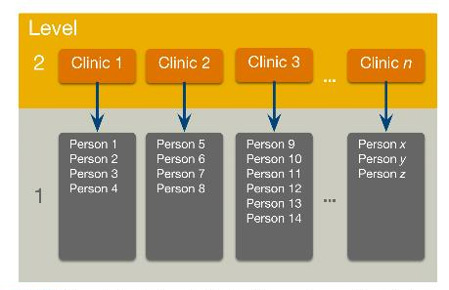
Hierarchical Structure of Cosmetic Surgery Data Set
Figure 21.6 Diagram to show the hierarchical structure of the cosmetic surgery data set. People are clustered within clinics. For each person several variables were measured: post-surgery quality of life, BDI, the number of days post surgery that quality of life was measured, the reason for the surgery and pre-surgery quality of life

Slide 12
Fixed and Random Coefficients
Intercepts and slopes can be fixed or random
  In OLS regression they are fixed.
Fixed coefficients
  Intercepts/slopes are assumed to be the same across different contexts.
Random coefficients
  Intercepts/slopes are allowed to vary across different contexts.

Slide 13
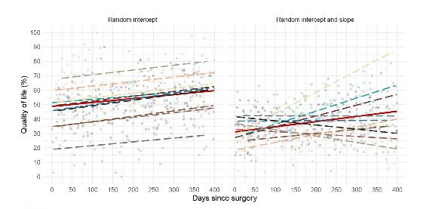
Intercepts and Slopes
Figure 21.7 Data sets showing an overall model (red line) and the models for separate contexts within the data (i.e. individual clinics are represented by different colours)

Slide 14
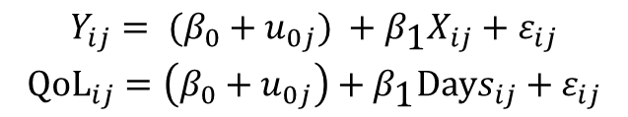
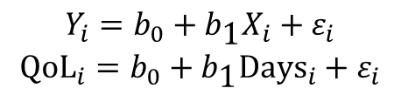
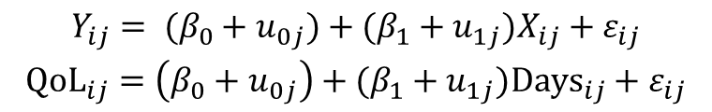
The Models (1 of 2)
Linear Model
Random Intercepts and Fixed Slopes
Fixed Intercepts and Random Slopes
$$\begin{matrix}Y_{i}=b_{0}+b_{\text{1}}X_{i}+ε_{i} \\ {\text{QoL}}_{i}=b_{0}+b_{\text{1}}{\text{Days}}_{i}+ε_{i}\end{matrix}$$
$$\begin{matrix}Y_{ij}= (β_{0}+u_{0j}) +β_{\text{1}}X_{ij}+ε_{ij} \\ {\text{QoL}}_{ij}=\left(β_{0}+u_{0j}\right)+β_{\text{1}}Days_{ij}+ε_{ij}\end{matrix}$$
$$\begin{matrix}Y_{ij}= (β_{0}+u_{0j})+(β_{1}+u_{1j})X_{ij}+ε_{ij} \\ {\text{QoL}}_{ij}=\left(β_{0}+u_{0j}\right)+(β_{1}+u_{1j})Days_{ij}+ε_{ij}\end{matrix}$$

Slide 15
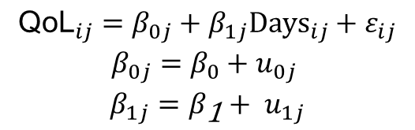
The Models (2 of 2)
Random Intercepts and Random Slopes
$$\begin{matrix}{\text{QoL}}_{ij}=β_{0j}+β_{1j}{\text{Days}}_{ij}+ε_{ij} \\ β_{0j}=β_{0}+u_{0j} \\ β_{1j}=β_{\text{1}}+ u_{1j}\end{matrix}$$

Slide 16
Assessing the Fit and Comparing Models
Assessing fit
  AIC
  AICC
  BIC
  CAIC
Models should be built up gradually
  Start with fixed coefficients
  Change 1 aspect of the model and compare to the previous with the change in the -2loglikelihood

Slide 17
Covariance Structures
Variance components
  Random effects are independent with similar variances.
Diagonal
  Random effects are independent with different variances.
AR(1)
  Random effects are related with data points closer in time being more similar than those distant in time.
  Variances of random effects are similar.
Unstructured
  Covariances and variances of random effects are unpredictable.

Slide 18
Centring
Group-mean centring
  Take each score and subtract from it the mean of scores from the same group (for that variable).
Effects of centring in multilevel models
  The effects are complicated.
  Models using centred variables tend to be more stable.
  It can help with problems of multicollinearity.

Slide 19
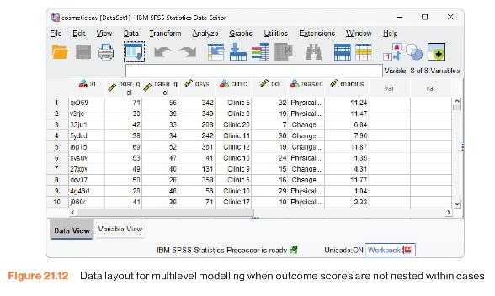
Multilevel Models Using SPSS Statistics
Figure 21.12 Data layout for multilevel modelling when outcome scores are not nested within cases

Slide 20
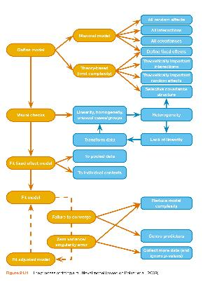
The Process
Figure 21.11 The process of fitting a multilevel model (based on Bolker et al., 2009)

Slide 21
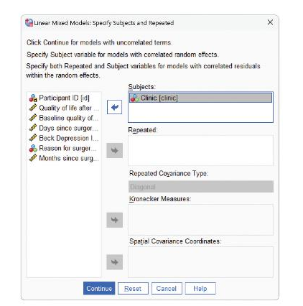
Multilevel Models: Defining Variables (1 of 2)
Figure 21.14 Specifying a level 2 variable in a hierarchical linear model

Slide 22
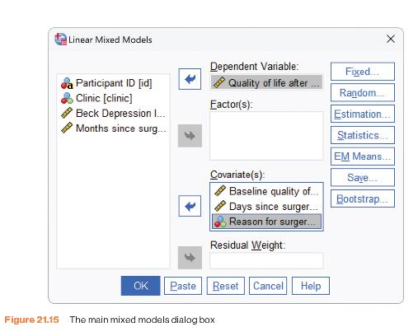
Multilevel Models: Defining Variables (2 of 2)
Figure 21.15 The main mixed models dialogue box

Slide 23
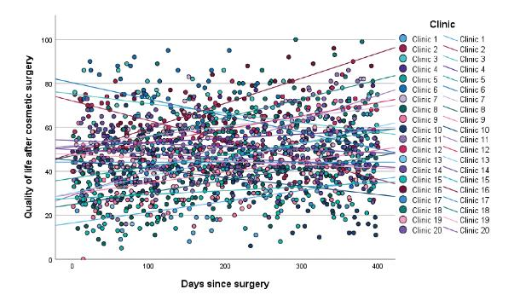
Figure 21.13 Plot of quality of life measured days post surgery at 20 clinics.

Slide 24
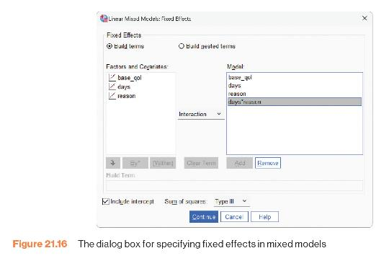
Specifying Fixed Effects
Figure 21.16 The dialogue box for specifying fixed effects in mixed models

Slide 25
Output 21.1 (1 of 2)
Type III Tests of Fixed Effectsª
Source | Numerator df | Denominator df | F | Sig.
Intercept | 1 | 1571.000 | 144.732 | <.001
base_qol | 1 | 1571 | 132.695 | <.001
days | 1 | 1571 | 4.276 | .039
reason | 1 | 1571.000 | 2.353 | .125
days * reason | 1 | 1571.000 | 10.271 | .001
a. Dependent Variable: Quality of life after cosmetic surgery.

Slide 26
Output 21.1 (2 of 2)
Estimates of Fixed Effectsª
Parameter | Estimate | Std. Error | df | t | Sig. | 95% Confidence Interval
 |  |  |  |  |  | Lower Bound | Upper Bound
Intercept | 24.755 | 2.058 | 1571.000 | 12.030 | <.001 <.001 | 20.719 | 28.791
base_qo | .459 | .040 | 1571 | 11.519 |  | .380 | .537
days | .009 | .004 | 1571 | 2.068 | .039 | .000 | .017
reason | -2.479 | 1.616 | 1571.000 | -1.534 | .125 | -5.649 | .691
days * reason | .023 | .007 | 1571.000 | 3.205 | .001 | .009 | .037
a. Dependent Variable: Quality of life after cosmetic surgery.

Slide 27
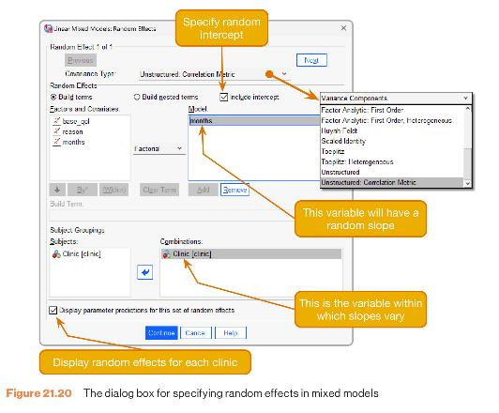
Specifying Random Effects
Figure 21.20 The dialogue box for specifying random effects in mixed models

Slide 28

Reporting the Multilevel Model
Table 21.1 Summary of the multilevel model
$$\hat{β}$$
 |  | 95% CI | t | df | p
Baseline QoL | 0.47 | [0.42, 0.52] | 19.56 | 1534.93 | < 0.001
Months | 0.48 | [−0.35, 1.31] | 1.22 | 19.63 | 0.239
Reason | −1.79 | [−3.71, 0.13] | −1.83 | 1535.47 | 0.067
Months × Reason | 0.45 | [0.19, 0.70] | 3.44 | 1535.12 | 0.001

Slide 29
To Sum Up …
Data can be hierarchical and this hierarchical structure can be important.
  Most of the tests that you learn simply ignore the hierarchy.
Hierarchical models are just a fancy regression in which you can estimate the variability in the slopes and intercepts within entities.
  i.e. slopes and intercepts can be random variables (allowed to vary) rather than fixed (assumed to be equal in different situations).
Start with a model that ignores the hierarchy and then add in random intercepts and slopes to see if they improve the fit of the model.
Growth curves model trends in the data over time.
  These trends can also have variable intercepts and slopes.

