Slide 1
Background: IC Progress
In business for over 3 years
Software-as-a-service (SaaS) company
Provides platform for construction projects to monitor progress with photos
Desires an updated look that integrates with current back-end software

Slide 2
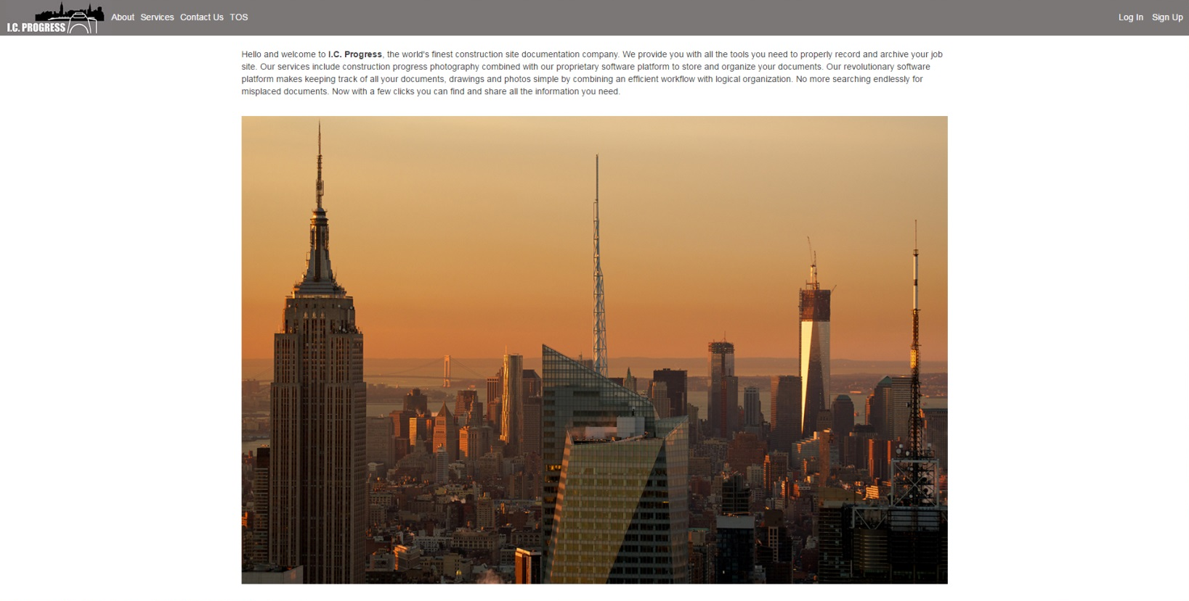

Slide 3
Background: IC Progress
Central Question: Is the service good enough to be used consistently?
General SaaS Focus - Customer Acquisition Costs and Customer Lifetime Value. (CAC and CLV) Common Ratio: CAC/CLV
These metrics will be used to evaluate our actions and decisions

Slide 4
Background: IC Progress – Goals
Increase Enrollments Per Quarter by adding two sign up pages, one for photographers and one for demos and/or a free account. Put the links up front and highlighted
Provide a sharper layout with calls to action, videos and jQuery demo of the product to help acquire more customers.
Add photographer sign up page
Build system to track metrics on a quarterly basis
Integrate with current back-end software

Slide 5
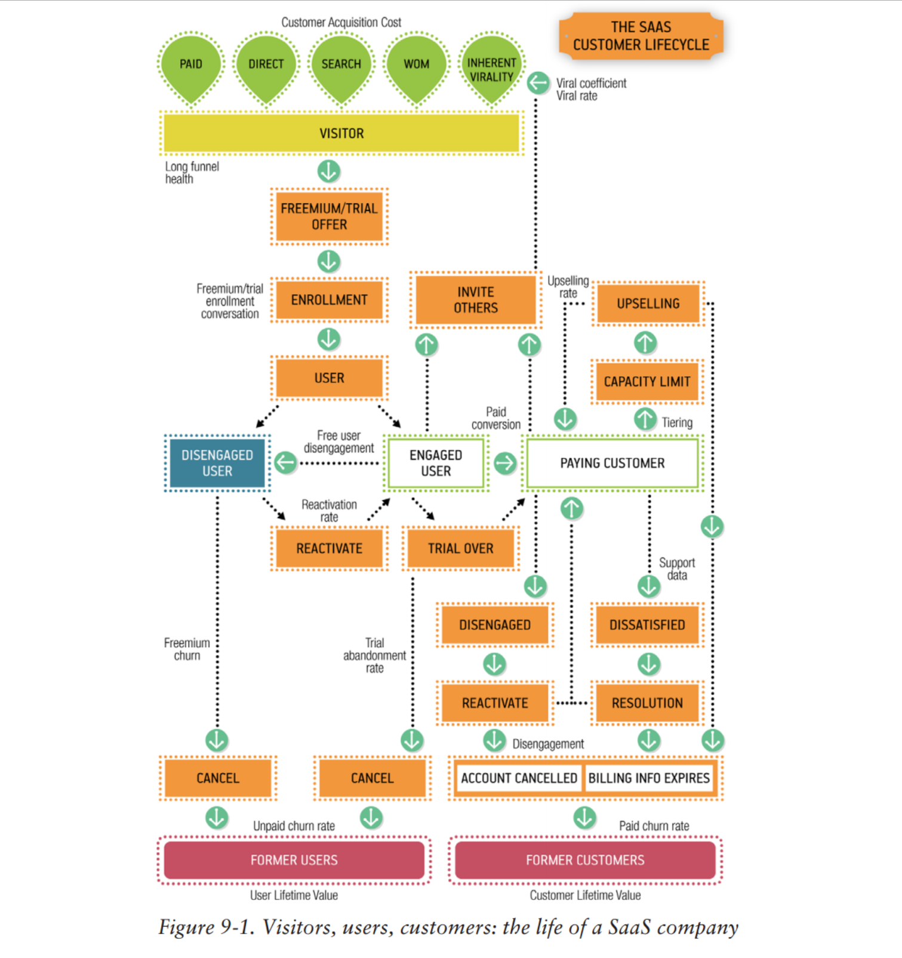
Design: IC Progress

Slide 6
Design: IC Progress
Front-End
Focus

Slide 7
Front End Focus:
Integration with back-end software
SEO Friendly
Responsive Design
Attention, Information and Trial Sign-Up
CAC/CLV
Customer Awareness of Features
Enrollment Conversion per Quarter

Slide 8
IC Progress – Attention and Enrollment
How effectively does the business attract visitors?
Traffic, mentions, cost per click, search results, cost of acquisition, open rate.
How often do these visitors request information or signup?
Enrollments, signups, completed onboarding process, used the service at least once, subscriptions
Main Goals/Metrics:
Increase Enrollments Per Quarter
Lower Cost of Acquisition: How much it costs to get a user and a paying customer
Add a Photographer Sign-Up Page
Redesign look of site
Look into adding a “demo” to the site

Slide 9
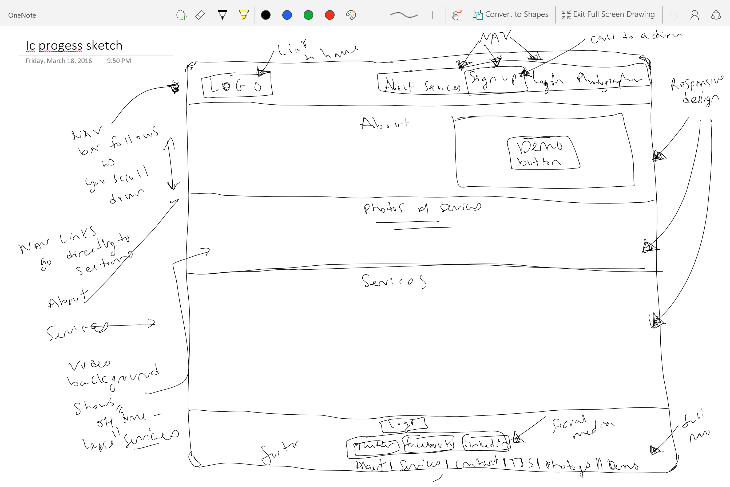



Slide 10
Site Map
About
Services
Main
Contact
Photographer Sign Up
Sign Up/Demo
Terms of Service
Log In

