Slide 1

Software: Computer Programming Basics II
OT 699 – Week 2
Sook-Lei Liew, PhD, OTR/L, sliew@usc.edu

Slide 2
Review of last week
Last week, we:
Reviewed the course outline and objectives
Installed Anaconda
Learned about Jupyter
Wrote our first Python commands
Wrote simple single-line commands to print to screen and to perform basic operations
Briefly reviewed a Python IDE (Spyder)

Slide 3
OBJECTIVES THIS WEEK
By the end of this session, students will understand and implement:
Command Line Prompts
Basic data types
Variables
Conditionals
Syntax
Conditional statements:
If/Then statements
For loops
Basic functions and libraries
Reading/writing CSV files (input/output)

Slide 4
Command Line Prompts
Anaconda Navigator is a GUI (graphical user interface)
We can open Anaconda Navigator > Jupyter Notebook
But, we can also use a CLI (command line interface) to open Jupyter Notebook
Typing a line of code will have the same effect as pressing a button/clicking an icon

Slide 5
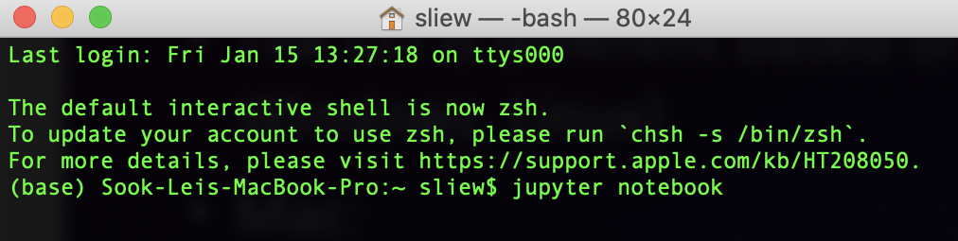
Command Line Prompts
Command Line Prompt
Command
The CLI may look/be different based on your operating system (Mac, Windows, Linux)
Mac:
Click the search icon at the top right corner
Type in “Terminal”
Open the “Terminal” application
Type in “jupyter notebook” at the prompt (all lowercase)

Slide 6
Command Line Prompts
Windows:
Click the start/search button at the bottom right corner
Type in “Anaconda Prompt”
Open the “Anaconda Prompt” application
Type in “jupyter notebook” (all lowercase)

Slide 7
Command Line Prompts
Linux:
Open the native terminal
Type in “jupyter notebook” (all lowercase)

Slide 8
Command Line Prompts & your OS
Mac has a native Linux-like system built in plus a more friendly GUI-based system on top of it
Windows does not really have native terminal access
Another difference is file paths (/ on mac vs \ on windows)
Therefore, in this class, since there are a mix of OS, we will use language-specific IDEs (Python → Jupyter Notebook, Spyder) so we don’t have to show everything on Windows vs Mac

Slide 9
Basic Data Types
In addition to binary to understand what you’re typing, computers also need to know what data type the input you provided is
Each data type has different properties, rules, and operations
Pause here to watch this short Youtube video (also included in the Youtube description):
https://www.youtube.com/watch?v=A37-3lflh8I

Slide 10
Basic Data Types
Different data types have different properties and are allowed for different operations
For instance, numbers (type: integer, float) can be used with math operations, but strings can’t because it wouldn’t make sense
5/5 = 1
“hello”/”goodybye” = ??? ERROR
Note – typo in video “11” + “1” = “111”
Note: “ “ denotes string
“1” is string, 1 is integer

Slide 11
Basic Data Types
Common data types include:
Integer (-1, 0, 1, 2, 3)
Float (-1.99, 0.01, 1.01)
String (a, b, c, d, words)
Boolean (True, False)

Slide 12
VARIABLES
However, you can assign a value to a string:
X=5
Y=4
X+Y = 9
In this case, X and Y are called “variables” because they represent an assigned value. The benefit of this is that the assigned value can change easily.
You can assign a variable to be an integer, float, string, or Boolean, etc.
Another example:
X=“Hello”, Y=“World”, X+” “+Y = “Hello World”

Slide 13
CONDITIONALS
Sometimes you want the computer to do something only when a variable meets a certain condition
Equals: a == b
Not Equals: a != b
Less than: a < b
Less than or equal to: a <= b
Greater than: a > b
Greater than or equal to: a >= b

Slide 14
Syntax
One of the most common issues that has to be debugged is incorrect syntax
Similar to sentence structures in English, the computer needs commands in a specific order and format
Commands should be typed with precision, noting capitalization, semicolons, operations, etc. (remember binary!) – otherwise: error
In Python, spaces and tabs matter! Tab tells the computer you aren’t done with your command

Slide 15
CONDITIONAL STATEMENTS
Often, you will want the computer to do something when a variable meets a certain requirement.
Two common ways to write this are:
If/then statements (if x is true, then do y)
For loops (while x is true, then do y)

Slide 16
If Statements
a = 33
b = 200
if b > a:
print(“b is greater than a”)

Slide 17
If/ELSE (also called if/Then) Statements
Else If → elif
a = 33 b = 33 if b > a: print("b is greater than a") elif a == b: print("a and b are equal")

Slide 18
If/ELSE (also called if/Then) Statements
Else
a = 200 b = 33 if b > a: print("b is greater than a") elif a == b: print("a and b are equal") else: print("a is greater than b")

Slide 19
If/ELSE (also called if/Then) Statements
a = 200 b = 33 if b > a: print("b is greater than a") else: print("b is not greater than a")

Slide 20
IF/ELSE REVIEW
if
if / elif
if / elif / else
if / else

Slide 21
For/WHILE Loops
As long as a conditional is true, do X
Considered “iterative” as it will iterate (or repeat) command(s) for as many inputs as it is given
Great for repetitive tasks
Basic syntax:
for x in ”banana”: print(x)

Slide 22
WHILE Loops
Can also be used to count through items
x=1
while x < 10:
print(x)
x=x+1

Slide 23
Basic Functions
Usually, we will want to do more complicated commands, which require many commands
Instead of writing the same commands over and over, these can be written as a function
Functions can be called, and will do all the commands in the function then return to the code
Functions can take inputs and can provide outputs (but don’t have to)

Slide 24
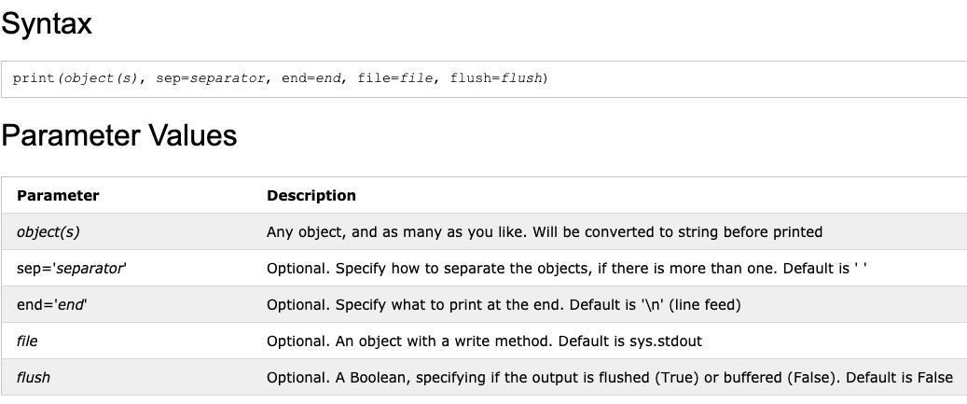
BASIC functions
The inputs to a function are called parameters or arguments and can vary
print(x)
print(“hello”, “world!”, sep=“ ”)

Slide 25
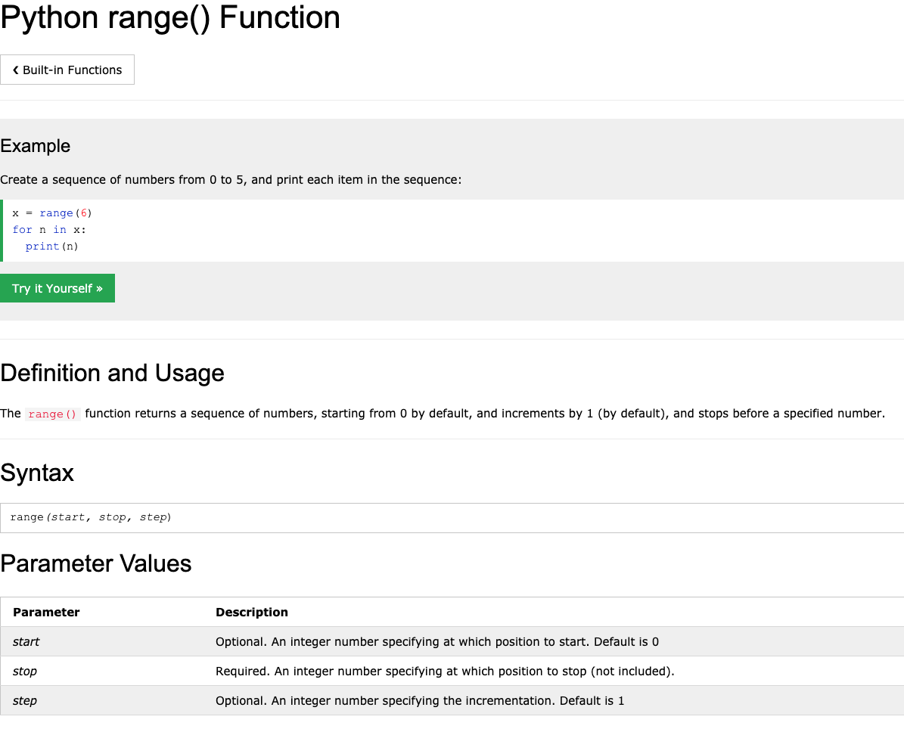
Example: The RANGE() FUNCTION

Slide 26
Example: The RANGE() FUNCTION IN A FOR LOOP
Note: Python is a 0-indexed language, meaning it counts the first value as 0 (not 1)
range(6) → 0, 1, 2, 3, 4, 5
range(2,6) → 2, 3, 4, 5 (2 is starting, 6 is ending)
range(2,6,2) → 2,4 (2 is starting, 6 is ending, and it takes steps of 2)

Slide 27
MODULES, PACKAGES, and LIBRARIES
Functions usually do one simple task
Libraries are bundles of code that may have hundreds of functions and do lots of things, usually around a theme, such as:
os: a module that contains operating system interfaces
csv: a module that supports reading and writing csv files
pandas: a library for data analysis and manipulation, including reading and writing csv files
matplotlib: a library for plotting data
numpy: a library for more complex mathematical operations and statistics

Slide 28
MODULES, PACKAGES, and LIBRARIES
When we work with modules/packages/libraries, we need to import them (otherwise, python would be massive) using the import command
import os
import pandas as pd

Slide 29
INSTALLING PACKAGES
Some packages/libraries are “native” to python, or so regularly used that they are included when you download python.
Others need to be installed separately (otherwise the download would be massive)
Generally to download a new package with anaconda, you can type:
conda install [package name]
conda install pandas

Slide 30
MODULES, PACKAGES, and LIBRARIES
Then, when we call a function from a library, we reference the function
os.getcwd()
pd.read_csv(filename)
mydf.to_csv(filename) (<-- updated/fixed after lecture)

Slide 31
INPUTs & OUTPUTS
Input: Computers can take in user input from the command line, or they can read input from files
Files with lots of formatting that make it easier for humans to read (e.g., Microsoft word) have a LOT of extra code in them that make it harder for computers to read
Some of the more common computer-readable files are .txt (text) files and .csv (comma-separated values) files

Slide 32
READING AND WRITING CSV FILES
A computer can read in data from a CSV file
Then we can manipulate that data (e.g., as a data frame) as integers, strings, etc.
The computer can then write out the data frame back to a CSV file
Other inputs: matricies (.mat), text files (.txt), json files (.json), etc.

Slide 33
READING AND WRITING CSV FILES
In python, the pandas library is one useful option (but there are many!):
(may need to first do: conda install pandas)
import pandas as pd
mydf = pd.read_csv(“week2.csv”)
mydf.head(5)
[can do additional operations to manipulate the file]
mydf.to_csv(“week2_updated.csv”, index=False)

Slide 34
WRITING YOUR OWN FUNCTION
def my_function(x):
y=x+10
print(y)
return y
a=my_function(1)
print(a)
definition function_name(input parameters)
what you want the function to do with input
what you want the function to do with input
what you want it to return (optional)

Slide 35
OTHER PYTHON IDES
Here we used jupyter notebook because it is a quick and easy way for you to get started with short commands and seeing output quickly
For more involved programming (e.g., many lines of code), you would use something more like Spyder (also in Anaconda Navigator)
We briefly looked at Spyder in the lab, as you may use it later in the class → you will see your variables, can debug, etc.

Slide 36
ASSIGNMENT AND TROUBLESHOOTING
One of the most important parts of programming is learning to figure out errors and think through logic on your own!
Here we gave you most of the code, but you can play around, try different inputs, tweak the commands slightly, etc.
Try the assignment to write your own function to will output whether the number you give your function is greater than equal to 10 or not
Write the function and three test cases (how would you know if it works correctly or not)

Slide 37
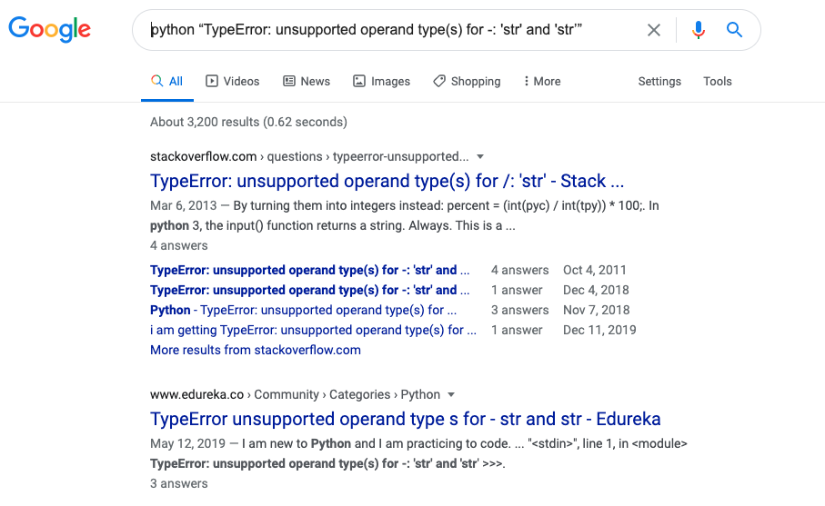
TROUBLESHOOTING
If you get an error, or don’t know how to do something, Google is your best friend ☺
Google the language + the error in quotes

Slide 38
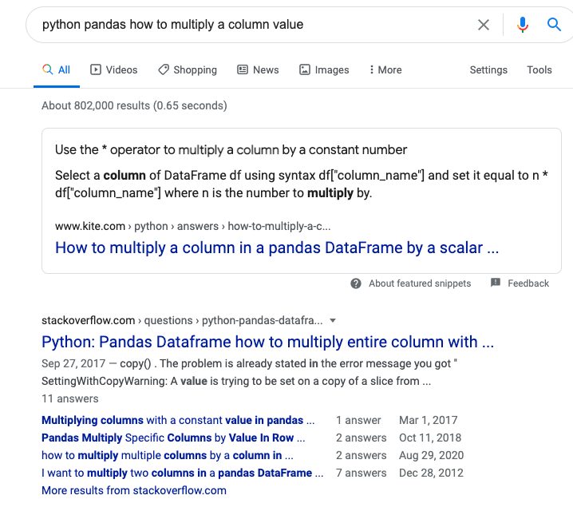
TROUBLESHOOTING
StackOverflow is your friend!
Googling questions also helps you to learn the right way to ask questions

Slide 39
Good LUCK!
Programming is SO MUCH trial and error, and googling every thing you want to do
Once you do it for a long time, you start to remember specific commands, and learn how to find the information that you need
I still google most things that I want to do, unless I do them ALL the time ☺

