Slide 1

Wordpress

Slide 2
Wordpress
Easy to use Most popular to develop websites
30% of the websites use wordpress
No coding knowledge required. It is a content management system (CMS)

Slide 3
Local Server
A local server is required on your system
XAMPP – for windows
MAMP for MAC
You can download XAMPP from the link below https://www.apachefriends.org/index.html
For mamp Continue with the video tutorial provided.

Slide 4
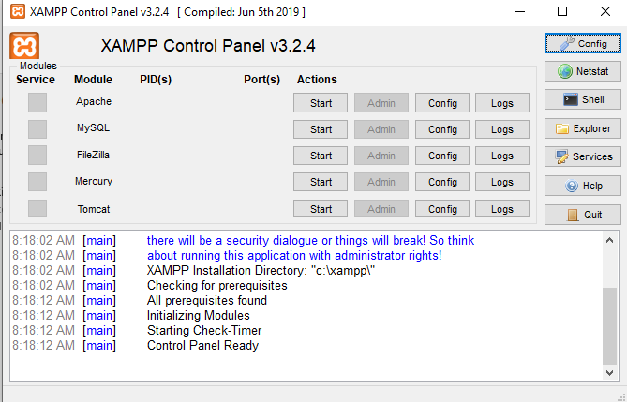
After Installation : Search for Xampp control panel in the search box
Please start APACHE & MYSQL
After pressing Apache and mysql will be highlighted with green

Slide 5
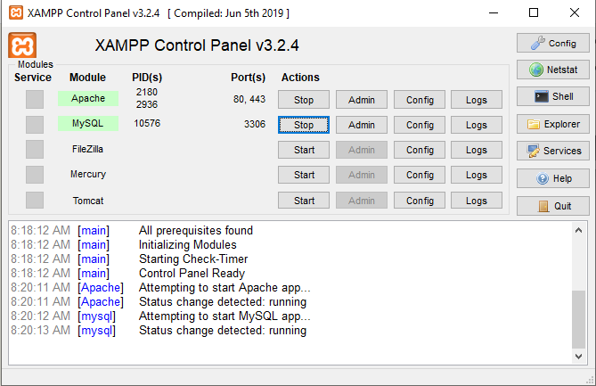

Slide 6
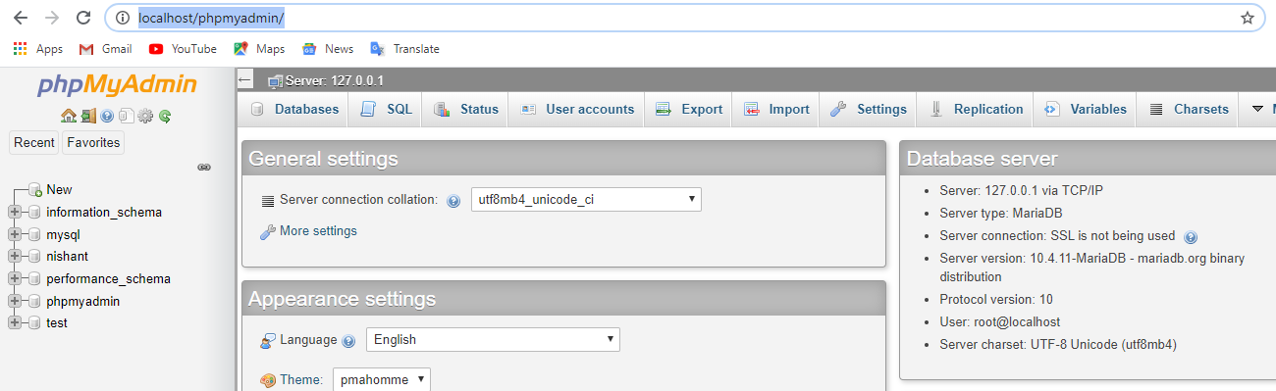
Open any web browser of your choice
Type http://localhost/dashboard/
Then, press on phpMyAdmin present on the right top corner
Or you could also directly type
http://localhost/phpmyadmin/
To view the page

Slide 7
Please follow the tutorial weblink provided to you
https://webdesign.tutsplus.com/courses/a-beginners-guide-to-using-wordpress/lessons/welcome-to-the-course
At the end you would be required to develop a website of your own choice individually as a project.

