Slide 1
Using MVVM Pattern in Avalonia

Slide 2
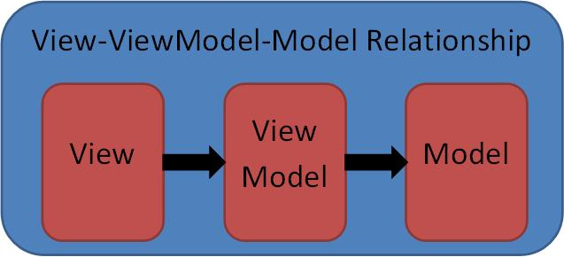
What is Model-View-ViewModel
View knows about VM (not vice versa)
VM knows about Model (not vice versa)
Model – code representing data e.g. coming from backend
View – Code representing the Visuals
View Model (VM) – serves as the glue between the View and the Model. It wraps the Model and makes it friendly for being presented and modified by the View.

Slide 3
View-ViewModel (Simplification of MVVM)
Often the backend data can be deserialized straight into the View Model and vice versa the View Model can be serialized into the data understandable by the backend.
This allows to remove the model code and use simply View – ViewModel pattern.

Slide 4
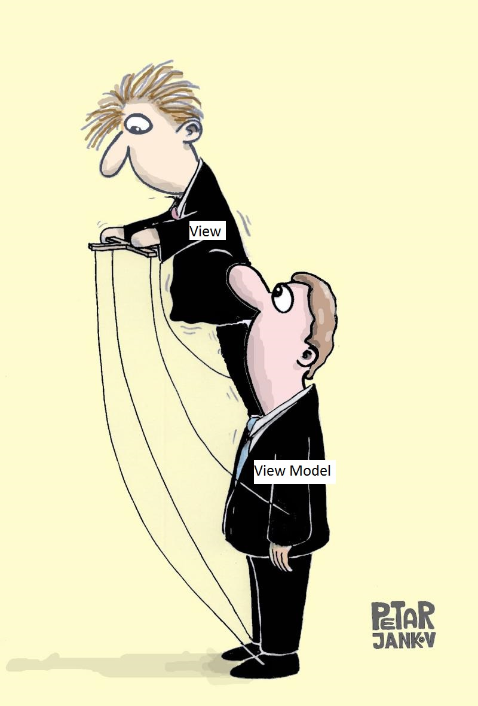
The reason for MVVM (VVM) pattern
View consists of very complex visual objects with a lot of properties and behaviors. ViewModel consists of much simpler, non-visual objects consisting of the data and properties specific to the View.
VVM results in a complex View passively mimicking the behavior of a non-visual much simpler View Model. Because of that the code becomes easier to work with, extend and test.

Slide 5
Connecting the View to VM in Avalonia/WPF
Binding
One Way for passing info from VM to View
Two way for passing info (usually user modifications) from View to VM.
Commands or custom behaviors for invoking actions on a View Model when e.g. a user presses a button within View.

Slide 6
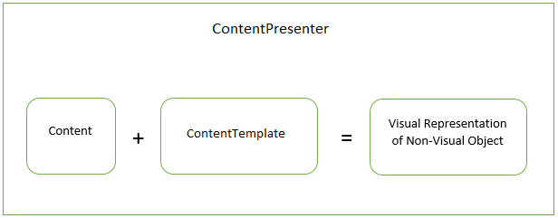
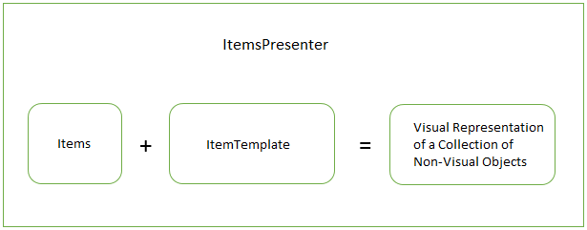
DataTemplates
Best way to create a View in Avalonia and WPF is by means of a DataTemplate. Essentially a Data Template can be a View.
Avalonia ContentPresenter turns a single non-visual object into a Visual object with the help of a DataTemplate
ItemsPresenter turns a collection on non-visual objects into a collection of Visual objects with the help of a DataTemplate

Slide 7
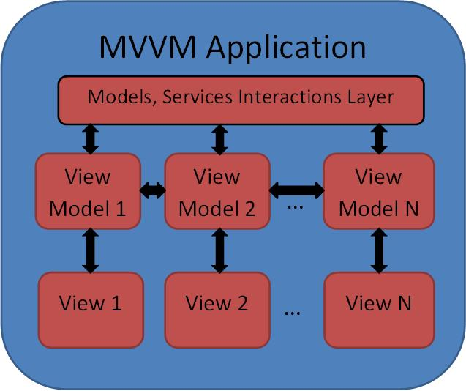
Multiple View/ViewModels within an App
There can be multiple View/ViewModel pairs within a single Application. Usually the Views should not be aware of each other and all communications between different Views should be conducted via their View Models as well as the communications with backend and services.

Slide 8
Code Samples

