Slide 1
Predicting Acetylcholinesterase Inhibitors for Alzheimer's Disease from Chemical Structure
Dora Díaz, Marwan El Saabi, Juan Jiménez, Nerea Portabales

Slide 2
01
Introduction

Slide 3

Project Overview: Modern Discovery
Our Goal → Inhibit Acetylcholinesterase (AChE) to treat Alzheimer’s
We simulated a modern pharmaceutical laboratory workflow to overcome the limitations of physical testing.
METHODOLOGY SHIFT
Wet Lab
→
In Silico (IA)
Slow & Expensive
Instant & Predictive

Slide 4
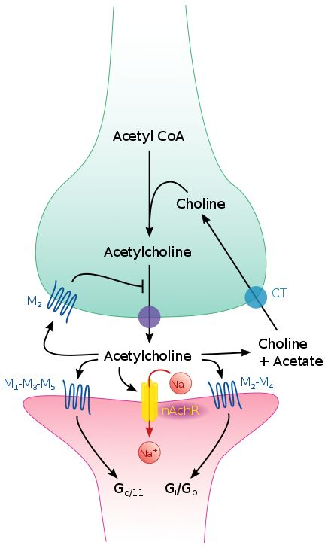



The Challenge: Volume vs Time
The "Volume" Problem: Testing millions of candidates physically takes years
Our Hypothesis: We can use Machine Learning to predict biological activity based on chemical structure
The Pipeline:
Data Mining (ChEMBL)
Labeling Strategy
Chemical Translation
Model Training

Slide 5
02
Data Preparation

Slide 6
Data Loading & Filtration
We mined the ChEMBL Database and applied rigorous filters to ensure high-quality training data
METRIC SELECTION
STANDARDIZATION
CLEANING
Retained only IC50 assays (Standard Potency)
Converted all units to Nanomolar (nM) for consistency
Removed incomplete entries and ambiguous data

Slide 7
Curating a High-Confidence Dataset
From a raw deposit of 9,731 ChEMBL records to a balanced, bias-free modeling base.
9,731
8,372
Raw Entries
Strip Missing
Valid Data Points
(ChEMBL 2025)
Filter IC50 & nM
(IC50 in nM)

Slide 8
Labeling
We removed the biological "grey zone" to ensure the model learns clear phenotypes
ACTIVE
THE GAP
8,372
INACTIVE
Valid Data Points
IC50 ≤ 1000 nM
1000 - 10000 nM
IC50 ≥ 10000 nM
(IC50 in nM)
High Potency Drugs
Ambiguous Data
Removed to reduce noise
Weak/Useless
Compounds

Slide 9
Curating a High-Confidence Dataset
From a raw deposit of 9,731 ChEMBL records to a balanced, bias-free modeling base.
9,731
8,372
6,366
Raw Entries
Strip Missing
Valid Data Points
Binary Labels
Dataset
(ChEMBL 2025)
Filter IC50 & nM
(IC50 in nM)
Without grey zone data
This significantly increases the robustness and accuracy of our machine learning models

Slide 10
Class Preprocessing and Balancing
Before Balancing
Inactive: 38.96% | Active: 61.04%
Actual biological data is often unbalanced. Our code detected more active compounds than inactive ones.
To avoid bias, we applied random undersampling to the majority class (Class 1: Active), creating a perfectly balanced dataset (50/50)
After Balancing
Inactive: 50% | Active: 50%
6,366
4,960
Previous Dataset
Final Dataset
(Inactive: 2,480
Active: 3,886)
(2,480 per class)
Undersampling

Slide 11
03
Feature Engineering

Slide 12
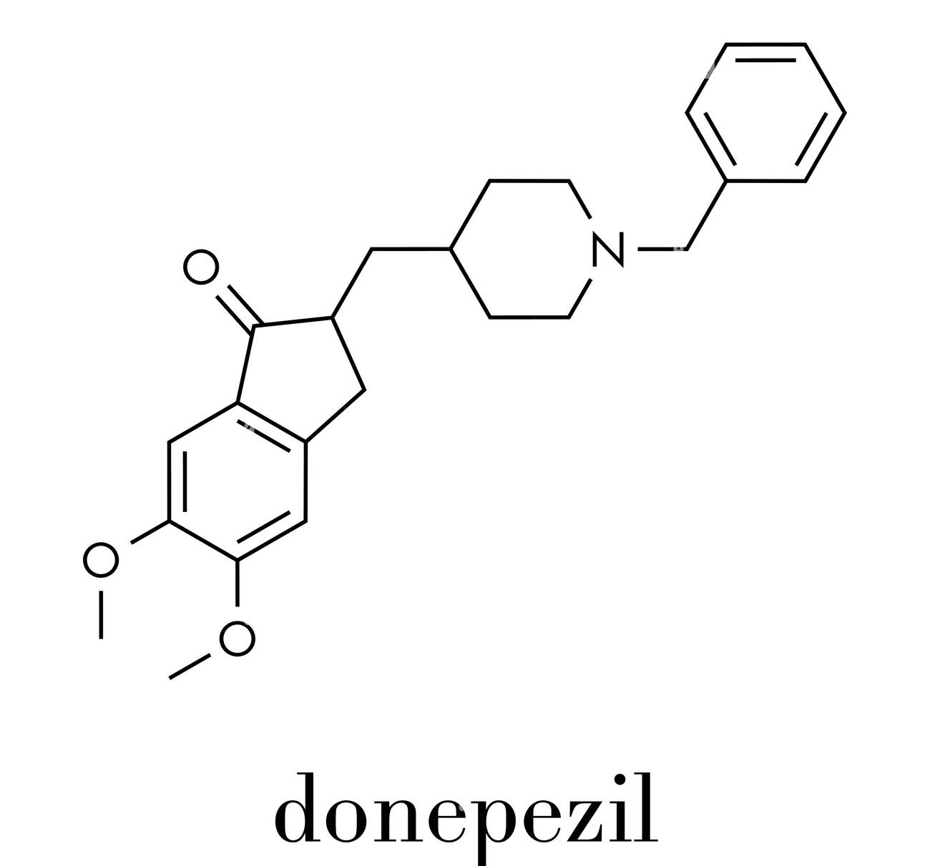
From SMILES to Mathematical Objects
This process translates chemistry into a fixed-length vector, so that classic Machine Learning algorithms can understand them
RDKit Fingerprinting
Chemical Structure
SMILES String
Morgan Fingerprint
COC1=C(C=C2C(=C1)CC(C2=O)CC3CCN(CC3)CC4=CC=CC=C4)OC
1024-bit Vector
Actual training data

Slide 13
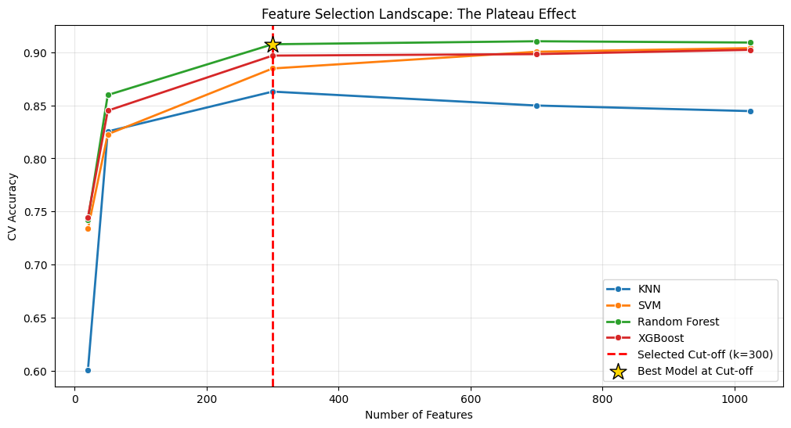
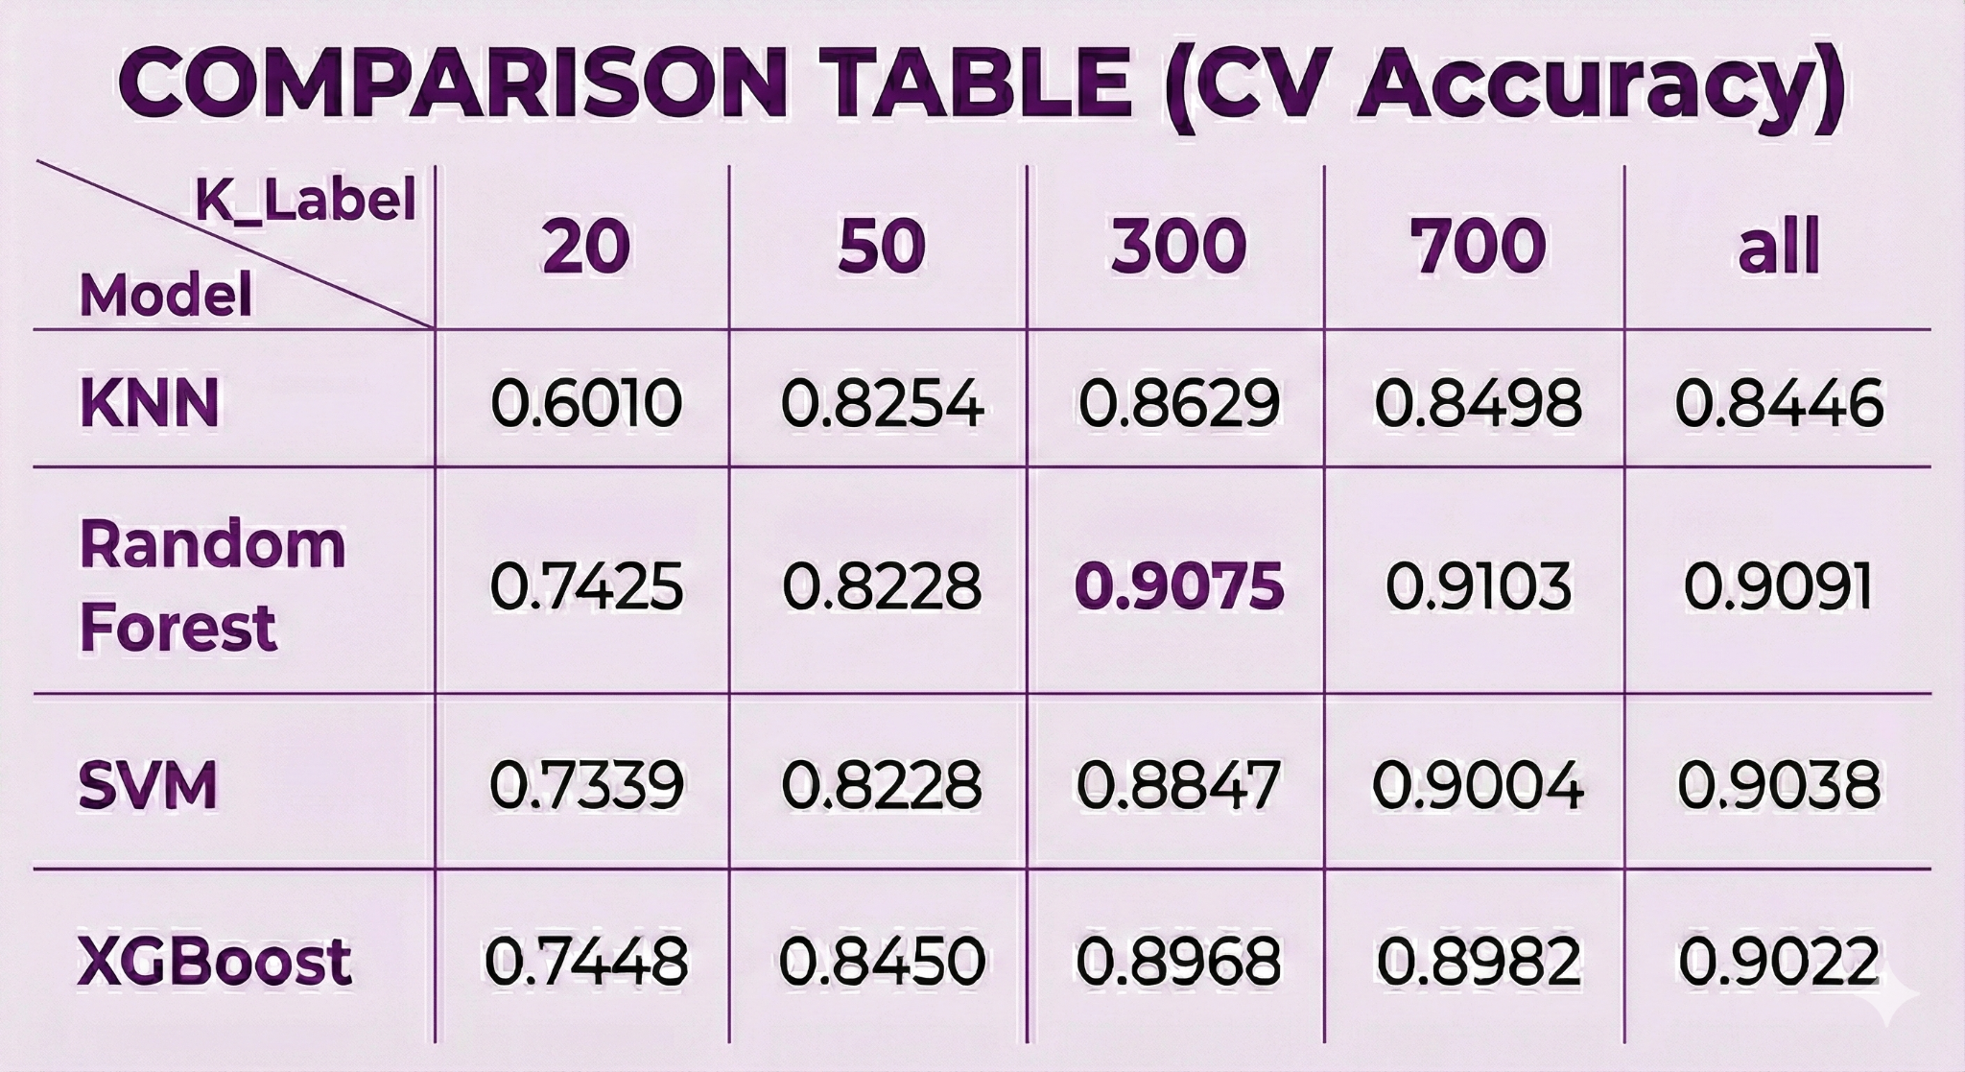
Finding the Optimal Feature Set
Sensitivity Analisis with different k-values: 20, 50, 300, 700 and all.
ANOVA F-score ranking reveals a point of diminishing returns.

Slide 14
Finding the Optimal Feature Set
We strategically selected the parsimonious 300-bit subset.
Strategic Decision
We selected k = 300 because it marks the start of the performance plateau.
Same Accuracy: Performance is nearly identical to using 700+ features.
Faster Training: Reduces computational load and complexity.
Simpler Model: Adheres to the principle of parsimony, improving interpretability.
We have isolated the 300 most predictive substructures for acetylcholinesterase inhibition

Slide 15
04
Internal Validation

Slide 16
Four-Algorithm Benchmarking Pipeline
Data
Pipeline
Model
Validate
X, y (300 feats)
Scale & Select
Classify
5-Fold CV
KNN
SVM
Random Forest
XGBoost
Models

Slide 17
Models Comparison
Model | Accuracy | F1-Score | Precision | Recall | AUROC
KNN | ~0.86 | ~0.87 | ~0.84 | ~0.90 | ~0.93
SVM | ~0.88 | ~0.88 | ~0.89 | ~0.87 | ~0.94
XGBoost | ~0.89 | ~0.89 | ~0.90 | ~0.89 | ~0.95
Random Forest | ~0.91 | ~0.90 | ~0.91 | ~0.90 | ~0.96
Random Forest achieved the highest mean accuracy and stability, making it our final candidate model.

Slide 18
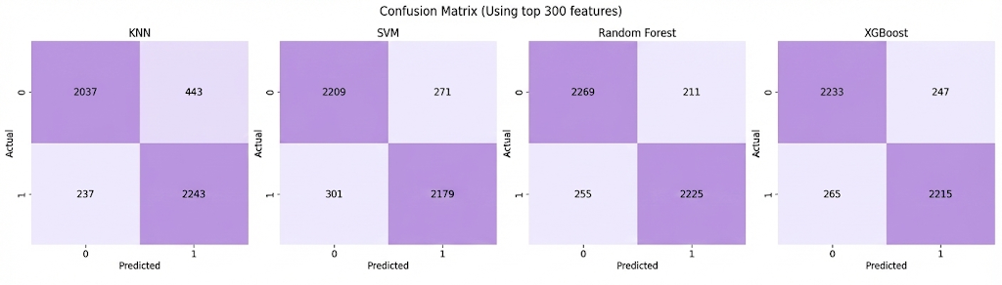
Confusion Matrix Insights
Random Forest delivers the lowest false-negative rate, which is critical for not discarding potential drugs.

Slide 19
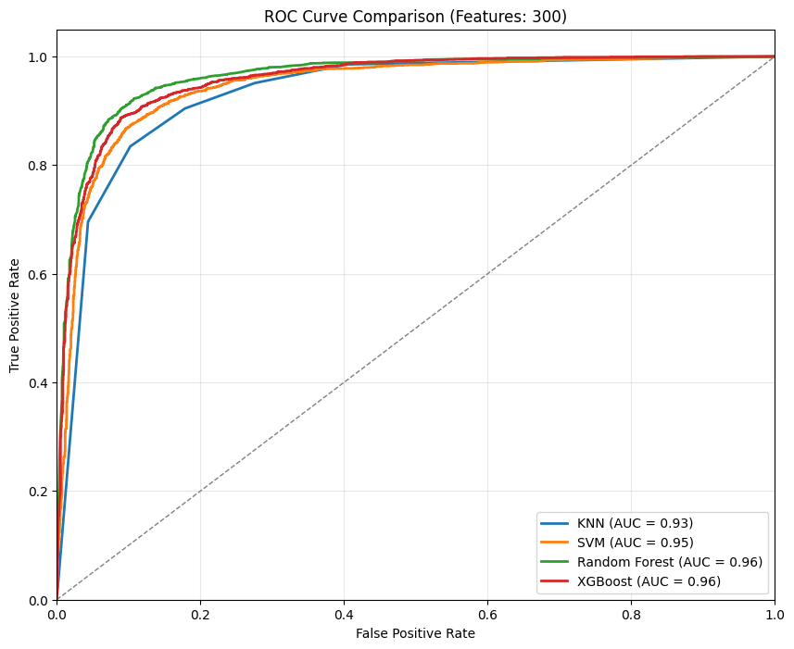
ROC Curve Analysis
High AUC (0.96) signals reliable ranking, enabling enrichment of true actives in top-hit lists.

Slide 20
05
External Validation

Slide 21
Validation Against External Molecules
Retrained Random Forest on full balanced dataset (300 features) + Integrated Leakage Detector to distinguish memory from true prediction.
Controls
Experimental Candidates
Positive Controls
Correctly rejected weak candidates from Vignaux et al.
Demecarium
Correctly flagged as 'IN DATASET' and predicted ACTIVE with high confidence.
Specificity
A potent inhibitor, absent from training data.
Galantamine: 0.78
NEW predictions
Donepezil: 0.98
NEW & ACTIVE
Serdemetan: 0.28
Negative Control
Vesatolimod: 0.35
0.6650
Aspirin correctly predicted as NEW and Inactive (0.18).

Slide 22
06
Limitations

Slide 23
Limitations
Structural Limitation
Insight: Our 50/50 balanced training set optimizes learning but over-inflates confidence versus real screens where actives occur below 1 %.
Next step Calibration will be essential before deployment to avoid false positives.
Prevalence Bias
The Tacrine case
Real-world deployment
Insight: The Tacrine derivative false-negative reveals that 2-D Morgan fingerprints miss the 3-D structure of hybrid scaffolds.
Next step must incorporate 3-D descriptors to expand the model's applicability domain.

Slide 24
07
Conclusions

Slide 25
Conclusions
Data Curation
Robust Model
Proven Generalization
Rigorous 'Grey Zone' filtering & Class Balancing removed statistical bias.
Random Forest (k=300) predicts AChE inhibition with >90% accuracy, scientifically validated.
Leakage safeguards confirmed the identification of Demecarium (new active) & rejection of weak candidates
We successfully integrated rigorous data curation and efficient modeling to create a scientifically validated Targeted Virtual Screening engine for Drug Discovery.

Slide 26
THANK YOU

